Slide 1
General Purpose Mobile Robot

Slide 2
Overview
The project evolved over many steps reaching its final shape. in the beginning it was made out of wood, then it was changed to ALCABOUND. The project was built on a Raspberry Pi microprocessor, allowing many processes to work simultaneously leading to the integration of all sensor’s data to be used in real-time in one main program.

Slide 3
Dead reckoning
In navigation, dead reckoning is the process of calculating one's current position by using a previously determined position, or fix, and advancing that position based upon known or estimated speeds over elapsed time and course. The corresponding term in other sciences is path integration.

Slide 4
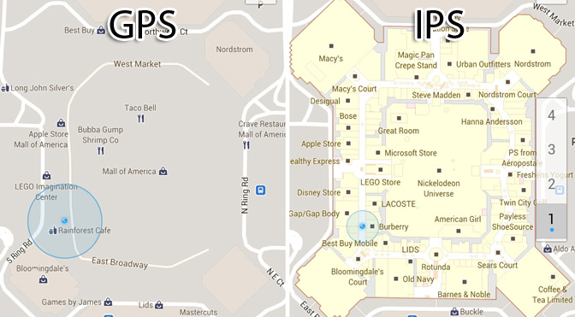
Indoor positioning system

Slide 5
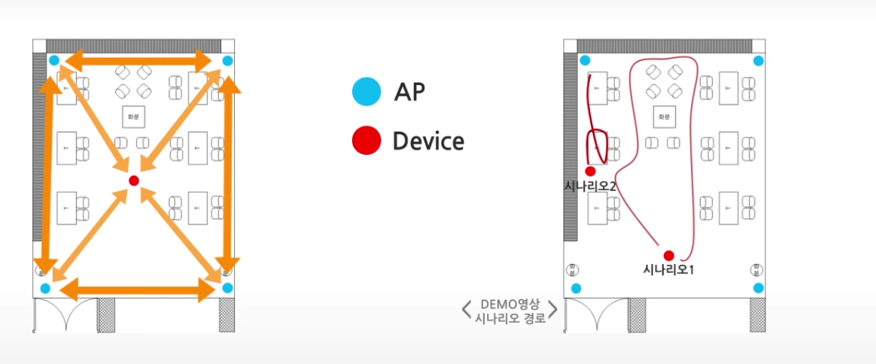

Slide 6
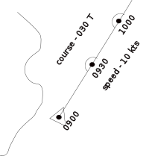
Dead reckoning

Slide 7
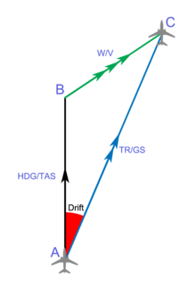

Slide 8
Objectives
1.Obtain velocity and distance information from odometer data, and obstacle distances from ultrasonic sensor.
2.Combine localization information from odometers and ultrasonic sensors to produce a single representation of the robot’s position and orientation.
3.Obtain velocity profiles and an overall trajectory of motion for a given instruction
4.Utilize localization information to maintain robot’s trajectory.
5.Develop a PID control system to maintain wheel velocities at the appropriate levels.
6.Incorporate MPU 9250, optical encoder and obstacle distances data in a collision avoidance system so that the robot can react to a dynamic environment

Slide 9
Mechanical Analysis

Slide 10
Wheel friction on different surfaces:

Slide 11
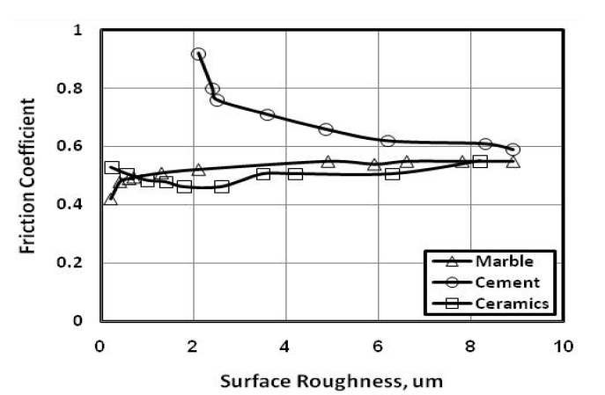

Slide 13

Maximum force before slipping (Horizontal plane):
${\text{F}}_{\text{max}}$=$\frac{\text{3}}{\text{2}}$𝑚∗$a_{\text{max}}$
= $\frac{\text{3}}{\text{2}}$𝑚∗2∗𝑔∗μ
=3∗𝑚∗𝑔∗μ
Where:
$a_{\text{max}}$=$\frac{\text{2}\text{Frmax}}{\text{M}}$=$\frac{\text{2}\text{∗}\text{M}\text{∗}\text{g}\text{∗}\text{μ}}{\text{M}}$

Slide 14

Maximum force before slipping (inclined plane):
${\text{F}}_{\text{max}}$ =$\frac{\text{3}}{\text{2}}$𝑚∗$a_{\text{max}}$
=$\frac{\text{3}}{\text{2}}$𝑚∗2∗𝑔∗μ∗𝑐𝑜𝑠𝜃
=3∗𝑚∗𝑔∗μ∗𝑐𝑜𝑠𝜃
Where:
$a_{\text{max}}$=$\frac{\text{2}\text{Frmax}}{\text{M}}$=$\frac{\text{2}\text{∗}\text{M}\text{∗}\text{g}\text{∗}\text{μ}\text{∗}\text{cos}\text{θ}}{\text{M}}$
$\tan{\text{θ}}$ = 3* 𝜇

Slide 15
Modules Used:

Slide 16
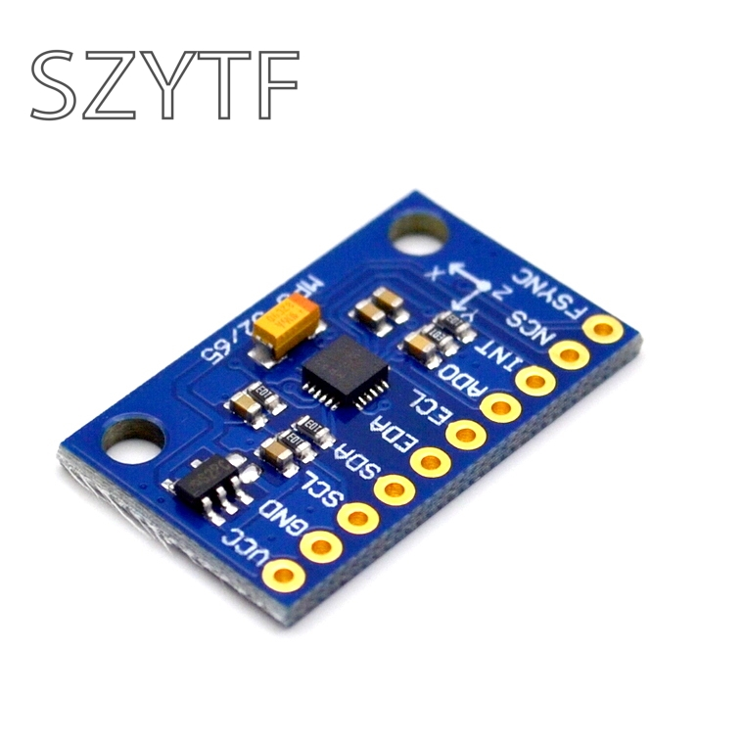
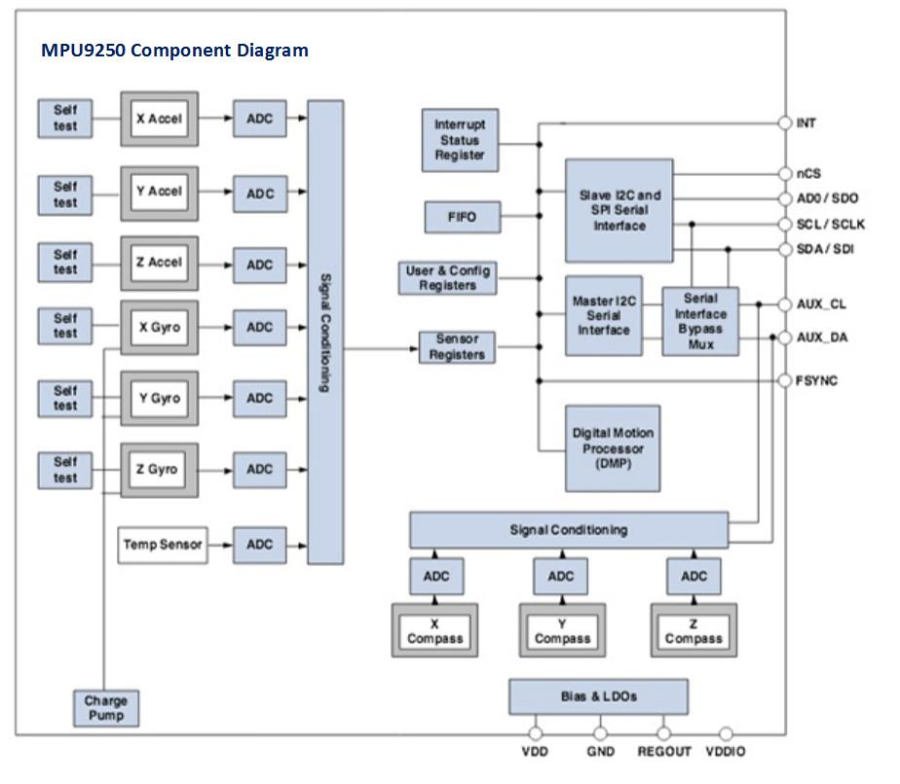
modules used:

Slide 17
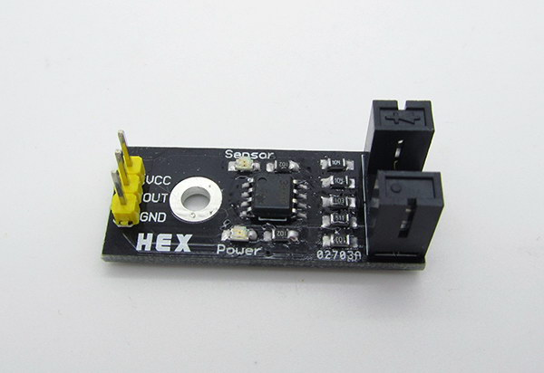
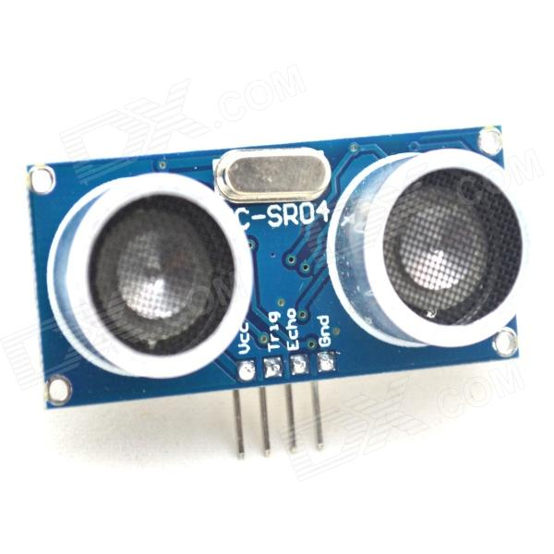
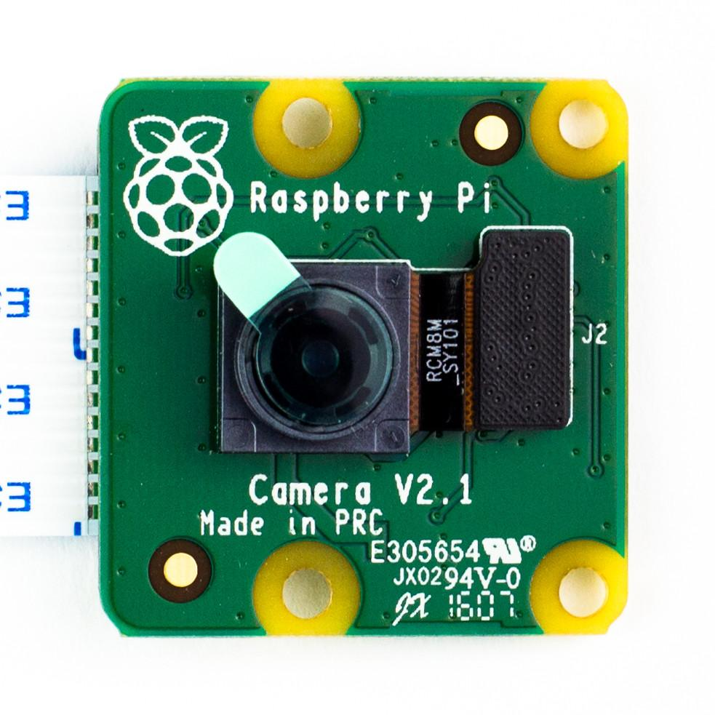

Slide 18
Sensor fusion:
Integrating the data from all sensors and incorporating them in one single program to yield the most accurate reading of the surrounding environment and arrive to the final goal while avoiding all obstacles along the way.

Slide 19
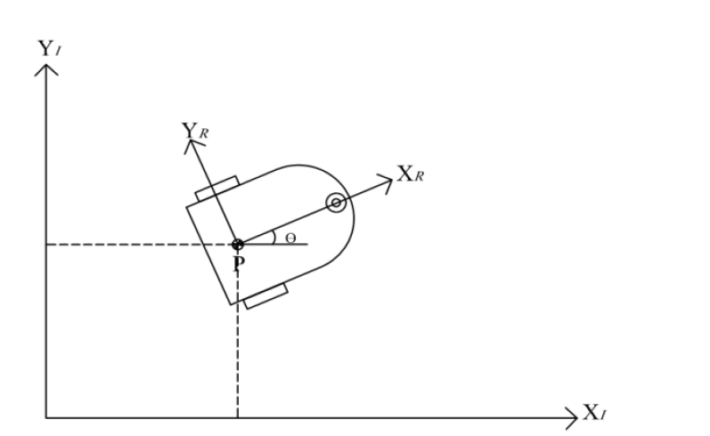
Differential Drive

Slide 20
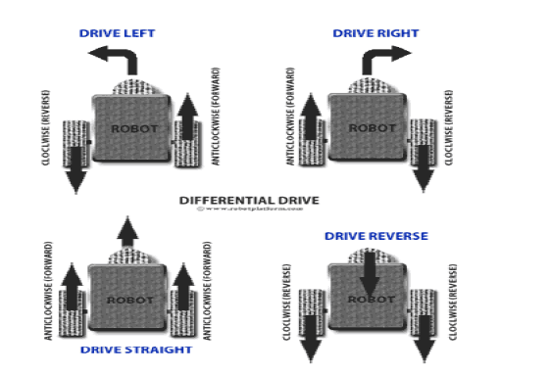

Slide 21
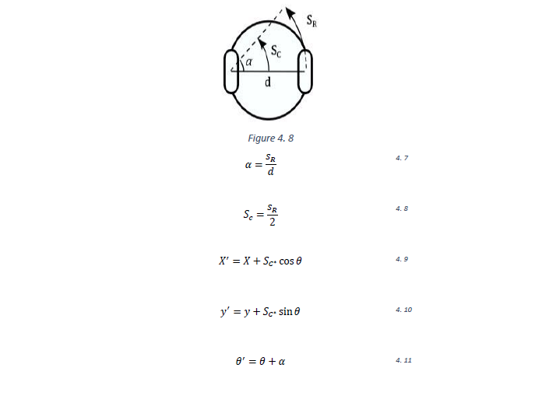

Slide 22
video

Slide 23
Future work

