Slide 1
Seismic Design of Fatima Al Zahra Mosque
By: - Khattab Salawdeh
- Mohammad Oraib
- Mohannad Abdo
Under Supervision of: Dr.Abdulrazzaq Tuqan

Slide 2
Seismic Design of Fatima Al Zahra Mosque
Outline:
Just a reminder.
Models.
Checks.
Response spectra.
Design and detailing.
Shear wall design
Rapid visual screening.
Recommendations.
Conclusion.

Slide 3
Just a reminder
Fatima Al Zahra mosque is an old prominent landmark in Qaffen-Tulkarm city where engineering offices do not design for seismic loads.
This mosque, consists of a ground floor and a first floor with a total area of 476m² (238m² for each).
Structural elements will be designed as reinforced concrete members according to strength and serviceability criteria as specified in ACI 318, for seismic design IBC2012 code will be used.

Slide 4
Revit Model
Export to
AutoCAD Drawing
Revit
Physical Model
Analytical Model
ETABS
Verify it.

Slide 5
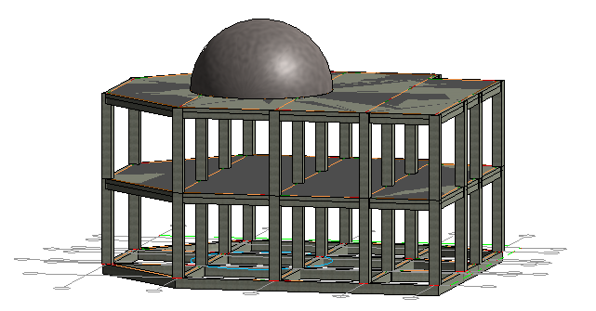
Revit Model
Exporting to ETABS …

Slide 6
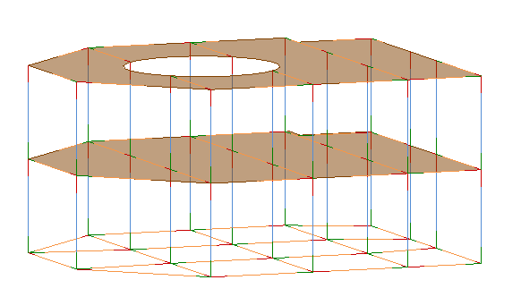
Analytical 3D model in Revit.

Slide 7
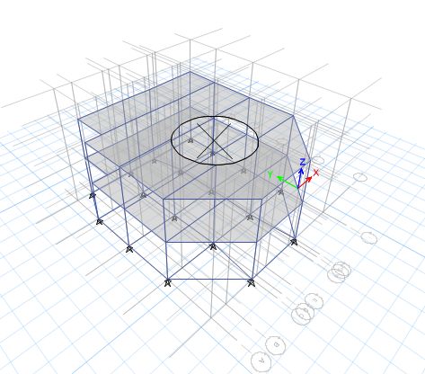
ETABS Model

Slide 8
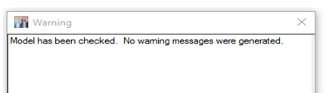
ETABS Model
Checks
Checks
Compatibility
Stress-Strain
Equilibrium
Period
- Model Check -

Slide 9
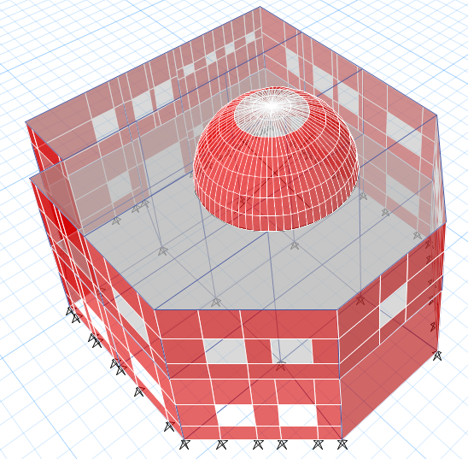
ETABS Model
RUN…

Slide 10
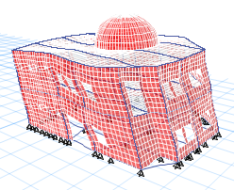
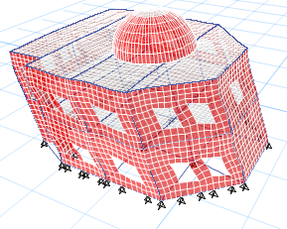
ETABS Model
Checks
Compatibility
OK

Slide 11
ETABS Model
Checks
Equilibrium
TABLE: Base Reactions
Load Case/Combo | FZ: ETABS | Manually | %difference
 | kN | kN
Dead | 8449.9 | 8399 | -0.0061
Live | 2344.6 | 2349.4 | 0.0021
SID | 2246.1708 | 2250 | 0.0017

Slide 12
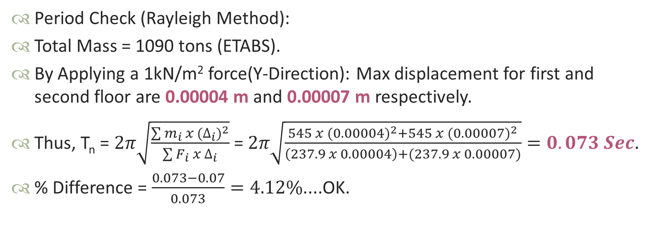
ETABS Model
Checks
Period Check (Rayleigh Method):
Total Mass = 1090 tons (ETABS).
By Applying a 1kN/m² force(Y-Direction): Max displacement for first and second floor are 0.00004 m and 0.00007 m respectively.
Thus, T_{n} = $2π\sqrt{\frac{\sum{m_{i} x {(∆_{i})}^{2}}}{\sum{F_{i} x ∆_{i}}}}$ = $2π\sqrt{\frac{545 x {(0.00004)}^{2}+545 x {(0.00007)}^{2}}{\left(237.9 x 0.00004\right)+(237.9 x 0.00007)}}=0.073 Sec.$
% Difference = $\frac{0.073−0.07}{0.073}=4.12\%$....OK.

Slide 13
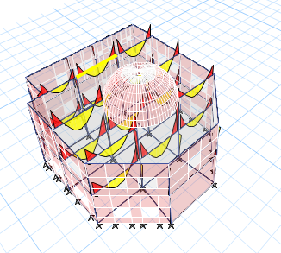
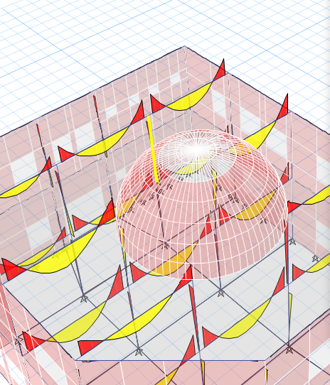
ETABS Model
Checks
Stress – Strain Check
Column Check

Slide 14
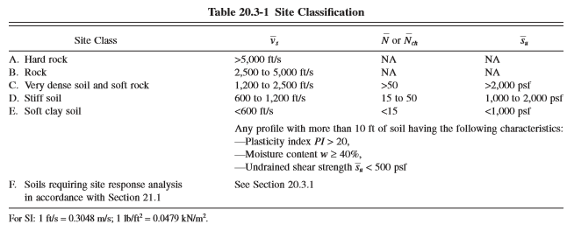
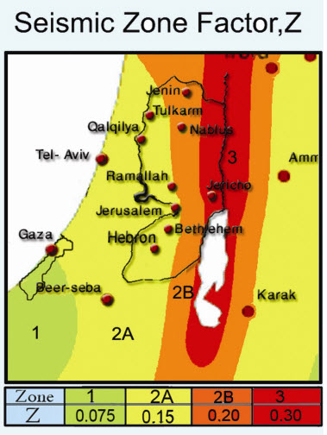
Seismic Design
Using Response Spectrum
Site soil classification and seismic zone factor
- Site Classification -
- Zone Factor Z=1.5 -

Slide 15
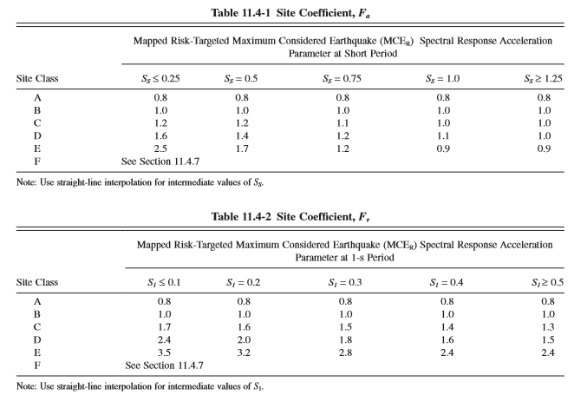

Seismic Design
Determine SDS and SD1
S_{S} = 2.5 x Z = 2.5 x 0.15 = 0.375
S₁ = 1.25 x Z = 1.25 x 0.15 = 0.1875
S_{MS} = F_{a} x S_{S} = 1 x 0.375 = 0.375
S_{M1} = F_{v} x S_{1.} = 1 x 0.1875 = 0.1875
$SDS= \frac{2}{3}SMS$ x $\frac{3}{2}$ = S_{MS} = 0.375
$SD1= \frac{2}{3}SM1$x $\frac{3}{2}$ = S_{M1} = 0.1875

Slide 16
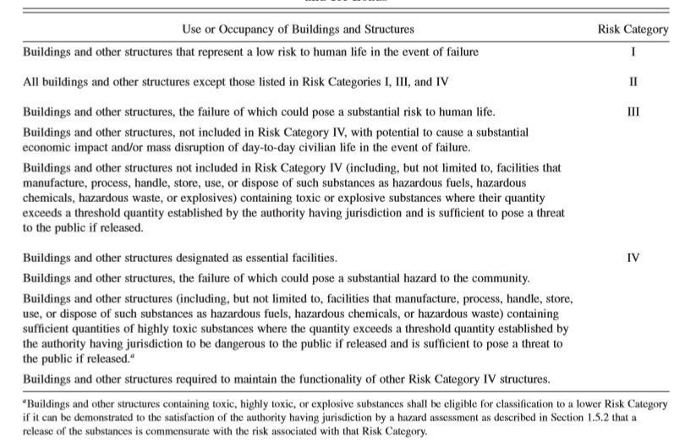

Seismic Design
Risk Category
Risk Category

Slide 17
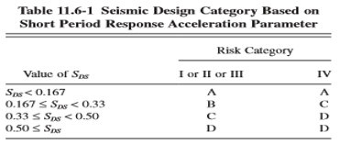
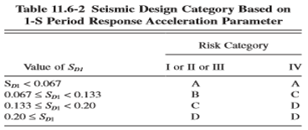
Seismic Design
Seismic Design Category
Seismic design category is determined based on:
- Risk category
- Values of S_{DS} and S_{D1.}
“Seismic Design Category: C”

Slide 18
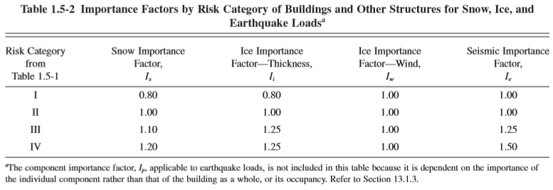
Seismic Design
Importance factor
See ASCE 7-10 Table 1.5-2, I = 1.25

Slide 19
Seismic Design
Selection of structural system type
Bearing wall system: walls carrying gravity and lateral loads.
Building frame system: Frames carrying gravity loads, and shear walls take a lateral loads.
Moment resisting frame: Frames walls carrying gravity and lateral loads.

Slide 20
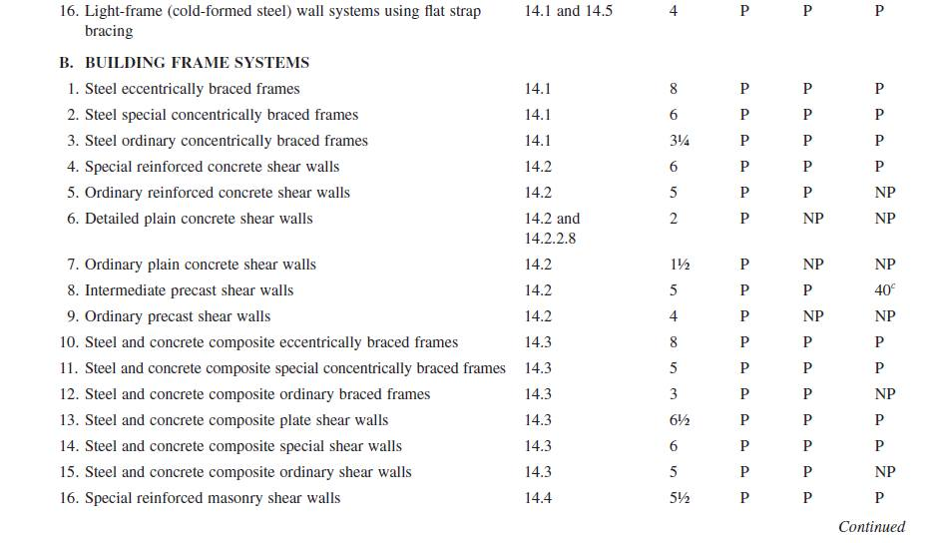
Seismic Design
Determine Response modification factor (R)
Table 12.14-1 ASCE10-7

Slide 21
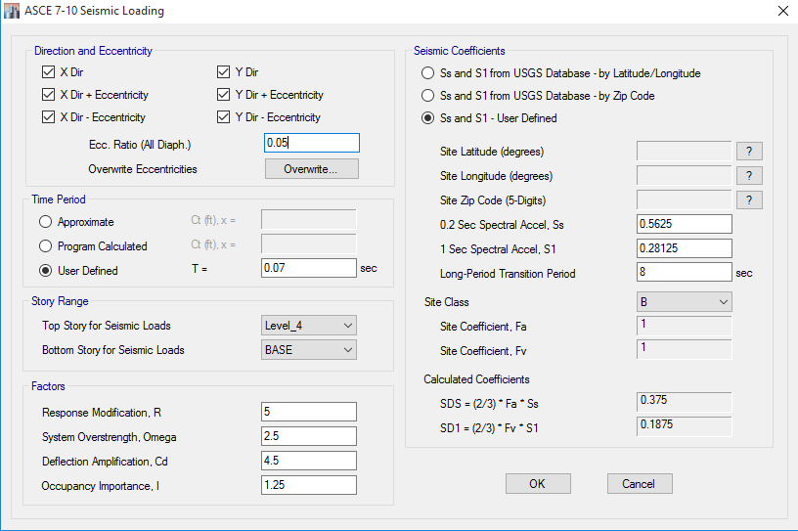
Seismic Design
Determine of Base shear using IBC2012
Define mass source
Define Load patterns
Seismic, ASCE10-7 Code
R = 5
I = 1.25
SDS = 0.375
SD1 = 0.1875
- Seismic Loading -

Slide 22

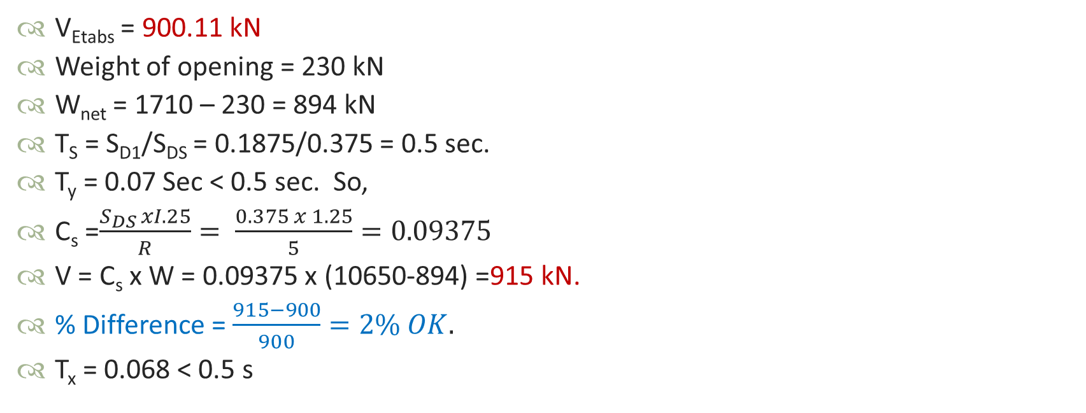
Seismic Design
Determine of Base shear using IBC2012
V_{Etabs} = 900.11 kN
Weight of opening = 230 kN
W_{net} = 1710 – 230 = 894 kN
T_{S} = S_{D1}/S_{DS} = 0.1875/0.375 = 0.5 sec.
T_{y} = 0.07 Sec < 0.5 sec. So,
C_{s} =$\frac{S_{DS }xI.25}{R}= \frac{0.375 x 1.25}{5}=0.09375$
V = C_{s} x W = 0.09375 x (10650-894) =915 kN.
% Difference = $\frac{915−900}{900}=2\% OK.$
T_{x} = 0.068 < 0.5 s

Slide 23
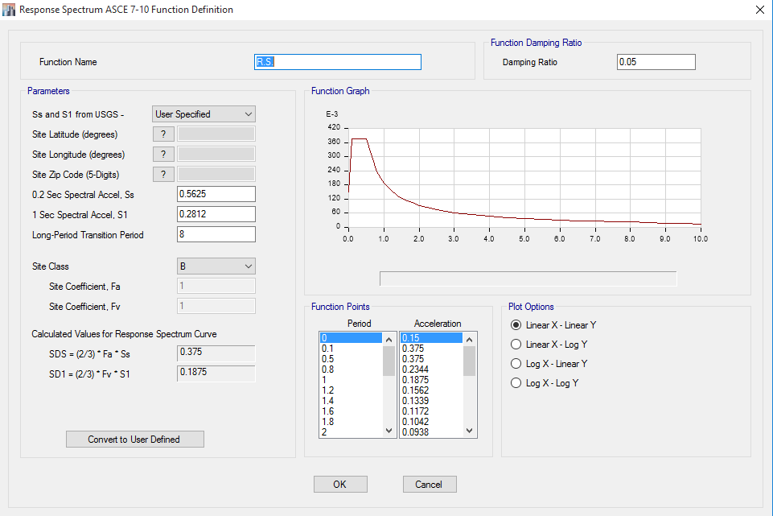
Seismic Design
Response spectrum analysis using ETABS 2015
S_{S} = 3 x 0.375/2 = 0.5625
S₁ = 3 x 0.1875/2 = 0.2812
SDS = 0.375
SD1 = 0.1875
- Response Spectrum Function Definition -

Slide 24
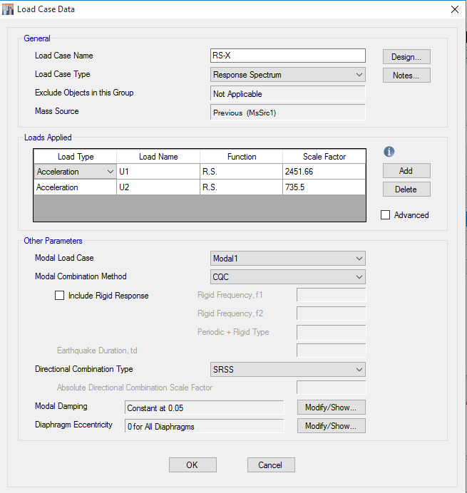
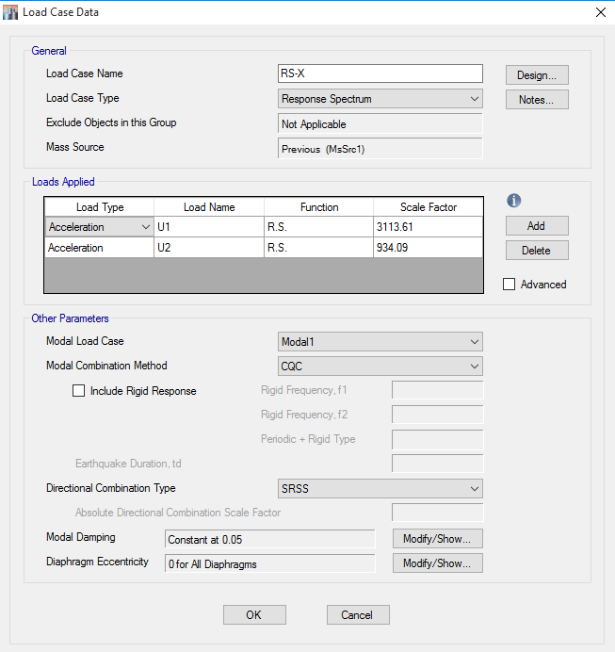
Seismic Design
Define Response in X, and Y directions
U1 = 2451.66
U2 = 735.5
X Scale up factor = 778/612.26 = 1.27
- X – Direction -

Slide 25
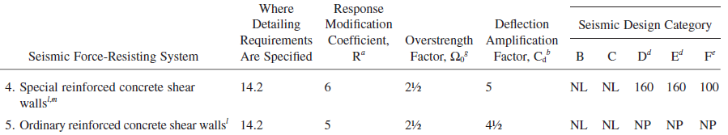
Seismic Design
Check for inelastic response displacement
Δ_{m} = ∆_{Etabs}*Cd/I < h/200 = 8.4/200 = 0.042 m = 42 mm
TABLE: Diaphragm Center of Mass Displacements
Story | Diaphragm | Load Case/Combo | UX | Uxm
 |  |  | mm | mm
Level_3 | D2 | RS-X Max | 0.1 | 0.36
Level_2 | D1 | RS-X Max | 0.04748 | 0.17
TABLE: Diaphragm Center of Mass Displacements
Story | Diaphragm | Load Case/Combo | UX | UY | Uym
 |  |  | mm | mm | mm
Level_3 | D2 | RS-Y Max | 0.02673 | 0.1 | 0.36
Level_2 | D1 | RS-Y Max | 0.01494 | 0.04758 | 0.17

Slide 26
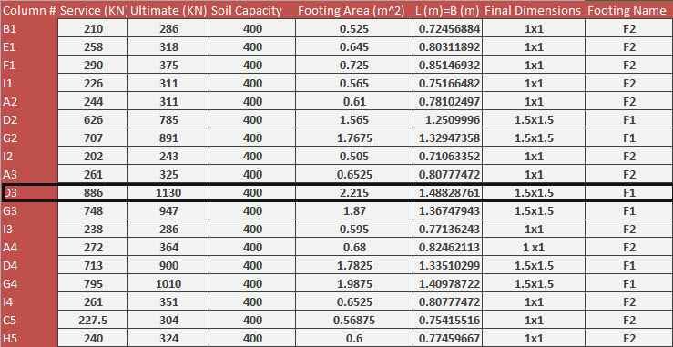
Design and Detailing
Single Footing
Check DIM
Check Shear
Reinforcement
Check by SAP2000
-Compatibility
-Stress
-Moment and
reinforcement

Slide 27
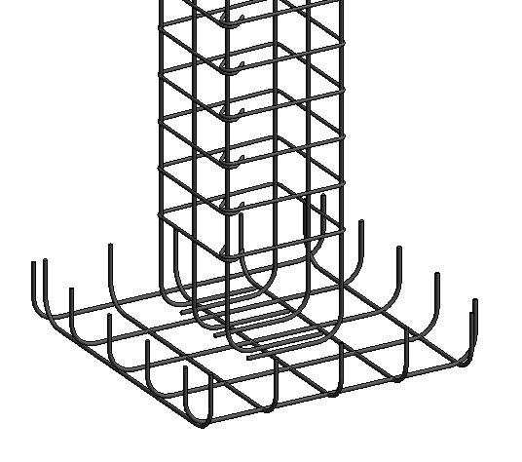
Design and Detailing
Single Footing
- Detailing -

Slide 28
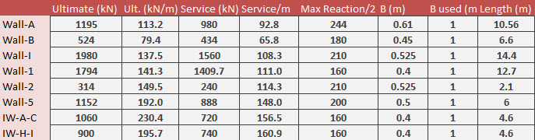
Design and Detailing
Walls Footing
DIM
Reinforcement
Check by ETABS
-Displacement
-Stress
-Moment and
reinforcement

Slide 29
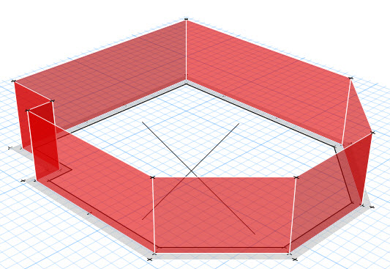
Design and Detailing
Walls Footing

Slide 30
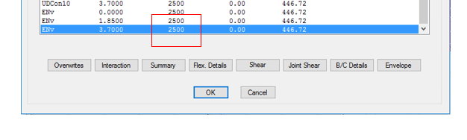
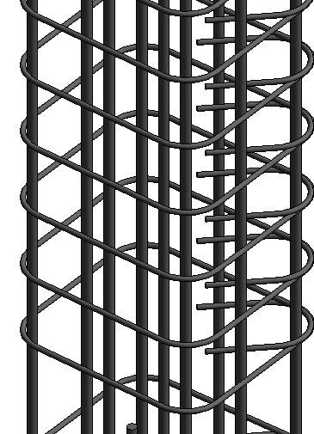

Design and Detailing
Column
Rebar percentage = 1%
(Area of steel = 0.01 x 500 x 500 = 2500 mm² $≡8∅20 )$
S₀ = 150 mm
- ETABS check -
- Detailing -

Slide 31
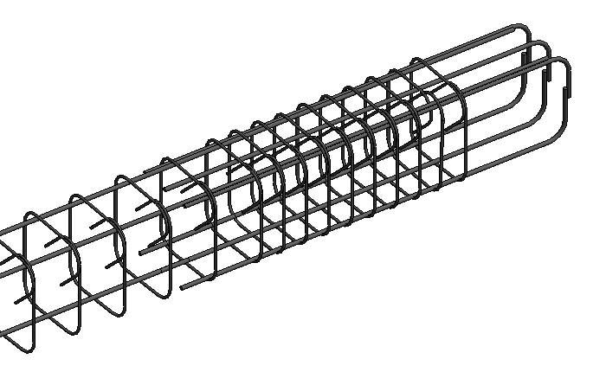
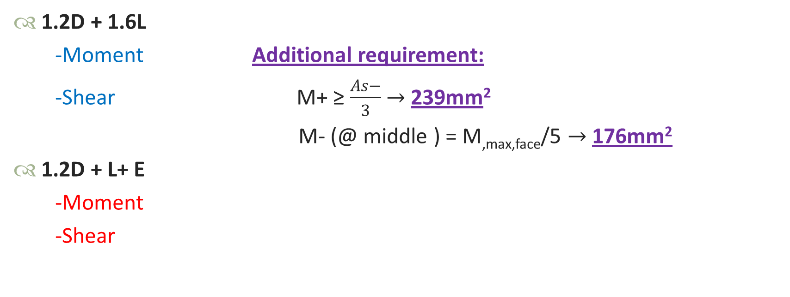
Design and Detailing
Beam
1.2D + 1.6L
-Moment Additional requirement:
-Shear M+ ≥ $\frac{As−}{3}$ $→$239mm²
M- (@ middle ) = M_{,max,face}/5 $→$176mm²
1.2D + L+ E
-Moment
-Shear
- Detailing -

Slide 32
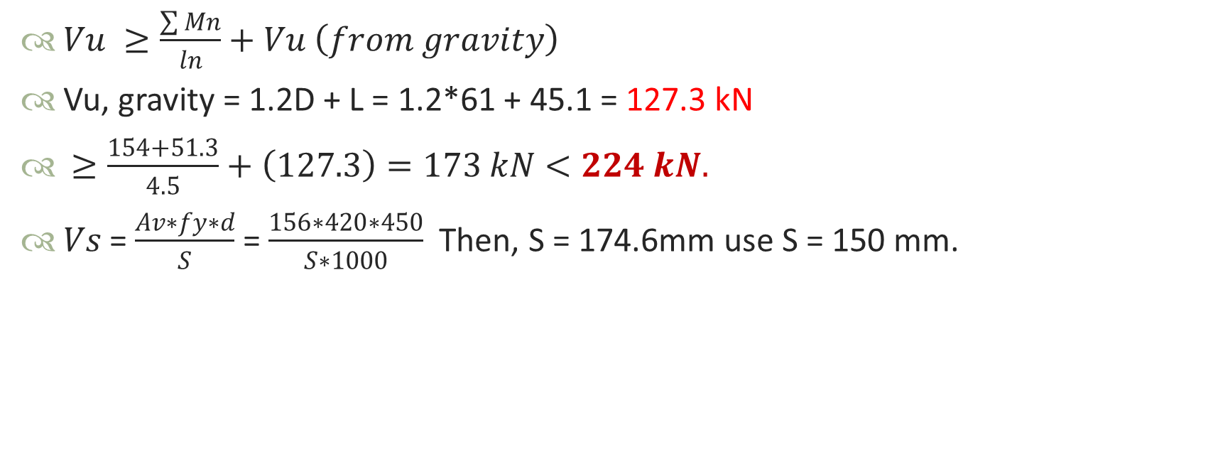
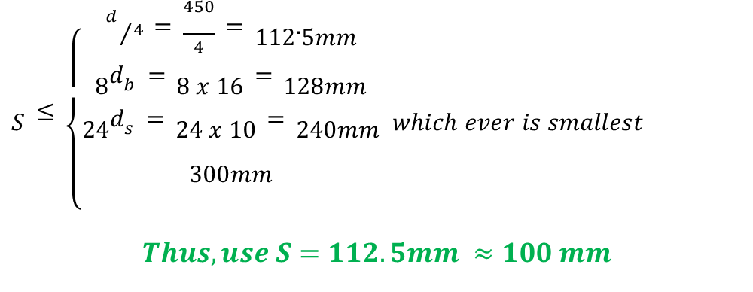
Design and Detailing
Beam
$Vu ≥\frac{\sum{Mn}}{ln}+Vu \left(from gravity\right)$
Vu, gravity = 1.2D + L = 1.2*61 + 45.1 = 127.3 kN
$≥\frac{154+51.3}{4.5}+\left(127.3\right)=173 kN<224 kN.$
$Vs$ = $\frac{Av∗fy∗d}{S}$ = $\frac{156∗420∗450}{S∗1000}$ Then, S = 174.6mm use S = 150 mm.
$S≤\left\{\begin{aligned}d/4=\frac{450}{4}=112.5mm \\ 8d_{b}=8 x 16=128mm \\ 24d_{s}=24 x 10=240mm \\ 300mm\end{aligned}\right. which ever is smallest$
$$Thus, use S=112.5mm ≈100 mm$$

Slide 33
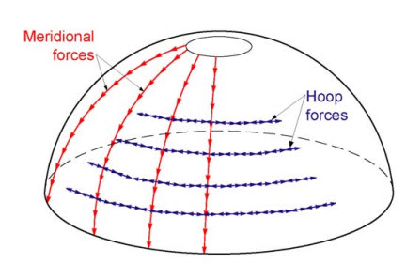

Design and Detailing
Dome
Meridian forces ($N_{∅}$)
Hoop forces($N_{θ}$)

Slide 34
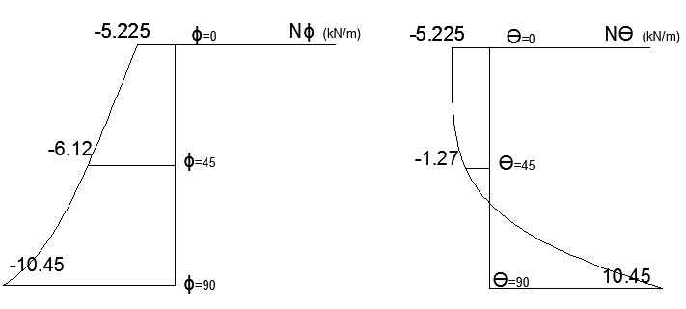
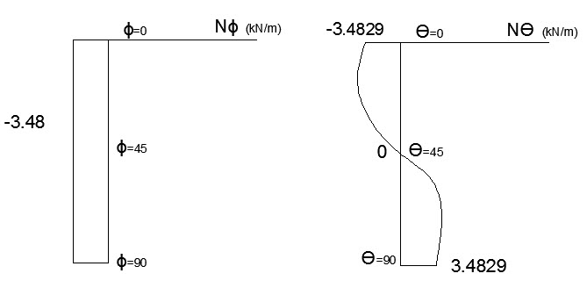
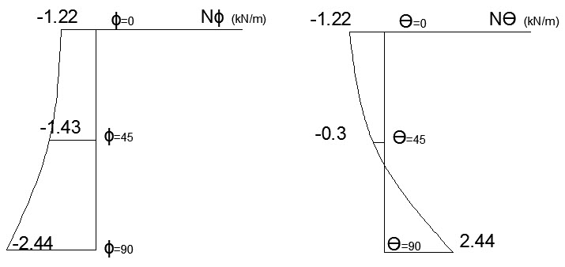


Design and Detailing
Dome
- From own weight-
- From Live load -
Ultimate $N_{∅}$ = $21.036\frac{kN}{m}$ C As minimum
- From SID Load -
Ultimate $N_{θ}$ = $21.036\frac{kN}{m}$ T As minimum

Slide 35
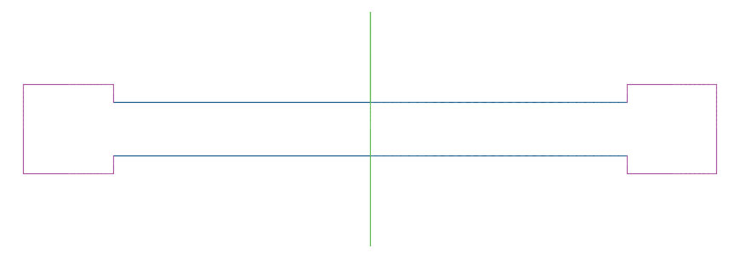
Design and Detailing
Shear Wall
Since F_{y} = 420 MPa and d_{b} < 16 mm:
- ρ_{horizontal} = 0.002
- ρ_{vertical} = 0.0012
 | L | Moment | As,min | D (mm) | # of bars | use
Wall-A | 10.6 | 420.00 | 3801.6 | 12 | 33.6 | 34
Wall-B | 6.6 | 172.00 | 2376.0 | 12 | 21.0 | 22
Wall-I | 14.4 | 256.00 | 5184.0 | 14 | 33.7 | 34
Wall-1 | 12.7 | 456.00 | 4572.0 | 14 | 29.7 | 30
Wall-2 | 2.1 | 225.00 | 756.0 | 12 | 6.7 | 8
Wall-5 | 6.0 | 237.00 | 2160.0 | 12 | 19.1 | 20
IW A-C | 4.6 | 300.00 | 1654.4 | 12 | 14.6 | 16
IW H-I | 4.6 | 300.00 | 1654.4 | 12 | 14.6 | 16

Slide 36

Design and Detailing
Check for ETABS

Slide 37
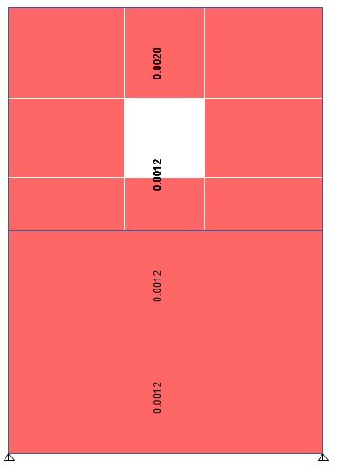
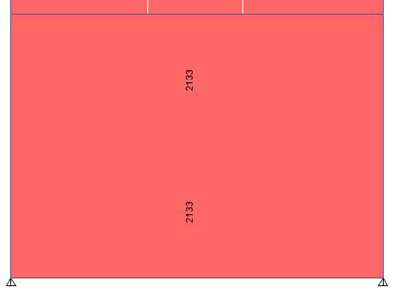
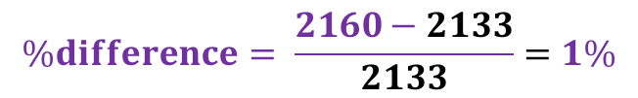

Design and Detailing
Shear Wall
$All S.Ws with As,min=2133$ mm2
$$\%difference= \frac{2160−2133}{2133}=1\%$$

Slide 38
RVS
RVS
What is new ?
For the mosque

Slide 39
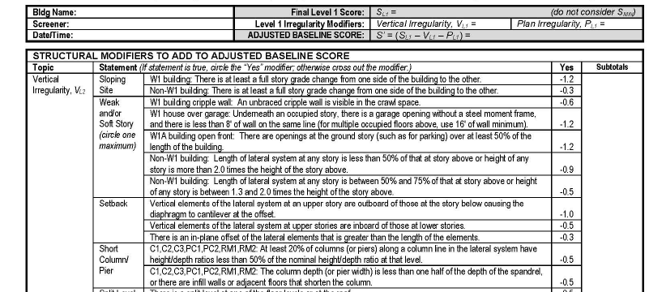
What is new?!
An “optional Level 2” Data Collection Form has been added.

Slide 40

What is new?!
The number of seismicity regions has been expanded from three to five.
Based on MCER ground motions (rather than the two-thirds of MCE ground motions)
Low.
Moderate.
Moderately High.
High.
Very High.
New

Slide 41
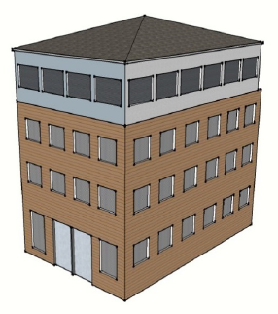
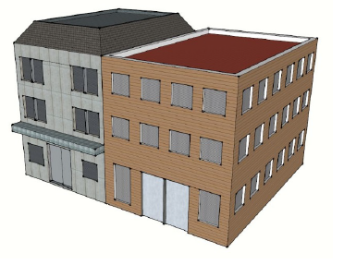
What is new?!
Screening buildings with additions is provided.

Slide 42
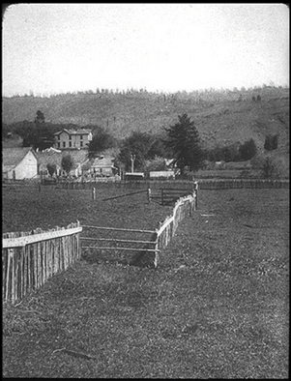
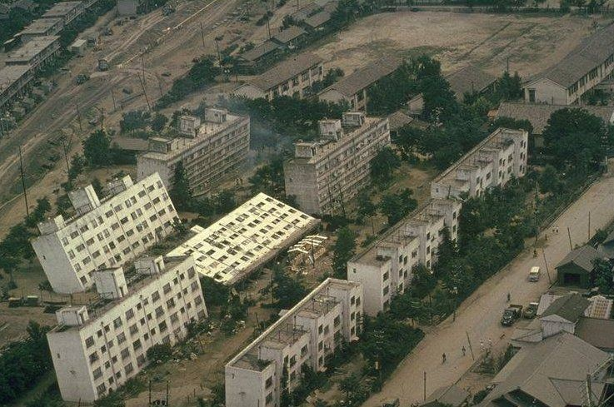


What is new?!
Geologic hazards.
Liquefaction.
Landslide.
Surface Rupture.

Slide 43

What is new?!
Pounding and adjacency are now considered.
Falling hazards from taller adjusting building.

Slide 44

What is new?!
Exterior Falling Hazards.

Slide 45

What is new?!
Vertical and plan irregularities have been updated.
Moderate Vertical Irregularities:
Sloping Site.
In-Plane Setback.
Split Levels.
Sever Vertical Irregularities:
Weak and/or Soft Story.
Out-of-Plane Setback.
Short Colum.

Slide 46


What is new?!
A minimum score has been included, F.Smin.
Probability of failure%: $P= \frac{1}{{10}^{n}}$
Where n: Final Score.

Slide 47

What is new?!
Soil Type CD Rather Than AB.

Slide 48

RVS For Mosque
S_{S} = 0.375 x 1.5 = 0.5625
S₁ = 0.1875 x 1.5 = 0.2812

Slide 49


Recommendations:
Concrete frame with unreinforced masonry-
walls.
Falling hazard.
F.S = 1.4 < 2.
Detailed Structural Evaluation is required.
Not-acceptable.
Probability of failure: $P= \frac{1}{{10}^{n}}= \frac{1}{{10}^{1.4}}=4 \%$

Slide 50


Recommendations:
Concrete shear wall building.
F.S = 2.9 > 2.
Acceptable building.
Probability of failure: $P= \frac{1}{{10}^{n}}= \frac{1}{{10}^{2.9}}=0.13 \%$

Slide 51
Recommendations
Recommendations:
It is preferred to eliminate super dead load, by using false-ceiling (by the way we need false-ceiling for sound isolation).
Stone should be fixed with shear walls.
Provide a small, and BRACED water tank.
Non-structural elements should be fixed and designed.
It is preferred to provide Refuge.
It is NOT permitted at all to remove any of shear walls.
We need to develop our own RVS.

Slide 52
Conclusion
{وَلا تَقْفُ مَا لَيْسَ لَكَ بِهِ عِلْمٌ}
{قُلْ إِنَّمَا أَعِظُكُمْ بِوَاحِدَةٍ أَنْ تَقُومُوا لِلَّهِ مَثْنَى}
{خَلَقَ السَّمَاوَاتِ بِغَيْرِ عَمَدٍ تَرَوْنَهَا}
Humility
Back-Up-System
Shear Walls

Slide 53

Quality!
{إن الذين آمنوا وعملوا الصالحات إنا لا نضيع أجر من أحسن عملاً}
Quality control is the first lesson in seismic design.
Be honest, be honest, and be honest.

Slide 54
Questions & Comments

