Slide 1
Structural Analysis and Design of Al-Sayed Mall in Qalqilia
Prepared By:
Ahmad Mazen Abd-Alkareem Labat
Hamza Walid Shareef Dawoud
Mohammad Khaled Mohammad Nassoura
Mo'men Mahmoud Ahmad Khalifeh
Zaid Hilal “Mohammad-Rohi” Hijazi
Under supervision of:
Eng. Ibrahim Mohammad Arman

Slide 2
Outline
Chapter One: Introduction
Chapter Two: Preliminary Design
Chapter Three: Three-dimensional analysis and design

Slide 3
Chapter one: Introduction
Outline:
Project Plans and site location
Floors Information
Codes and standards
Software programs
Materials
Geotechnical investigations
Loads ( Gravity and lateral)
Load combinations

Slide 4
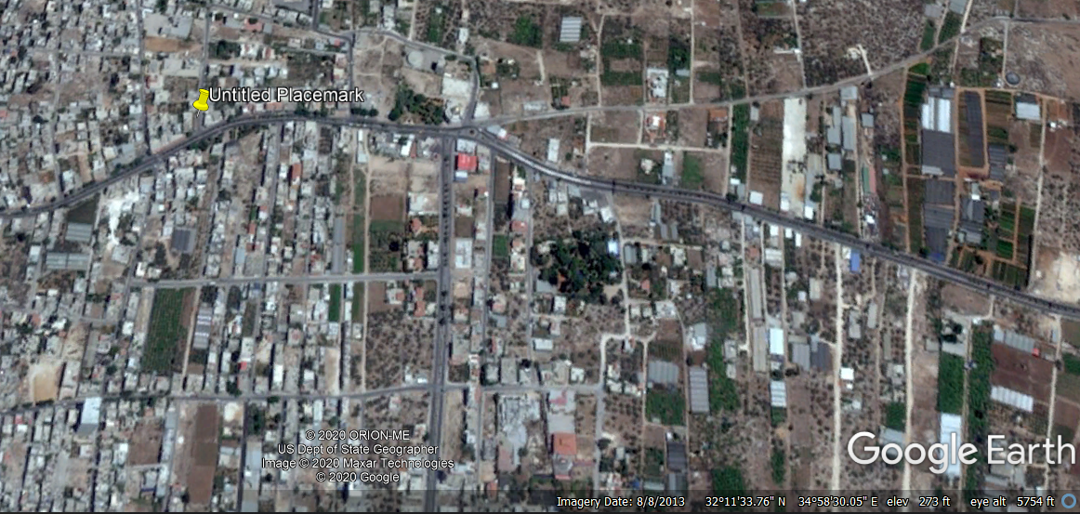
Site location
Chapter One

Slide 5
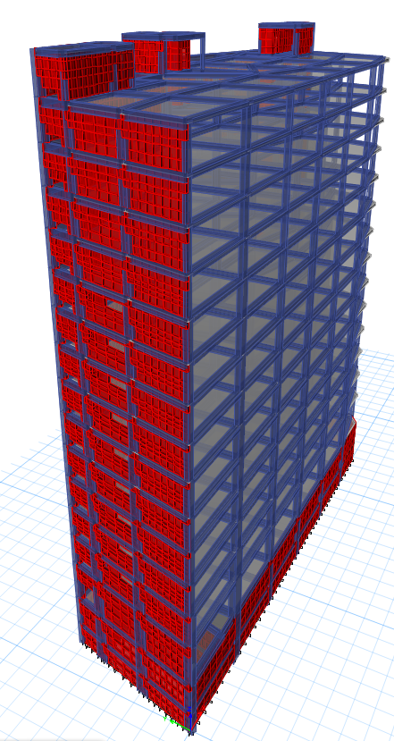
Site location
Chapter One

Slide 6
Floors Information
Chapter One
Area for each floor is approximately equal to 1260 m²
Floor | Height (m) | Utilization
Basement two | 3.0 | Garages
Basement one | 3.8 | Stores
Ground floor | 5.0 | Stores
First floor | 3.8 | Stores
Second floor-forth floor | 3.8 | Offices
Fifth floor-Tenth floor | 3.8 | Hotels
Eleventh floor -twelfth floor | 3.8 | Lounge
Thirteenth floor | 3.8 | Restaurant

Slide 7
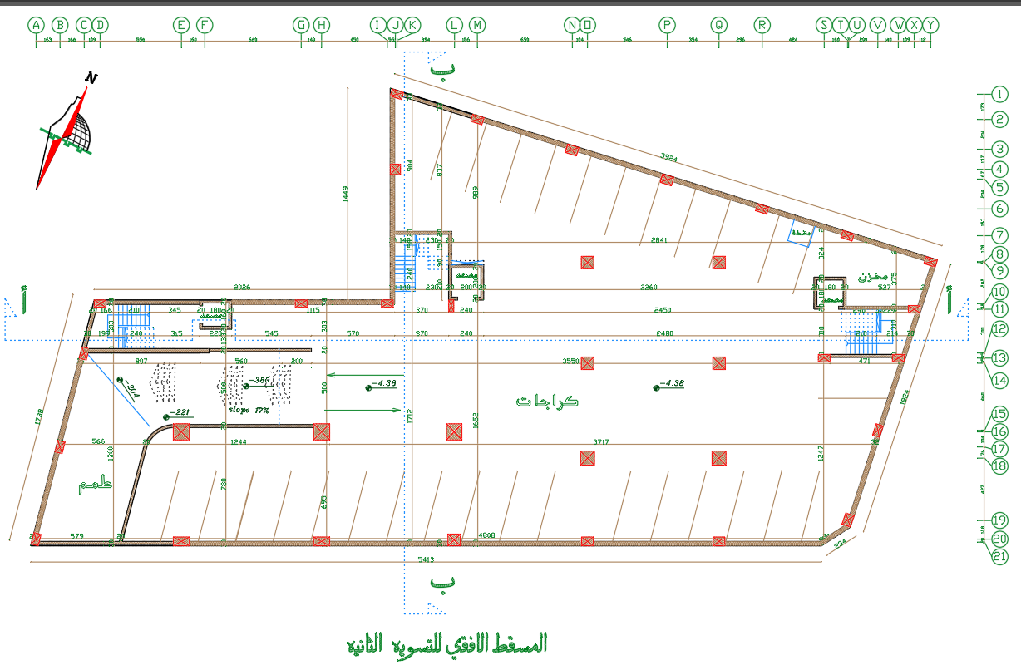
Project plans
Chapter One

Slide 8
Codes and standards
Chapter One
ACI 318-11 (American Concrete Institute)
IBC 2012 (International Building Code)
ASCE 7-10 (American Society of Civil Engineers)
ASTM 2016 (American Society for Testing and Materials)
AASHTO (American Association of State Highway and Transportation Officials)

Slide 9
Software programs
Chapter One
ETABS 2016 (to analyze and design the model)
SAFE 2016 (to analyze and design the foundation)
AutoCAD 2018 ( to prepare the structural drawings)
Excel 2019 ( for calculation operations)

Slide 10
Materials
Chapter One
Concrete
Structural Element | Concrete Type | f_{c}ʹ (MPa) | E_{c} (MPa) | f_{t}ʹ (MPa) | f_{r} (MPa) | Poisson ratio | Ɣ (kN/m³)
Slabs, Beams and stairs | B400 | 32 | 2.66*10⁴ | 1.87 | 3.51 | 0.2 | 25
Columns , Walls and foundation | B500 | 40 | 2.97*10⁴ | 2.1 | 3.92 | 0.2 | 25

Slide 11
Materials
Chapter One
Reinforcing steel
Yield strength (F_{y}) | 420 MPa
Ultimate strength (f_{u}) | 620 MPa
Steel grade | 60
Modulus of elasticity (E_{s}) | 200 GPa

Slide 12
Materials
Chapter One
Nonstructural elements
Materials | Ɣ (kN/m³)
Mortar | 23
Tiles (porcelain) (3cm) | 27
Masonry stone (4cm) | 27
Bricks (20,15,10) | 15
Aggregates (filling materials) | 18
Plastering | 23
Glass clear float | 25
Aluminum | 26.1

Slide 13
Soil investigations
Chapter One
Based on the available soil investigation report that has been taken from the NCTN Company in 22 January 2018, it was found that the soil is Medium Hard Rock (Sc) and the allowable bearing capacity is 3.6 kg/cm²

Slide 14
Loads
Chapter One
Gravity loads
Dead load
Superimposed dead load
Slabs
Live load
Beams and external walls
Loads
Lateral loads
Soil load
Earthquake load
Temperature load

Slide 15
Loads
Chapter One
Gravity load:
Dead load: Self weight of the structural elements.
Live loads: Referring to ASCE7-10 code
Live load was used as the table above, except the offices 5 kN/m² has been used.
Type | Live load (kN/m²) | Type | Live load (kN/m²)
Heavy Stores | 12 | Offices | 2.5
Light Stores | 6 | Restaurant | 5
Generator room | 12 | Stairs and ramp | 5
Public rooms | 5 | Private rooms | 2

Slide 16
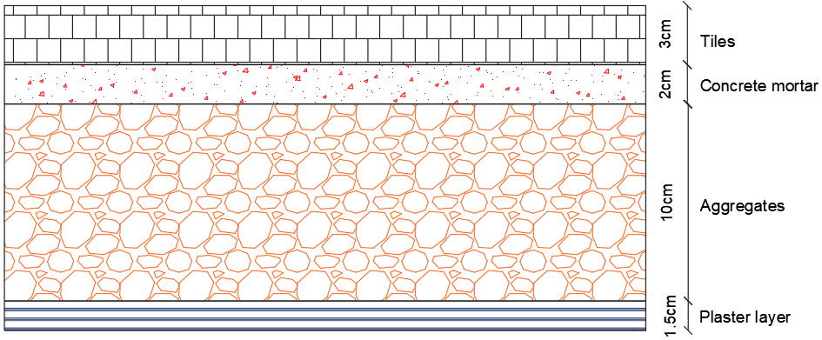
Loads
Chapter One
Gravity load:
Superimposed loads on slab:
Floor layers (3.42 kN/m²)

Slide 17
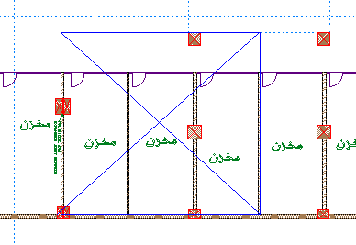
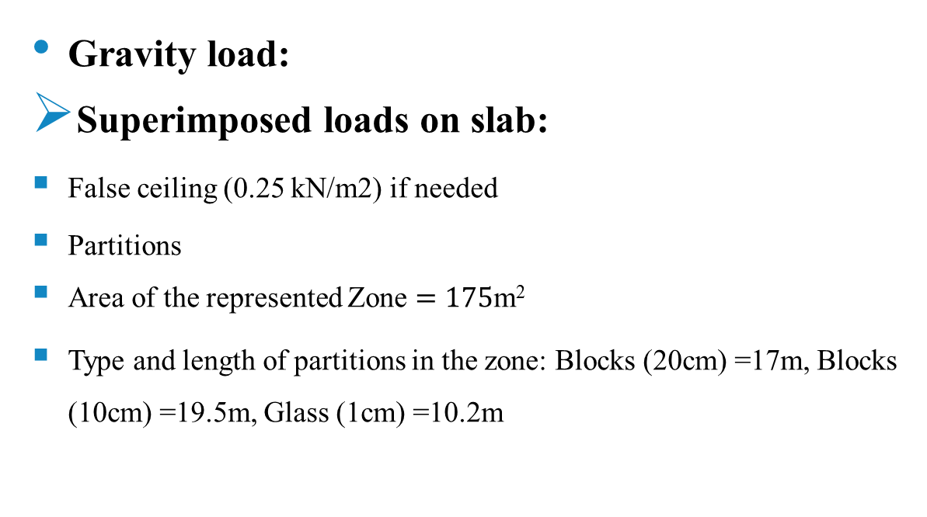
Loads
Chapter One
Gravity load:
Superimposed loads on slab:
False ceiling (0.25 kN/m2) if needed
Partitions
Area of the represented Zone $=175$m²
Type and length of partitions in the zone: Blocks (20cm) =17m, Blocks (10cm) =19.5m, Glass (1cm) =10.2m

Slide 18
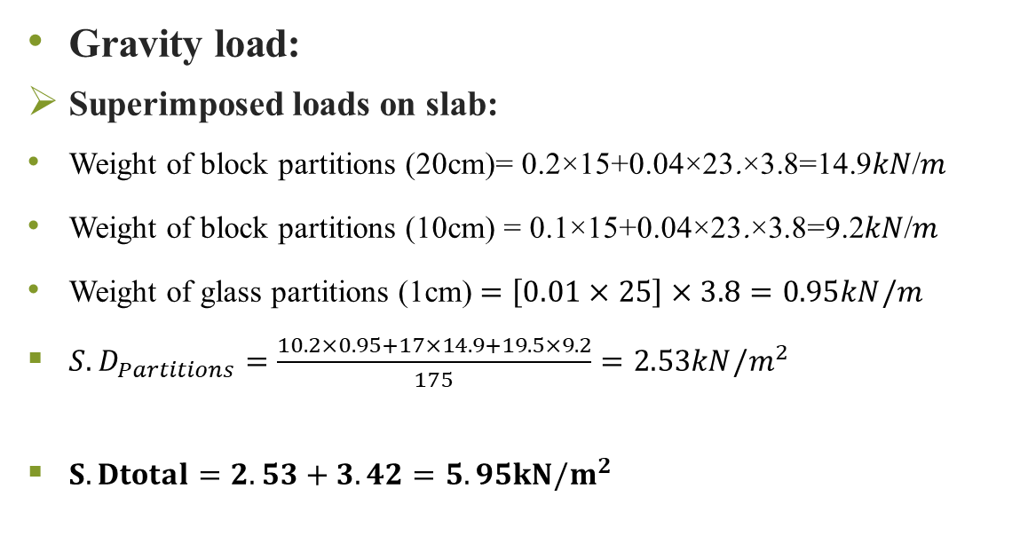
Loads
Chapter One
Gravity load:
Superimposed loads on slab:
Weight of block partitions (20cm)= 0.2×15+0.04×23.×3.8=14.9𝑘𝑁/𝑚
Weight of block partitions (10cm) = 0.1×15+0.04×23.×3.8=9.2𝑘𝑁/𝑚
Weight of glass partitions (1cm)$=\left[0.01×25\right]×3.8=0.95kN/m$
${S.D}_{Partitions}=\frac{10.2×0.95+17×14.9+19.5×9.2}{175}=2.53kN/m^{2}$
$S.Dtotal=2.53+3.42=5.95kN/m^{2}$

Slide 19
Loads
Chapter One
Temperature load: Due to large length of the structure, temperature load has been used rather than using of expansion joint. And it is equal to 15 °C due to average change of the temperature during the day.

Slide 20
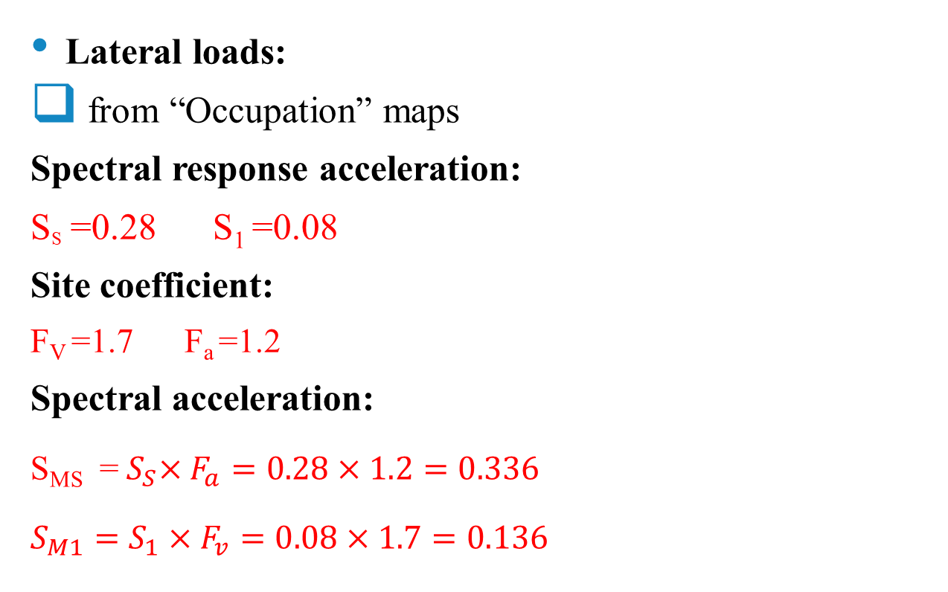
Loads
Chapter One
Lateral loads:
from “Occupation” maps
Spectral response acceleration:
S_{S} =0.28 S₁ =0.08
Site coefficient:
F_{V} =1.7 F_{a} =1.2
Spectral acceleration:
S_{MS} =${ S}_{S}×F_{a}=0.28×1.2=0.336$
$$S_{M1}=S_{1}×F_{v}=0.08×1.7=0.136$$

Slide 21

Loads
Chapter One
Lateral loads:
The design spectral acceleration parameters:
$$S_{DS}=S_{Ms}=0.336$$
$$S_{D1}=S_{M1}=0.136$$

Slide 22
Loads
Chapter One
Lateral loads:
Risk category (III) (ASCE 7-10)
Importance factor (I_{e}) = 1.25 (ASCE 7-10 )
Seismic design category (SDC) ➔ C (ASCE 7-10)
Redundancy factor (ρ) = 1.0 (ASCE 7-10 )

Slide 23
Loads
Chapter One
Lateral loads:
seismic forces resisting system:
The seismic forces resisting system was chosen to be “Building frame system-ordinary reinforced concrete shear wall”
Response modification coefficient (R) = 5
Overstrength factor (Ω₀ ) = 2.5
Deflection amplification factor (C_{d}) = 4.5

Slide 24
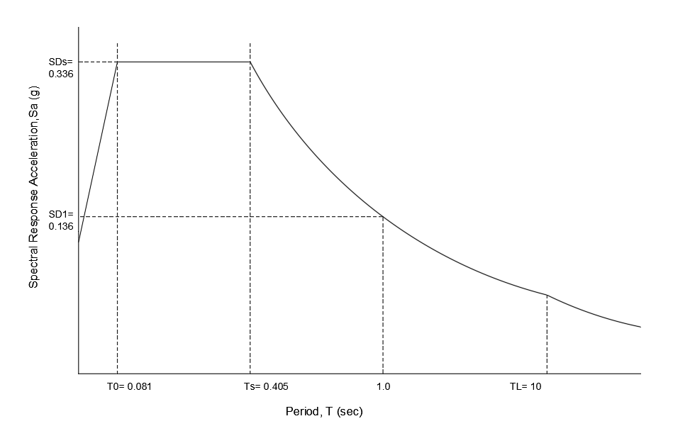

Loads
Chapter One
Lateral loads:
T₀ = 0.2 * $\frac{SD1}{SDS}$ = 0.081 second
T_{S} = $\frac{SD1}{SDS}$ = 0.405 second
T_{L} = Long-period transition period (s)
it is equal to 10 seconds

Slide 25
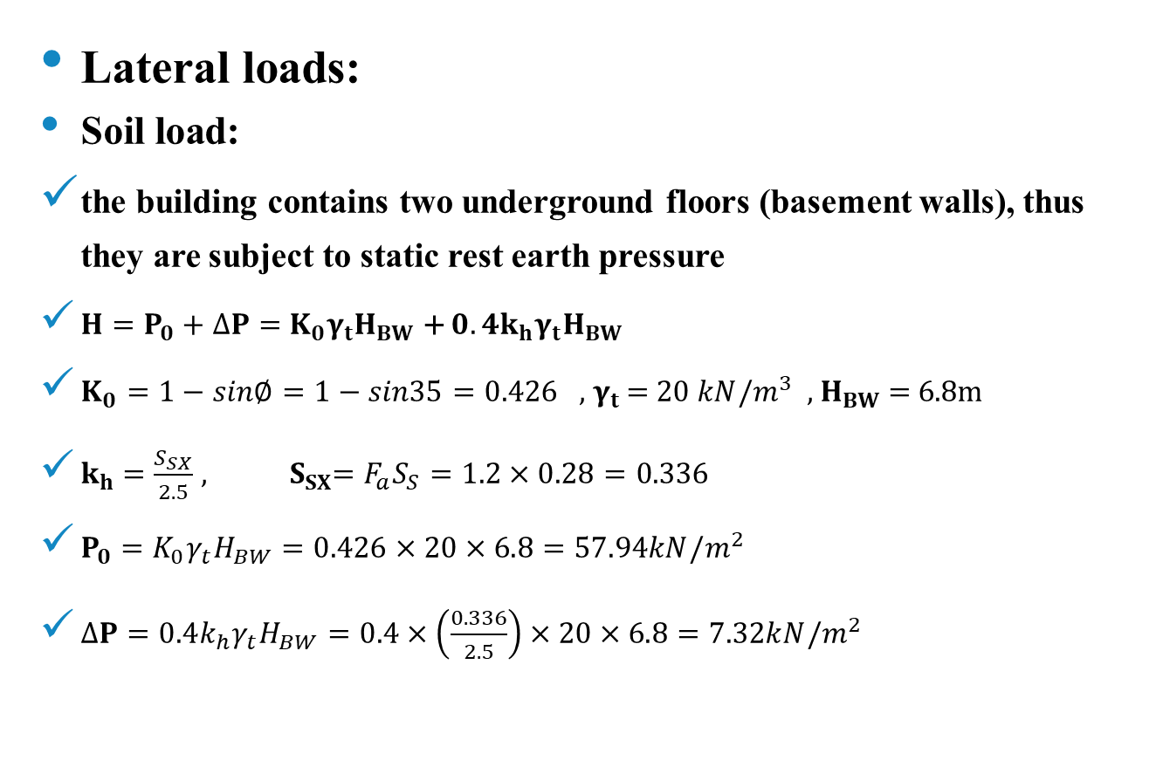
Loads
Chapter One
Lateral loads:
Soil load:
the building contains two underground floors (basement walls), thus they are subject to static rest earth pressure
$H=P_{0}+∆P=$ $K_{0}γ_{t}H_{BW}$ + $0.4k_{h}γ_{t}H_{BW}$
$K_{0}=1−sin∅=1−sin35=0.426$ , $γ_{t}$ = 20 $kN/m^{3}$ , $H_{BW}$ = 6.8m
$k_{h}$ $=\frac{S_{SX}}{2.5}$, ${ S}_{SX}=F_{a}S_{S}=1.2×0.28=0.336$
$P_{0}=K_{0}γ_{t}H_{BW}=0.426×20×6.8=57.94kN/m^{2}$
$∆P=0.4k_{h}γ_{t}H_{BW}=0.4×\left(\frac{0.336}{2.5}\right)×20×6.8=7.32kN/m^{2}$

Slide 26
Loads
Chapter One
Lateral loads:
Soil load:
So, 𝐻=𝑃0+Δ𝑃=57.94+7.32=65.26𝑘𝑁/𝑚2
Effect of Vehicles movement on basement walls:
AASHTO code recommended to add 12 kN/m² as a uniform distributed load as surcharge on soil
So the total pressure effects on the basement walls at z=0 equal to 12.43 kN/m² and at z=6.8 equal to 70.4 kN/m²( effect of the surcharge load =0.426×12=5.11 kN/m²).

Slide 27
Load combinations
Chapter One
Factored load combinations:
1.4D + 1.6H
1.2D + 1.6L + 1.6H Where: 𝐸=𝐸_{ℎ}+𝐸_{𝑣} 𝐸=𝐸_{ℎ}−𝐸_{𝑣}
1.2D + 1.0E + L + 1.6H 𝐸ℎ=𝜌𝑄_{𝐸} 𝐸𝑣=0.2𝑆_{𝐷𝑆}𝐷
0.9D + 1.0E + 0.9H 𝑄𝐸𝑥=𝐸𝑄𝑥+0.3𝐸𝑄𝑦
D + L +T 𝑄𝐸_{𝑦}=𝐸𝑄_{𝑦}+0.3𝐸𝑄_{𝑥}

Slide 28
Load combinations
Chapter One
Service load combinations:
D + H
D + L + H
D + 0.7E + H
D+ 0.75L + 0.75(0.7E) + H
0.6D + 0.7E + 0.6H

Slide 29
Chapter Two: Preliminary Design
Outline:
Slab structural system
Preliminary slab thickness
Preliminary dimensions of beams
Preliminary dimensions of columns
Preliminary dimensions of walls

Slide 30
Slab structural system
Chapter Two
Due to large spans length, two way slabs system was used.
Slab of | Type of slab
Basement two floor -Third floor | Solid Slab
Forth floor - Thirteenth floor | Voided Slab

Slide 31
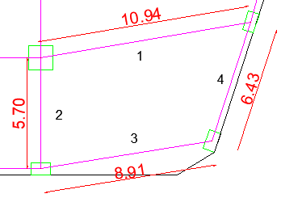

Preliminary slab thickness
Chapter Two
For solid slab
According to the average values of beam to slab flexural stiffness ratio ($α_{f}$) for the four sides of panel.
Try h= 300mm

Slide 32
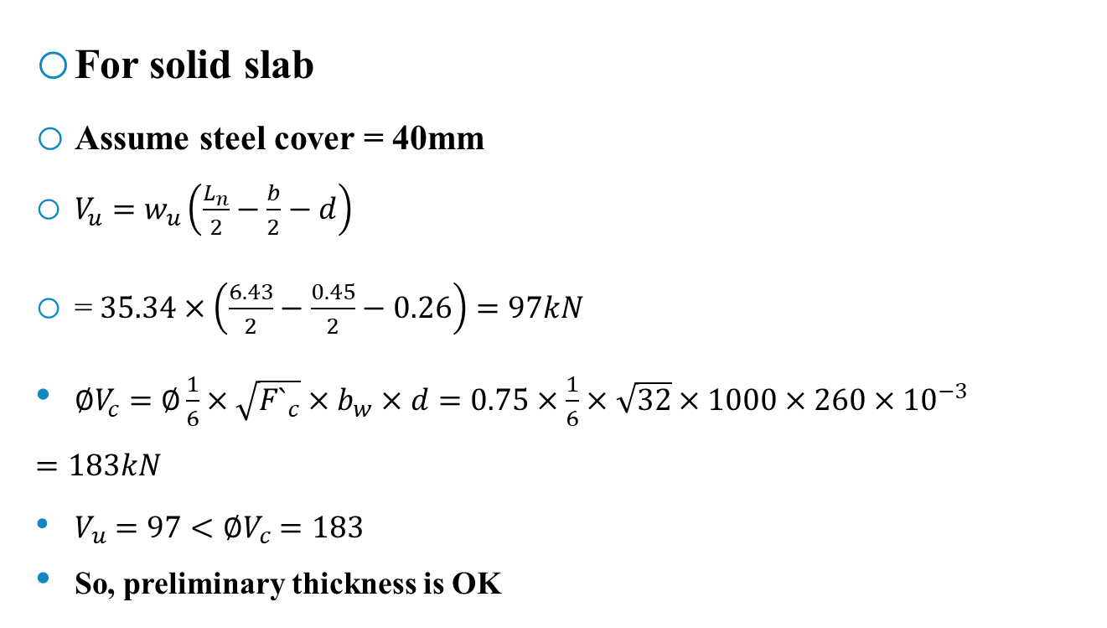
Preliminary slab thickness
Chapter Two
For solid slab
Assume steel cover = 40mm
$V_{u}=w_{u}\left(\frac{L_{n}}{2}−\frac{b}{2}−d\right)$
= $35.34×\left(\frac{6.43}{2}−\frac{0.45}{2}−0.26\right)=97kN$
$∅V_{c}=∅\frac{1}{6}×\sqrt{{F`}_{c}}×b_{w}×d=0.75×\frac{1}{6}×\sqrt{32}×1000×260×{10}^{−3} =183kN$
$V_{u}=97<∅V_{c}=183$
So, preliminary thickness is OK

Slide 33
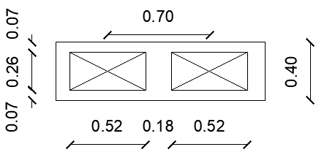

Preliminary slab thickness
Chapter Two
For Voided slab
$h_{voided}=1.2h_{solid}=1.2×30=36cm$
Try h = 40cm
$I_{solid}=\frac{1}{12}×0.7×{0.3}^{3}=1.575×{10}^{−3}$
$I_{voided}=2.972×{10}^{−3}$
$I_{voided}>I_{solid}$ The section dimensions is ok

Slide 34
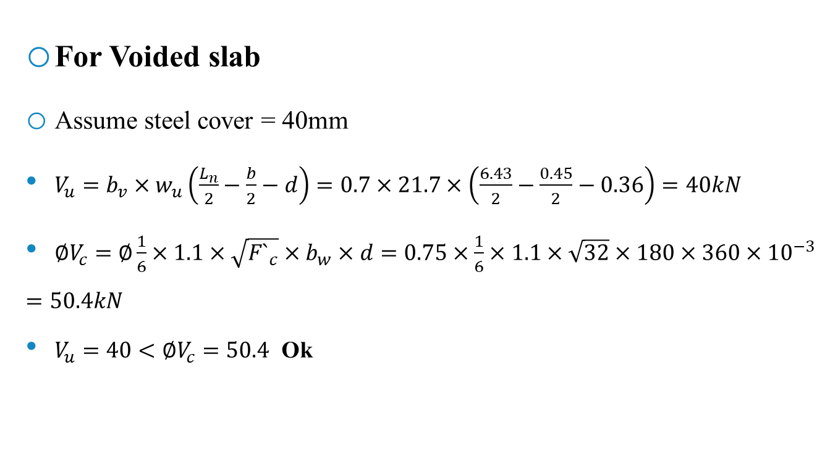
Preliminary slab thickness
Chapter Two
For Voided slab
Assume steel cover = 40mm
$V_{u}=b_{v}×w_{u}\left(\frac{L_{n}}{2}−\frac{b}{2}−d\right)=0.7×21.7×\left(\frac{6.43}{2}−\frac{0.45}{2}−0.36\right)=40kN$
$∅V_{c}=∅\frac{1}{6}×1.1×\sqrt{{F`}_{c}}×b_{w}×d=0.75×\frac{1}{6}×1.1×\sqrt{32}×180×360×{10}^{−3}=50.4kN$
$V_{u}=40<∅V_{c}=50.4$ Ok

Slide 35
Preliminary dimensions of beams
Chapter Two
Beams location | Dimensions
In the external perimeter within shear walls. | 1000mm depth and 300mm width
In the elevators and stairs | 1000mm depth and 300mm width
In the roof slab | 500mm depth and 600mm width
In the Solid Slab | 500mm depth and 800mm width
In the Voided Slab Slab | 400mm depth and 800mm width

Slide 36
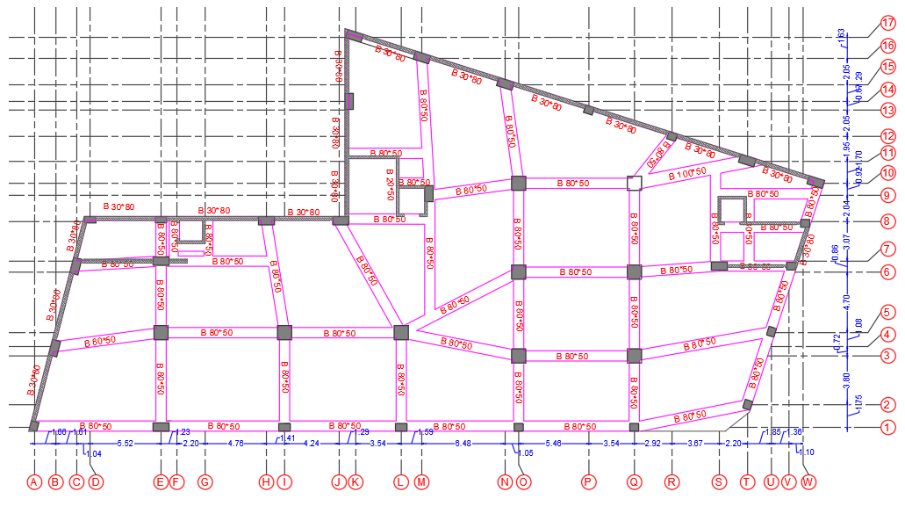
Preliminary dimensions of beams
Chapter Two
Layout of the beams:

Slide 37
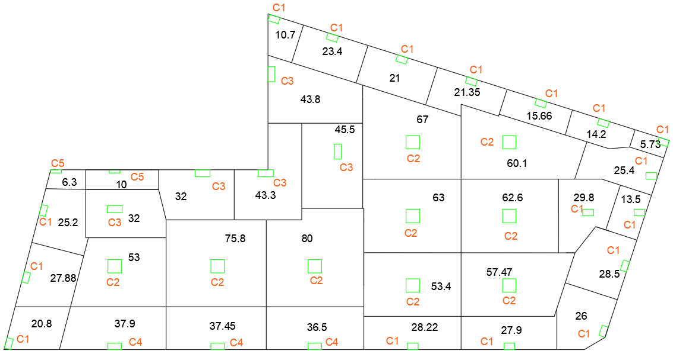
Preliminary dimensions of columns
Chapter Two
Tributary area between columns:

Slide 38
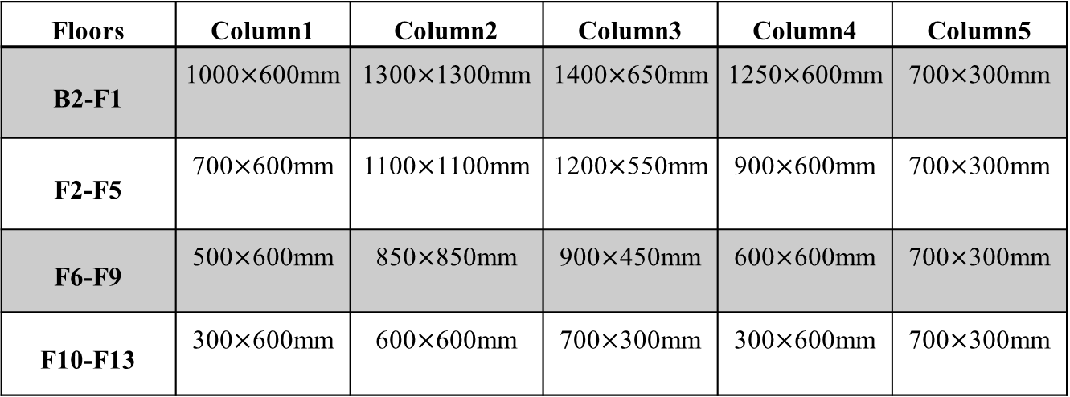
Preliminary dimensions of columns
Chapter Two
Columns groups and dimensions based on tributary area:
Floors | Column1 | Column2 | Column3 | Column4 | Column5
B2-F1 | 1000$×$600mm | 1300$×$1300mm | 1400$×$650mm | 1250$×$600mm | 700$×$300mm
F2-F5 | 700$×$600mm | 1100$×$1100mm | 1200$×$550mm | 900$×$600mm | 700$×$300mm
F6-F9 | 500$×$600mm | 850$×$850mm | 900$×$450mm | 600$×$600mm | 700$×$300mm
F10-F13 | 300$×$600mm | 600$×$600mm | 700$×$300mm | 300$×$600mm | 700$×$300mm

Slide 39
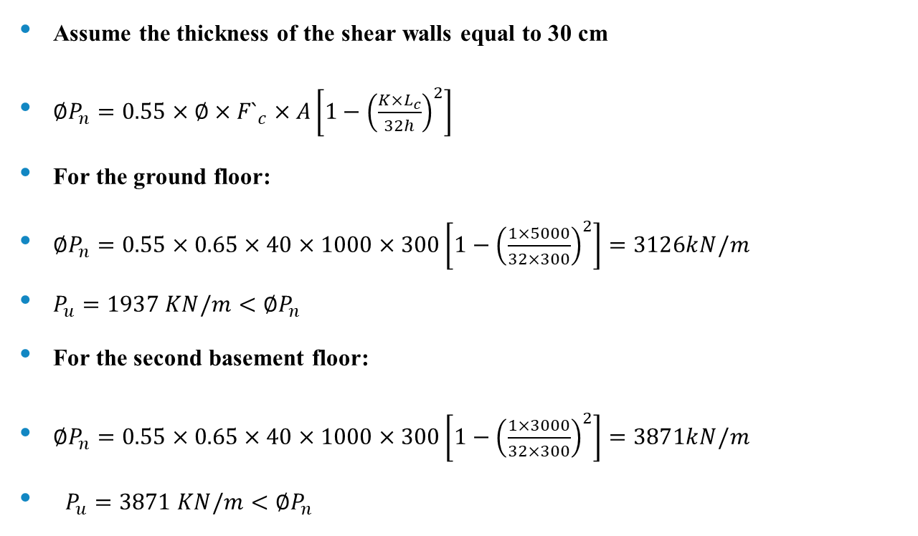
Preliminary dimensions of walls
Chapter Two
Assume the thickness of the shear walls equal to 30 cm
$∅P_{n}=0.55×∅×{F`}_{c}×A\left[1−{\left(\frac{{K×L}_{c}}{32h}\right)}^{2}\right]$
For the ground floor:
$∅P_{n}=0.55×0.65×40×1000×300\left[1−{\left(\frac{1×5000}{32×300}\right)}^{2}\right]=3126kN/m$
$P_{u}=1937 KN/m<∅P_{n}$
For the second basement floor:
$∅P_{n}=0.55×0.65×40×1000×300\left[1−{\left(\frac{1×3000}{32×300}\right)}^{2}\right]=3871kN/m$
$P_{u}=3871 KN/m<∅P_{n}$

Slide 40
Chapter Three: Three-dimensional analysis and design
Outline:
Structural modeling of the building.
Evaluation of the preliminary design.
Verification of the structural analysis.
Seismic forces checks.
Structural irregularity.
Effect of P-delta.
Deflection computations.
Design of beams
Design of columns
Design of slabs
Design of walls
Design of Footings
Design of stairs
Design of ramp

Slide 41
Structural modeling of the building

Slide 42
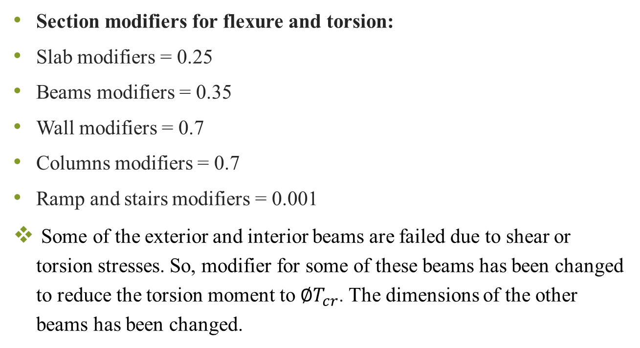
Structural modeling of the building
Chapter Three
Section modifiers for flexure and torsion:
Slab modifiers = 0.25
Beams modifiers = 0.35
Wall modifiers = 0.7
Columns modifiers = 0.7
Ramp and stairs modifiers = 0.001
Some of the exterior and interior beams are failed due to shear or torsion stresses. So, modifier for some of these beams has been changed to reduce the torsion moment to $∅T_{cr}$. The dimensions of the other beams has been changed.

Slide 43
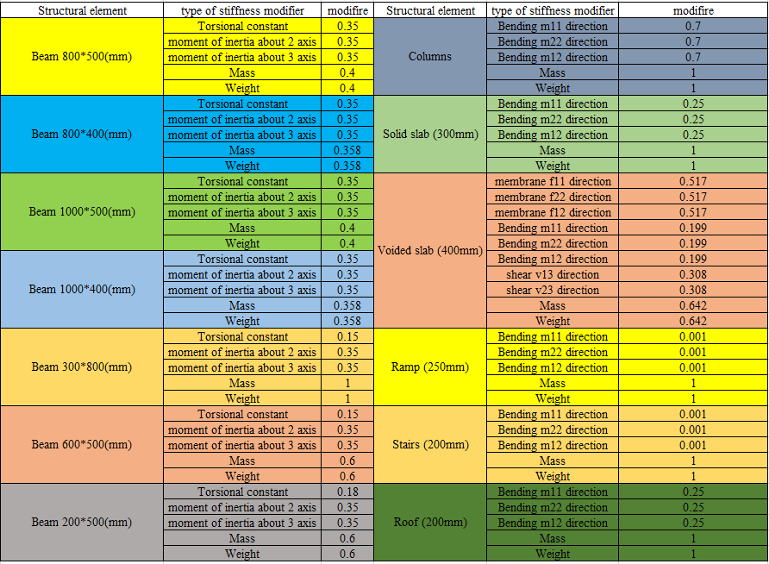
Structural modeling of the building
Chapter Three
Final sections modifiers

Slide 44
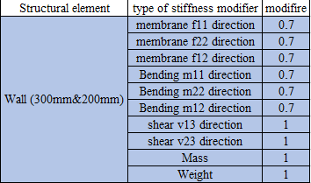
Structural modeling of the building
Chapter Three
Final sections modifiers

Slide 45
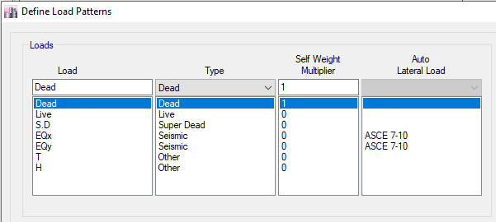
Structural modeling of the building
Chapter Three
Load definition:

Slide 46
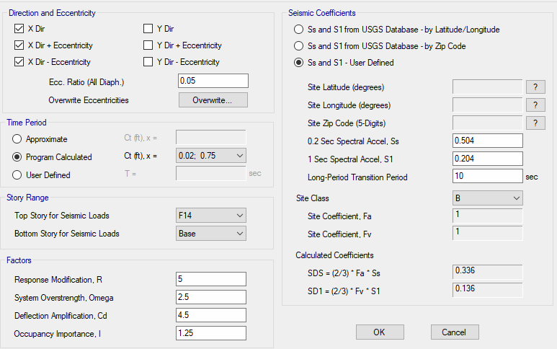
Structural modeling of the building
Chapter Three
Load definition
Parameters of seismic forces in X and Y direction.
The values of S_{S}, S₁ and site class coefficient were changed in both directions until the values of S_{DS} and S_{D1} reached the previously calculated values.

Slide 47
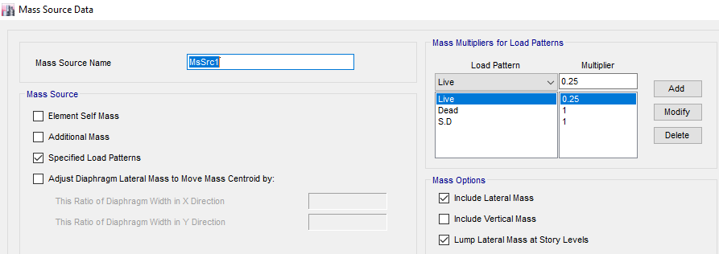
Structural modeling of the building
Chapter Three
Masses
The total seismic load (w) includes: 100% from dead loads and superimposed dead loads, in addition to 25% from live loads

Slide 48
Structural modeling of the building
Chapter Three
Functions
Response Spectrum function was defined in ETABS software based on ASCE 7-10 code.
Load cases
In response spectrum method, two load cases were defined, based on assumption that 100% of the force in one direction plus 30% of the force in the perpendicular direction and vice versa.

Slide 49
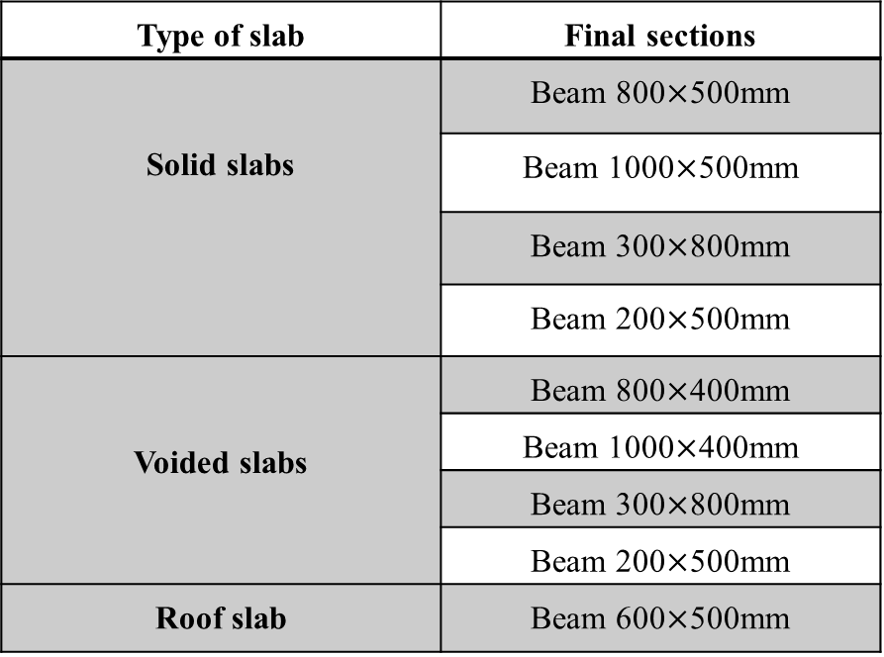
Evaluation of the preliminary design
Chapter Three
Beams final dimensions:-
Type of slab | Final sections
Solid slabs | Beam 800$×$500mm
 | Beam 1000$×$500mm
 | Beam 300$×$800mm
 | Beam 200$×$500mm
Voided slabs | Beam 800$×$400mm
 | Beam 1000$×$400mm
 | Beam 300$×$800mm
 | Beam 200$×$500mm
Roof slab | Beam 600$×$500mm

Slide 50
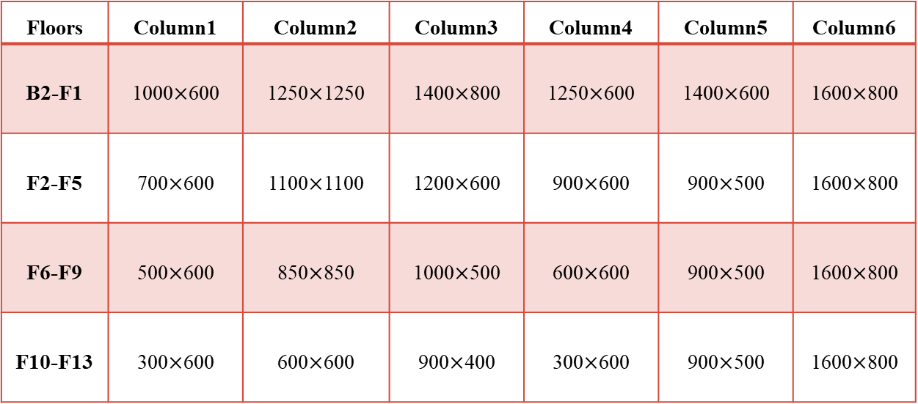
Evaluation of the preliminary design
Chapter Three
Final dimensions of columns:-
Floors | Column1 | Column2 | Column3 | Column4 | Column5 | Column6
B2-F1 | 1000$×$600 | 1250$×$1250 | 1400$×$800 | 1250$×$600 | 1400$×$600 | 1600$×$800
F2-F5 | 700$×$600 | 1100$×$1100 | 1200$×$600 | 900$×$600 | 900$×$500 | 1600$×$800
F6-F9 | 500$×$600 | 850$×$850 | 1000$×$500 | 600$×$600 | 900$×$500 | 1600$×$800
F10-F13 | 300$×$600 | 600$×$600 | 900$×$400 | 300$×$600 | 900$×$500 | 1600$×$800

Slide 51
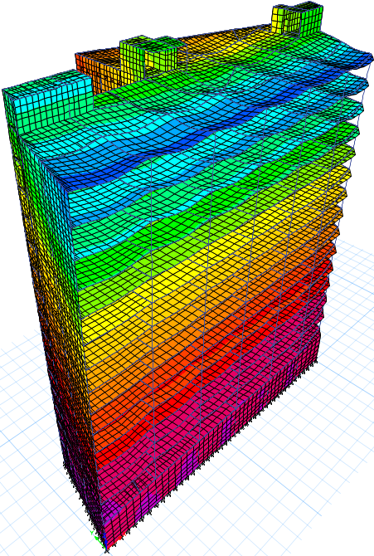
Verification of structural analysis
Chapter Three
1- Compatibility of the structure

Slide 52
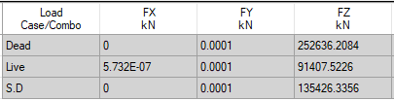
Verification of structural analysis
Chapter Three
2- Equilibrium check:
Soil load from ETABS software:-

Slide 53

Verification of structural analysis
Chapter Three
2- Equilibrium check:
Comparison between manual calculations and program results:
Manual calculation for soil load: $∑F_{y}=25.9 KN$ $∑F_{x}= −23 KN$
Loads | Manual calculations | ETABS calculations | Difference percentage
Dead load (KN) | 255742.738 | 252719.2084 | 1.2%
Superimposed dead load (KN) | 135430.851 | 135426.3356 | 0%
Live load (KN) | 91407.97 | 91407.5226 | 0%

Slide 54
Verification of structural analysis
Chapter Three
3- Stress strain check:
The manual moment values of the slab and the beam were calculated on the internal span with 6m length inside the frame that shown below in basement two floor by using Direct Design Method.
9m

Slide 55
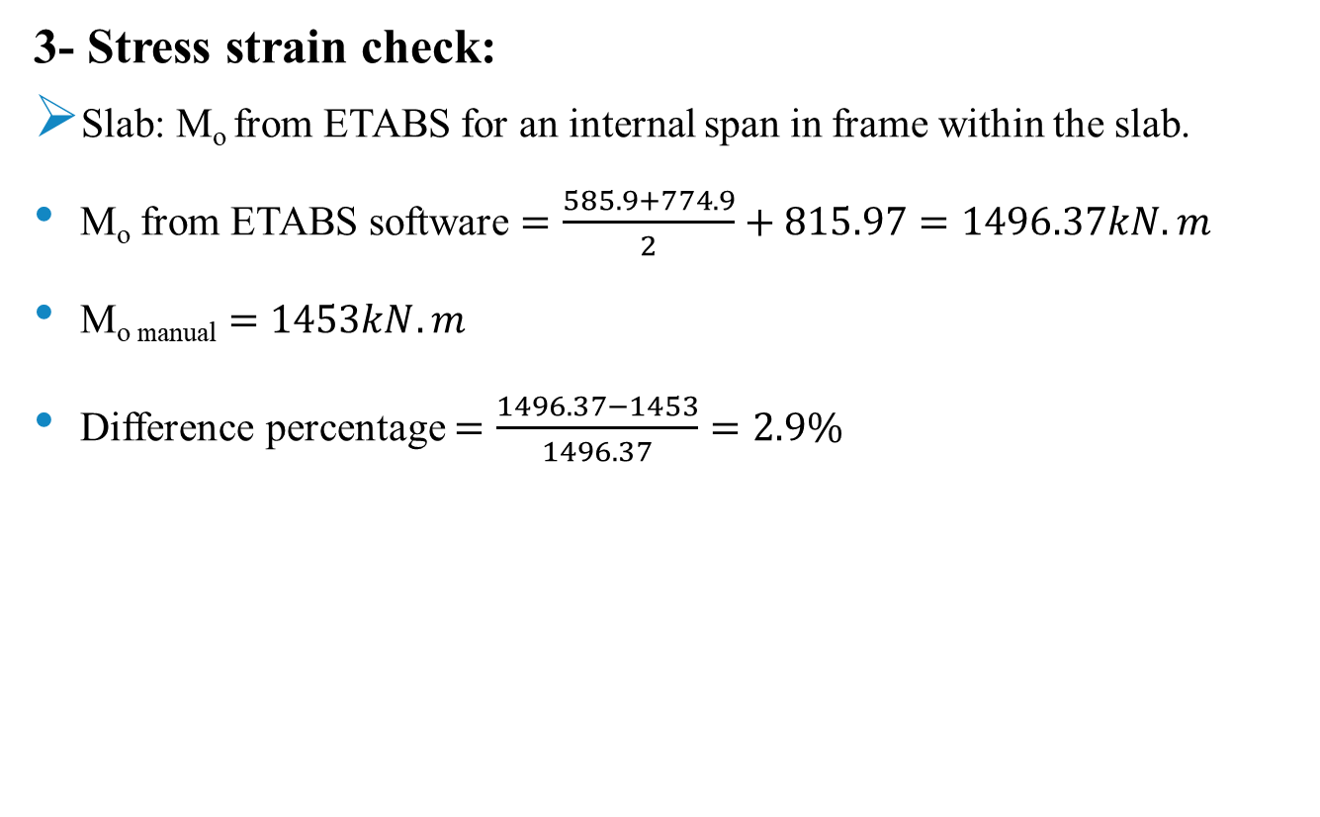
Verification of structural analysis
Chapter Three
3- Stress strain check:
Slab: M_{o} from ETABS for an internal span in frame within the slab.
M_{o} from ETABS software $=\frac{585.9+774.9}{2}+815.97=1496.37kN.m$
M_{o manual} $=1453kN.m$
Difference percentage $=\frac{1496.37−1453}{1496.37}=2.9\%$

Slide 56
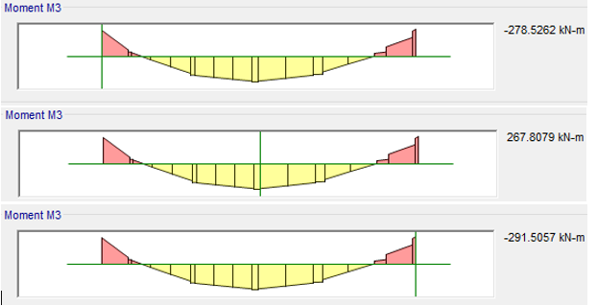
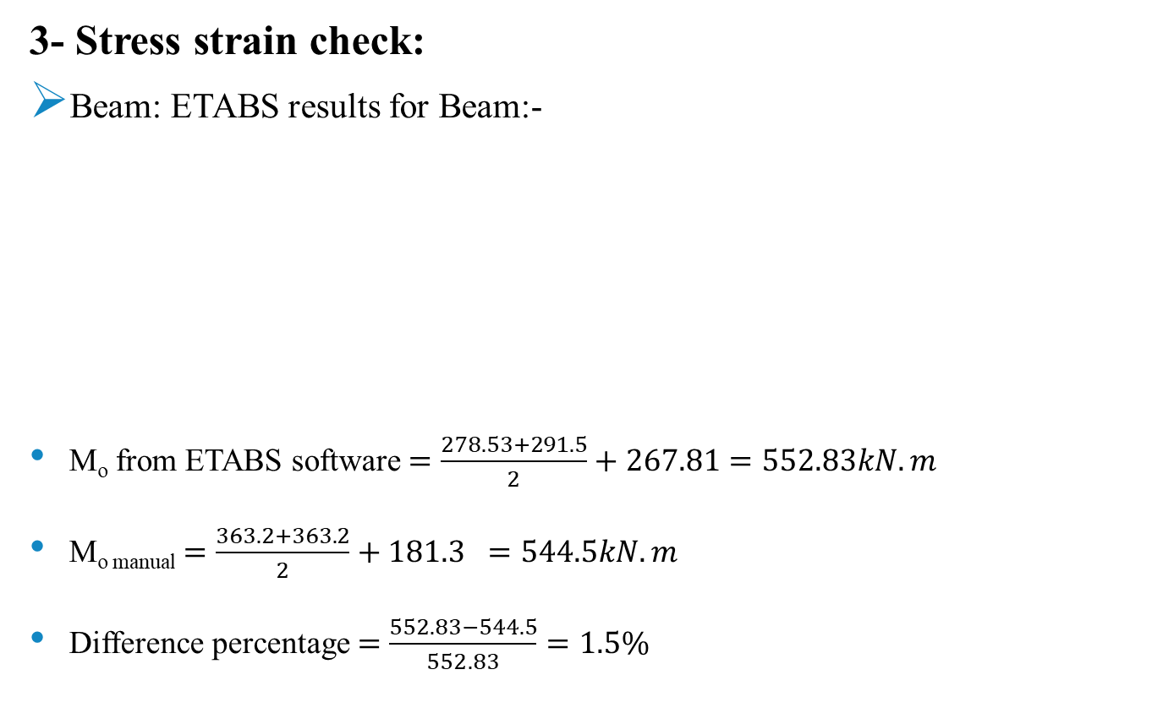
Verification of structural analysis
Chapter Three
3- Stress strain check:
Beam: ETABS results for Beam:-
M_{o} from ETABS software $=\frac{278.53+291.5}{2}+267.81=552.83kN.m$
M_{o manual} $=\frac{363.2+363.2}{2}+181.3 =544.5kN.m$
Difference percentage $=\frac{552.83−544.5}{552.83}=1.5\%$

Slide 57
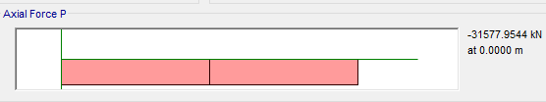
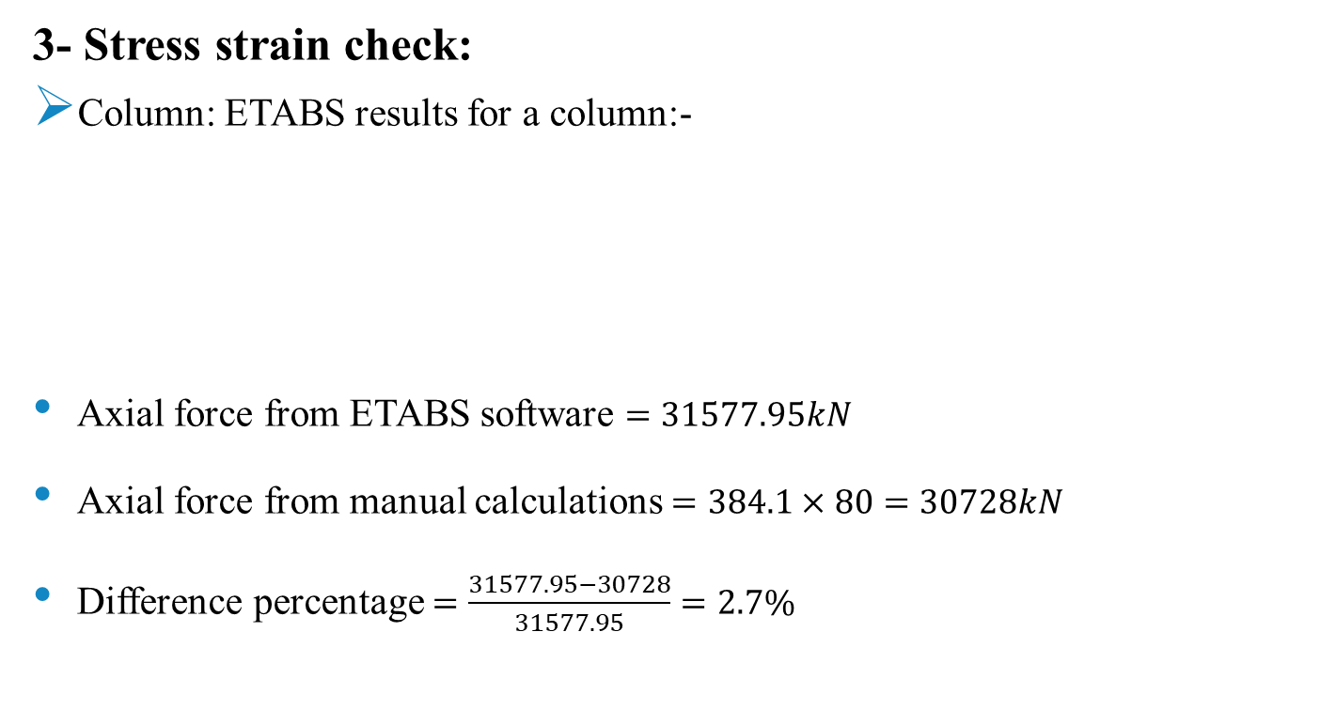
Verification of structural analysis
Chapter Three
3- Stress strain check:
Column: ETABS results for a column:-
Axial force from ETABS software $=31577.95kN$
Axial force from manual calculations $=384.1×80=30728kN$
Difference percentage $=\frac{31577.95−30728}{31577.95}=2.7\%$

Slide 58
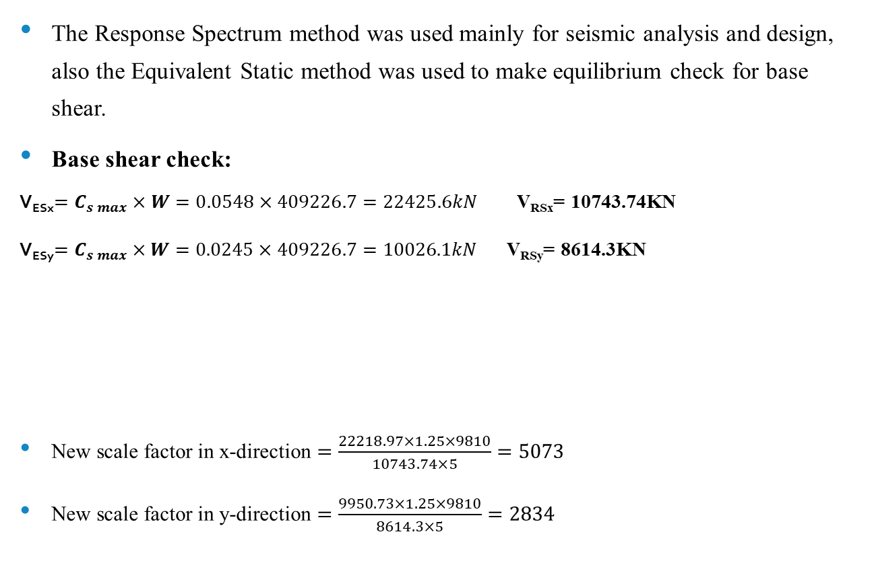
Seismic forces checks
Chapter Three
The Response Spectrum method was used mainly for seismic analysis and design, also the Equivalent Static method was used to make equilibrium check for base shear.
Base shear check:
V_{ESx}$=C_{s max}×W=0.0548×409226.7=22425.6kN$ V_{RSx}= 10743.74KN
V_{ESy}$=C_{s max}×W=0.0245×409226.7=10026.1kN$ V_{RSy}= 8614.3KN
New scale factor in x-direction $=\frac{22218.97×1.25×9810}{10743.74×5}=5073$
New scale factor in y-direction $=\frac{9950.73×1.25×9810}{8614.3×5}=2834$
Direction | Manual (kN) | ETABS (kN) | Difference percentage
Vx | 22425.6 | 22218.97 | 1.0%
Vy | 10026.1 | 9950.73 | 0.96%

Slide 59
Seismic forces checks
Chapter Three
Story forces check: V_{x} = C_{VX}* Base shear value
Story | h_{i} (m) | W_{i} (kN) | h_{i}^{k} | W_{i} * h_{i}^{k} | C_{VX} | V_{X} (kN) | V_{ETABS} (kN) | Difference percentage
F14 | 65 | 3574.77 | 83.50 | 298494.39 | 0.0189 | 419.41 | 298.56 | 40%
F13 | 61.2 | 22063.89 | 78.34 | 1728377.40 | 0.1093 | 2428.53 | 2307.25 | 5%
F12 | 57.4 | 22416.51 | 73.19 | 1640644.61 | 0.1038 | 2305.26 | 2343.28 | -2%
F11 | 53.6 | 22264.17 | 68.06 | 1515378.88 | 0.0958 | 2129.25 | 2165.49 | -2%
F10 | 49.8 | 22370.63 | 62.96 | 1408449.81 | 0.0891 | 1979.00 | 2013.67 | -2%
F9 | 46 | 24114.09 | 57.88 | 1395706.85 | 0.0883 | 1961.10 | 1968.55 | 0%
F8 | 42.2 | 23839.92 | 52.82 | 1259319.45 | 0.0796 | 1769.46 | 1799.20 | -2%
F7 | 38.4 | 23839.92 | 47.80 | 1139451.42 | 0.0721 | 1601.03 | 1627.92 | -2%
F6 | 34.6 | 23839.92 | 42.80 | 1020294.11 | 0.0645 | 1433.61 | 1457.66 | -2%
F5 | 30.8 | 24714.31 | 37.83 | 935001.32 | 0.0591 | 1313.76 | 1311.24 | 0%
F4 | 27 | 24685.68 | 32.90 | 812251.85 | 0.0514 | 1141.29 | 1159.73 | -2%
F3 | 23.2 | 27265.73 | 28.02 | 763896.38 | 0.0483 | 1073.34 | 1092.33 | -2%
F2 | 19.4 | 27539.91 | 23.18 | 638311.02 | 0.0404 | 896.89 | 911.87 | -2%
F1 | 15.6 | 28789.11 | 18.40 | 529590.72 | 0.0335 | 744.12 | 739.81 | 1%
G | 11.8 | 29931.70 | 13.68 | 409568.28 | 0.0259 | 575.48 | 559.96 | 3%
B1 | 6.8 | 29982.76 | 7.63 | 228734.15 | 0.0145 | 321.39 | 329.58 | -2%
B2 | 3 | 27993.67 | 3.20 | 89703.27 | 0.0057 | 126.04 | 132.87 | -5%
Total |  |  |  | 15813173.92 | 1.00 | 22218.97

Slide 60
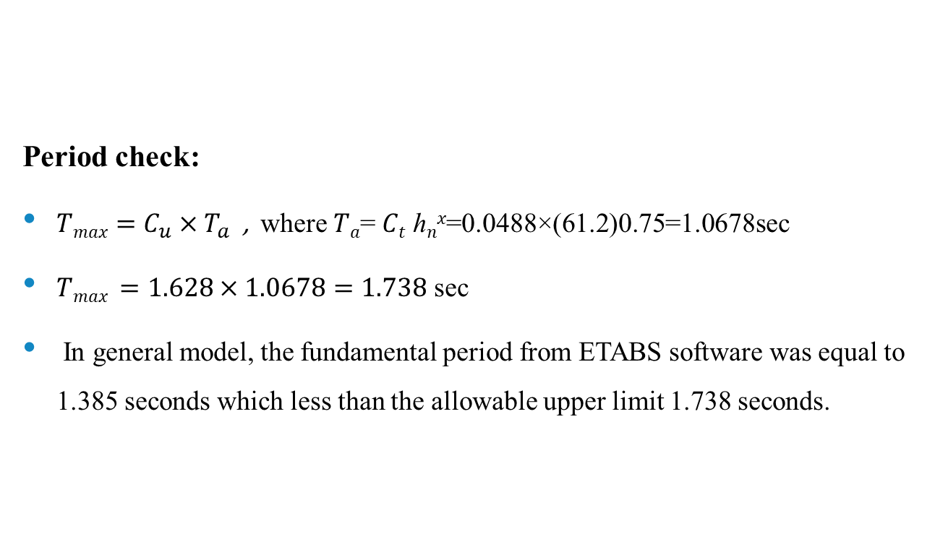
Seismic forces checks
Chapter Three
Period check:
$Tmax=C_{u}×T_{a}$ , where 𝑇_{𝑎}= 𝐶_{𝑡} ℎ_{𝑛}^{𝑥}=0.0488×(61.2)0.75=1.0678sec
$Tmax =1.628×1.0678=1.738$ sec
In general model, the fundamental period from ETABS software was equal to 1.385 seconds which less than the allowable upper limit 1.738 seconds.

Slide 61
Seismic forces checks
Chapter Three
Modal mass participation ratios:
Both directions must be greater than or equal to 90% when using the Response Spectrum method and this thing was achieved when 25 modes were used in analyzing process in ETABS. where the sum of the modal mass participation ratios in x-direction was equal to 0.9053 and in y-direction was equal to 0.9593.

Slide 62
Structural irregularity
Chapter Three
Horizontal irregularities
Type | Description | Comments
1a | Torsional Irregularity | Exist
1b | Extreme Torsional Irregularity | Exist
2 | Reentrant Corner Irregularity | Not needed to be checked, as the seismic design category is C
3 | Diaphragm Discontinuity Irregularity | Not needed to be checked, as the seismic design category is C
4 | Out-of-Plane Offset Irregularity | Not exist
5 | Nonparallel System Irregularity | Exist

Slide 63
Structural irregularity
Chapter Three
Vertical irregularities:
Type | Description | Comments
1a | Stiffness-Soft Story Irregularity: | Not needed to be checked, as the seismic design category is C
1b | Stiffness-Extreme Soft Story Irregularity: | Not needed to be checked, as the seismic design category is C
2 | Weight (Mass) Irregularity: | Not needed to be checked, as the seismic design category is C
3 | Vertical Geometric Irregularity: | Not needed to be checked, as the seismic design category is C
4 | In-Plane Discontinuity in Vertical Lateral Force-Resisting Element Irregularity: | Not exist
5a | Discontinuity in Lateral Strength–Weak Story Irregularity: | Not exist
5b | Discontinuity in Lateral Strength–Extreme Weak Story Irregularity: | Not exist

Slide 64

Effect of p-delta
Chapter Three
$θ=\frac{P_{x}∆I_{e}}{V_{x}h_{sx}C_{d}}$
$θ_{max}=\frac{0.5}{βC_{d}}≤0.25$
All $θ$ values are less than
0.1, So, no need for
use the second order analysis.

Slide 65
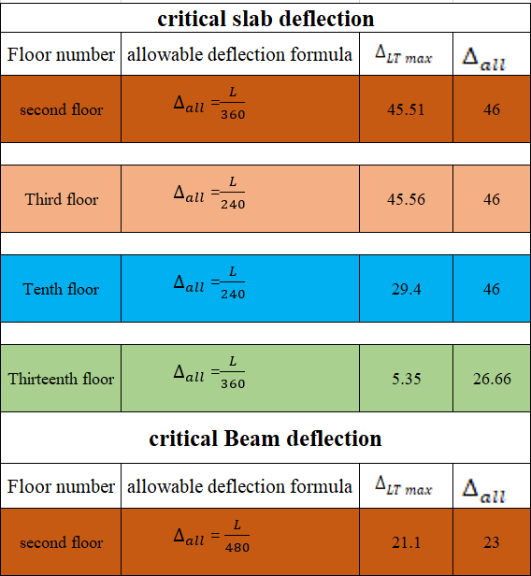

Deflection computations
Chapter Three
Immediate and long term deflections
$∆_{LT}=∆_{L}+λ_{∞}∆_{D}+λ_{t}∆_{LS}$ $λ_{∆}=\frac{ξ}{1+50ρ^{`}}$ = 2
Assume 50% sustained live loads and 50% un-sustained live loads, so
Load combination = 2 Dead loads + 2 Superimposed dead loads + 1.5 Live loads

Slide 66

Deflection computations
Chapter Three
Drift check:
$δ_{M}=\frac{C_{d }×δ_{max}}{I_{e}}$
$∆_{a}=0.015h_{sx}$
$δ$_{M} equal to 16.63mm is less than $δ$_{allowable} which equal to 57mm.

Slide 67
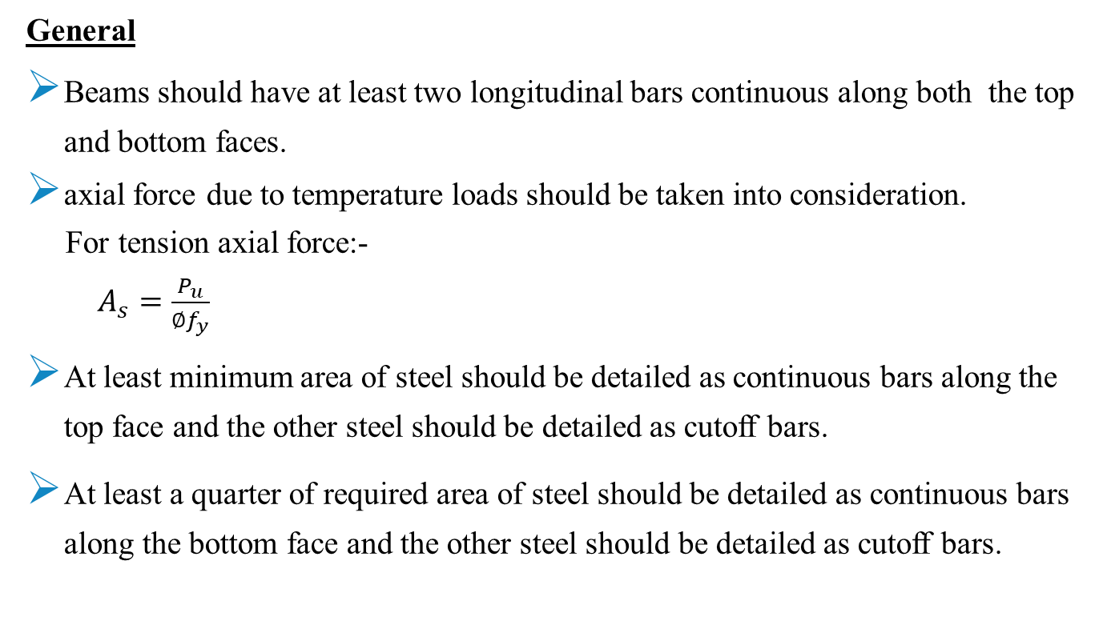
Design of beams
Chapter Three
General
Beams should have at least two longitudinal bars continuous along both the top and bottom faces.
axial force due to temperature loads should be taken into consideration.
For tension axial force:-
$A_{s}=\frac{P_{u}}{∅f_{y}}$
At least minimum area of steel should be detailed as continuous bars along the top face and the other steel should be detailed as cutoff bars.
At least a quarter of required area of steel should be detailed as continuous bars along the bottom face and the other steel should be detailed as cutoff bars.

Slide 68
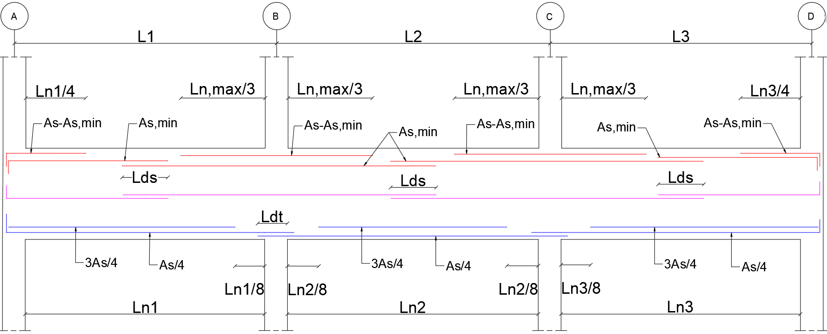
Design of beams
Chapter Three
General
Beam details layout:-

Slide 69
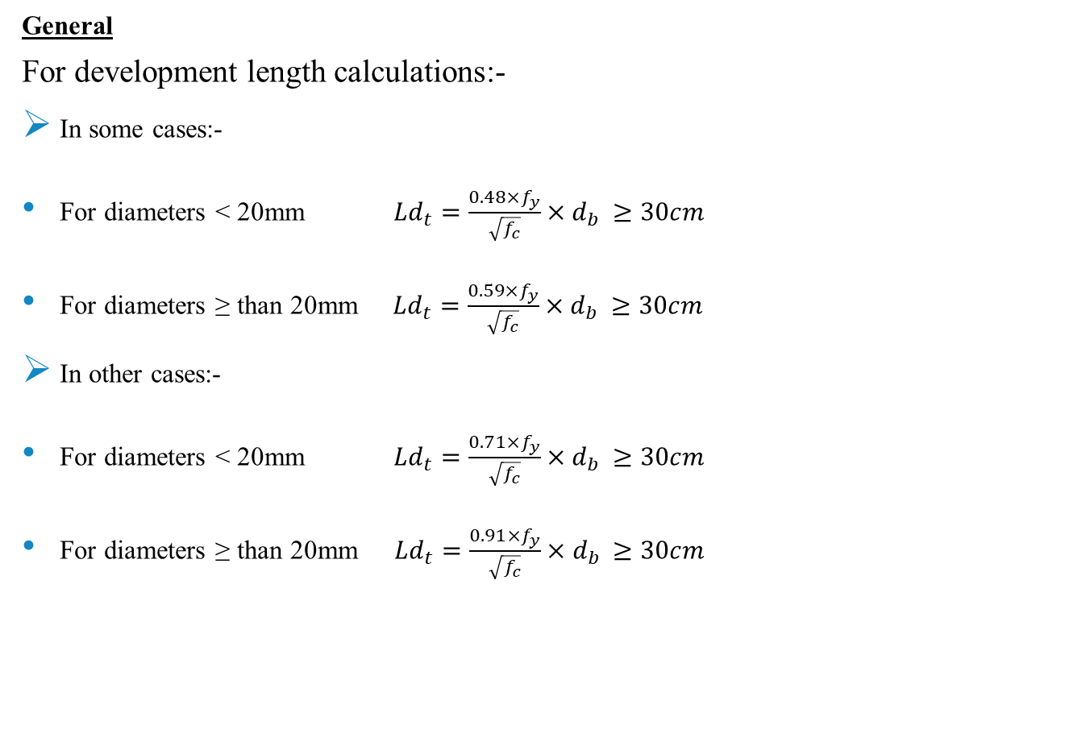
Design of beams
Chapter Three
General
For development length calculations:-
In some cases:-
For diameters < 20mm ${Ld}_{t}=\frac{0.48×f_{y}}{\sqrt{f_{c}}}×d_{b }≥30cm$
For diameters ≥ than 20mm ${Ld}_{t}=\frac{0.59×f_{y}}{\sqrt{f_{c}}}×d_{b }≥30cm$
In other cases:-
For diameters < 20mm ${Ld}_{t}=\frac{0.71×f_{y}}{\sqrt{f_{c}}}×d_{b }≥30cm$
For diameters ≥ than 20mm ${Ld}_{t}=\frac{0.91×f_{y}}{\sqrt{f_{c}}}×d_{b }≥30cm$

Slide 70
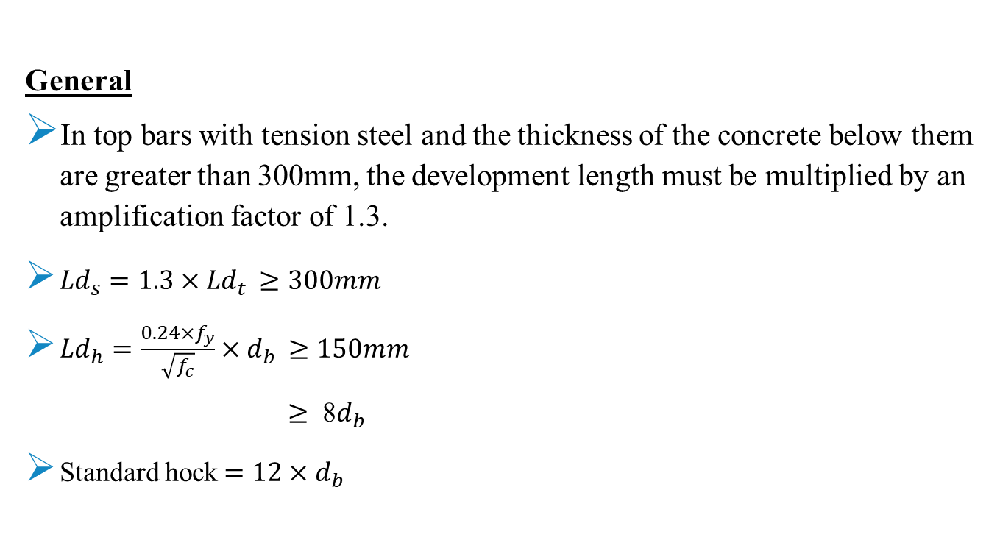
Design of beams
Chapter Three
General
In top bars with tension steel and the thickness of the concrete below them are greater than 300mm, the development length must be multiplied by an amplification factor of 1.3.
${Ld}_{s}=1.3×{Ld}_{t }≥300mm$
${Ld}_{h}=\frac{0.24×f_{y}}{\sqrt{f_{c}}}×d_{b }≥150mm$
$≥$ 8$d_{b }$
Standard hock$=12×d_{b }$

Slide 71
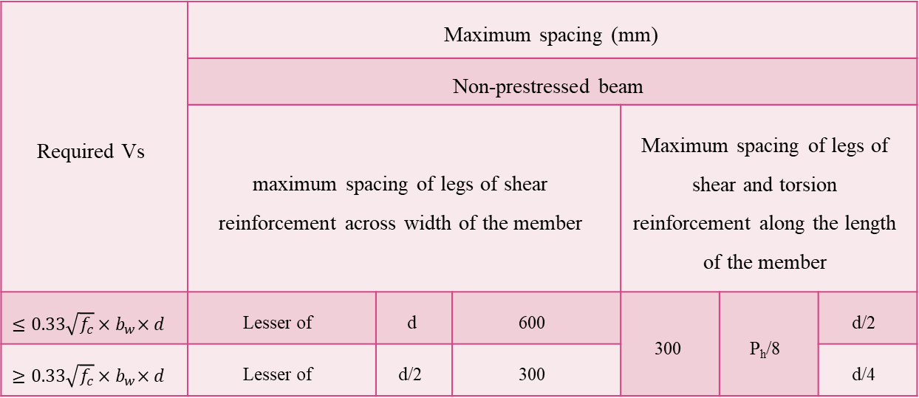
Design of beams
Chapter Three
General
Maximum spacing of stirrups for shear and torsion:-
Required Vs | Maximum spacing (mm)
 | Non-prestressed beam
 | maximum spacing of legs of shear reinforcement across width of the member |  |  | Maximum spacing of legs of shear and torsion reinforcement along the length of the member
$≤0.33\sqrt{f_{c}}{×b}_{w}×d$ | Lesser of | d | 600 | 300 | P_{h}/8 | d/2
$≥0.33\sqrt{f_{c}}{×b}_{w}×d$ | Lesser of | d/2 | 300 |  |  | d/4

Slide 72
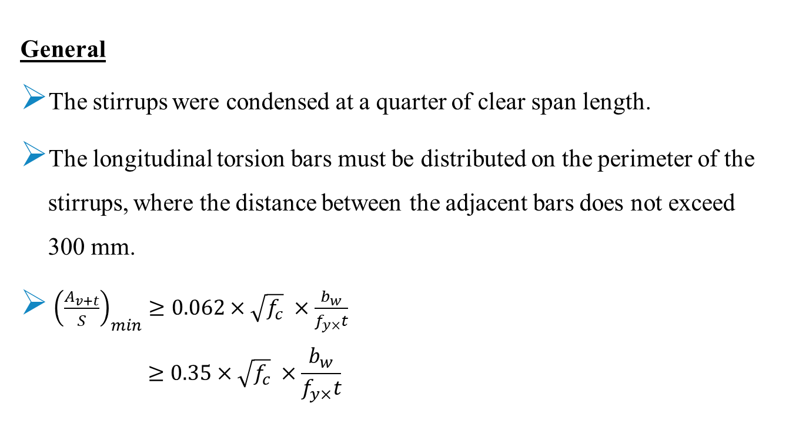
Design of beams
Chapter Three
General
The stirrups were condensed at a quarter of clear span length.
The longitudinal torsion bars must be distributed on the perimeter of the stirrups, where the distance between the adjacent bars does not exceed 300 mm.
${\left(\frac{A_{v+t}}{S}\right)}_{min}≥0.062×\sqrt{f_{c}} ×\frac{b_{w}}{f_{y×}t}$
$$≥0.35×\sqrt{f_{c}} ×\frac{b_{w}}{f_{y×}t}$$

Slide 73

Design of beams
Design check
Design check was done on beam B24-1 in third floor with width equal to 800mm, depth equal to 500mm.
Chapter Three

Slide 74

Design of beams
Chapter Three
Design check
For negative moment = 404.47kN.m
$$ρ=7.31×{10}^{−3} { A}_{s}=2574{mm}^{2}$$
$$A_{s, min}=1186{mm}^{2}$$
Shear force = 372.4kN
$∅V_{c}=248.9kN$ \ ${∅V}_{s}=123.5kN$
$\frac{A_{v}}{s}=0.9{mm}^{2}/mm$ \ ${\left(\frac{A_{v}}{s}\right)}_{min}=$ $0.67{mm}^{2}/mm$
$\frac{A_{v}}{s}=0.9{mm}^{2}/mm >{\left(\frac{A_{v}}{s}\right)}_{min}=0.67{mm}^{2}/mm$

Slide 75

Design of beams
Chapter Three
Design check
Torsion = 39.1kN.m
$T_{u}=39.1kN.m >T_{th}=21.76kN.m$
$\frac{A_{t}}{s}=0.18{mm}^{2}/mm$
$A_{l}=382{mm}^{2}$
$A_{l min}=1546{mm}^{2}$
Axial Force = 9.56kN compression
$P<0.1{×f}_{c}^{`}×A_{g}$
$9.56<1280$

Slide 76

Design of beams
Chapter Three
Design
The design sample has been done on beam B24-1 in third floor with width equal to 800mm, depth equal to 500mm and cover equal to 60mm.
Design results of beam B24-1:-

Slide 77

Design of beams
Chapter Three
Design
One-third of AL was added to the longitudinal reinforcing.
Torsion longitudinal reinforcing = $\frac{1523}{3}=508 {mm}^{2}$ (2Ø20), so:-
${As }_{left negative }=3068{ mm}^{2}$ (8Ø25)
${As }_{positive}=2533{ mm}^{2} \left(7Ø22\right)$
${As }_{right negative}=2445{ mm}^{2}$ (7Ø22)
It is required to place two stirrups across the width of the beam.
$\frac{A_{v+t}}{s}=2.08{ mm}^{2}/mm$
$S=217mm$ Use 2Ø12/200mm

Slide 78

Design of beams
Chapter Three
Design
Beam B24-1 details:-

Slide 79

Design of columns
Chapter Three
General
Columns having clear height less than or equal to five times the dimension of column (C1) shall be designed for the minimum shear of:-
The shear associated with development of nominal moment strengths of the column at each restrained end of the unsupported length.
$V_{u}=\frac{M_{e1}+M_{e2}}{L}$
The maximum shear from the ultimate load combinations that include “$E$”, with “$E$” increased by the over-strength factor (Ωo).

Slide 80

Design of columns
Chapter Three
General
This check was performed on column C36, with dimensions of 1400$×$800mm, and clear height equal to 3m.
Moment axial interaction diagram for column C36 at zero degrees:-

Slide 81


Chapter Three
Load Case/Combo | $$P(KN)$$ | $$M_{3}$$ $$( kN.m)$$
1.2D+1.6L+1.6H | 5064.5094 | 5900
1.4D+1.6H | 4959.3315 | 5750
1.2672D+L+EQx+0.3EQy+1.6H Max | 3494.0486 | 5400
1.2672D+L-EQx-0.3EQy+1.6H Max | 5206.6594 | 5950
1.2672D+L+EQx-0.3EQy+1.6H Max | 76.9269 | 3500
1.2672D+L+0.3EQx+EQy+1.6H Max | 9302.5541 | 7300
1.2672D+L-0.3EQx-EQy+1.6H Max | -548.9317 | 3000
1.2672D+L-0.3EQx+EQy+1.6H Max | 10841.4738 | 7500
0.833D+EQx+0.3EQy+0.9H Max | 1453.9135 | 4000
0.833D-EQx-0.3EQy+0.9H Max | 3166.5243 | 5000
0.833D+EQx-0.3EQy+0.9H Max | -1963.2082 | 4100
0.833D+0.3EQx+EQy+0.9H Max | 7262.419 | 6500
0.833D-0.3EQx-EQy+0.9H Max | -2589.0667 | 2000
0.833D-0.3EQx+EQy+0.9H Max | 8801.3387 | 7000
1.2672D+Rx+L+1.6H Max | -1114.0171 | 2300
1.2672D+Ry+L+1.6H Max | 790.02 | 3200
0.833D+Rx+0.9H Max | -3154.1521 | 1700
0.833D+Ry+0.9H Max | -1250.1151 | 2500
D+L+T | 8350.7388 | 6950
D+L-T | 25.4696 | 3300
General
Moment axial
interaction diagram
for column C36 at
zero degrees:-
${ V}_{u}=\frac{7500+7500}{3}$
$=5000KN$

Slide 82


Design of columns
Chapter Three
General
The maximum shear (V2) obtained from the ultimate load combinations after increasing earthquake load (E) by over-strength factor (Ωo) equal to 2018KN.
2018kN < 5000kN, so column C36 shall be designed for 2018kN.
${∅V}_{c}=1308KN$\ $V_{s}=947kN$ $\frac{A_{v}}{s}=1.67$

Slide 83


Design of columns
Chapter Three
Design check
Design check was performed on column C11 with dimensions of 1250$×$1250mm.
Design information of column C11:-
The reciprocal load method was used.
$\frac{1}{P_{ni}}=\frac{1}{P_{nx}}+\frac{1}{P_{ny}}−\frac{1}{P_{0}}$

Slide 84

Design of columns
Chapter Three
Design check
ρ=1.29%
$P_{0}=λ\left[0.85×{F`}_{c}×\left(A_{g}−A_{s}\right)+f_{y}×A_{s}\right]$
$P_{0}=48725KN$
Moment axial interaction diagram for column C11 at zero degrees:-

Slide 85

Design of columns
Chapter Three
Design check
Moment axial interaction diagram for column C11 at nineteen degrees:-
Using the moment axial interaction diagrams, and at the design moment values of both zero and nineteen degree curves$(M_{u2},M_{u3})$, the nominal axial load strength along the zero degrees curve ($P_{nx}$) equals 48700$KN$, also along the nineteen degrees curve ($P_{ny}$) equals 48700$KN$.

Slide 86

Design of columns
Chapter Three
Design check
$\frac{1}{P_{ni}}=\frac{1}{48700}+\frac{1}{48700}−\frac{1}{48725}$
$P_{ni}=48675KN$
$P_{u}$ = 31598$KN$
$\frac{P_{u}}{∅}=\frac{31598}{0.65}=48613KN <48675KN$

Slide 87


Design of columns
Chapter Three
Design
The design sample was performed on column C2 , with dimensions of 1400x800mm, and cover equal to 50mm.
Using diameter of bars equal to 20mm:-
$No. of bars = \frac{11200}{\frac{π}{4}{×20}^{2}}=36$, use 40$∅$20.

Slide 88


Design of columns
Chapter Three
Design
Shear reinforcing required for column C2:-
Six stirrups in whole section were used.
$S≤48×12=576mm$
$≤16×diameter of longitudinal bar=16×20=320mm$
$≤the smaller dimention of the column=800mm$
$$≤{A_{v} }/{\frac{A_{v}}{S}=}6×\frac{π}{4}{×12}^{2}/1.33=510mm$$

Slide 89

Design of columns
Design
Use spacing between the stirrups equal to 300mm.
Column C2 details:-
Chapter Three

Slide 90
Design of slabs
Chapter Three
Mesh reinforcement with additional steel in some areas due to the increased load in them has been placed in both directions (X and Y).
The design check was made on a point with coordinates X= 24.6m, Y= 5.6m, in the third floor with 300mm thickness solid slab.
Using ETABS software, the positive moment value was taken from load combination 1.2D+1.6L+1.6H, which equal to 53kN.m.

Slide 91

Design of slabs
Chapter Three
$ρ=2.1×{10}^{−3}$
$A_{s}=2.1×{10}^{−3}×1000×260=548{mm}^{2}$
$A_{min}=1.8×{10}^{−3}×1000×300=540{mm}^{2}$
$A_{s}=548{mm}^{2}>A_{min}=540{mm}^{2}$
Using ETABS software, the bottom rebar area value at the same joint equal to 576 ${mm}^{2}$, so the design is correct.

Slide 92

Design of walls
Chapter Three
General
Walls that have thickness exceeds 250mm shall have reinforcement for each direction placed in two layers parallel with faces of these walls.
The horizontal reinforcement was spliced at supports with development length of $L_{ds}$ or larger, while the vertical reinforcement was spliced at the connection area between the two successive walls with development length of $L_{dt}$ or larger.

Slide 93

Design of walls
Chapter Three
Design check
Design check was performed on wall W-05 that exist in the second basement (B2) floor with thickness of 300mm and length equal to 20300mm.
Design information of wall W-05:-

Slide 94

Design of walls
Chapter Three
Design check
This wall was modeled as a column in SAP2000 software.
After running and design the model, the column bending axial interaction ratio (P-M-M) was 0.885 , which is smaller than 1, so the design of ETABS software for this wall is correct.

Slide 95
Design of walls
Chapter Three
Design
Set of piers and spandrels were defined in ETABS software.
Piers and spandrels in all walls were reinforced with the required steel reinforcement for each of them.
The design sample has performed on wall W-03 in the second basement (B2) floor with thickness of 400mm and length equal to 5871mm.

Slide 96


Design of walls
Chapter Three
Design
Longitudinal reinforcing for wall W-03 from ETABS software:-
Longitudinal reinforcing per meter length $=\frac{10925}{5.871}=1861{mm}^{2}/m$
Longitudinal reinforcing in each layer $=\frac{1861}{2}=930.5{mm}^{2}/m$
Use 1$∅$18/200mm

Slide 97


Design of walls
Chapter Three
Design
Shear reinforcing for wall W-03 from ETABS software:-
Shear reinforcing per meter length $=\frac{4.21}{1/{1000}}=4210{mm}^{2}/m$
Shear reinforcing in each layer $=\frac{4210}{2}=2105{mm}^{2}/m$
Use 1$∅$16/90mm

Slide 98

Design of walls
Chapter Three
Design
Wall W-03 details:-

Slide 99

Design of Footings
Chapter Three
General
Mat foundation was used in this structure, and SAFE software was used to design this foundation.
The bearing capacity of the soil equal to 360$KN/m^{2}$, this value was increased due to the existing soil around the structure, as shown:-
${Bearing capacity}_{new}={Bearing capacity}_{old}+(γ×h)$ ${Bearing capacity}_{new}=360+\left(18×6.8\right)=480 KN/m^{2}$

Slide 100

Design of Footings
Chapter Three
General
The thickness of the mat foundation was assumed to be 2.0m, and punching shear check was performed on this thickness:-
In the columns, the maximum axial force equal to 31578 KN, which is in column C11 with dimensions of 1250$×$1250mm.
$ØV_{p}=0.75×0.33×\sqrt{{F`}_{c}}×d×b_{°}$
$ØV_{p}=0.75×0.33×\sqrt{40}×1880×4(1250+1880)=34645KN$
$P_{u}=31578KN <ØV_{p}=34645KN$

Slide 101
Design of Footings
Chapter Three
Mat foundation modeling
Concrete B500 (40MPa) was used for this mat foundation. It was defined in SAFE software with bending modifiers equal to 0.7.
An expand with a value of 2000mm was created at all sides of the mat foundation.
The design code selected in SAFE software is ACI 318-11 code.

Slide 102
Design of Footings
Chapter Three
Evaluation of design
After running the model, the soil pressure under the mat from service combinations exceeded the bearing capacity of 480 KN/m2.
Therefore, piles with a diameter of 1 meter and a length of 20 meters were placed under the mat foundation every 3 meters, it was represented in SAFE software as a point spring.
The capacity of the pile was calculated by referring to “Principles of Foundation Engineering 8th edition”.

Slide 103

Design of Footings
Chapter Three
Evaluation of design
$Q_{u}=Q_{p}+Q_{s}$
$Q_{p}=4790KN \backslash$ $Q_{s}=1815 KN$ using alpha method
Take factor of safety equal to 3.
$Q_{u}=\frac{4790+1815}{3}=2200 KN$
It was assumed that the settlement in the piles is 14.5mm.
Point spring translation for the pile = $\frac{Q_{u}}{settlment}=\frac{2200}{14.5}=150 KN/mm$
This point spring property were defined in SAFE software for all the piles.

Slide 104

Design of Footings
Chapter Three
Evaluation of design
The layout of the piles under the mat foundation:-

Slide 105

Design of Footings
Chapter Three
Evaluation of design
After running the model, the soil pressure in the mat and pile capacity didn’t exceed the bearing capacity of 480 KN/m2 and 2200KN, respectively.

Slide 106


Design of Footings
Shear check
$ØV_{c}=\frac{0.75×0.17×\sqrt{40}×1000×1900}{1000}=1532 KN$
The maximum shear force (Vu) in mat foundation was 1487kN.
Chapter Three

Slide 107

Design of Footings
Reinforcement check
The moment value using safe software from load combination 1.2D+1.6L+1.6H at a point with coordinates of X= 24.2m, Y= 6.2 m, equal to 1427kN.m/m.
Chapter Three

Slide 108

Design of Footings
Chapter Three
Reinforcement check
$ρ=1.05×{10}^{−3}$
$A_{s}=ρ×b×d=1.05×{10}^{−3}×1000×1800=1997{mm}^{2}$
$A_{min}=ρ_{min}×b×d=1.8×{10}^{−3}×1000×2000=3600{mm}^{2}$
$A_{s}=1997{mm}^{2}<A_{min}=3600{mm}^{2}$
Using SAFE software, the top rebar area value at the same joint equal to 3546${mm}^{2}$, so the design is correct.
1Ø25/250mm top steel and 1Ø22/250mm bottom steel were used in mat foundation reinforcement using SAFE software.

Slide 109

Design of Footings
Chapter Three
Punching shear check
In order for the design to be correct the punching shear ratio must be less than one.
Maximum value of punching shear ratio in mat foundation:-

Slide 110

Design of Footings
Chapter Three
Piles reinforcement
Number of bars = $\frac{The perimeter of a circle from the center of the bars}{the space between the bars=150mm}$
$Number of bars=\frac{π×0.85}{0.15}=18 bars$
$Area of one bar=\frac{0.005×π×{500}^{2}}{18}=218$, so use 18$∅$18
Use spiral stirrups of 1Ø12/150mm.

Slide 111
Design of Stairs
Chapter Three
General
This structure contains three stairs. Therefore, three models were created and represented in ETABS software.
For each stair:-
Height of the riser is 170mm.
Width of the tread (or going) is 300mm.
The thickness of landing is 200mm.
Concrete cover is 40mm.
Superimposed dead load equal to 5 KN/m2.
Live load equal to 5 KN/m2.

Slide 112


Design of Stairs
Chapter Three
General
As example, the plan of stairs 3 was taken from the Architectural plans, and the three-dimensional (3D) view of for this stair was taken from ETABS software:-

Slide 113


Design of Stairs
Chapter Three
Stairs shear check
Solid slab with thickness equal to 200mm and reinforcement cover of 40 mm has been used to all stairs.
$∅V_{c}=0.75×\frac{1}{6} ×1×\sqrt{32}×1000×160=113.14$ kN
The maximum shear (Vu) was discovered in stairs 2 with value equal to 72.79 KN.
No need for shear reinforcement.

Slide 114

Design of Stairs
Chapter Three
Stairs flexural reinforcement
The minimum flexural strength at section ($M_{min}$) has been calculated:-
$C=T$
$0.85×32×1000×a=420×360$ $a=5.5mm$
$M_{min}$ = $360×420×\frac{(160−\frac{5.5}{2})}{{10}^{6}}$ = 23.7$kN.m$
All moment values in ETABS software were less than minimum flexural strength at section ($M_{min}$).

Slide 115

Design of Stairs
Chapter Three
Stairs flexural reinforcement
So, all steel reinforcement will be shrinkage steel in both directions (1∅12/250mm).
Moment values in stairs (M11) using ETABS software:-

Slide 116

Design of Stairs
Chapter Three
The typical detailed reinforcement for all stairs:-

Slide 117

Design of Ramp
Chapter Three
Ramp flexural reinforcement
The ramp was analyzed manually with 250mm thickness as one way solid slab in one direction and use minimum reinforcement steel in the other direction.
For the ramp:-
Live Load = 5kN/m2
Superimposed dead load = 1.15kN/m2
Own weight = $0.25×25$ = 6.25kN/m2
$W_{u}=16.88KN/m^{2}$
$M_{u}=101KN.m$
$ρ$ =$\frac{0.85×32 }{420} ×$ $\left[1−\sqrt{1−\frac{2.61×101×{10}^{6}}{1000×{(210)}^{2}×32}} \right]$ = 0.00636

Slide 118


Design of Ramp
Chapter Three
Ramp flexural reinforcement
$A_{s}=$ 0.00636 $×$ 1000 $×$ 210 $=$1336${mm}^{2}$
$A_{s min}$ = 0.0018$×$250$×$1000 = 450${mm}^{2}$
Use 1$∅$20/200mm, for the other direction use 1$∅$12/250mm
Detailed reinforcement for the ramp:-

Slide 119
The End

