Slide 1
Graduation project II
AN – NAJAH UNIVERSITY PROJECT
NABLUS PROJECT 145KW
By
Ameen samer masad – 11611985
TALEB SELWADY– 11422182
Mohamad ahmad subeh – 11611958
Under supervision of: Dr. imad braik

Slide 2
Chapter 1
Introduction

Slide 3
Beginning to complete the graduation project 2, we have done a graduation project 1 by doing a study to analyze the performance of a solar cell system at different tilt angles and different azimuths. It was found that one of the best cases is the
orientation of the cells to the true south.
But there were cases when solar cells could be installed in the direction (east-west) so that we got rid of the problem of shadows and provided with us an additional land area that helped us increase the amount of energy produced.
Through this project, work will be carried out on the implementation, operation and examination of a 145 kilowatt project on the roof of the Faculty of Literature and Education at
An-Najah National University – Nablus

Slide 4
Project goals
- Determine project performance between software results with actual project results.
- We will simulate and design the actual project

Slide 5
Factors that impact specific yield:-
1-Location
A project’s location determines the amount of sunlight, or irradiance, it will receive.
Irradiance is usually the biggest driver of specific yield because irradiance can vary so much.
Irradiance depends directly on the location of an array, as well as on other factors related to location, such as the array's exposure to shade, soiling and snow cover.
2- module direction
Module tilt and azimuth affect the amount of available sunlight that will strike the array's surface, Which actually affects the amount of energy produced.

Slide 6
Factors that impact specific yield
3-Choose the module
The module should be chosen carefully but in terms of power per watt, not all units are equal. All units lose efficiency in hot and low light conditions, but lose efficiency at different rates. Temperature performance in particular can make a real difference; A unit with better heat coefficient can improve your project return up to 2-4%.
4-Balance of system efficiency (BOS)
BOS efficiency includes inverter efficiency, inverter clipping, , DC and AC wire losses, mismatch losses and more. Many energy production model tools simply assume a fixed value for system losses.

Slide 7
One of the factors that help in analyzing any solar energy
Project
(1- array yield (YA) (KWH / KWP
Specific yield (kWh / kWp) is one of the most widely used performance metrics for solar systems of all sizes. It is used to compare different sites, to analyze different designs or to evaluate array integrity.
YA= EDC/(PPV,RATED) ………………(KWH/KWP)
2- THE final yield (Yf)
The final yield can be defined as the total AC energy during a given period divided by the rated PV array power and is given by where EAC is the total AC energy output from the inverter generated by the PV power system for a specific period (kWh)..
YF = EAC / (PPV,RATED)………………… (KWH/KWP)

Slide 8
One of the factors that help in analyzing any solar energy
Project
3- THE reference yield (YR)
The reference yield can be determined as a total in plane irradiance divided by the reference irradiance under standard temp (1kw/m^2) it is calculated as in equ
YR = HT / HR………………… (KWH/KWP)
4- ENERGY LOSSES
The array captured losses (LA) duo to PV array losses can be calculated As the following equ
LA = YR – YA…………………(KWH/KWP)
And system loss (Ls) , duo to inverter inefficiencies and is calculated as equ
Ls = Ya – Yf…………………(KWH/KWP)

Slide 9
One of the factors that help in analyzing any solar energy
Project
5- system efficiencies for pv systems
the efficiency of pv system is cascading of pv array efficiency , system installation efficiency and inverter efficiency .
1- ƞpv = (100*EDC)/(HT*AM)
2- ƞsys = (100*EAC)/(HT*AM)
3- ƞinv =(100*EAC)/(EDC)
Note :-
HT : solar radiation vertical to modules area
AM : area of modules

Slide 10
One of the factors that help in analyzing any solar energy
Project
6- PERFORMANCE RATIO
The performance ratio (PR) is describe quality of a pv solar system that is independent of capacity and location of system , it can be calculated as percent and describes the relationship between the real and estimated energy outputs of the pv sys .
PR = (100)/(Yf/YR)
7- cap utilization factor
CF = EAC /(PPV ,RATED *8760)
8760 : Number of hours per year
8760 = 24 hour/ day * 365 day

Slide 11
Chapter 2
Implementation of the project by pvsys software &autocad

Slide 12
Implementation of the project by pvsys software &autocad
-The pvsys program will be used for the existing project at An-Najah National University and compare its results with the actual results.
The peak power needs of each building are as follows :-
peak power needs of each building | Faculty
54.6kwp | Faculty of education
90.4 kwp | Faculty of Literature

Slide 13
Implementation of the project by pvsys software &autocad
The #NO. panel needs of each building are as follows :-
A capacity that each college shares | #NO. inverter | Cap of inverter | A capacity that each college shares | peak Power of panel (watt)
140 | 1 | 50kw | 54.6kw | 390 | faculty of Education
226 | 2 | 50kw | 90.4kw | 400 | Faculty of Literature
145 kw
366

Slide 14
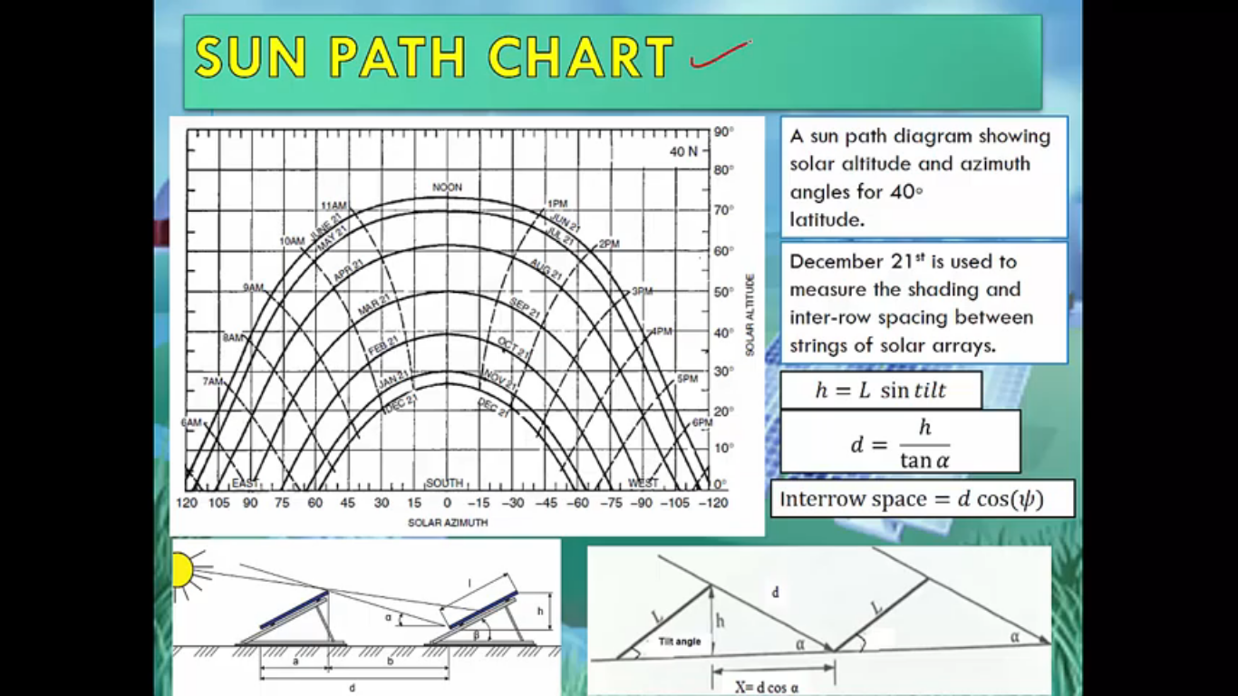
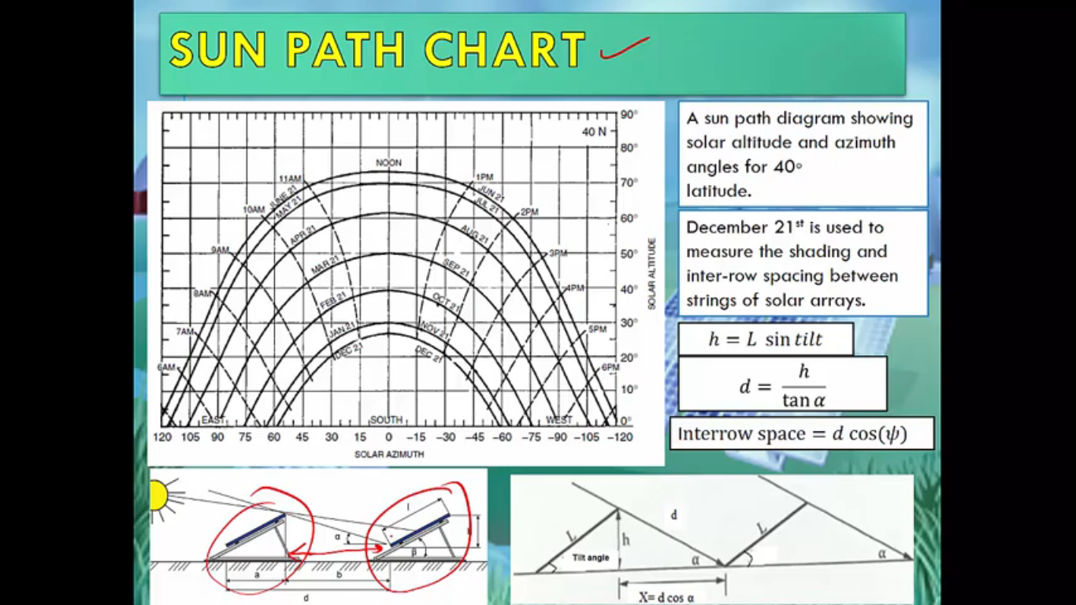
Implementation of the project by pvsys software &autocad
Now we will make an illustration of the diagram using 2D Autocad
Taking into account the space between each string and the other
The calculations used to calculate the distance between each will be
explained.
Note :- 21/December is used to measure the shading and inter-row spacing between string of solar arrays . The length of the shadow will be calculated at 9 am, because it is the longest shadow in the day.

Slide 15
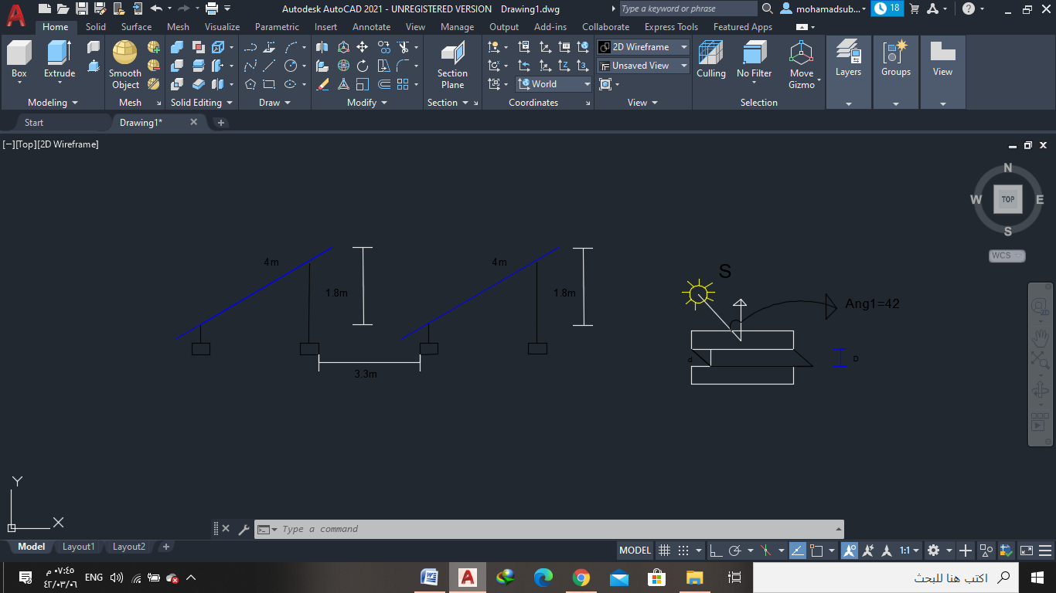
Implementation of the project by pvsys software &autocad
h = L sinTILT , d = h/(tanα) , row space = d cos(φ)
Φ = 42⁰ , the highest of sun = 22⁰ ,
h= 4*sin(27)
=1.8 m
d= 1.8/tan(22)
=4.45 m
D= 4.45*cos(42)
=3.3 m
(space between each table and the other)

Slide 16
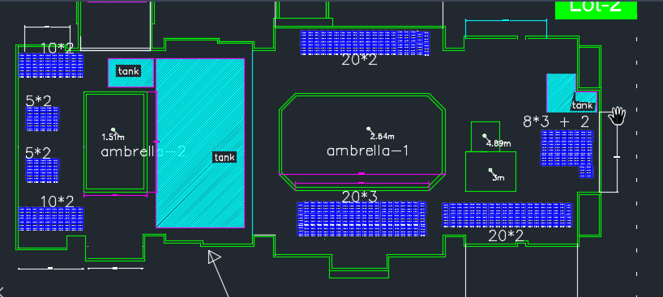
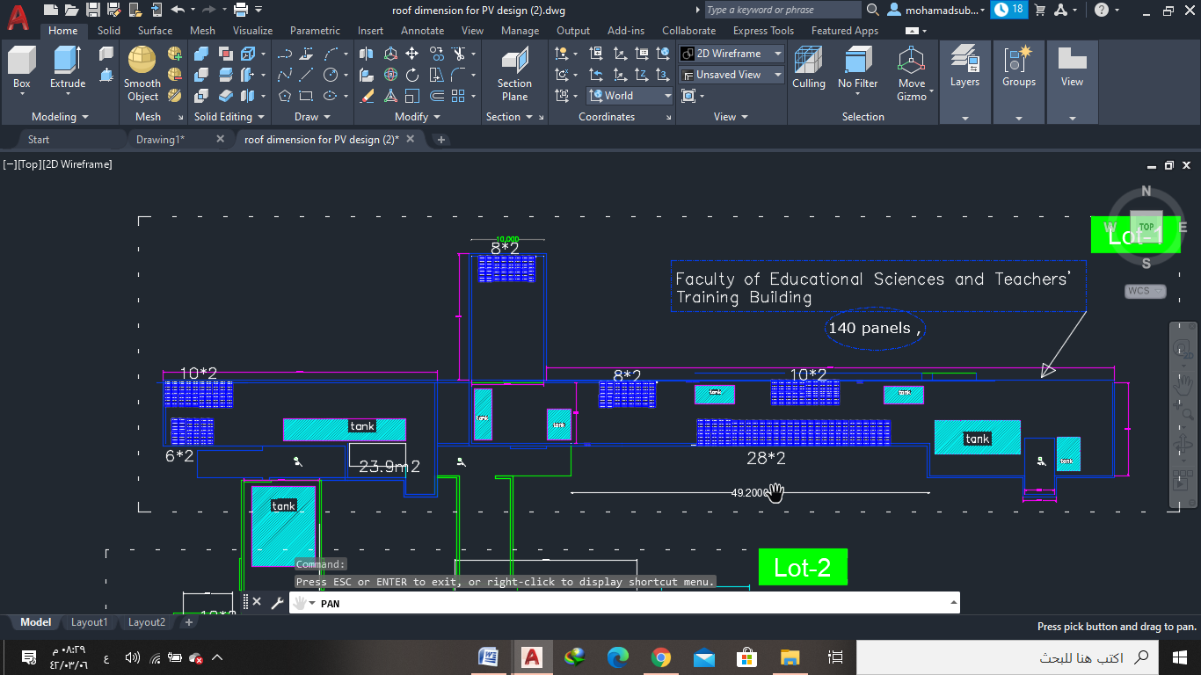
Implementation of the project by pvsys software &autocad
-Now, autocad diagrams for both college will be shown and how the panels have been distributed in different areas to avoid shading.
Faculty of Arts – (226 panel - 90.4 kw)
Faculty of Education–(140 panel - 54.6 kw)

Slide 17
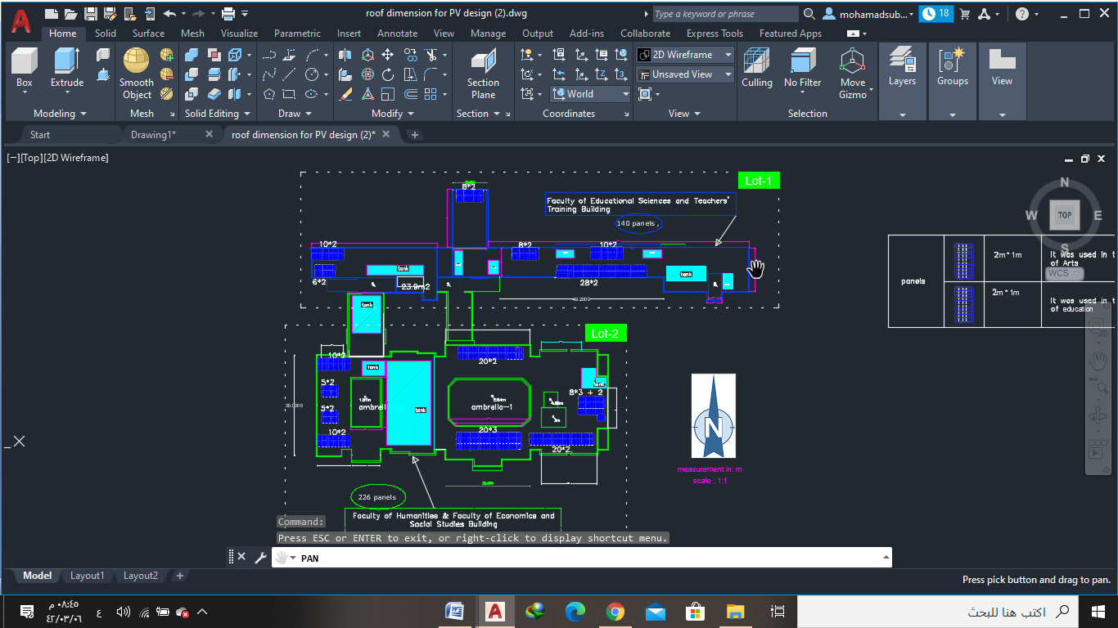
Implementation of the project by pvsys software &autocad

Slide 18
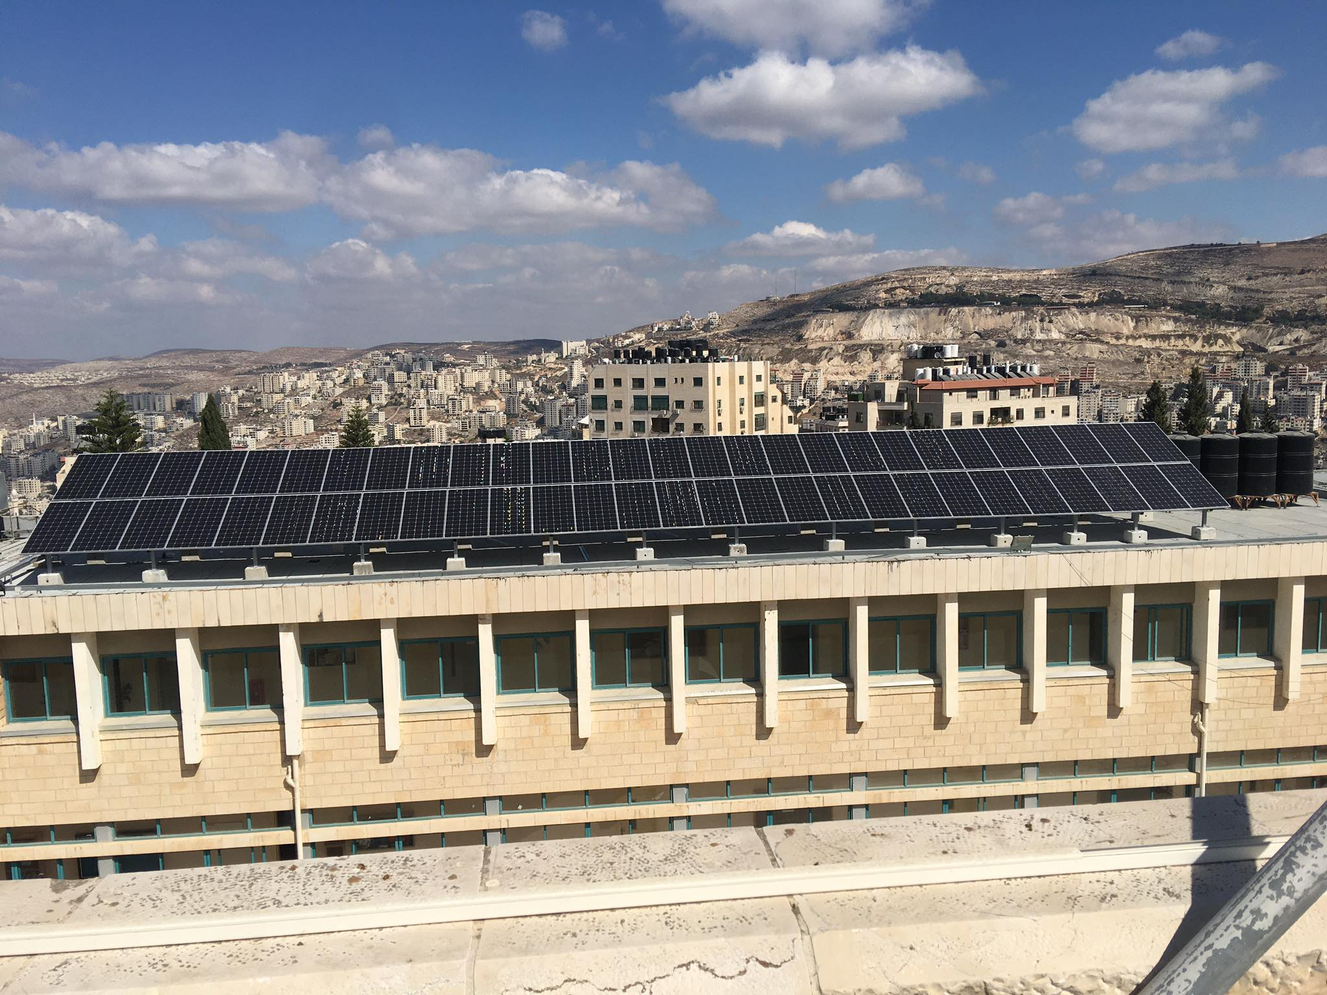
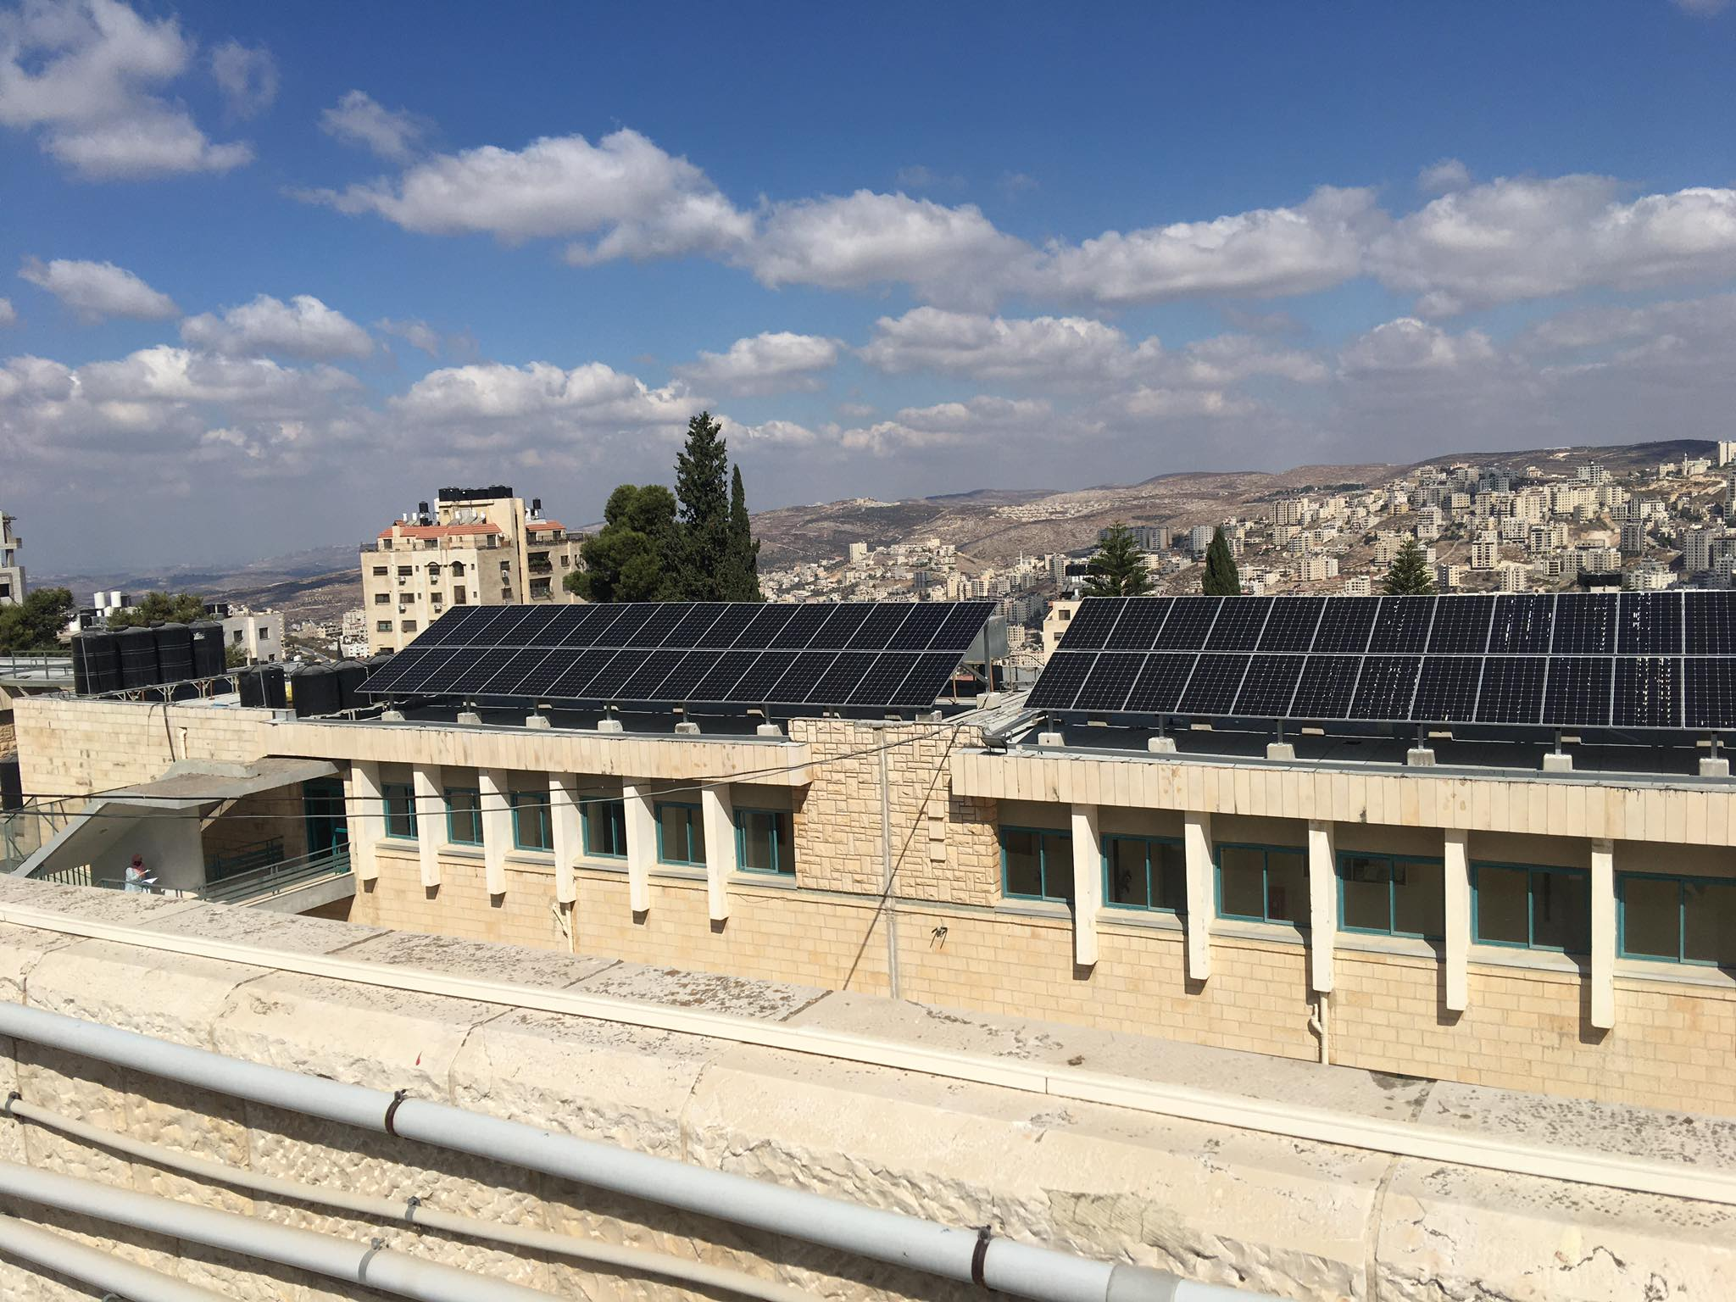

Slide 19
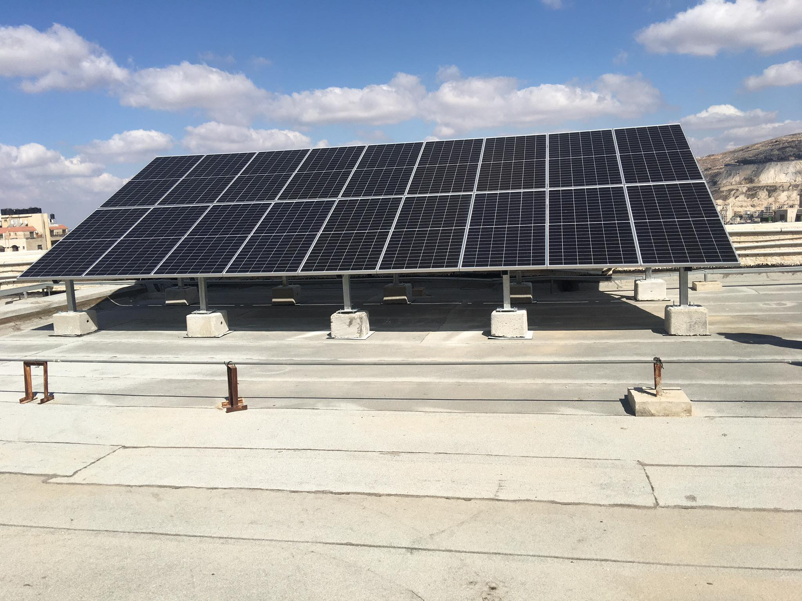
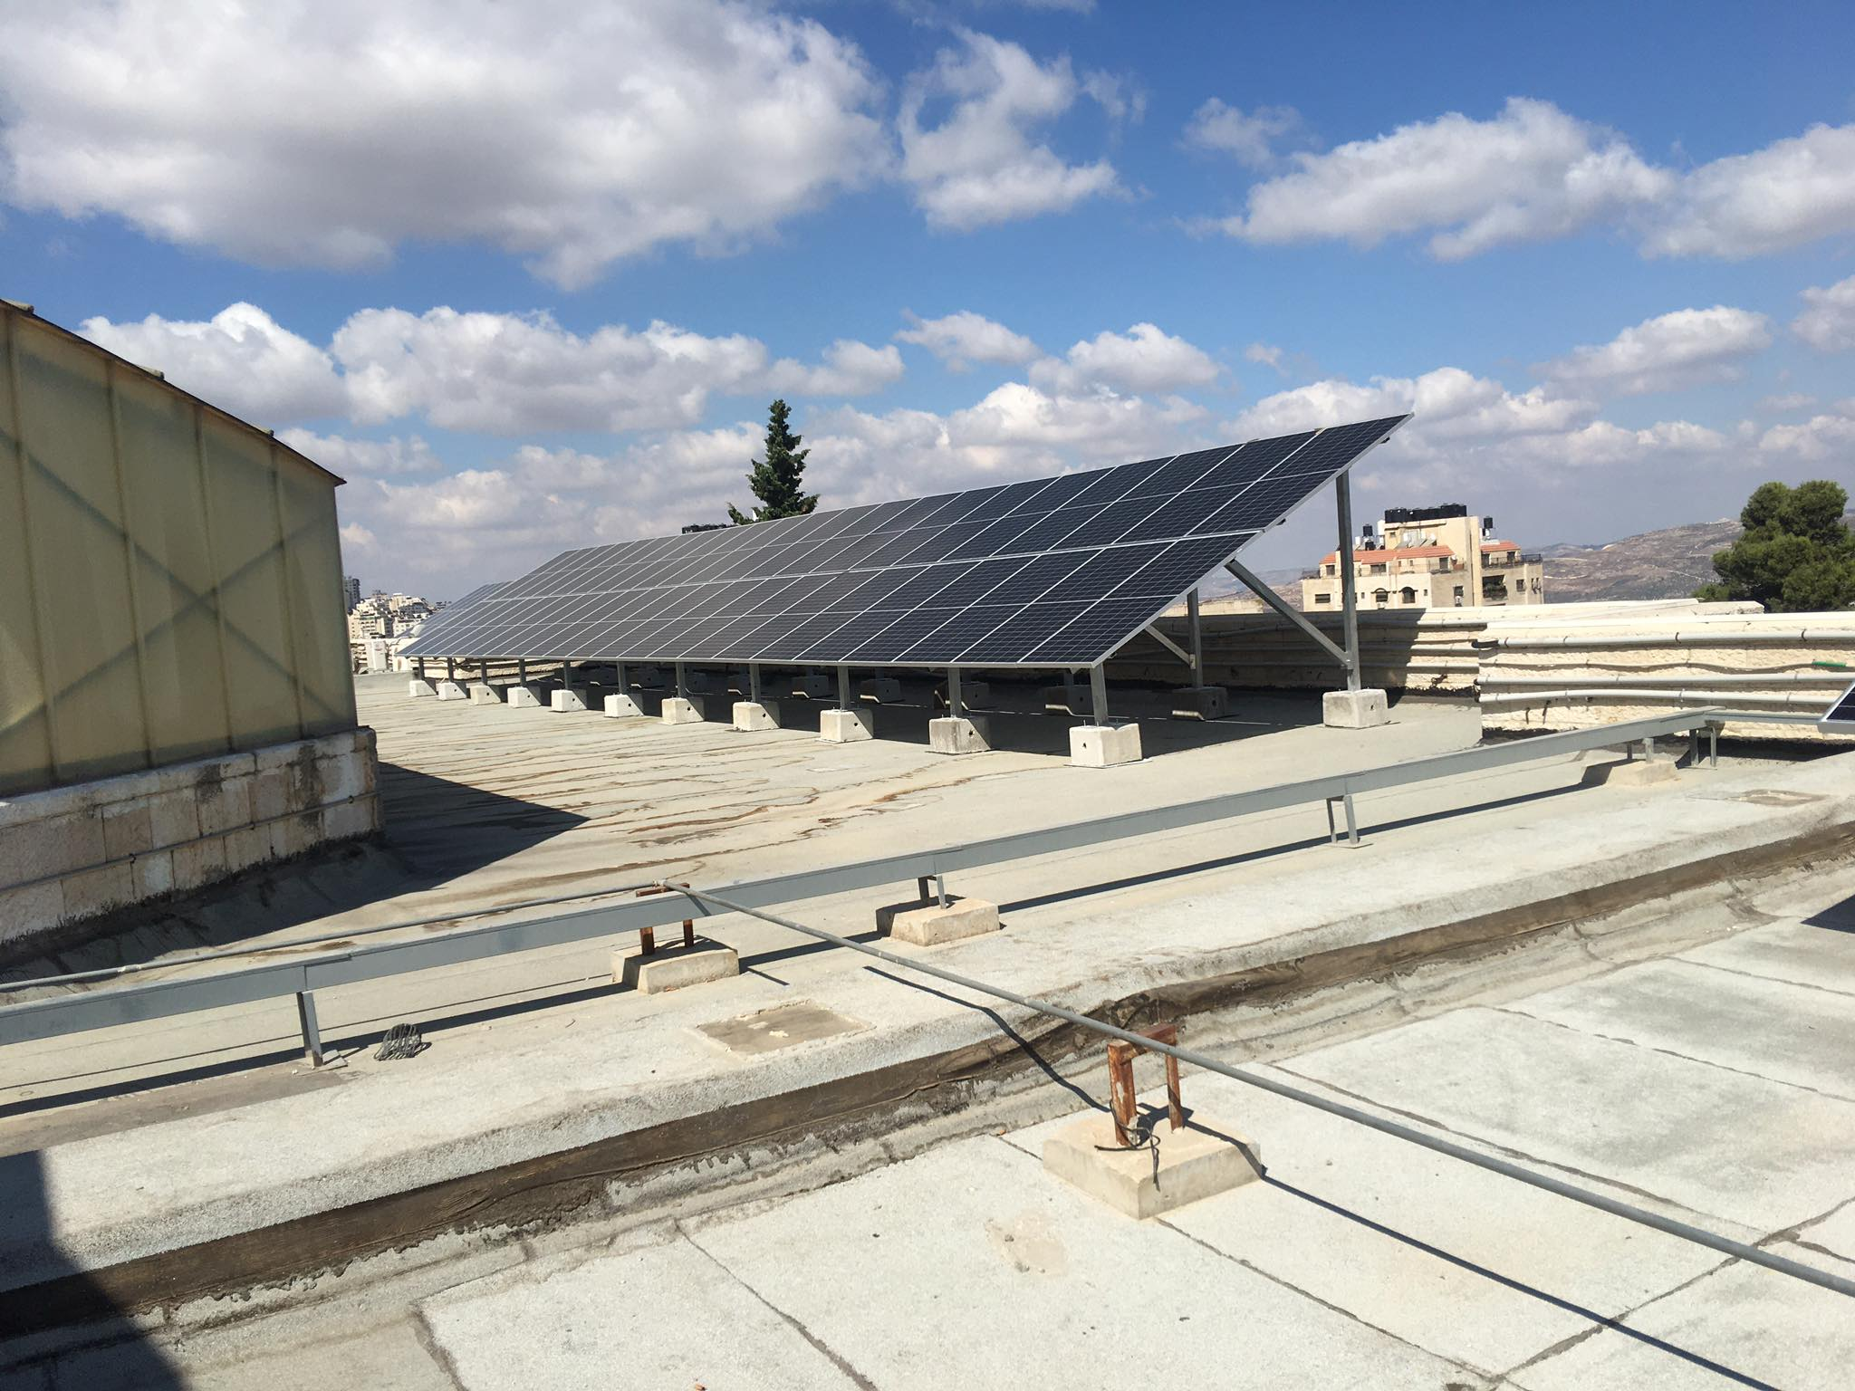

Slide 20
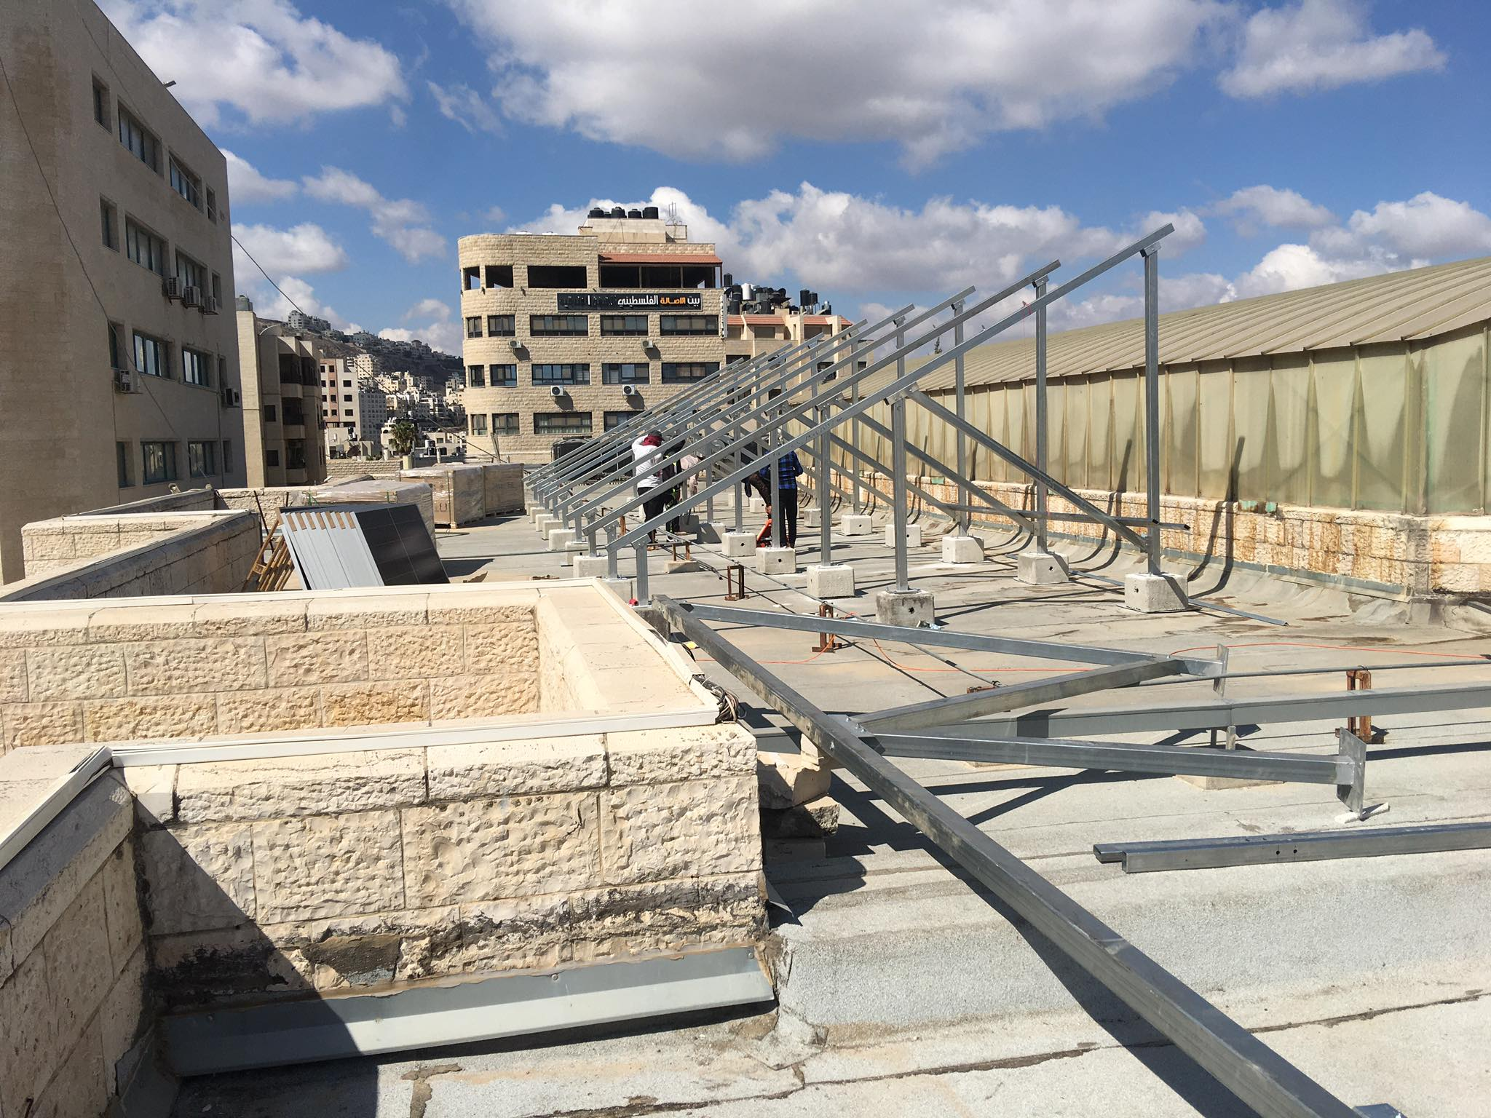

Slide 21
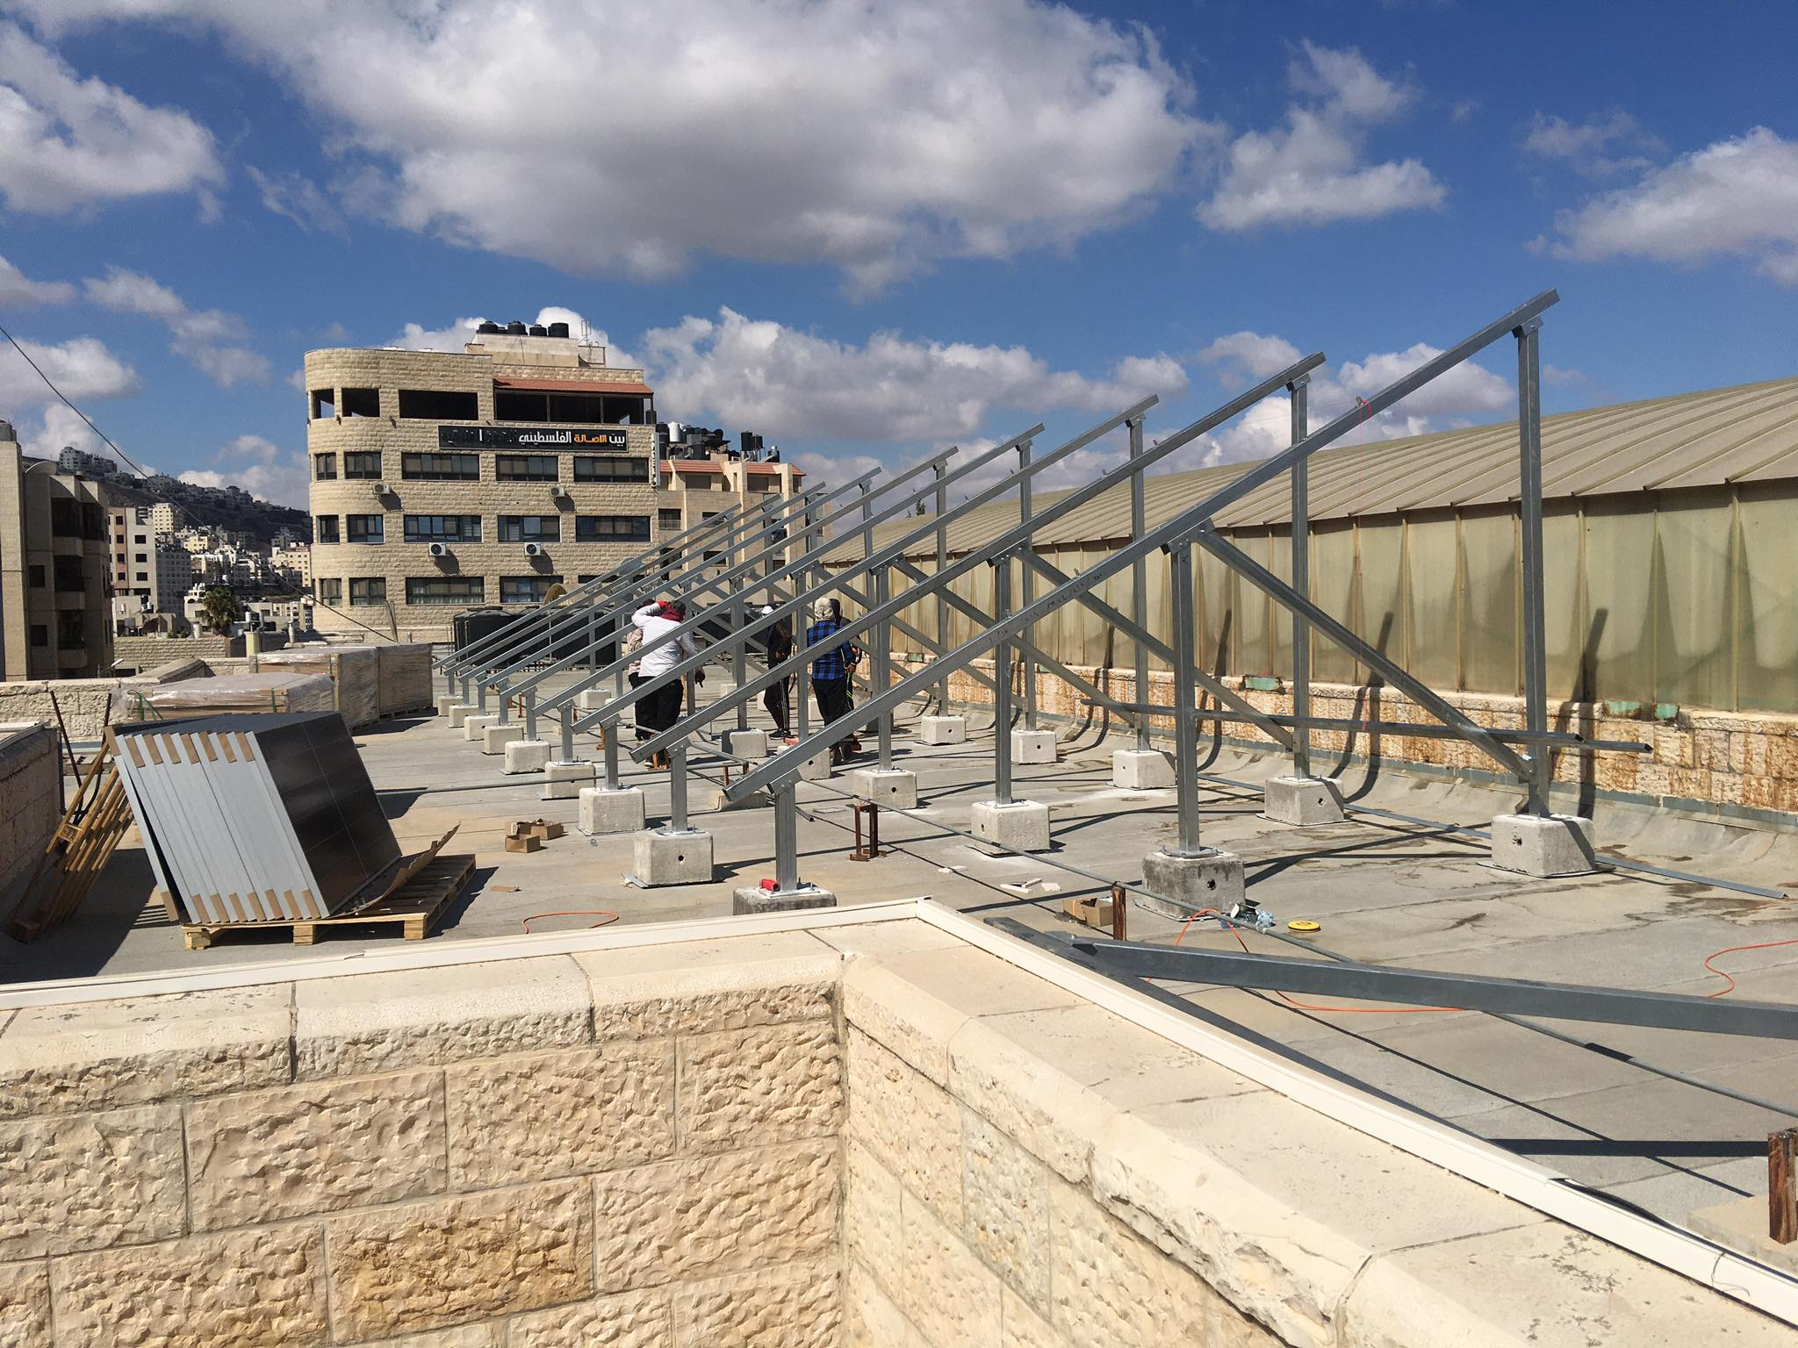

Slide 22
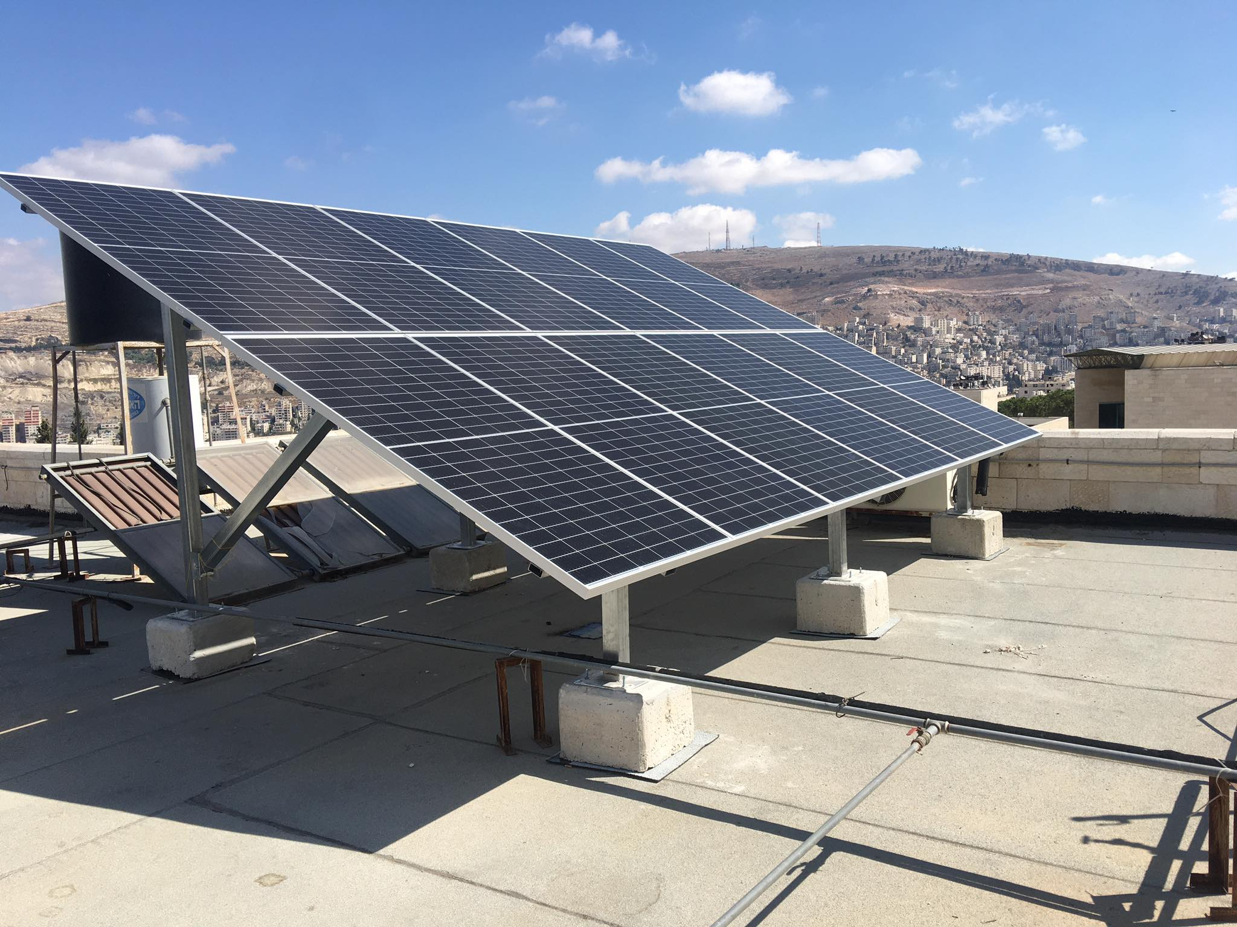

Slide 23
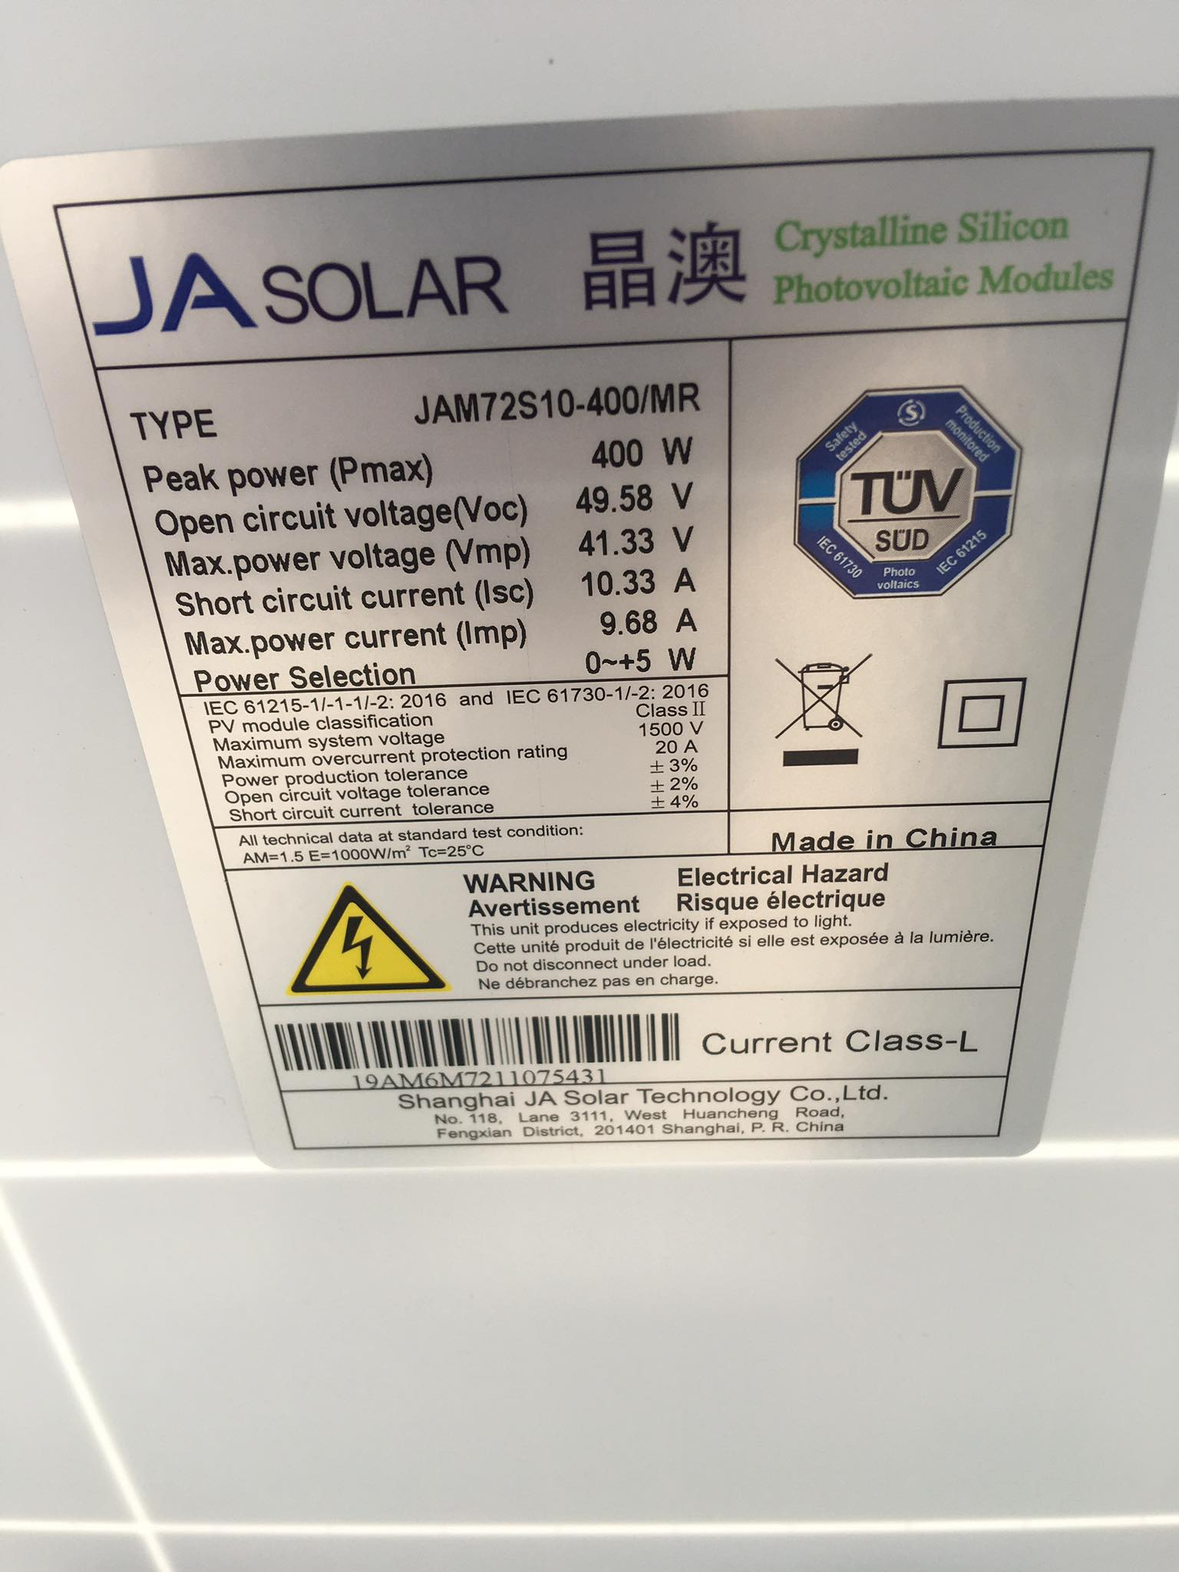

Slide 24
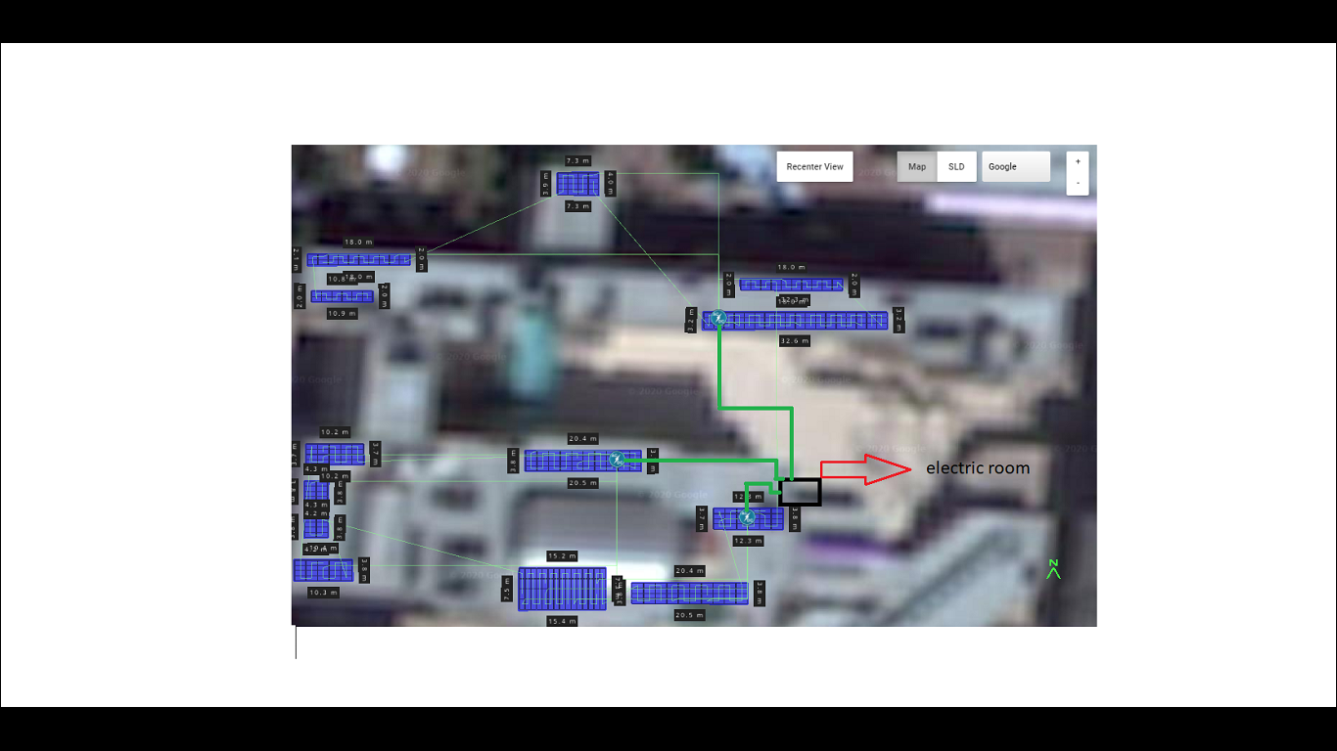
Implementation of the project by pvsys software &autocad
As we can see in the image above, the panels that were connected to each inverter and inverter sites were shown

Slide 25
Implementation of the project by pvsys software &autocad
Note
-The actual results of the project we were supposed to take from the actual figures of the project But because the project was delayed by the executing company (3k comapney).
-An estimate was made for the numbers that were supposed to come out of the project.

Slide 26
Implementation of the project by pvsys software &autocad
PPV,RATED = 145kw
The average daily solar brightness in Palestine is (4.5-5 ) hours
Edc/day = PPV,RATED * Average number of solar hours per day
= 145kw * 5
= 725kwh/day
Edc / month = 725 kwh/day * 30 day / month
= 21.75 Mwh /month
Edc / year = 21.75 Mwh/month * 12 month
= 261MWH
EAC = EFFCINCEY INVERTER * EDC
= 0.982 * 261 MWH/year
= 256.302 Mwh /year

Slide 27
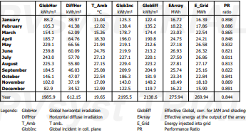
Implementation of the project by pvsys software &autocad
And now we will show the actual readings of the pv sys program, through which it was calculated according to the values in the table.

Slide 28
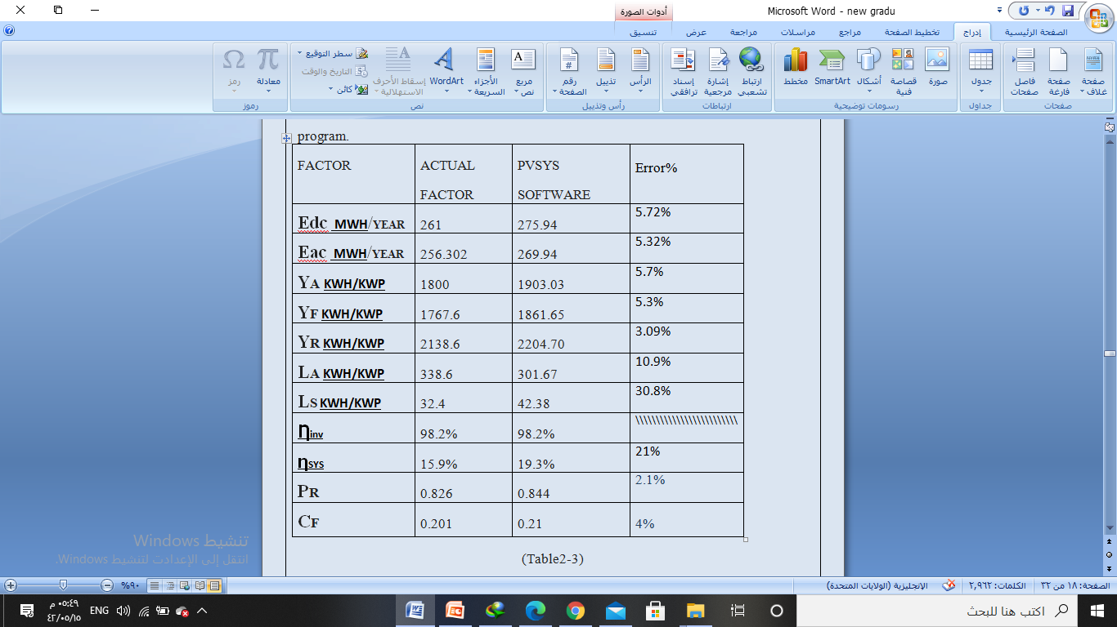
Implementation of the project by pvsys software &autocad

Slide 29
Chapter 3
Electrical connections and
electrical protection systems

Slide 30
Electrical connections and electrical protection systems
Now it will be shown the correct electrical connection, how to connect the panels to the inverter, collect all inverters and feed to the
national grid.
-Note that max input votage inverter = 1000 volt dc

Slide 31
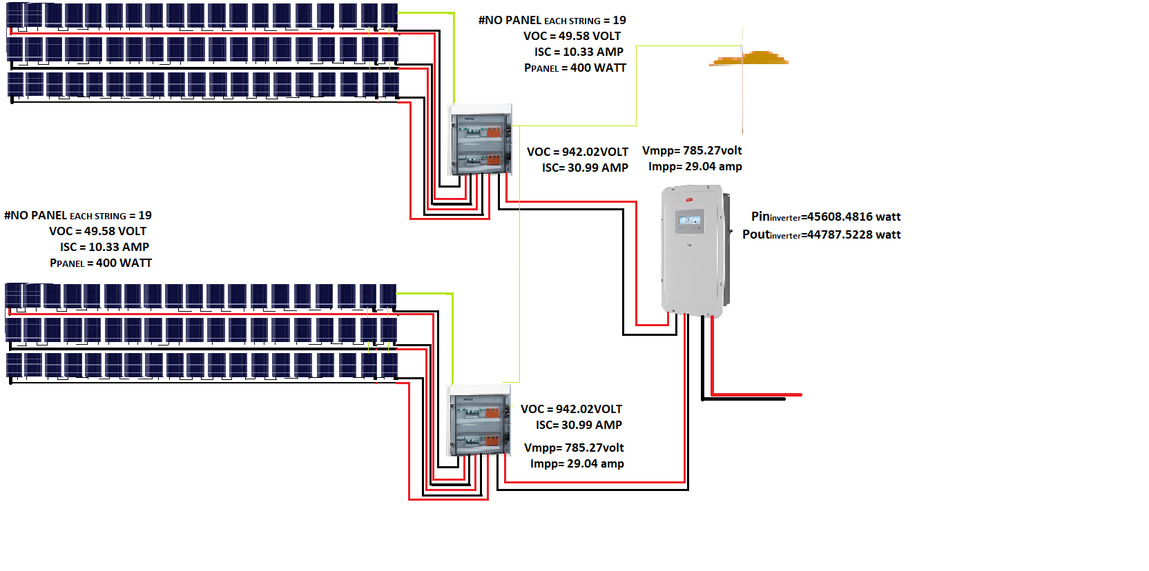
Electrical connections and electrical protection systems
-First inverter in Literature faculty

Slide 32
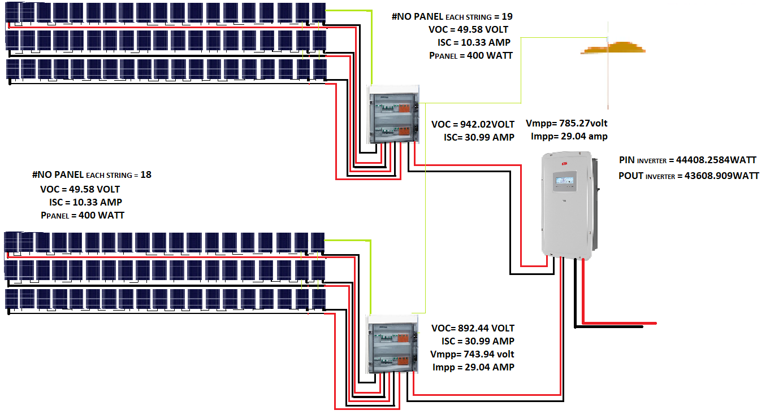
Electrical connections and electrical protection systems
-second inverter in Literature faculty

Slide 33
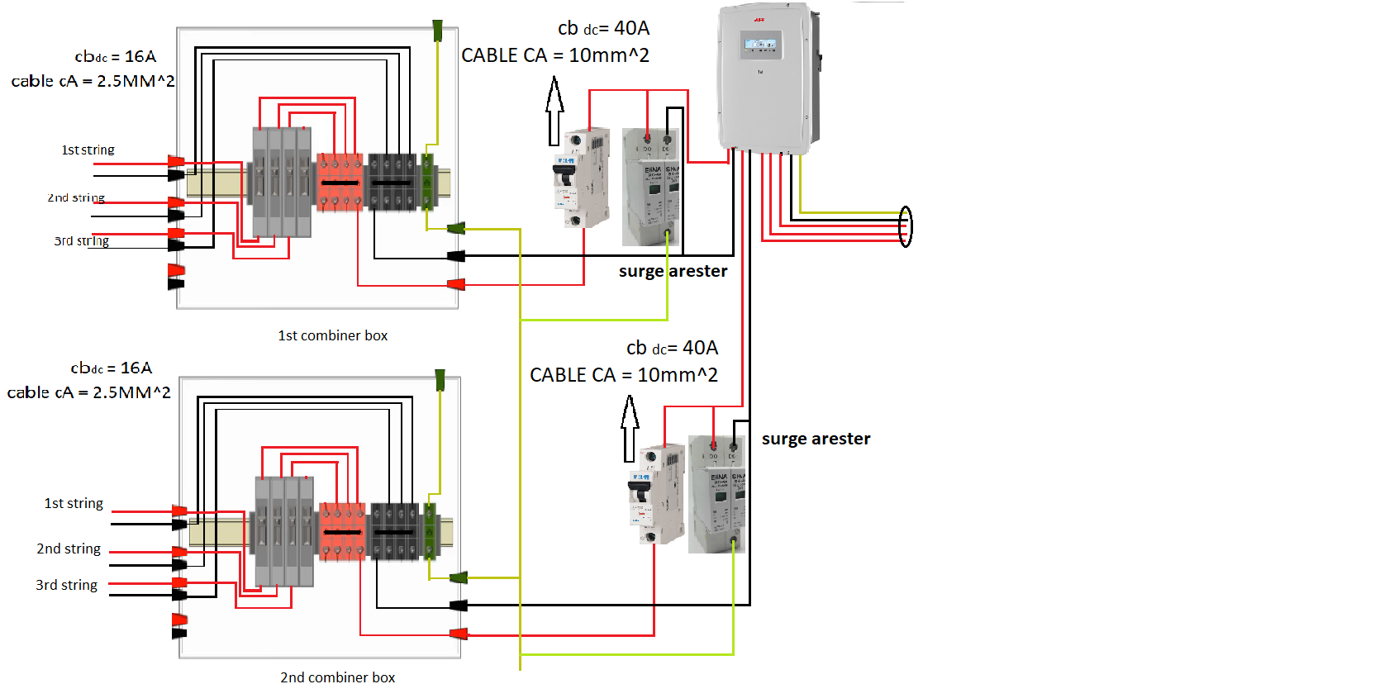
Electrical connections and electrical protection systems
- combiner box FIRST INVERTER & SECOND INVERTER
-It is the place where the outputs of each string are collected, and they exit with one output with voltage and current, which the designer is concerned with.

Slide 34
Electrical connections and electrical protection systems
-After converting the photovoltaic energy into DC electrical energy, it will be entered into the inverter to convert the DC energy to AC power ,Then the power output from the panels will be fed into a step-up transformer (0.38-6.6kv) and feeding the Nablus municipal station near the university that uses a transformer
step down (6.6-0.38kv).

Slide 35
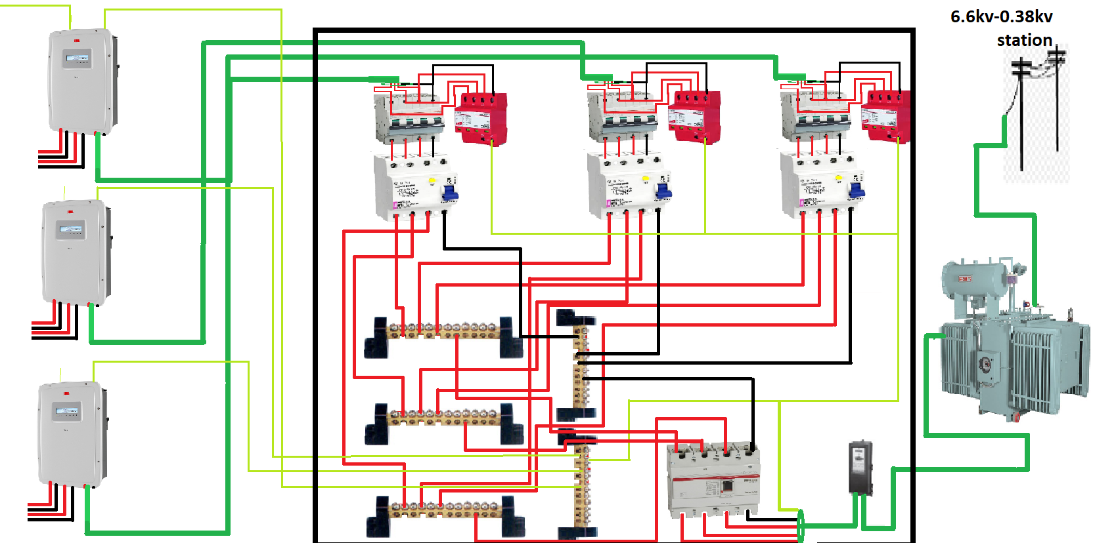
Electrical connections and electrical protection systems

Slide 36
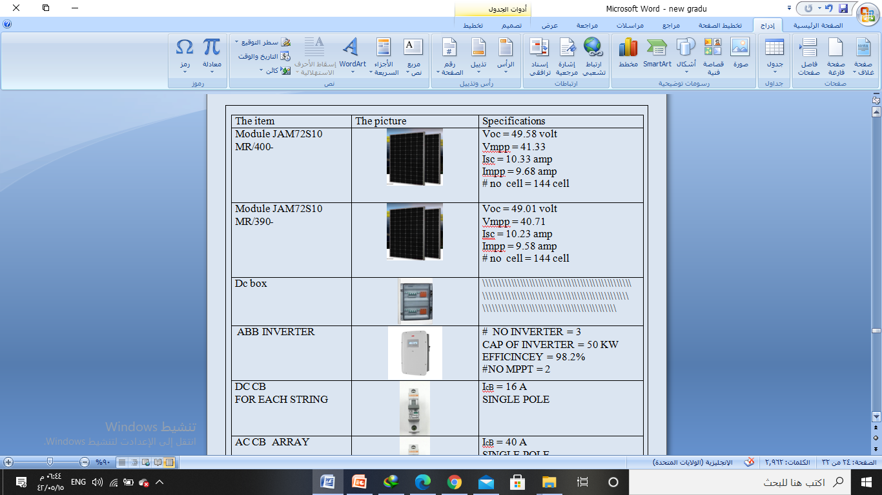

Slide 37
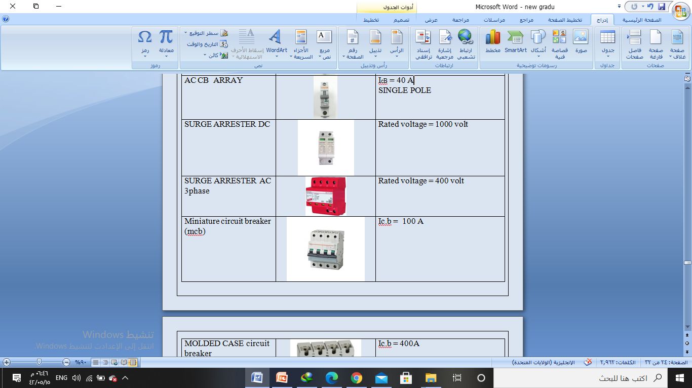

Slide 38
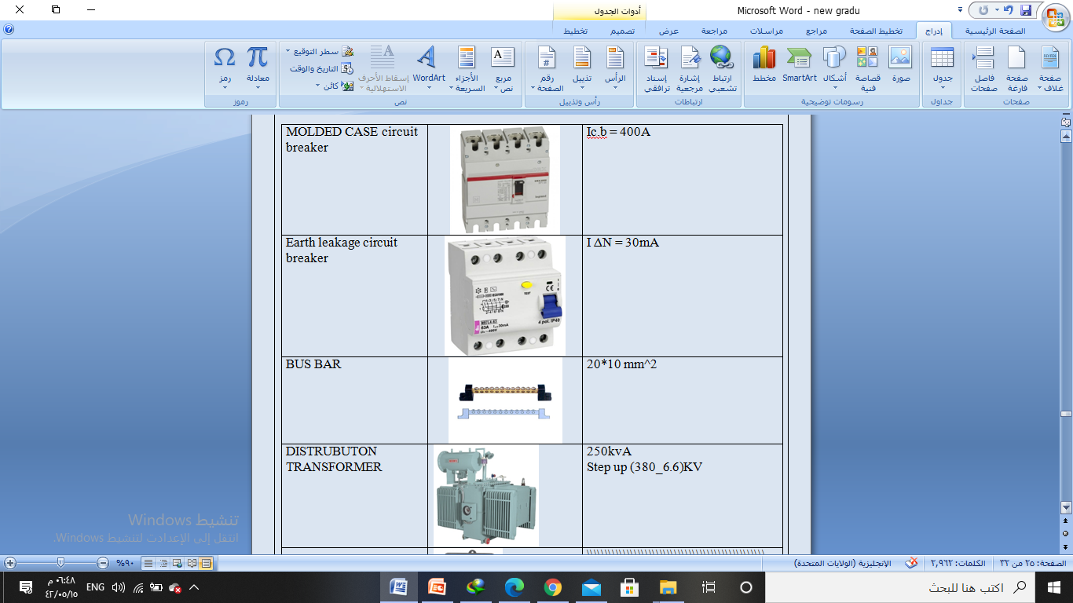

Slide 39
Chapter 3
Calculate the voltage drop and
Calculation of the cross-sectional area of ​​a wire

Slide 40
Calculate the voltage drop and
Calculation of the cross-sectional area of ​​a wire
One of the most important things that must be taken into account during these large projects is taking into account and taking care of the voltage drop, because any excess voltage drop causes dangerous fires because it increases the current passing through the wires.
The length of the wires and their cross-sectional area must be taken into account in order to
Prevent any danger .
Vd = (mv/m/amp) * L * I SC
(mv/m/amp): Drop in voltage due to wire
L: the length of wire
I SC: the rated current*1.25
% Vd = Vd/source voltage

Slide 41
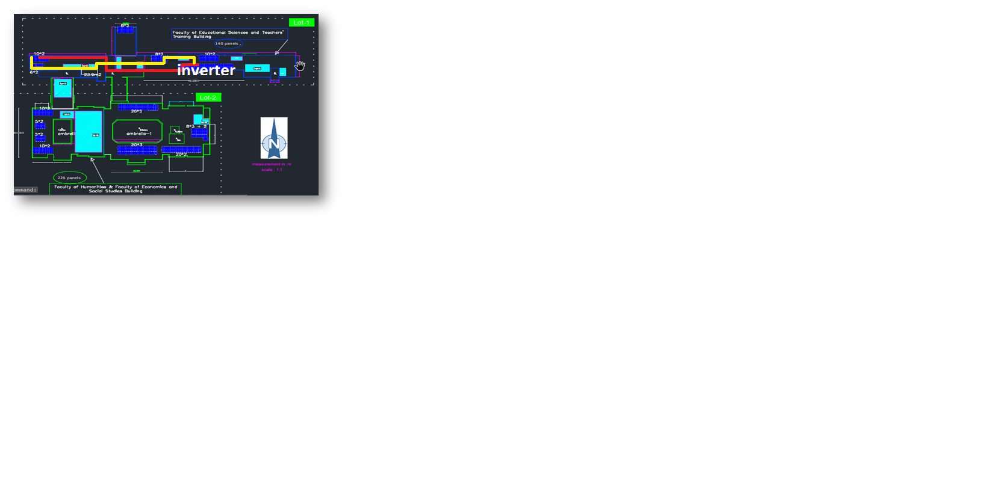
Calculate the voltage drop and
Calculation of the cross-sectional area of ​​a wire
There was some problem on one of the strings , It is the occurrence of a voltage drop on the 2 strings in the system due to the large distance of the connection wires between the panels for this string and the inverter,
and the location of this string will be shown on the picture below

Slide 42
Calculate the voltage drop and
Calculation of the cross-sectional area of ​​a wire
This problem will be solved by using a higher wire section to avoid damage to the system
A 10mm ^ 2 wire segment was chosen, It was used to connect the panels and the inverter.
The voltage drop | Cross-sectional area | The distance of the wire
1.966% | 10mm^2 | 44 m yellow wire
1.69% | 10mm^2 | 38 m red wire

Slide 43
Calculate the voltage drop and
Calculation of the cross-sectional area of ​​a wire
Now to calculate drop voltage to the outside of the inverter (ac) ,The output power will be calculated. This depends on the efficiency of the inverter used.
-As we explained, 3 ABB inverters were used with an efficiency of 98.2%.
Education faculty inverter Literature Faculty second inverter Ƞinv = pout / pin
Ƞinv = pout / pin 98.2% = pout/ 44408.2584
98.2% = pout/ 54600 Pout =43608.9097 watt
Pout = 53617.2 watt
Literature faculty first inverter
Ƞinv = pout / pin
98.2% = pout/ 45608.4816
Pout = 44787.5289 watt

Slide 44
Calculate the voltage drop and
Calculation of the cross-sectional area of ​​a wire.
-Knowing that a drop in the voltage is permissible to a value of 3%.
The voltage drop | Cross-sectional area | inverter
1.6% | 35mm^2 | Inverter of education faculty
2.4% | 35mm^2 | InverterS of LITRITURE faculty

Slide 45
Calculate the voltage drop and
Calculation of the cross-sectional area of ​​a wire
-Bus bar copper size calculation = (standard size mm*mm) * 1.4 > the rating current
= (20mm*10mm) * 1.4 >the rating current
= 280 > 245 A
-bar copper size (20mm*10mm).

Slide 46
Chapter 4
Conclusion

Slide 47
End in this project with its two separate parts
There are factors through which you can determine the quality of any
project's performance such as final yield, refrance yield, array yield, performance ratio, utlization factor.
Accordingly, the project was implemented ,It has good running performance.
In the stage of interconnecting the panels and entering them into the inverter, it was necessary to choose suitable circuit breakers to enter the current , And choosing the appropriate number of meshed cells in series and the number of string in parallel For safe access to the inverter.
One of the most important problems we encountered was the voltage drop due to the large distance between the cell site and the MDB
He had to choose an appropriate section of wire for the flow of current to prevent fires.

Slide 48

THANKS
For LISTENING

