Slide 1

Graduation Project 1
Rakkibna “ ركّبنا”
Public Transportation App
Supervisor: Dr. Haya Sammaneh
Mahmoud Draidi Mohammed Obaid

Slide 2
Contents
Introduction
How our app solve the problem
Used techniques
Constraints

Slide 3
Introduction
Problems :
The public transport sector in Palestine have minimal integration with technology.
Conflict with private cars.
Poor communication between driver and passengers so
they don’t know location of each other .

Slide 4
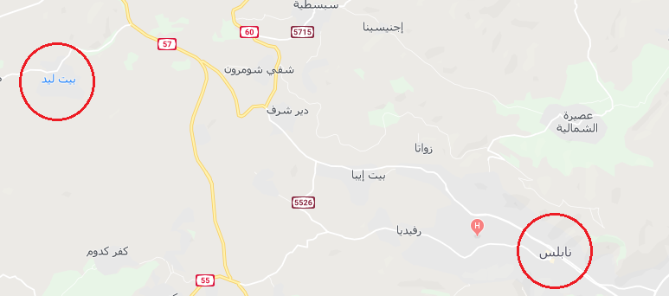
Introduction

Slide 5
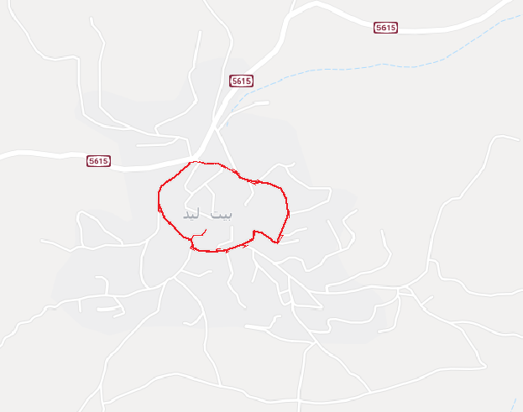

Slide 6
Objectives
Solve previous problems by:
Map to show location of both driver and passenger.
Reservation system

Slide 7
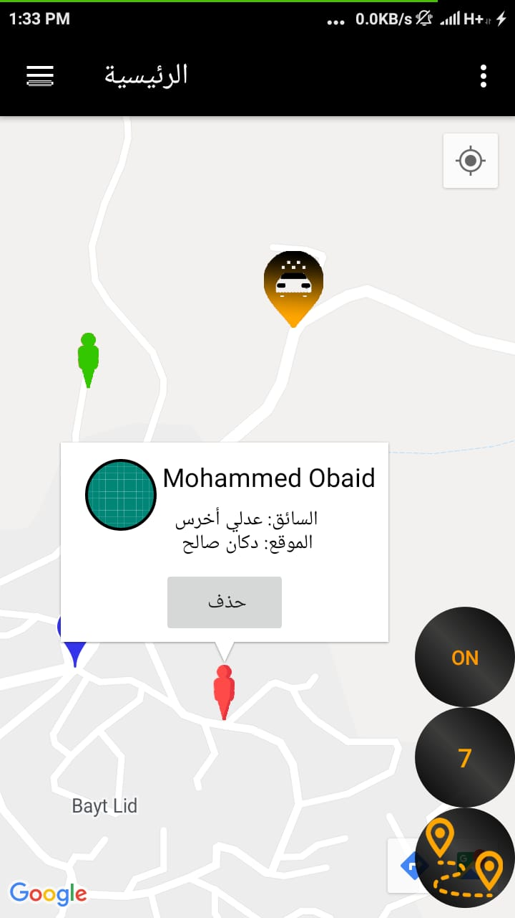
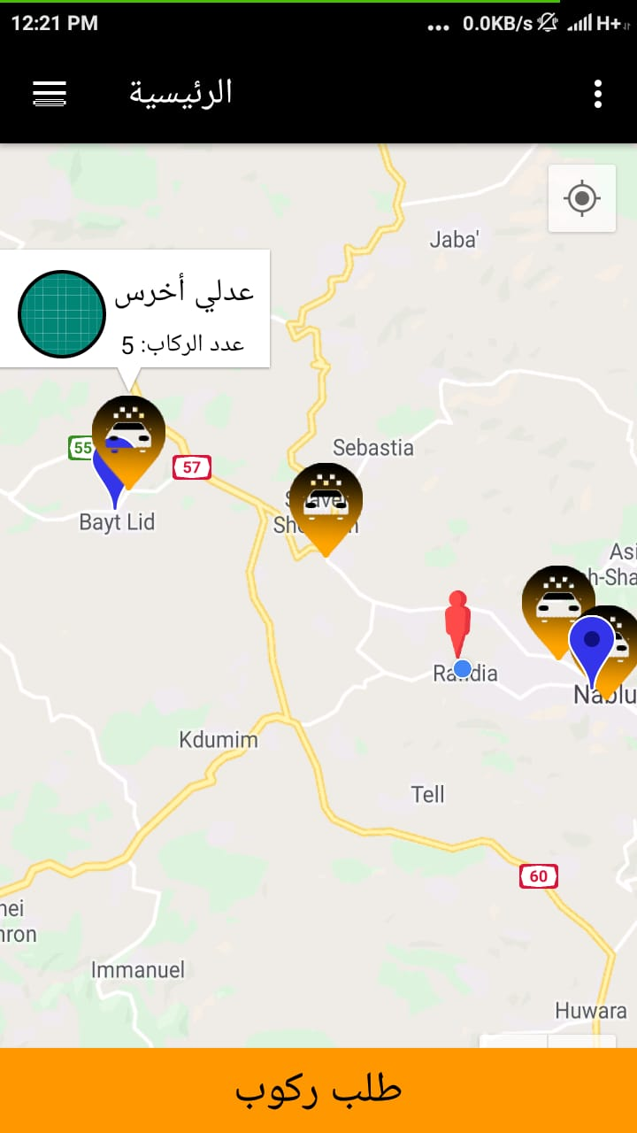
Driver map
Passenger map

Slide 8
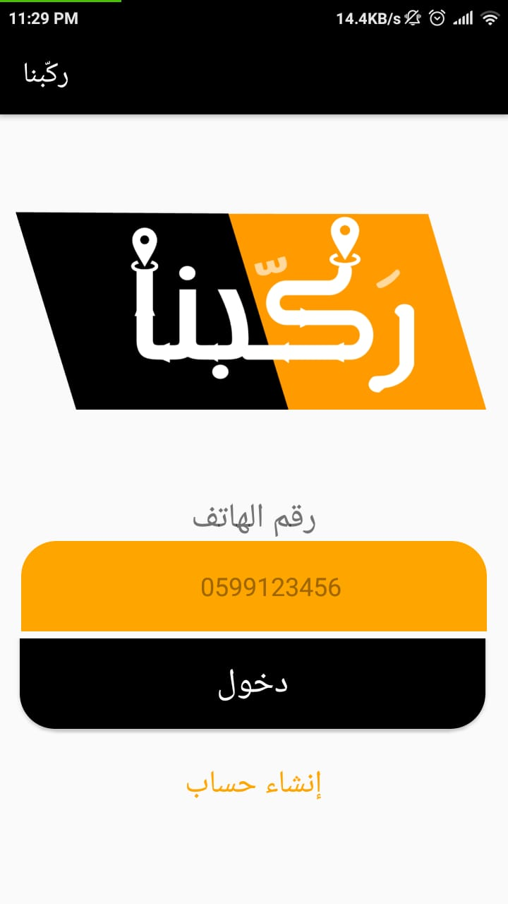
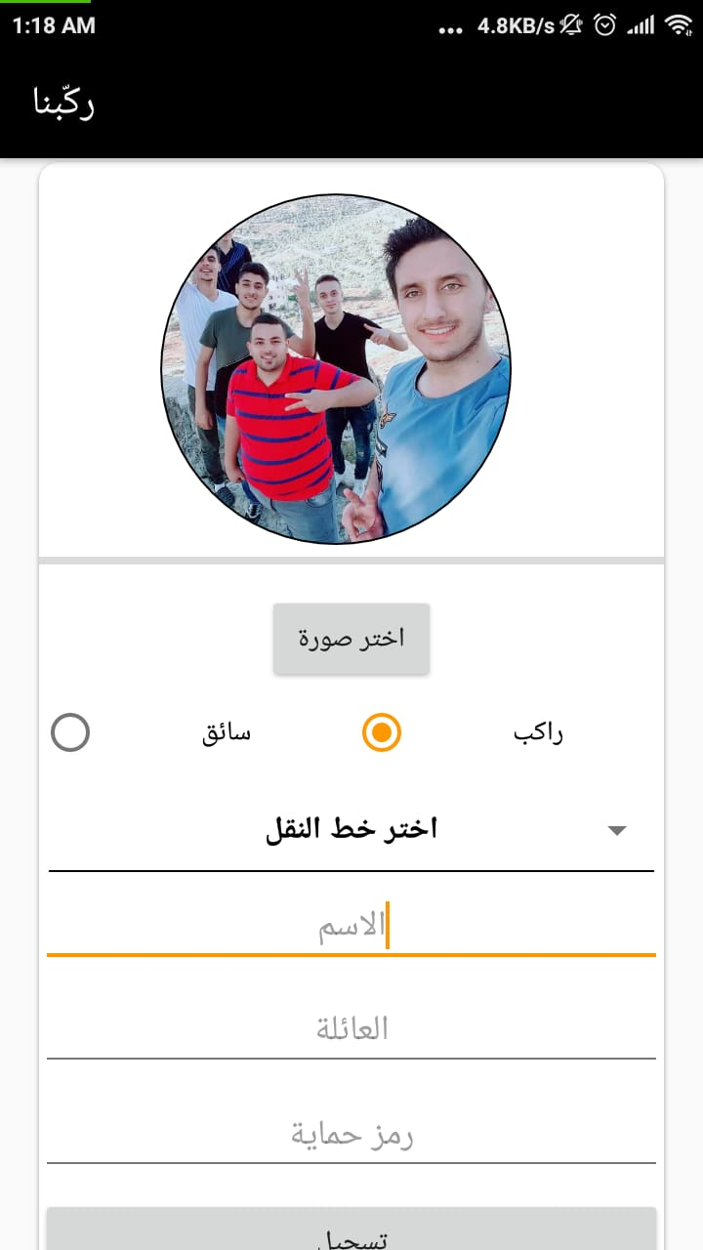

Slide 9
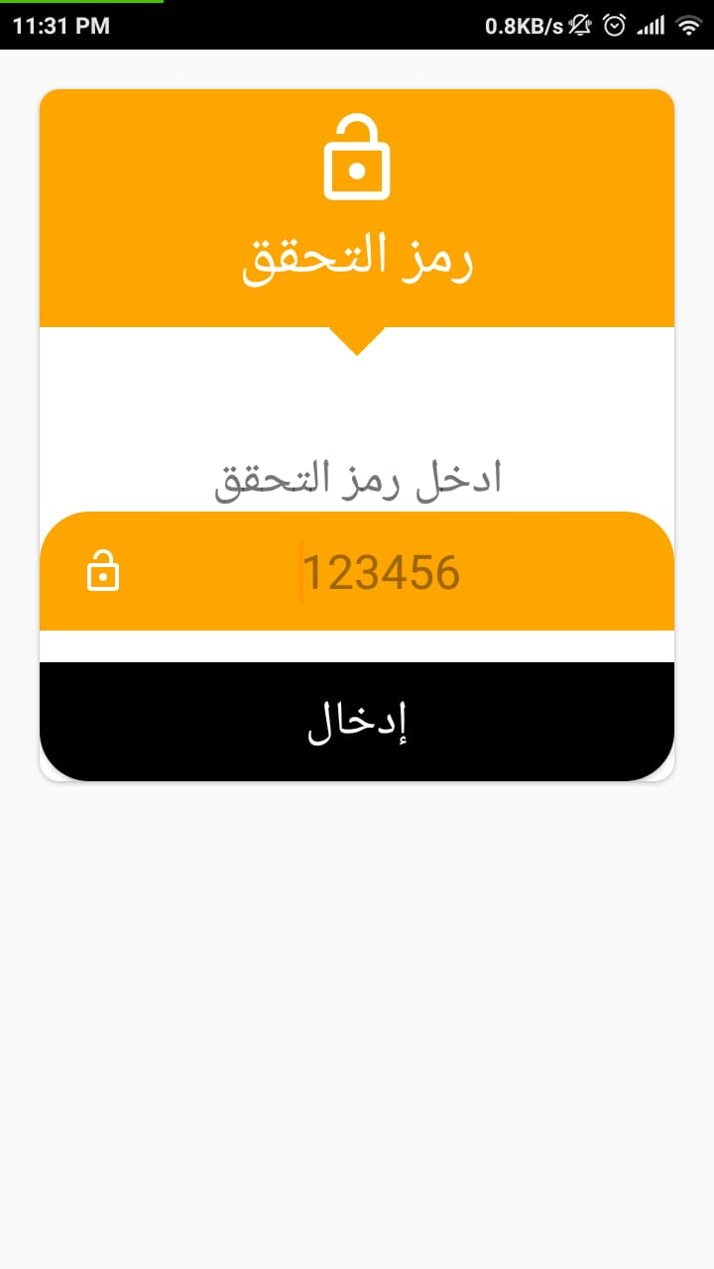
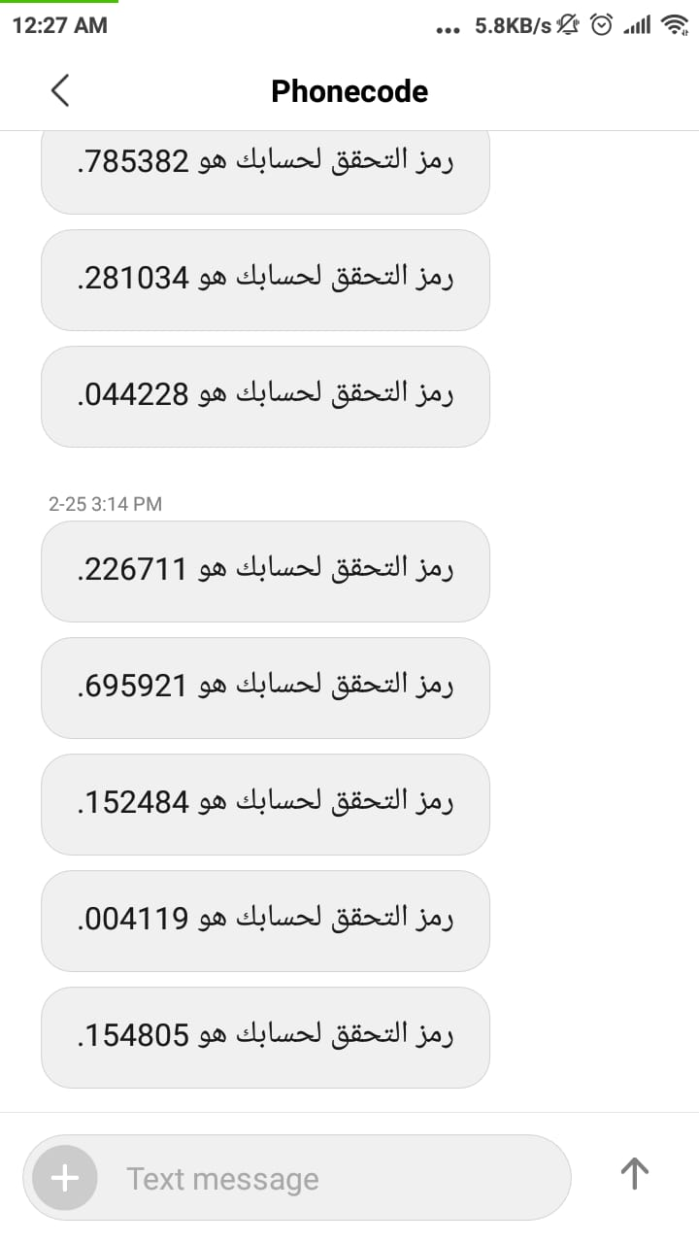

Slide 10
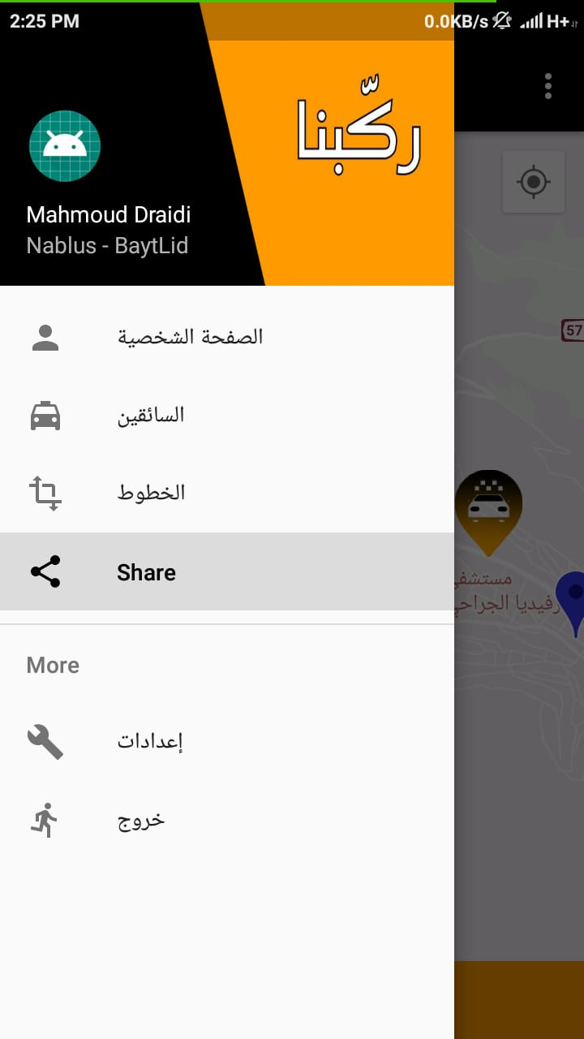

Slide 11
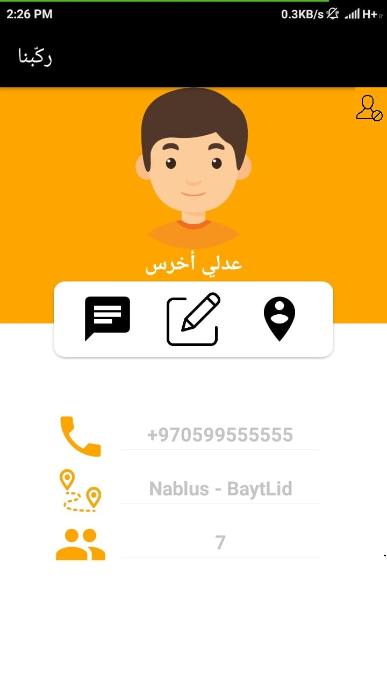

Slide 12
Solve previous problems by:
Map to show location of both driver and passenger.
Reservation system

Slide 13
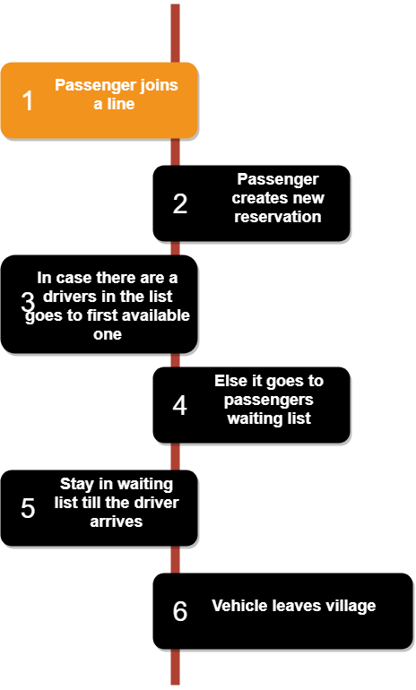
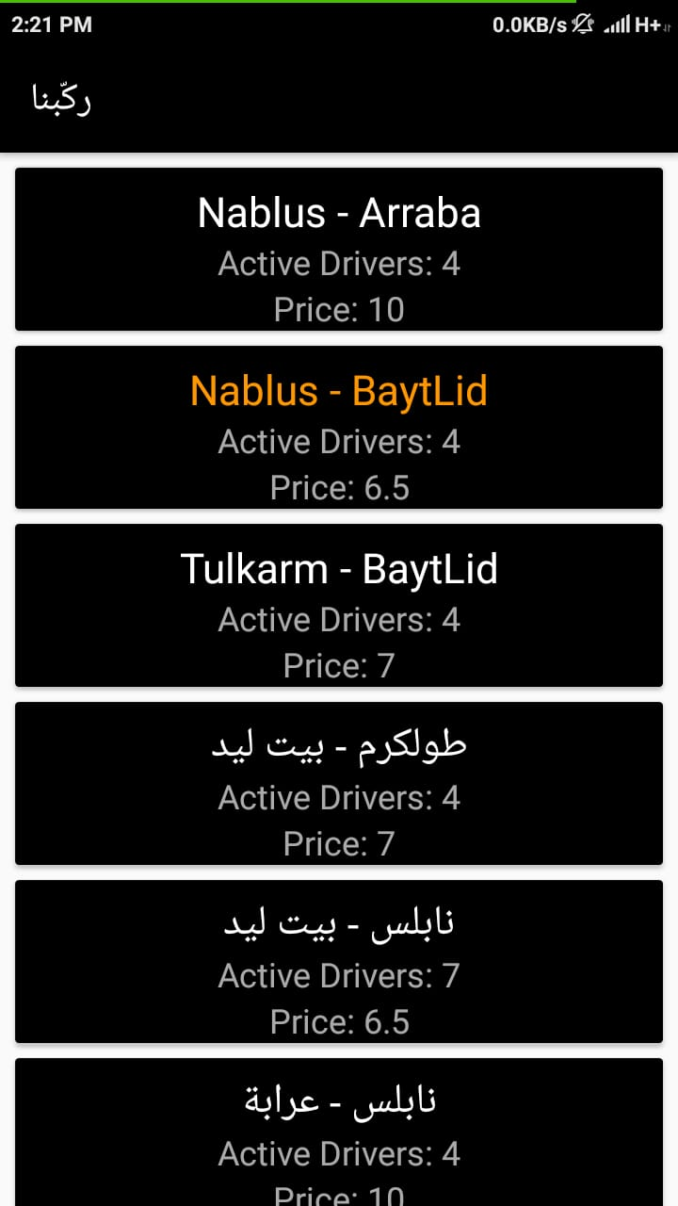
Reservation

Slide 14
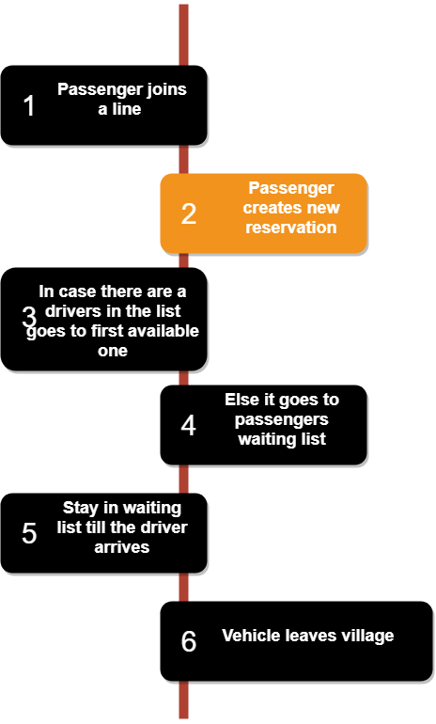
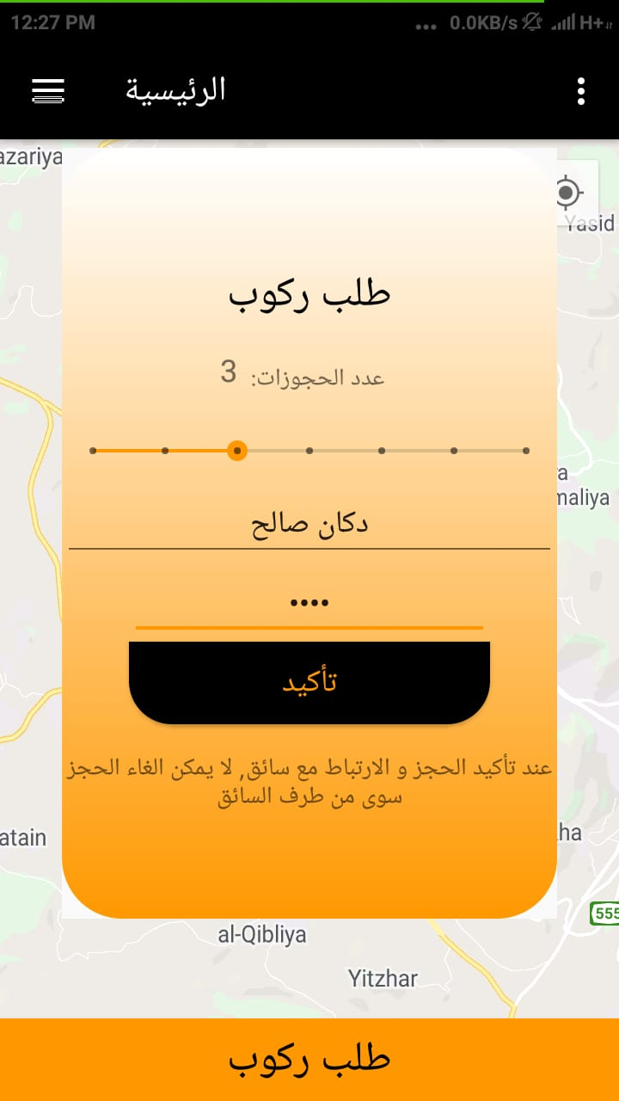
Reservation

Slide 15
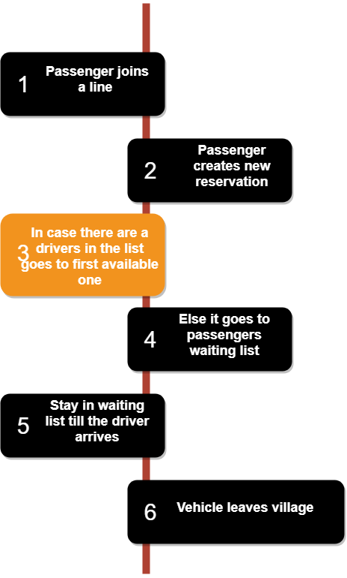
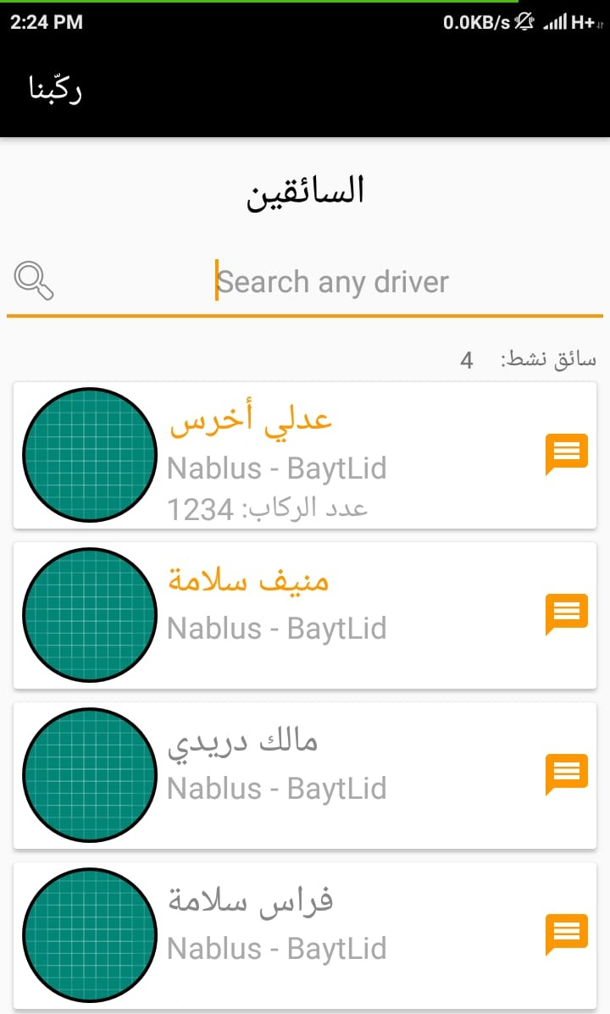
Reservation

Slide 16
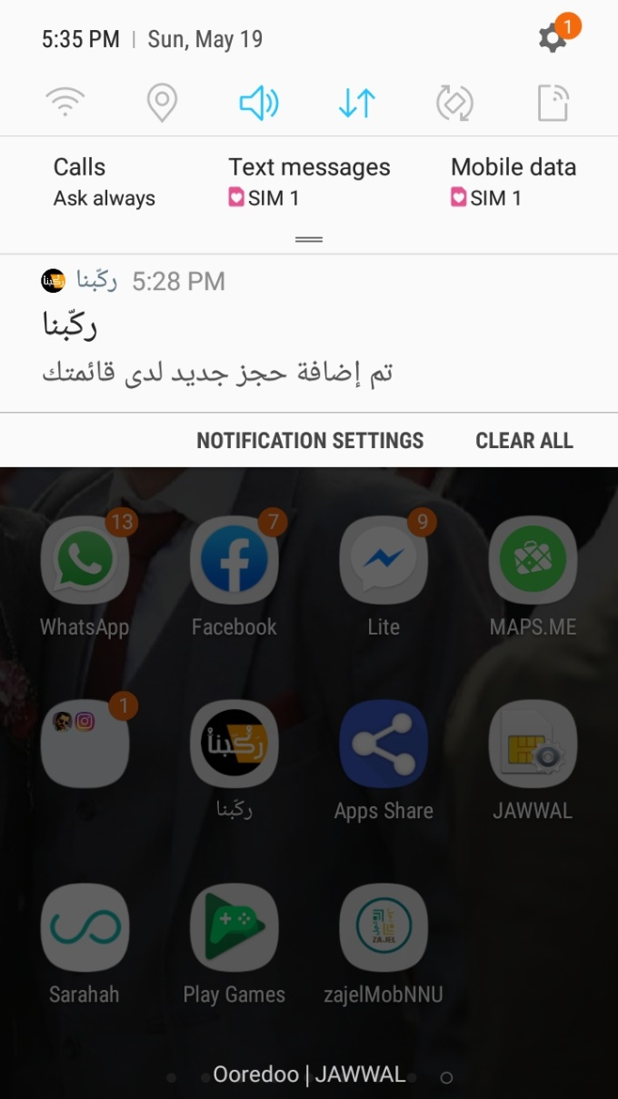

Slide 17
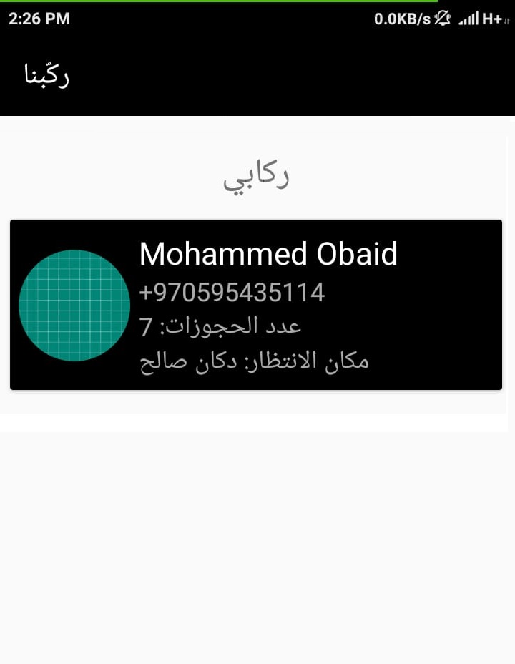

Slide 18
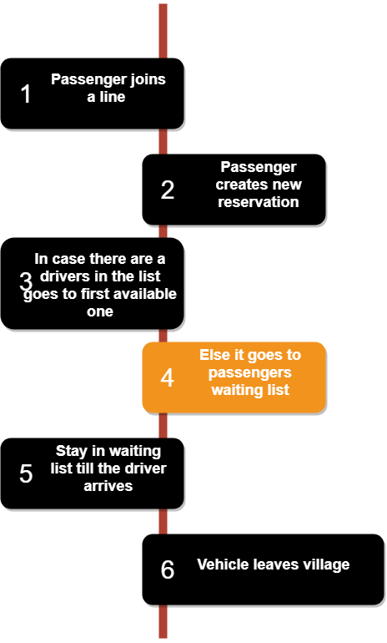
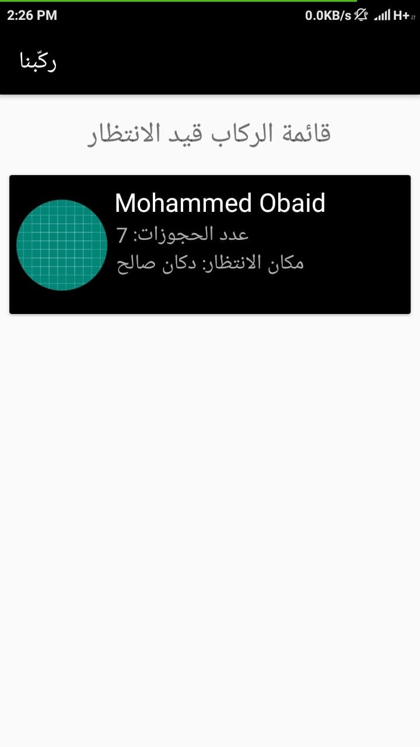
Reservation

Slide 19
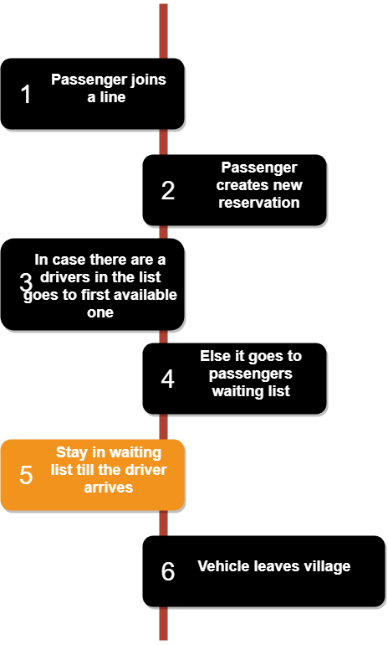
Reservation

Slide 20

Tools & Techniques
Android studio

Slide 21

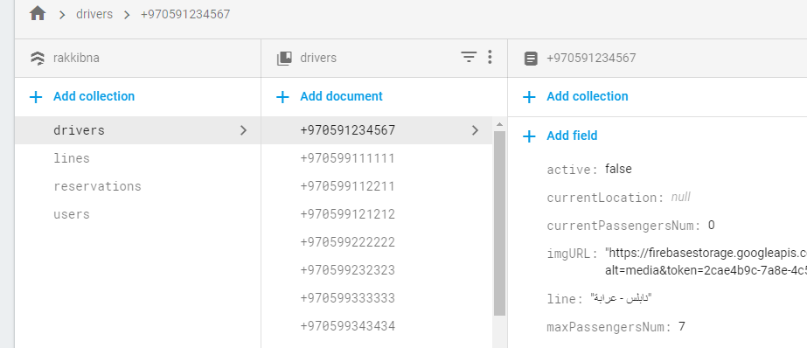
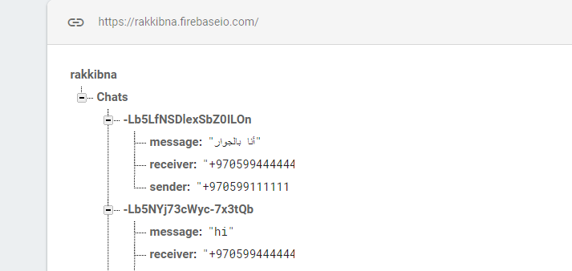
Firebase database

Slide 22

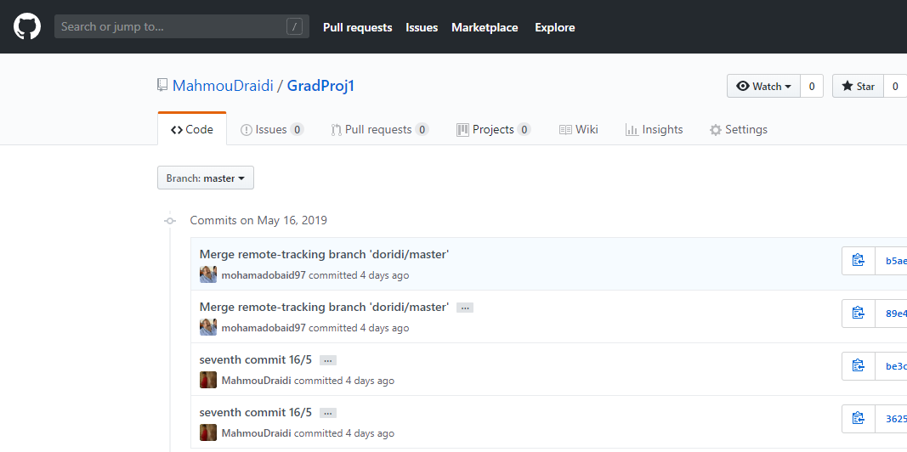
GitHub

Slide 23
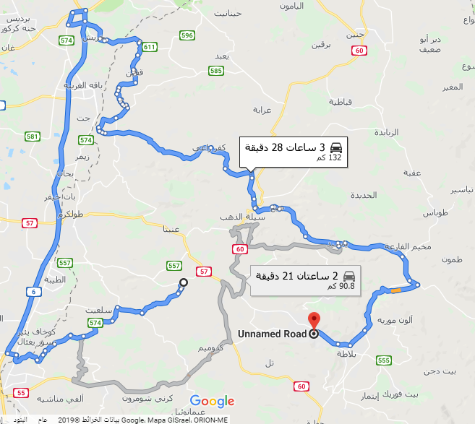
Constraints
Google “Routes” is unsupported in West Bank

Slide 24



Slide 25
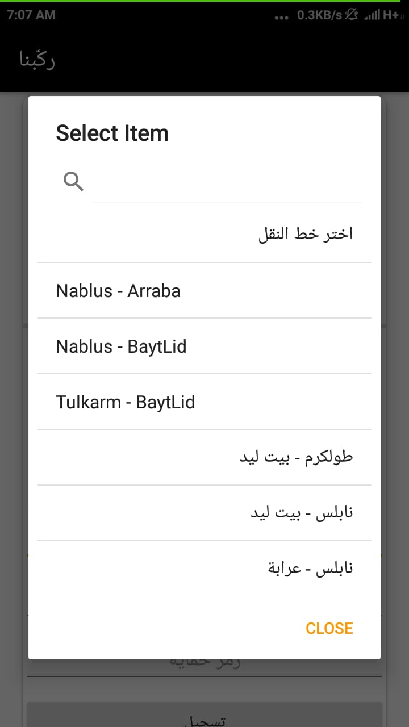
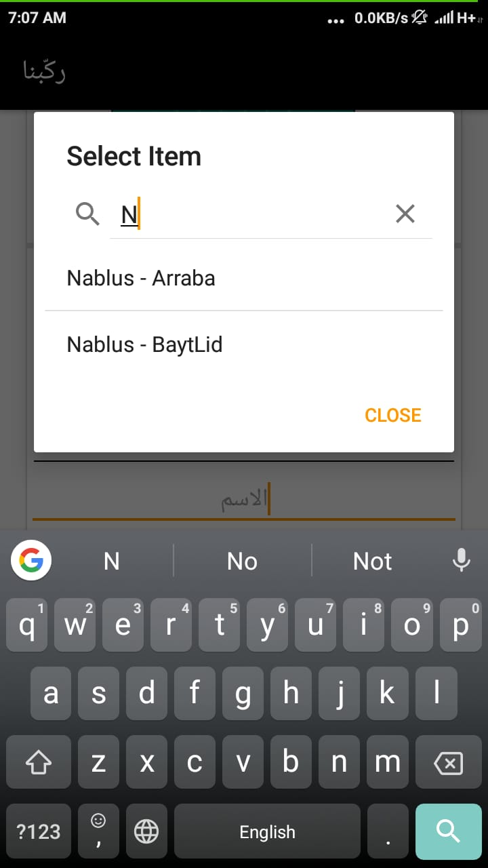
Constraints

Slide 26
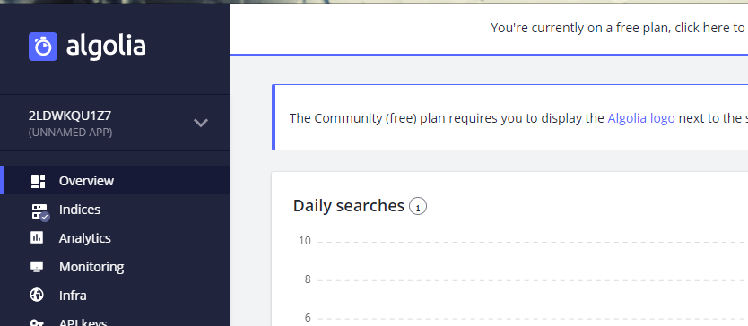
Constraints
Search not supported in Firebase , algolia is solution:

Slide 27
Thank You !

