Slide 1


2026-01-26
Graduation Project II
“Your Whisper Key-Sound ID Unlock”
Supervisor :
Dr.Falah Hasan
Prepared by :
Jana Nazem Sa’ad Hanini
Noor Aldeen Moneer Mahmoud Mahameed

Slide 2
Introduction
Overview of Speaker Recognition Technology
This project follows an intelligent design for an access control system based on voice recognition of specific individuals, enhancing security and facilitating access by relying on voice prints instead of traditional passwords. The system analyzes the unique voice data of authorized individuals, which is then recorded in real time. The recording is then recorded, allowing the door to open immediately if a match is found.

Slide 3
Problem Statement
Problem: Need for a secure, contactless, intelligent access system
Solution:
Voice recognition offers:
Unique biometric identity
Hands-free operation
Improved security and convenience
can be easily copy
Requires contact
easy to open with other tools

Slide 4
Existing Technologies
Traditional
RFID cards
Physical keys
Biometric
Voice recognition
Fingerprint
Face ID
Current speaker recognition systems use diverse methods, yet they struggle with variability in voice and environmental noise.

Slide 5
Methodology: Data Collection and Preprocessing
Filtering
Noise Handling
1
Conversion
2
Mono - Resampling - trimming
3
Signal Normalization
for amplitude consistency
Overview of Data Collection
Multiple voice attempts per user
Authorized and unauthorized speakers ( 300 samples )

Slide 6
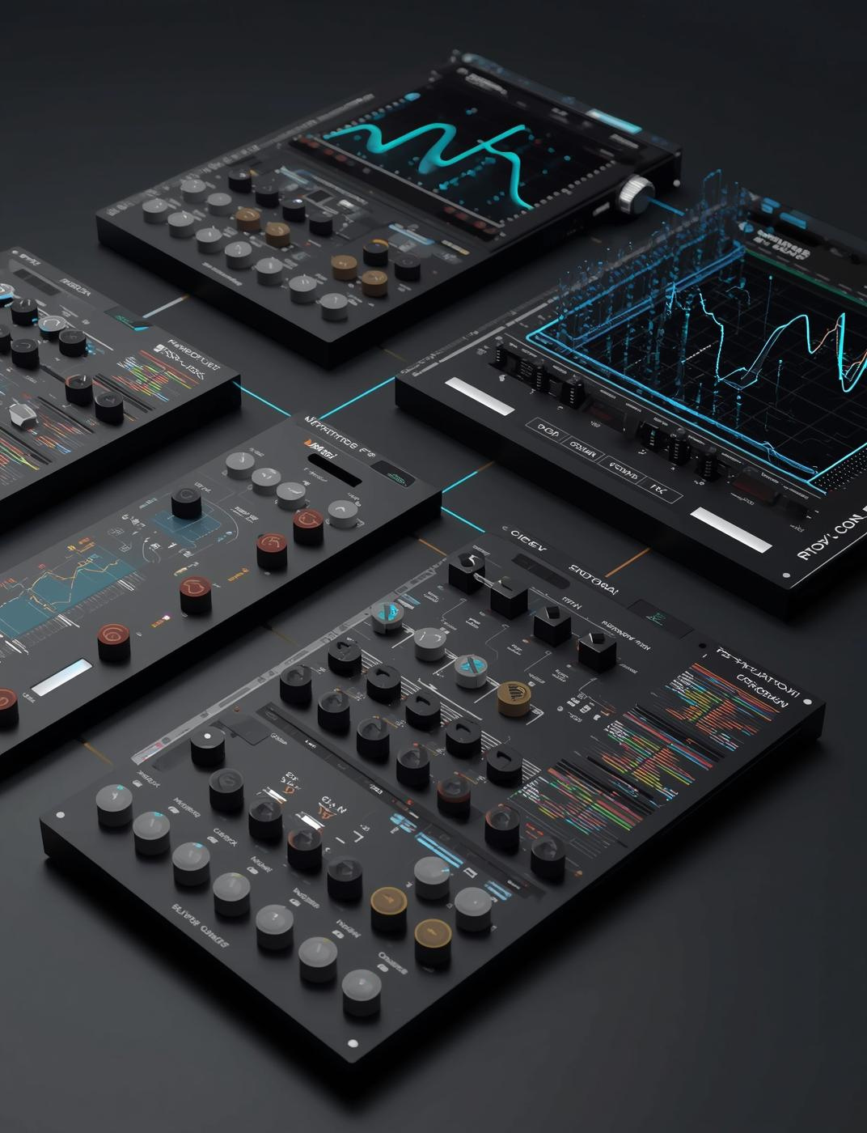
Feature Extraction
This section focuses on utilizing Mel-frequency cepstral coefficients (MFCC), pitch period, forments and spectrograms for effective speaker identification.
MFCC : for summarize voice characteristics.
Pitch Period : determines the pitch of a speaker.
Forments : refers to the resonance frequencies of the vocal tract.
Spectrograms : to represent the voice in a way that the computers can easily deals with.

Slide 7
Model Selection
WAV Record
Conversion
MFCC / spectrogram
DT/RF/SVM/XGBoost
Decision making
WAV Record
Conversion
PP/MFCC/Formants
SpeechBrain
Decision making
ML
Pre-
trained

Slide 8

Machin learning models
Decision Tree 🌲
Random Forest 🌲🌲🌲
What it is:
A Decision Tree is a model that makes decisions by asking a series of yes/no questions, like a flowchart.
How it works?
➢It starts at the root (first question).
➢Each question splits the data into branches.
➢At the end (leaf), it gives a final decision.
What it is:
A Random Forest is a group of many decision trees working together.
How it works?
➢Builds many different decision trees.
➢Each tree gives a prediction.
➢Final result = majority vote (classification) or average (regression).

Slide 9

Machin learning models
SVM (Support Vector Machine) 📏
XGBoost 🚀
What it is
SVM is a model that separates data using a line or boundary (called a hyperplane).
How it works
➢Finds the best separating line between classes.
➢Maximizes the margin (distance) between classes.
➢Can use kernels to separate complex data.
What it is:
XGBoost is an advanced version of decision trees, trained sequentially to fix previous mistakes.
How it works?
➢Builds trees one by one.
➢Each new tree focuses on correcting errors of the previous trees.
➢Uses optimization and regularization.

Slide 10

Future Work
In the future, this system can be further developed by platforms to enable remote control, real-time monitoring, and access management through mobile applications. Expanding the system to support multilingual voice commands and adaptive learning would also enhance its flexibility and usability in diverse environments.

