Slide 1

بسم الله الرحمن الرحيم
An-Najah National University Institute of Childhood Redesign
Prepared By: Supervisor : Eng. Mo’ayad Salhab
Yazan Shehab
Hadi Majjad
Ahmad Gabaren

Slide 2
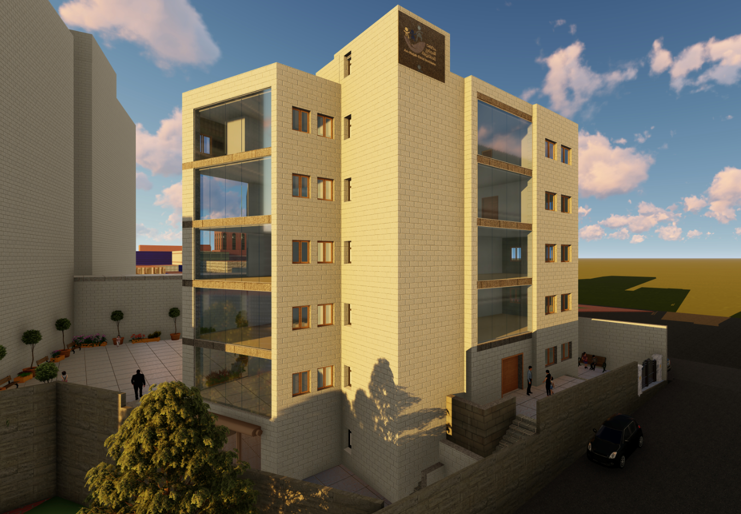
Outline:
1. Introduction.
2. Architectural Design.
3. Environmental Design.
4. Structural design.
5. Electrical design.
6. Mechanical design .
7. Quantity Survey.

Slide 3
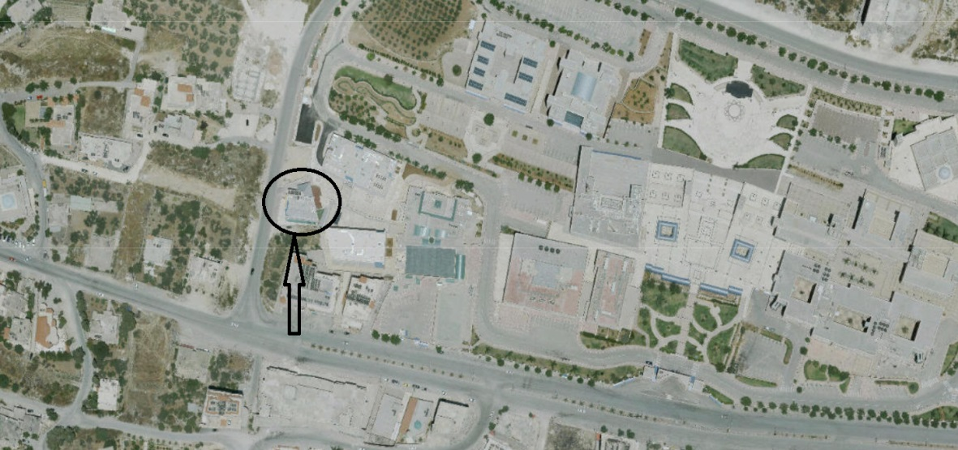
Site Location

Slide 4
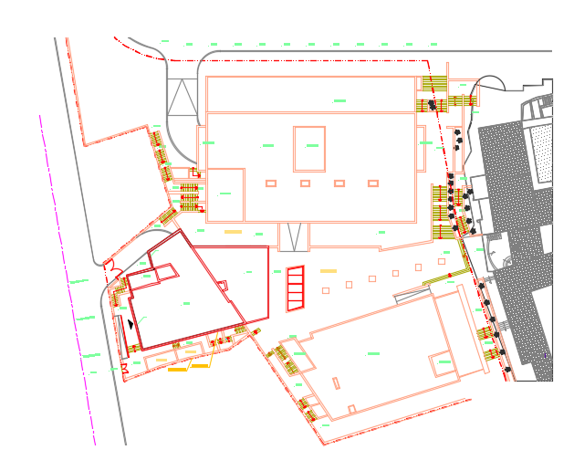
Site plan:

Slide 5
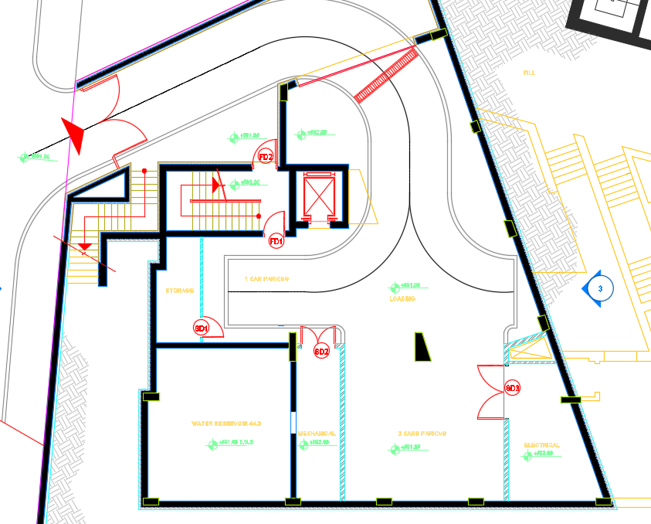
Architectural Design.
Basement Floor :
Total floor area : 335 ms
The floor contains:
2 parking areas and
1 loading area, electrical room
Mechanical room and the water
reservoir.
Before

Slide 6
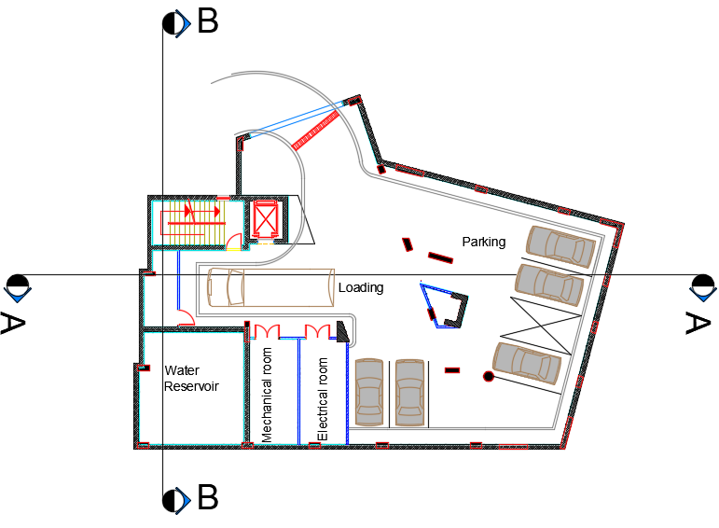
Architectural Design.
Basement Floor :
Total floor area : 490 ms
The floor contains:
5 parking areas and
1 loading area, electrical room
Mechanical room and the water
reservoir.
After

Slide 7
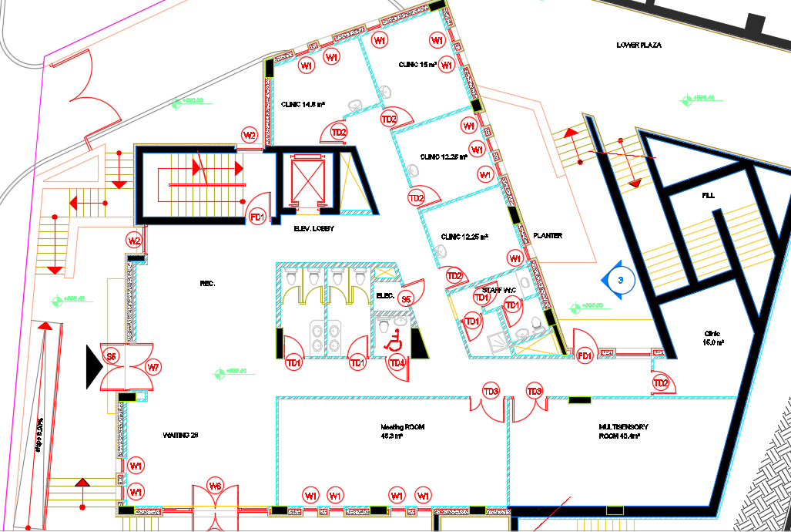
Architectural Design.
Ground Floor:
Total floor area : 335 ms
The floor contains:
4 clinics,
1 Meeting room, Multi-sensory
room, reception and
A waiting area.
Before

Slide 8
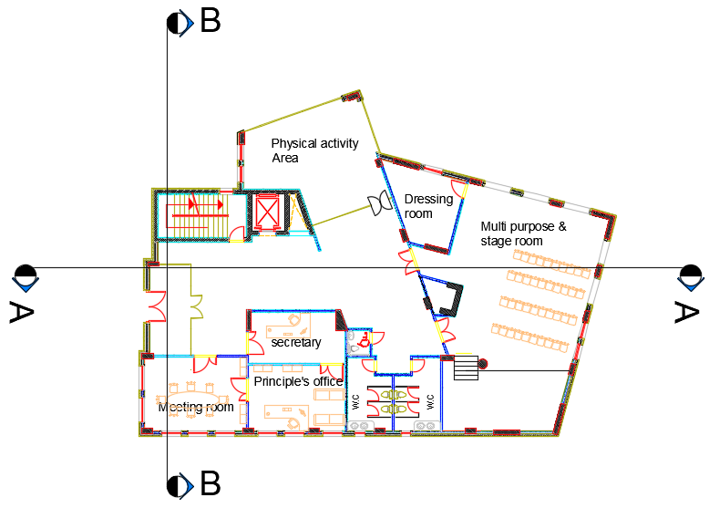
Architectural Design.
Ground Floor:
Total floor area : 490 ms
The floor contains:
Principle’s office and secretary,
1 Meeting room, Multi-purpose
room, and a physical activity area.
After

Slide 9
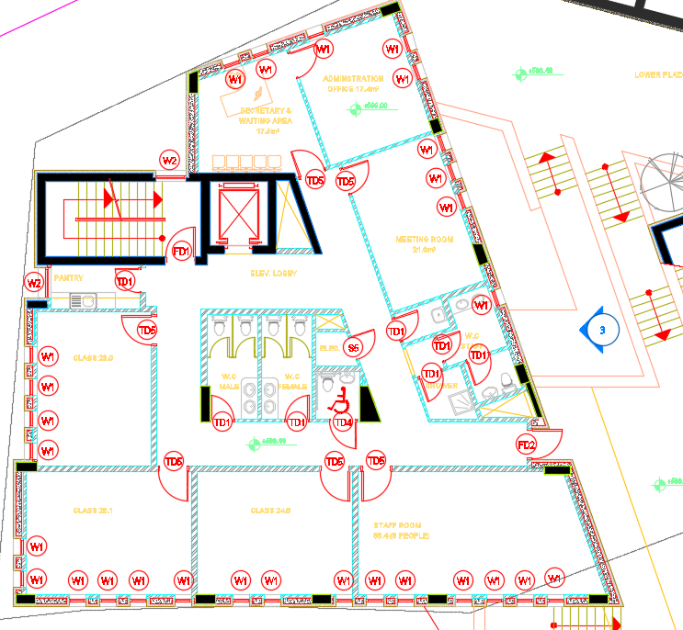
Architectural Design.
First Floor :
Total floor area : 335 ms
The floor contains:
4 classes,
1 Meeting room, secretary
room, and the principle's office
Before

Slide 10
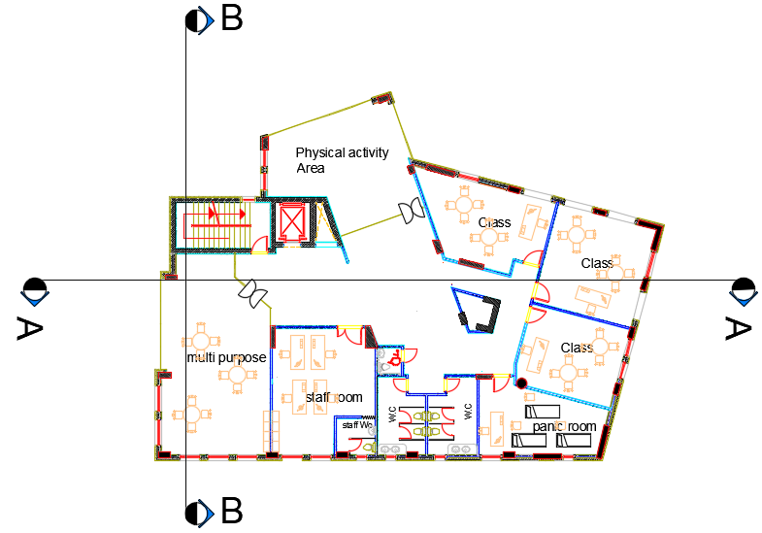
Architectural Design.
First Floor :
Total floor area : 490 ms
The floor contains:
3 classes,
panic room, staff room, physical activity
area and a multi purpose room.
After

Slide 11
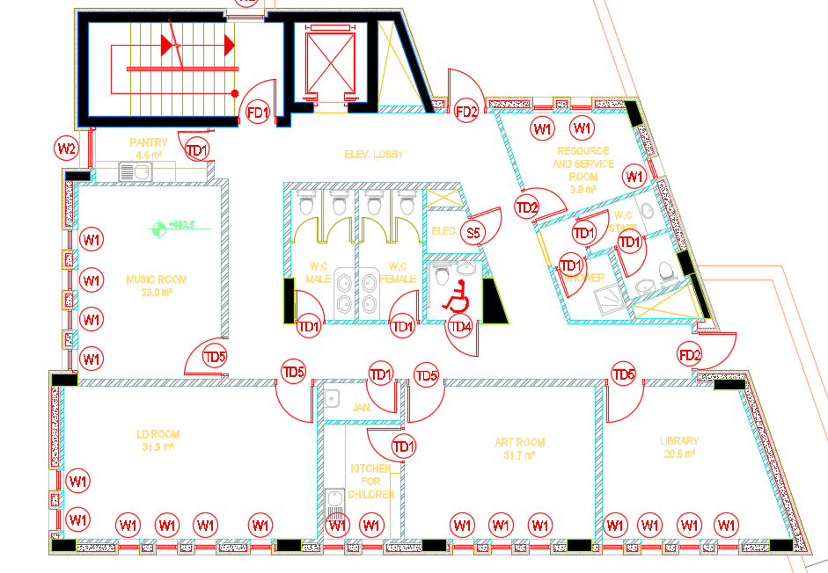
Architectural Design.
Second Floor :
Total floor area : 335 ms
The floor contains:
4 classes and 1 resources room.
Before

Slide 12
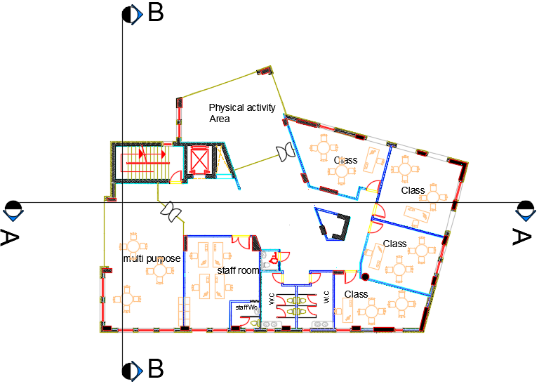
Architectural Design.
Second Floor :
Total floor area : 490 ms
The floor contains:
4 classes,
staff room, physical activity
area and a multi purpose room.
After

Slide 13
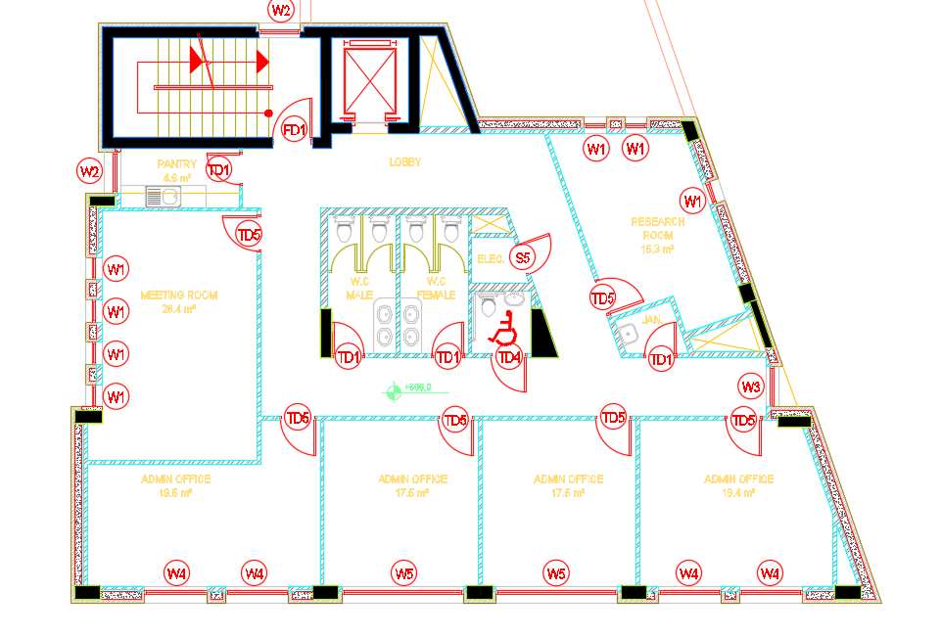
Architectural Design.
Third Floor:
Total floor area : 335 ms
The floor contains:
3 administration offices,
1 meeting room, institute
manager office and a research room.
Before

Slide 14
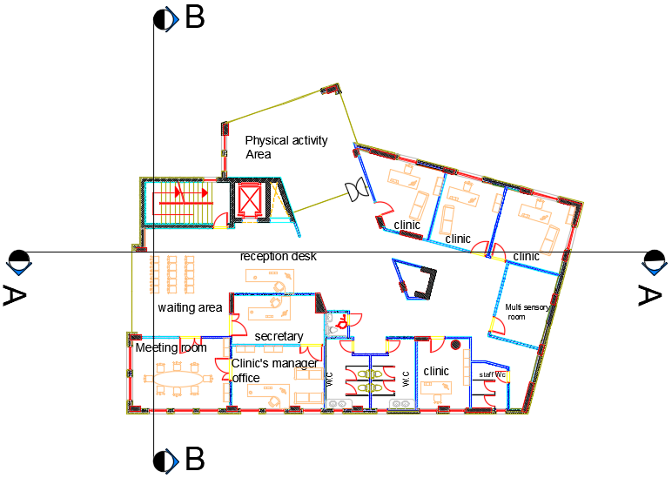
Architectural Design.
Third Floor:
Total floor area : 490 ms
The floor contains:
4 clinics,
1 Meeting room, multi-sensory
room, reception, waiting area,
secretary room and the clinic’s
manager office.
After

Slide 15
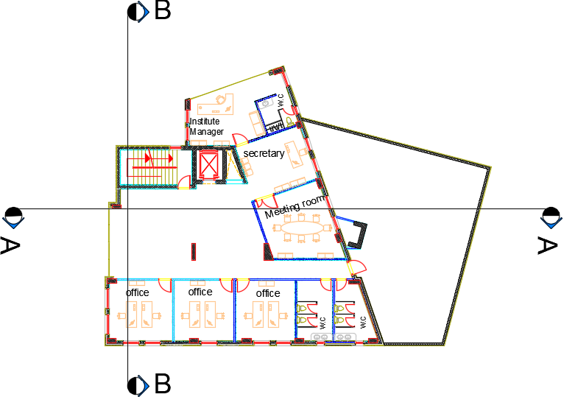
Architectural Design.
Fourth Floor:
Total floor area : 335 ms
The floor contains:
3 administration offices,
1 meeting room, institute
manager office and a secretary room.
After

Slide 16
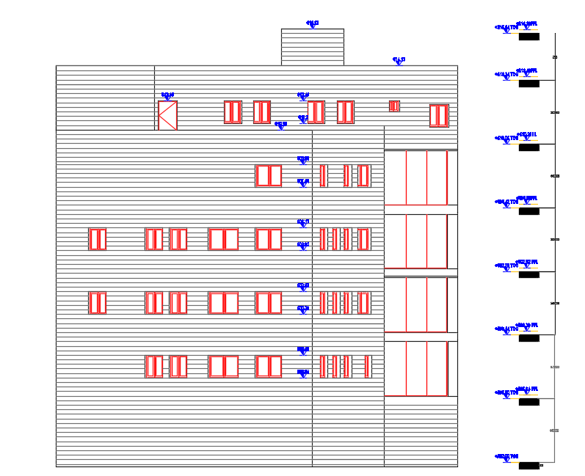
Architectural Design.
Elevations :
Eastern Elevation.

Slide 17
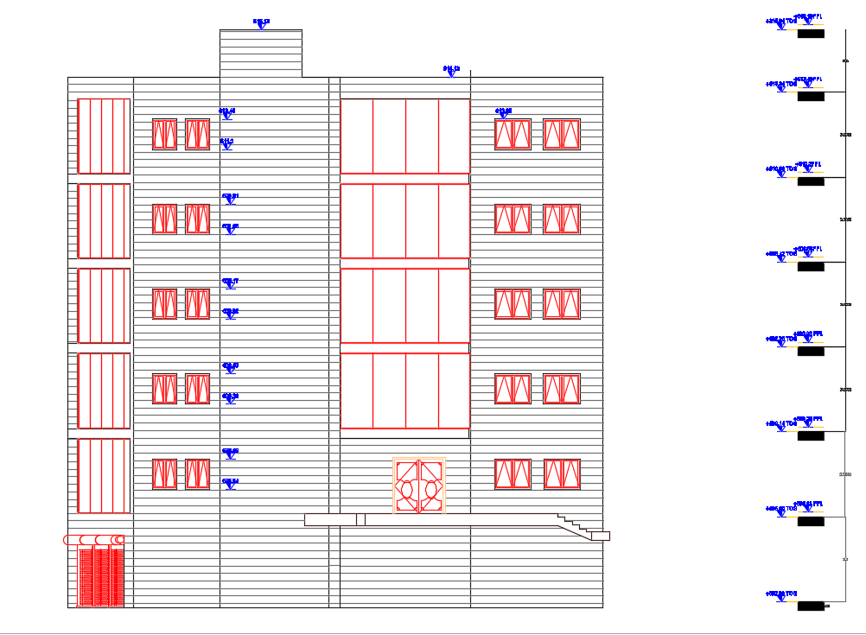
Architectural Design.
Western Elevation.

Slide 18
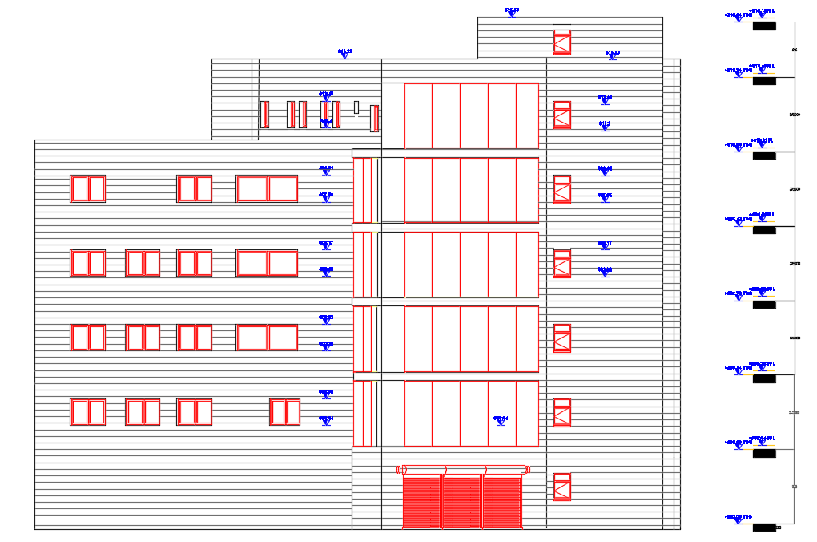
Architectural Design.
Northern Elevation.

Slide 19
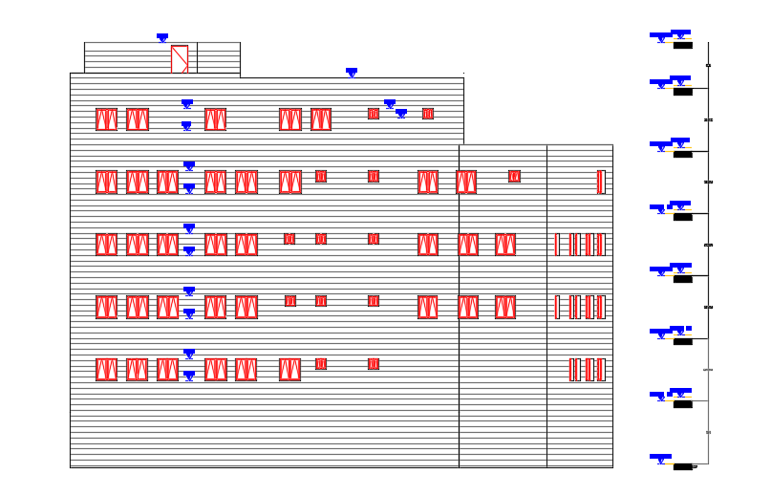
Architectural Design.
Southern Elevation.

Slide 20
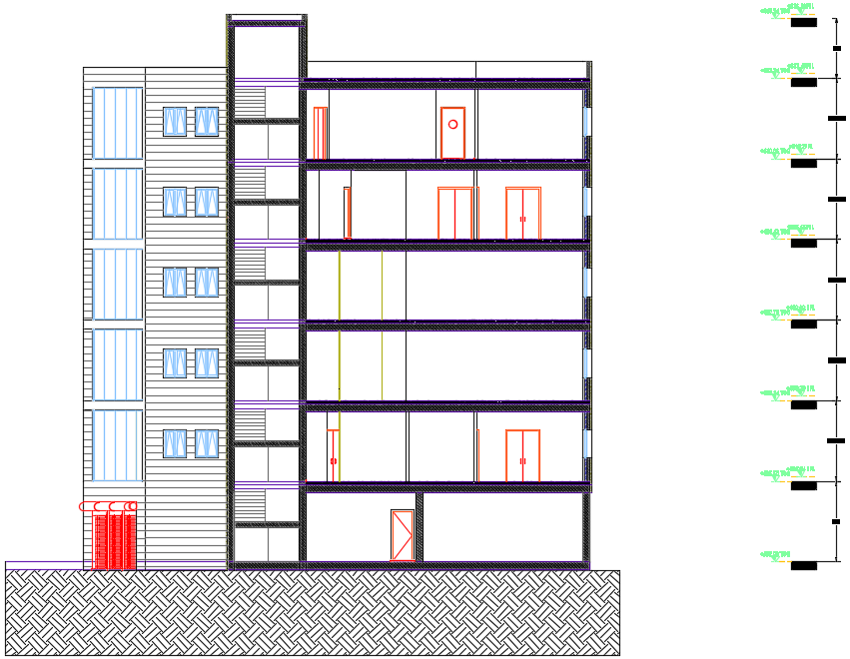
Architectural Design.
Sections :
Section A-A

Slide 21
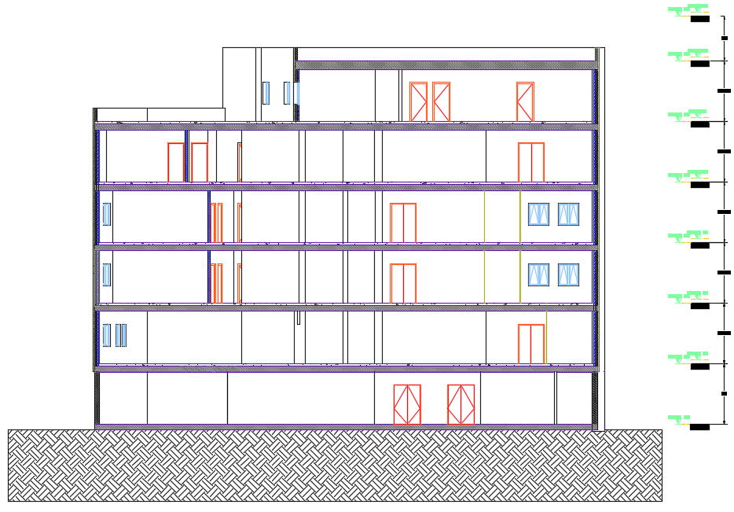
Architectural Design.
Sections :
Section B-B

Slide 22
Architectural Design.
Areas:
New Spaces
Recommended (m^2) | New design(m^2) | Old design(m^2) | space
32 | 36.3 | 26 | Class Room
40 | 40 | 35.4 | Staffroom
16 | 18.4 | 14.9 | Clinic Room
30 | 30.2 | 28.4 | Meeting Room
25 | 26.5 | 35 | Administration Area
Note | New spaces
The new design basement contains 5 car spaces | Multi-purpose Room
 | Small Auditorium
 | Physical Activity Areas
 | Panic Room
Direction
Notes | New Design | Old design | Space
Suitable | Northern East | Southern East | Class Room
Suitable | Northern East | Northern East | Clinics

Slide 23
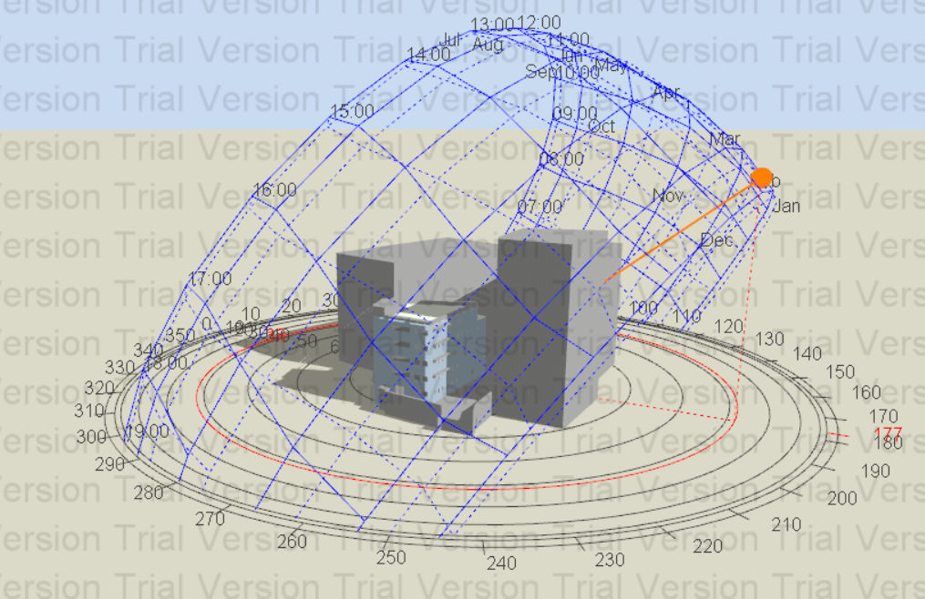
Environmental Design:
*Thermal Design
*Acoustical Design
*Day Light

Slide 24
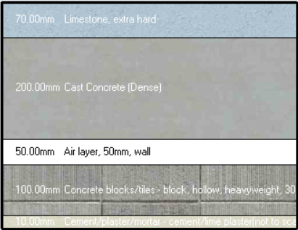
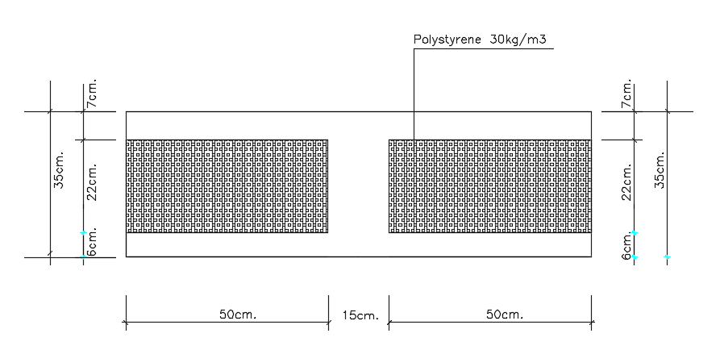
Thermal Design.
* U-Values for the old design:
External Wall : Ceiling :
0.17 w/m^2.k = U-Value =1.50 w/m^2.k U-Value

Slide 25
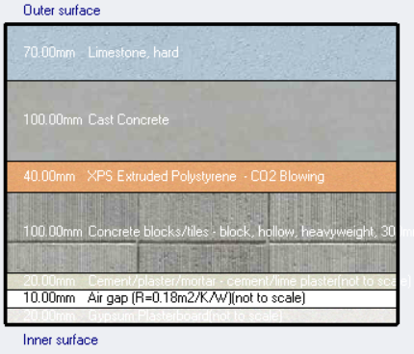
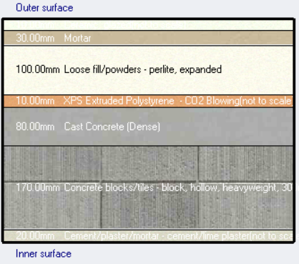
Thermal Design.
U-Values for the new design:
External Wall : Ceiling :
0.38 w/m^2.k = U-Value =0.54 w/m^2.k U-Value

Slide 26
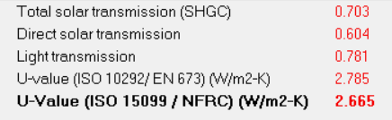
Thermal Design.
* U-Values for the old design:
Widows:
U-Value =2.66 w/m^2.k
* U-Values for the New design:
Widows:
U-Value =2.66 w/m^2.k

Slide 27
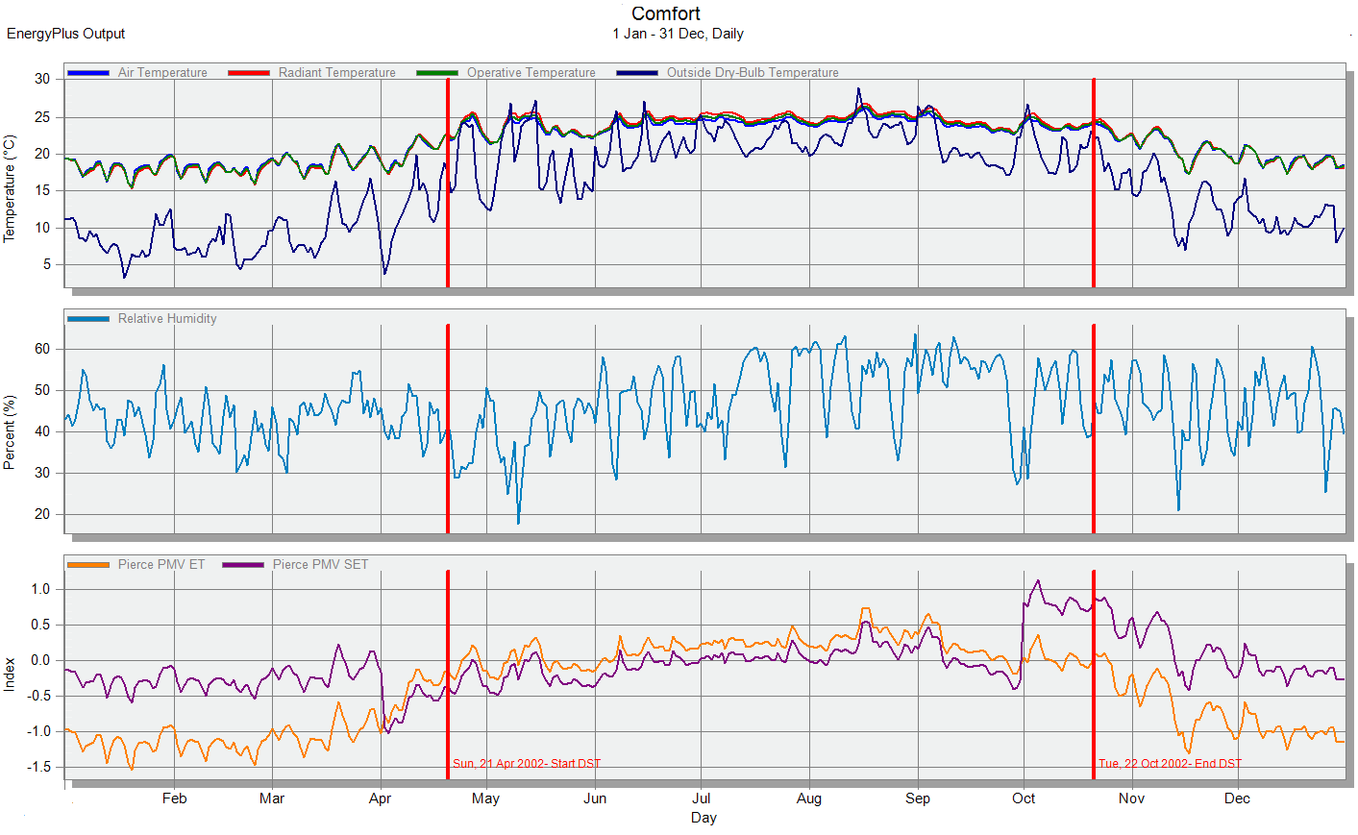
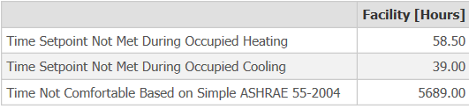
Thermal Design.
Comfort simulation for the old design:

Slide 28
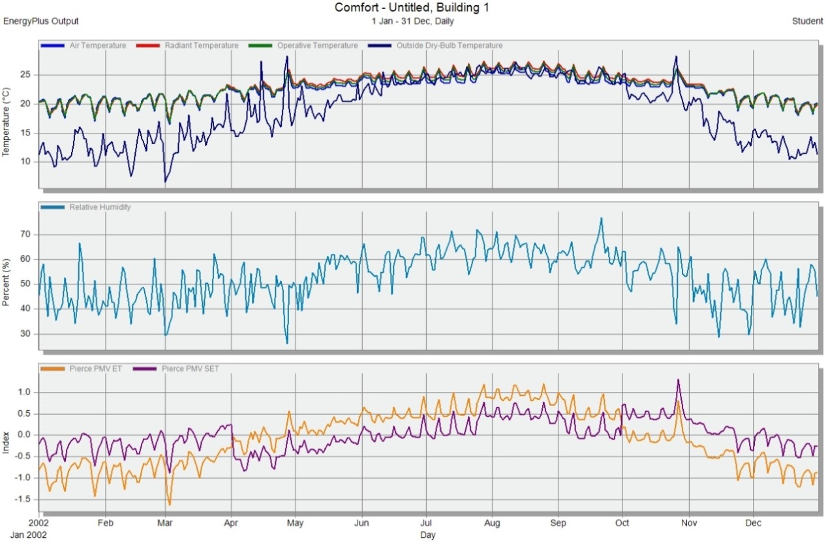
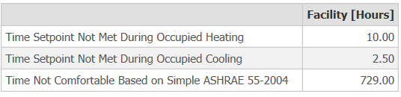
Thermal Design.
Comfort simulation for the new design:

Slide 29
Thermal Design.
New Design | Old Design
141.9 | 152.39 | Energy Per Total Building Area (KW.h/m^2/y)
729 | 5690 | Time not comfortable in the building per year (h)
160 | 180 | Conditioning system capacity (KW)
159.19 | 198.8 | Design Capacity (KW)
141.9 | 152.39 | Total Electricity Intensity (KW.h/m^2)

Slide 30
Thermal Design.
Shading:
Sun path and shadow on 21, Jan at 12:00 Pm.

Slide 31
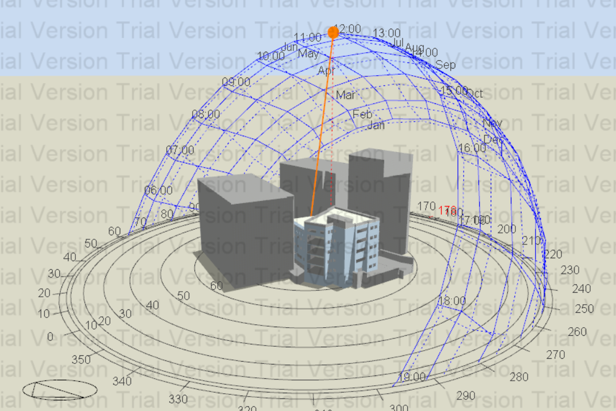
Thermal Design.
Shading:
Sun path and shadow on 21, Jul at 12:00 Pm.

Slide 32
Acoustical Design.
Reverberation Time (RT60):
Ecotect Software used for calculation of RT60. Five zones were taken into consideration

Slide 33
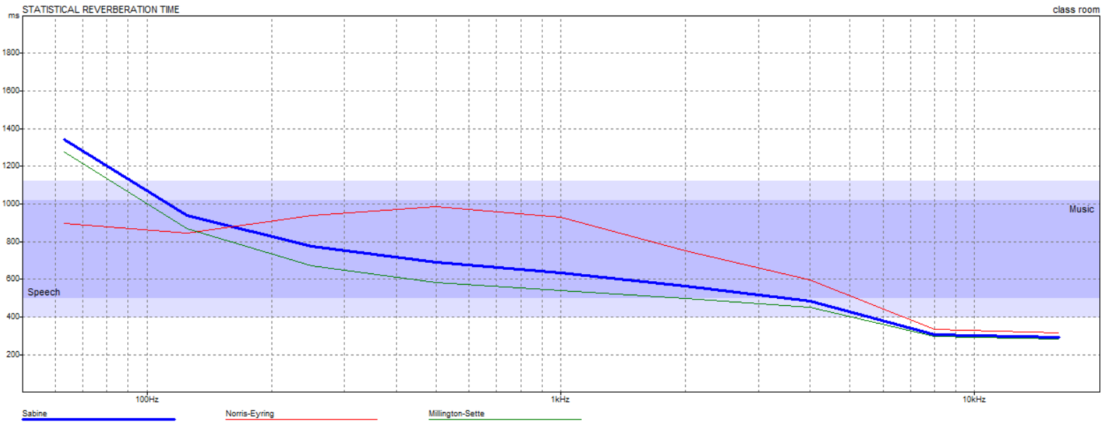
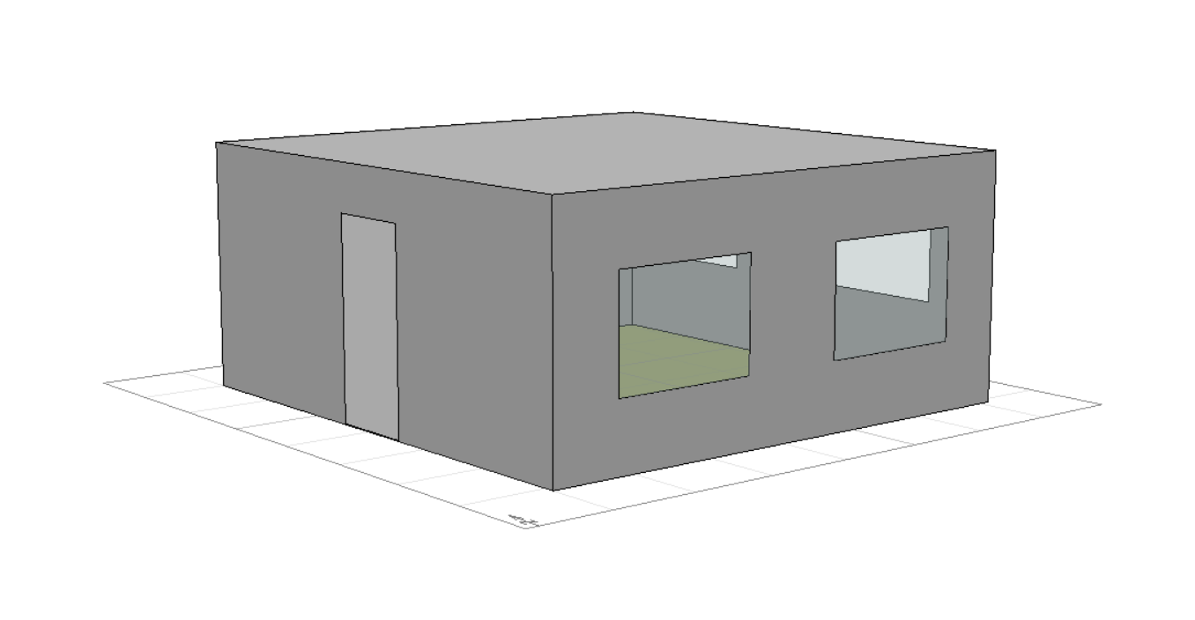
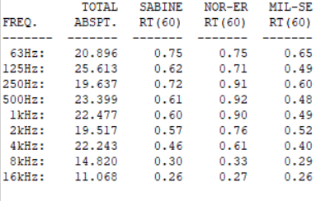
Acoustical Design.
Classroom:
RT60 (0.6-0.8).

Slide 34
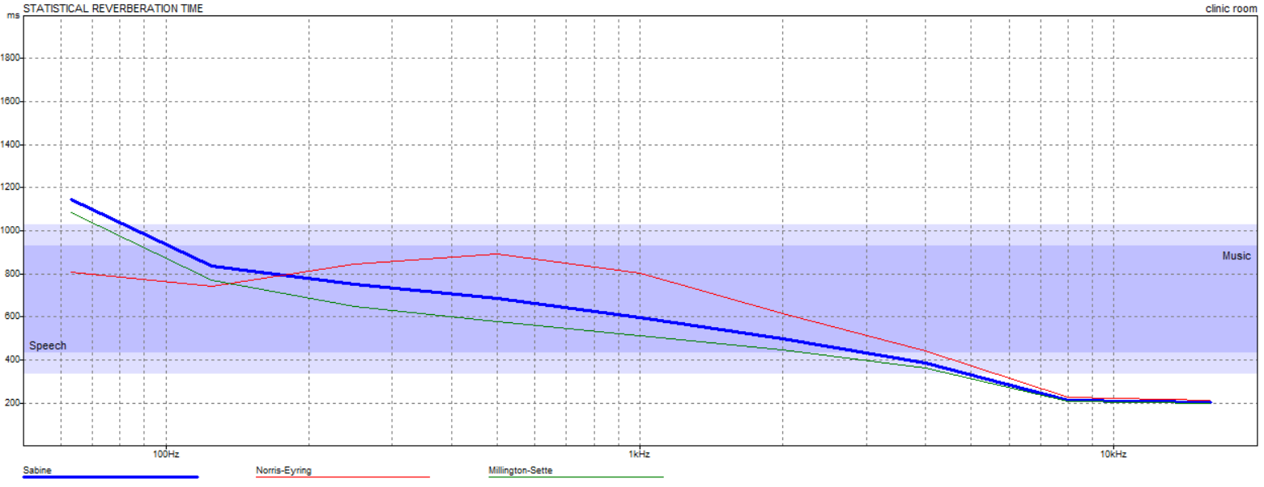
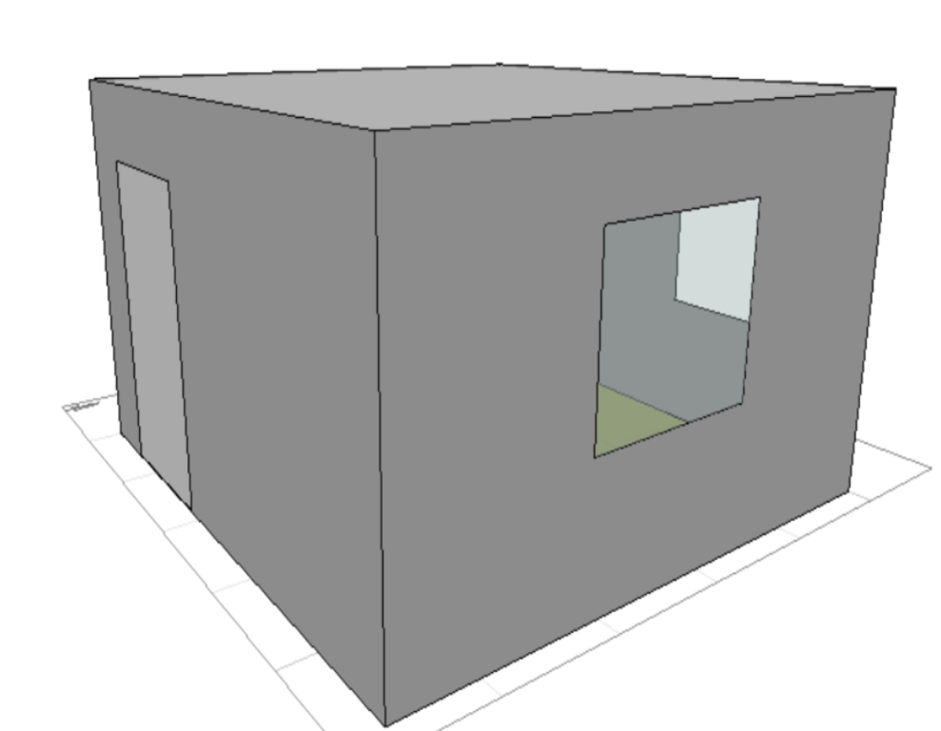
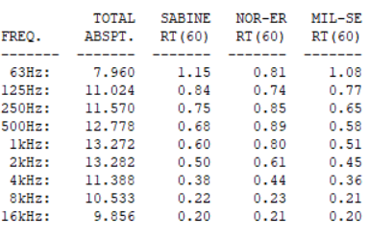
Acoustical Design.
Clinic room:
RT60 (0.6-0.8).

Slide 35
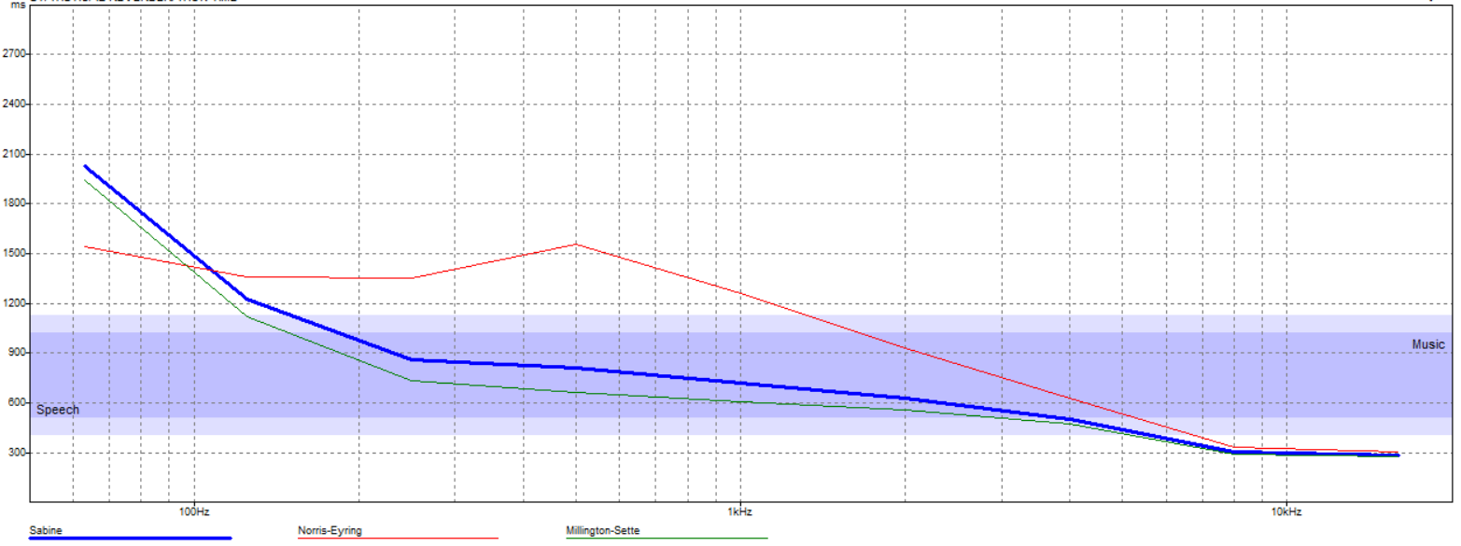
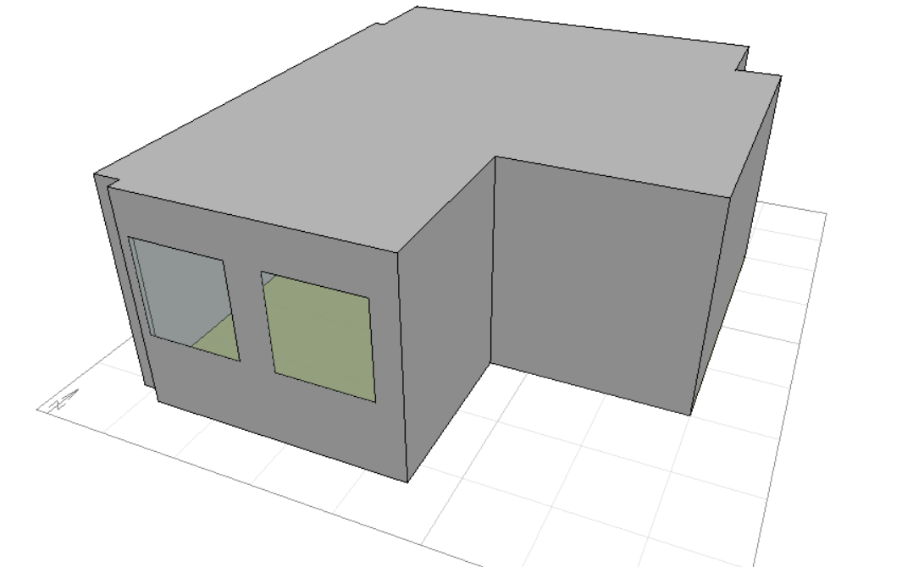
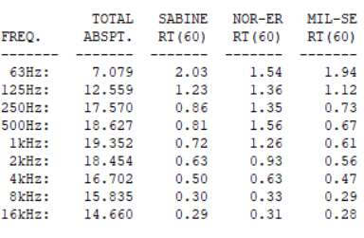
Acoustical Design.
Staff room:
RT60 (0.6-0.8).

Slide 36
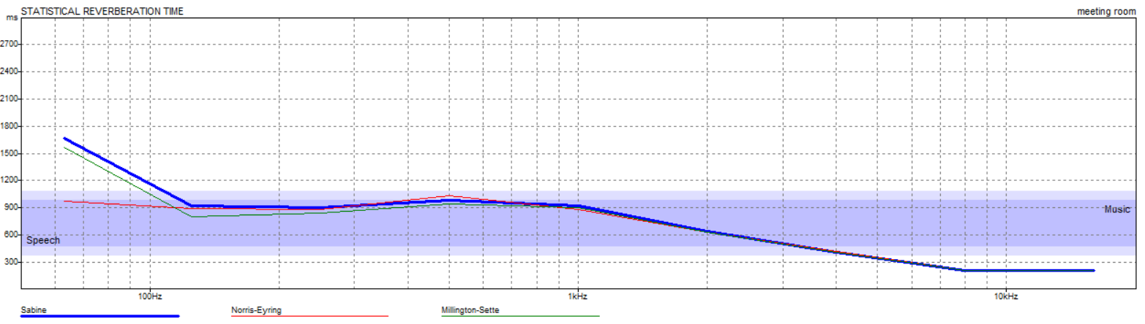
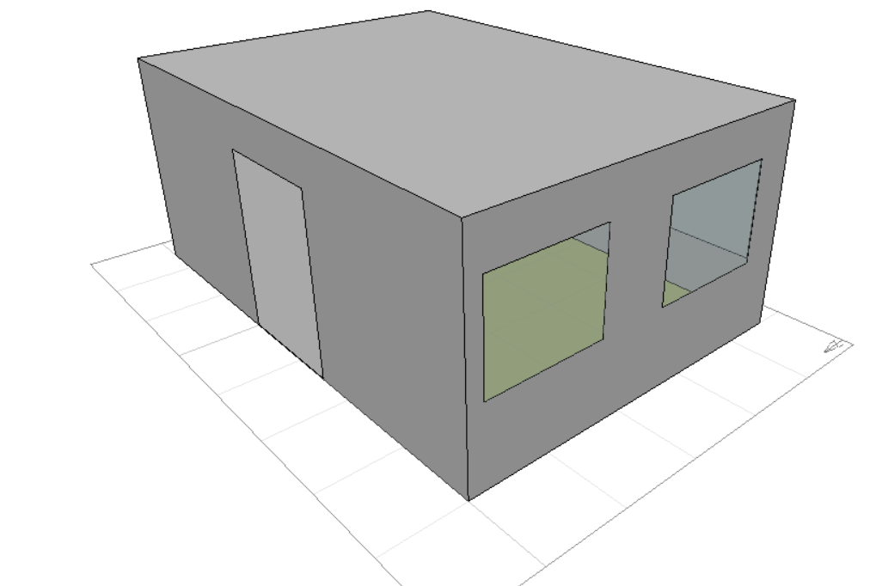
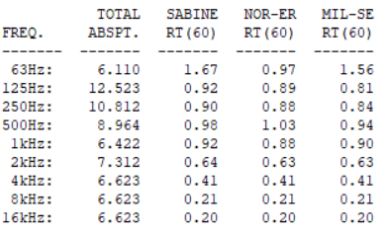
Acoustical Design.
Meeting room:
RT60 (0.9-1.1).

Slide 37
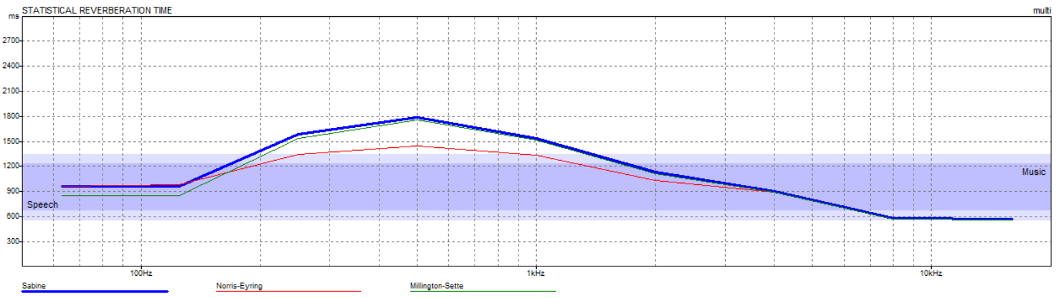
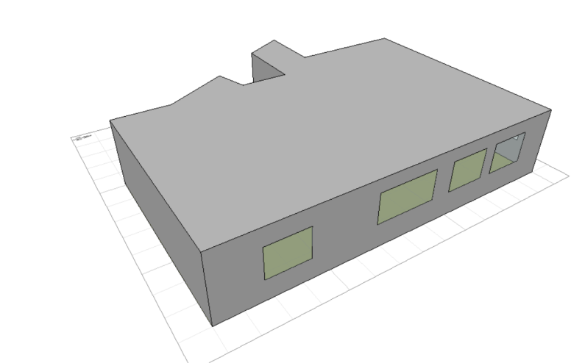
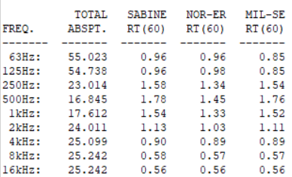
Acoustical Design.
Multi-purpose room:
RT60 (1.6-1.8).

Slide 38
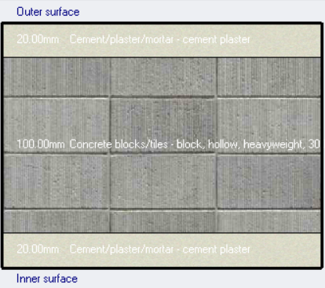
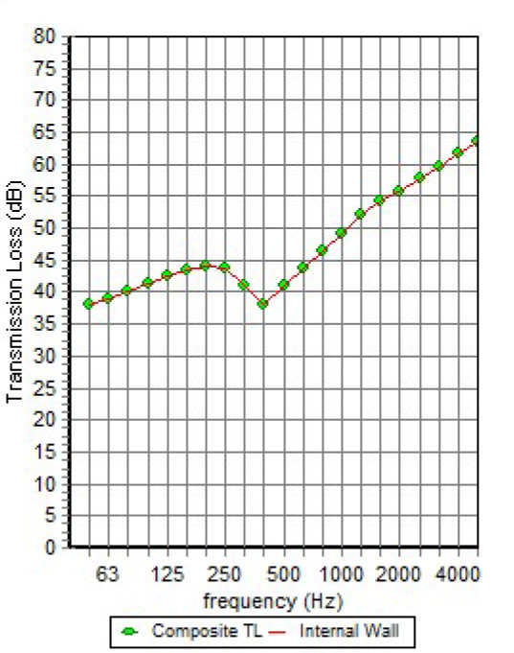
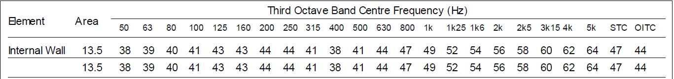
Acoustical Design.
Sound Transmission Class (STC):
Internal Wall:
The calculated value for the internal wall was 47 dB, larger than 38 dB this mean it is good.

Slide 39
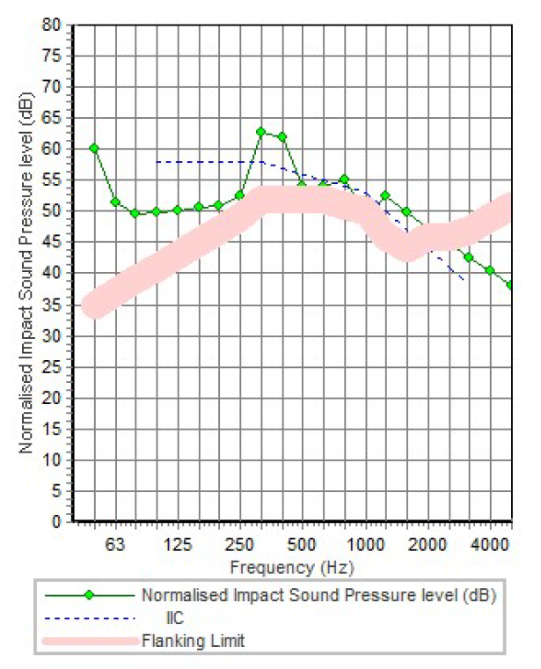

Acoustical Design.
Impact Insulation Class (IIC):
Roof:
The calculated value for the Roof was 54 dB, larger than 40 dB this mean it is good.

Slide 40


Acoustical Design.
Sound Transmission Class (STC):
External Wall For Class Room:
The calculated value for the external wall was 40 dB, equals 40 dB this mean it is good.

Slide 41
Acoustical Design.
Existing Value | Normal Value | Adjacent Area | Spaces
40 | 40 | Class Room | Class Room
45 | 45 | Clinic Room | Clinic Room
40 | 40 | Corridor , Lobby | Meeting Room
42 | 38 | Corridor , Lobby | Staff Room
40 | 40 | Corridor , Lobby | Multi-purpose Room

Slide 42


Day Light
Day light factor for the old design:

Slide 43


Day Light
Day light factor for the new design:

Slide 44
Structural Design
Old system
One way voided slab with 350mm thickness & two way solid slab with 200 mm thickness.
New system
One way ribbed slab with 350mm thickness.

Slide 45

Structural Design
Codes and Standards:
ACI 318-14 for reinforced concrete design.
UBC-97 for seismic design and load combinations.
Materials :
Property | Value
B300 Concrete Compressive Strength${f′}_{c}$ | 24 MPa
B300 Modulus of Elasticity, $4700\sqrt{f_{c}^{′}}$ | 23025 MPa
B350 Concrete Compressive Strength${f′}_{c}$ | 28 MPa
B350 Modulus of Elasticity, $4700\sqrt{f_{c}^{′}}$ | 24870 MPa
ASTM A955 Grade 60 | 420 MPa

Slide 46
Structural Design
Loads :
Dead load.
Super imposed dead load =4 kN/m².
Live load = 4 kN/m².
For external walls load = 18 kN /m.

Slide 47

Structural Design
Lateral loads:
Nablus City.
Seismic zone is 2B (z=0.2)
Soil profile is S_{B}
Acceleration seismic coefficients, Ca=0.2
Velocity seismic coefficients, Cv= 0.2
Importance factor, I=1.25
Force reduction factor, R=5.5

Slide 48

Structural Design
Checks:
Compatibility check.

Slide 49
Structural Design
Checks:
2. Equilibrium check.
 | Hand | ETABS | Error% | Ok?
Live load | 3200 | 3144 | 1.7% | ok
SID | 4884 | 4857 | 0.5% | ok
DL | 8466.8 | 8402 | 0.7% | ok

Slide 50
Structural Design
Checks:
3. Internal forces check.
All columns, beams and slab that checked are Ok.
Base shear check.
V manual = 1500
Vx =1511kN > 1500 kN ➔ Ok.
Vy= 1506 kN > 1500 kN ➔ Ok.

Slide 51

Structural Design
Checks:
5. Model masse participation ratio check.

Slide 52
Structural Design
Checks:
6. Time period check.
period from ETABS = 0.63 sec. , period from hand calc.= 0.45sec
T from ETABS <= 1.40 period from hand calc. ➔ Ok.

Slide 53
Structural Design
Checks:
7. Deflection Check.
Gravity Check: The allowable deflection value in largest span 4.3/ 240 = 18 mm
The maximum deflection value from ETABs = 4 mm ➔ Ok.
Drift Check: from ETABS ∆S = 5.5 mm
∆M = 0.7*R*∆S = 0.7*5.5*5.5 = 25 mm
Code required that ∆M value must be lower than this value ∆M= 0.025 * h story = 0.025 * 3.5 = 87.5mm
25 mm < 87.5 mm ➔ Ok.

Slide 54

Structural Design
Basement floor beams distributions :

Slide 55

Structural Design
Typical floor beams distributions :

Slide 56



Structural Design
New design slab section
Old design slab section

Slide 57

Structural Design
Beams Reinforcement table:

Slide 58




Structural Design
Beams Reinforcement:

Slide 59

Structural Design
Columns Reinforcement table:

Slide 60

Structural Design
Columns Reinforcement:

Slide 61

Structural Design
Footing Layout:

Slide 62


Structural Design
Footing Sections:

Slide 63


Structural Design
Footing Sections:

Slide 64

Structural Design
Retaining wall Sections:

Slide 65

Structural Design
Shear wall Section:

Slide 66

Structural Design
Water tank reinforcement:

Slide 67

Structural Design
Water tank reinforcement section D-D:

Slide 68

Structural Design
Water tank reinforcement section B-B:

Slide 69

Structural Design
Water tank reinforcement section C-C:

Slide 70


Structural Design
Stairs reinforcement:

Slide 71


Structural Design
Old Block Check:
Old Block Compatibility Check
Old Block Columns Check

Slide 72


Structural Design
Old Block Check:
Old Block Period Check
Old Block Columns Check

Slide 73

Structural Design
Old Block footing Check:
Moment capacity for the footing = 1655 KN.m/m
Pu on the footing = 5620 KN
Moment acting on the footing = 670 KN.m/m
670 > 1655 ➔ OK
ØVc for the footing = 7605 kN.
Vu.p acting on the footing = 3447 kN.
the footings will be able to carry the added floor above the building.

Slide 74
Structural Design
Structural Break Calculations:
From ETABS ∆S1 = 5 mm
∆M1 = 0.7*R*∆S1 = 0.7*5.5*5 = 23 mm
∆S2 = 5.5 mm
∆M2 = 0.7*R*∆S2 = 0.7*6.5*5.5 = 25 mm
∆MT = ((∆M1)^2 + (∆M1)^2)^1/2
= ((23)^2 + (25)^2)^1/2 = 34 mm ➔ use ∆MT = 50 mm = 5 cm

Slide 75
Electrical Design.
Loud Speakers System.
Lighting Arrangement.
Sockets Arrangement.

Slide 76



Electrical Systems
Loud Speakers:
Bose Free Space DS 40F In-Ceiling Loudspeaker was used.
Distribution for the speakers in the Ground Floor
Distribution for the speakers in the First Floor

Slide 77

Lighting design
A simulation using Dialux evo software was made to achieve a comfortable lighting design.

Slide 78

Lighting Design

Slide 79

Lighting Design

Slide 80

Lighting Design

Slide 81


Lighting Design

Slide 82


Lighting Design

Slide 83


Lighting Design

Slide 84


Lighting Design

Slide 85


Lighting Arrangement:
Basement Floor
Ground Floor

Slide 86
Lighting Arrangement:
All units were used in the building are LED units.
Unit Number on plans | Unit description
1 | Philips 37.5 watt unit
2 | Dizzano 36 watt unit
3 | Philips 21.5 watt unit
4 | Philips 12 watt unit
Lighting arrangement plan’s legend

Slide 87

Sockets and Switches Arrangement:
Ground Floor sockets and switches arrangement

Slide 88

Sockets and Switches Arrangement:
First Floor
Second Floor

Slide 89


Electrical System.
Sockets and Switches Arrangement:
Third Floor
Roof

Slide 90
Elevators
The elevator used In the old design is suitable so it remained the same.
3500/400 | 3500/350 | 3000/400 | 3000/350 | 2500/400 | 2500/350
19 | 19 | 16 | 16 | 13 | 13 | P
94 | 97 | 88 | 91 | 75 | 78 | RT
60 | 58.7 | 54.5 | 52.7 | 52 | 50 | hc
0.2 | 0.2 | 0.22 | 0.23 | 0.23 | 0.24 | N
1 | 1 | 1 | 1 | 1 | 1 | N'

Slide 91

Water Supply distribution
Diameter for hot water | Diameter for cold water | Pipe
2 inch | 2 inch | Vertical
1 inch | 1.5 inch | Horizontal
3/4 inch | 3/4 inch | Branch
Water supply system for fourth floor

Slide 92

Water Supply distribution
Diameter for hot water | Diameter for cold water | Pipe
2 inch | 2 inch | Vertical
1 inch | 1.5 inch | Horizontal
1/2 inch | 1/2 inch | Branch
Water supply system for 3rd floor

Slide 93

Water Supply distribution
Diameter for hot water | Diameter for cold water | Pipe
2 inch | 2 inch | Vertical
1 inch | 1.5 inch | Horizontal
1/2 inch | 1/2 inch | Branch
Water supply system for ground,1st and 2nd floor

Slide 94

Drainage system
Diameter | DFu | Fixture
4" | 4 | W.C
2" | 1 | Lavatory
2" | 2 | Kitchen sink
4" | 111 | Stack
Drainage system for ground floor

Slide 95


Drainage system
Drainage system for 1st, 2nd and 3rd floors
Drainage system for 4th floor

Slide 96

Drainage system
Drainage system for 4th floor

Slide 97

Drainage system
Drainage system for one stack

Slide 98


Hvac System
VRF system was used
for all building rooms.
Main component of VRF
system is:
1- Outdoor unit.
2- BC controllers.
3- Pipes.
4- Cassette Unit.
Outdoor Unit
BC Controller

Slide 99

Hvac System
Hvac design:
Cooling load for building = 159.19 KW
Chose System capacity = 160 KW = 2 units * 80 KW
All units was selected from Mitsubishi Company.
Indoor Unit

Slide 100


Hvac System
Indoor units in the ground floor

Slide 101




Safety Design
1-Hose Station:
2-Sprinklers system:
3-Smoke detectors and fire alarming systems:
4-Emergency Exit Signs and escape roots:

Slide 102

Distribution of fire suppression system in ground floor:
Smoke detectors
Sprinklers
Hose Station

Slide 103

Means of Egress in ground floor
Emergency Exit Signs

Slide 104

Reflected ceiling for ground floor

Slide 105

Reflected ceiling for ground floor

Slide 106
Cost Estimation
Work type | Cost (Nis)
Structural | 2,009,005
Finishing | 1,991,885
Mechanical | 930,260
Electrical | 144,840
Total Cost | 5,075,990
Unit Cost | 1,803.32

Slide 107
Thanks for Listening

