Slide 1

Sana Application
Presented by: Shahd Zabade
Zahra Abu Zahra
Supervisor: Dr.Anas Toma

Slide 2
Outline
Name Inspiration
Introduction
Problem
Sana Application
  Features
  Technologies & Tools
  Components
Constraints
Future work

Slide 3
Name inspiration
Main objective: Helping users to choose the best products
Sana «سنا»:
  An Arabic word
  Mentioned in the Holy Quran
  Means the flash or the bright light that leads in the darkness
Sana application: Leads to the truth in a time where you can not believe every thing you see or hear on social media

Slide 4
Introduction: Sana Application
An IOS application .
Facilitates the search for a certain product
  makes it faster and simpler through several features
Helps both customers and business owners

Slide 5
Problem
An increased number of online offers for the same product
  Long search time for more information and for the best offer
Some of companies use social influencers to market their products
  Giving fake reviews

Slide 6
Problem
An increased number of online offers for the same product
  Long search time for more information and for the best offer
Some of companies use social influencers to market their products
  Giving fake reviews
Solution: An application that provides detailed information about products and lets them share their experience and exchange reviews.

Slide 7
Features
Registration using Email or Facebook.
Users can search for a certain product visually.
Users can get products review analysis.
Users can add posts , comments and reactions.
Users can add products to favorite.

Slide 8
Features cont.
6. Products provider can upload products manually or
Directly from their Facebook account.
Products provider can add story.
Dealing with map system.
Notification system.

Slide 9






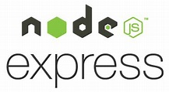





Technologies & Tools
Swift
Swift UI
Xcode
REST API
Python
VS Code
Create ml
Core ml
Firebase
Map kit

Slide 10
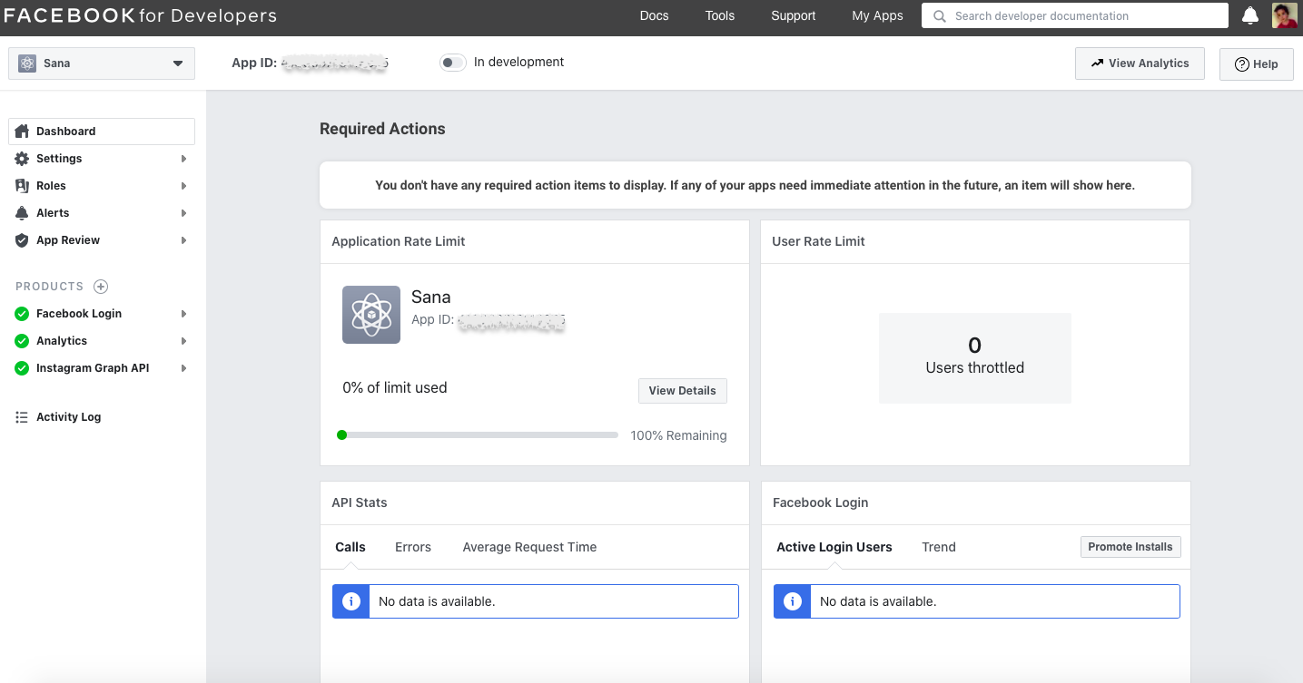
Components
Collecting products from product providers
- Facebook SDK for IOS.
1- Facebook Login is used .
2- Graph API is used.

Slide 11
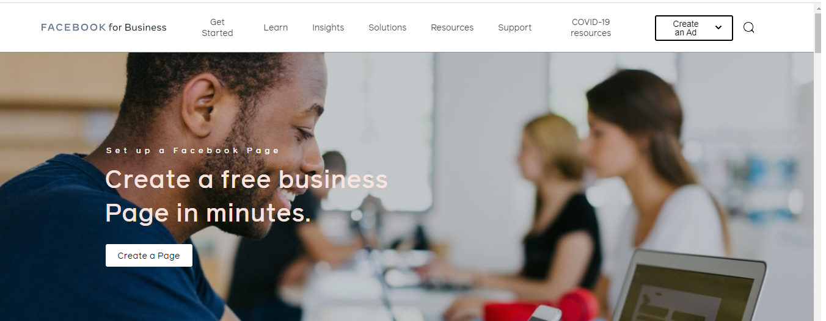
The business owner must have a business account on our application and have a Facebook page in which he can add products.

Slide 12
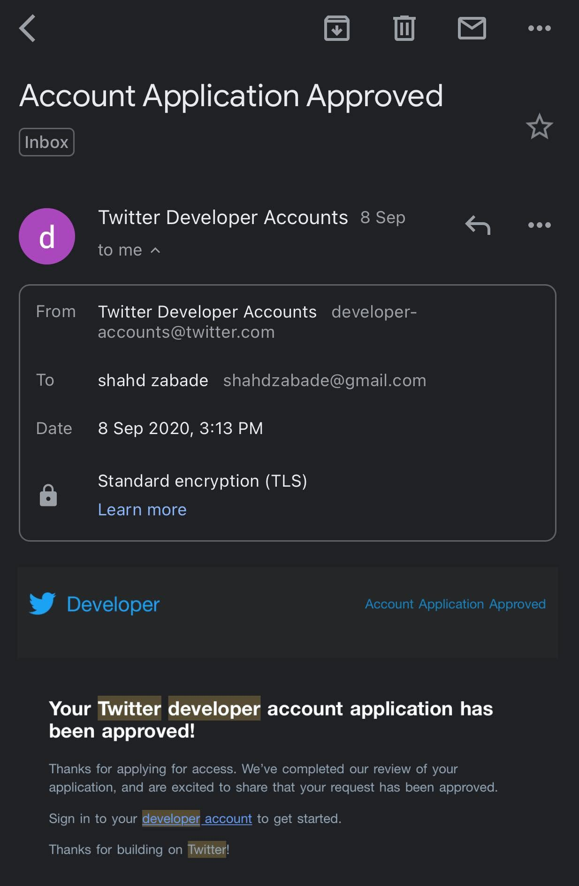
Collecting reviews from Twitter
- Twitter developer account was requested.
- Tweepy (is a Python library for accessing the Twitter API) was used to collect the data.
-Searching by product brand ,product name and
search_label (product brand+name).

Slide 13

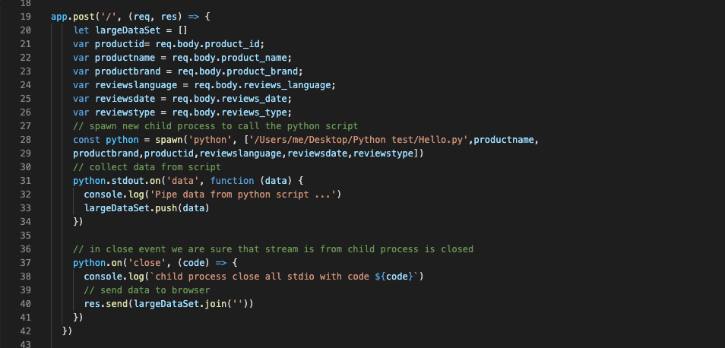
Collecting reviews from Twitter cont.
-The language,type,date of
tweets are determined
dynamically.
-The file of reviews was stored
in database as Blob.
-child process was used to
run python script in node js.

Slide 14
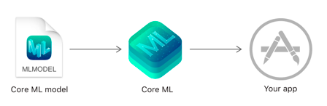
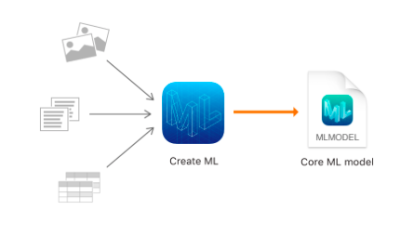
Core ML Create ML

Slide 15
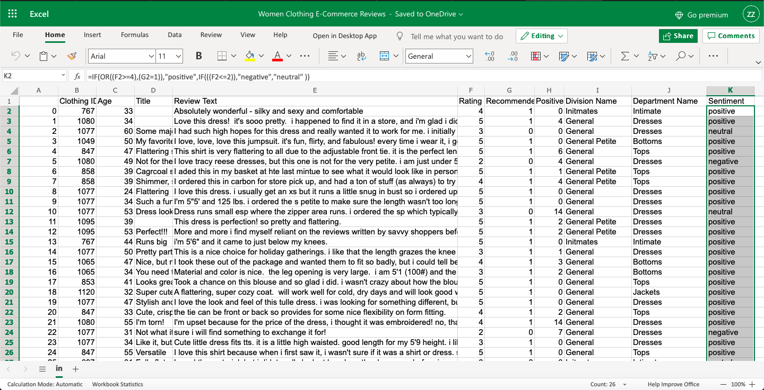
Building our sentiment analysis model only by using Create
ML Framework and a Playground.
-Reviews from Kaggle
that contains more than
23000 records.
-A simple logical function
Was applied in Excel to
classify the reviews into
positive , negative and
neutral.

Slide 16
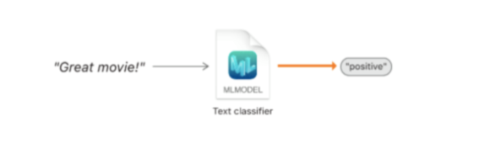
Training the model
- Model trainer called MLTextClassifier was chosen which supports 57 language including Arabic.
- Maximum Entropy algorithm was chosen.

Slide 17
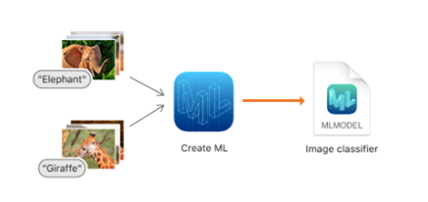
Building image classification model using Create ML App
- Data Set was gathered from Kaggle that contains 3000 pictures,
distributed in different types.

Slide 18
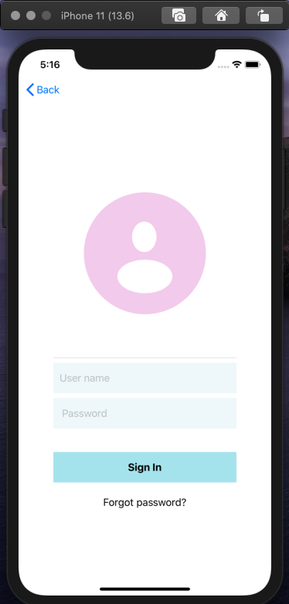
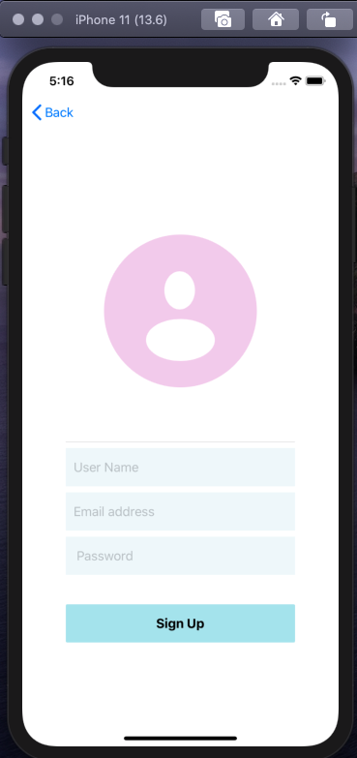
Sign up , Log in
-Registration by entering User Name, Email address, Password).
-log in by entering user name and password.

Slide 19
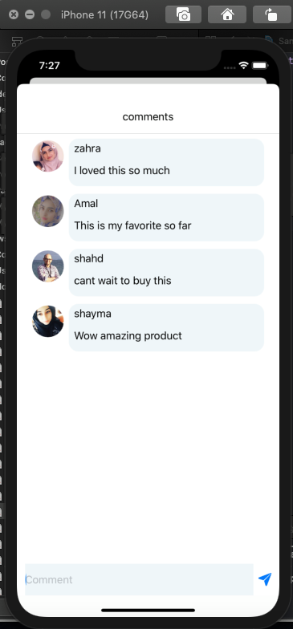
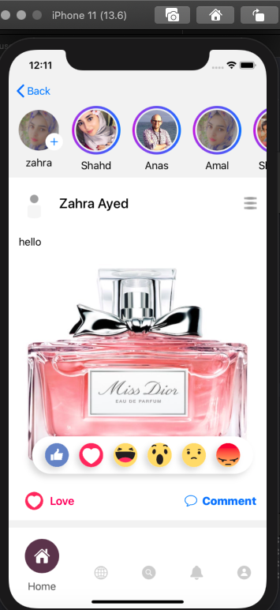
-Adding a post
-Adding reaction
-Adding a comment.

Slide 20
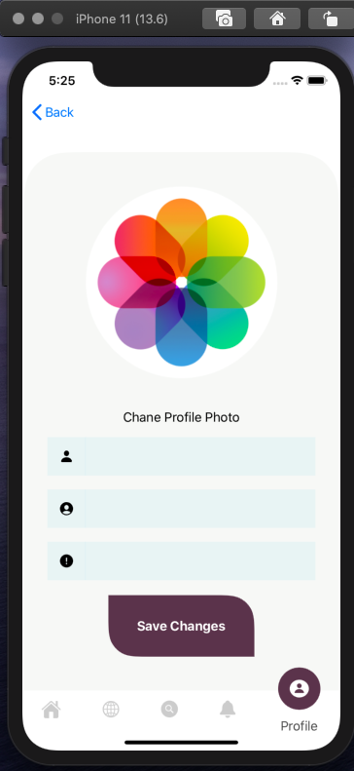
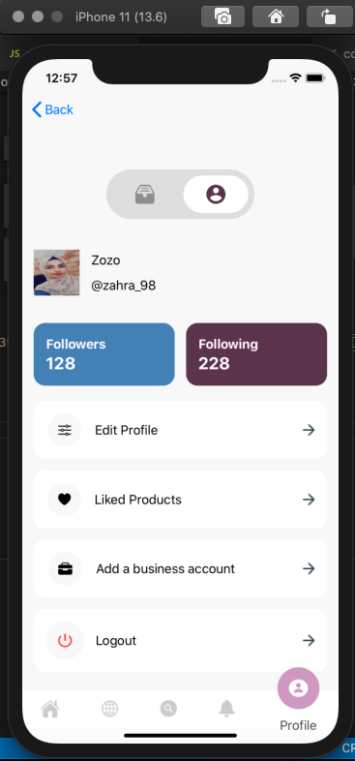
User profile
•Editing the profile.
•Showing liked products.
•Adding a business
account.

Slide 21
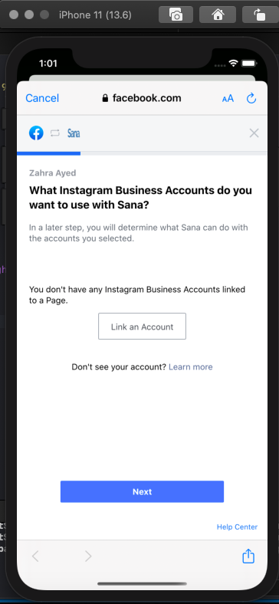
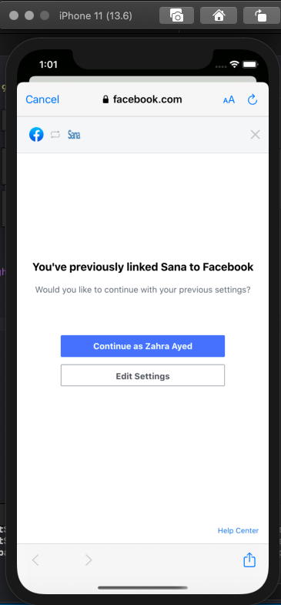
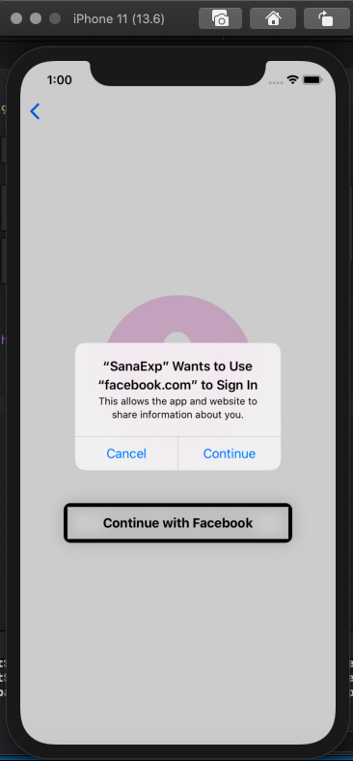
Creating a Business account.

Slide 22
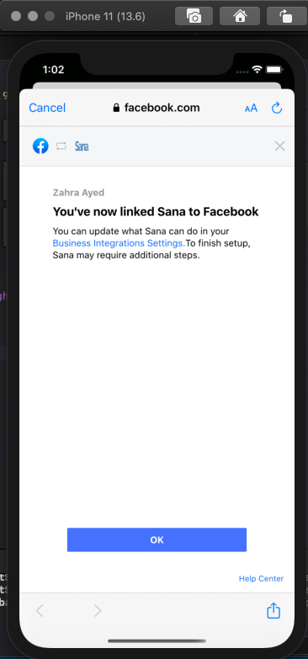
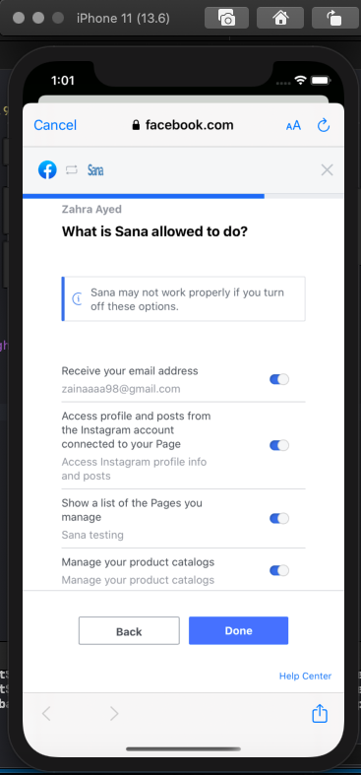
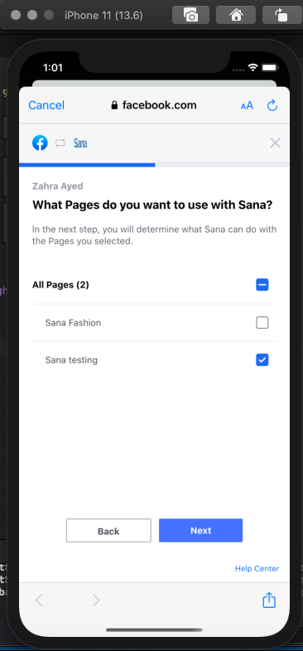

Slide 23
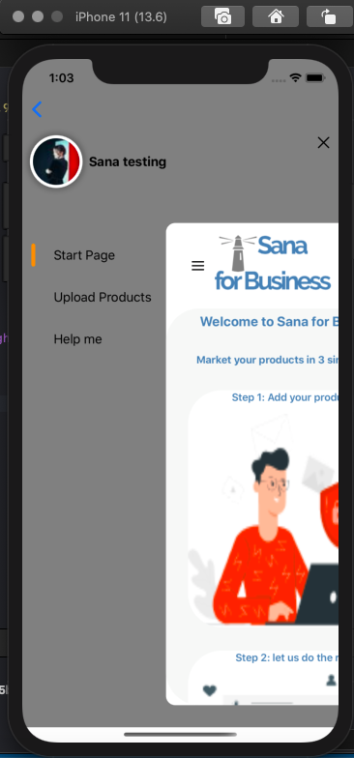
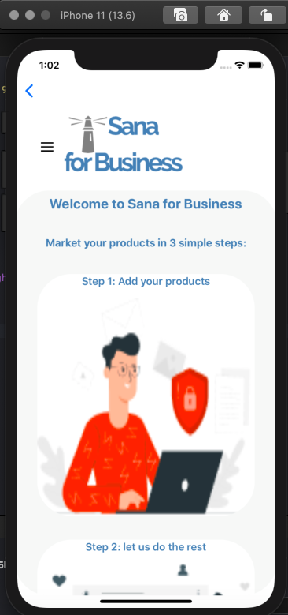

After a successful business account creation.

Slide 24
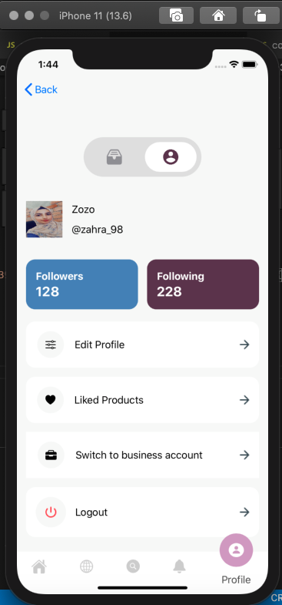
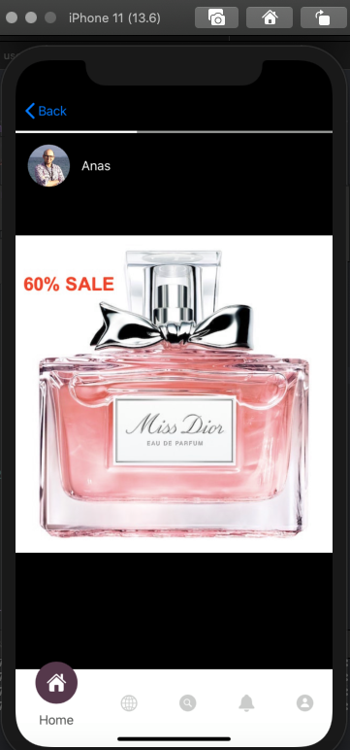
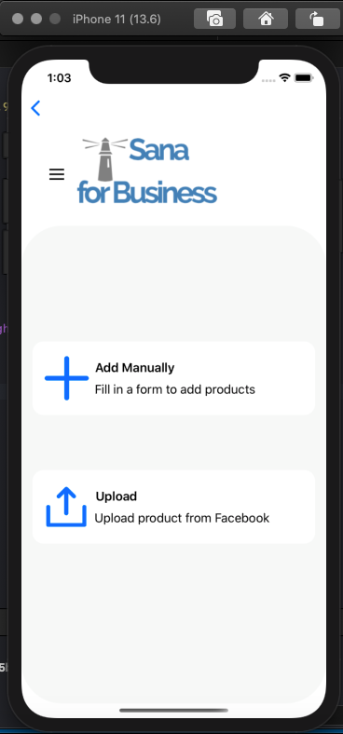
-The business
owner can
upload products and add stories.

Slide 25
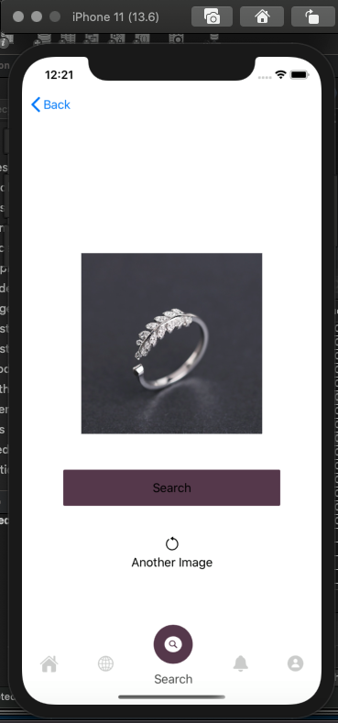
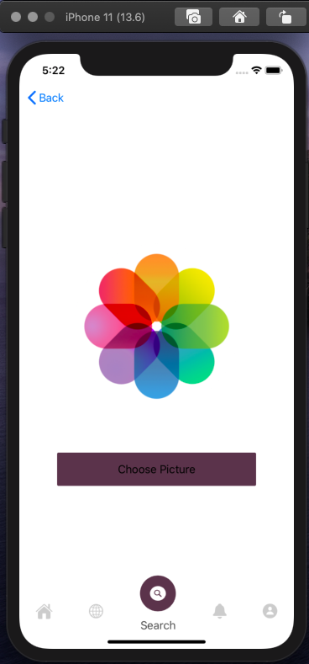
Visual Search.
-Choosing the photo of a certain product or he can use the.
-Clicking at Search button to see the similar product.

Slide 26
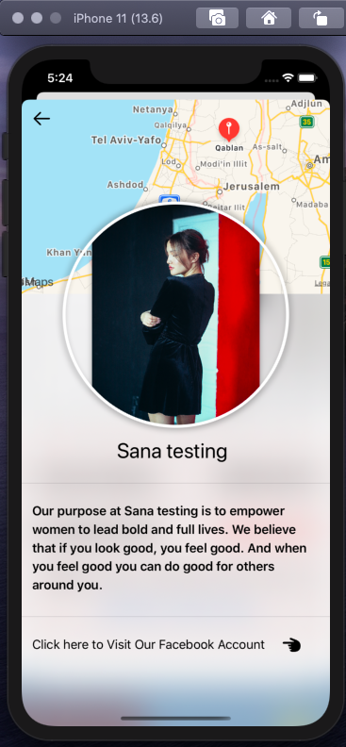
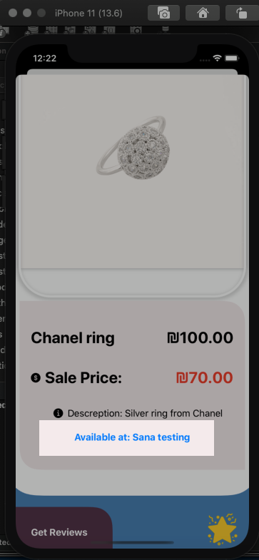
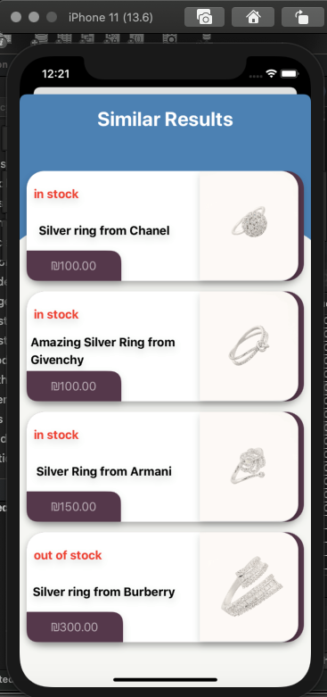
-Similar products .
-The information
was collected from Facebook.
-Adding the
product to favorites
.
-Getting the
reviews

Slide 27
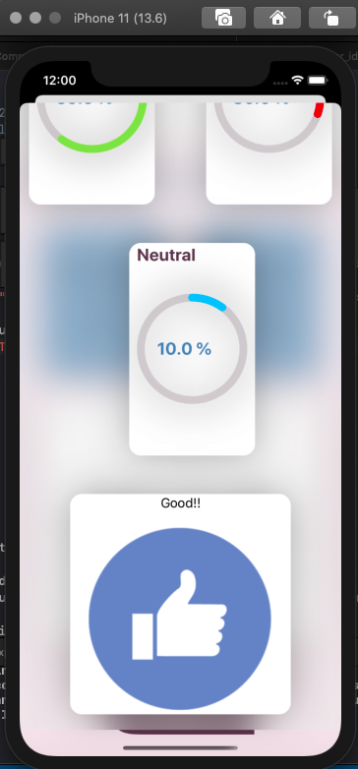
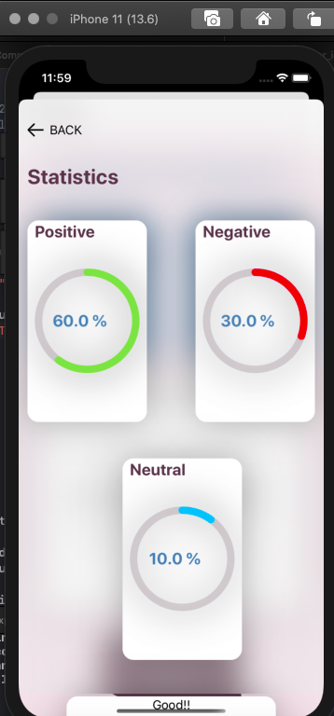
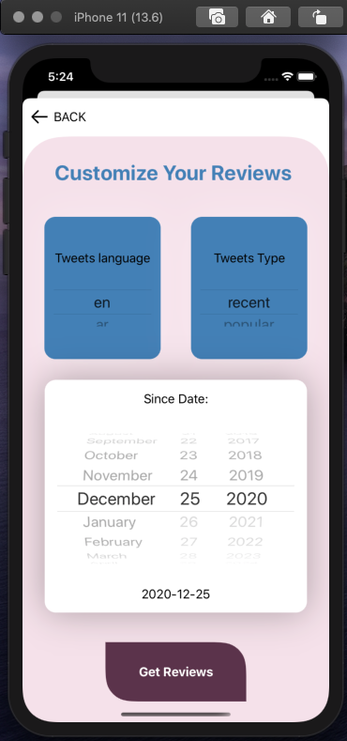
Get reviews

Slide 28
Constraints
Using Swift UI as the main framework created some issues .
-It was released in June 2019 , so there is not much tutorials on the
internet
We have different platforms on our laptops (Mac,Windows).
- we faced many problems in choosing frameworks and tools.
Corona Virus, which restricted communication between each other, as most of our meetings were online(Poor internet connection).

Slide 29
Future Work
Searching for products by barcode.
Adding recommendation system.
Adding payment system.

Slide 30
Thank You

