Slide 1
Roadway Artist
Hardware project
By: Yahia Mansour & Omar Quzmar
Supervisor: Dr.Aladdin Masri & Dr.Haya samaana

Slide 2
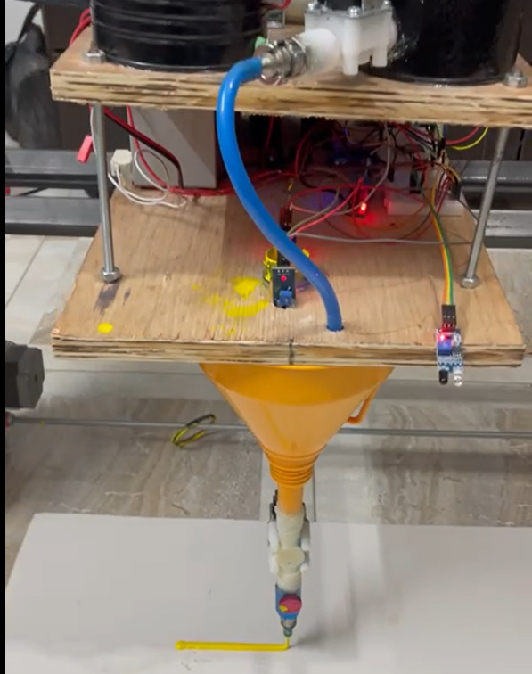
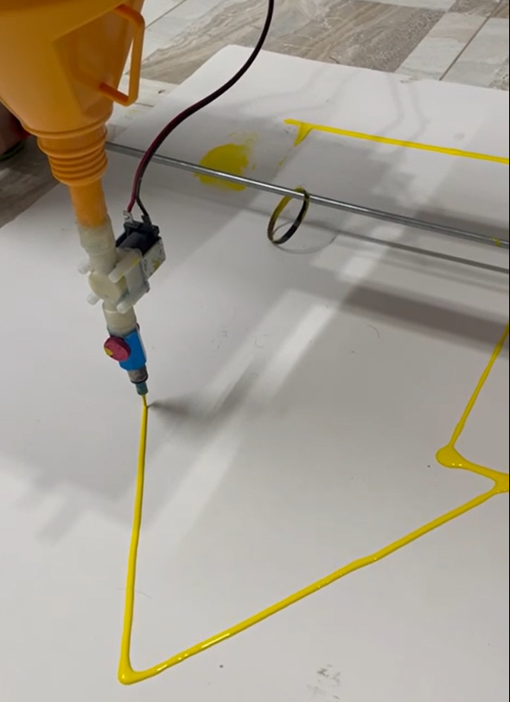
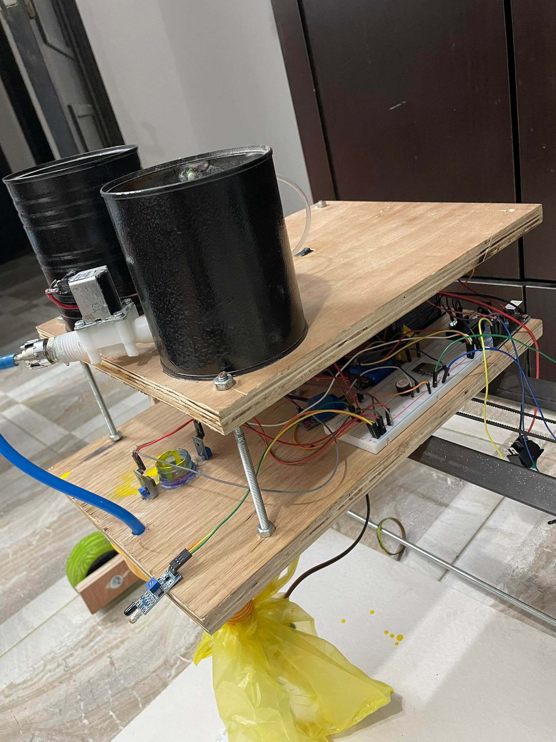
What is the Roadway Artist ?
( Roadway Artist) it’s a painter’s car that automatically draws drawings on the street floors.

Slide 3
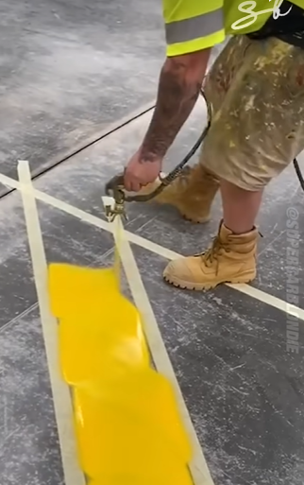
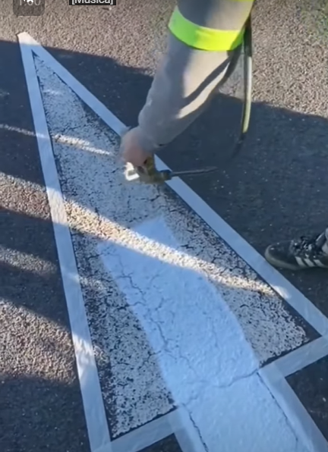
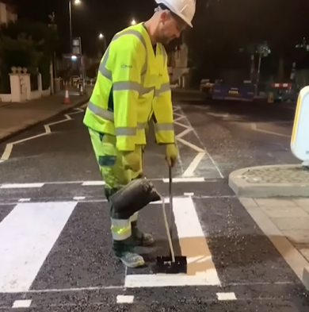
Problem Statement
1- Hand drawing.
2- Time.
3- Accuracy.
4- Less practical.
5- Difficult.

Slide 4
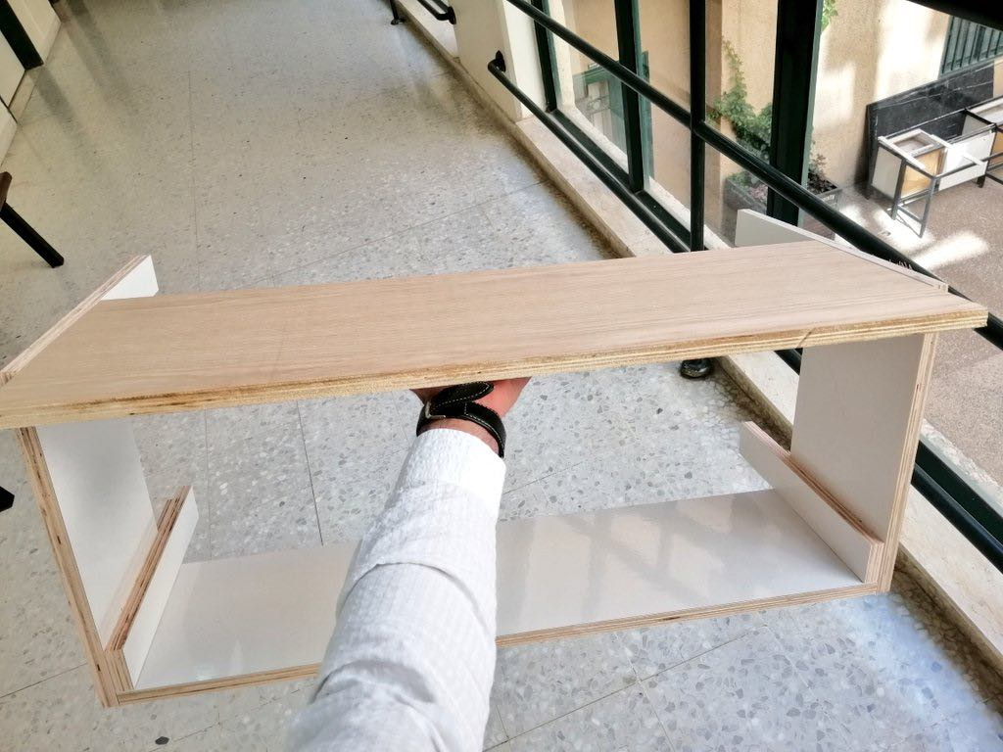
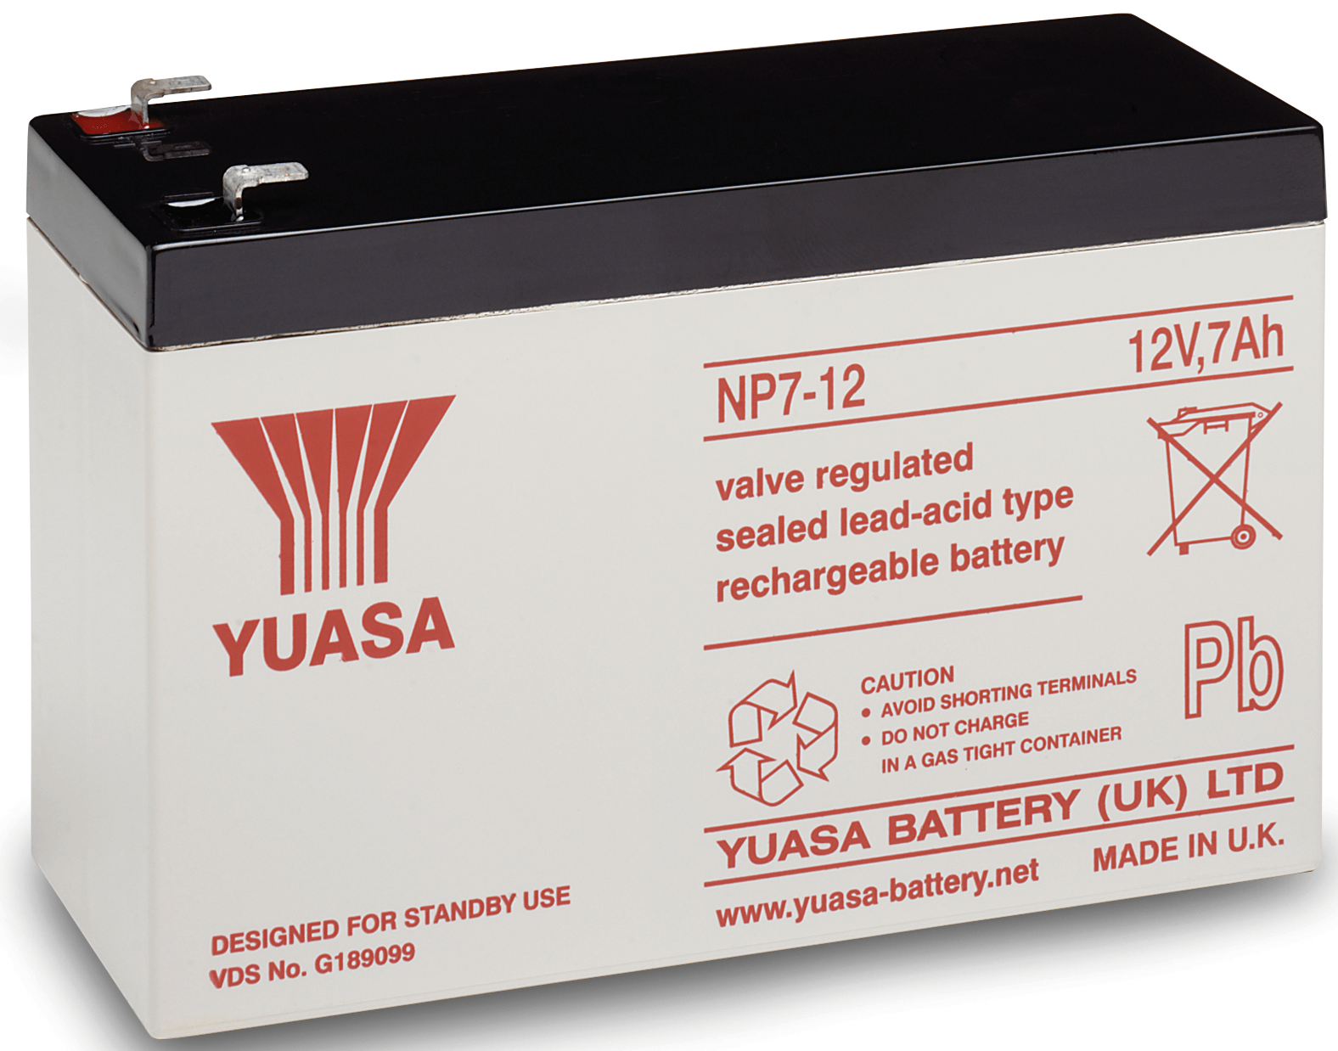

Challenges
1- Paint Handling.
2- Infinite Y-axis.
3- Weight .
4- Power.
5- GRBL & G-Code Wireless.

Slide 5
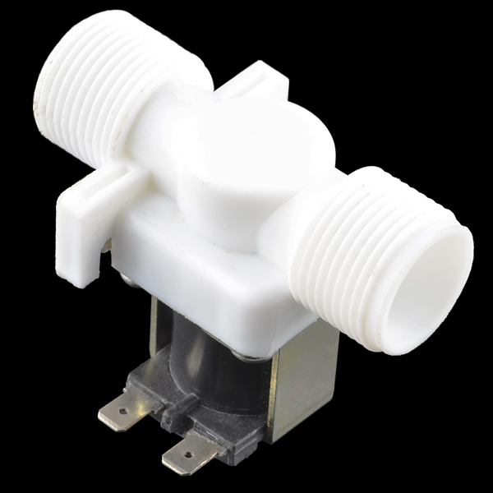
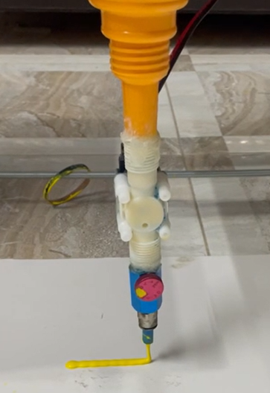
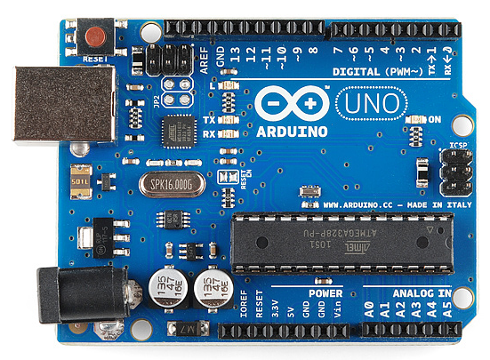
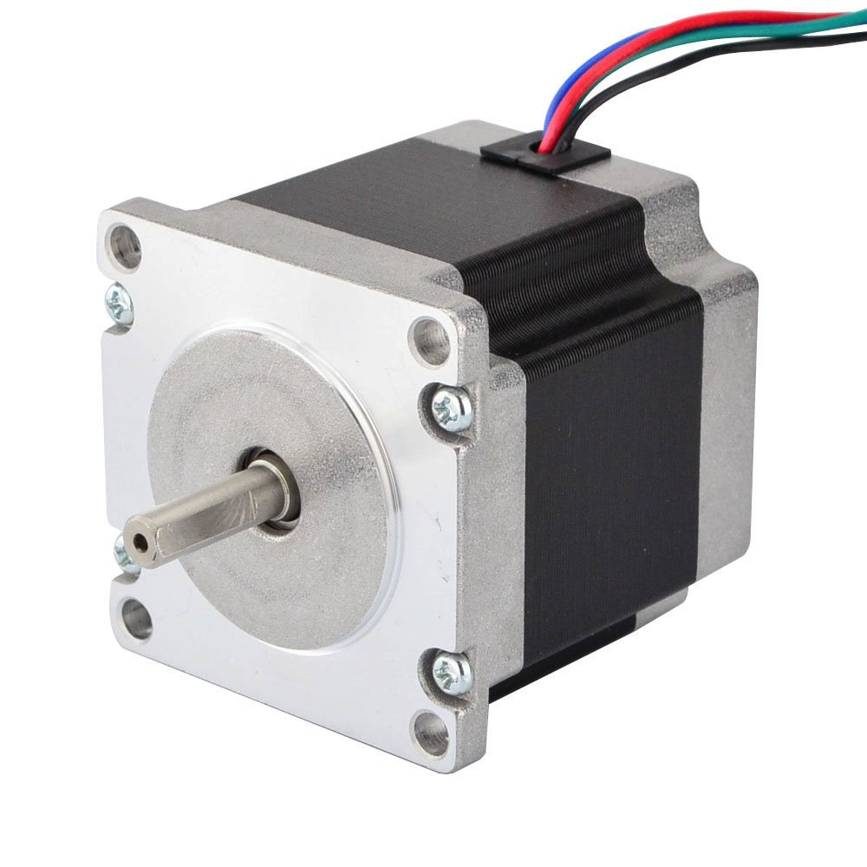
How it’s works?

Slide 6


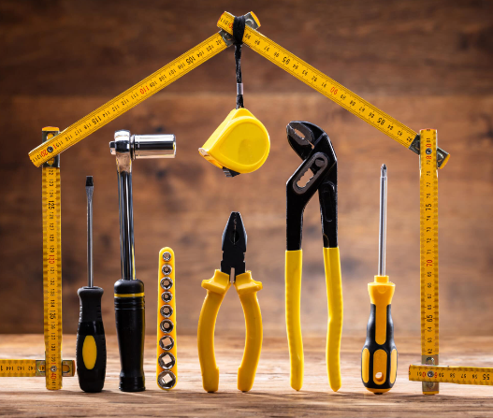
Features
1- Remote Control.
2- Automatic cleaning.
3- Database.
4- Motion sensor and liquid
ratio sensor.
5- GRBL & G-Code Wireless.
6- Use fewer tools.

Slide 7
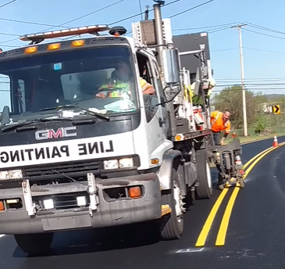
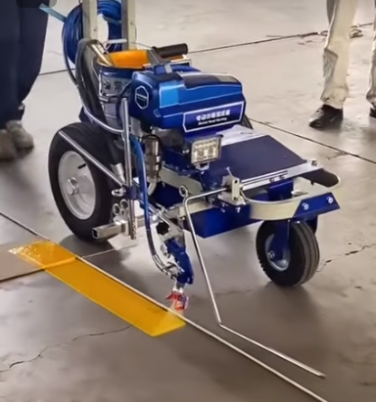
Competitors
Automatic
Manual

Slide 8
Thank you for listening
By: Yahia Mansour & Omar Quzmar
Supervisor: Dr.Aladdin Masri & Dr.Haya samaana

