Slide 1
Implementation of Quality Function Deployment in Cartoon Industry
Supervised by:
Eng. Walaa Johari
Prepared by:
Asala Shakhshir Amnh Badran
Ahd Qasrawi Reham Radad
Saja Saadeh

Slide 2
Outline
Abstract
Problem statement:
Project Objectives
The National Carton Industry Company NCI
Importance of Quality Management
Quality function deployment (QFD)
QFD Methodology Phases
Methodology
Conclusions

Slide 3
Abstract
The aim of this project is to build a structured approach to product development through using House of Quality (HOQ) tool and Applied to carton products in the National Cartoon Industry Company (NCI).
Several tools and techniques will be used in this project to achieve the desired goal, such as making interviews and questionnaire then using excel and SPSS to analyze the data.

Slide 4
Problem statement
Main problem of our project is developing the quality of the company to the highest levels including design, packaging...etc. In order to achieve specific objectives in the company and to remain at a high level of competition in the local market.
Another goal is to build scientific comparison in National Carton Industry Company now and its previous situation(before 2012) by comparing strengths and weaknesses point in current status with the previous.

Slide 5
Project Objectives
The main objective of this project is improve quality and customer satisfaction by use QFD in National Carton Industry Company NCI.
But there is other objectives we aspire to achieve and are summarized as follows:
Comparison between current and previous situation of company In terms of customers, competition, quality…etc.
Determining customer requirements and satisfaction with their service.
Identifying the products’ quality elements from customers’ point view.
Introducing the competitive position of the organization for the competing organizations within the same environment or in approach environment.
Introducing the competitive position of the organization for the other organizations in terms of technical capabilities.
Determine the strengths and weaknesses point of engineering specifications.

Slide 6

The National Carton Industry Company NCI
NCI was founded in 1989 as a private company with a starting capital of 600,000 JDIn 1993, the company raised new capital after becoming a public shareholding company,
The currently serves over 300 businesses in a wide array of sectors; industrial, sanitary, food and many others.
There are 52 employees in the factory, there is 6 Industrial Engineers.

Slide 7
Departments of the company:
Human Resources Department:Financial & Sales Department, Inventory Department.,Quality Assurance Department, Production Department.
Production lines: Closed Carton Boxes production line, Opened Carton Boxes production line, Furniture Corrugation production line.
This factory runs over than 100 customers needs from carton and most of them is the head in it's industry such like Anabtawi group, Al Junaidy, coca kola and Marawi factory for fruit drinks.
There are many local competitors with little market share, but the biggest competitor of the plant is the Israeli factories.

Slide 8
Importance of Quality Management
“Quality management” ensures superior quality products and services.
Quality of a product can be measured in terms of performance, reliability and durability.
Quality is a crucial parameter which differentiates an organization from its competitors.
Quality management tools ensure changes in the systems and processes which eventually result in superior quality products and services.
Quality management methods such as Total Quality management or Six Sigma have a common goal - to deliver a high quality product.
Quality management is essential to create superior quality products which not only meet but also exceed customer satisfaction.

Slide 9
What is QFD?
QUALITY
What the customer/user needs or expects.
How those needs or expectations are to be satisfied.
Making it happen throughout the organization.
FUNCTION
DEPLOYMENT

Slide 10
House of Quality
  do customers want and need from your product or service?
  (Customer requirements).
What
HOQ
HOQ
  will your company achieve the what?
  (Technical requirements).
How

Slide 11
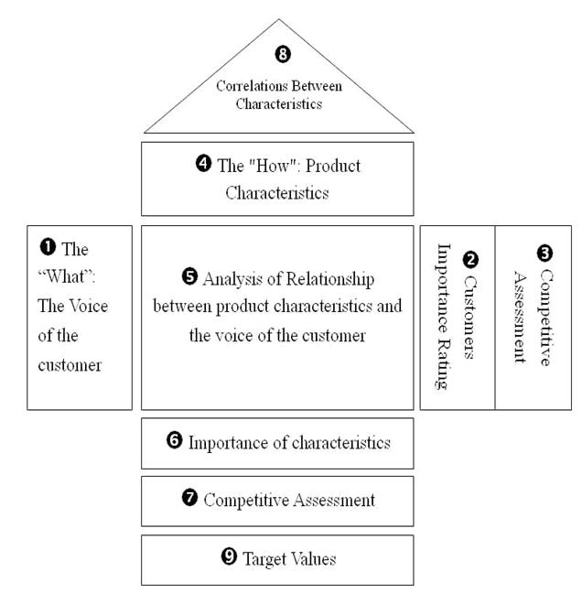
HOQ

Slide 12
QFD Methodology Phases
The basic Quality Function Deployment methodology involves four basic phases of the product development process:
Product Planning.
Product Design.
Process planning.
Process Control.

Slide 13
Product Planning :
Building the House of Quality, Led by the marketing department.
Getting good data from the customer in Phase 1 is critical to the success of the entire QFD process.

Slide 14
Product Design:
This phase is led by the engineering department, and it also create product concepts and part specifications are documented.
Product design requires creativity and innovative team ideas.

Slide 15
Process planning:
Process planning comes is led by manufacturing engineering.
It develop production equipment requirements and also establish critical process parameters.

Slide 16
Process Control:
In production planning, performance indicators are created to monitor the production process, maintenance schedules, and skills training for operators.
Also , decisions are made as to which process poses the most risk and controls are put in place to prevent failures.

Slide 17
Methodology
After deciding to apply QFD and taking the approval from the company we will follow these steps to implement QFD theory :
collected data.
Define and prioritize customer needs.
Analyze competitive opportunities.
Using tool to analyze the data.
distribute a questionnaire for customers.
finally Determining Voice of Company.

Slide 18
First step
is collected data, to build the whole House of Quality Matrix requires a complete data collection methodology starting from determining customers’ requirements and needs and ending by self-evaluation in comparison with Israeli competitor for further improvement activities to take place which will lead to increase the quality level and the market share among Palestinian society.

Slide 19
Second step
Define and prioritize customer needs, identifying customers’ needs and requirements through taking a sample of customers as an input for building HOQ.

Slide 20
Thread step
Analyze competitive opportunities, understanding how customers rate the competition can be a tremendous competitive advantage. In this step of the QFD process, it is also a good idea to ask customers how your product or service rates in relation to the competition. There is remodeling that can take place in this part of the House of Quality.

Slide 21
Forth step
Using tools like SPSS, excel, HOQ In order to analyze the data that collected.

Slide 22
Fifth step
We plan to distribute a questionnaire for customers to distinguish what they expect from the factory and what are the current quality problems it suffers from.

Slide 23
Sixth step
finally Determining Voice of Company (How) through meetings with the factory Engineers.

Slide 24
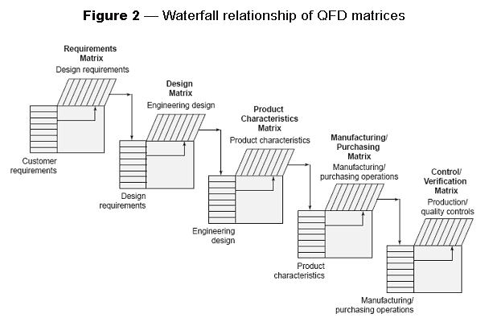
Once you have prioritized the attributes and qualities, QFD deploys them to the appropriate organizational function for action, as shown in figure below.

Slide 25

Conclusions

Slide 26
QFD is a powerful tool in service and industry.
During the second project we will build a structured approach to product development through using House of Quality (HOQ) tool.
Also we aim to determine the strengths and weaknesses point of engineering specifications

Slide 27
Thank You!

