Slide 1
Graduation project 2
Optimization of rawabi building
Dr. mother thiab

Slide 2
isra Azzam
asia hamza
rawan barham .

Slide 3
Chapter One

Slide 4
introduction
This project is the final graduation project submitted to the Civil Engineering Department in partial fulfillment of the requirements for the degree of B.Sc. in Civil engineering at AL-Najah National University.
The project is rawabi residential building in Ramallah with an overall area = distributed over existing 7 stories of which 1 is basement.

Slide 5
Objectives:
In this project we work to apply all concepts of structural Engineering that we are learned over five years. We have studied many courses in the program of the Civil Engineering Department at Al-Najah University. Different types of analysis and design are done in this project in order to choose the most safe and economical type

Slide 6
  Importance:
The importance of rawabi project: - rawabi is one of the important buildings in the nation in all parts of Palestine. Rawabi is a new city for Palestinian families it will provide opportunities for affordable home owner ship, employment, education and leisure and an attractive environment in which to live ,work and visit .best of all rawabi is the best quality of life option well within the financial reach of many young Palestinian families .

Slide 7
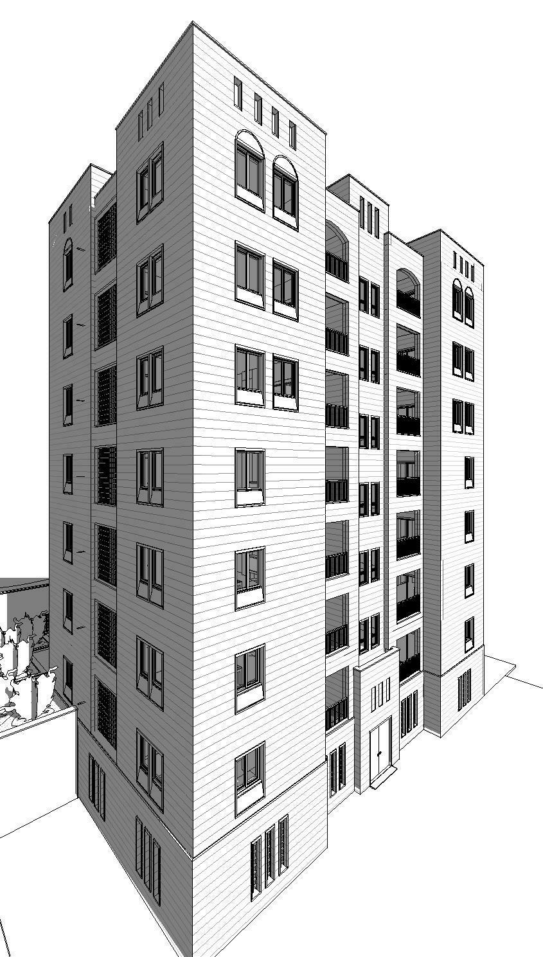
The building

Slide 8
Structural systems
Form – active structures (transfer of loads in single stress, compression or Tension)
Vector – active structures (transfer of loads in one dimension tension and compression)
Section – active structures
Surface – active structures (transfer of loads through surfaces)
Height – active structures (high – rise structures

Slide 9
Type of structure

Slide 10
Chapter Two
Site , material , loads And program used

Slide 11
location
Description of rawabi project:- rawabi is one of the biggest residential building in Palestine , which is constructing in Ramallah city , it has been started in 2007. Rawbi building consists of seven stories of total area ,the total height of the building (19..8m).

Slide 12
Materials of construction
Structural materials used locally can be classified into two categories; steel and reinforced concrete. Each type is suitable for certain types of buildings.
In this project reinforced concrete is used, this choice is built on several reasons; first of all that concrete has less cost than steel locally , second is the availability of this material in Palestine so there is no need to import it from other countries like steel.

Slide 13
Concrete:-
Concrete normal weight γc .
Concrete compressive strength fcʹ
Concrete modulus of elasticity EC
The rest of the materials are assumed to have the following properties:
      Density of tiles is .
      Density of stone is .
      Density of un-reinforced concrete is .
      Density of sand is .
      Density of block is .

Slide 14
Steel Reinforcement
The deformed bars are the type of the bars that were used in this project. Local markets of building materials provide deformed bars with a 12 m length.

Slide 15
Loads:
Gravity Loads
Dead Load
Live Loads
Environmental Loads

Slide 16
Load Combination
U= 1.2*D.l+1.6*LL
U=1.2D.l+1.6L.L+.5S
U= .9D+1.6W+1.6H

Slide 17
Chapter Three
Slabs

Slide 18
Introduction :
Structural concrete slabs are constructed to provide flat surfaces, usually horizontal, in building floors, roofs, bridges, and other types of structures. The slab may be supported by walls, by reinforced concrete beams usually cast monolithically with the slab, by structural steel beams, by columns, or by the ground. The depth of the slab is usually very small compared to its Span.
The slabs of this project are divided into panels with one way structural systems and maximum values of moment and shear for each panel is taken as critical value and used in the design of panels.

Slide 19
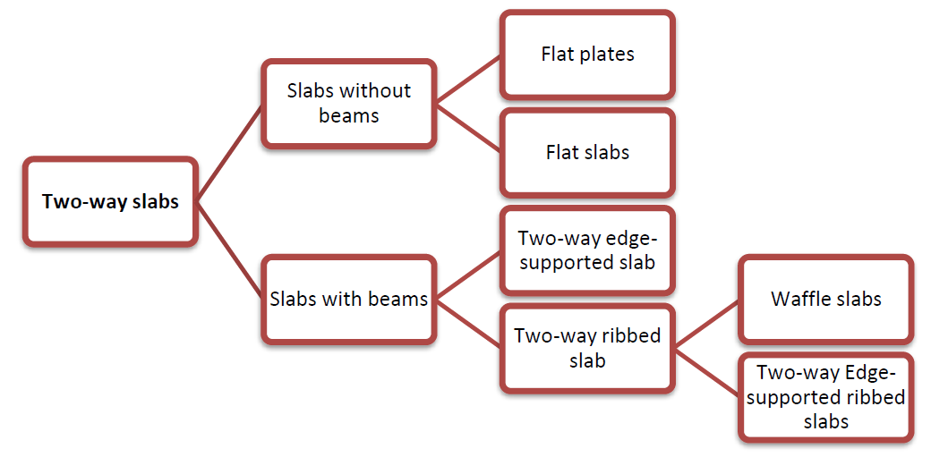

Slide 20
slab design check:
Slab weight =( .12*.2 + .08*.67)*25+(.55*.2*12)=3.26 kn/m
Slab weight = 3.26/.67= 4.85kn/m2
Wu = 1.2*4.85 +4*1.6= 12.22 kn/m2
After that we draw the bending moment diagram
Mu= 5.28/(5.28+3.39)*(19-7.84)= 6.69kn.m
As = 138mm2 top steel =2Φ8
Mu bottom = 19kn.m
From interpolation As = 392mm2 (3Φ12)
(Which is acceptable as ETABS give us )

Slide 21
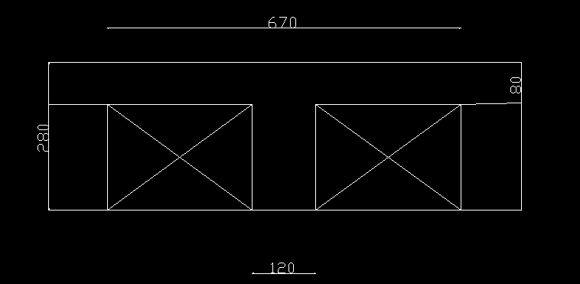

Slide 22
Chapter four
Beams

Slide 23
Introduction:-
A beam is a structural element that carries load primarily in bending (flexure). Beams generally carry vertical gravitational forces but can also be used to carry horizontal loads (i.e. loads due to an earthquake or wind). The loads carried by a beam are transferred to columns, walls, or girders, which then transfer the force to adjacent structural compression members. In Light frame construction the joists rest on the beam.

Slide 24
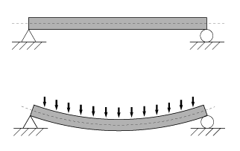

Slide 25
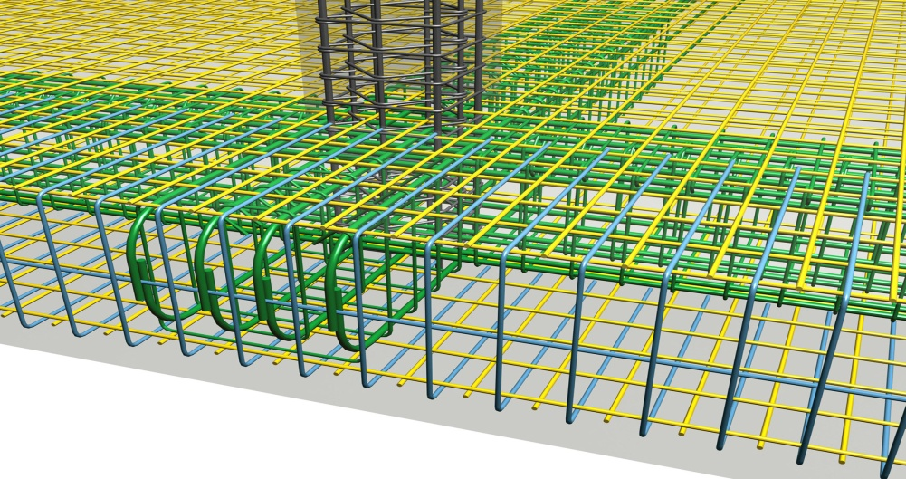
Beams are classified into two types

Slide 26
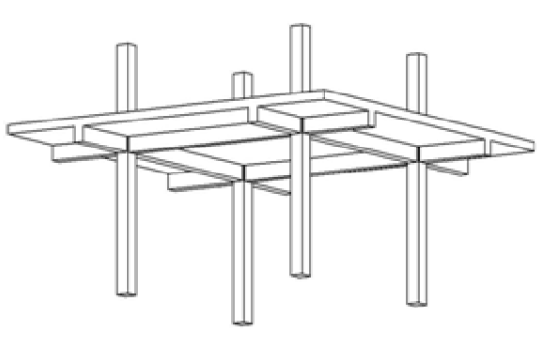
Dropped beams

Slide 27
2Beam design check
The beam name is L 1-B2
L.L =4KN/M2
D.L =load from slab+ load from beam its own weight
Weight of the slab = 3.26 kn /m
Weight of the beam = .28*.4*25 =2.8kn/m
D.L= 3.26*3.17+2.8*3.08=18.9kn
Wu= 1.6*4+1.2*18.9= 660 kn
After drawing mu and computing then we compute AS=ρbd
Mu= wL2/8= 29*3.08^2/8= 34.3kn.m
As = ρbd = .0035*400*260= 364mm^2
3Φ14 ok for beam and all beams done as that

Slide 28
Chapter 5
Columns

Slide 29
Introducttion
Columns are vertical compression members of a structural frame intended to support the load carrying beams. They transfer loads from the upper floors to the lower levels and then to the soil through foundations. Failure of one column in a critical location can cause the progressive collapse of the adjoining floors and the ultimate total collapse of the entire structure.
In general, the column is a member subjected to an axial compressive force, in addition to bending moments in some cases.
Columns can be classified on the basis of the form arrangement of reinforcement as; rectangular or square, circular, and composite columns, the position of load on the cross section, and the length of the column relation to its lateral dimensions.
Although tied columns are the most commonly used because of lower construction cost, spirally bound columns are also used where more ductility is needed as in earth- quake zones.

Slide 30
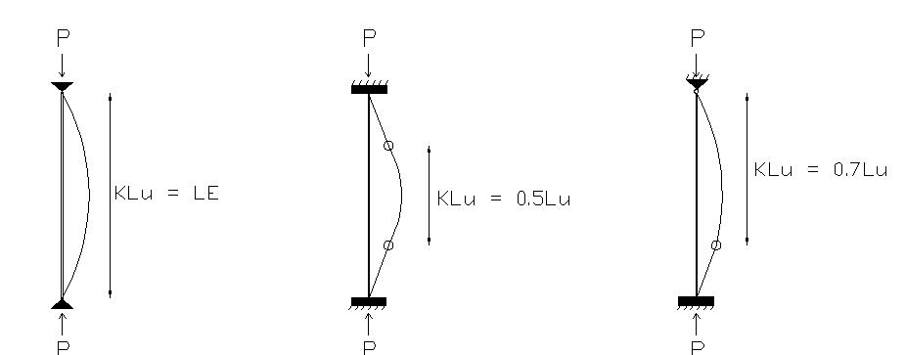
Type of coloumn

Slide 31
Chapter 6
Foundation

Slide 32
Introduction
Reinforced concrete footings are structural members used to support columns and walls to distribute their loads to the soil .The design is based on the assumption that the footing is rigid so that the variation of the soil pressure under the footing is linear.
Foundation used to transmit high concentrated columns , wall reactions and lateral loads from retaining walls to ground without cause unsafe differential settlement of the structural system or soil failure .
Uniform soil pressure is achieved when the column load coincides with the centroid of the footing. Although this assumption is acceptable for rigid footing, such an assumption becomes less accurate as the footing becomes relatively more flexible

Slide 33
Types of footings
Depending on depth
Sallow footings : its depth is usually D ≤ B, it contains isolated, combined , strip and raft footing .
Deep footings : with D> (4 to 5) B pile footing is one type of deep footing .

Slide 34
Shallow Foundation Types
Continuous footings
. Cantilever or strap footings
-Combined
-Isolated
Wall Footings
Raft) footings (Thickened slabs)
Mat (
2Deep foundations
1. Pile foundations
2. Piers
4. Compensated foundations
3. Caissons

Slide 35
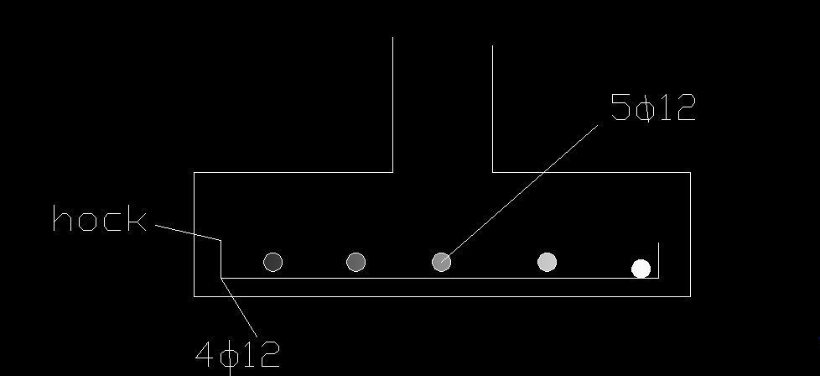
manual design for some type of footing in the project

Slide 36
Fc=32Mpa
Fy=420Mpa
We have ribbed slab with thickness 28 cm
Slab own weight = 4.85kn/m^2 was calculated previous
Live load = 4kn/m2
The tributary area that the column cover =15.5m2
So that :
DL= 15.5*4.85=75KN
LL=15.5*4=62KN
This calculation for one floor so for 7 floors :
P=7*(75+62)=959kn

Slide 37
To determine the area of footing we need:
qall for the soil=400knlm2
σ=p/A=400
A=959/400=2.4
Take L=1.5 B= 1.5
Now we want to determine the thickness of the footing
Pu=1.6*75+1.2*62=194.4
D=10√pu=10(194.4)^.5=140

Slide 38
Assume d=320mm , h=400mm
Φvc=.75*(1/6)√32(320)*1.75*10^-3= 396kn
Vu=.625*400*1.5=375 kn<396 ok
For punching also the design is ok
Vu=pu*bo*σ=194.4*540*400=42kn<Φvc ok

Slide 39
Reinforcement :
Longitudinal reinforcement:
Mu=σul^2/2=400*.625^2/2=78.125kn.m/m
= 2.079*10^-3
As =ρbd=666 mm^2/m(4Φ14)
Transverse direction :
l= .625 M= 400*.625^2/2 =55.3kn.m
From interpolation we found AS =470mm^2/m(3Φ14)

Slide 40
wall footing
Shear wall need wall footing design
L=1m
L.L= 4kn/m2
D.L= weight of the shear wall + weight of the slab
Weight of the shear wall= 25*1*.2*3= 15kn /m
Weight of the slab= 4.85kn/m
D.L=15+4.85= 20 kn/m
L.L=4* tributary area= 4*(3.5)=14kn/m
D.L=7*20=140kn/m
L.L=7*14=98kn/m
Determining B (width of footing)
σ = L.L+D.L/B+1=400kn/m2
=238…………………B=238/400=.6=1m
σu= 1.2*140+98*1.6/1*1=325kn/m2
determining the thickness by considering the wide beam shear only :
Vu= σu(.4-d/1000)
Φvc= .75(1/6)√fc*1000*d/1000=vu
From these to equations determine d=150mm
H=d+80(cover)=150+80=230mm≈250mm
The reinforcement :
M = σ u* L^2/2 = 325*.4^2/2=26kn.m (b=1000 d=150)
Ρ=3.43*10^-3
As = Ρbd=515mm^2/m
Asmin= .0018bH=.0018*1000*250=450 <As use As 5Φ12/m
Longitudinal reinforcement :
Use Asmin=450mm2

Slide 41
Chapter 7
Modeling

Slide 42
introduction
The main aim of our project is to choose the most economical design that we can get after taking safety factors in our consideration . so four modals has been done so that to choose the most appropriate one ,and here there are

Slide 43
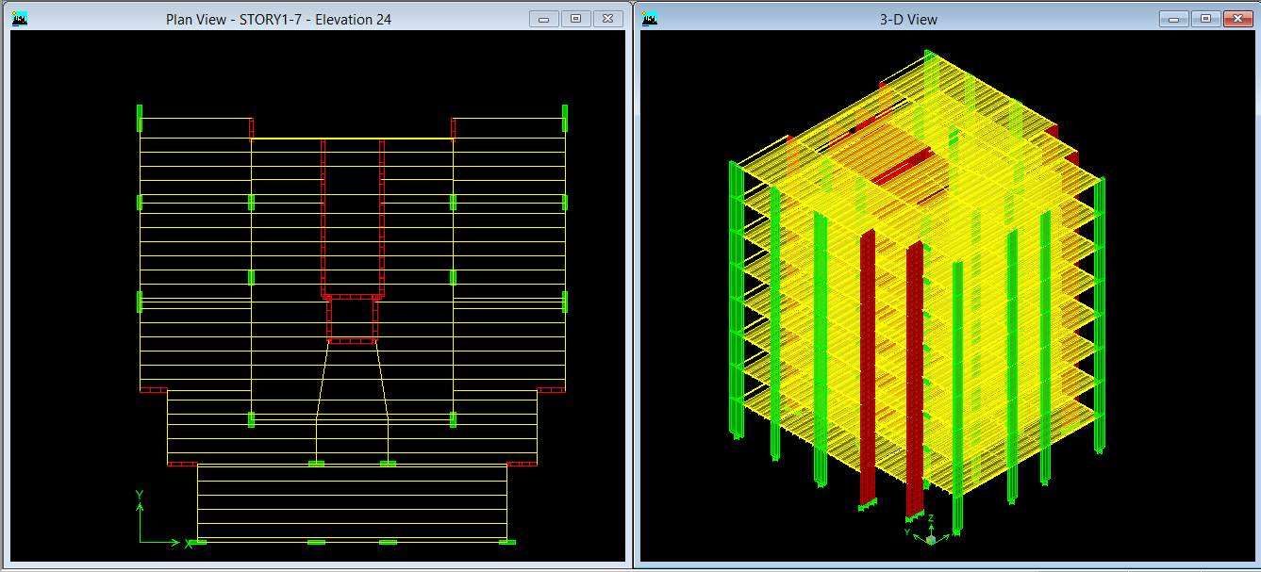
The first modal is Ribbed slab T-section

Slide 44
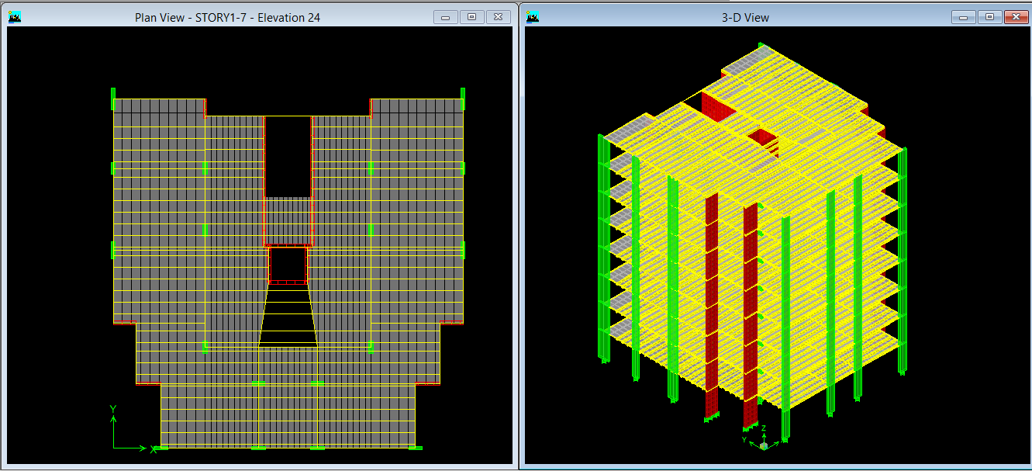
The second model is ribbed slab &slab rectangular

Slide 45
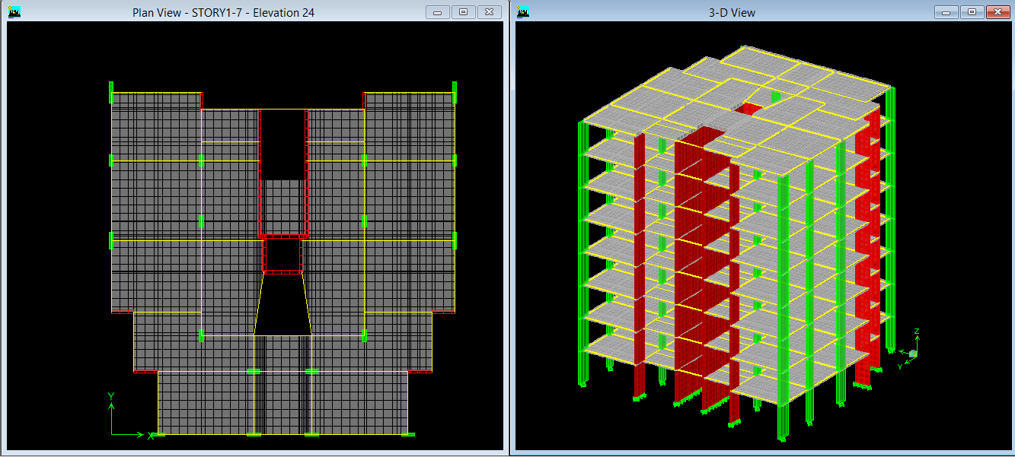
The third modal is solid slab

Slide 46

The final modal is solid slab set modifiers

Slide 47
The end
Happy to listen to any questions

