Slide 1

AN-NAJAH NATIONAL UNIVERSITY
FACULTY OF ENGINEERING
DEPARTMENT OF MECHANICAL ENGINEERING
“ PROTABLE MASSAGE BED “
Prepared by :
Mohammed Abu younis
Qusay Abu Al Wafa
Adel Dwekat
Ahmed Omer

Slide 2
The presentation is divided into 4 main parts
1- Introduction
2- The Bed Design
3- Electrical Circuit and Control
4- The Calculations

Slide 3
I -Introduction
Portable Massage Bed Definition
The idea of chosen Portable Massage Bed
Project
Problems that we will try to solve in Portable Massage Bed project .

Slide 4
Mechanism of the Portable Massage Bed:
Massage Procedure
قصي هون صورة لل رولرات الي راح تعمل دوران طيب؟؟؟؟

Slide 5
Mechanism of the Portable Massage Bed:
Operating and Safety

Slide 6

Back Pain Treatment
1- treatment using drugs and medications

Slide 7
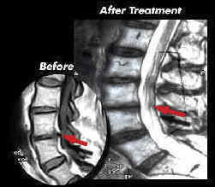
Back Pain Treatment
2- treatment using surgery

Slide 8
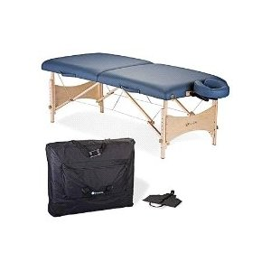
Back Pain Treatment
Treatment using physiotherapy

Slide 9
II -Design of the Bed
Introduction
In Designing any model, The mechanical properties must be known such as :
1-Elasticity
2-Rigidity
3-Tensile Strength
4-Yield Strength
The loads and safety factor must be known

Slide 10

II -Design of the Bed
This section talks about characteristics of every part in Portable Massage Bed , and its divided into :
1- Frame
The material that will be used in the outside frame is carbon steel, and this table shows the following characteristics:

Slide 11
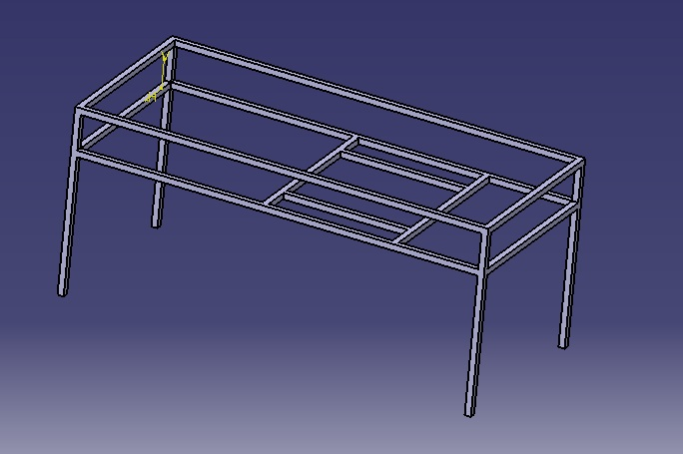
II -Design of the Bed
the dimensions for the outside frame are :
Height =90 cm
Width = 90 cm
length = 200 cm

Slide 12

II -Design of the Bed
2- The Weld Process
The objective of this phase is to install surface bed columns that carry the bed and this is done through a process of welding on the cross sectional area for the column.
The process of connecting the parts of the frame with E40XX welding type and it has the following characteristics, shown in Table

Slide 13
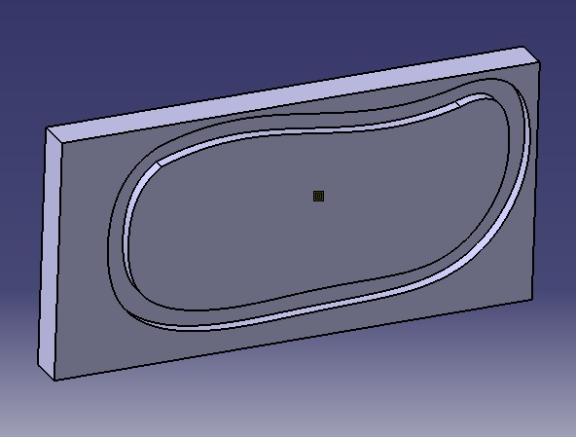
II -Design of the Bed
3- The Slider Design
The slider is designed in a way to comfort the back area and make the bearings movements easier .

Slide 14

II -Design of the Bed
4- Rod Design
The most important part and the primary process in the slider is the Rod , which carries the weight and the rollers , and this table shows the characteristics of the rod :
The length of the rod is chosen according to Physiotherapy Doctors

Slide 15
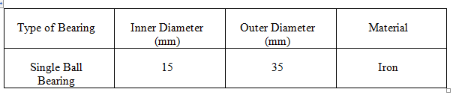
II -Design of the Bed
5- Bearing Design
The bearings are designed and chosen according to their abilities of carrying loads, and this table shows the characteristics of the Bearing :

Slide 16
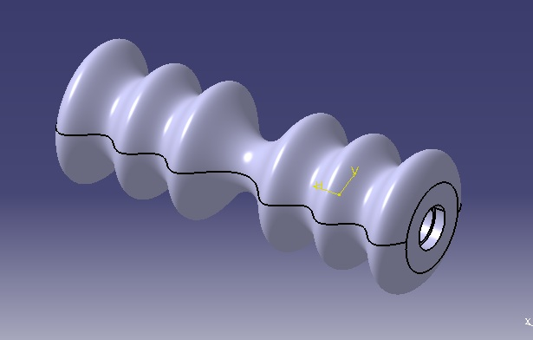
II -Design of the Bed
6- Roller Design
According to physiotherapy doctors , the points at the back area that must be massaged were determined for all the back area (40-50 cm).
There were three points on every side of the back area and according to that roller has the following shape:

Slide 17
IV - ELECTRICAL CIRCUIT AND CONTROL
1 Introduction
In Portable Massage Bed, two D.C. motors of continues current will be used in order to make the massage operation, The D.C. motors that must deal with converting electrical energy into rotational energy.

Slide 18
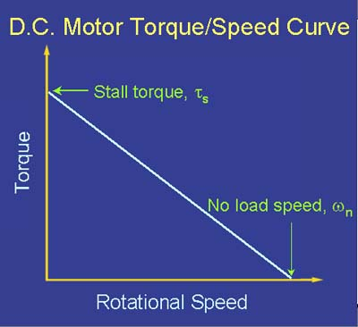
IV - ELECTRICAL CIRCUIT AND CONTROL
  2- Motor Characteristics
Torque\speed carves

Slide 19
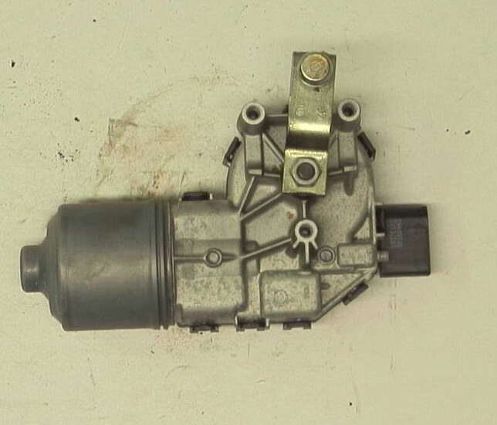
IV - ELECTRICAL CIRCUIT AND CONTROL
3- Type of DC Motor
In Portable Massage Bed , a D.C. motor of type BOSCH will be used in order to rotate the rollers to make the massage process

Slide 20
V – The Calculations
1- Calculations Of The Columns
the maximum loading = P_{max} = 2000 N = 2 KN
P_{critical}= 600 N
From these values and by using Jonson's equation
P = 560 KN > P_{critical} → a = 0.0219 m will be used

Slide 21
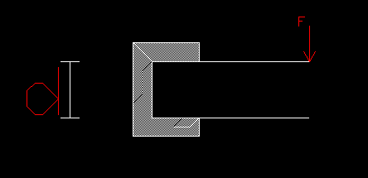
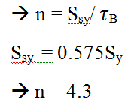
V – The Calculations
2-The Welding Calculations
The welded joints are in Torsion

Slide 22
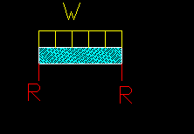
V – The Calculations
3-The Deflection of the Beam
→ y = wX / 24 EI [ 2LX² – X³ – L³ ] → y = -5.96 * 10⁻⁷ m
→y_{max} = 5wL⁴ / 384EI = 7.45 *10⁻⁷ m

Slide 23
V – The Calculations
4- The Calculation for the Bearing
[C_{d} ( R ) ]_{req} = {L_{d} /K_{r}*10⁶}^{1/a} (I_{f}) P_{e} = 908,03 N
Choose P_{se1} , from table 11.5 the bearing number is chosen with 6206 , which have inner diameter = 15 mm , and outer diameter = 35 mm

Slide 24
V – The Calculations
5- The Calculation of the Roller Chain
→ the nominal power H₁ = (0.003N₁^{1.08} ) (n₁^{0.9}) *[ P/25.4^{(3-0.07P/25.4)}]
→ H₁ = 14.7 w
The nominal power H₂ = [746 Kr N₁^{1.5} (P/25.4^{0.8}) ] / (n₁)^{1.5}
H₂ = 3.22 Kw
The center to center distance = C = 0.715 m
H_{tab} = n_{d}*H_{nominal} * K_{s} / K₁*K₂ =3.84 w

Slide 25
Thank You For Your Time

