Slide 1

An-Najah National University
Faculty of Engineering and Information Technology
Building Engineering Department
Graduation Project - II
Integrated Design of Basic School
Supervisor:
Dr.Hind Tubelih.
Students’ Names:
1. Muheeb saddouq.
2. Mohammad rabaea.
3. Mohammad melhim.
4. Mahmoud Nadeem.
Date: 2.June.2020.

Slide 2
Contents:
Introduction
Site Analysis
Architectural Design
Structural Design
Environmental Design
Mechanical Design
Electrical Design
Cost Estimation

Slide 3
Introduction
An innovative concept was produced in this project for a school that keeps up with age growth and satisfies the core educational needs, as well as extracurricular programs and functions.

Slide 4
Site Analysis
Location
The land on which the school will be built locates in wadi Al faraa Neighborhood in Tubas city.

Slide 5
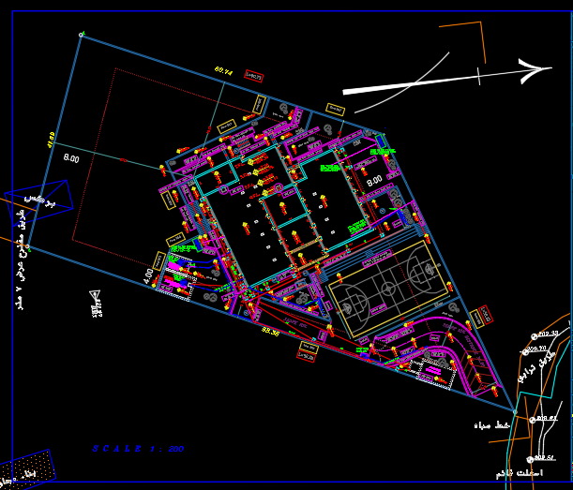
Site Analysis
Areas and slope
Area of land which school is built on equals to3341m² with slope 14% approximately
The school building is built on 536m².
Figure 5: Site plan od school

Slide 6
Architectural Design
General Information
Floors
Elevations
Sections

Slide 7
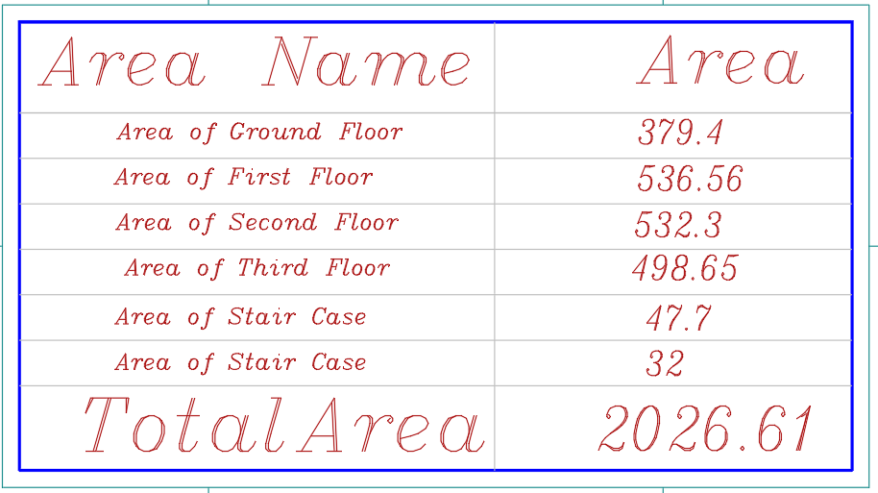
Architectural Design
General Information
The school is composed of four floors.
Total area of school building = 2026 m².
School has two entrances and exit scattered across ground.
School contains two staircases.

Slide 8
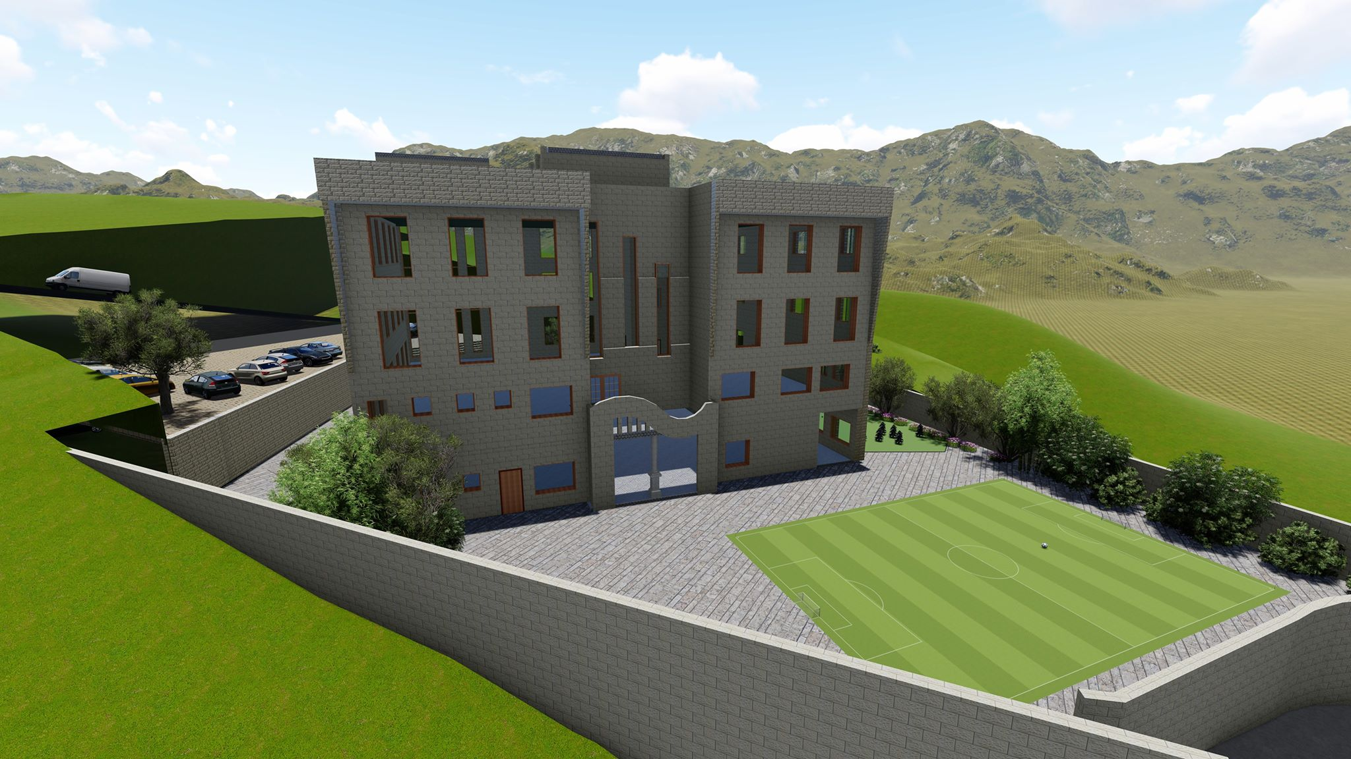
Architectural Design

Slide 9
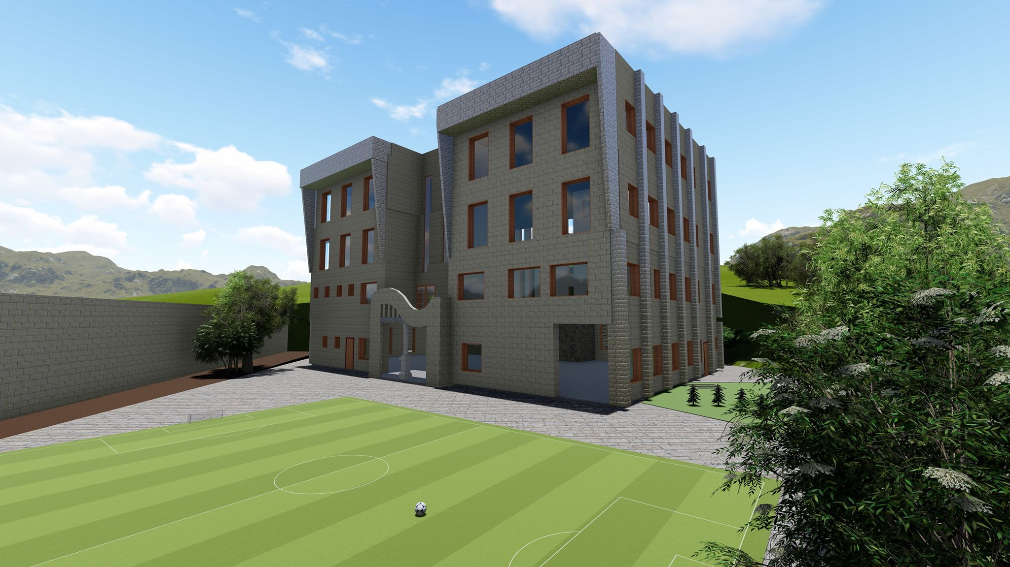
Architectural Design

Slide 10
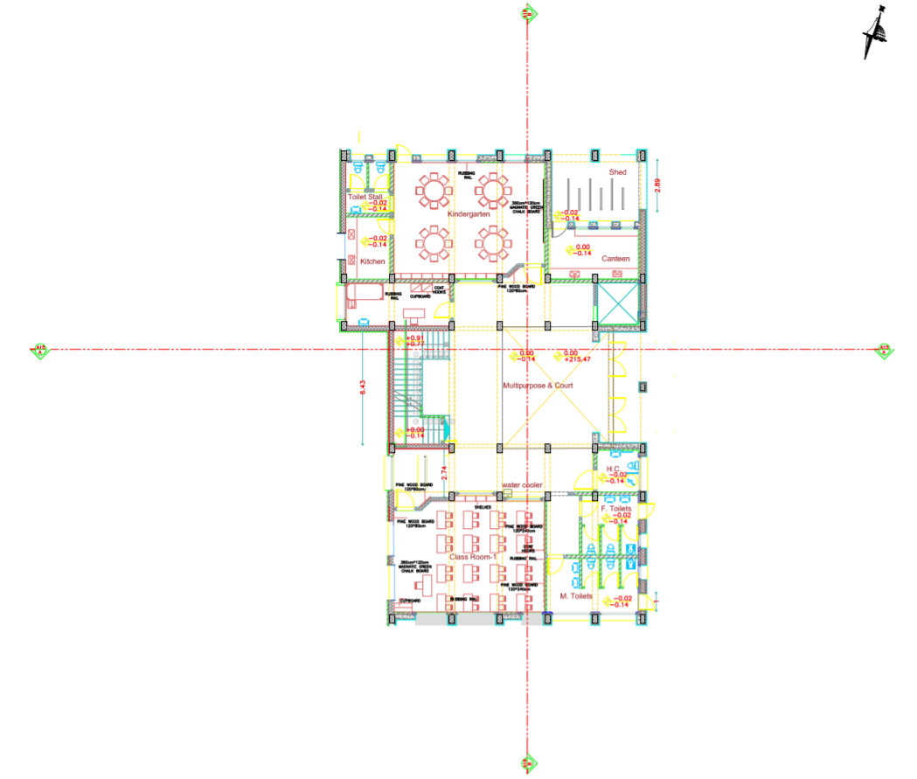
Architectural Design
Ground floor
Area = m²
Floor height = 5 m
Figure 6: Basement floor plan

Slide 11
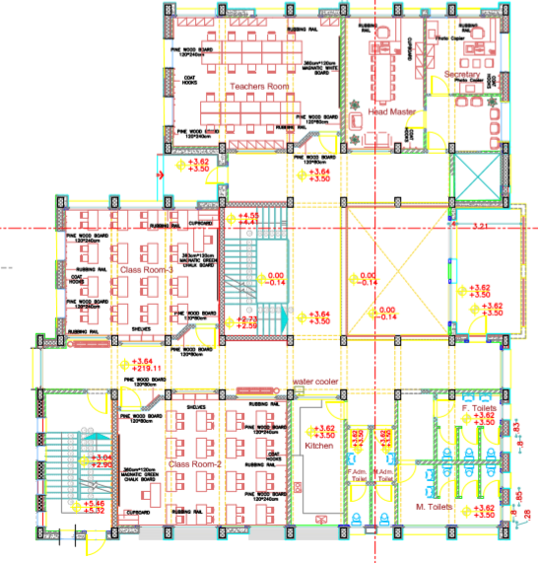
Architectural Design
First floor
Floor height = 3.50 m
Figure 9: Second floor plan

Slide 12
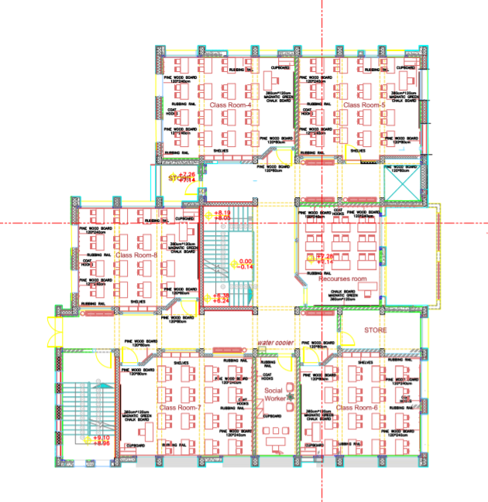
Architectural Design
Second floor
Floor height = 3.5m
Figure 7: Ground floor plan

Slide 13
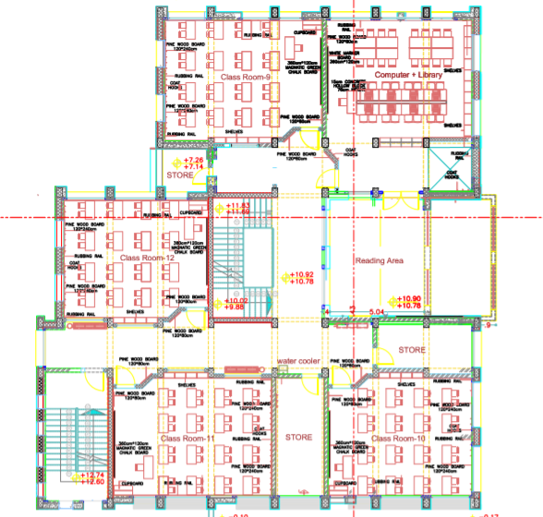
Architectural Design
Third floor
Floor height = 3.50 m
Figure 8: First floor plan

Slide 14
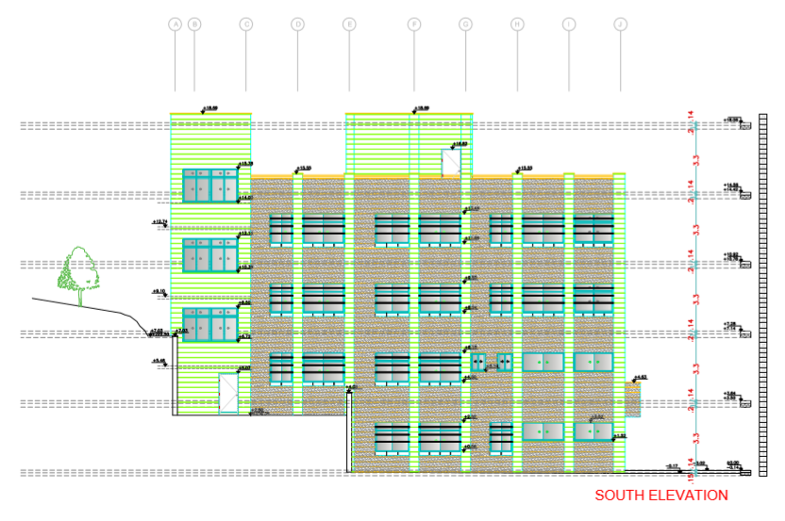
Architectural Design
South Elevation
Figure 10: South Elevation

Slide 15
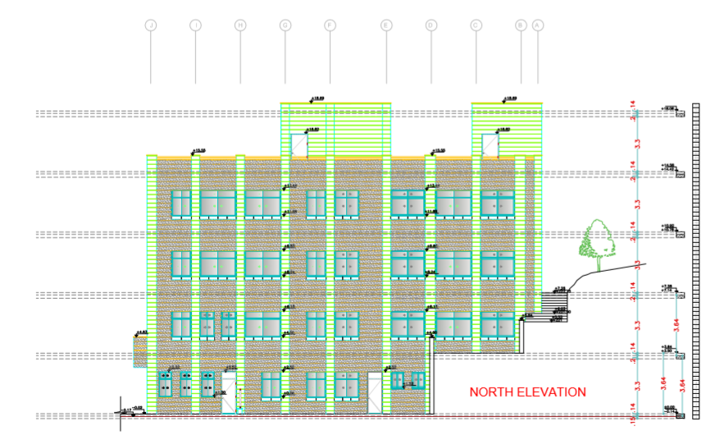
North Elevation
Figure 11: North Elevation

Slide 16
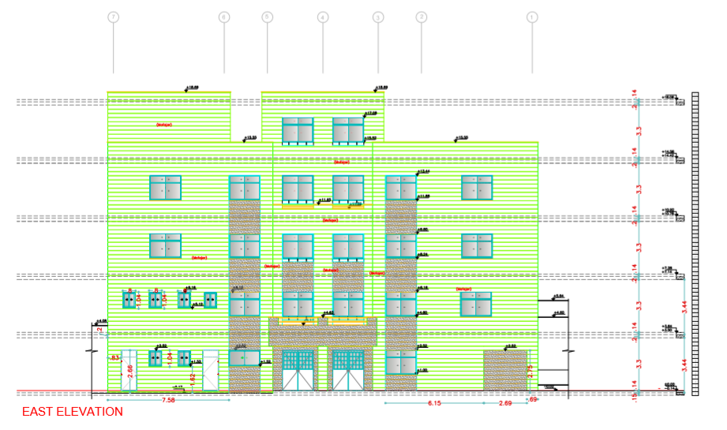
East Elevation
Figure 12: East Elevation

Slide 17
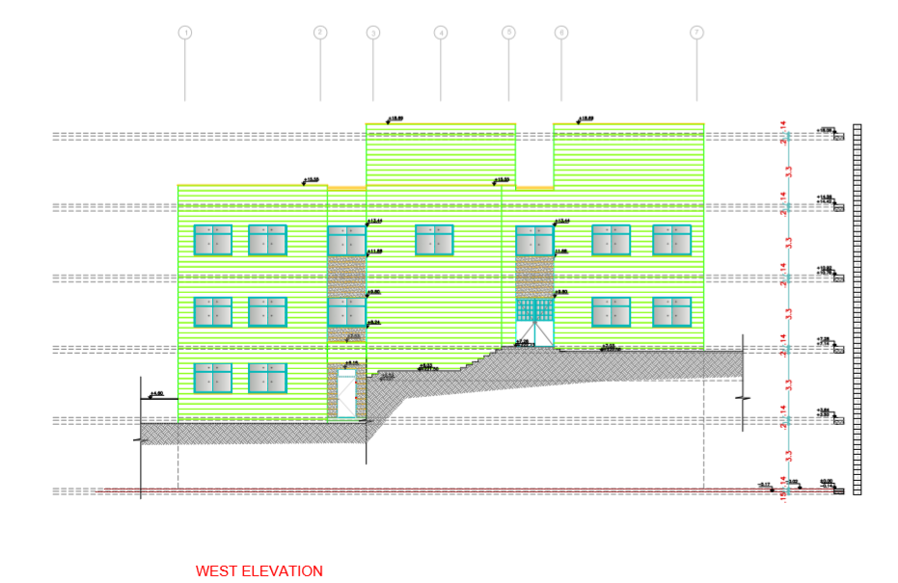
West Elevation
Figure 13: West Elevation

Slide 18
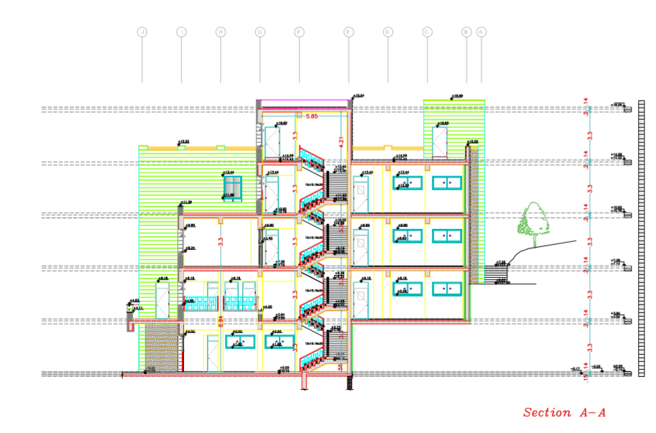
Section A-A
Figure 14: Section A-A

Slide 19
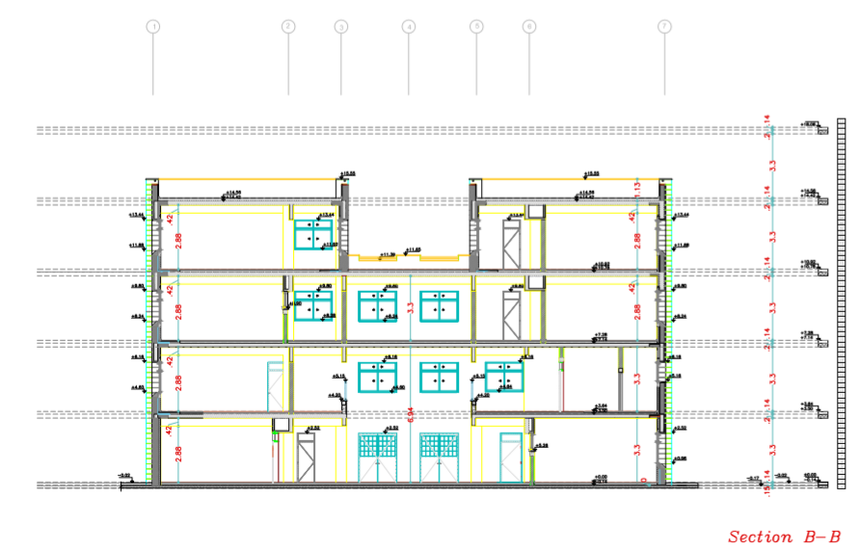
Section B-B
Figure 15: Section B-B

Slide 20
Structural Design
General Information
Design code
American Concrete Institute ACI 2014 for design.
Uniform Building Code (UBC 97) is adopted the code in Earthquake Analysis.
Materials
Concrete.
f´c = 32 Mpa for columns, walls and footings
f´c = 24 Mpa for slabs and beams
Reinforcement steel (Fy = 420 Mpa)

Slide 21
Structural Design
General Information
Loads
Live Load= 5 KN/m²
Superimposed dead load = 4 KN/m²
Properties of Materials
specific weight of Reinforced concrete = 25 KN/m³
Weight of Masonry wall = 21 KN/m
Weight of glass wall = 0.6 KN/m
Specific weight of block = 12 KN/ m³

Slide 22
Structural Design
Slab Structural System
One way solid slab with 250 mm thickness
This type was designed with drop beams

Slide 23
Structural Design
Structural Models
Since the school building is not tall and has a uniform design, there is no need to use joints to separate the building into sections.

Slide 24
Structural Design
Structural Models
Seismic joint

Slide 25
Structural Design
Structural Models
Figure 16: Seismic layout

Slide 26
Structural Design
Structural Models
ETABS Model
Figure 17:3D model

Slide 27
Structural Design
Structural Models
ETABS Checks
To ensure that the calculation is done correctly and to adopt the design results from ETABS; some checks are required:
compatibility check
Equilibrium check
internal force check
period check
deflection check
drift check
Modal mass participate ratio check (MPMR)
All checks were done for the three parts and all were acceptable.

Slide 28
Structural Design
Structural Models
Compatibility check
Figure 20:compatibility check

Slide 29
Structural Design
Structural Models
Equilibrium check
Table 2:Equilibrium check

Slide 30
Structural Design
Design of structural elements
Slabs
Figure 23:section of one way slab

Slide 31
Structural Design
Design of structural elements
Beams
We have five different sections of Beams in building:
Table 5: beams section
Table 6: Forces and capacities for Beam B1
Figure 25: beams layout

Slide 32
Structural Design
Design of structural elements
Beams
Reinforcement for Beam B1
Table 7: Reinforcement for B1

Slide 33
Structural Design
Design of structural elements
Beams
Figure 26: Detailing for B1
Figure 27: Section B-B

Slide 34
Structural Design
Design of structural elements
Columns
We have different sections of columns in building
Table 8:Columns detailing
Figure 28:Column C1 section
Figure 29:Column C2 section
Figure 30:Column C3 section
Figure 31:Column C4 section

Slide 35
Structural Design
Design of structural elements
Columns
Figure 32:Columns distribution

Slide 36
Structural Design
Design of structural elements
Walls
Table 9: walls section
Figure 33:walls layout

Slide 37
Structural Design
Design of structural elements
Shear walls 1and2
Figure 34: wall 1 section
Figure 35: wall 2 section

Slide 38
Structural Design
Design of structural elements
Cantilever retaining wall
Figure 36: Cantilever retaining wall dimensions and checks

Slide 39
Structural Design
Design of structural elements
Cantilever retaining wall
Table 10: Cantilever retaining wall reinforcement
Figure 37: Cantilever retaining wall detailing

Slide 40
Structural Design
Design of structural elements
Footings
Figure 38: isolated footing detailing

Slide 41
Structural Design
Design of structural elements
Wall footing
Figure 39: wall footing detailing

Slide 42
Structural Design
Design of structural elements
Stairs
Figure 40: internal stairs

Slide 43
Structural Design
Design of structural elements
Stairs
Figure 42: stairs detailing
Figure 41: external stairs

Slide 44
Environmental Design
As any aspect , environmental design is very important and it should be taken into consideration
Acoustical systems design
Photovoltaic system design

Slide 45
Environmental Design
Acoustical system
Acoustical system design and calculations were applied on Meeting hall and Classroom and corridors

Slide 46
Environmental Aspects Acoustic
Acoustical standard and value :
Sound pressure level(SPL)
Back ground noise
Noise rating (NR): difference between the sound intensity levels in the two rooms
Sound Transmission Class (STC): the sound transmission loss between adjacent closed rooms.
Impact Insulation Class (IIC): provides a means of comparing the acoustical performance of floor-ceiling assemblies
Reverberation time(RT60)

Slide 47
Environmental Aspects Acoustic
Name | Value
IIC | 45-70
STC | 45-60
RT60 | 0.6-0.8
Back ground noise | 35 db
SPL | 40-105
NR | 35

Slide 48
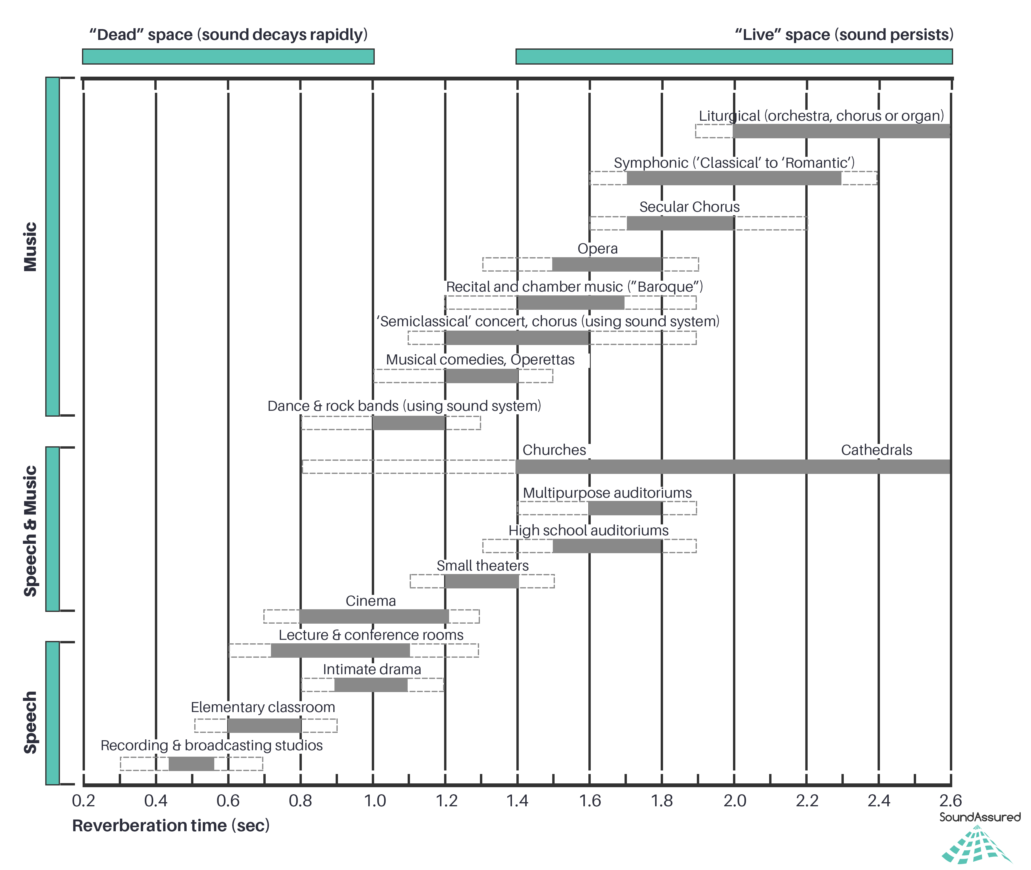

Slide 49
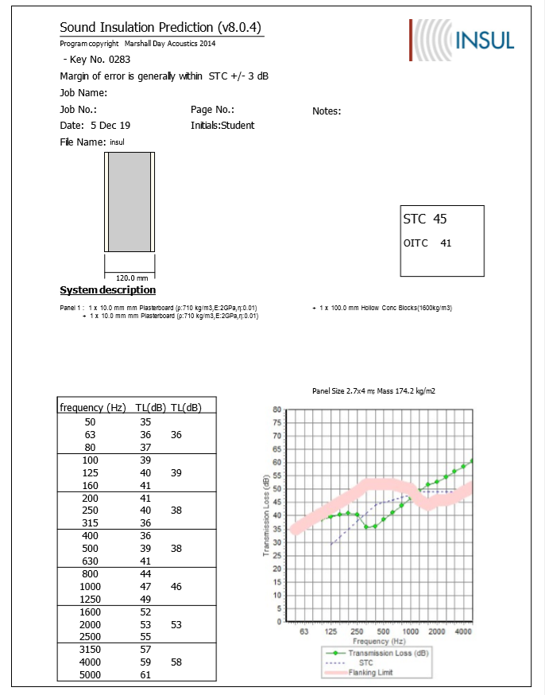
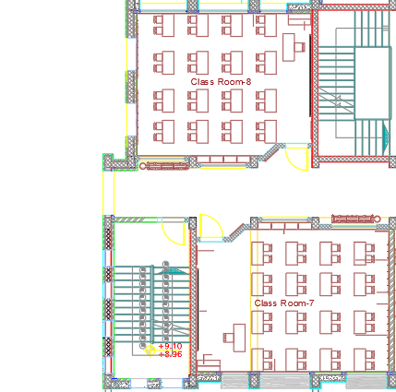
Use insul program
STC-45 if the adjacent space is a corridor, staircase, office or conference room

Slide 50
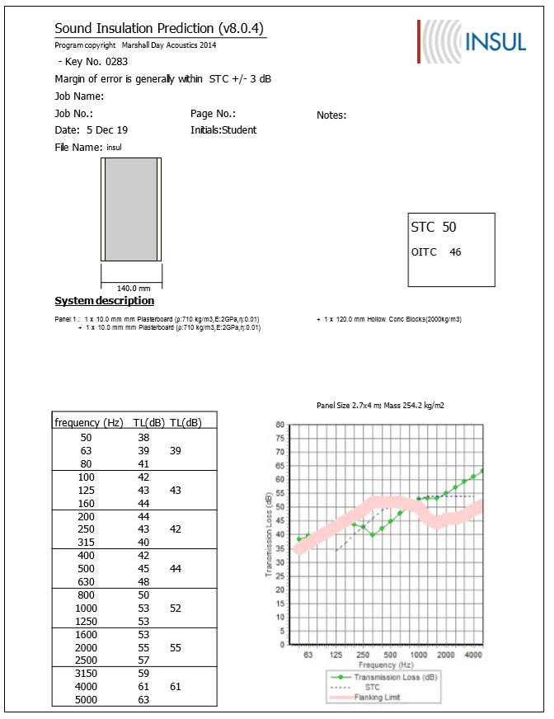
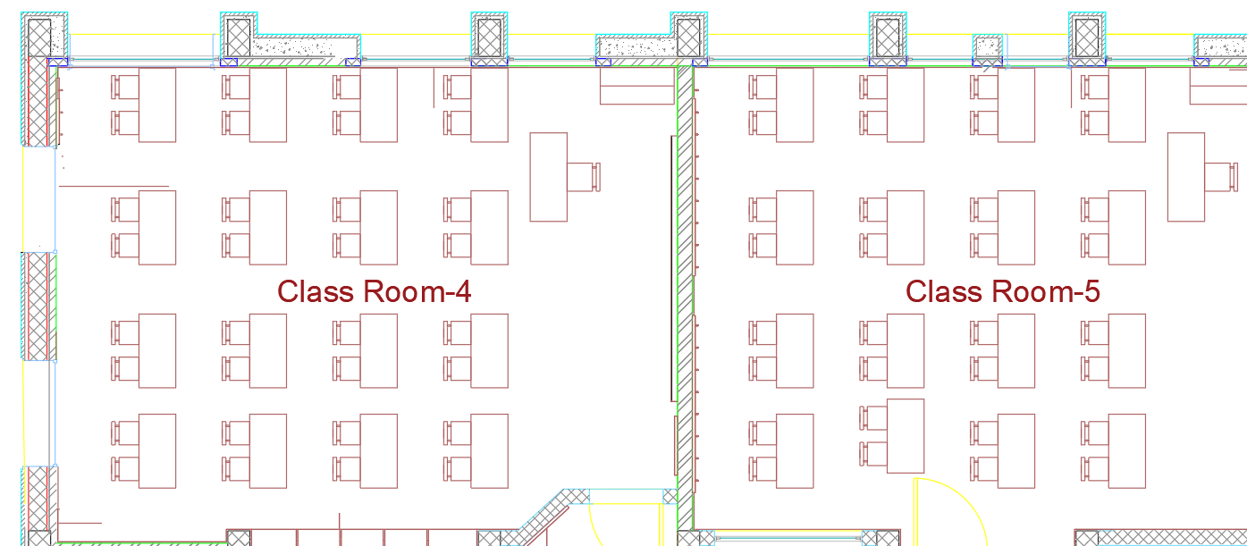
STC-50 if the adjacent space is
another core learning space, speech clinic ,health care room or outdoors

Slide 51
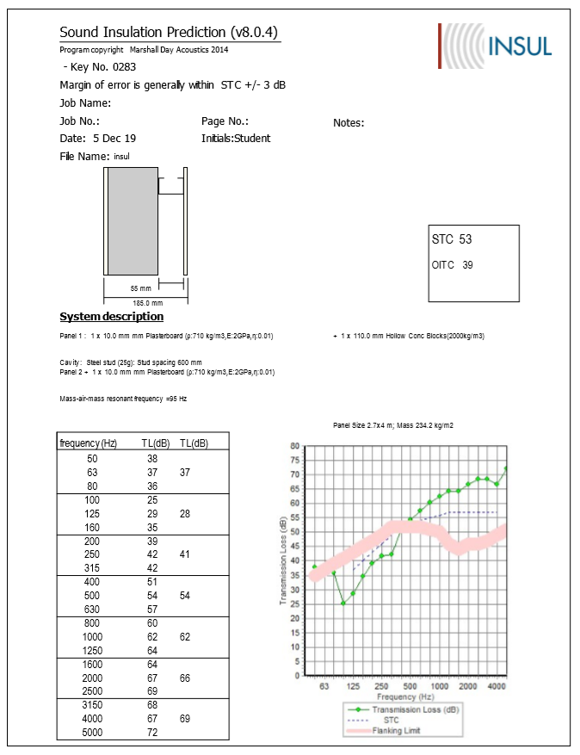
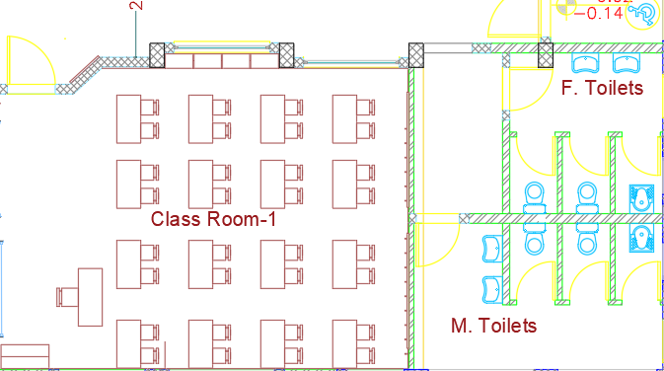
STC-53 if the adjacent space is a restroom

Slide 52
IIC (impact insulation class)
IIC ratings for floor-ceiling assemblies above core learning spaces should be at least IIC-45 and preferably IIC-50 (measured without carpeting on the floor).

Slide 53
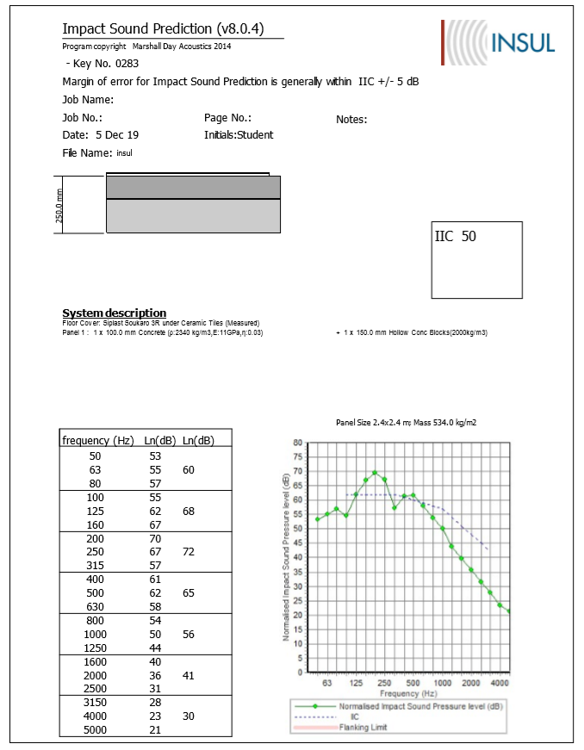

Slide 54
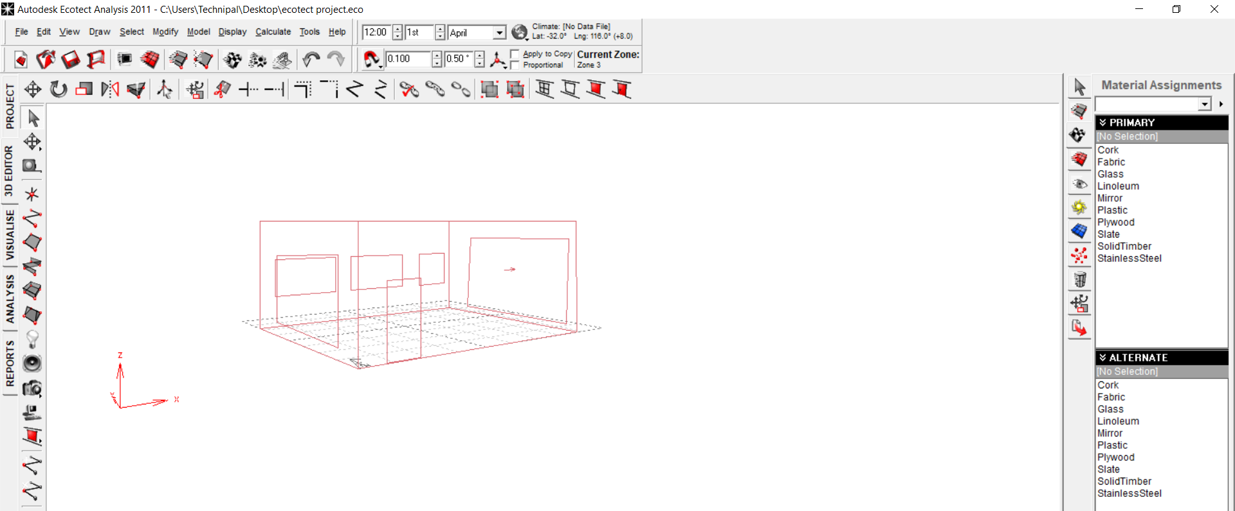
Ecotect program to calculate RT60

Slide 56
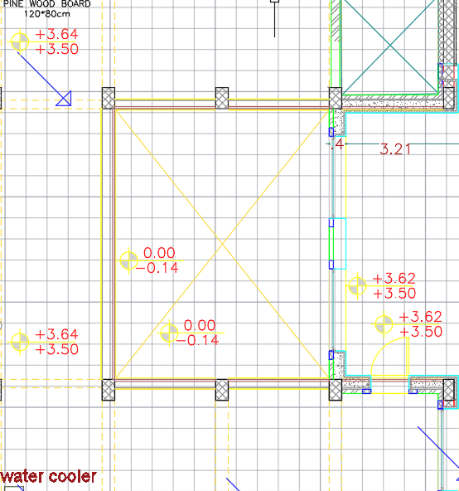
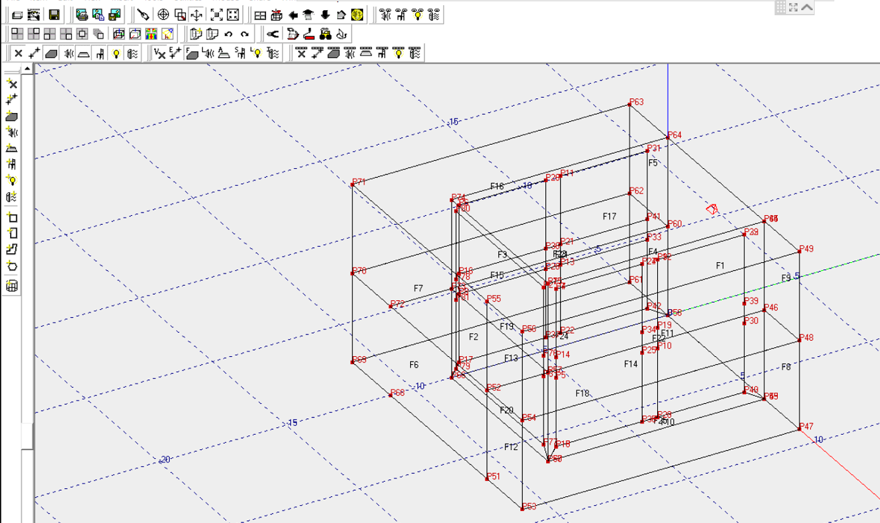
Environmental Design
Acoustical system
We used ease program to analyzed the sound
We took the court area.
Figure 43:ease program

Slide 57
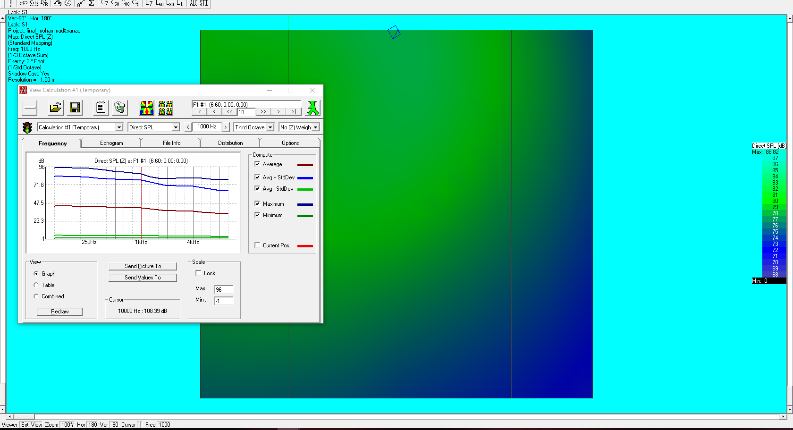
Environmental Design
Acoustical system
Figure 43: the result from ease program

Slide 58
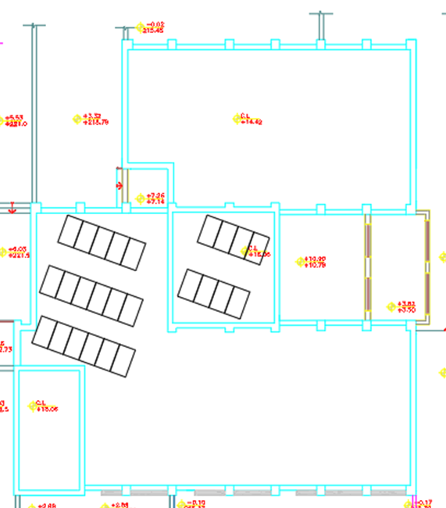
Environmental Design
Photovoltaic system design
We will design solar cells by the PV syst program as described
The number of modules = 24 panel
The maximum KWP generated = 8.8 KWP.
Number of invertors = 4 invertors.
Area of system = 50 m².
Figure 44: PV system distribution

Slide 59
Mechanical Design
Plumping Works.
Fire Fighting Works.
HVAC Works.
Ventilation System

Slide 60
Mechanical Design
Plumping works.
Procedure of the IPC Code of Water Supply and drainge Systems.
The capacity of underground storage tank =40.2 m³
For the roof tank capacity = 20.1 m³
The amount of rain water collection = 89.2m³
The capacity of Storm Tank =13.44 m³ .
Lift pump Flow in GPM =100

Slide 61
Mechanical Design
Water Supply System
We have two type systems
For flush tank from storm tank
For other functions from fresh tank

Slide 62
Mechanical Design
Water Supply System
Pipes Diameters
Types of pipes:
Stainless Steel for Vertical pipes
PVC for horizontal and branch pipes

Slide 63
Mechanical Design
Water Supply System
Ground Floor
Table 12: Pipes diameters for ground floor
 |  |  | Riser
 | SERV | Type | WFU | GPM | Size | Pipe Length | Pressure Drop (PSI)
G.F | CW | FT | 160 | 56.26 | 11/4" | 1044 | 10
 | HW | FT | 160 | 56.26 | 2-1/2" | 1044 | 10
 |  |  | Horizontal pipe
 | SERV | Type | WFU | GPM | Size | Pipe Length | Pressure Drop (PSI)
G.F | CW | FT | 32 | 20.55 | 1-1/2" | 225 | 7.44
 | HW | FT | 32 | 20.55 | 1-1/2" | 225 | 7.44
 |  |  | Riser at second collector
 | SERV | Type | WFU | GPM | Size
G.F | CW | FT | 12 | 8.75 | 1"
 | HW | FT | 12 | 8.75 | 1"

Slide 64
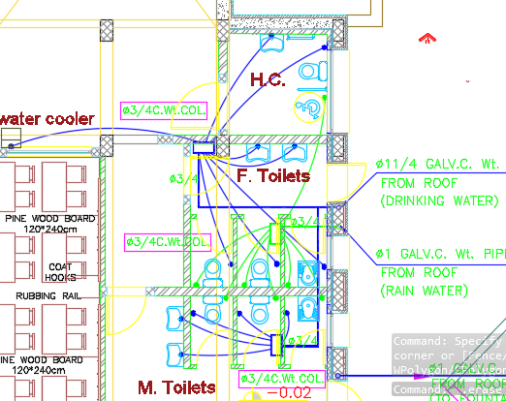
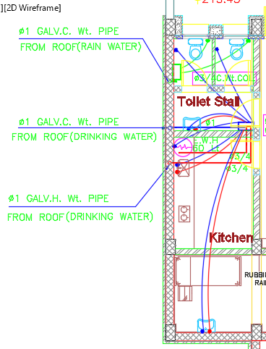
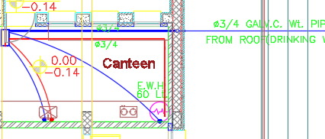
Mechanical Design
Water Supply System
Ground Floor
Figure 50: Pipes distribution for Ground floor

Slide 65
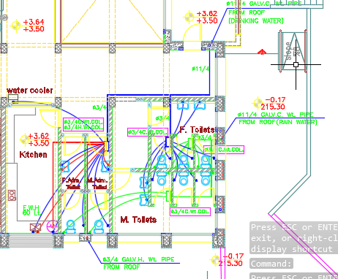
Mechanical Design
Water Supply System
First Floor
Figure 51: Pipes distribution for first

Slide 66
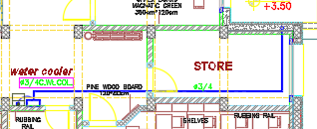
Mechanical Design
Water Supply System
Second Floor
Figure 53: Pipes distribution for second floor-West side

Slide 67
Mechanical Design
Water Drainage System
Three types of drainage water systems:
Black water
We use 4 inch stakes with slope 1% for all WC's.
Grey water
We use 2 inch with slope 2% for lavatories.
Rain water
We use 4 inch with slope 1%
We use 6 inch with slope 1% between manholes.

Slide 68
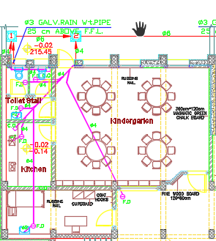
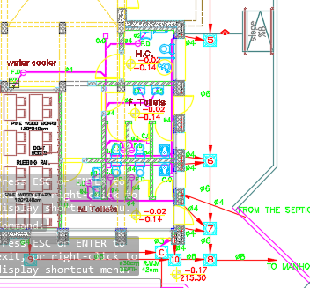
Mechanical Design
Water Drainage System
Ground floor
Figure 55: drainage system for ground floor

Slide 69
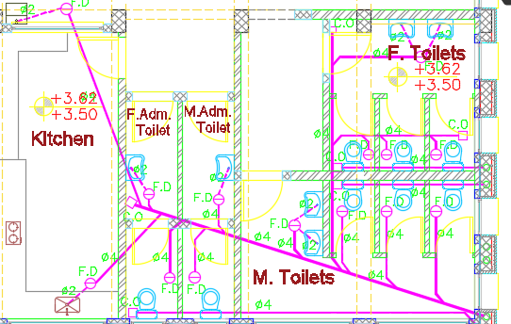
Mechanical Design
Water Drainage System
First floor
Figure 56: drainage system for first floor-West side

Slide 70
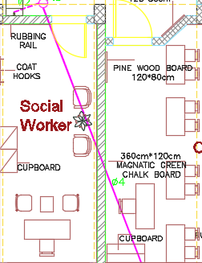
Mechanical Design
Water Drainage System
Second floor
Figure 58: drainage system for second floor-West side

Slide 71
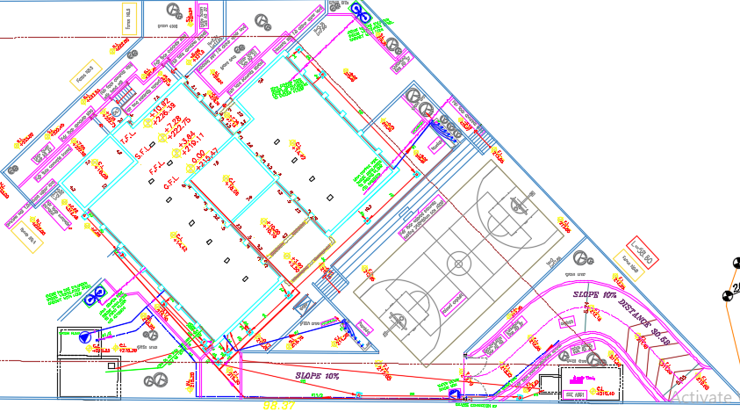
Site plan derange with septic tank.

Slide 72
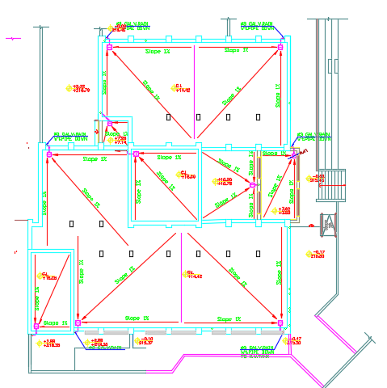
Mechanical Design
Water Drainage System
Rain Water drainage
Diameter of Horizontal pipe |  |  |  | 4 | Inch.
Get Maximum GPM in Conductors |  |  |  | 78 | GPM
Diameter of roof Gutters drain |  |  |  | 4 | Inch
Maximum GPM for Gutters |  |  |  | 8 | GPM
NO. of Gutters Required |  |  |  | 10 | GUILTERS
Figure 60: Rain Water drainage system

Slide 73
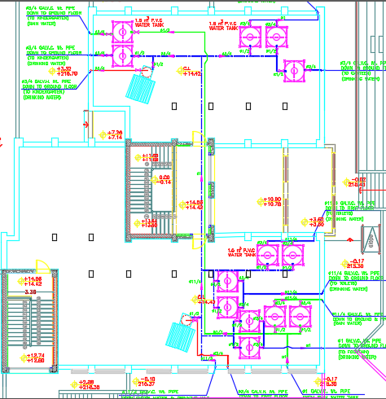
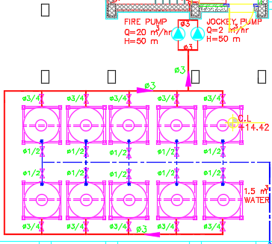
Roof Tank layout.

Slide 74
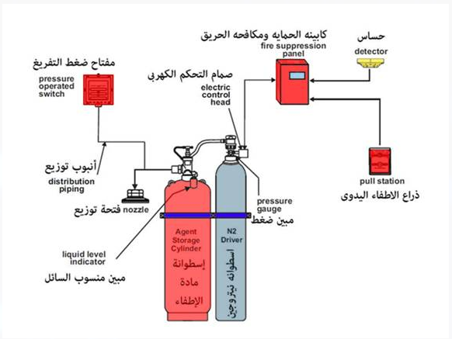
Fire protection
Fire protection system
The most common systems used in schools is:

Slide 75
Fire Fighting
Fire Protection System
First: Sprinkler’s:This type was used in areas with no electrical appliances due to its low price and ease of use :
We used Elite software
Number Of Unique Pipe Sections: | 8
Pipe System Water Volume: | 21.33 | gal
Sprinkler Flow: | 209.69 | gpm
Minimum Required Residual Pressure At System Inflow | 15.56 | psi
Node:
Demand Flow At System Inflow Node: | 207.04 | gpm

Slide 76
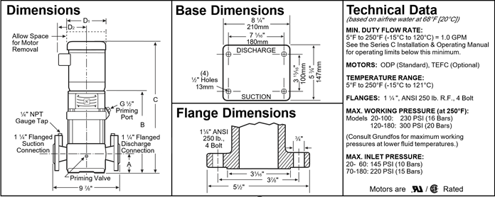
Fire Fighting
Fire Protection System
Fire pump
We used National pump selector software.

Slide 77
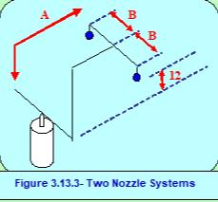
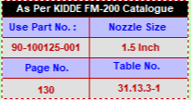
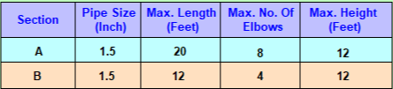
Fire Fighting
Fire Protection System
Second:FM 200:This device is also used in electrical control and distribution booths to extinguish fires of electricity,
FM200 Clean Agent Calculations.
Sample calculation :
Room Name (Space): ,head master room.
Hazard Level: Class “C” (Electrical)-AUTOMATICALLY ACTIVATED-Medium Hazard
Volume = 145.75 m3
Concentration Ratio = 7 %
Design Temperature = 20°C
Specific Volume = 0.1373 kg/m3
Altitude = 31.9 m, From Sea Level
Altitude Correction Factor = 0.1373
Flooding Correction Factor = 0 [ w = (V/s) X (c/(100-c) ] kg w = 79.9011661145439 kg
w = 80 kg
Number of Cylinders = 1
Size of Cylinder = 87 Lit.

Slide 78
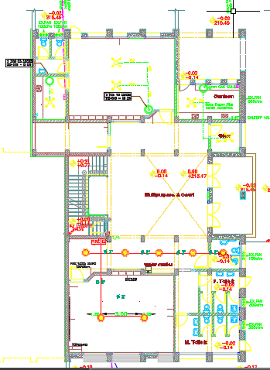
Fire Fighting
Fire Protection System
Figure 77: Fire Protection System for ground floor

Slide 79
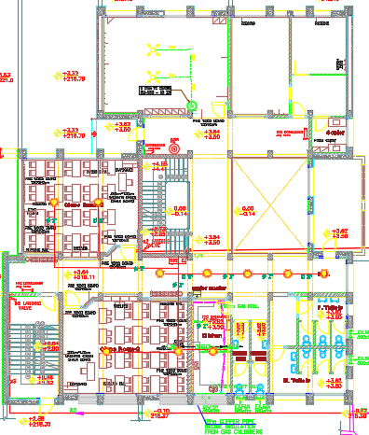
Fire Fighting
Fire Protection System
Figure 77: Fire Protection System for First floor floor

Slide 80
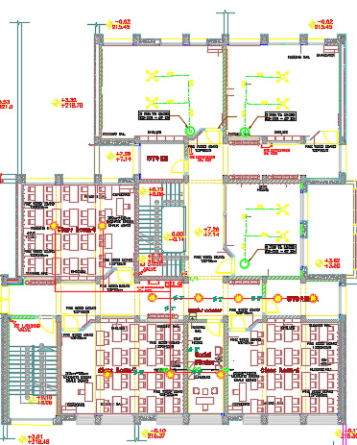
Fire Fighting
Fire Protection System
Figure 77: Fire Protection System for second floor

Slide 81
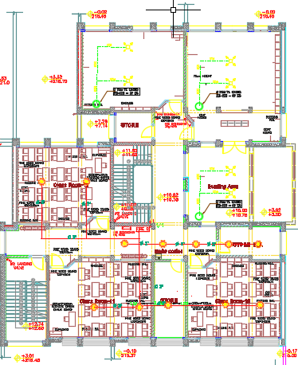
Fire Fighting
Fire Protection System
Figure 77: Fire Protection System for third floor

Slide 82
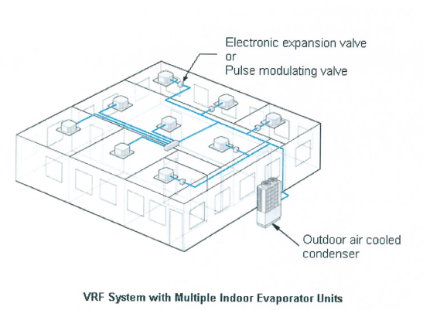
Mechanical Design
HVAC system.
VRF (FLOW REFRIGERANTE VARIABLE):This system consists of one piece of OUTDOOR and the INDOOR kit can be INDOOR wall, ceiling, concealed or floor etc.
Figure 61 VRF system

Slide 83
Mechanical Design
HVAC system.
System component :
1.Out door unit .
2.Indoor units.
3.Ducts.
4.Diffusers,

Slide 84


Mechanical Design
HVAC system.
Sample of calculation for class room.
We used HAP software to Find Air system information
And we used Ductilator software to find “duct dimension”

Slide 85

Mechanical Design
HVAC system.
Sample of calculation for class room.
Diffuser
Supply and return calculation
Air flow=A*V
.0.7=”X*Y”*3.25
0.7/325
Square diffuser = 0.5 *0.5 m
Selection of Air condition
We used selection VRV tools to select model of VRV system.

Slide 86


Mechanical Design
HVAC system.

Slide 87

Mechanical Design
Figure 62: HVAC system for ground floor.

Slide 88

Mechanical Design
Figure 62: HVAC system for First floor.

Slide 89

Mechanical Design
Figure 62: HVAC system for second floor.

Slide 90

Mechanical Design
Figure 62: HVAC system for Third floor.

Slide 91


Mechanical Design
Mechanical Ventilation
Exhaust Fan
CFM= V * ACH / 1.7
= 8 * 19 / 1.7
=100 CFM.
CFM = 8 * 48 / 1.7
= 300 CFM.

Slide 92


Mechanical Design
Mechanical Ventilation
Exhaust Fan
CFM= V * ACH / 1.7
= 10 * 48 /1.7
=300 CFM.
CFM = 10 * 48 / 1.7
= 300 CFM.

Slide 93
Electrical Design
The Electrical systems is one of the significant systems in the building
Lighting System
Outlets Socket
Power Calculations

Slide 94

Electrical Design
Lighting System
DIALux program was used to design lighting system in school
Figure 65: School model in DIALux

Slide 95


Electrical Design
Lighting System
Some of spaces in school
Figure 66: Classroom
Figure 67: Meeting hall

Slide 96

Electrical Design
Lighting System
Eight types of luminaire was used in lighting system design
Table 17: Number of lamps that were used in the school

Slide 97

Electrical Design
Lighting System
Figure 68: Lighting design for basement floor

Slide 98

Electrical Design
Lighting System
Figure 69: Lighting design for ground floor

Slide 99

Electrical Design
Lighting System
Figure 70: Lighting design for first floor

Slide 100

Electrical Design
Lighting System
Figure 71: Lighting design for second floor

Slide 101


Electrical Design
Lighting System
Table 18 : Summary of results of lighting design

Slide 102

Electrical Design
Outlet Socket
Figure 72: Outlet socket design for basement floor

Slide 103

Electrical Design
Outlet Socket
Figure 73: Outlet socket design for Ground floor

Slide 104

Electrical Design
Outlet Socket
Figure 74: Outlet socket design for First floor

Slide 105

Electrical Design
Outlet Socket
Figure 75: Outlet socket design for Second floor

Slide 106

Electrical Design
Power Calculations
Basement Floor
Table 19: Summary of power calculation for basement floor

Slide 107

Electrical Design
Power Calculations
Ground Floor
Table 20: Summary of power calculation for ground floor

Slide 108

Electrical Design
Power Calculations
First and Second Floors
Table 21: Summary of power calculation for First and Second floors

Slide 109

Electrical Design
Power Calculations
Table 22: Summary of Power Calculations

Slide 110

Electrical Design
Main Circuit Breaker
Figure 76: Main Circuit Breaker

Slide 111
Safety Design
Egress Route
Figure 81: Egress Route for ground floor

Slide 112

Cost Estimation
Table 23: Summary of cost estimation
Total cost = 1290208 US$
Total cost for each squared meter = 636.9US$/m²

Slide 113
Thank You

