Slide 1

Water Distribution Network of Anabta

Slide 2
Outline
Introduction
Objective
Study area
Analysis
Design criteria and assumptions
Design
Conclusion and recommendations
Halt and difficulties

Slide 3
Introduction
Water has always been an essential part in life. And it is our job as civil engineers to make it available easily . This is why network distribution is very important every where.

Slide 4
Objective
  To analyze the existing network .
  2. To redesign the network to meet people needs in present and future for 30 years.
3. To reduce cost and effort

Slide 5
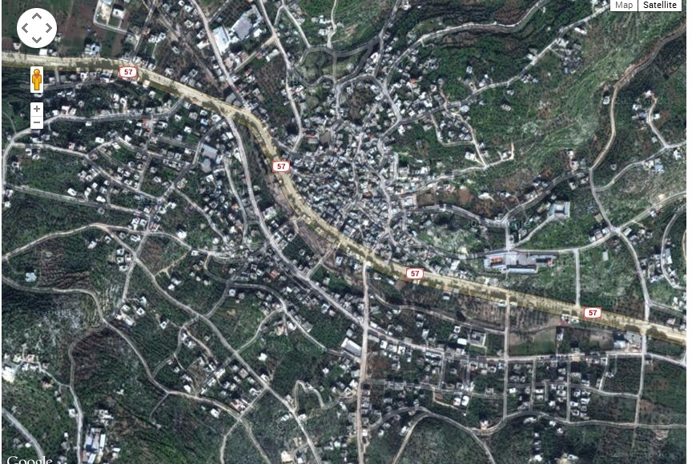
  Study Area

Slide 6

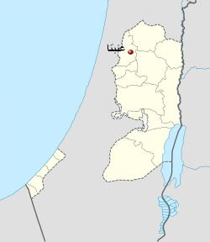

  Study Area
Anbta’s location.
Area equals 19471 donoms.
Population is 8300 inhabitant.
Climate: Temp. approx. 27
humidity (40 - 70 )summer.
(70 – 85) winter.

Slide 7
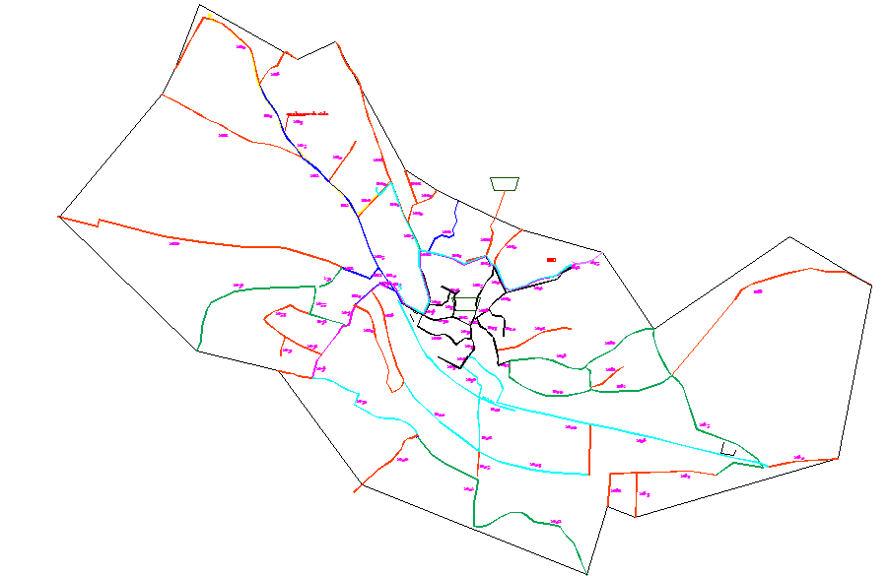
Existing Network of Anabta

Slide 8

Analysis
Sample Calculation
Node ID | Elevation | Demand (L/sec)
5 | 160 | .101
Demand for 1 node:
Area covered by node 5 = ( 1/9 A10 + 1/5 A11 + 1/10 A14) = 13276.97 m2
Number of people = ( 1/9 A10 x 5.07 )+ (1/5 A11 x 5.07) + (1/10 A14 x 6.73)/1000
=73 ca.
Demand of node 5 = 73 x (100 L /C.day) = .101 L/sec

Slide 9
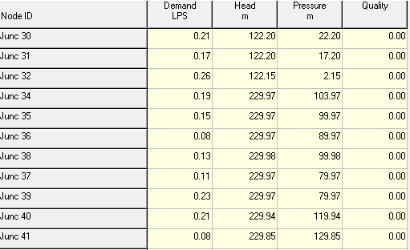
Analysis Results :
Pressure in nodes

Slide 10
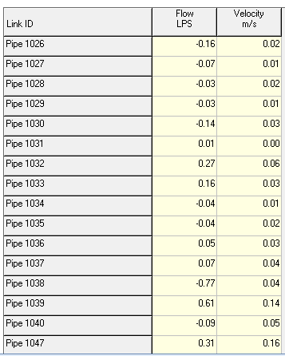
Velocity in pipes

Slide 11
Design Criteria
Velocity (0.6 – 3 ) m3/s
2) Pressure ( 20 – 80 ) m.H20
Assumptions
Growth rate = 1.9 %
Future demand = 120 L/c.d
Density is not constant
Demand pattern

Slide 12
Unit price
Unit price | component
40 $/ m | 2” ductile iron pipe
45 $/m | 3” ductile iron pipe
58 $/m | 4” ductile iron pipe
75$/m | 6” ductile iron pipe
95 $/m | 8” ductile iron pipe
200 $ | 4” PRV
300 $ | 6” PRV

Slide 13
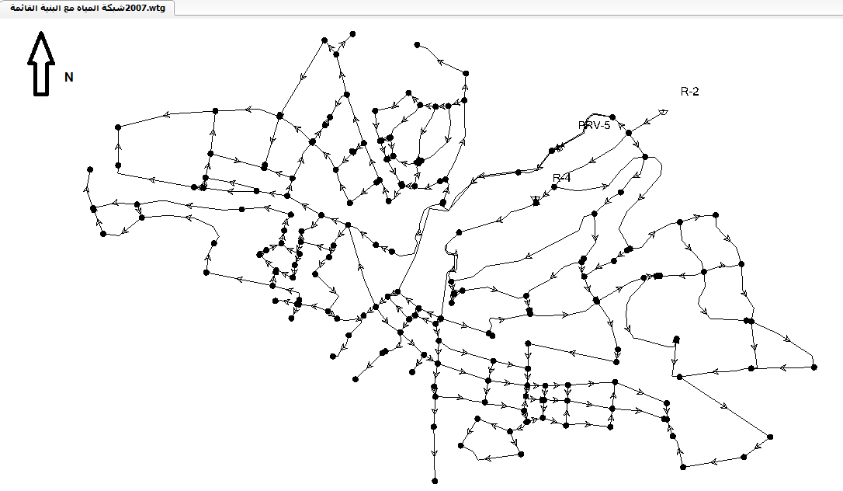
Network design :
Model 1
Looped system
Nodes 191
Pipes 243
Cost = 1,415,289$.

Slide 14
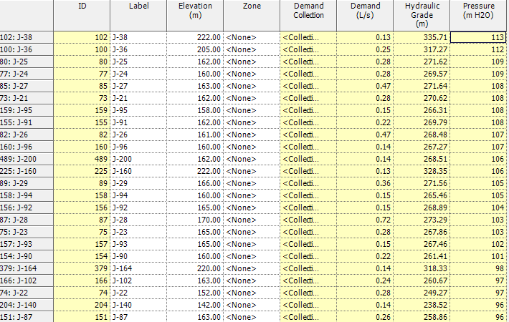
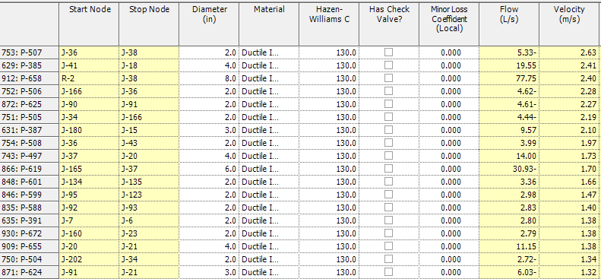

Slide 15
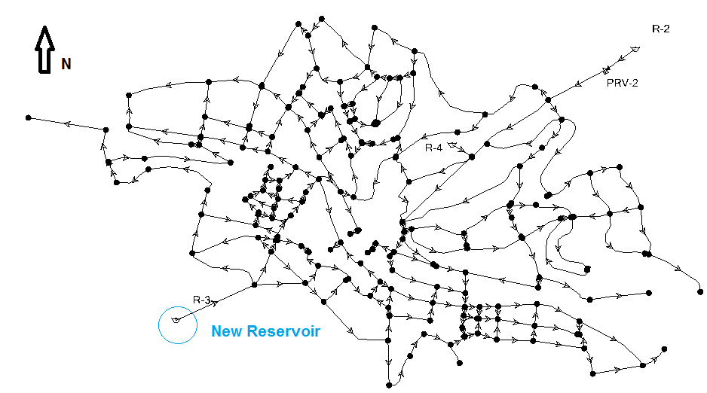
Model 2
Looped system with constructing new reservoir
Nodes 193
pipes 246
Cost =1 ,660,931 $

Slide 16
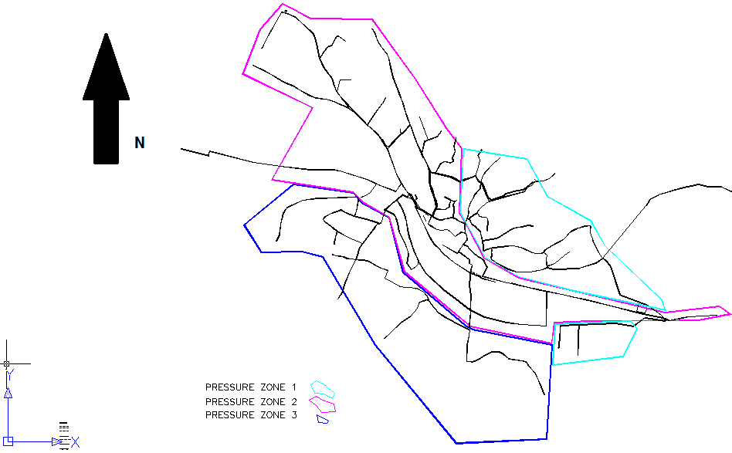
Pressure zones

Slide 17
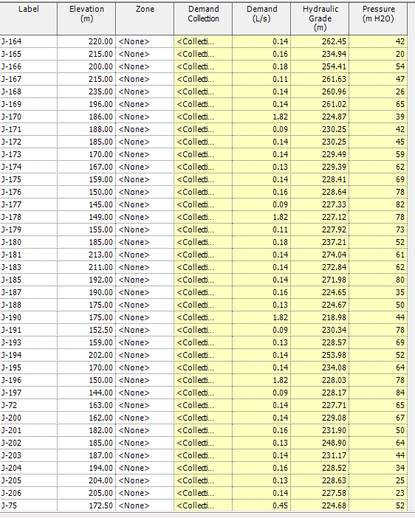
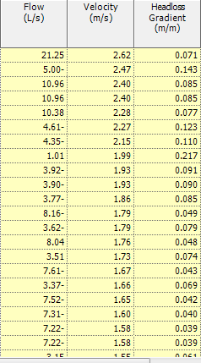

Slide 18
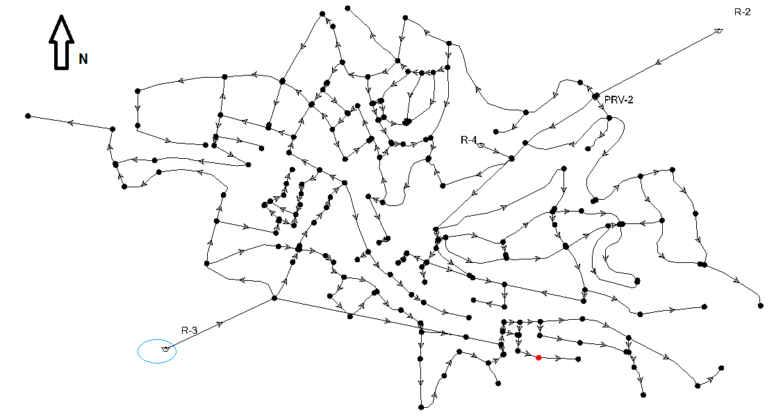
Model 3
branched system with constructing new reservoir
Nodes 193
pipes 200
Cost = 1,501,102 $

Slide 19
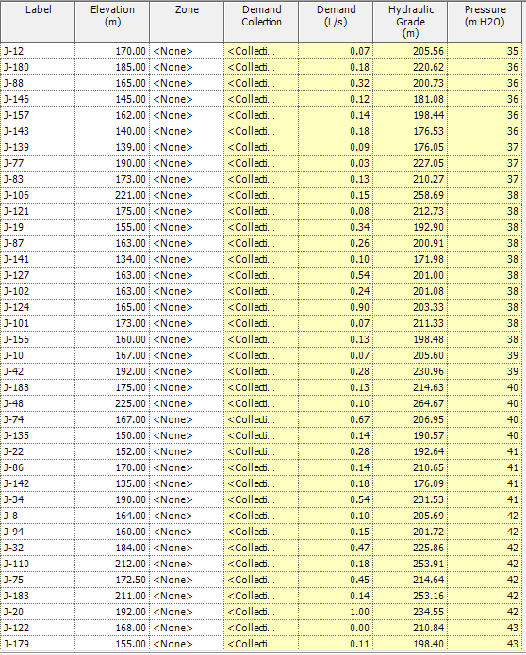
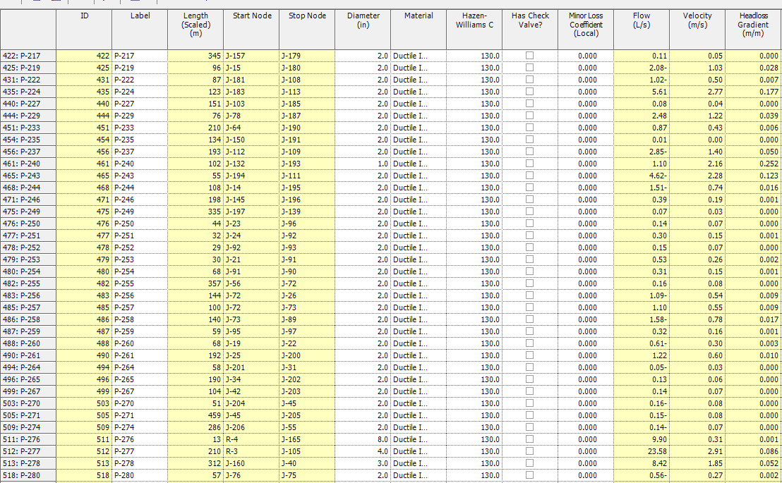

Slide 20
Network Design
Disadvantages | Advantages | Designed model
Values of pressure don’t meet design criteria | Most economic | Model 1
Not economic | Meets the criteria | Model 2
Branched ! | Meets the criteria | Model 3

Slide 21
Conclusion and Recommendations :
Model 2 is not the most economic but the best
2) All the designed models are gravity systems
3) losses are reduced

Slide 22
Halts and Difficulties
Inability to simulate reality conditions
2) Lack of cooperation by the consultant to provide us the prices
3) Scarcity of information

Slide 23


