Slide 1
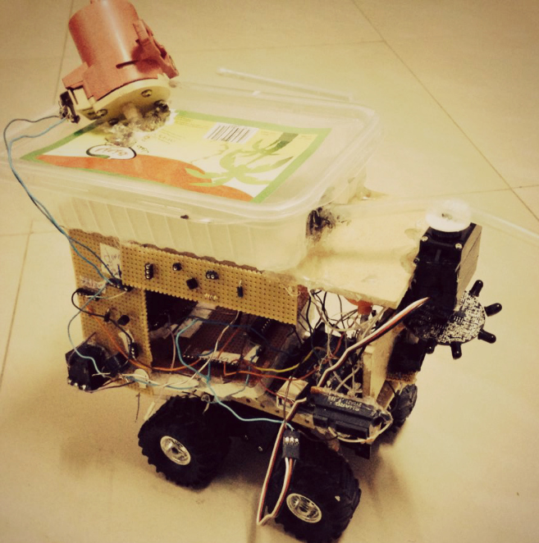
Fire Fighting
Robot
Prepared by:
Fatima Darawsheh
Jameela Rabaya

Slide 2
Outline
Introduction
Problem statement
Objectives
Scope
Component
Vehicle Design
Problems
Costs
Conclusion
Demo

Slide 3
What is a fire fighter robot?
A robot that detects the fire and extinguish it.
Should work automatically and detect the flame.
A good replacement of fireman in dangerous places.

Slide 4
Why fire fighter robot?
Now a days if any fire accidents happens in Power plants, Buildings, etc., the time and consumption of human power is high. So there may be a possibility of Heavy damage to human beings.
The elimination of fire before it spread away will avoid the catastrophic effects.

Slide 5
Objective
Design and development of low cost firefighting robot.
Run automatically firefighting robot.
Extinguish fire.

Slide 6
Scope
Design a fire fighting robot using numerical approach.
Select the suitable material to develop the robot.
The developing of programming is necessary to develop a mechanism of the robot.

Slide 7
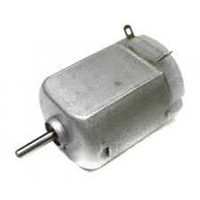
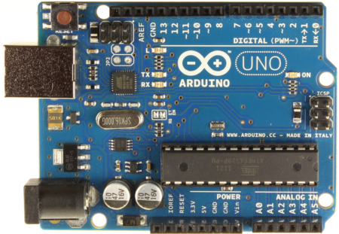
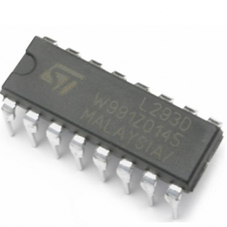
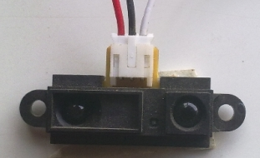
Component
Arduino Uno
DC Motor
Infrared Proximity Sensor
L293D H-Bridge

Slide 8
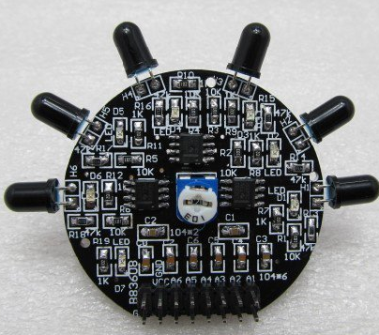
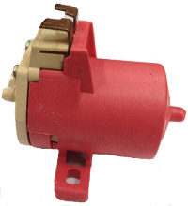
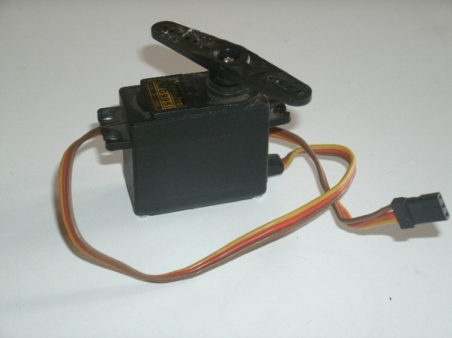
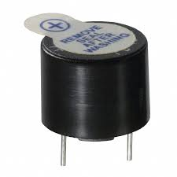
CONT’s
Flame sensor
Water pump
Servo Motor
Buzzer

Slide 9
DESIGN:
Steps of building the module
Movement step.
Flame tracking step.
Extinguishing Fire step.

Slide 10
Movement step
Read from front sensor if it’s less than specified value go forward. Else stop and find new route.
Find new route by going backward .Read left and right sensors. If left distance less than right distance then turn left else turn right.
Go back to first step.

Slide 11
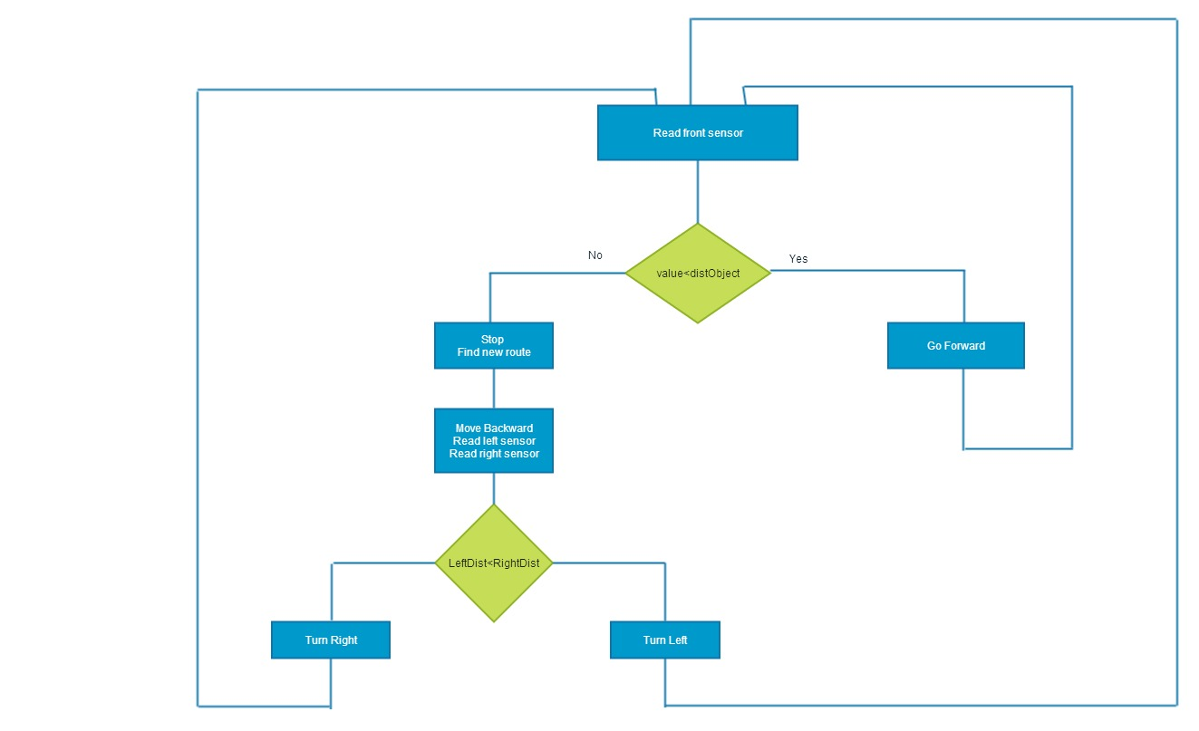
ALGORITHM
Figure ‎1-2: Movement Algorithm

Slide 12
Flame tracking step
After we test the movement model we integrate the flame sensor to the model.
The flame sensor is an array of sensors, it detect the fire from front, left and right. So, in this step the robot will not move until the flame sensor sense the fire.

Slide 13
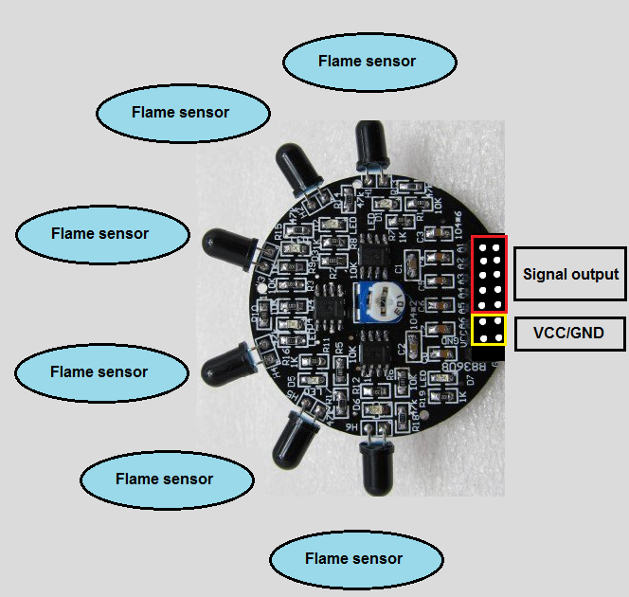
CONT’s
Three flame sensors from the array are used to detect fire from front, left and right.
To be accurate we read three values for each one and evaluate the average and we must wait few milliseconds before start reading new values from the sensors.

Slide 14
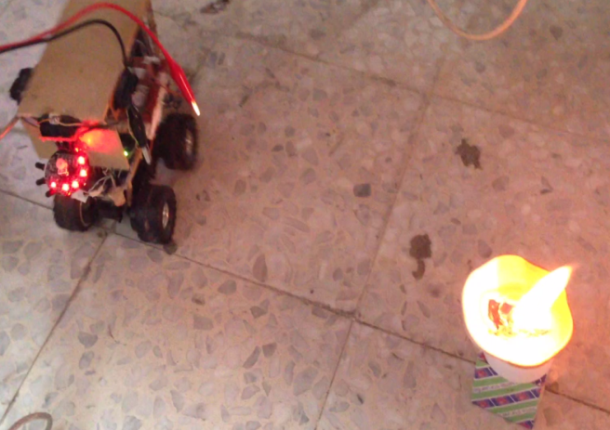
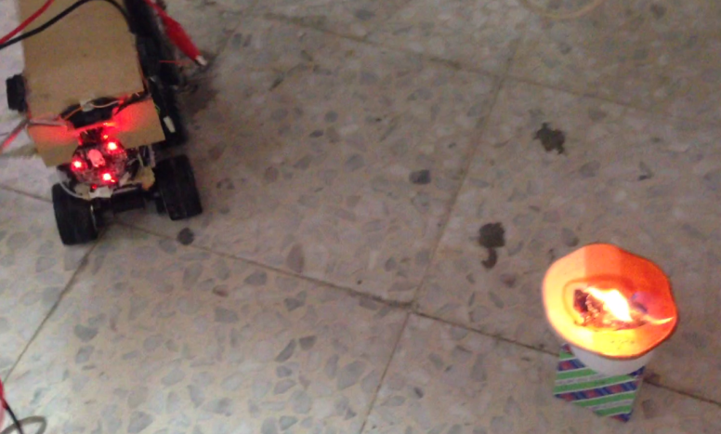
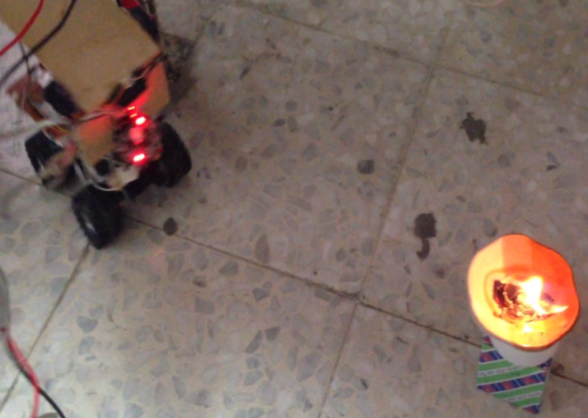
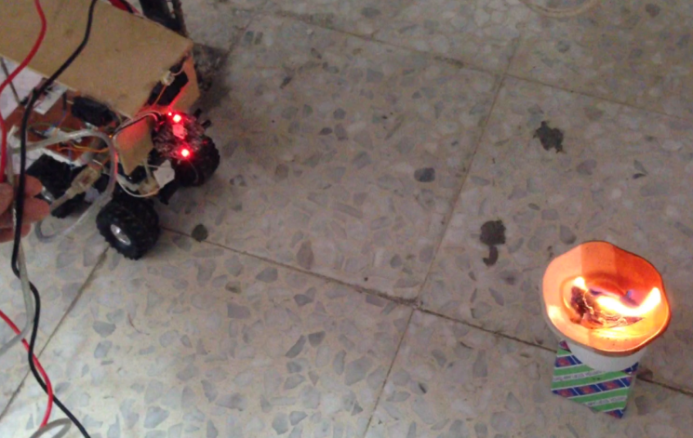
CONTT’s

Slide 15
Extinguishing Fire step
The robot track the flame.
When the fire is near stop and turn on the pump.
While the water pump is running the robot will keep sensing the fire if no flame (fire) then it will turn off the buzzer and pump.

Slide 16
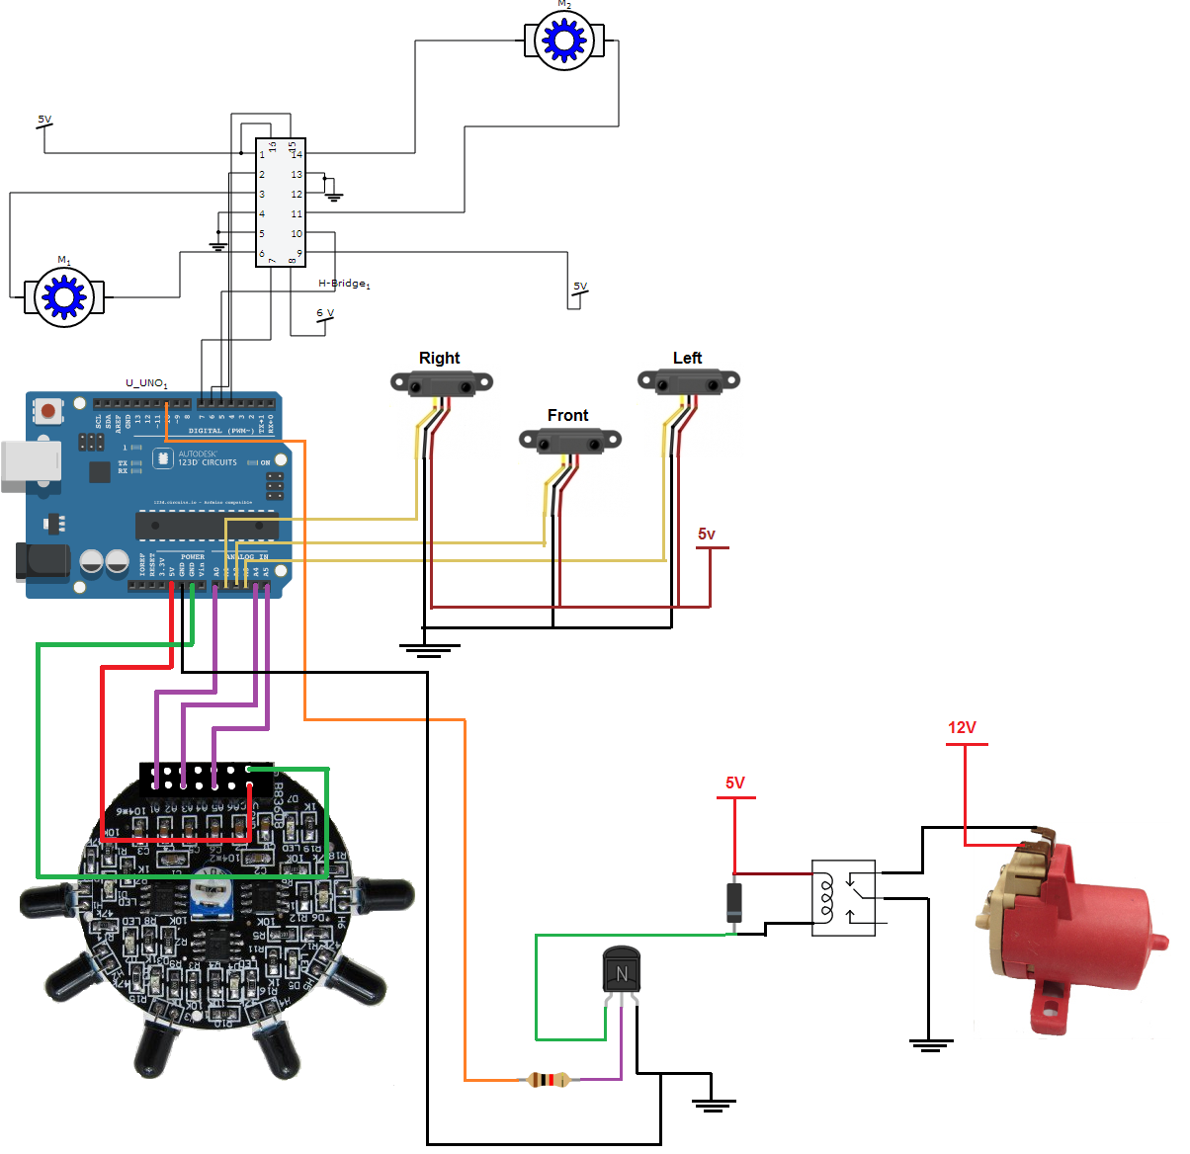
The module circuit

Slide 17
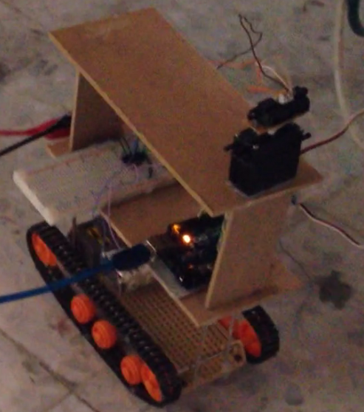
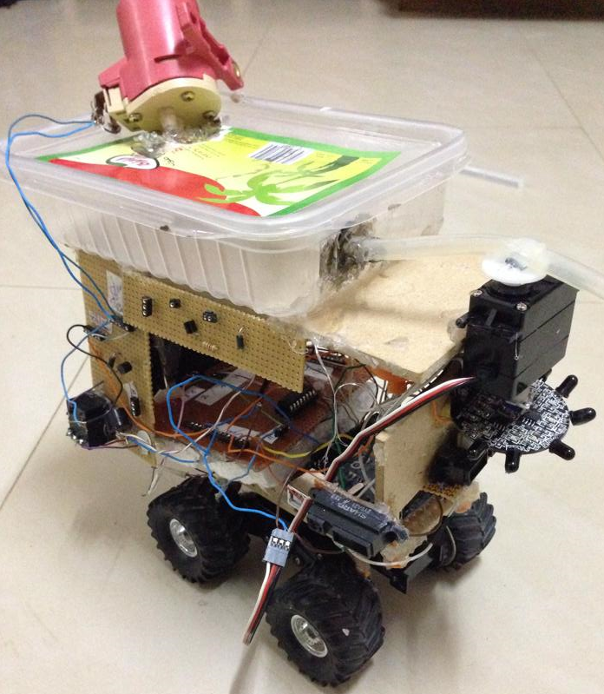
Models
Old
New

Slide 18
Final Model

Slide 19
Problems
Mechanical constraints.
    How to build the model to be robust, balanced, reliable and safe.
Components constraints.
    The quality of some components such as servo motor which damaged quickly
Environment constraints.
    Flame sensor range
Money constraints.

Slide 20
Costs
Component name | Quantity | Price
Flame sensor | 1 | 95nis
Distance sensor | 3 | 85nis
Arduino | 1 | 170nis
Servo motor | 2 | 85nis
Dc motor | 1 | 65nis
Water Pump | 1 | 35nis
H-bridge | 8 | 15nis
Relay | 1 | 6nis
Total cost=400$

Slide 21
Conclusion
In this project we aim to reduce the effect of fires accidents which usually start from small flame, therefore people life and money would be saved.
The robot can successfully find fire and reach it without running into obstacle.
We managed to construct the robot comfortably and user friendly within the budget of $400.

Slide 22
References
http://www.extremeelectronics.co.in/avrtutorials/pdf/avr_tutorial7---motor-control.pdf
GP2Y0A21YK-DATA-SHEET.pdf
http://es.aliexpress.com/item/The-new-flame-sensor-module-6-road-detection-analog-to-digital-dual-output-fire-robot-updated/764636161.html

Slide 23
Demos

Slide 24


Slide 25


