Slide 1

Tourist Helper Application
By:
Omama Yousef
Yasmin Najar
Supervised by
Dr. Wael Mustafa

Slide 2
CONTENTS
Basic idea of the project
Software Used
Challenges
System Architecture
Design Diagram
System scenarios
Future Works

Slide 3
CONTENTS
Basic idea of the project
Software Used
Challenges
System Architecture
Design Diagram
System scenarios
Future Works

Slide 4
IDEA
An application to help tourist communicate with places to save time and effort, in many situations
Provide a system to helps you to meet places by easiest way possible in a new country such as restaurants ,hotels,police station ,shops,public places
know new place and information about it
Other features

Slide 5
CONTENTS
Basic idea of the project
Software Used
Challenges
System Architecture
Design Diagram
System scenarios
Future Works

Slide 6
Programming langs
-java android
-firebase for database

Slide 7
CONTENTS
Basic idea of the project
Software Used
Challenges
System Architecture
Design Diagram
System scenarios
Future Works

Slide 8
CHALLENGES
Learn a new PL (Android) and programming at the same time
Create DataBase on online web server and connect android app with server
re-study how to build a database article to avoid problems in a project
Unlimited availability of features
Patience and time in accomplishment and tension
Using maps set and get the location from it
handle error
Search in google for information

Slide 9
CONTENTS
Basic idea of the project
Software Used
Challenges
System Architecture
Design Diagram
System scenarios
Future Works

Slide 10
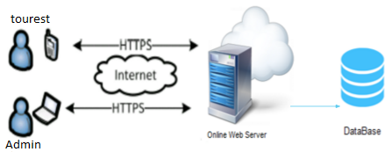
System Architecture

Slide 11
CONTENTS
Basic idea of the project
Software Used
Challenges
System Architecture
Design Diagram
System scenarios
Future Works

Slide 12
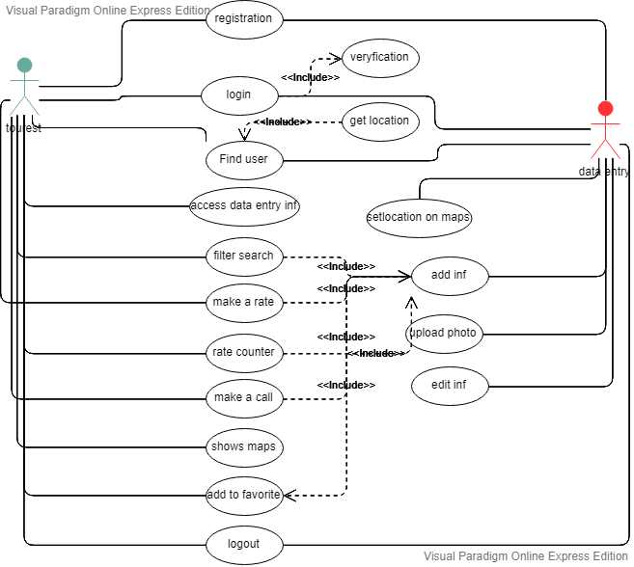
Use Case Diagram

Slide 13
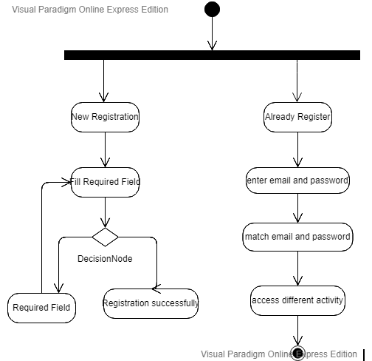
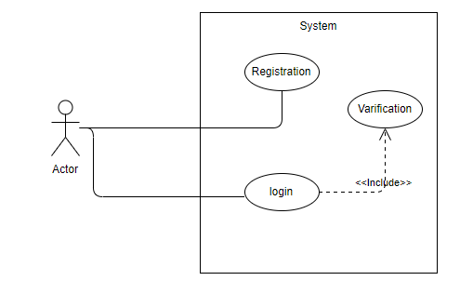
Login Diagram

Slide 14
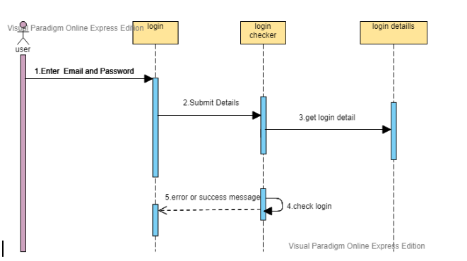
Login Diagram

Slide 15
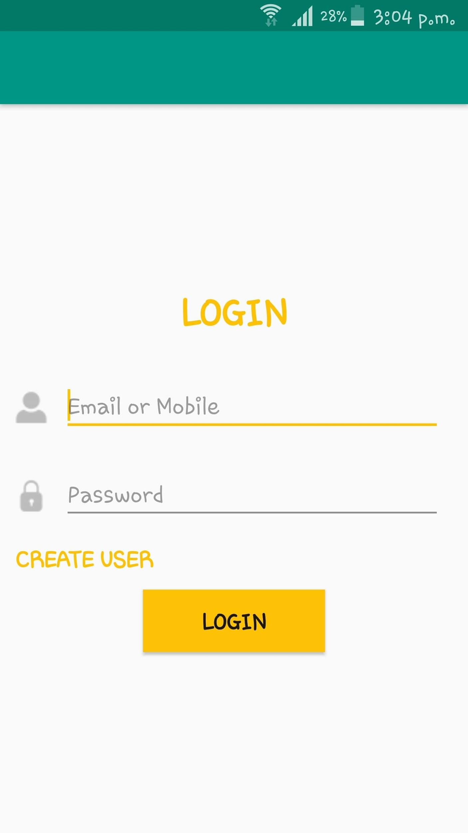
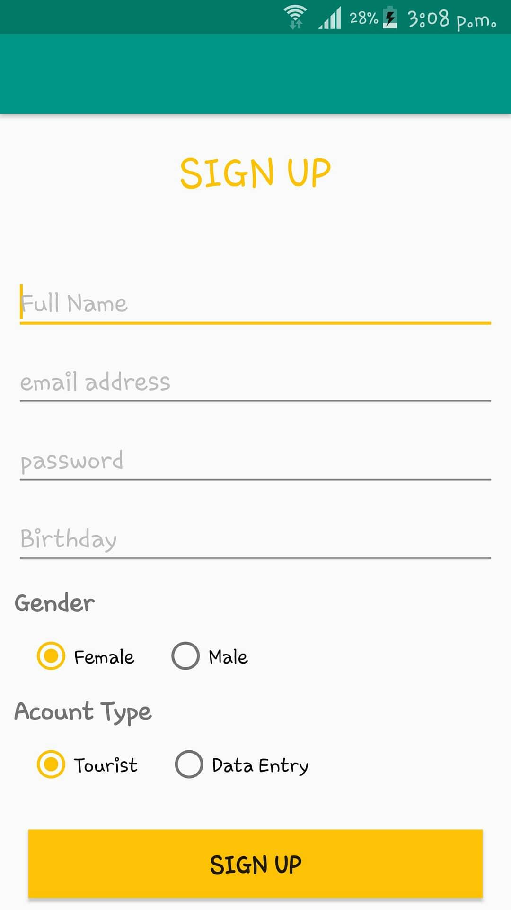
Login

Slide 16
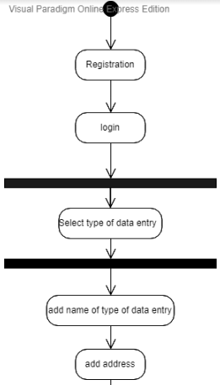
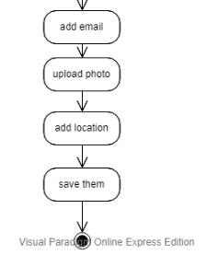
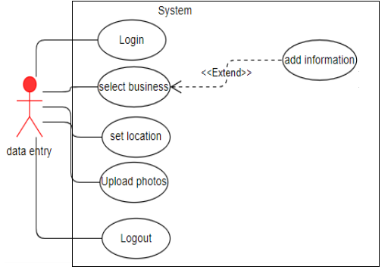
Data Entry Diagram

Slide 17
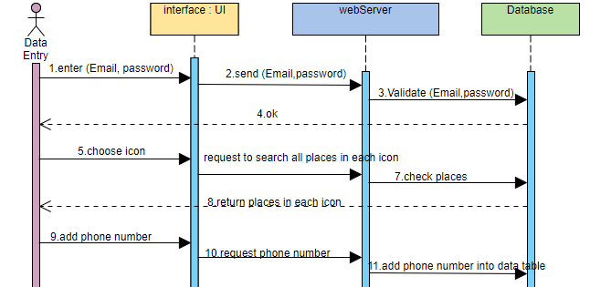
Data Entry Diagram

Slide 18
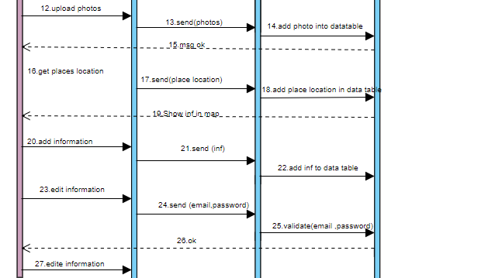
Data Entry Diagram
user id

Slide 19
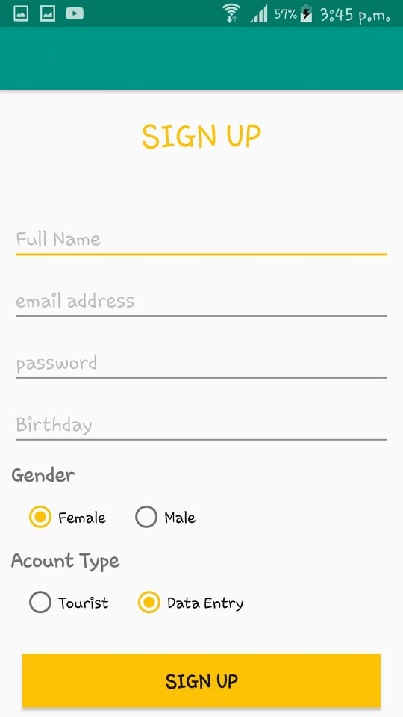
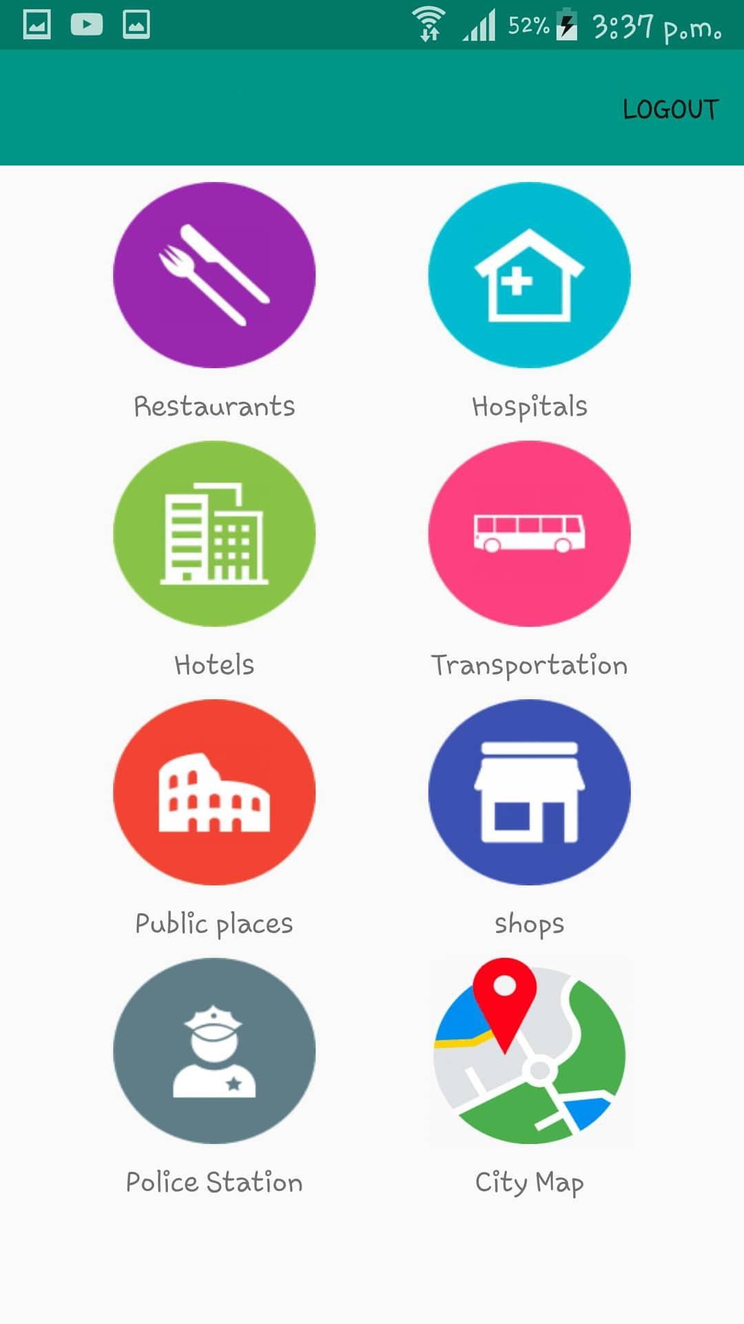
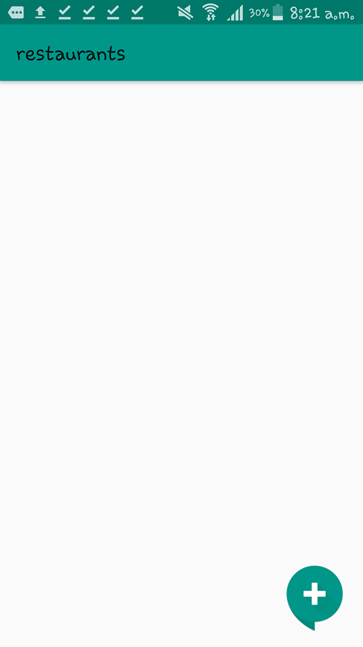
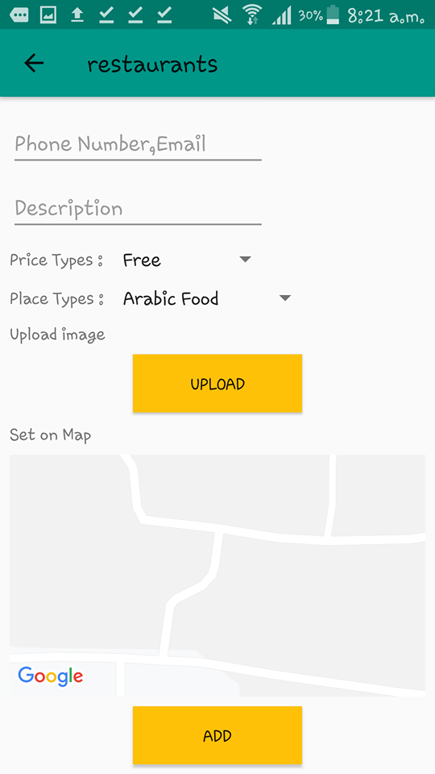
Data entry pages

Slide 20
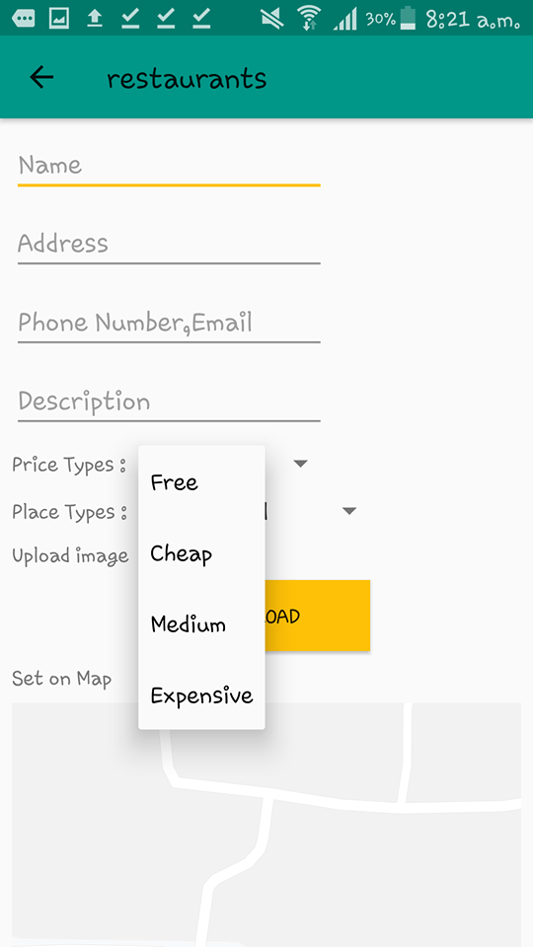
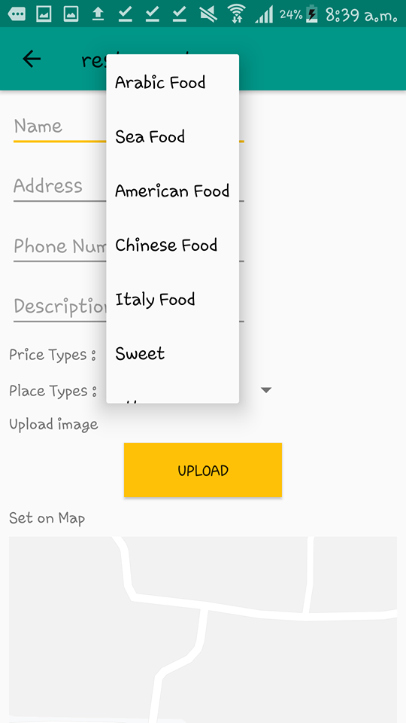
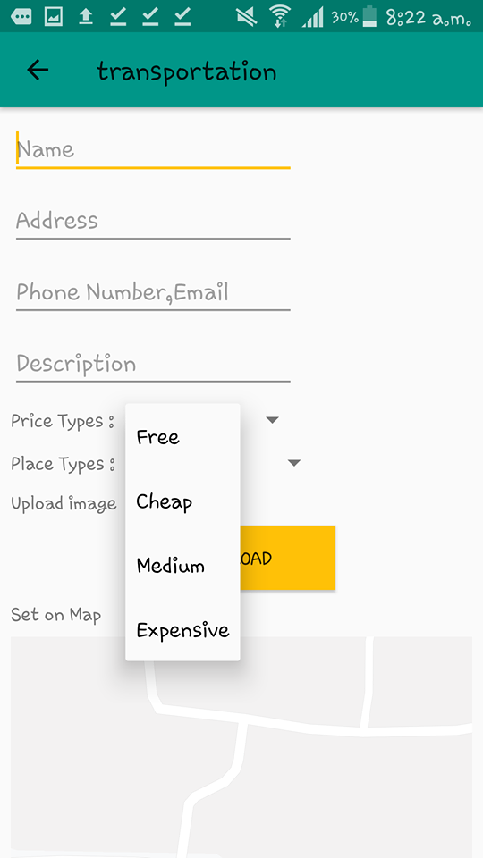
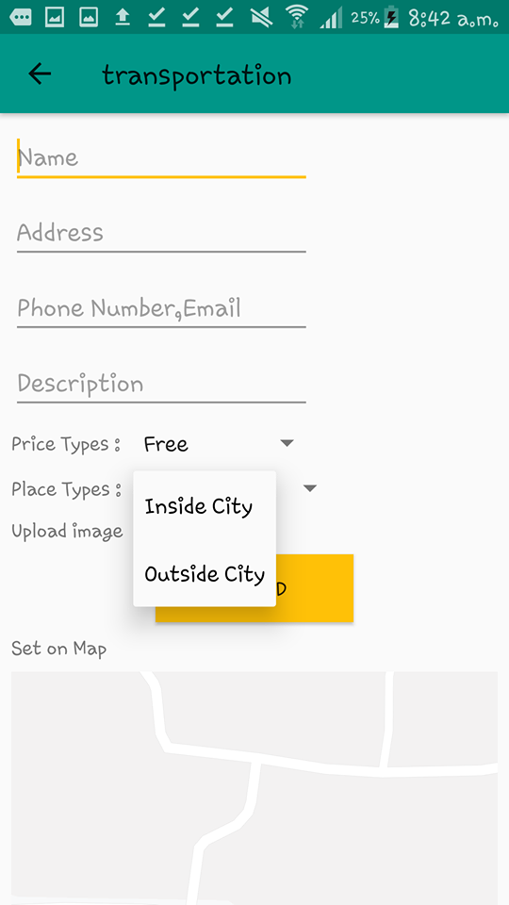
Data entry pages

Slide 21
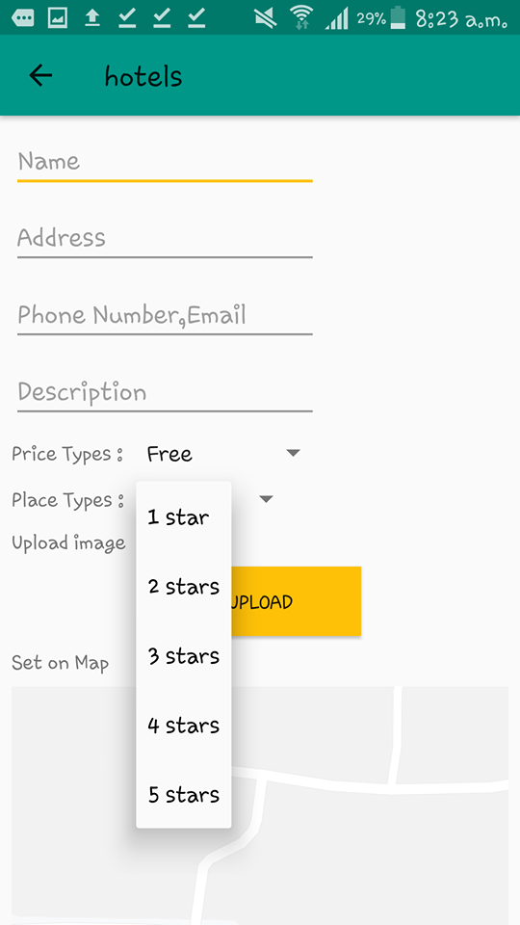
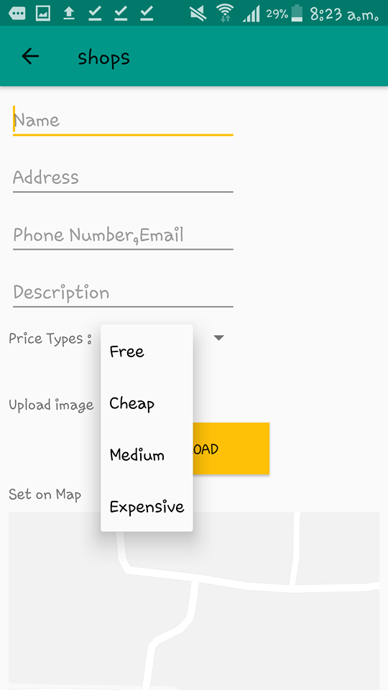
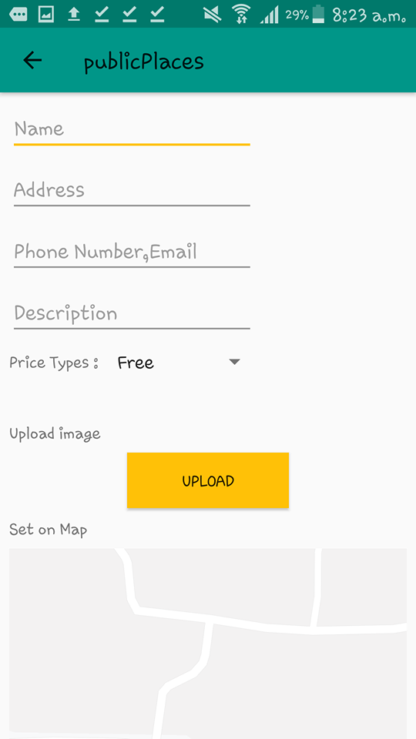
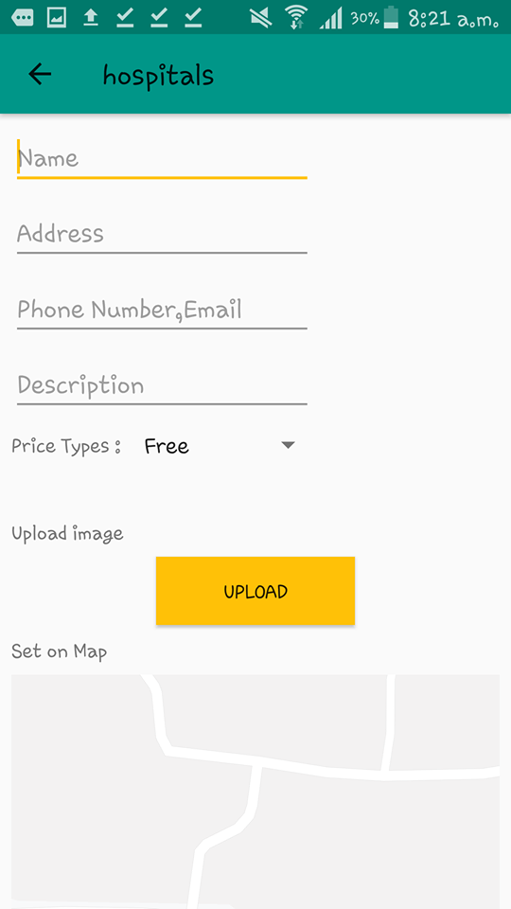
Data entry pages

Slide 22
Data entry pages

Slide 23
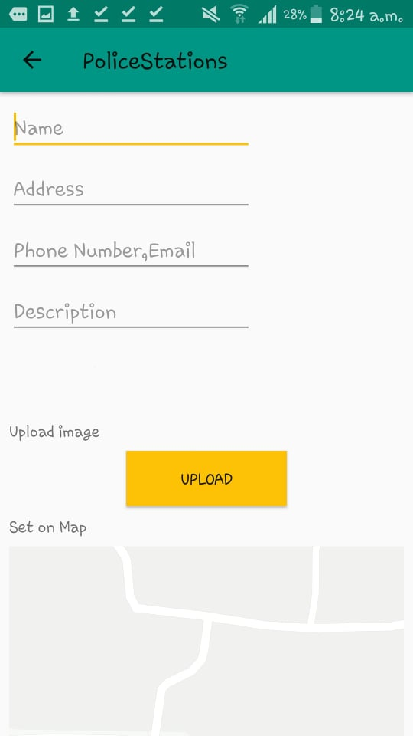
Data entry pages

Slide 24
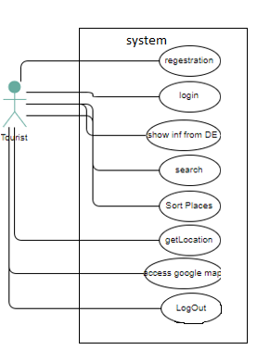
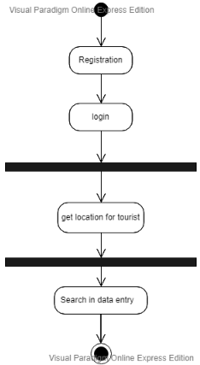
Tourist Diagram

Slide 25
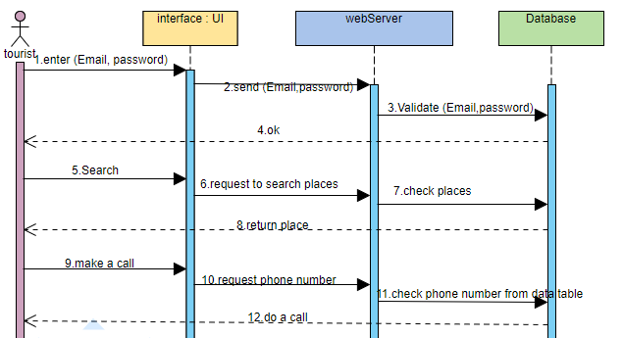
Tourist Diagram

Slide 26
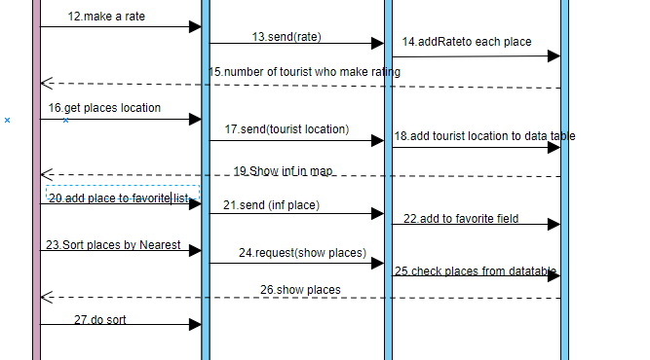
Tourist Diagram

Slide 27
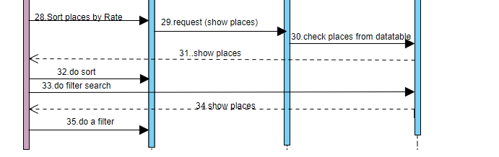
Tourist Diagram

Slide 28
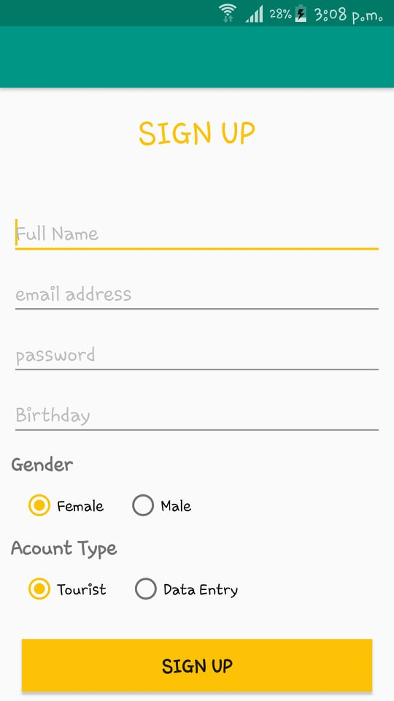
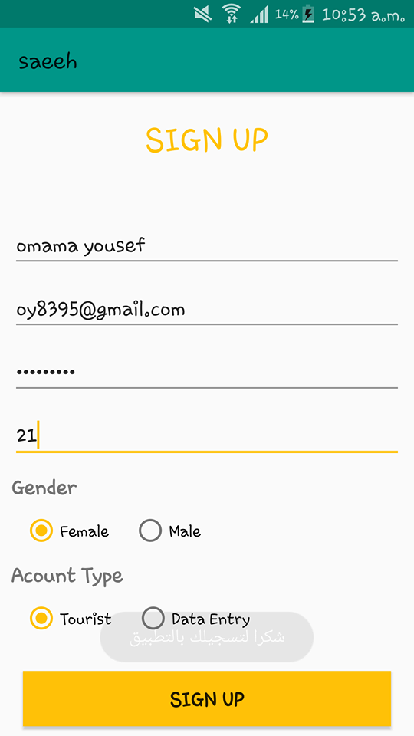
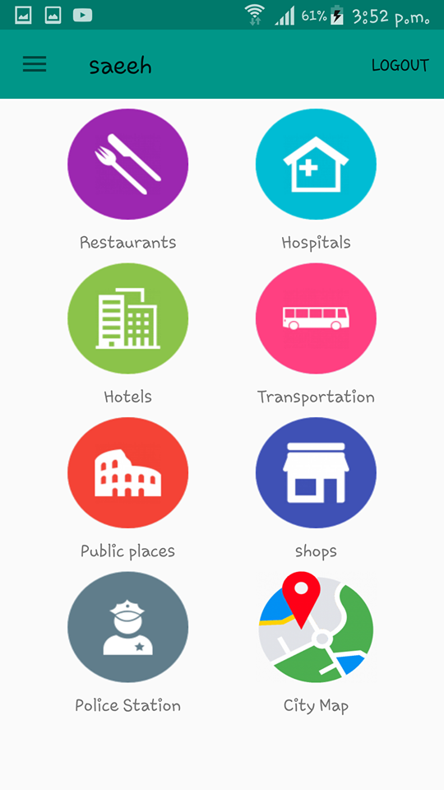
Tourist entry pages

Slide 29
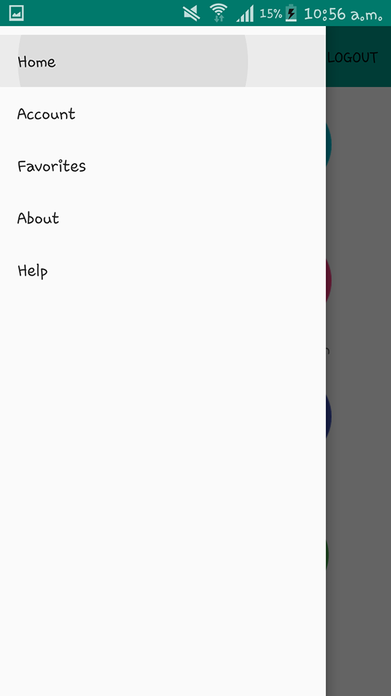
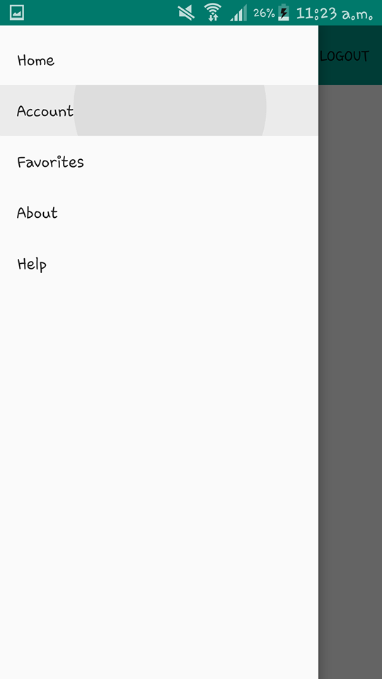
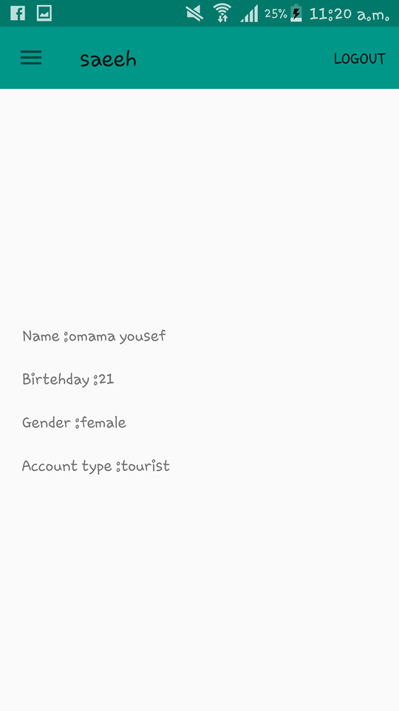
Tourist entry pages

Slide 30
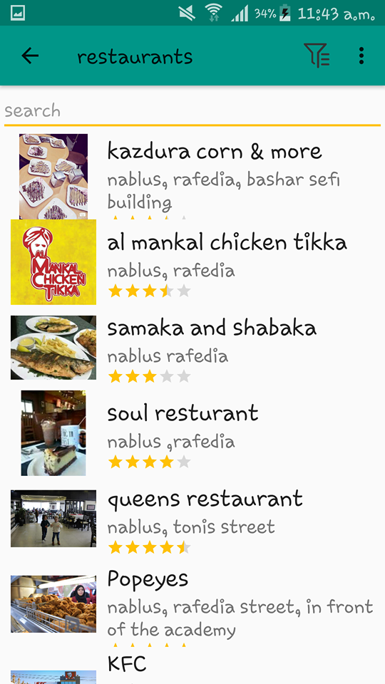

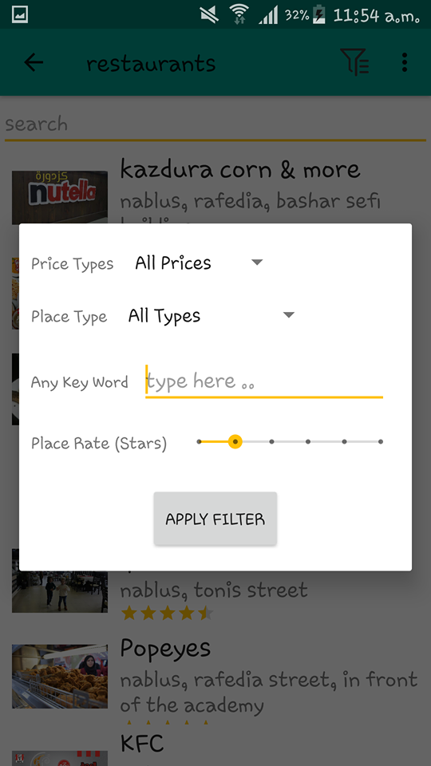
Tourist pages

Slide 31
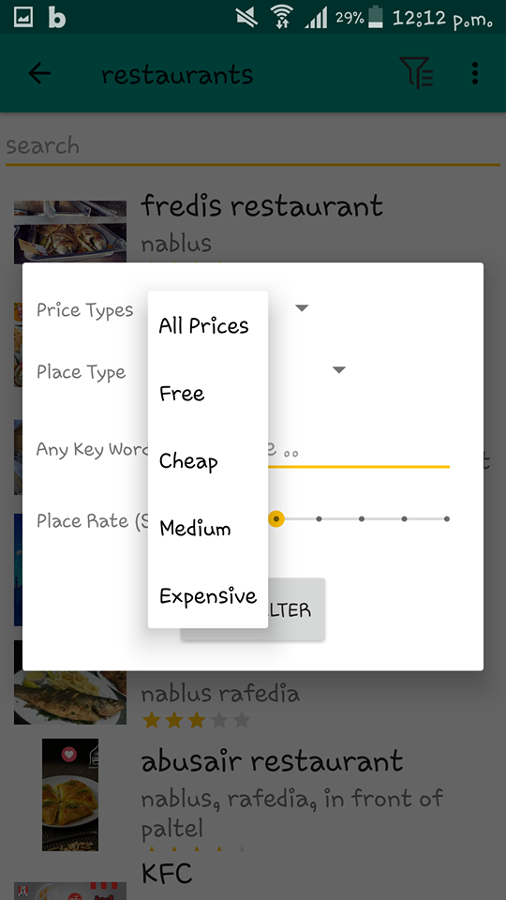
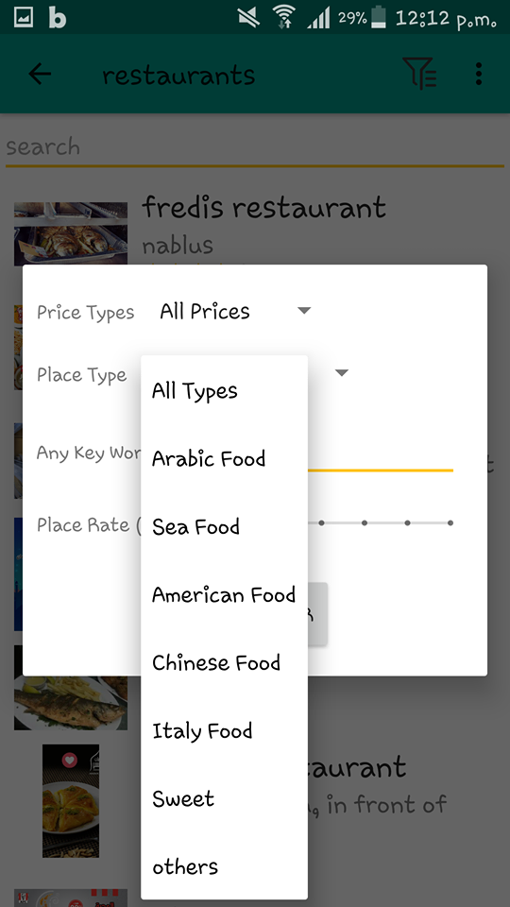
Tourist pages

Slide 32
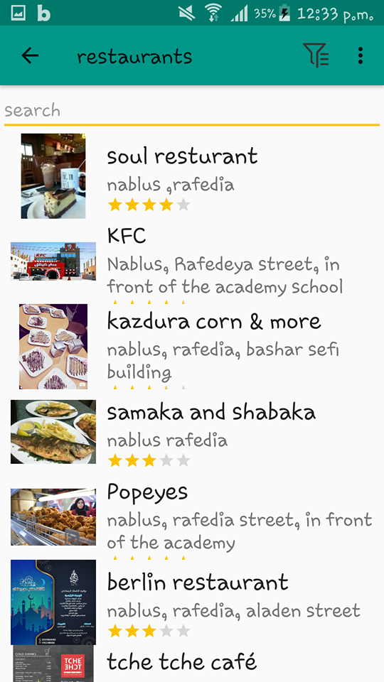
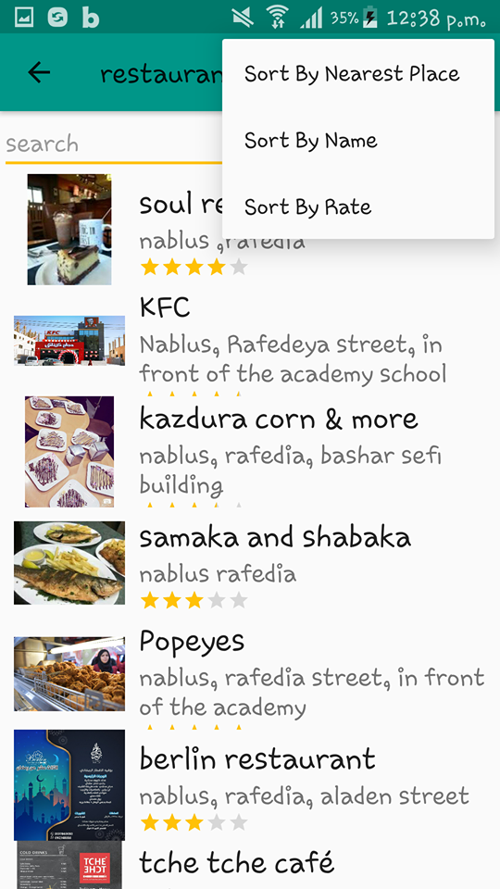
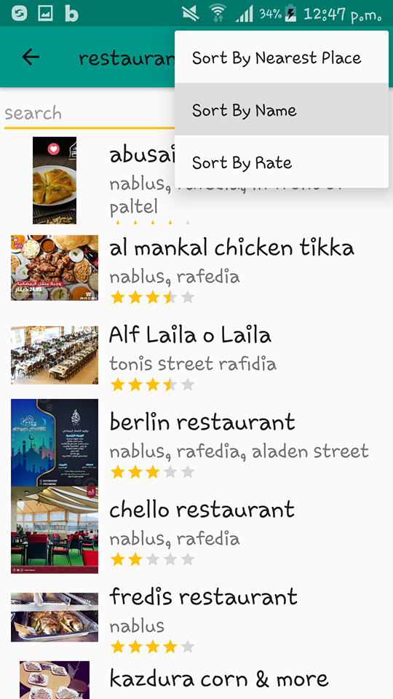
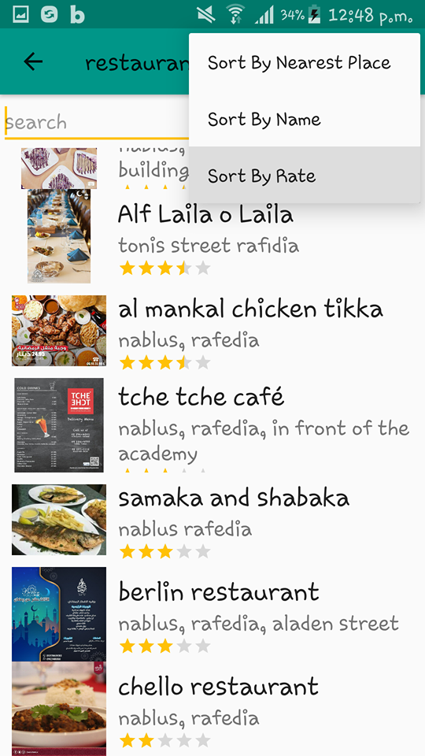
examples

Slide 33
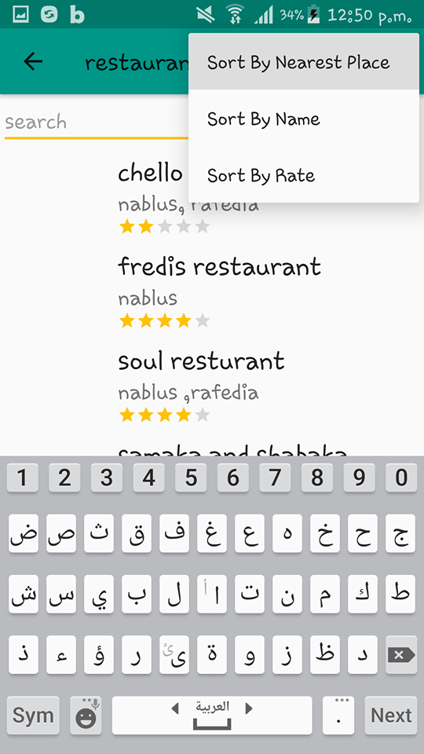
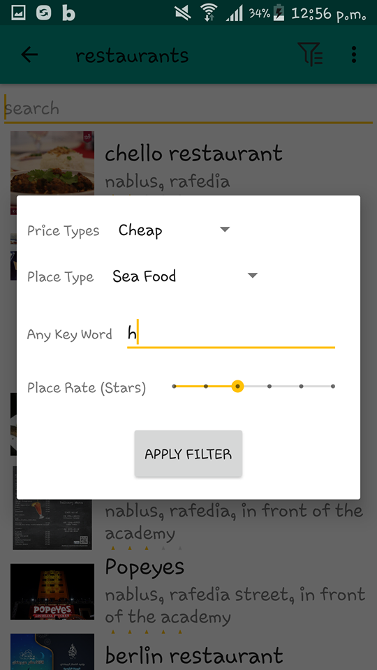
examples

Slide 34
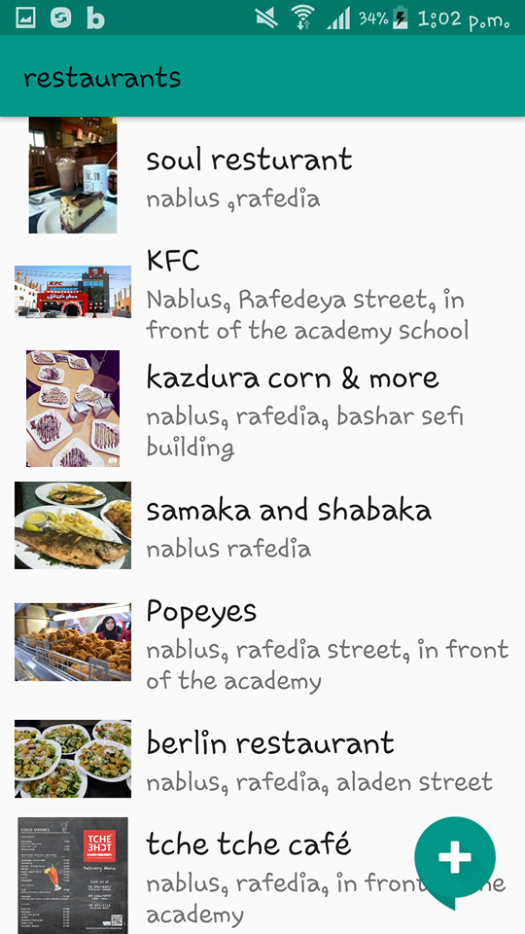
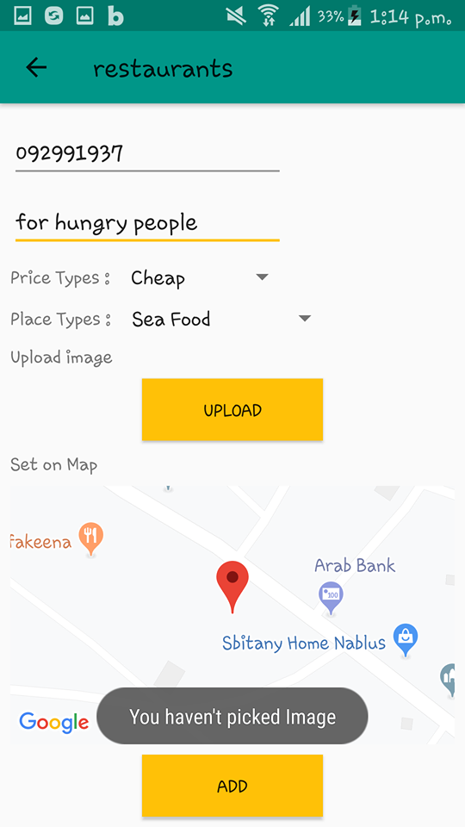
examples

Slide 35
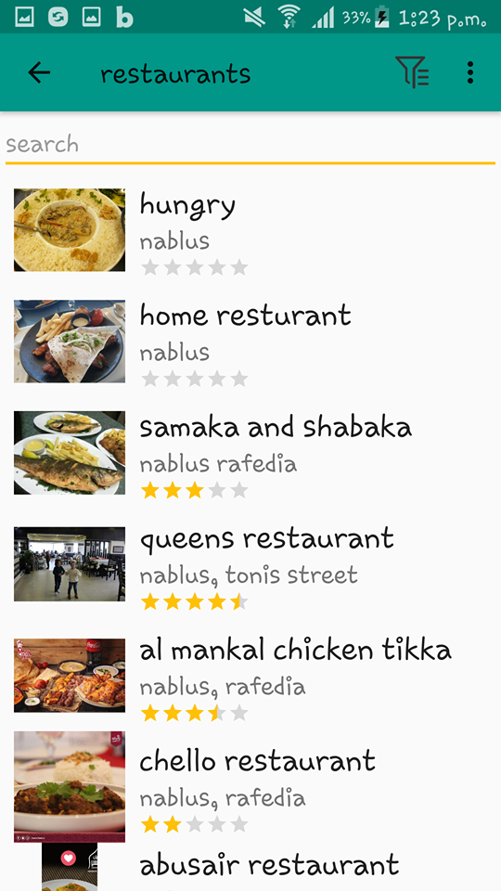
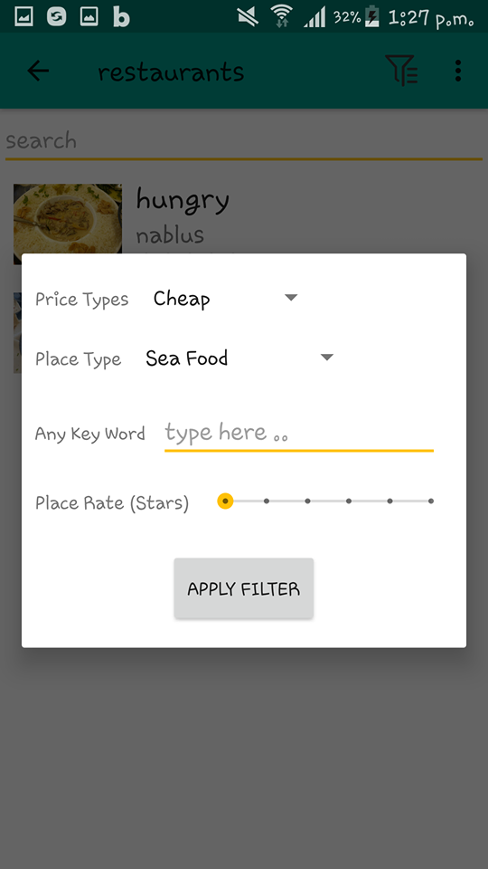

examples

Slide 36

Database Structure

Slide 37

ER Diagram

Slide 38

Future Work

