Slide 1
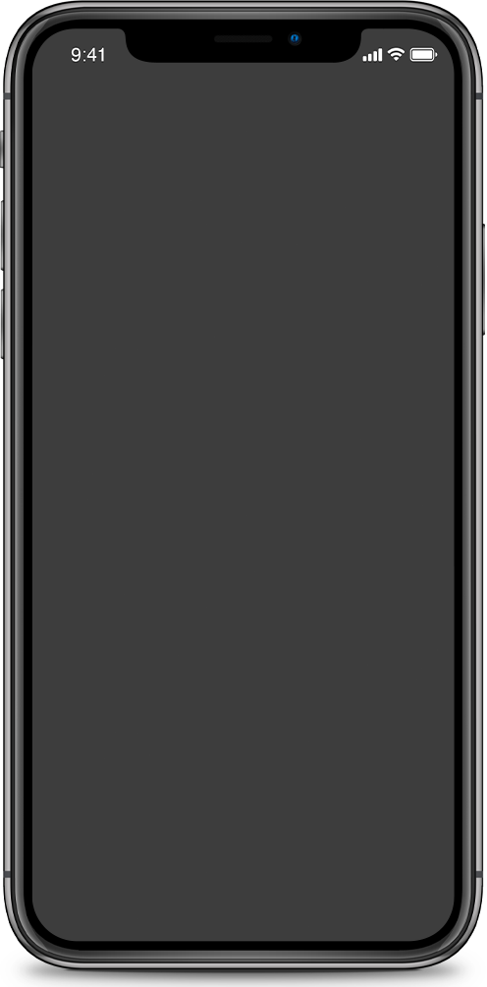
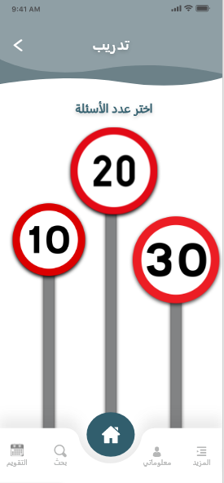
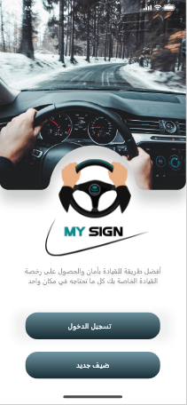
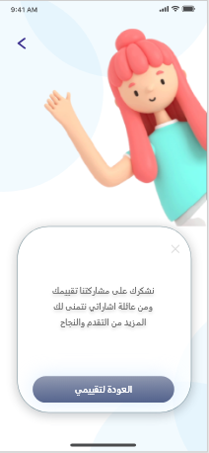
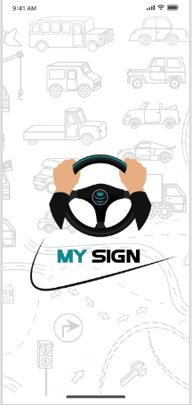
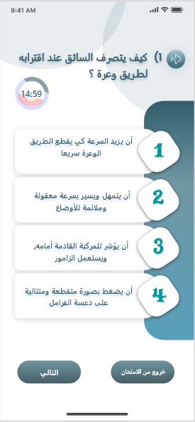
My Signs
اشاراتي
Supervisor:
Dr.Najwan Al Deleq
Students :
Baraah Ashqar & Dana Tamimi

Slide 2

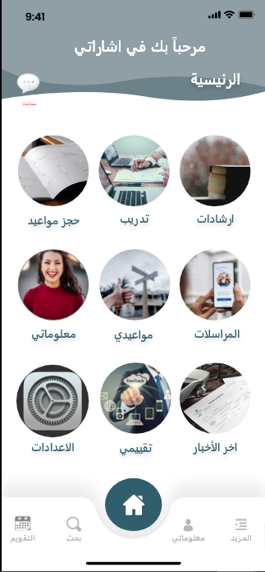
02
MY SIGNS
is a mobile application aims to facilitate everything the user needs to obtain a driving license from A to Z with a full guide and many more new features that will make it the first destination for a ny new learner.

Slide 3

Why Application?
  Much quicker than a mobile website.
  Apps usually store their data locally on mobile devices, in contrast to websites that generally use web servers. For this reason, data retrieval happens swiftly in mobile apps.
  Apps can further save users’ time by storing their preferences.
03

Slide 4
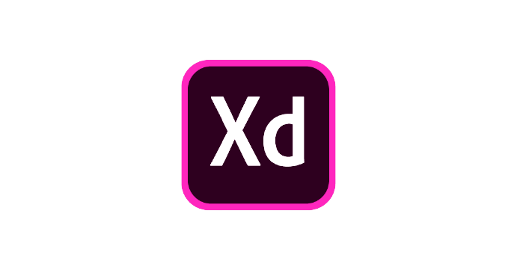


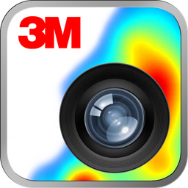
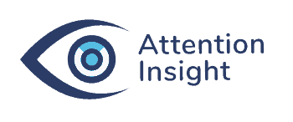


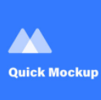
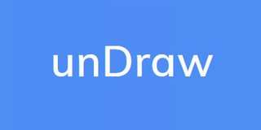
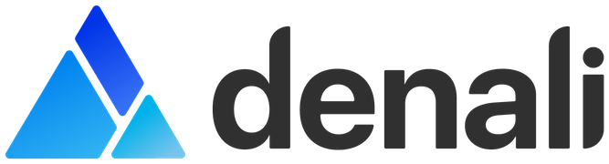
07

Slide 5



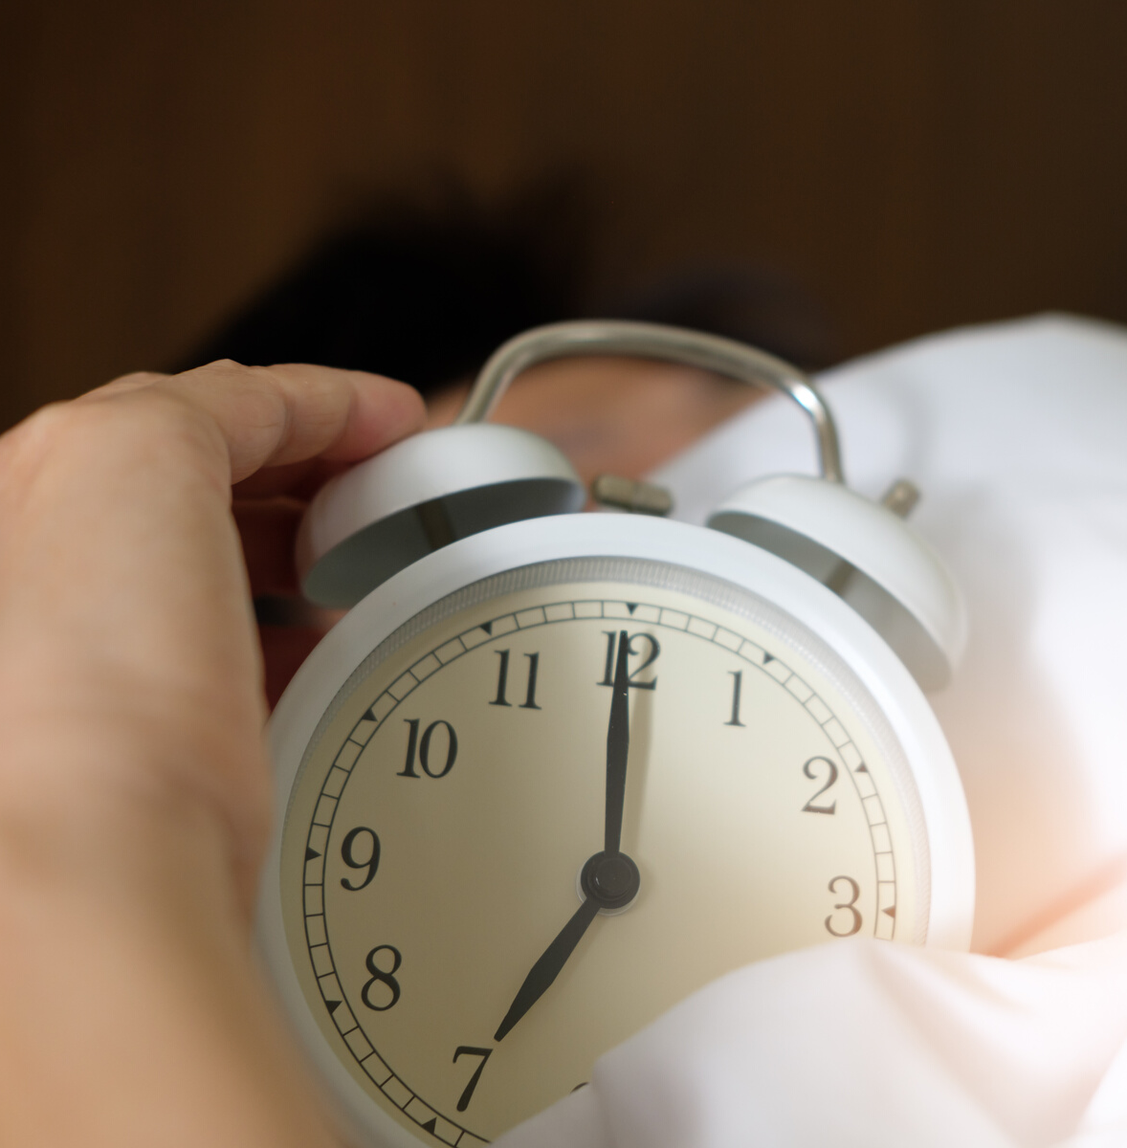
Problems to be Solved Through the Application
03

Slide 6

Motivation
We were motivated with the idea of trying to solve the problems that any new learner might face ,and going beyond that by developing new ways to make everything they need more easier and satisfying by facilitating life through technology, moving apart from the traditional way.
04

Slide 7
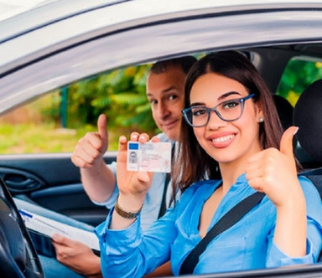
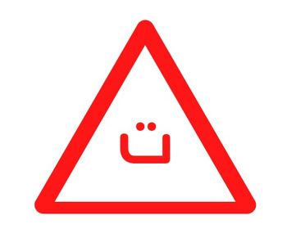

Students that are going to take their driving license
CustomerSegments
Driving schools
Syndicate of owners of driving schools
05

Slide 8
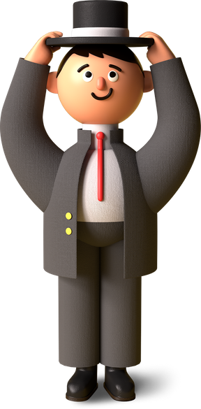


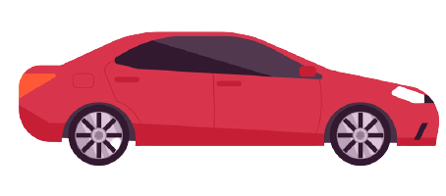
Main Services of the Application
Reserve Appointments
Instructions
Feedback
choosing schools
Training
Latest News
06

Slide 9
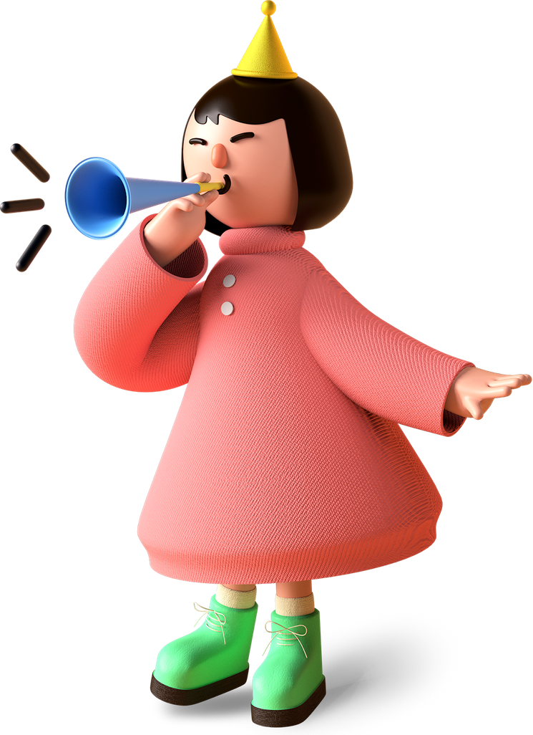
What We Done ?
-Vision & Mission
-Feasibility Study
-Research & Data collection
-Analysis and Functional Requirements
-The Mechanism of the Current Manual System
-Strategic Marketing Plan
-System Analysis ( Context Diagram, DFD, UseCases )
-Graphical user interface using XD ( interfaces for student , school)
-Userflow diagrams using overflow plugin for the guest & coach

Slide 10
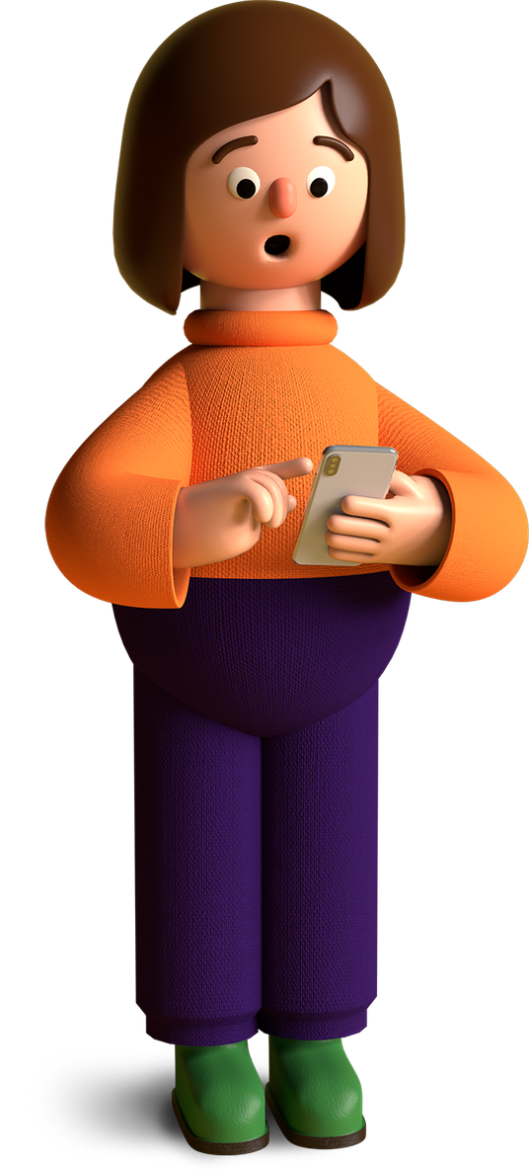
Remaining for us
-Graphical user interface using XD ( interfaces for guest, coach)
-Userflow diagrams using overflow plugin for the guest & coach
-Testing (with userzoom go)
-3M visual attention insight
-ER Diagram

