Slide 1
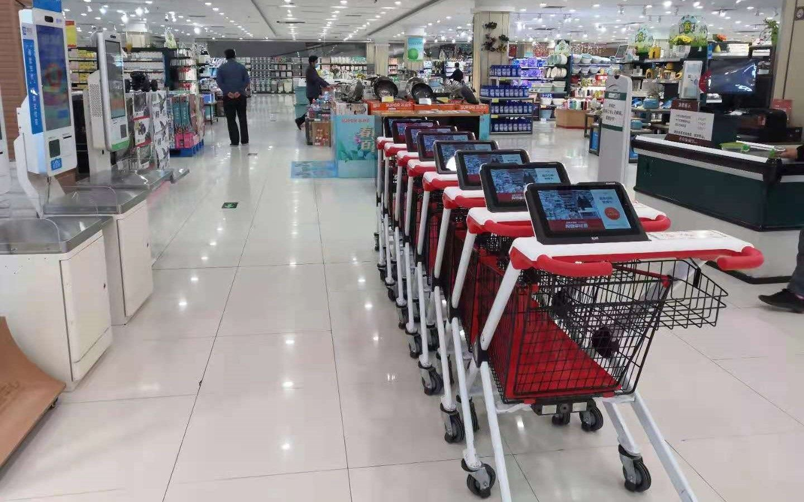
SMART SHOPPING CART
Supervisor: Dr. Luai Malhis
Presented by: 1. Aya Qartallo
2. Rand Ismail

Slide 2
01
02
03
What is Smart Shopping Cart?
Motivation
Features
OUTLINE
Overall Design
Constraints
06
07
08
Conclusion
Future Work
Demo
04
05

Slide 3

What is Smart Shopping Cart?

Slide 4

A cart available in the supermarket benefits both the buyer and the employee.
Is a Smart Cart that follows the customer and if you move away from him, it alert him by launching a sound using the buzzer.
Reads the ID of the cart, the price of the product through the barcode reader, and the weight of the product then sends it via Wi-Fi to the cashier (server).

Slide 5
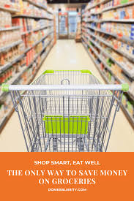
Motivation

Slide 6

With the spread of the use of technology and computerized techniques and the increase in their importance and reliance on them, we came up with an idea to create a smart shopping cart, among its advantages: reducing the crisis, the number of employees and saving time. And it is intended for large shopping centers and supermarkets, which are characterized by a large number of people. This will help speed up the shopping process by reducing congestion and also benefits people who find it difficult to push the cart.

Slide 7
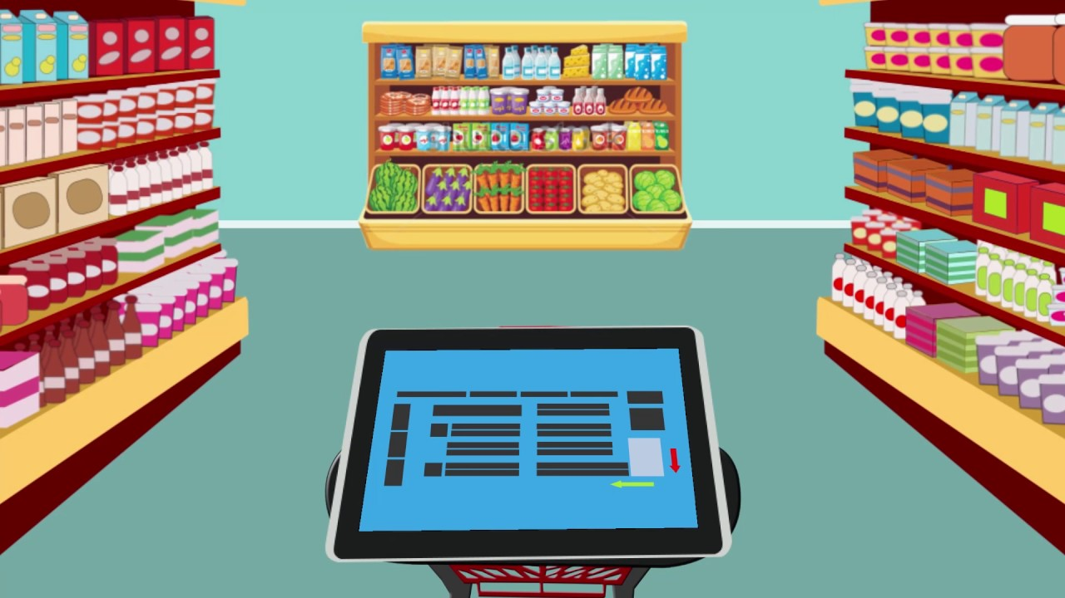
Features

Slide 8



Wi-Fi
BALANCE SCALE
TRACKING

Slide 9
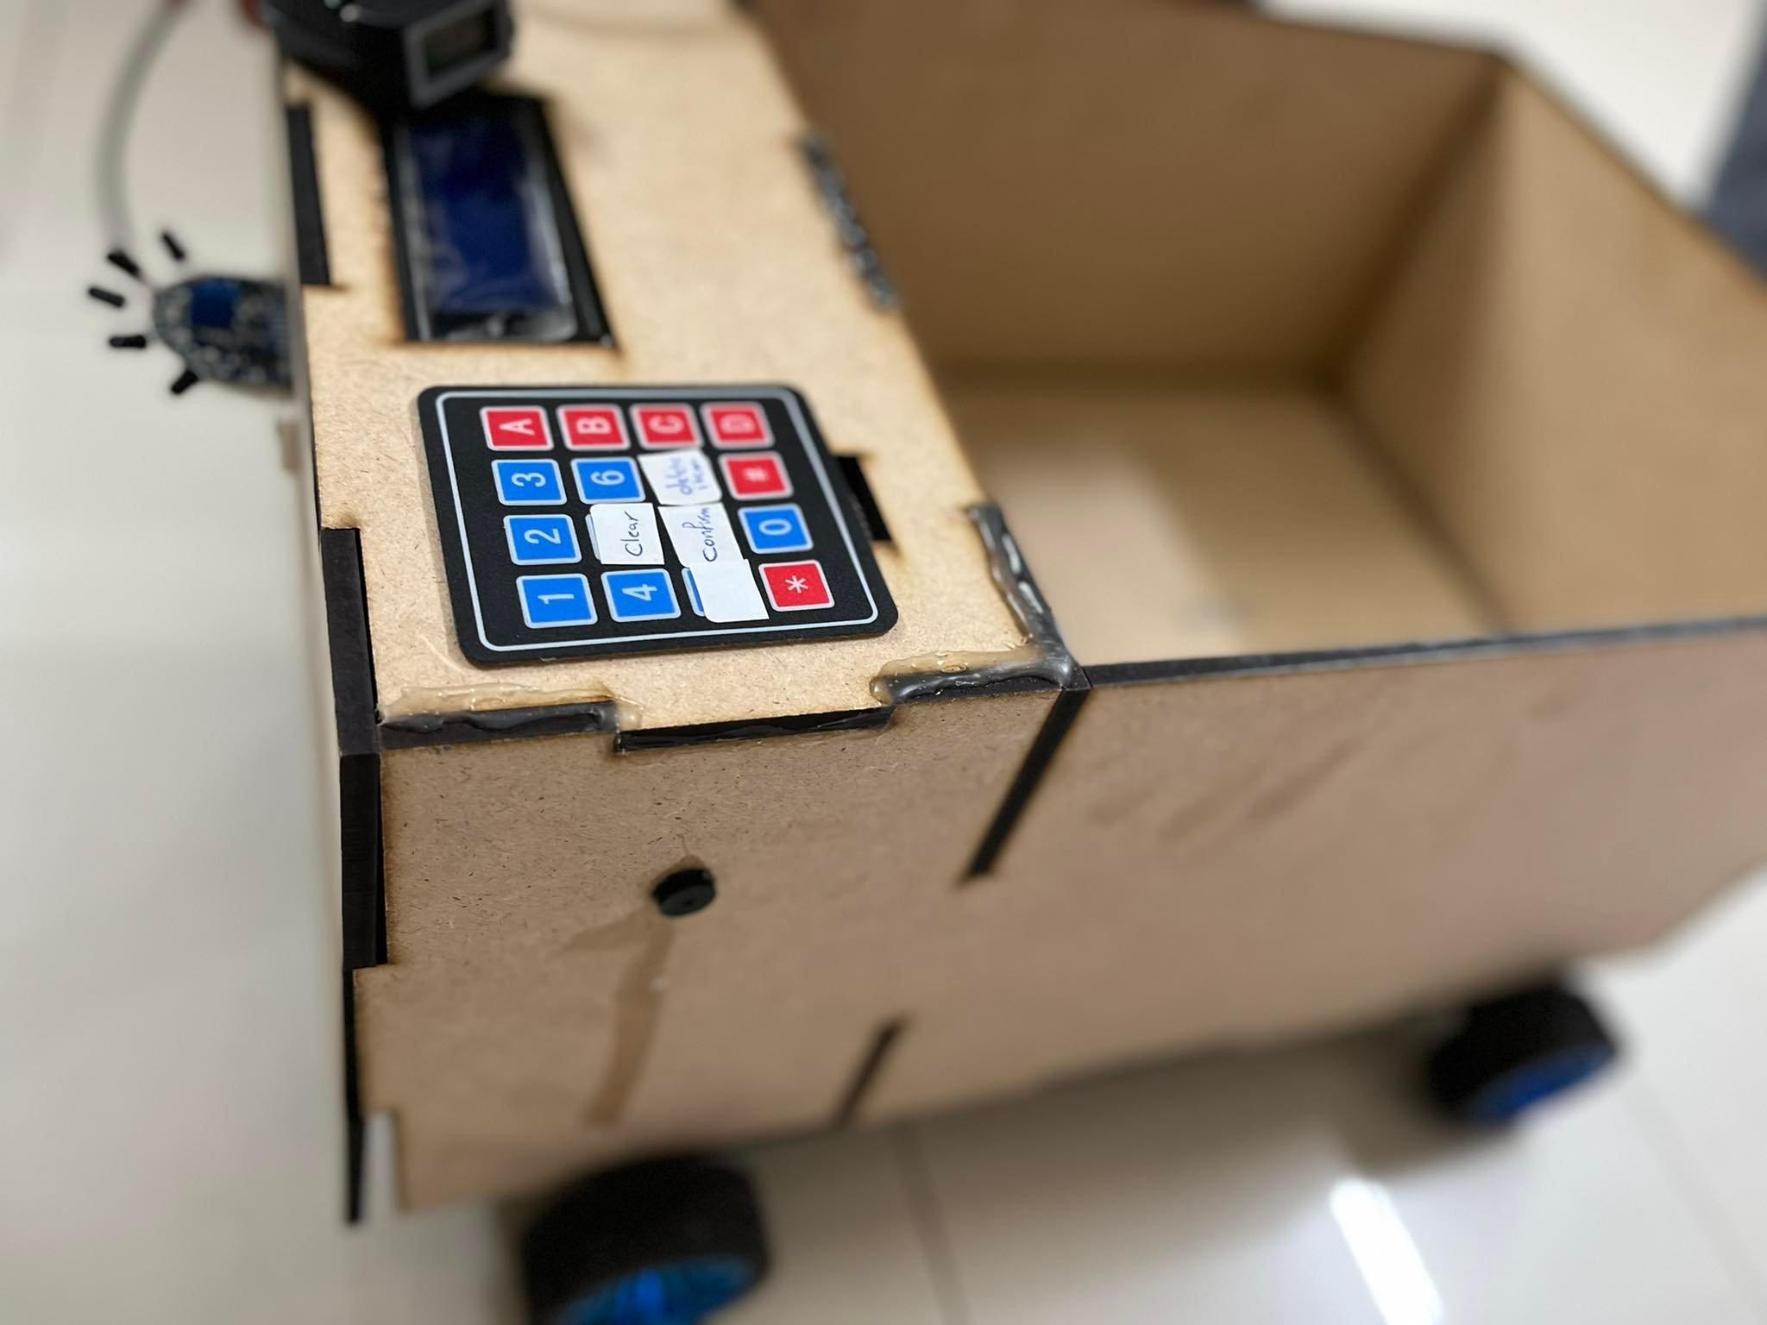
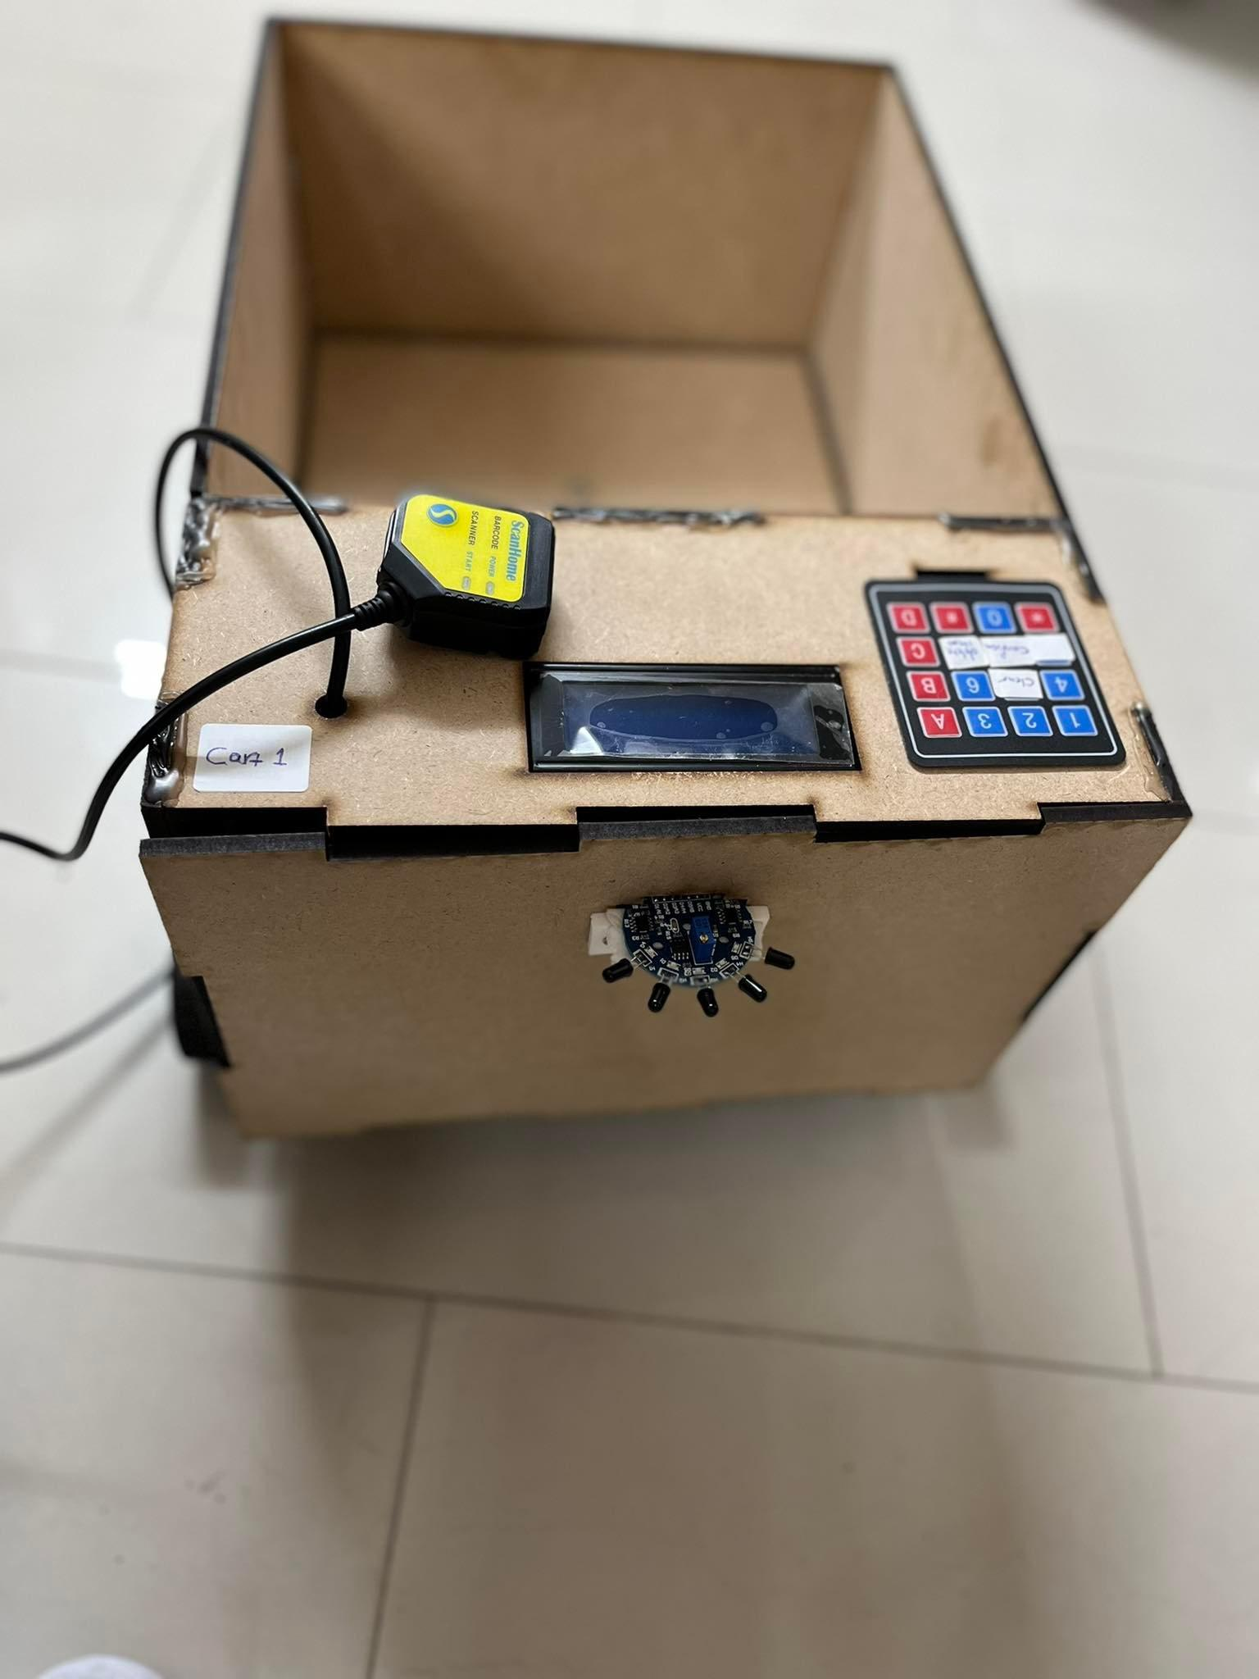
Overall Design

Slide 10
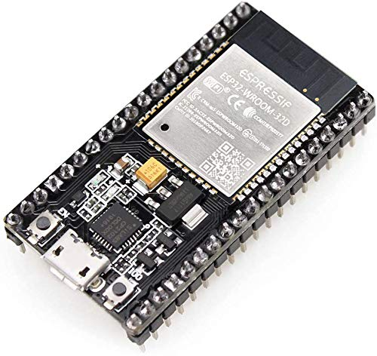
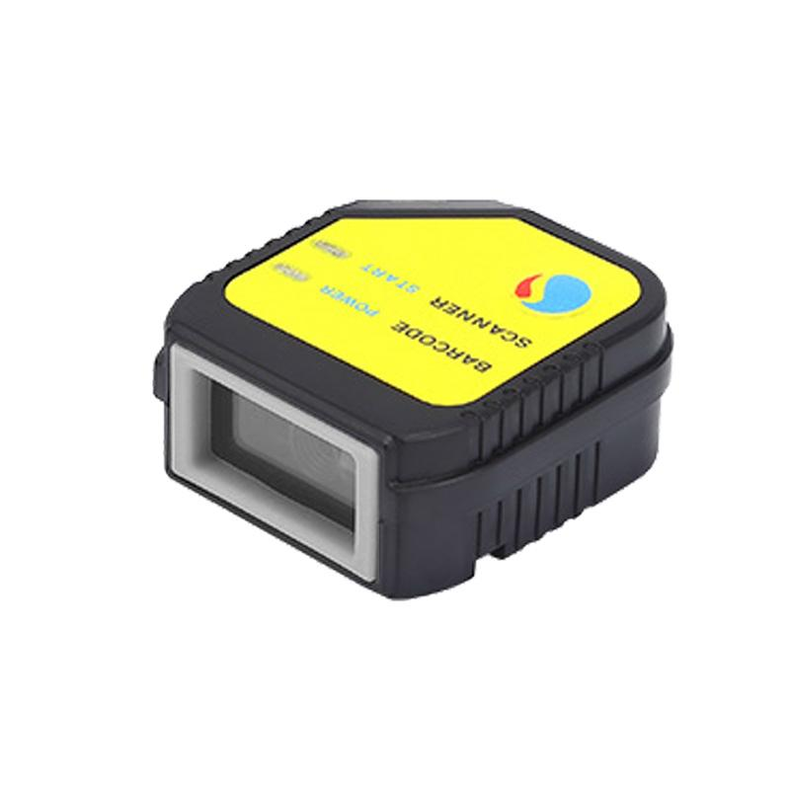
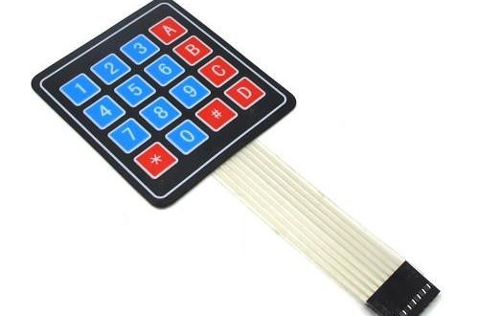
ESP32
Barcode Scanner
Keypad 4x4

Slide 11
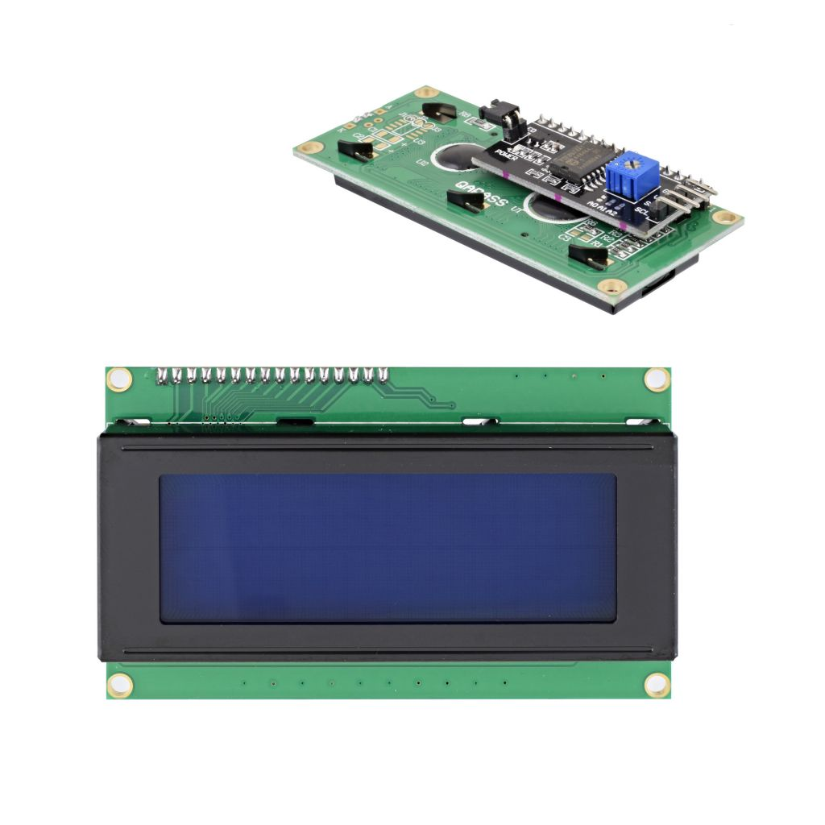
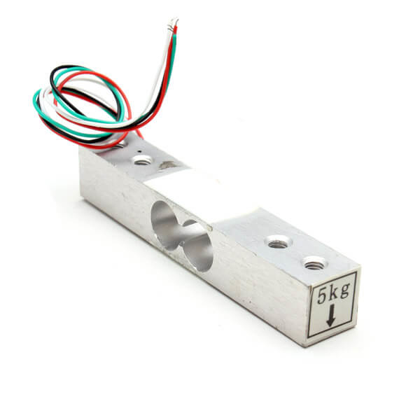
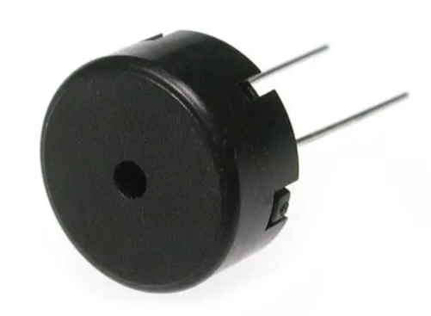
LCD 20x4 with I2C
5Kg Load Cell HX711
Piezo Buzzer

Slide 12
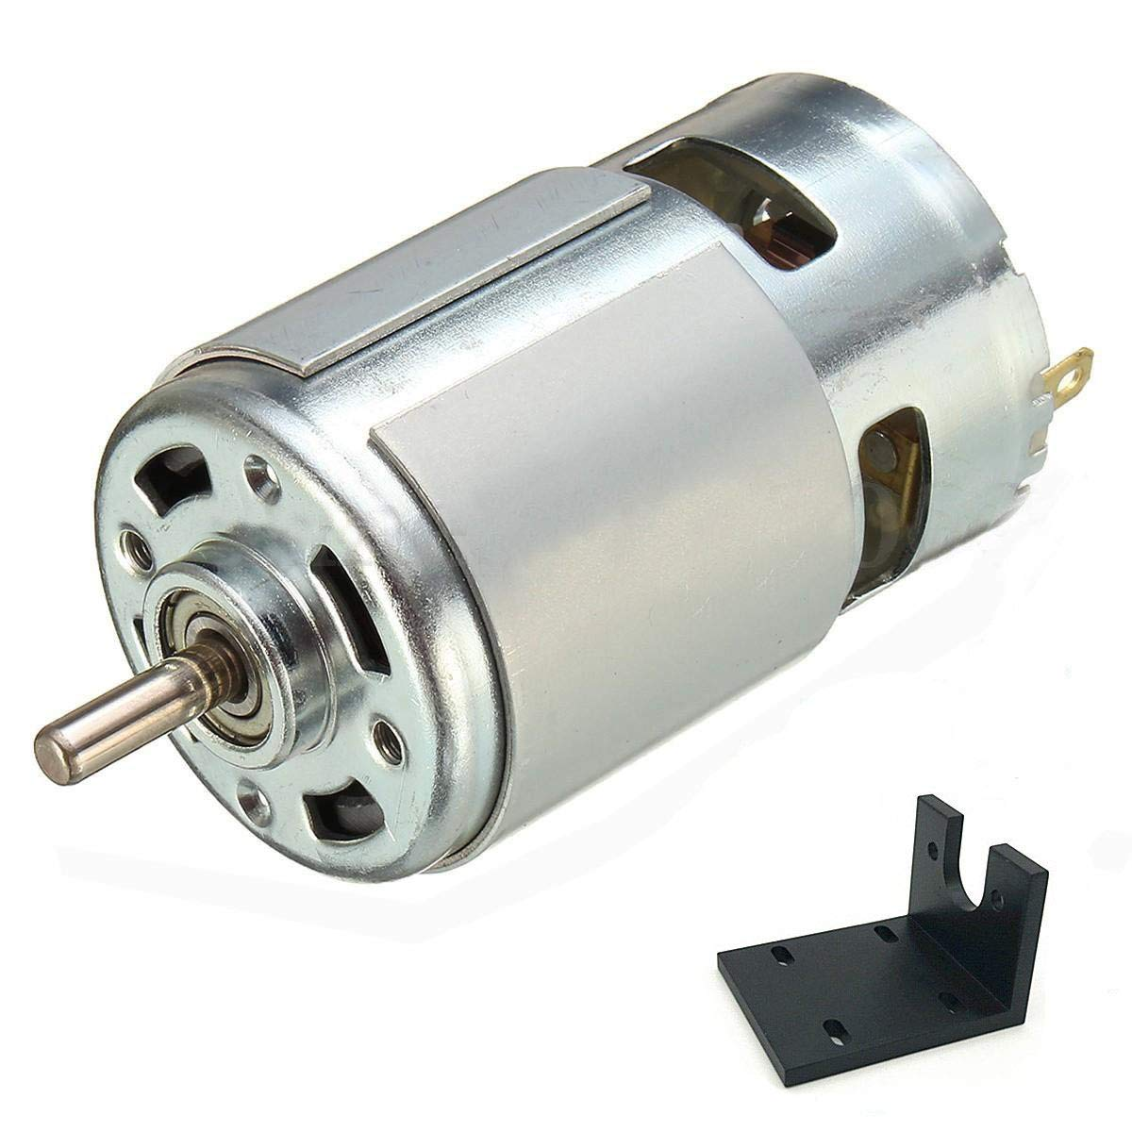
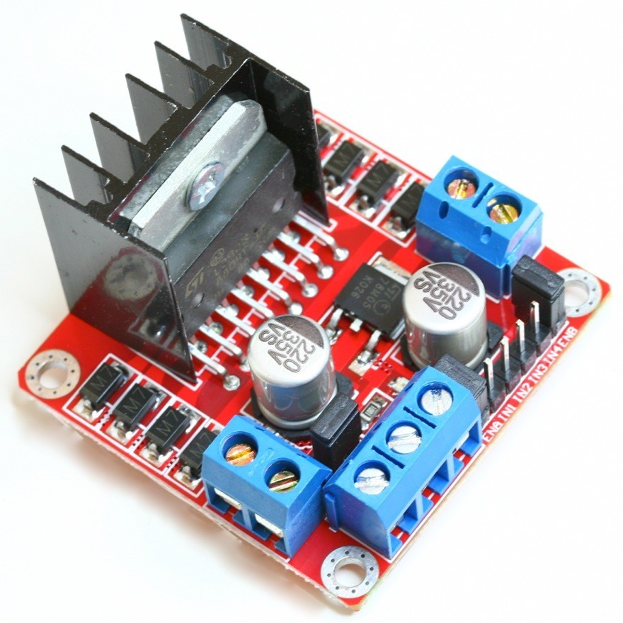
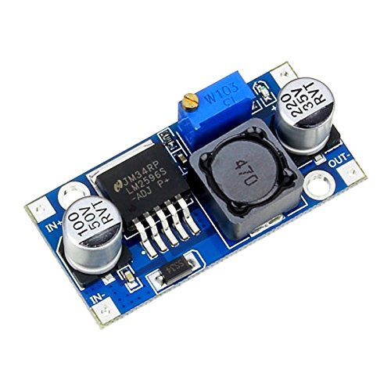
DC Motor
Dual H-Bridge
Buck Converter

Slide 13
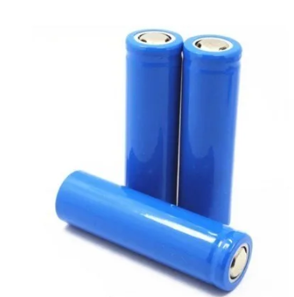
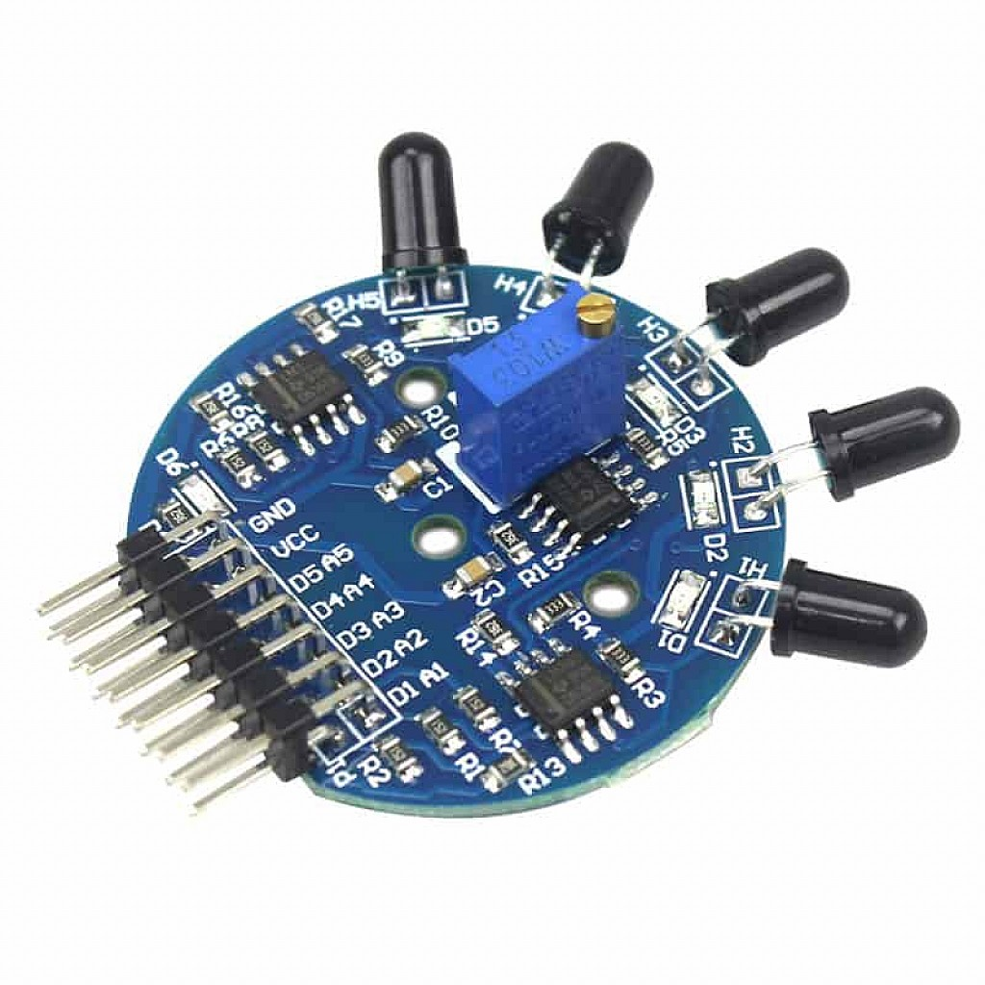
Li-lon Battery
5 Channel IR flame Detector Sensor

Slide 14

Constraints
Inaccurate Load Cell HX711 reading.
Some routers isolate devices on the same network from each other.
The IR sensor is affected by sunlight and does not measure large distances.

Slide 15

Conclusion
Save Time
Reduce congestion
Save Effort
Avoid theft Cases

Slide 16

Future Work
Return the car to its original position by itself
Credit card payment
Tracking by Image Processing
A place for special collectibles

Slide 17

Demo

Slide 18

THANKS

