Slide 1


Graduation Project 2
Structural Analysis and Design of Bidia Commercial Center in Bidia
An-Najah National University
Nablus - Palestine
Faculty of Engineering
Civil Engineering Department
Prepared by:
Ahmad Kharrousheh
Alaa Salameh
Supervised by:
Dr. Munther Thiab

Slide 2
Outline
Project Description
Codes and Standards and Software
Analysis
Materials
Load Types
Load Combinations
Preliminary Dimensions
Modeling
Checks
Design of structural elements

Slide 3
Project Description:
5 floors
Ground area of 912m2.
This projects presents a commercial center being constructed in Bidia, it's now in the construction phase.

Slide 4
The heights of each floor are given in the following table:
Floor | Height
Ground floor | 4
F1 | 4
F2 | 3
F3 | 3
F4(roof) | 3

Slide 5
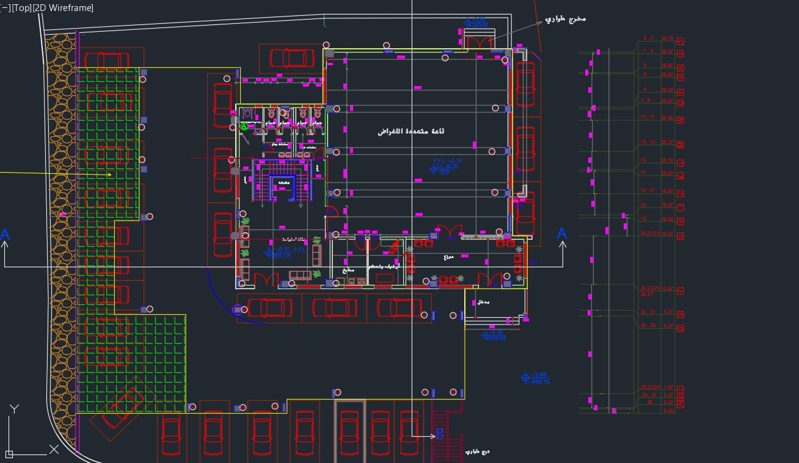
Plan for Basement Floor

Slide 6
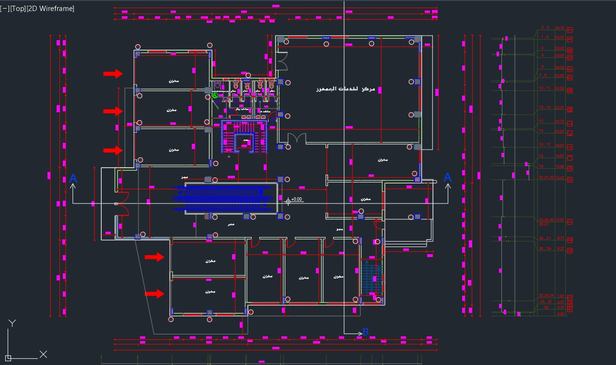
Plan For a floor

Slide 7
This projects aims to present Identifying the earthquake loads affecting the project and seismic analysis of the project in addition to its seismic design .

Slide 8
Analysis

Slide 9
Materials:
Materials for structural elements:
Concrete:
Property | Value
Compressive strength, fc ( MPa ) | 28
Modulus of elasticity, Ec ( GPa ) | 24870
Unit weight (kN/m3 ) | 25

Slide 10
Steel:
Property | Value
Yielding strength, fy ( MPa ) | 420
Modulus of elasticity, Es ( GPa ) | 200

Slide 11
Other Materials
Material | Ɣ in kN/m³
Blocks | 12
Filling Materials | 18
Tiles | 26
Plaster | 23
Aggregate | 13
Concrete Mortar | 23
Masonry Stone | 30

Slide 12
and Software Codes
For materials → (ASTM)
For design → (ACI 318-14)
Software Used: ETABS 2018

Slide 13
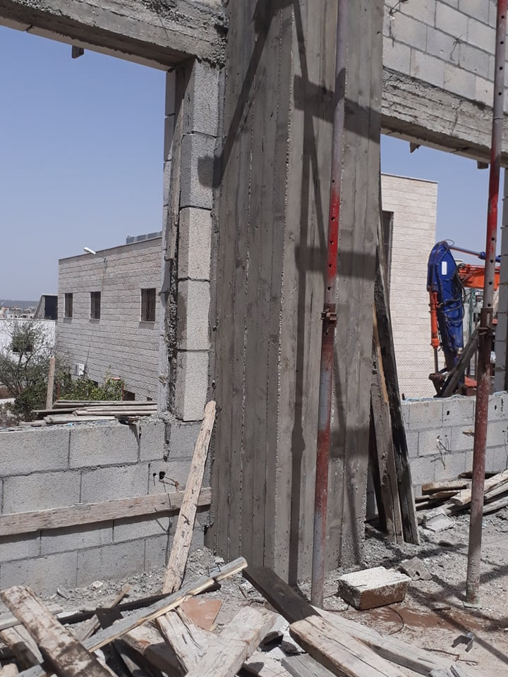
Load Types:
Dead Loads:

Slide 14
Superimposed Dead Loads:
Assume:
Tiles thickness = 3 cm Ɣ = 26 kN/m³
Sand thickness = 10 cm Ɣ= 16 kN/m³
Mortar thickness = 3 cm Ɣ = 23 kN/m³
WSD = 2.84 kN/m2 . Take WSD = 5 kN/m2

Slide 15
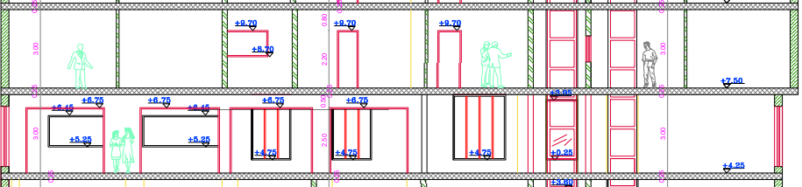
Live loads:
Are produced from the occupancy and movable objects on the building. For this commercial center it was taken as 5 Kn/m^2 for all the floors.

Slide 16
Reinforced concrete walls dead load :
Dead load for wall = 20 kN/m
Dead load for wall = 15 kN/m
Take 20 kN/m for all floors (preliminary).

Slide 17
Seismic load:
The analysis and design philosophy for seismic loads depends on the site location and the codes used to evaluate the earthquake forces
acting on a structure.
The location provides both the probability for earthquakes to happen in a certain location with a percentage of exceedance and the soil physical properties and effect on land stability.

Slide 18
Dynamic Analysis
Introduction

Slide 19
Codes:IBC
Dynamic Analysis Methods
Equivalent Static Method.
Response Spectrum Analysis (Modal Analysis).

Slide 20
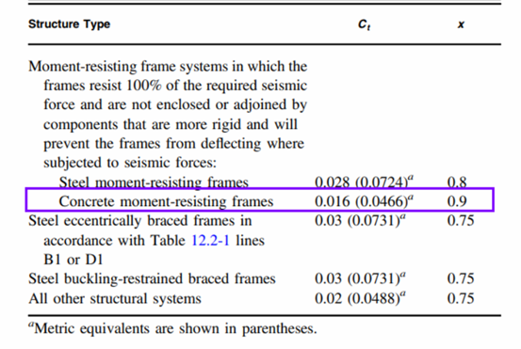
Period calculations
Fundamental period (Ta)
𝑇𝑎 = 𝐶𝑡∗ ℎ𝑛^{𝑥}
Values Of Approximate Period Parameters Ct and X
➔ Ct = 0.0466
➔ x = 0.9
➔ hn = 20.6 m
➔𝑇𝑎 = 0.0466∗ (20.6)^{0.9} = 0.71𝑠ec

Slide 21
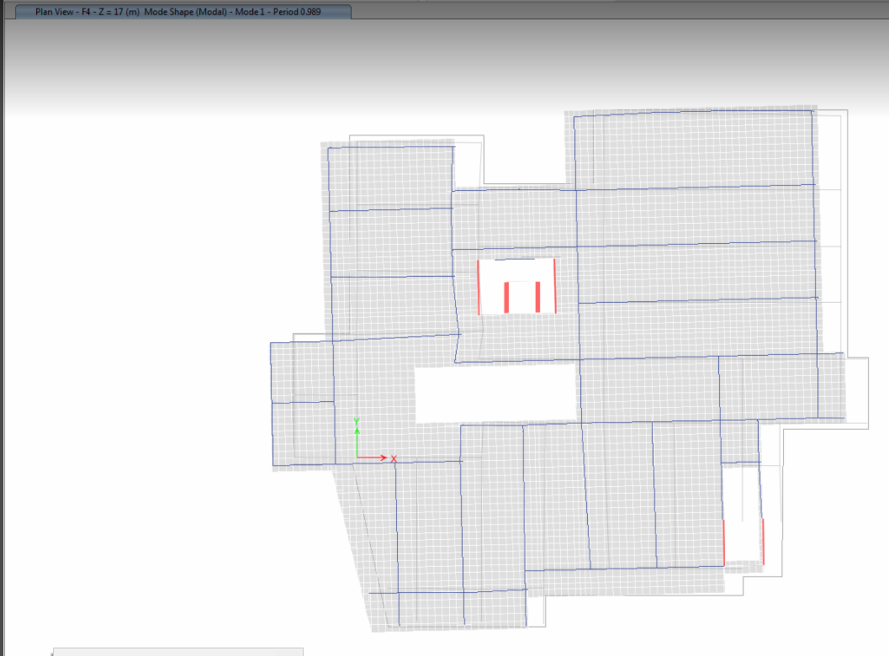
Period of 2D Model

Slide 22
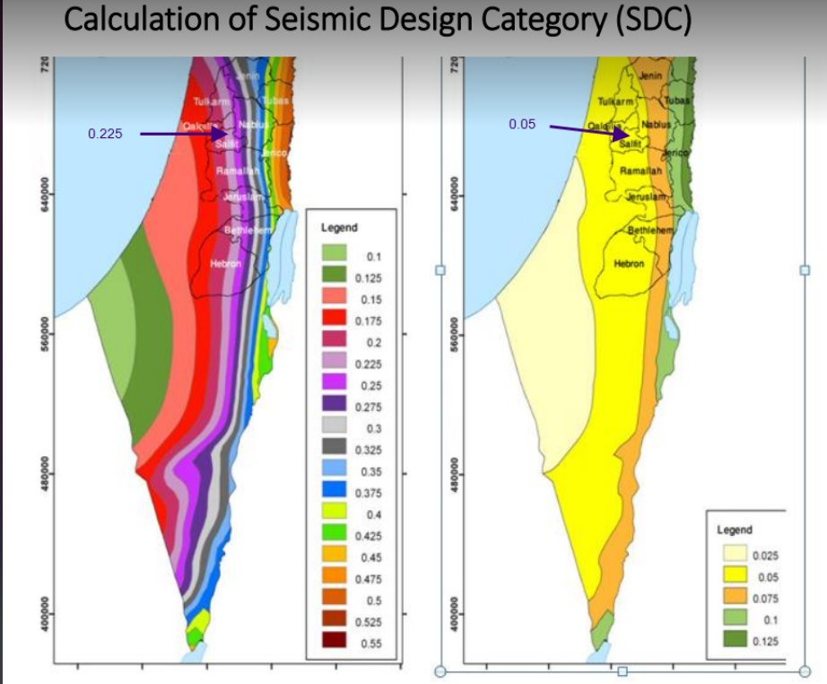
Steps to determine base shear
Determine Ss and S1:
• Ss: mapped MCER, 10 percent damped, spectral response acceleration parameter at
short periods.
• S1: mapped MCER, 10 percent damped, spectral response acceleration parameter at a
period of 1 s.
Figure 2 Values of Ss for the north of Palestineof 10%
Ss=0.225 S1=0.05

Slide 23
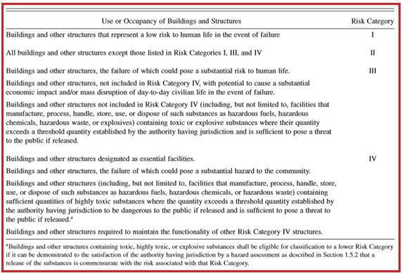
Determine risk category

Slide 24
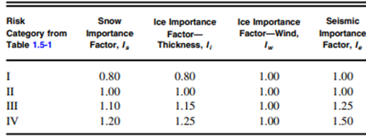
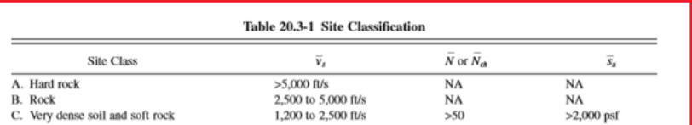
Importance Factors by Risk Category of Buildings and Other Structures for Snow, Ice, and Earthquake Loads

Slide 25
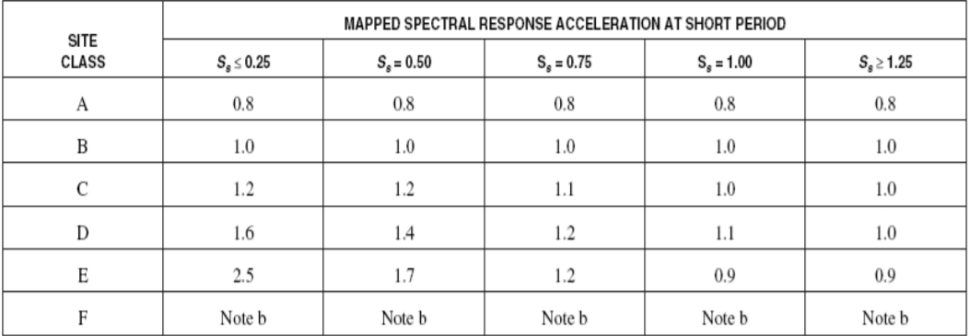
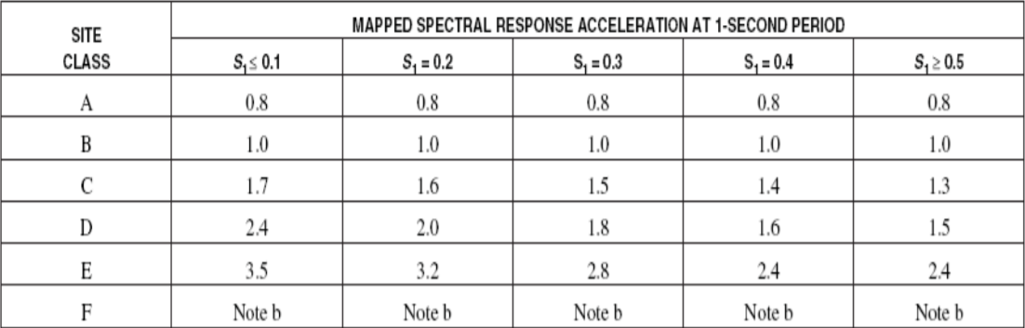
Soil physical properties are expressed in two factors, Fa and Fv.
• Fa: short-period site coefficient=1
• Fv: long-period site coefficient=1
Site Coefficient, Fa
Site Coefficient, Fv

Slide 26
• SMS: The MCER, 10 percent damped, spectral response acceleration parameter at short periods adjusted for site class effects.
• SM1: The MCER, 10 percent damped, spectral response acceleration parameter at short periods adjusted for site class effects
SMS =Fa*Ss=0.225
SM1= Fv*S1=0.05
• SDS: Design, 10 percent damped, spectral response acceleration parameter at short periods.
• SD1: Design, 10 percent damped, spectral response acceleration parameter at a period of 1 s.
➔➔➔
➢ SDS= (2/3)* SMS
➢ SD1= (2/3)* SM1

Slide 27
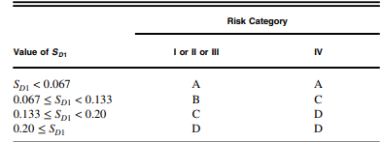
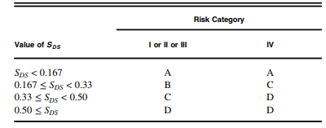
Determine Site Soil Classification:
Rock soil → Soil type B
SD1 = 0.05<0.067➔ Seismic design category A.
Seismic design category is B as
SDS =0.167<0.224<0.33
Seismic design category is then determined by taking the worst case.
➢ Design category is taken to be B.
According to ASCE 7-10
the only permitted lateral force resisting system with
seismic design category B

Slide 28
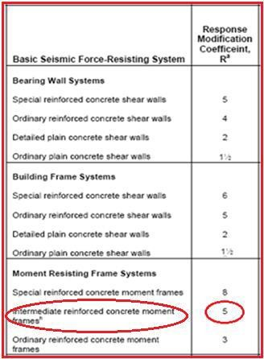
Determine response modification factor (R)
Type of Structural system
Moment-resisting frame systems

Slide 29
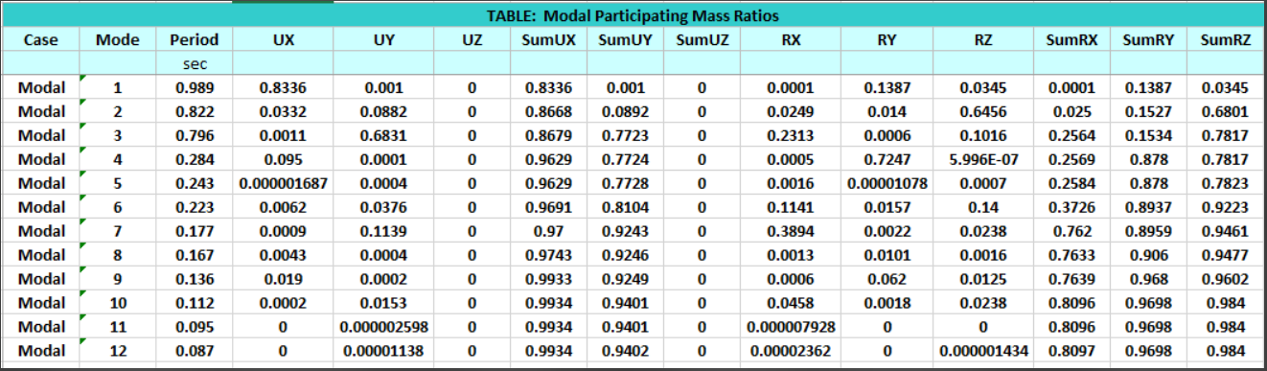
Modal Mass Participation Ratio

Slide 30
* To estimate the seismic base shear (V)
𝑉 = 𝐶𝑠*𝑊
Where:
V: Base shear .
Cs : the seismic response coefficient.
W: the effective seismic weight
To estimate the seismic response coefficient (Cs);
𝐶𝑠=𝑆𝐷𝑆*𝐼𝑒/R
• Total Weight (W) = SD + D + 0.25 L
𝑉 = Cs*W=0.014*75428.7 = 1056 KN

Slide 31
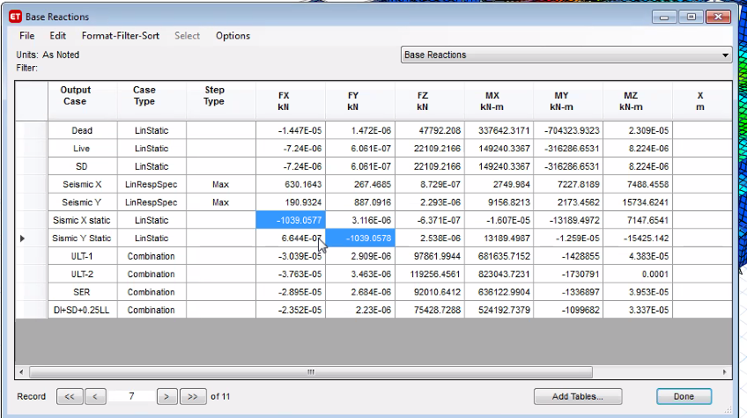
=1.6% < 15% ok
The base shear in x =1039 and y directions from equivalent static load pattern =1039 kN
%Difference =1.6%

Slide 32
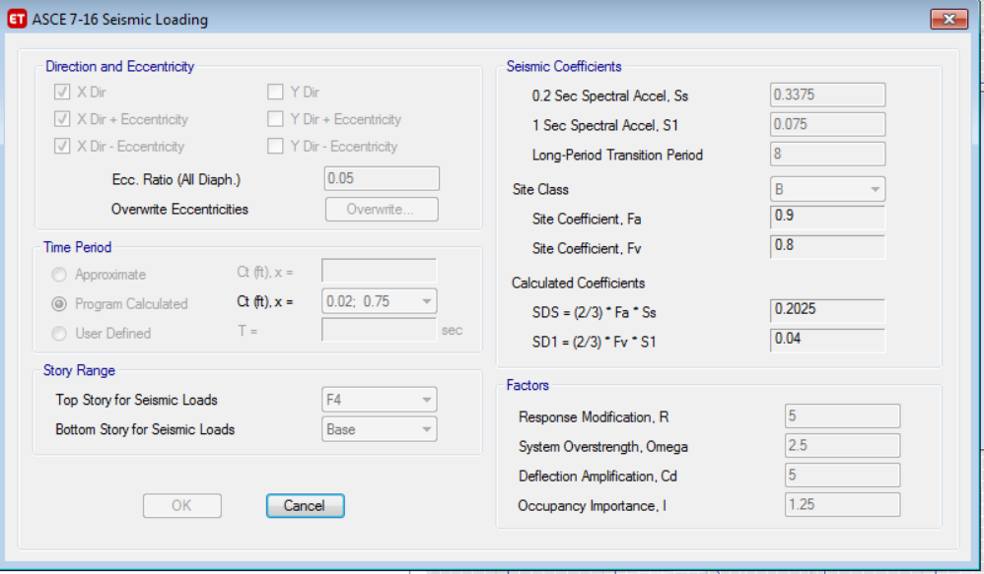
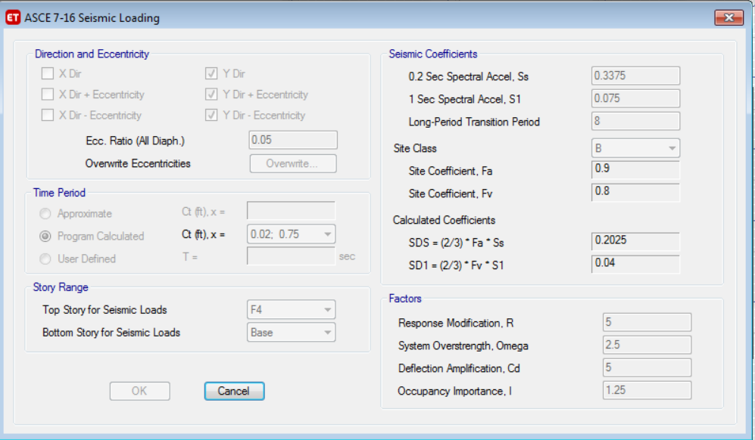
Seismic loading in X - direction
Seismic loading in Y - direction

Slide 33
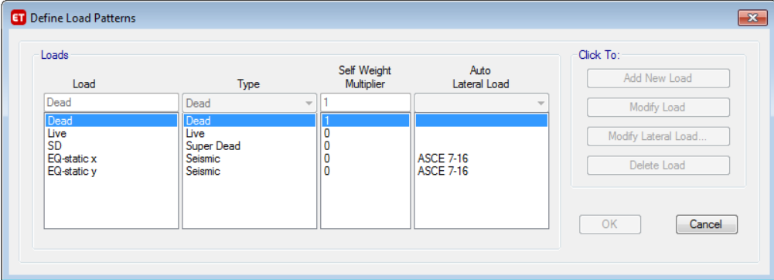
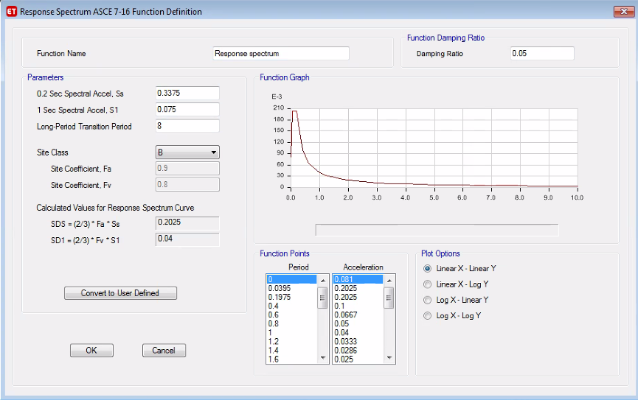
Define Load Patterns
Definition of response spectrum

Slide 34
Load Combinations:
Gravity Loads Combinations:
Service Load: D + S.D + L.
Ultimate Load: 1.2 D + 1.2 S.D + 1.6 L

Slide 35
Clarification for the ETBS default combinations
Load combinations :
combination 1 = 1.4D
combination 2 = 1.2D+1.6L
combination 3 = 1.2D+1L+1 eq-x
combination 4 = 1.2D+1L+1 eq-y
combination 5= 1.2D+1L-1 eq-x
combination 6 = 1.2D+1L-1 eq-y
combination 7 = 0.9D+1 eq-x
combination 8 = 0.9D+1 eq-y
combination 9 = 0.9D - 1 eq-
combination 10 = 0.9D - 1 eq-y

Slide 36
Checks of Seismic

Slide 37
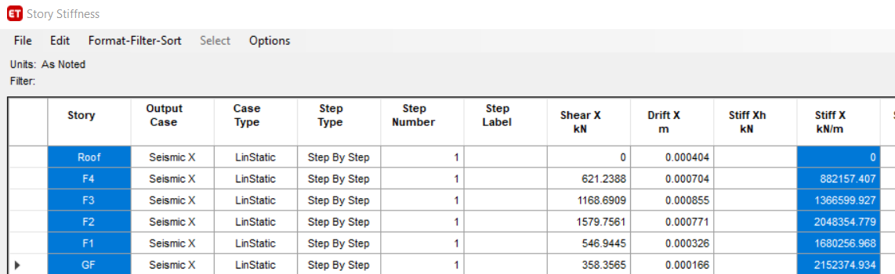
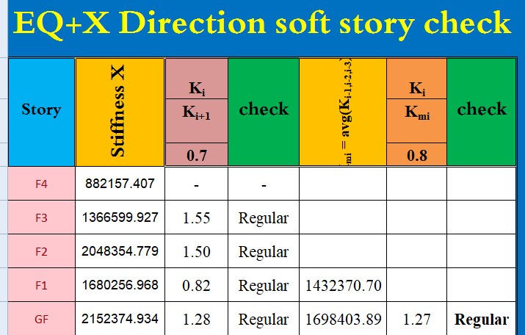
Horizontal Torsional Irregularity

Slide 38
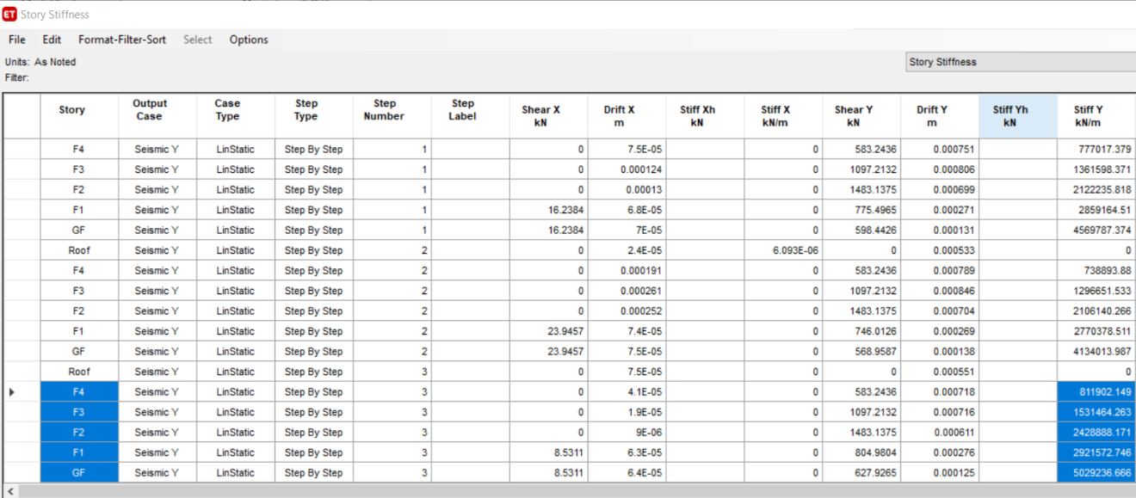
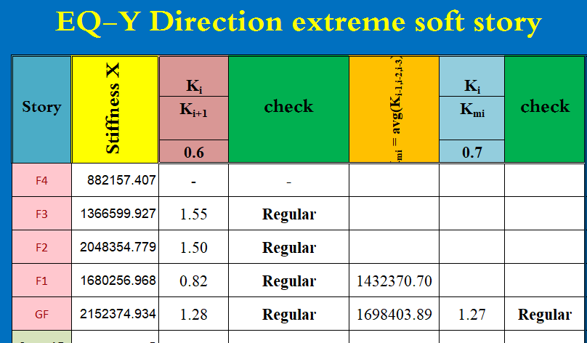
Vertical Torsional Irregularity

Slide 39
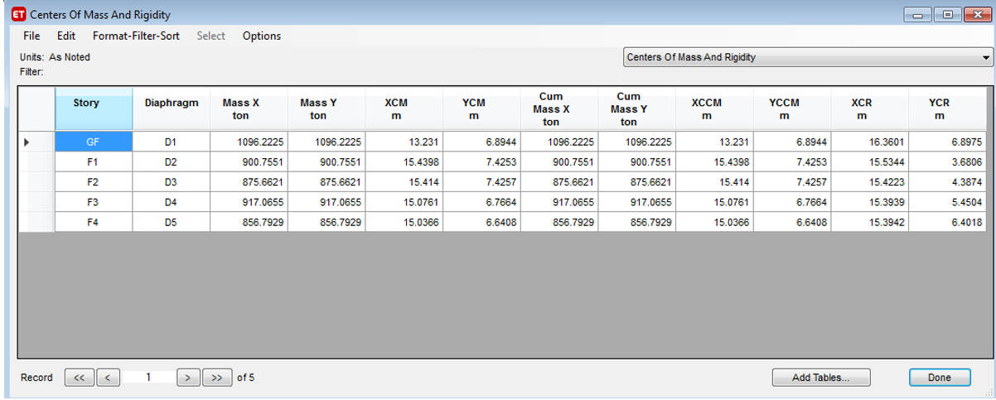
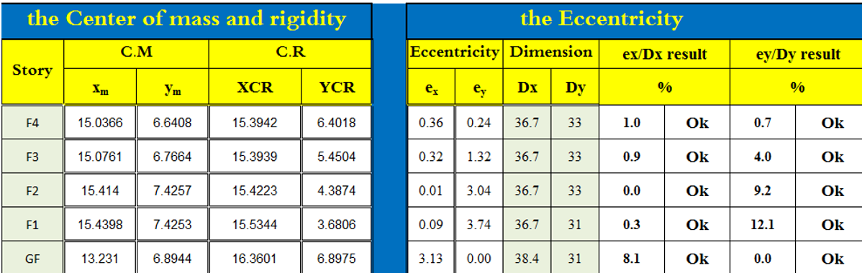
Drift Check

Slide 40
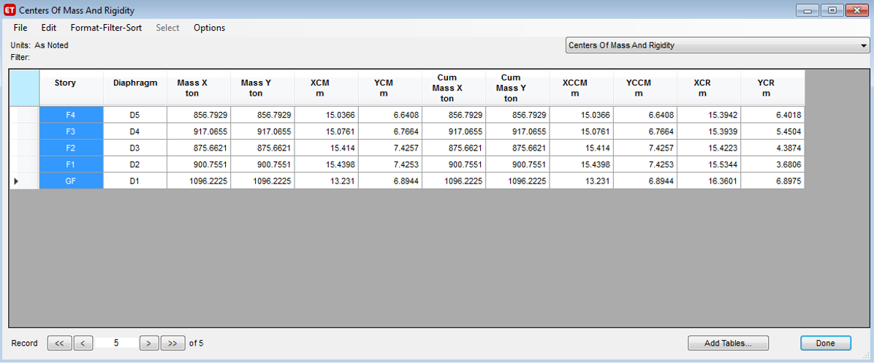
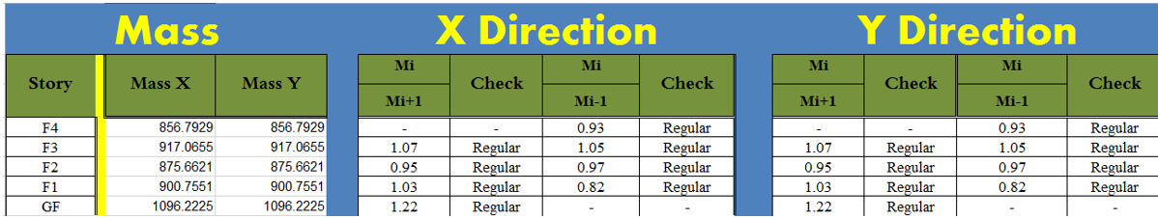
Mass checks

Slide 41
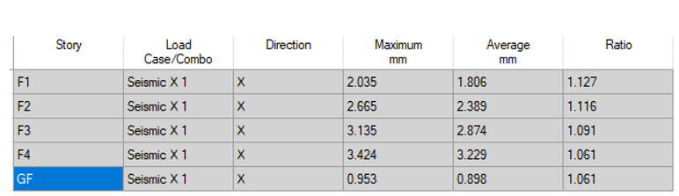
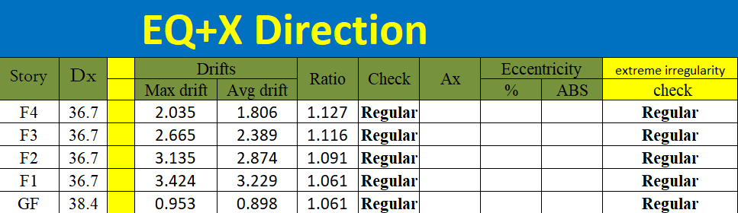
Torsional check

Slide 42
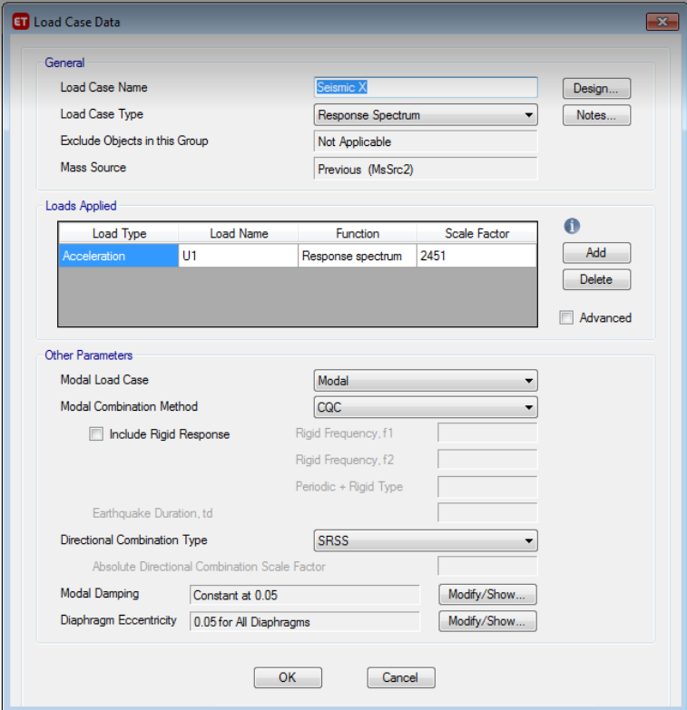
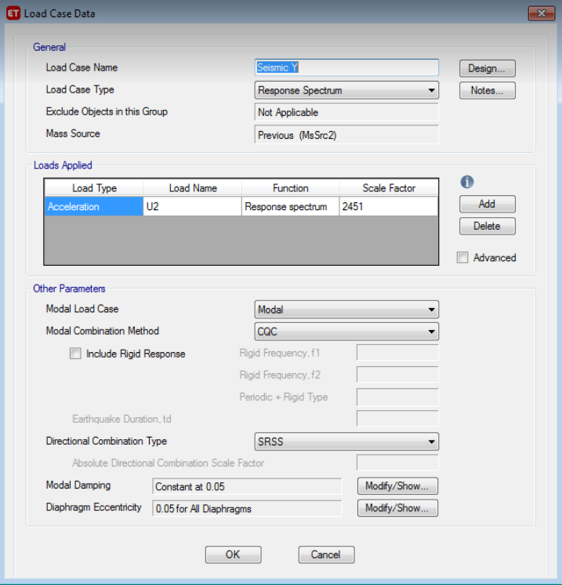
Response spectrum in X - direction
Response spectrum in Y – direction

Slide 43
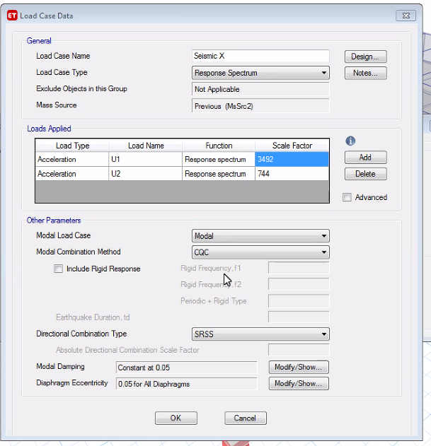
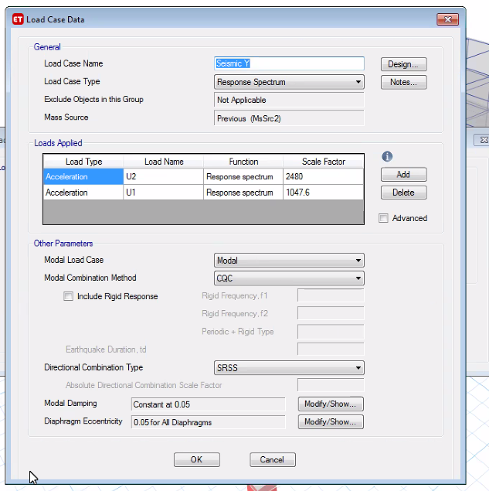
By ETABS
The Load Case Data X Direction
The Load Case Data Y Direction

Slide 44
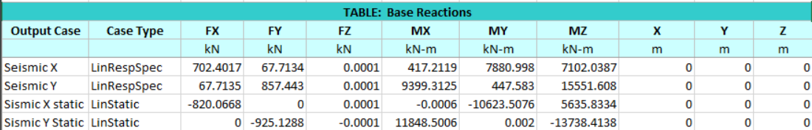
Values Base Reaction from response spectrum in X & Y directions

Slide 45
Preliminary Dimensions

Slide 46
Preliminary Dimensions For slab:
Critical spans were taken to determine the slab thickness for each system of slabs that will be used in the building:
Slab System | Thickness | Comments
Flat Slab | 0.53 | Rejected for its high thickness.
Flat Plate | 0.48 | Rejected for its high thickness.
Solid Slab 2m | 0.2 | Not the perfect solution.
Solid Slab 4m | 0.2 | Would be analyzed for the design.
Cobiax and Ribbed Slab | 0.35 | Rejected for the checks of deflection.

Slide 47
Solid Slab with Drop Beams every 4m

Slide 48
Preliminary Dimensions For Beams
Assume LL=SD=5KN/m^2
DL=0.2*25=5KN/m^2
Wu=1.2(DL+SD)+1.6LL=20Kn/m^2
M=(wL^2)/8=2524.9Kn.m
M=Rbd^2 Assume b=d/2, from table R=7.19
Then d=888.8mm use d=900mm
With Beam every 2m to be in safe side use slab thickness=0.2 instead of 0.18m
M=1232.43Kn.m ,d=450mm

Slide 49
Final Thickness of Slab
The final thickness of slab after the analysis using Sap is 25cm.

Slide 50
Final Dimensions for Columns
Column | Dimension(mm)
C1 | 25*25
C2 | 50*50
C3 | 60*60
C4 | 75*75
C5 | 90*90

Slide 51
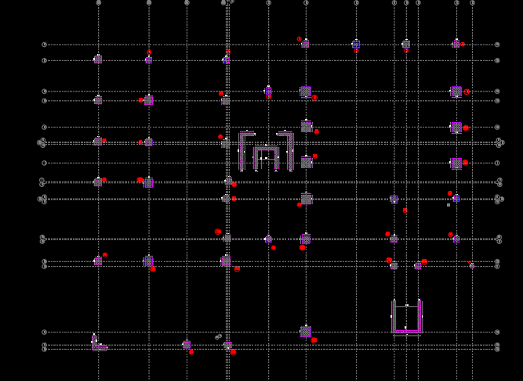
Columns Layout

Slide 52
Final Dimensions for Beams
Beam | Depth (mm) | Width (mm)
B1 | 1000 | 500
B2 | 800 | 400
B3 | 700 | 300
B4 | 500 | 300

Slide 53
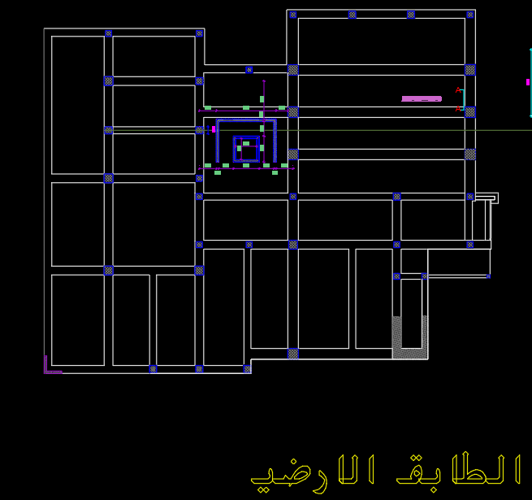
Beams Layout

Slide 54
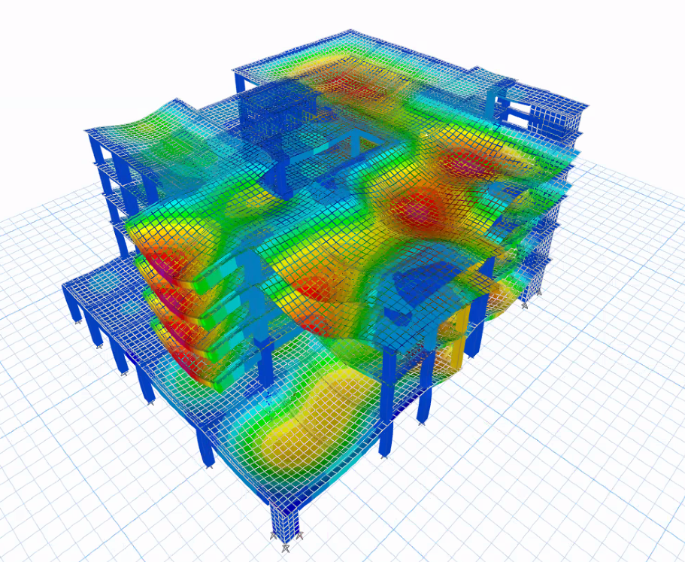
Modeling

Slide 55
Modifiers:
Slab Modifiers:

Slide 57
Ribbed slab and Cobiax Slab Modifiers:

Slide 59
Checks

Slide 60
Cobiax Slab Deflection Check
Deflection Avg = 0.49 mm
Slab = 155.3-0.49 = 154.8 mm
Allowable = (15.1*1000)/240 = 62.92 mm not ok
So the Cobiax slab system was excluded as it didn't achieve the deflection check.

Slide 61
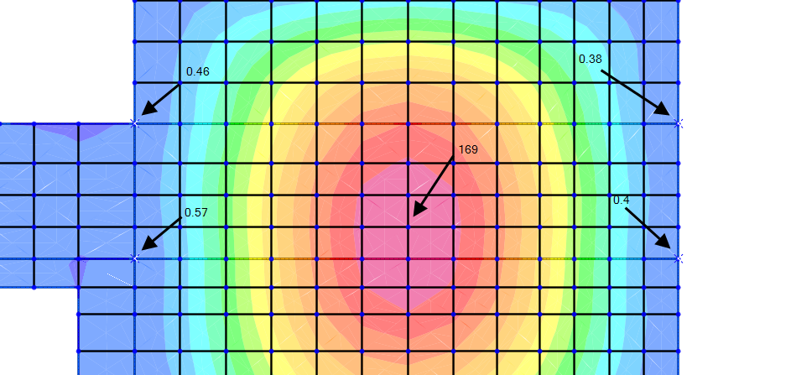
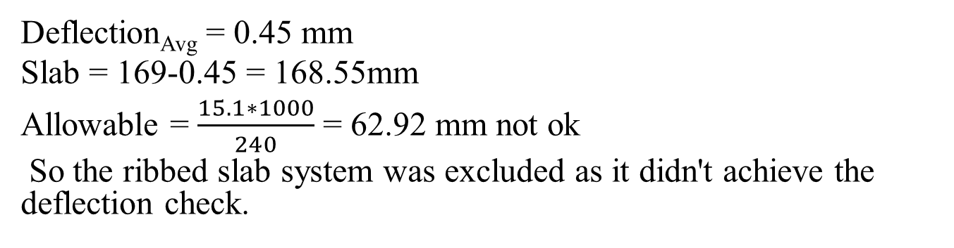
Ribbed Slab Deflection Check
Deflection_{Avg}= 0.45 mm
Slab = 169-0.45 = 168.55mm
Allowable = $\frac{15.1∗1000}{240}$ = 62.92 mm not ok
So the ribbed slab system was excluded as it didn't achieve the deflection check.

Slide 62
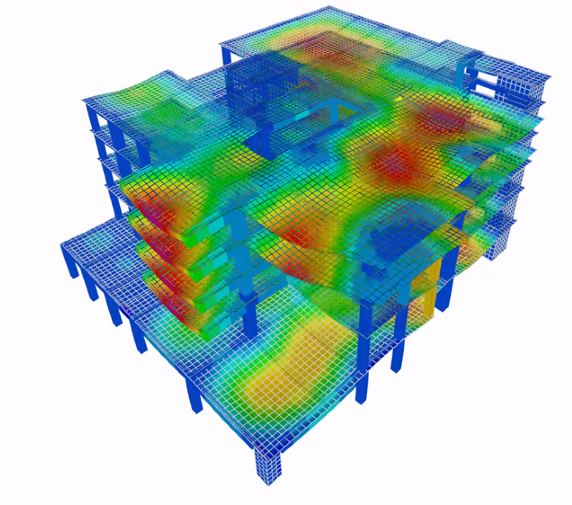
:Compatibility Check

Slide 63
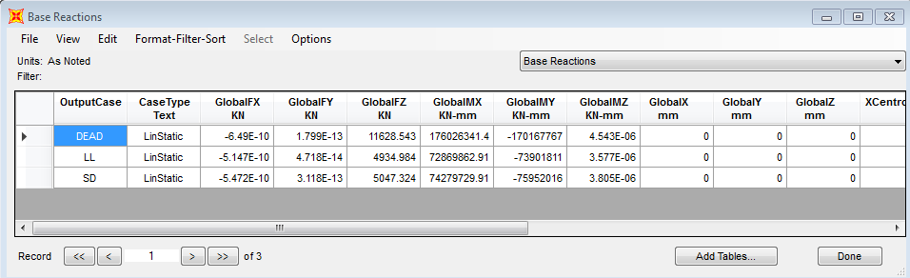
Equilibrium Check:
Dead Load = 11628.54 kN
Live load = 4934.98 kN
Super dead load = 4934.98 kN

Slide 64
Manual Calculations:
Super Dead load for basement floor =4934.88 kN
Error%=0%...ok
Live Dead load for basement floor =4934.88 kN
Error%=0%...ok
Dead Load :
Slab =6168.63 kN, Beams=2589.07 kN , Columns=1462.25 kN, Wall=1356 kN
Total Dead Load= 11575.95 kN
Error%= 0.4 %<5%...ok

Slide 65
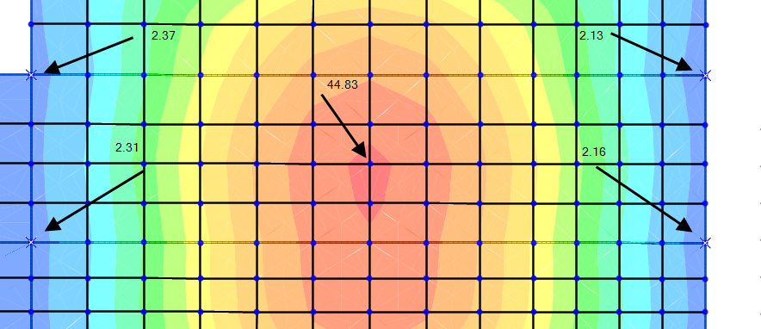
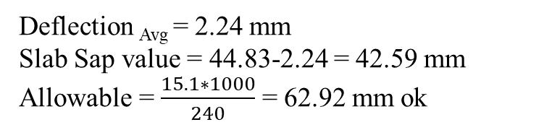
Slab deflection check:
Deflection _{Avg}= 2.24 mm
Slab Sap value = 44.83-2.24 = 42.59 mm
Allowable = $\frac{15.1∗1000}{240}$ = 62.92 mm ok

Slide 66
For slab Long term deflection

Slide 67

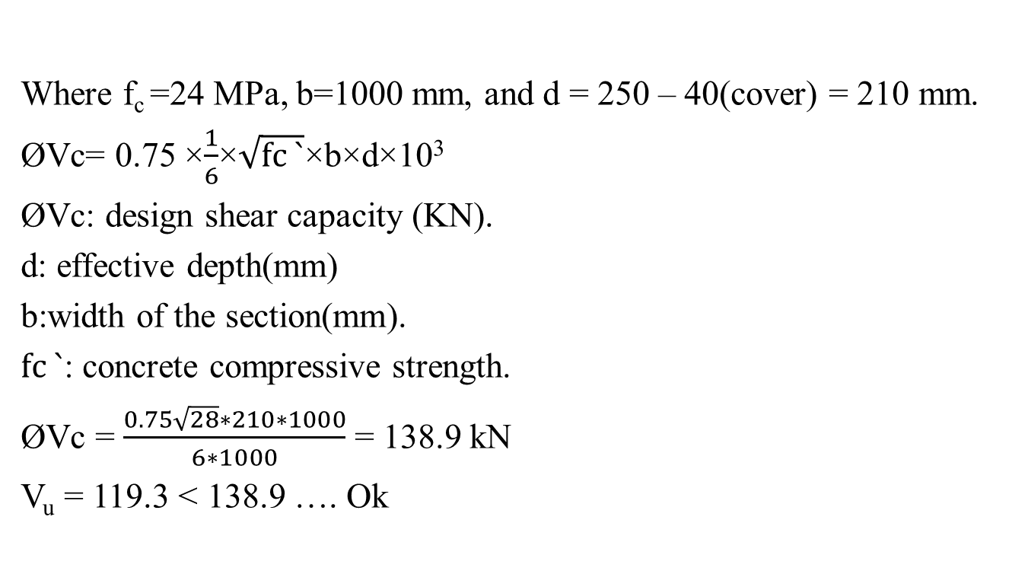
Check Shear for Slab
Where f_{c} =24 MPa, b=1000 mm, and d = 250 – 40(cover) = 210 mm.
ØVc= 0.75 ×$\frac{1}{6}$×$\sqrt{fc `}$×b×d×10³
ØVc: design shear capacity (KN).
d: effective depth(mm)
b:width of the section(mm).
$fc `$: concrete compressive strength.
ØVc = $\frac{0.75\sqrt{28}∗210∗1000}{6∗1000}$ = 138.9 kN
V_{u} = 119.3 < 138.9 …. Ok

Slide 68
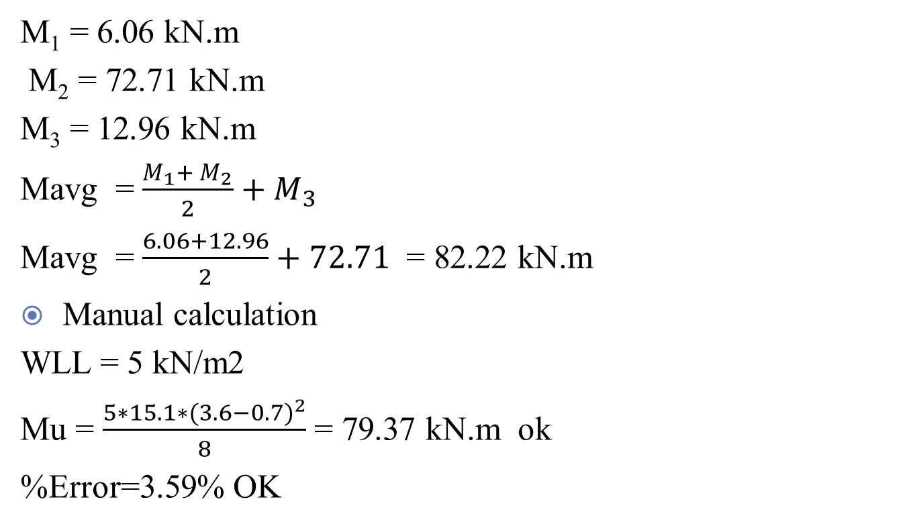
Check Moment on Slab:
M₁ = 6.06 kN.m
M₂ = 72.71 kN.m
M₃ = 12.96 kN.m
Mavg = $\frac{M_{1}+ M_{2}}{2}+M_{3}$
Mavg = $\frac{6.06+12.96}{2}+72.71$ = 82.22 kN.m
Manual calculation
WLL = 5 kN/m2
Mu = $\frac{5∗15.1∗{(3.6−0.7)}^{2}}{8}$ = 79.37 kN.m ok
%Error=3.59% OK

Slide 69
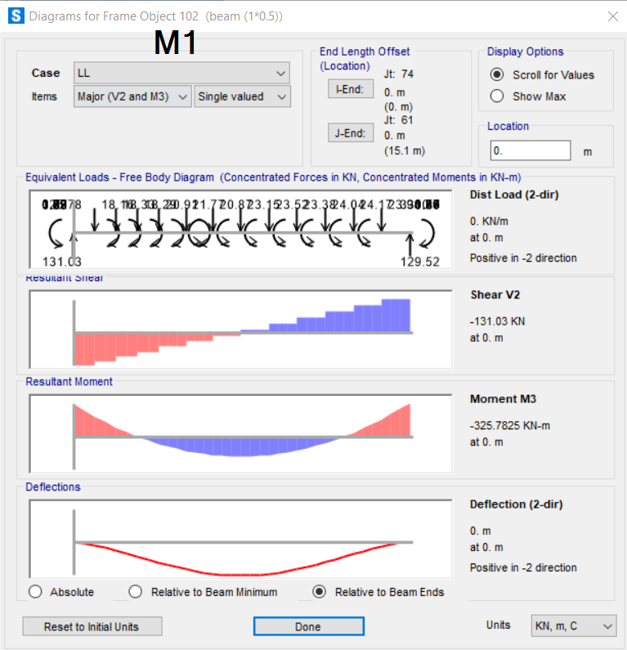
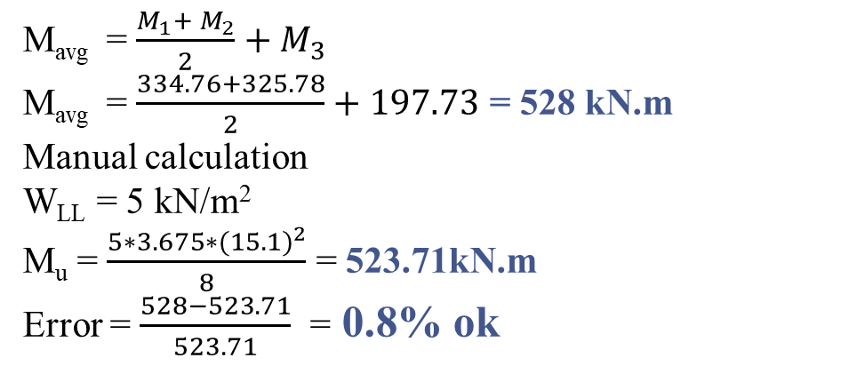
Check Moment for Beams:
M1= 325.78 kN.m
M2= 197.73 kN.m
M3= 334.76 kN.m
M_{avg} = $\frac{M_{1}+ M_{2}}{2}+M_{3}$
M_{avg} = $\frac{334.76+325.78}{2}+197.73$= 528 kN.m
Manual calculation
W_{LL} = 5 kN/m²
M_{u} = $\frac{5∗3.675∗{(15.1)}^{2}}{8}$ = 523.71kN.m
Error = $\frac{528−523.71}{523.71}$ = 0.8% ok

Slide 70
Columns Checks :
K10 Column
Manual calculation = Tributary area * LL = 138.7 kN
Sap value = 145.25 kN
%Error=4.7% OK

Slide 71
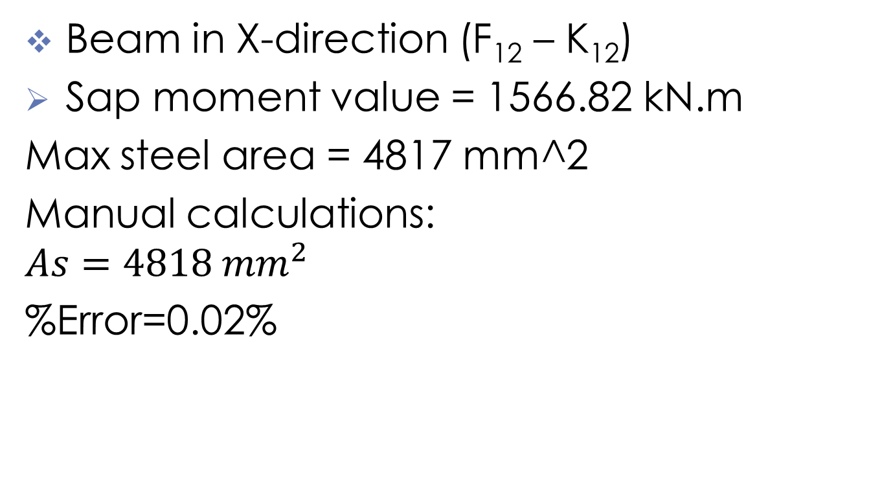
Design Checks:
Beam in X-direction (F₁₂ – K₁₂)
Sap moment value = 1566.82 kN.m
Max steel area = 4817 mm^2
Manual calculations:
$$As=4818 mm^{2}$$
%Error=0.02%

Slide 72
The Final Design of The Structure:

Slide 73

Slab Design:

Slide 74
Slab Design:

Slide 75

Slab Reinforcement:

Slide 76

Beam Design:
Figure 50:Beam Cross Section
Figure 50:Beam Cross Section

Slide 77

Columns Reinforcement:

Slide 79


