Slide 1


An-Najah National University
Faculty of Engineering
Civil Engineering Department
Graduation Project 2
2021-2022

Slide 2
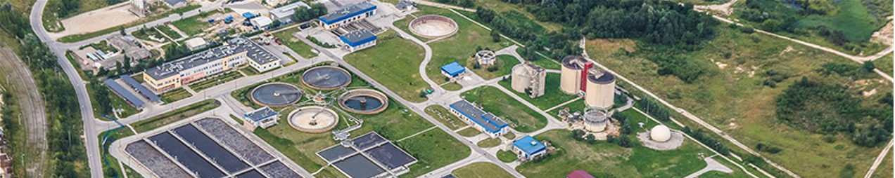
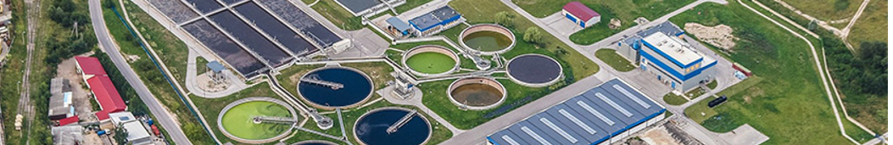
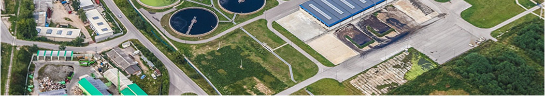
Untreated wastewater in East Nablus: characteristics and design
for treatment
  Prepared By : Ameer Draidi
  Reema Balsheh
  Mays Zakarni
Under Supervision of: Dr. Abdelhaleem Khader

Slide 3
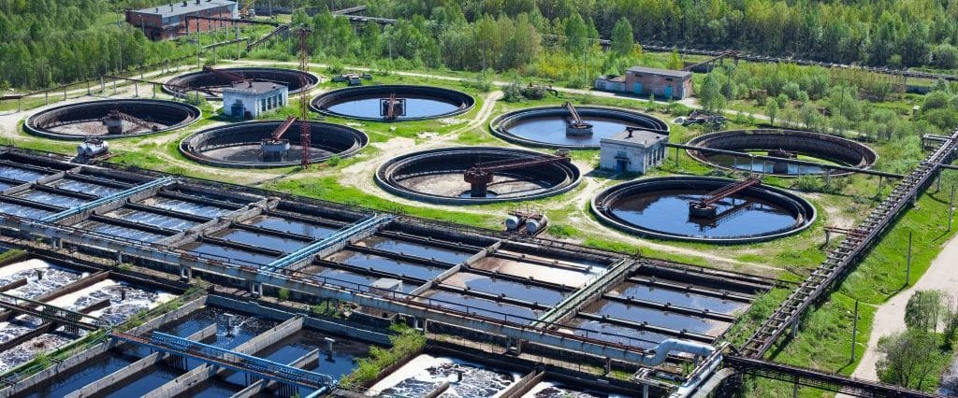
Outline
1 Introduction.
2 Problem Statement.
3 Objectives.
4 Literature Review.
5 Methodology.
6 WW analysis and treatment plant design.
7 Discussion.
8 Conclusion and recommendations.
9 Errors and constrains

Slide 4
Project Introduction
Palestinian per capita consumption of water is
about 81.9 liters per day
According to the WHO, 100 liters of water is
recommended for consumption per capita day
In Gaza and WB about 417.9 million cubic
meters of water is available annually

Slide 5
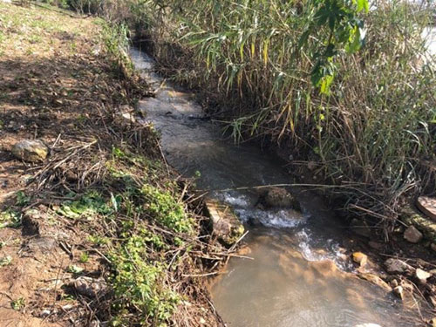
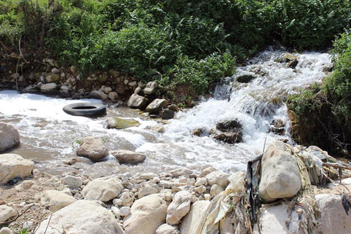
Project Introduction

Slide 6


Project Introduction
94%
of untreated sewage is released
to the ground and surface water
50%
of total groundwater that recharged from precipitation is wastewater

Slide 7
Problem Statement
A significant amount of
untreated WW
mix with rainfall then infiltrate into groundwater aquifers
the lack of exploitation of treated WW has become a political and social problem

Slide 8


Objectives
Analysis of the WW sample with clarification of pollutant values.
Preliminary design for the plant.
Conduct a software model (STOAT) for the plant
Suggest a proper solution for high pollutants rate.

Slide 9
Literature Review
  WW characteristic
1
Many pollutants expected to be in the selected sample: Temperature, PH, Chemical oxygen demand (COD), Biochemical Oxygen Demand (BOD), Solids Measurements (Gravimetric Method), Nitrite, Nitrate, Sulfate, phosphorous and Total Kjeldahl Nitrogen (TKN) which are a part of WW characterization.

Slide 10
Literature Review
WW Treatment Method
Physical treatment
Chemical treatment
Biological
treatment

Slide 11
Methodology
  Study Area
1
Regions | Total Population 2017 | Total Population 2045 Estimated | Study Area %
East Nablus Askar and Balata Camps | 81567 | 138163 | 76.22%
Azmout | 3410 | 5776 | 0.98%
Deir al Hatab | 2813 | 4765 | 3.76%
Salem | 6212 | 10523 | 1.59%
Beit Furik | 13360 | 22630 | 12.23%
Kufr Qalil | 3003 | 5087 | 1.24%
Rujeib | 5912 | 10015 | 3.99%
Total | 116277 | 196959 | 100%

Slide 12
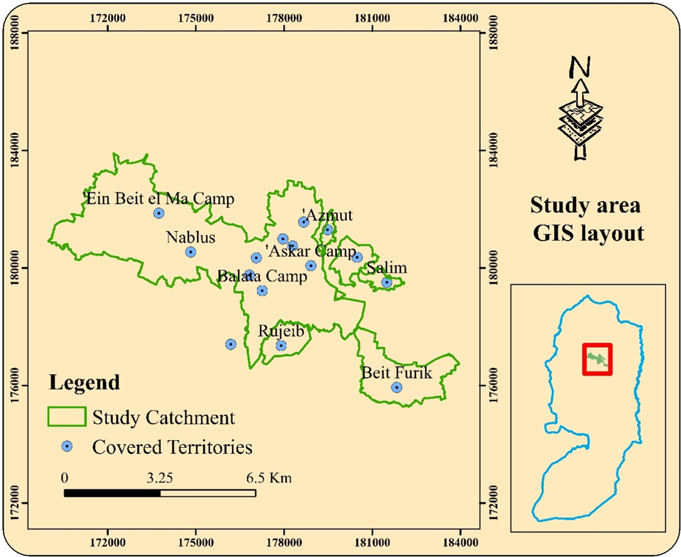
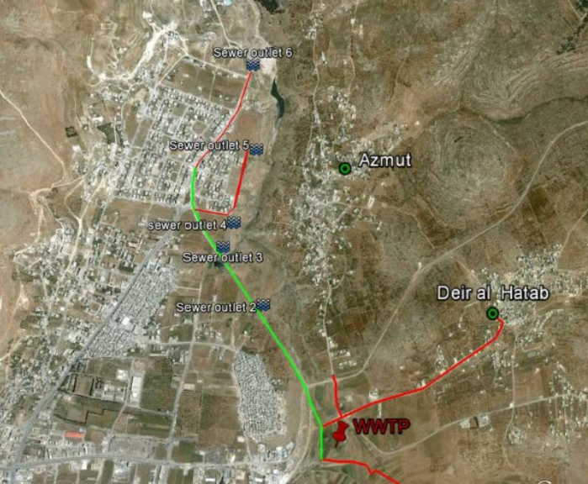
Methodology

Slide 13
Methodology
  Flow rate
2
Estimated in 2045
A maximum flow (assuming only sewage network)
is 451.36 L/s

Slide 14
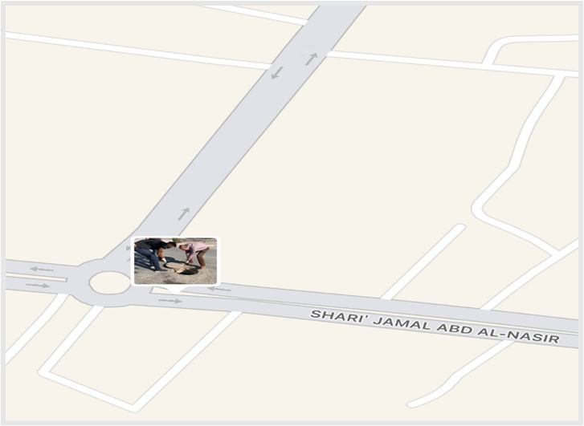
Methodology
  Water Sampling
3
The sample was collected from a representing manhole in east Nablus that charges in wadi al Sajour before the slaughterhouse of Nablus city on 21/9/2021 at nine o’clock in the morning.
Manhole coordination globally is 32°13'38.2 North
35°15'35.7 East

Slide 15
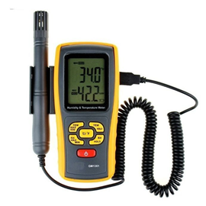
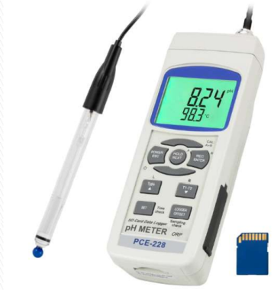
Methodology
  Quality Analysis
4
Parameter | Instruments | Device
Temperature | Temperature meter
pH | pH meter

Slide 16
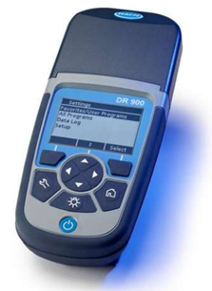
Methodology
  Quality Analysis
4
Parameter | Instruments | Device
COD | COD Vials (High and Medium range), Micro -pipette, COD Reactor, COD reagent vial Cooling Rack, DR 900 Colorimeter

Slide 17
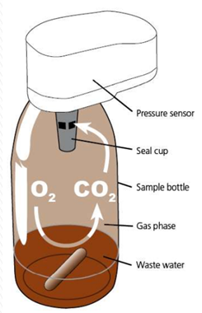
Methodology
  Quality Analysis
4
Parameter | Instruments | Device
BOD | BOD bottles and sensors, Traps, Sensor, Incubator, Stirring bars, Potassium hydroxide (KOH)

Slide 18
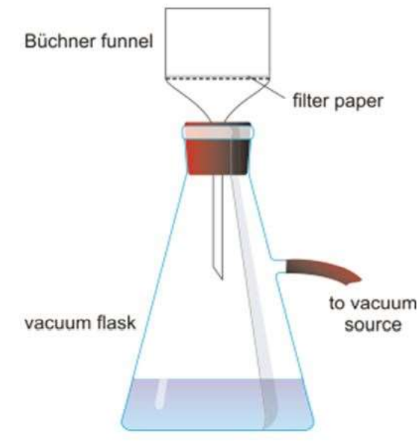
Methodology
  Quality Analysis
4
Parameter | Instruments | Device
Solids | Buchner Funnel, Filter Paper Pore size:1.5 µm, Crucible, Flask with arm, Micro -Pipette, Sensitive electronic balance, Vacuum pump, Oven

Slide 19
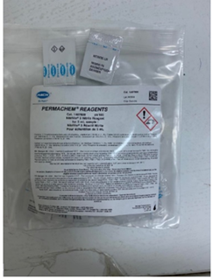

Methodology
  Quality Analysis
4
Parameter | Instruments | Device
Nitrite | Micro -Pipette, vial, DR 900 Colorimeter, distilled water, Nitrite Reagent for 5ml sample

Slide 20
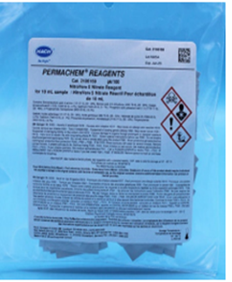
Methodology
  Quality Analysis
4
Parameter | Instruments | Device
Nitrate | Micro -Pipette, vil, DR 900 Colorimeter, distilled water, Nitrate Reagent for 10ml sample

Slide 21
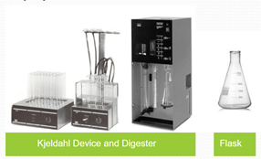
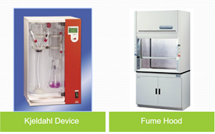
Methodology
  Quality Analysis
4
Parameter | Instruments | Device
TKN | Kjeldahl Device and Digester, Flask, Kjeldahl Device, Fume Hood

Slide 22
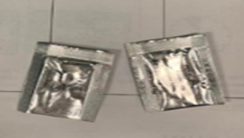
Methodology
  Quality Analysis
4
Parameter | Instruments | Device
Sulfate | 10mm vial, DR 900 Colorimeter, Micro –pipette, distilled water, sulfate reagent for 10ml sample

Slide 23
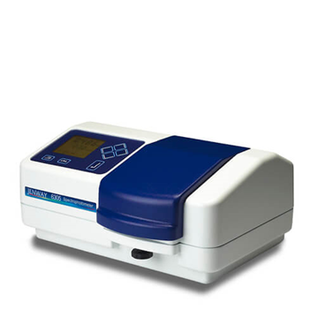
Methodology
  Quality Analysis
4
Parameter | Instruments | Device
Phosphorus | Spectro photometer, Cuvettes, (1cm Light path), test tube holder, 50 and 100ml graduated cylinders, 100ml volumetric flasks, funnels, 2,5ml pipette bulb, 200ml Erlenmeyer flask, beakers

Slide 24
Wastewater analysis
Parameter | unit | value
Temperature | º C | 24.9
PH | --- | 6.2
COD | mg/L | 1412
BOD₅ | mg/L | 746
TS | mg/L | 1620
TSS | mg/L | 331
TDS | mg/L | 997
Nitrite | mg/L | 67
Nitrate | mg/L | 26
Sulfate | mg/L | 35
Phosphorus | mg/L | 17.6
TKN | mg/L | 134.1

Slide 25
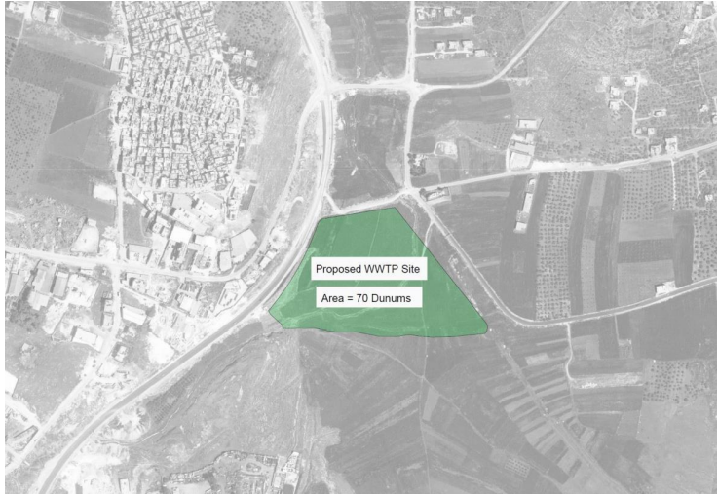
Wastewater Treatment Plant location

Slide 26
Treatment plant design
  Preliminary treatment
Parshall flume device : For Q _{max}=1625m³/hr.
W= 0.3m D = 0.84m
Channel : Channel width equal flow measurement
inlet 0.84m.
Bar rack : 34 bar
Horizontal-flow grit chamber : Area = 1.13m²
Height =1.34m , Total Depth = 2m , T=0.5min

Slide 27
Treatment plant design
  Primary & sedimentation treatment
Primary Clarifier :
Depth =2.1 m , Volume =3250 m³
Anoxic Tank :
Volume= 3250 m³
Aerobic Tank : Volume = 48488 m³
Depth = 5m Internal recycling =38998m³/d
Secondary Clarifier : Volume =6500 m³
Depth = 5.5m with 0.5m freeboard

Slide 28
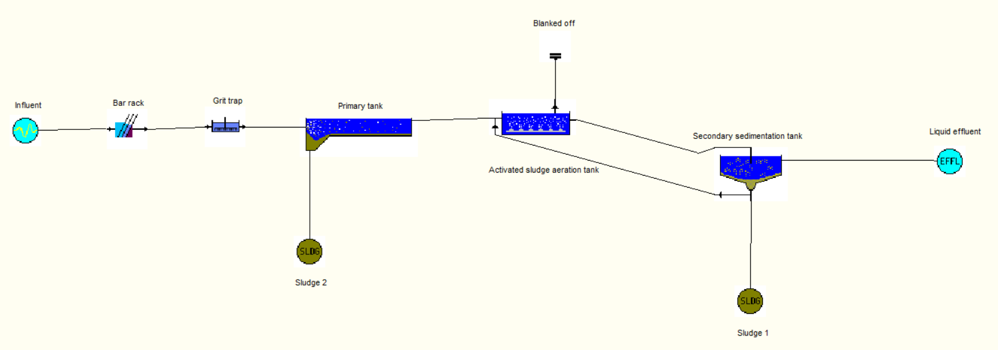
STOAT software

Slide 29
Result comparison
Parameter | Unit | Effluent -2021 | PSI Guidline,2012
BOD5 | mg/l | 4.28 | 20 | 20 | 40 | 60
COD | mg/l | 41.17 | 50 | 50 | 100 | 100
TSS | mg/l | 13.23 | 30 | 30 | 50 | 90
TP | mg/l | 6.64 | 30 | 30 | 30 | 30
Nitrate | mg/l | 9.11 | 20 | 20 | 30 | 40
PH | - | 7 | 6-9 | 6-9 | 6-9 | 6-9

Slide 30
Recommendations
Implementing treating units inside the factories this will reduce the burden on the plant
The elevated concentration of NH₃ due to slaughterhouse needs to special treatment before introducing WW to the treatment plant.
Split the total design period into different phases, owing to financial constrains.
Establish a new network for storm water in order to decrease the load burden especially in winter.
Sludge handling by anaerobic digester.
Add tertiary treatment (disinfection) using ultra violet radiation or chlorination to be applicable for instant use.

Slide 31
Errors
Error in taking the sample.
1
Human error.
4
Mechanical error.
5

Slide 32
Constrains
Equipment
Time
Age of Data
Literature Accessibility

