Slide 1
On Demand
Virtual Circuit-Network for QoS using SDN
Yaffa Albzour Khadijah Kazamel Dana Shamasnh
supervisor : Dr.Othman Othman

Slide 2
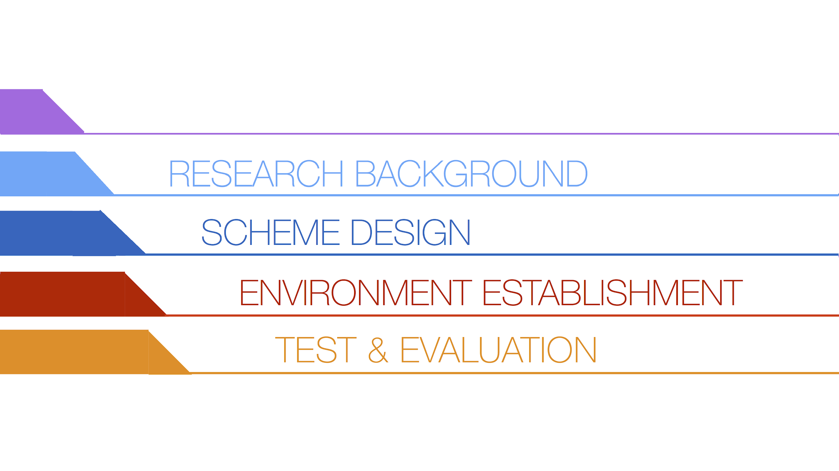
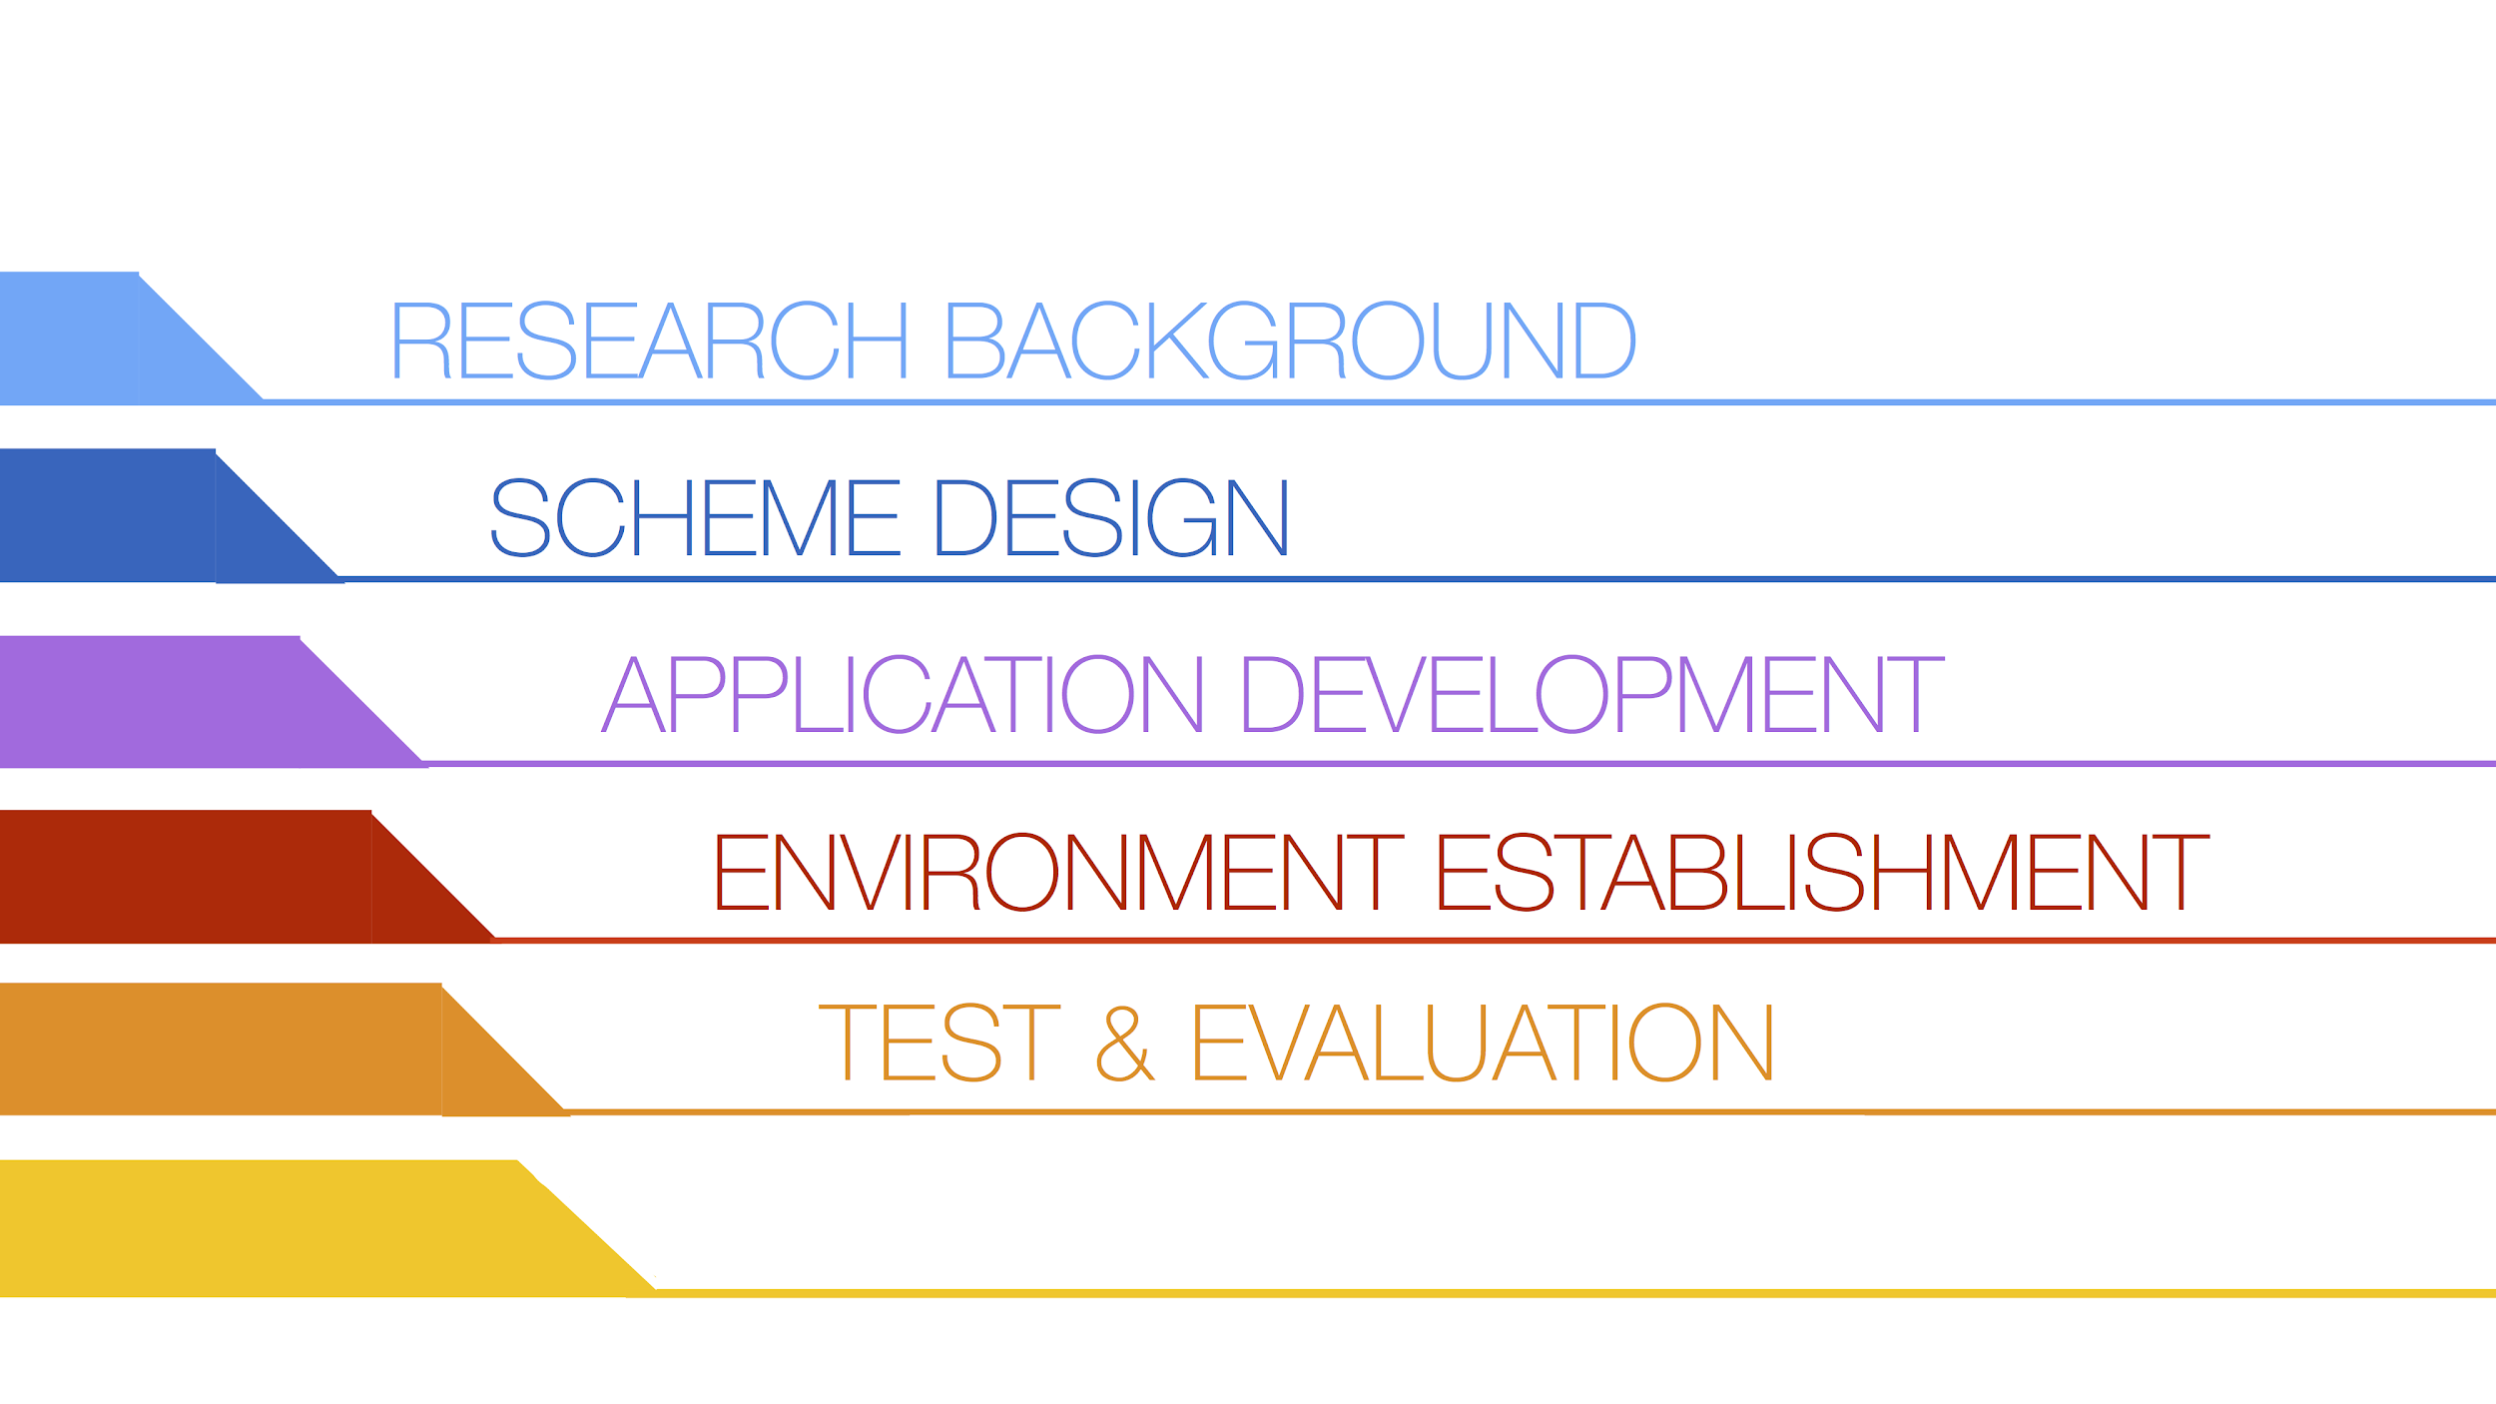
PROJECT GOALS
CONCLUSION & FUTURE WORK
Notes:
ا

Slide 3
PROJECT GOALS

Slide 4

Project Goals
Transfer video stream between predefined source and destination with low delay using traffic engineering (TE) and quality of service (QoS) in a software defined network (SDN) environment.
  TE : traffic management.
  QoS: to give priority to specific flows.

Slide 5


Slide 6

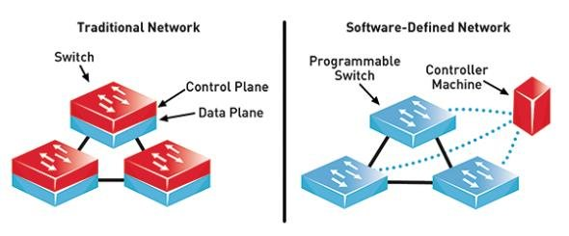
Notes:
SDN, often referred to as a “radical new idea in networking”, promises to dramatically simplify network management and enable innovation through network programmability.
Computer networks are typically built from a large number of network devices such as routers, switches and numerous types of middleboxes with many complex protocols implemented on them. Network operators are responsible for configuring policies to respond to a wide range of network events and applications. They have to manually transform these high level-policies into low- level configuration commands while adapting to changing network conditions. And often they need to accomplish these very complex tasks with access to very limited tools. As a result, network management and performance tuning is quite challenging and thus error-prone
The layer cake model, in essence, divides up networking activity into a number of layers: the physical level, the link level, the network level, the transport level, the applications level etc. The purpose of this model is to clarify the fact that each layer exists on different kinds of network, and that (within reason) the different kinds of network can be mixed and matched.
optical control plane is software that controls all aspects of configuring connections between optical switches across a network.
optical network control plane is responsible for tracking the network topology and the state of network resources, and for establishing, removing and maintaining connections
MPLS supports the forwarding of data packets based on a “label” that is prepended to each IP packet.
Label Switched Routers (LSR) forward packets according to the attached labels along a Label Switched Path (LSP). The LSPs are established using one of several signaling protocols.
Software Defined Networking (SDN) is a new networking paradigm in which the forwarding hardware is decoupled from control decisions.
It promises to dramatically simplify network management and enable innovation and evolution. The main idea is to allow software developers to rely on network resources in the same easy manner as they do on storage and computing resources.

Slide 7
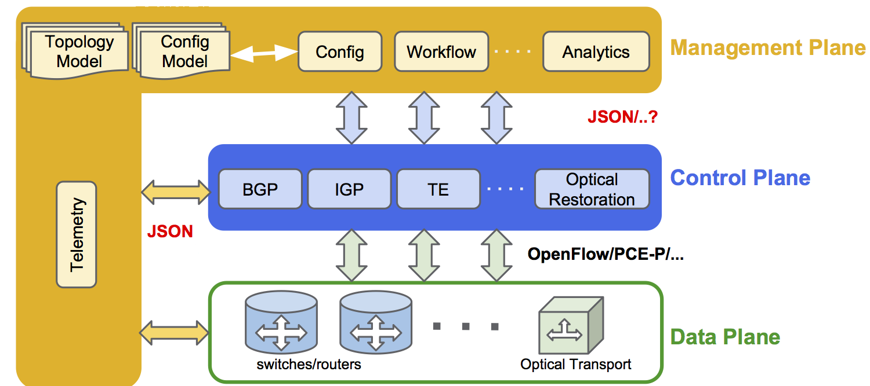
Anatomy of a Software Defined Network
Notes:
remove red

Slide 8
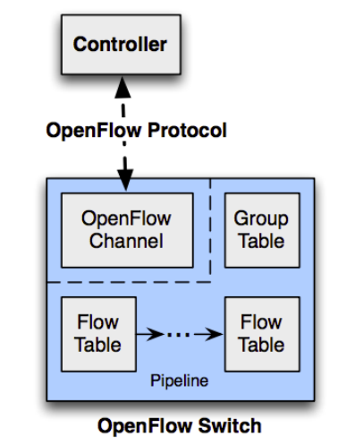
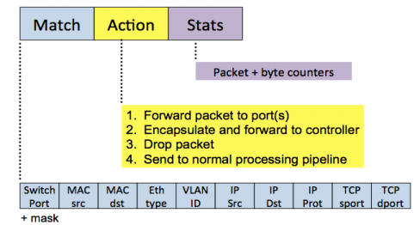
Software Defined Network Configuration

Slide 9
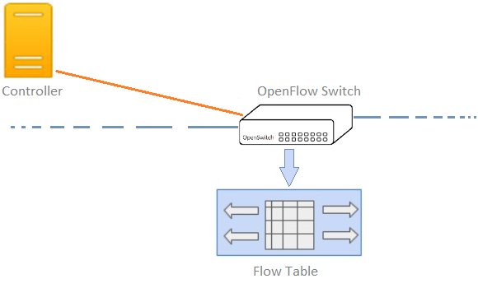
Software Defined Network Configuration
Ask the controller
Buffer the packet
Replay
No matching entry
Check flow Table

Slide 10
Software Defined Network Configuration
Insert new entry
in Flow table

Slide 11
Software Defined Network Configuration
matching entry
Check flow Table

Slide 12
Software Defined Network Configuration
Forward the packet

Slide 13


Slide 14

Current QoS Solution
Best effort (Internet) network not suitable for transferring video streaming
  High delay
Current solutions based on labeling the packets, but
  Per packet processing [A.R. Sharafat, MPLS-TE and MPLS VPNS with openflow]

Slide 15
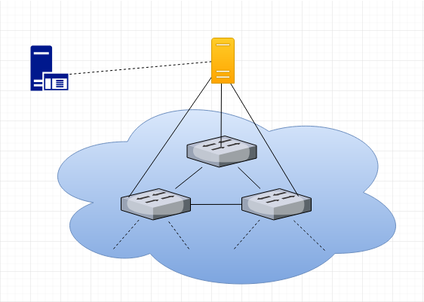
Overall Network Topology
SDN Controller (FloodLight)
Application
(TE & QoS)

Slide 16
Multiple flows between multiple hosts, but
One flow with high priority
  Delay is critical (Latency is a major metric)
  Jitter (variation of delays)
Other flows with low priority

Slide 17
high priority flow
  Flow Definition:
    Source IP = 10.0.0.1/32 #host 1
    Destination IP = 10.0.0.6/32 #host 6
  Actions:
    Route through minimum latency path
    Put into high priority queue

Slide 18
Other flows with low priority
  Action: Routing based on controller dissensions
Added to a default queue

Slide 19
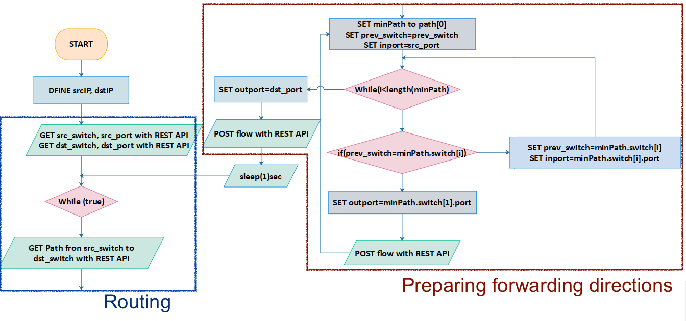
Notes:
simp;efy>>add labels

Slide 20


Slide 21

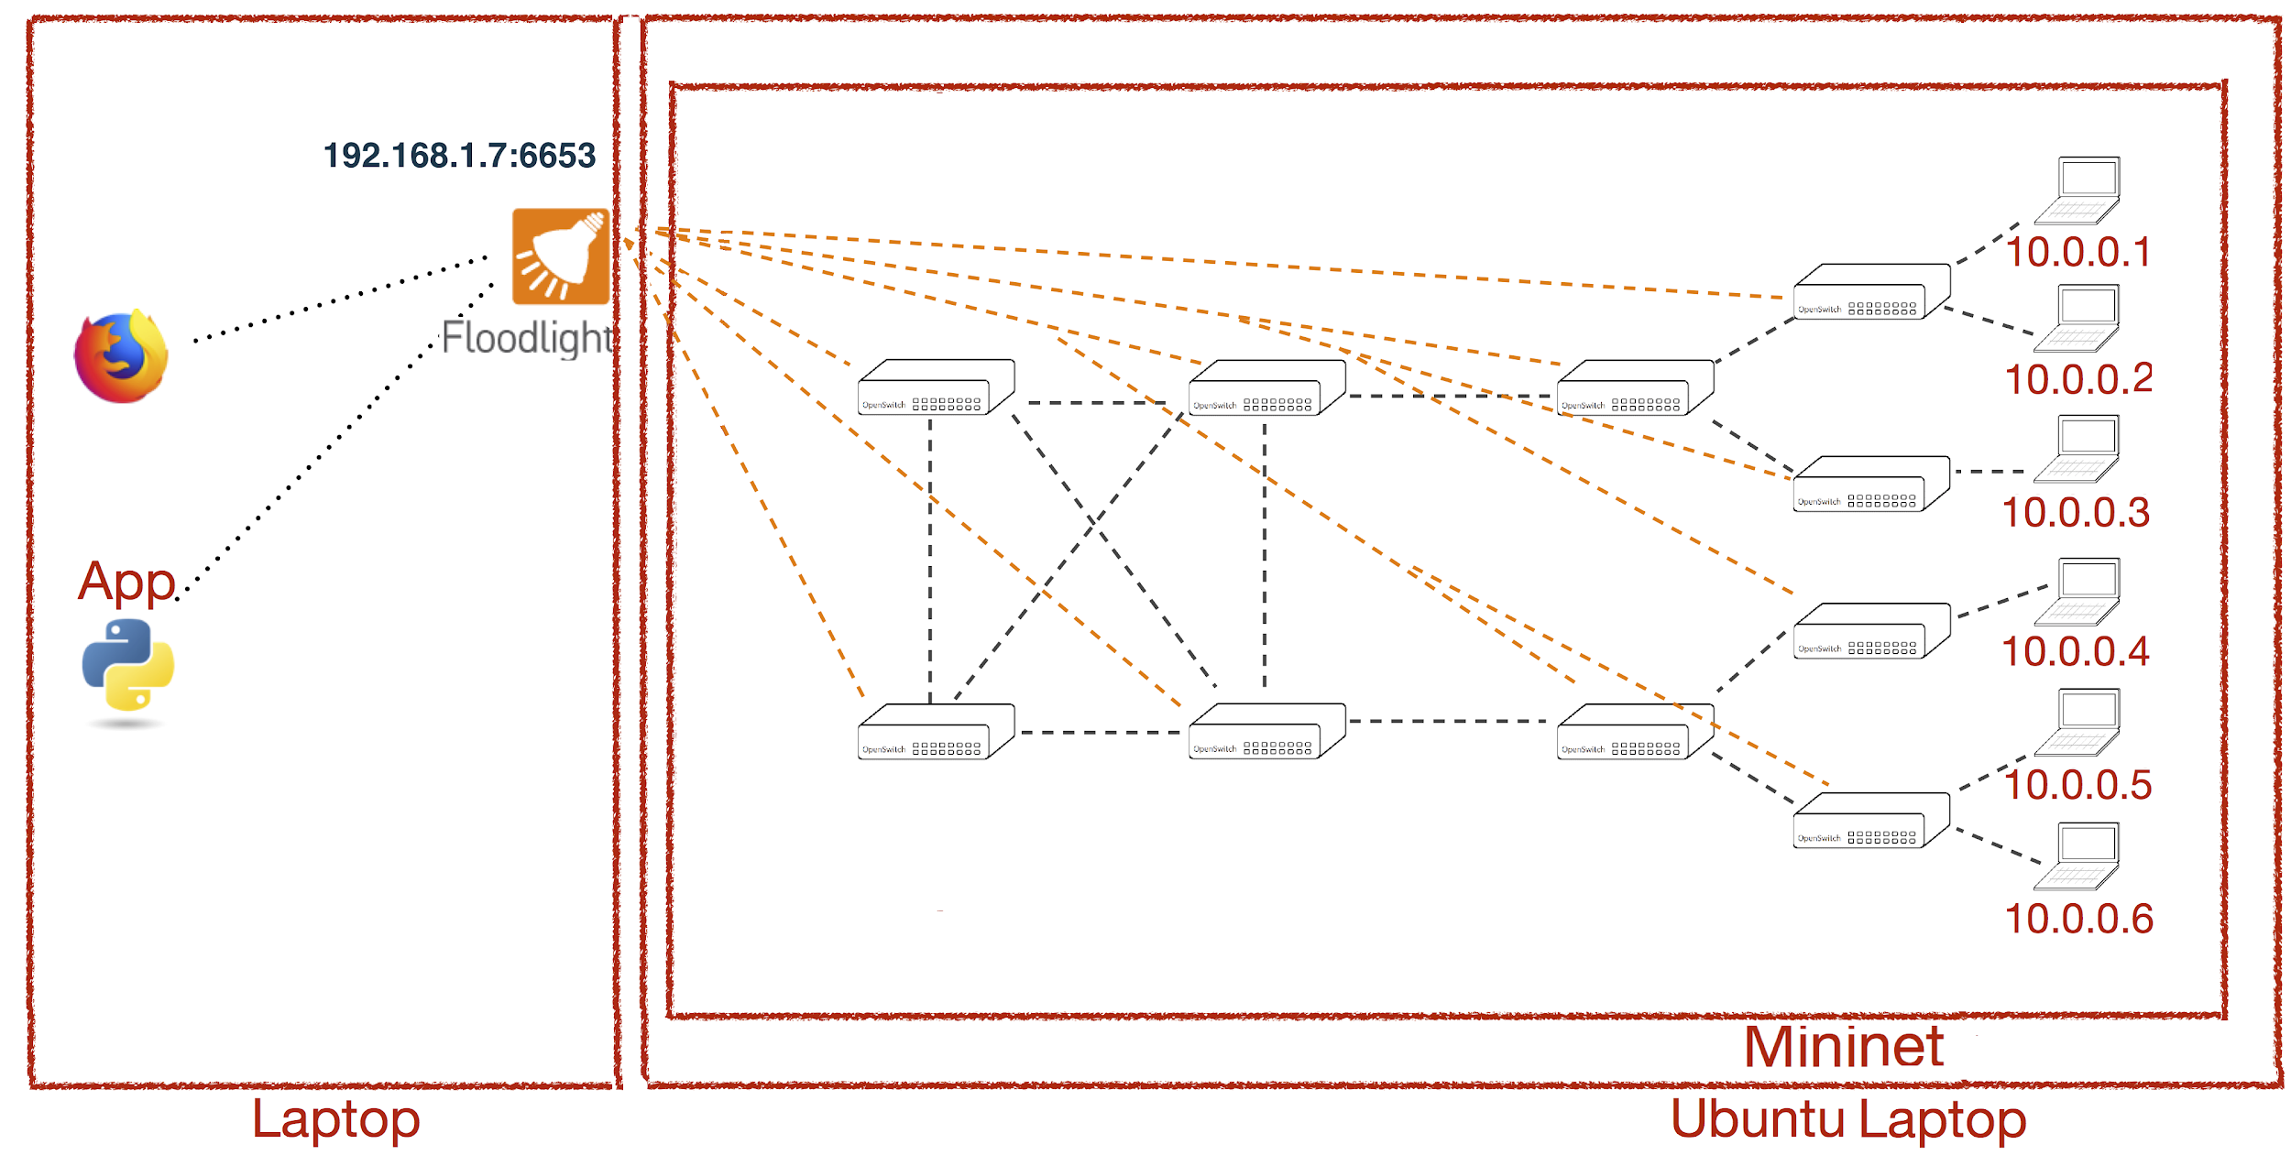
Notes:
remove VM

Slide 22


Slide 23

Three scenarios in each scenario
Measure Round Trip Time (RTT) for traffic from host 1 to host 6
Increase network load and measure changes

Slide 24
Scenario 1: SDN acts as traditional Switched Network
Convert SDN functionality to be as Traditional Network
  Open Virtual Switches (OVS) act as Normal Standalone Switches
    All flows are treated equally
    Each flow packet is processed independently

Slide 25
Scenario 2: Software Defined Network
  Controller & OV-Switches
  Processing only for first packet of each flow
    next packets of the flow forwarded according to flow table
      Reduce processing
  Paths decision by controller
Shortest Path

Slide 26
Scenario 3: SDN with TE and Quality of Service
▴SDN with TE and Quality of Service (QoS)
▴Adding Queues to the OV-Switches
▴Push static flows into controller
▴ Forward through least latency path and,
▴ Put flow into the highest priority queue

Slide 27
Amount of background traffic ( Number of flows ) | Traditional RTT | SDN RTT | QoS RTT
0 | 0.076 | 0.227 | 0.151
2 | 0.077 | 0.291 | 0.235
4 | 0.294 | 0.484 | 0.333
8 | 1.874 | 0.726 | 0.565
16 | 1211 | 1.261 | 0.874
32 | very high congestion | 6.432 | 3.937
64 | very high congestion | 15.068 | 5.356
128 | very high congestion | 164.203 | 7.96

Slide 28
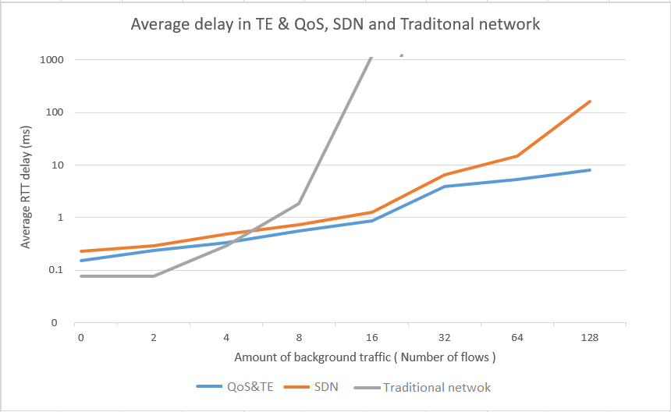

Slide 29
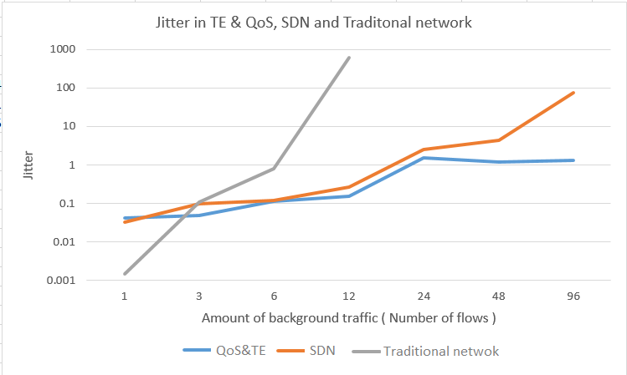
Amount of background traffic (Number of flows) | Traditional | SDN | QoS
1 | 0.001 | 0.032 | 0.042
3 | 0.108 | 0.096 | 0.049
6 | 0.79 | 0.121 | 0.116
12 | 604.563 | 0.267 | 0.154
24 | very high congestion | 2.585 | 1.531
48 | very high congestion | 4.318 | 0.209
96 | very high congestion | 74.567 | 1.302

Slide 30
CONCLUSION & FUTURE WORK

Slide 31

Conclusion & Future Work
SDN promises to transform today static network into flexible, scalable, programmable platforms with the intelligence to locate resources dynamically.
Adding TE and QoS to manage the flows in the network passed on the latency to minimize the delay and also the jitter.

Slide 32
Conclusion & Future Work
  Take another flows performance into account by adding thresholds for the load at the network links.
  Take SDN security issues into account in terms of the communication between controller and the forwarding elements.

Slide 33
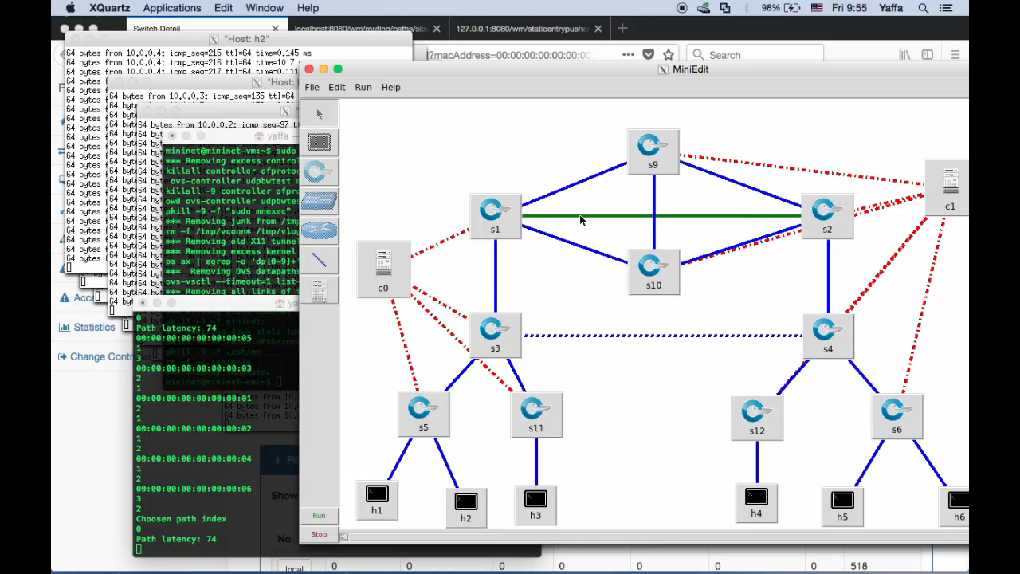

Slide 34


Slide 35


