Slide 1
Energy Engineering and Environment Department - An-Najah National University
Analysis of Thermal Energy systems at Al-Hijaz Company
Prepared by:
Mohammad Abdelhalim
Monther Qararia
Superviser:
Dr. Abdelrahim Abusafa

Slide 2
Agenda Style
01
INTRODUCTION
02
METHODOLOGY
04
RESULTS
04
03
CONCLUSION

Slide 3
INTRODUCTION

Slide 4
“
“
Electricity is the most important factor that has helped in the development of mankind and on which all sectors depend to continue their work
The previous diagram shows the electrical consumption depending on the sectors

Slide 5

AL-HIJAZ CHOCOLATE COMPANY
Main market is within Palestine and the UK
Founded in 2005
Prepare for and qualify for ISO 22000 specifications
Produces many chocolate and confectionery products
Located in the Anabta region
Number of employees is 100-150 employees

Slide 6

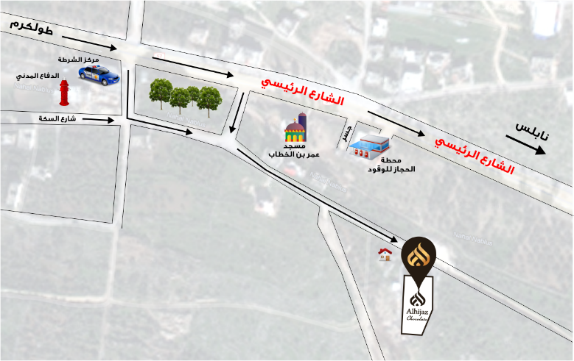
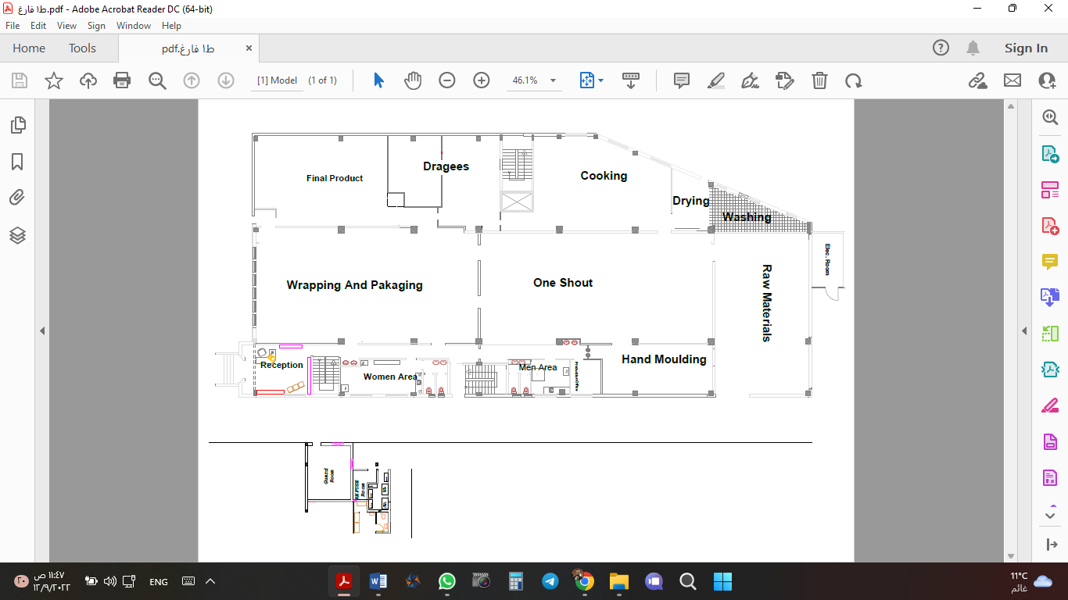
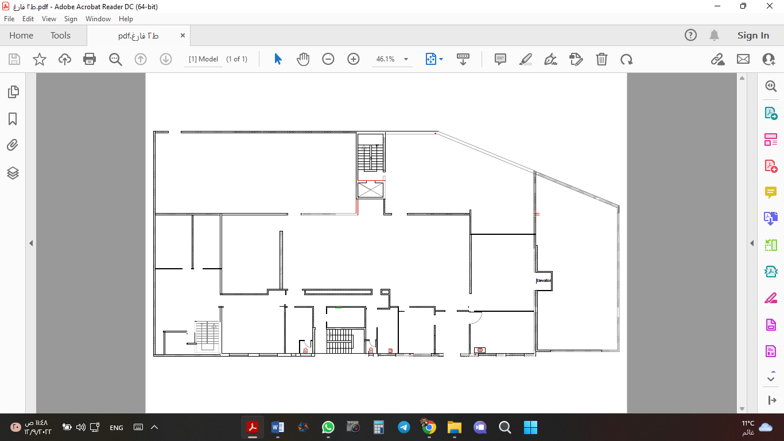
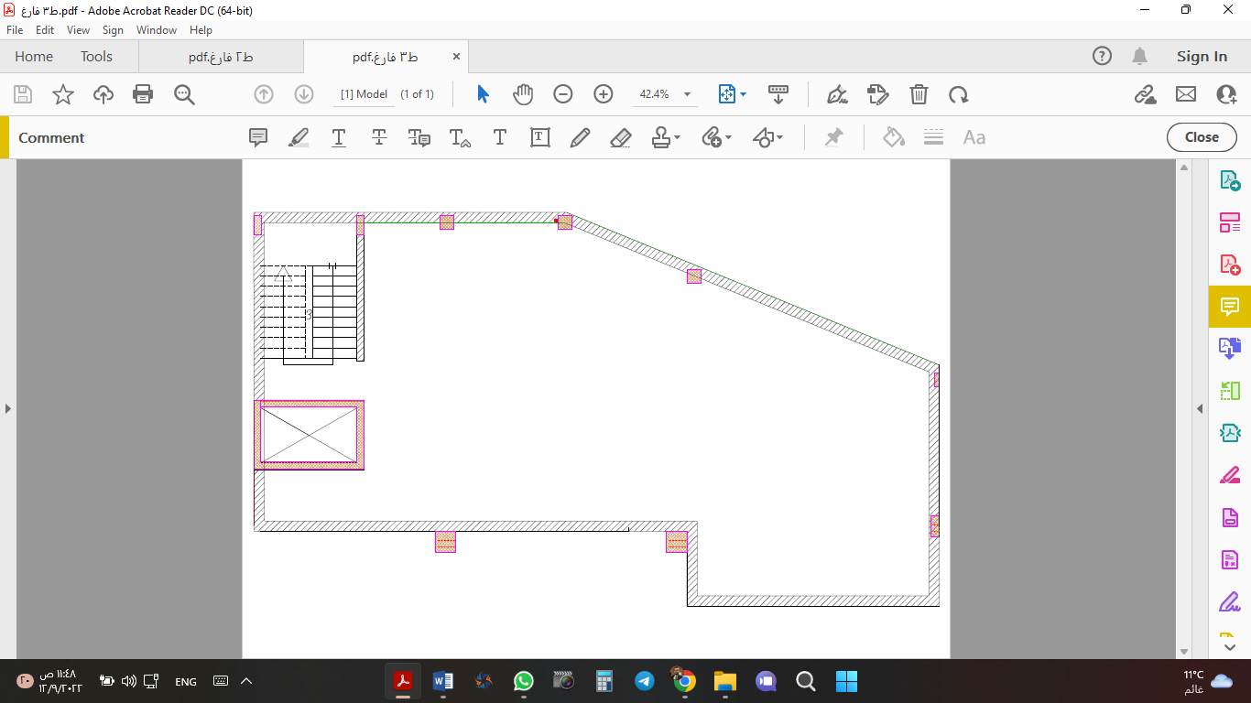
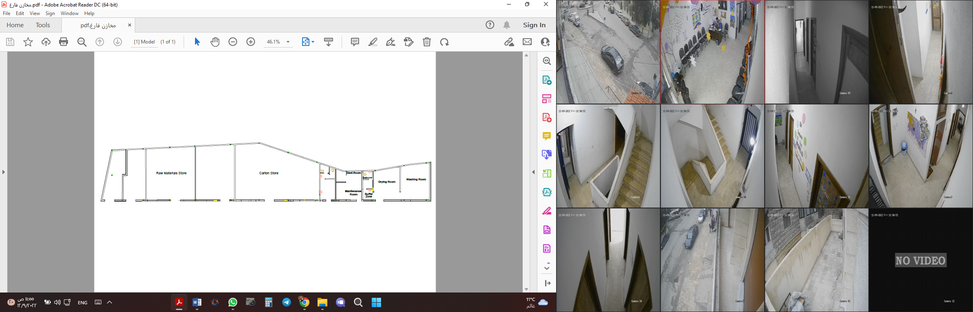
Company Photos

Slide 7
OBJECTIVES
Investigate the opportunities to reduce electrical consumption chillers and Split units air conditioning system.
Calculate each system if retrofitting or equipment replacement has been applied
1
2
3
4
5
Analyze the thermal energy consumption and energy used in Al-Hijaz company.
Explore the opportunities for energy conservation in the thermal system.
Feasibility study of the proposed new strategies.

Slide 8
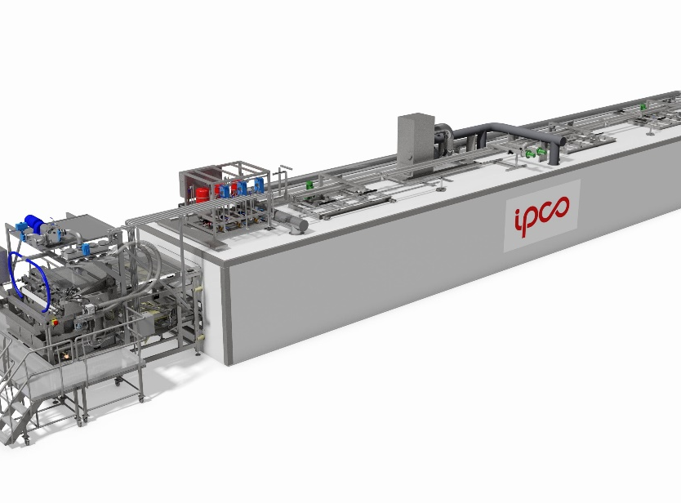
CHILLERS
The chillers are an essential element within the facility, which relies in its working system on passing chocolate through main channels and pipes surrounded by secondary pipes containing a coolant (the liquid used is distilled water).

Slide 9
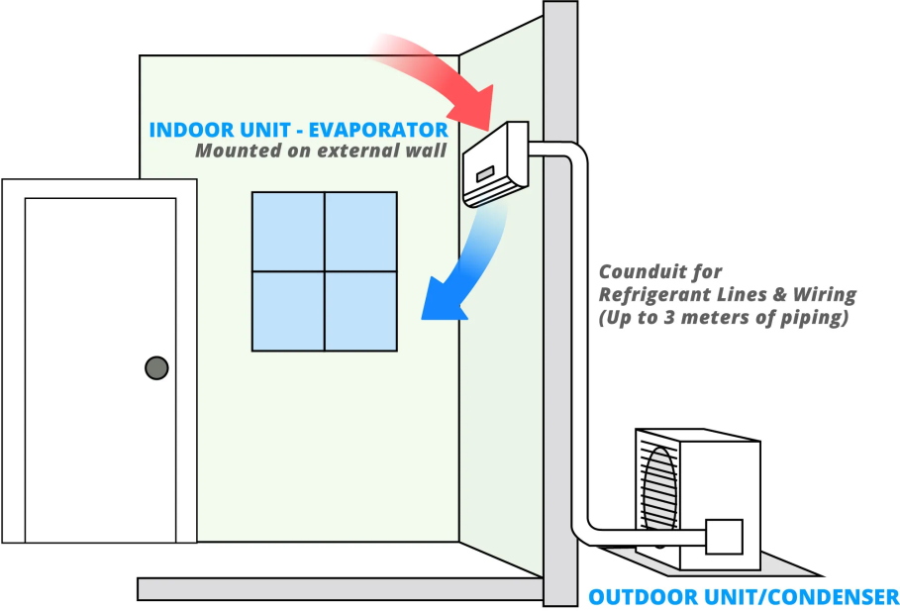
SPLIT UNITS
The SPLIT system is a very important part of the infrastructure . It takes a significant share of industrial production and the total daily energy consumption of buildings. In industry, the energy consumption of central air conditioning accounts for more than 40% of the total energy consumption.

Slide 10

“
is a behavior that leads to reducing the amount of energy consumed of all kinds, preserving the environment, saving on fuel consumption expenses, and raising the responsibility of individuals and communities towards the environment. it also reduces energy generation expenses by moving towards efficient use of energy and the use of clean energy resources.
“
ENERGY REDUCING OR ENERGY SAVING

Slide 11
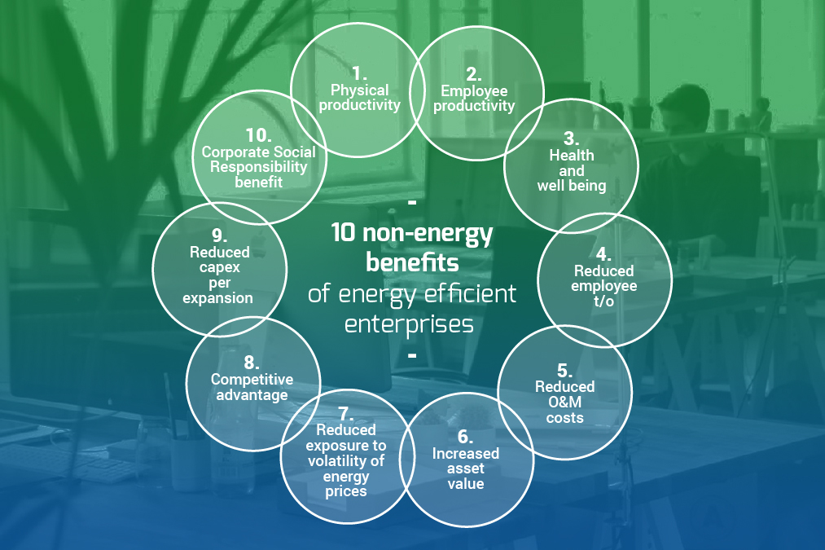
BENEFITS OF ENERGY REDUCING
01
02
03
Gradual Depletion of Energy
Improving Business and Industrial
Competitiveness of the Enterprise

Slide 12
METHODOLOGY

Slide 13
ITEM | VALUE | UNIT
The total capacity of the equipment (kW) | 513 | kW
The total capacity of the Chillers | 78 | kW
The total capacity of the Split unit | 95 | kW
The total of the estimated energy consumed during the estimated operating hours | 1,405,928 | kWh
The total capacity of the equipment (A) | 2,204 | A
The requirement for electrical power/220 (V) | 484 | kVA
The measurement was applied to 163 pieces of equipment and the final statistics were as follows

Slide 14
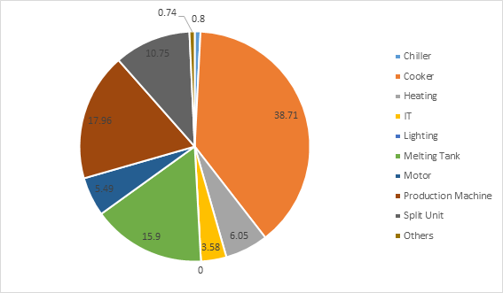
Analysis of consumption within the AlHijaz.company

Slide 15
REDUCTION OF ENERGY CONSUMPTION IN CHILLERS

Slide 16
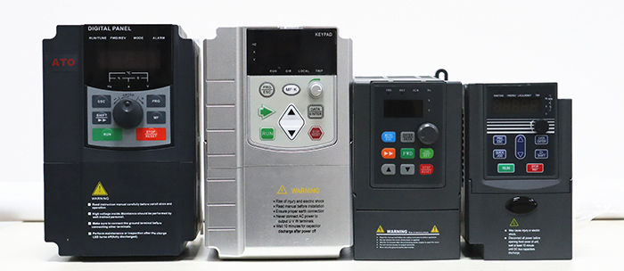
VFD
Variable Frequency Drive

Slide 17
REDUCTION OF ENERGY CONSUMPTION IN HVAC SYSTEM

Slide 18
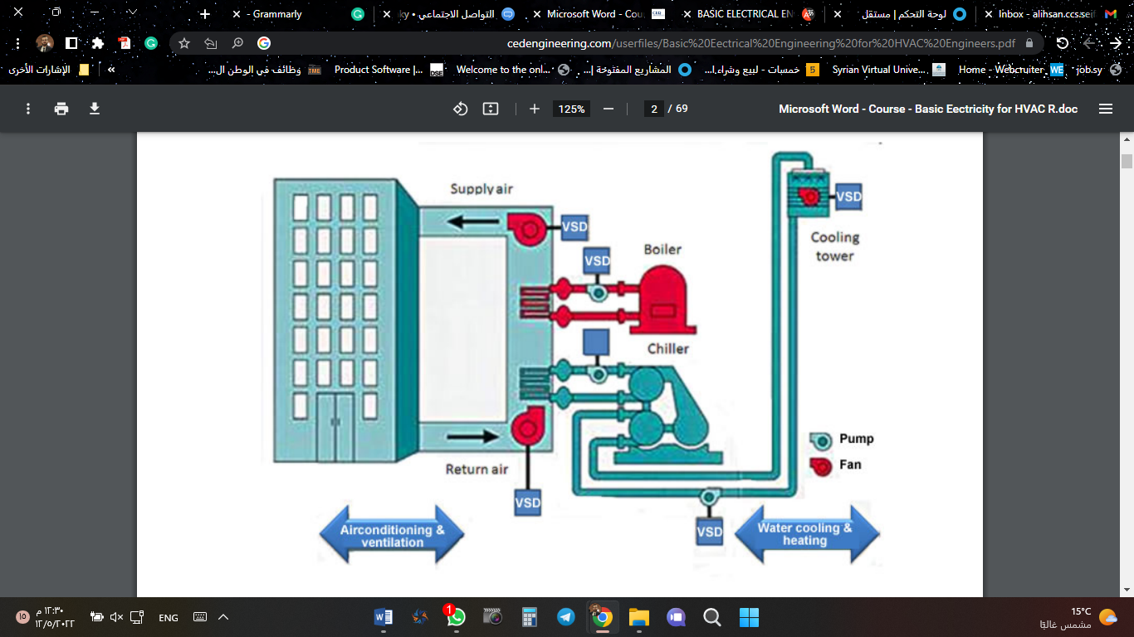
BASIC ELECTRICAL ENGINEERING FOR HVAC ENGINEERS

Slide 19
CLASSIFICATION OF THE MAIN METHODS OF AIR PURIFICATION
Chemical methods of cleaning polluted air
(catalytic and adsorptive cleaning methods).
Mechanical air cleaning methods
(centrifugal cleaning, water cleaning, wet cleaning).
Physical and chemical methods of air purification
(condensation, filtration, precipitation).

Slide 20
RESULTS

Slide 21
FEASIBILITY STUDY
The measurement was applied to 163 pieces of equipment and the final statistics were as follows
SYSTEM | INVESTMENT | SAVING | SPP | PV | SIR | ROR
HRU | 8000 | 2750 | 2.9 | 16960 | 3.1 | 34%
VRF | 150000 | 25100 | 6 | 77833 | 1.5 | 16%
VFD | 7000 | 1860 | 3.7 | 7147 | 2 | 25%

Slide 22
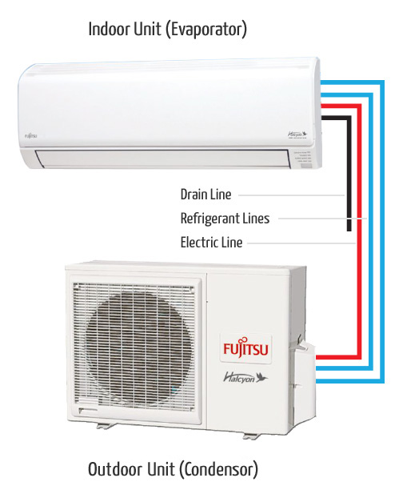
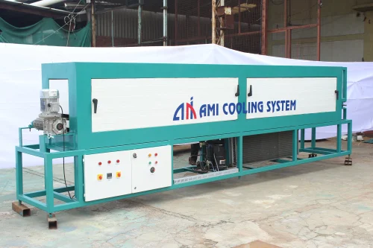
Action Plan
And ventilation systems within the facility.
HVAC system
Chillers
which cool the chocolate after it comes out of the mixing and melting machines and put it inside the molds

Slide 23
CONCLUSION

Slide 24
Thank you

Slide 25
Energy Engineering and Environment Department - An-Najah National University
Analysis of Thermal Energy systems at Al-Hijaz Company
Prepared by:
Mohammad Abdelhalim
Monther Qararia
Superviser:
Dr. Abdelrahim Abusafa

