Slide 1

بسم الله الرحمن الرحيم

Slide 2

An-Najah National University
Building Engineering Department
Design of Shopping Center -Nablus
Prepared By: Mohammad Khader , Israa Qadomi , Yousef Adnan
Supervisor: Eng. Amer AlSharif

Slide 3

Table of Contents
Introduction
Architectural
Environmental
Structure
Mechanical
Electrical
Safety

Slide 4

Introduction
Our project is design of Shopping Center in Nablus city, The design will consider the environmental requirements and needs, in addition to the architectural, structural, mechanical and electrical systems and the design will be eco friendly.
We designed and redesigned many systems to satisfy the suitable design.

Slide 5
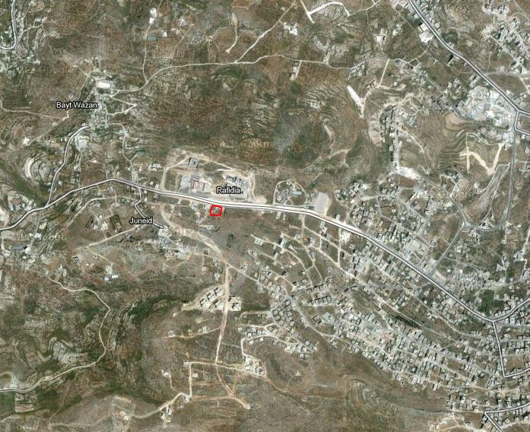
Proposed Location
The site is located around 5 km to the west of the city center at Rafidia Street. The area of the land equals about 4380 m ²

Slide 6

Architectural Design
Codes and specifications:
Neufort and Metric
Time Saver

Slide 7
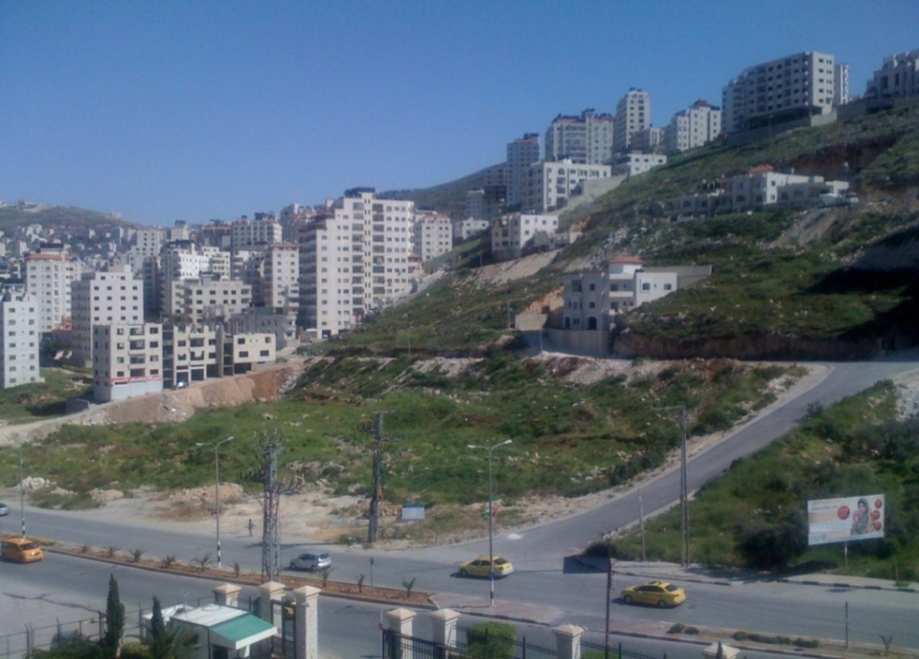
Location

Slide 8
Concept of the Project
Redesign already plans for a shopping center at Saudi Arabia taking into consideration the adaption of the project at new location in Nablus where climate and environment is different than it in Saudi Arabia.

Slide 9
Original Project
The area of the original project is (4132 m2), consists of four floors.
The floors are:
Basement floor which is used for Shops and Restaurant.
Ground, first and second floors consists of Shops.

Slide 10
Comments on original project
The parking was outside the building which wastes lots of area.
The special needs facilities were not taken in consideration such as ramps and WC’s.
The number of elevators is not enough and there is only one panoramic elevator and there is no services elevator.
There is no emergency exit.
The numbers of WC’s are not enough and there is only one WC unit in the basement floor.

Slide 11
Proposed Project
The project is (4132 m2) , consists of four floors and many departments.
The floors are:
Basement floor for Parking.
Ground floor consists of Shops, Super store, Reception and Administration area.
First floor consists of Shops.
Second floor consists of Restaurant and Shops.

Slide 12
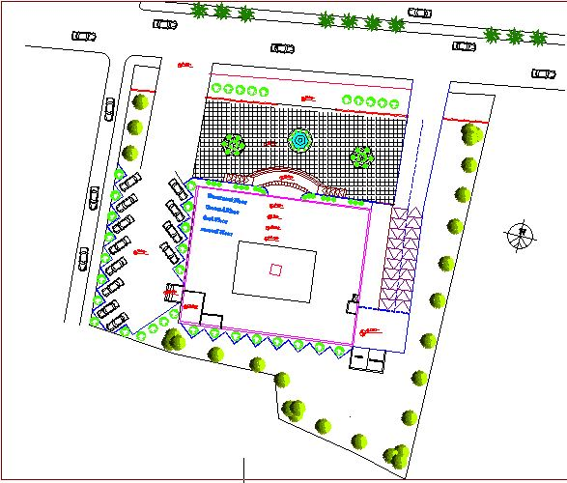
Site plan

Slide 13
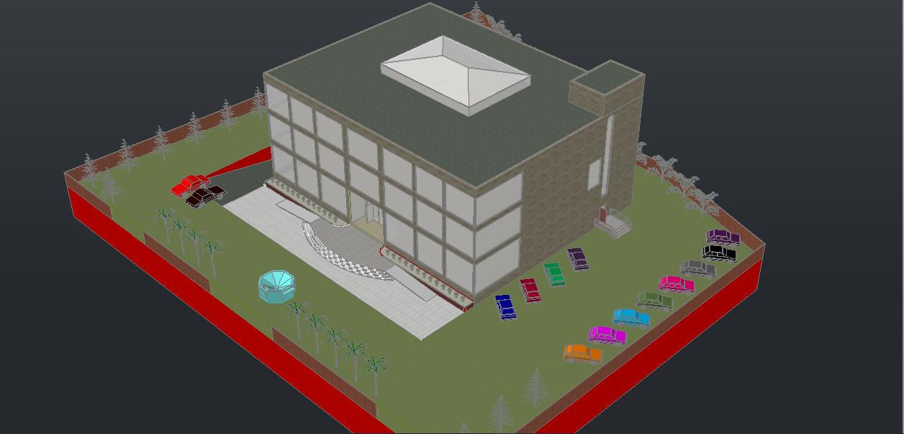
3D view for the project

Slide 14
Facilities that added to plans
Design a parking in the basement floor with a capacity for 29 cars.
Add ramps in main entrance .
Design W.C's as requirements by code dimension and standards.
Add two elevators for people and one for services.
Add emergency exits for the building.
Redesign Floors departments to achieve the requirements for facilities we proposed for shopping center in Nablus City.

Slide 15
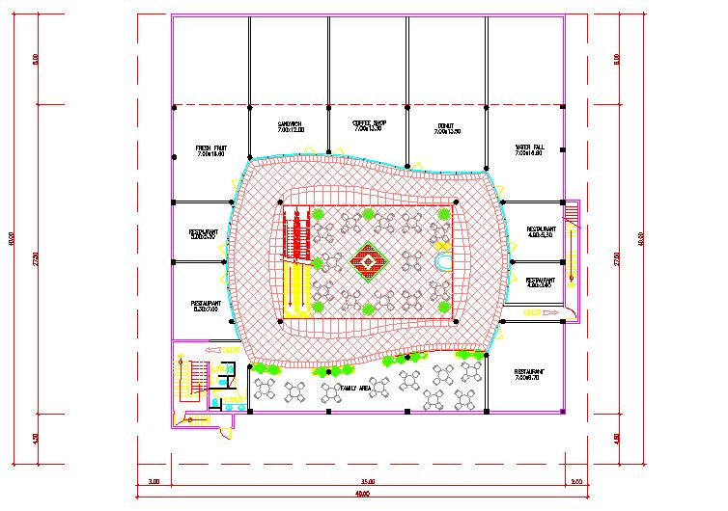
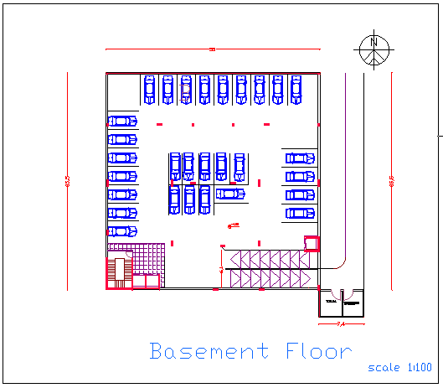
Basement Floor Redesign
Old New

Slide 16
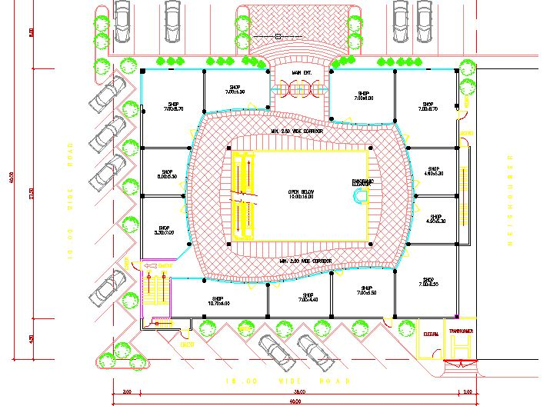
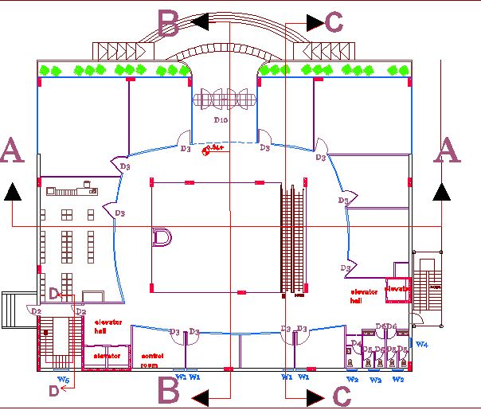
Ground Floor Redesign
Old New

Slide 17
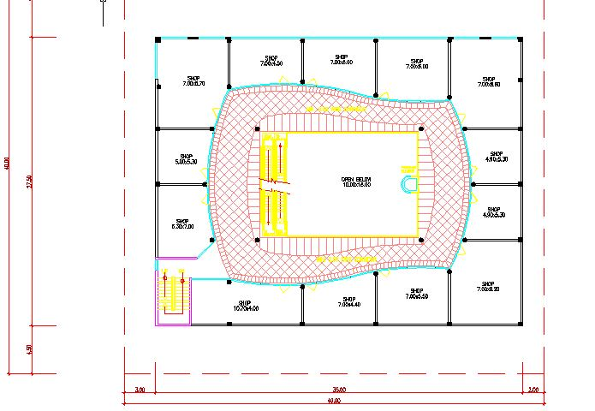
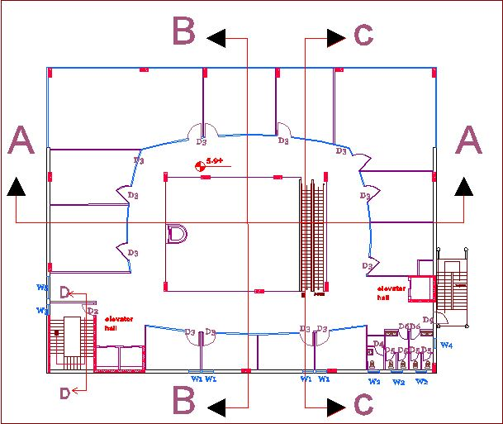
First Floor Redesign
Old New

Slide 18
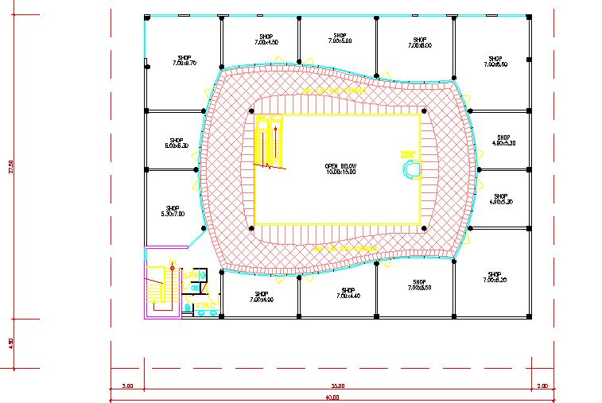
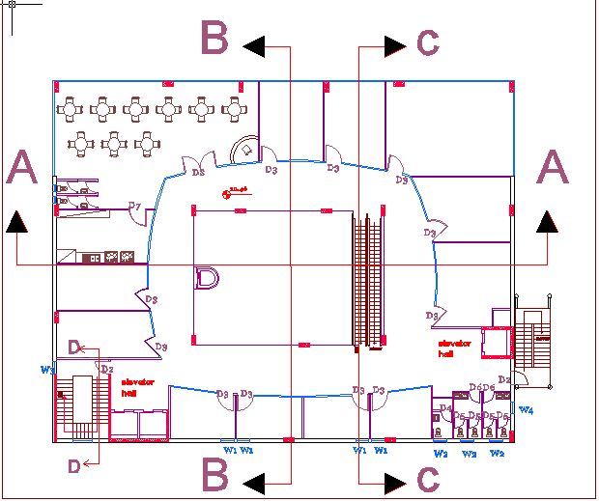
Second Floor Redesign
Old New

Slide 19
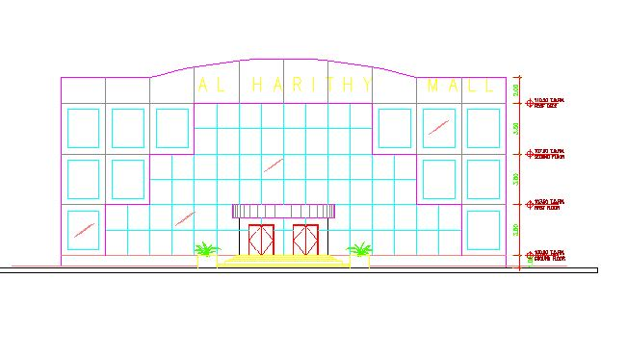
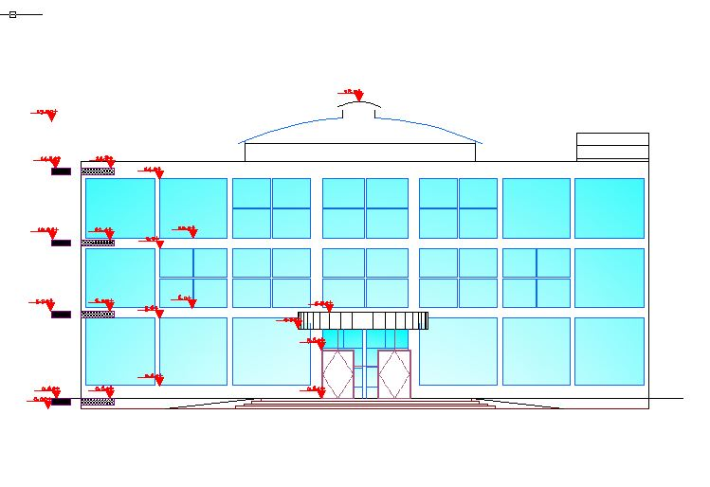
South Elevation
Old New

Slide 20
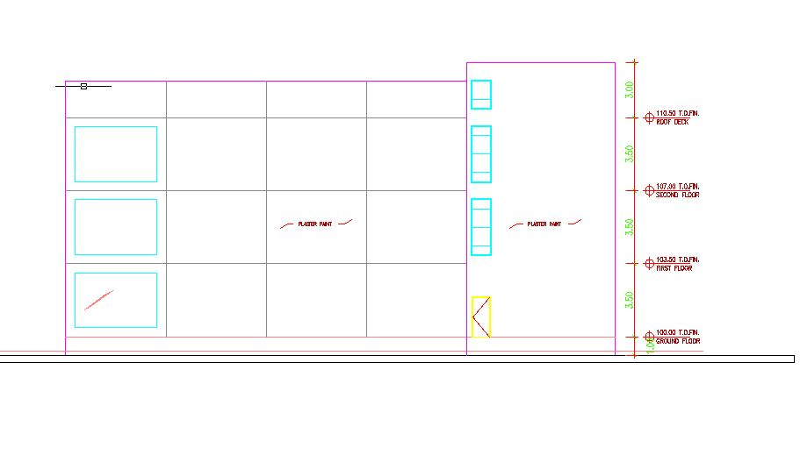
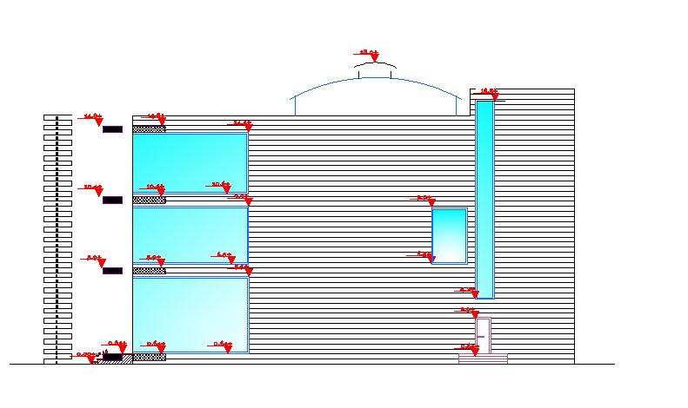
West Elevation
Old New

Slide 21
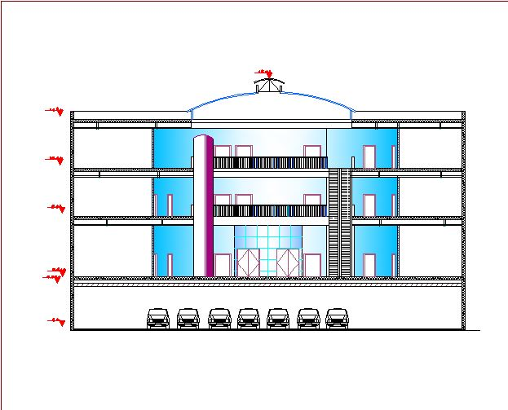
Section A-A

Slide 22
Environmental Design
Codes and specifications:
Energy Efficient Palestinian Building Code
Software:
Autodesk Ecotect Analysis, 2011

Slide 23
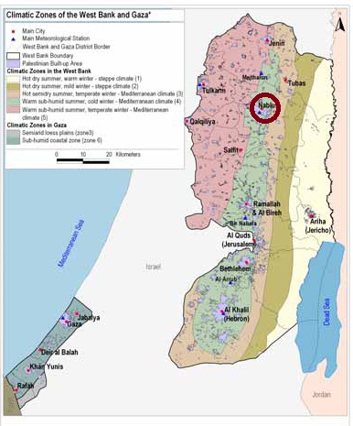
Project Climate Zone
The Project is located in Nablus city
in "Zone 3" as shown :

Slide 24
Climate Data for Nablus
The climate data analysis for Nablus shown in table:

Slide 25
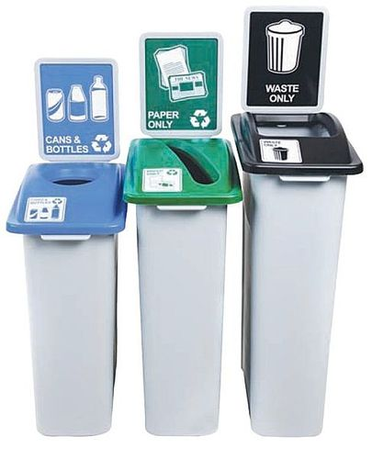
Facilities Used to Achieve Environmental Design
Reoriented the building to be more compatible with the site.
Use double skin glazing system in north elevation to reduce thermal losses in winter and solar heat gain in summer.
Separation of black water and gray water systems.
Separation of wastes depend on waste type.

Slide 26
Orientation and Sun Path
The building was oriented to the south as possible to gain the largest amount of solar energy in winter.
Figures below shows the sun path at 21-July and 21-January respectively because those are the critical months to design

Slide 27
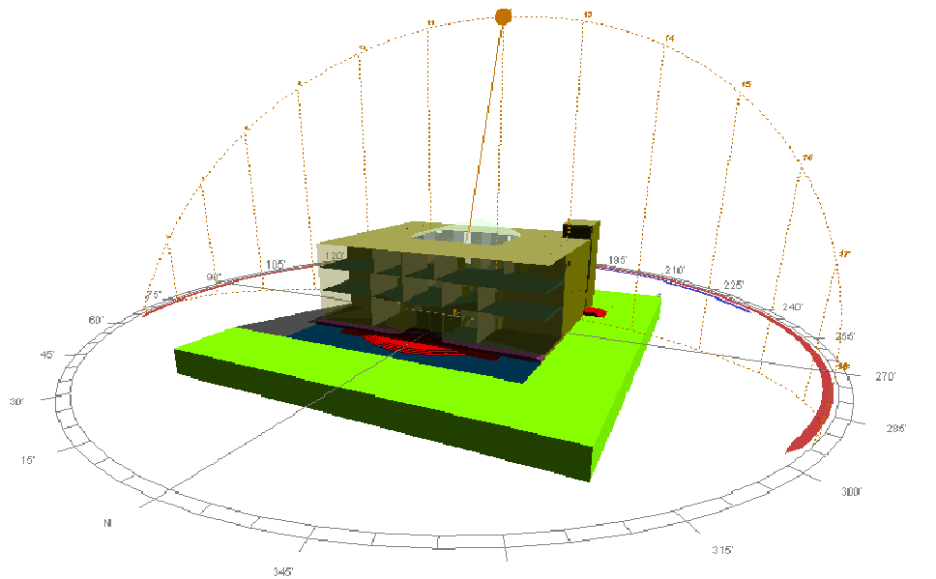
Sun path on the building at 21 July

Slide 28
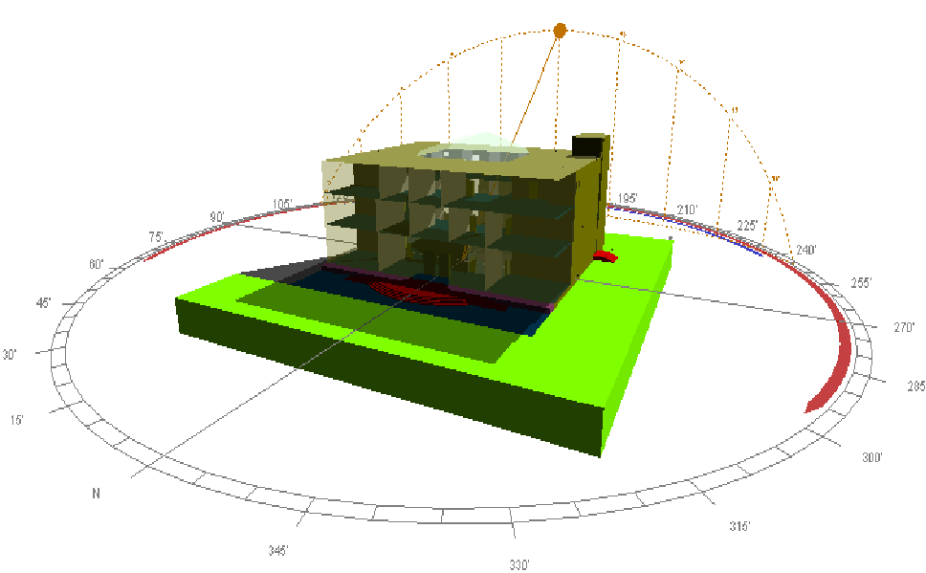
Sun path on the building at 21-January

Slide 29
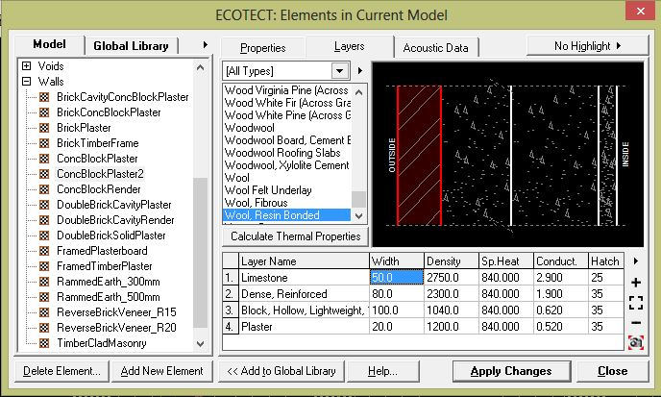
Thermal Insulation
Simulation the Model without insulation:
1.External Walls Section

Slide 30
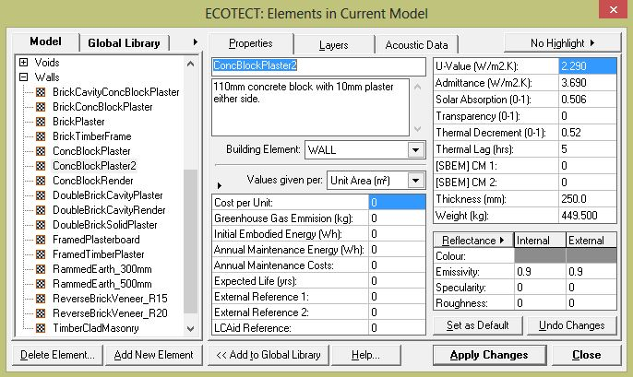
Thermal Insulation
Simulation the Model without insulation:
2.U Value (W/m².K) for the External Wall
U = 2.290 w/m2.k

Slide 31
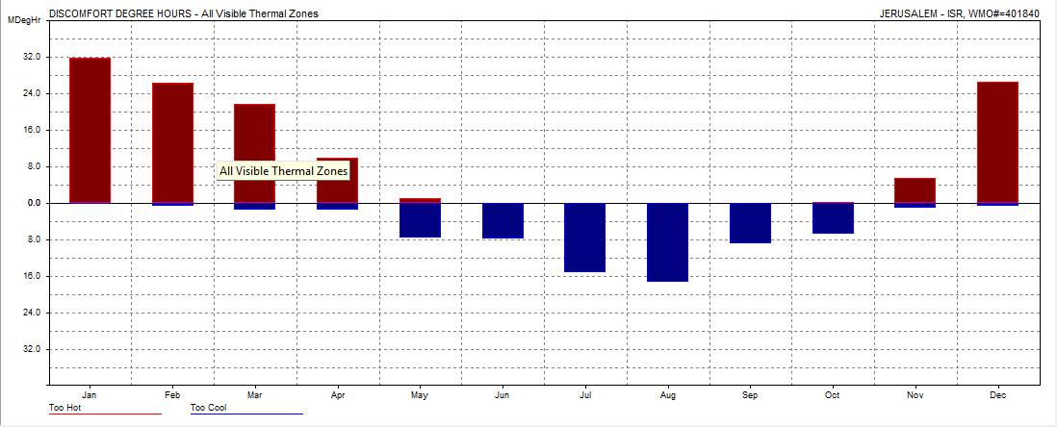
Thermal Insulation
Simulation the Model without insulation:
3.Heating and Cooling Loads Without Insulation

Slide 32
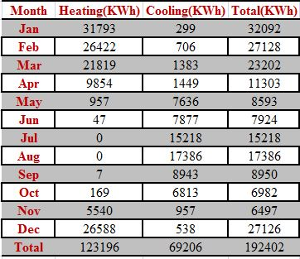
Thermal Insulation
Simulation the Model without insulation:
3.Heating and Cooling Loads Without Insulation

Slide 33
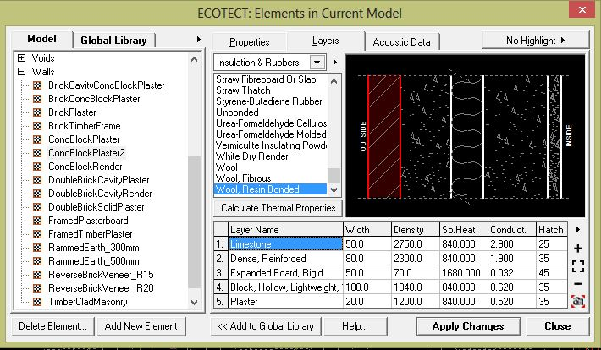
Thermal Insulation
Simulation the Model with insulation:
1.External Walls Section

Slide 34
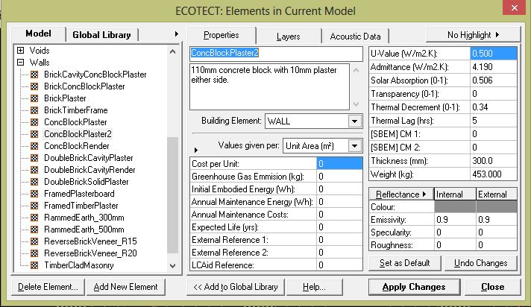
Thermal Insulation
Simulation the Model with insulation:
2.U Value (W/m².K) for the External Wall
U = 0.500 w/m2.k

Slide 35
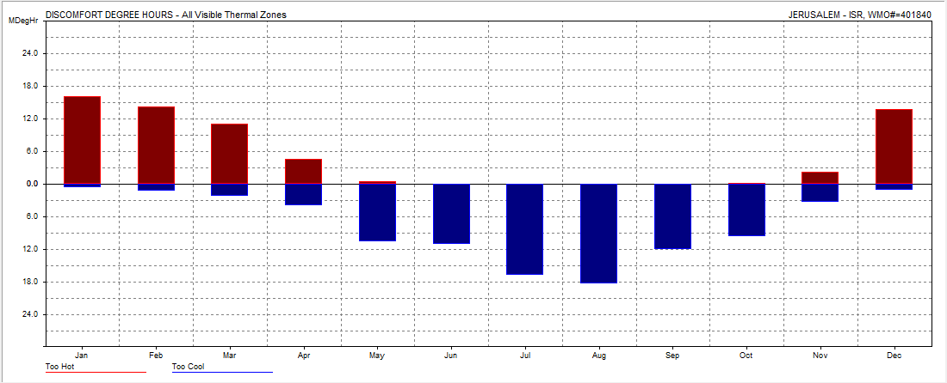
Thermal Insulation
Simulation the Model with insulation:
3.Heating and Cooling Loads With Insulation

Slide 36
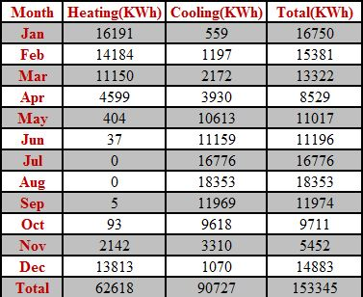
Thermal Insulation
Simulation the Model with insulation:
3.Heating and Cooling Loads With Insulation

Slide 37
Conclusion
Total heating load needed without insulation=123196 KW
Total cooling load needed without insulation=69206 KW
Total heating and cooling load without insulation=192402 KW
Total heating load needed with insulation= 62618 KW
Total cooling load needed with insulation=90727KW
Total heating and cooling load with insulation=153345 KW
The insulation reduces the Heating load by 49% per year.
The insulation increase the Cooling load by -31% per year.
The insulation reduces the Compound System load by 20.29% per year.

Slide 38
Acoustical Design
To reduce the noise we used:
special false ceiling to absorb the noise.
PVC tiles to reduce the sound transmission between floors.
carpeting which hanged from sky light to absorption the acoustic that may reflection by glass.
In the Parking we used roughcast in walls and Polystyrene plates in ceiling to absorb the noise from cars.

Slide 39
Skylight Design
To reduce heat gain in summer and heat lose in winter we used:
Multiple layers of glazing.
Cover skylight with horizontal shutters to reduce indirect light.
The sky light designed to open mechanically on the south and north elevation that will allow warm air rising toward the ceiling to escape,which provides natural cooling on hot days.

Slide 40
Structural Design
Codes and specifications:
ACI -318-08
UBC -97
ASCE
Software:
SAP 2000, V14.2.2

Slide 41
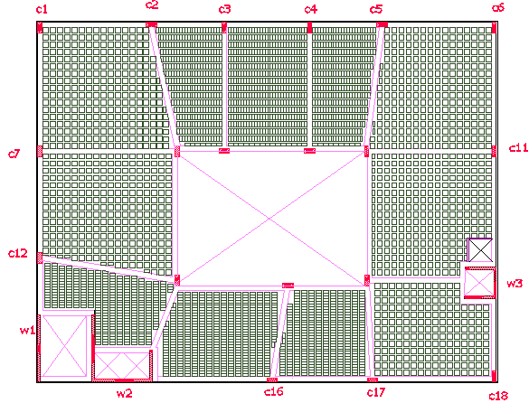
Project Description
The project consists of one block with four floors.
Slabs are designed as :
1.One way ribbed slabs .
2.Two way ribbed slabs.

Slide 42
Data
Type of soil: Clay soil
Soil bearing capacity is 200kN/m²
Soil Type is SD
Reinforcement Steel Yielding Stress fy = 420 Mpa
Concrete Compressive Strength f’c = 30 Mpa for column, shear wall and footings.
Concrete Compressive Strength f’c = 25 Mpa for beams and slabs.

Slide 43
Loads
1- Dead load consist :
Own weight for building come from weight of (beams, columns , slabs, wall).
Superimposed come from a weight of back fill and tiles = 3Kn/m².
2- Live load equal 3Kn/m² .

Slide 44
Designed Elements
Footings (Isolated, Combined, Shear wall footing, Retaining wall footing).
Columns.
Beams (tie beam, main beam, secondary beam).
Slabs.
Shear wall.
Retaining wall.
Stairs.

Slide 45
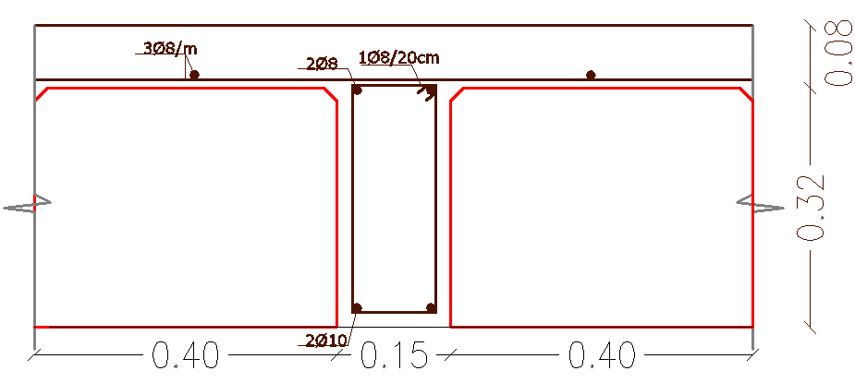
Preliminary Design
Slab:
a. One way ribbed slab : L/16 = 6/16= .37 m
L/21 = 5.7/21= .27 m
b. Two way slab:
Assumed that a thickness of slab = 30 cm.
Computed αm = .64
Computed Ts new= 26.5 =27cm
After doing equivalency h ribbed slab = 38 cm
But the deflection result on SAP program was unsafe
Deflection = 10.44/240= .043m
we have many values unsafe like 0.05, 0.044, meter.
So h ribbed slab = 40cm

Slide 46
Preliminary Design
2. beams:
Main beam :
For one end cont. span:
hmin= L/18.5 = 10.44 /18.5 = 56 cm
For two end cont. span:
hmin= L/21 = 9.29 /21 = 44.2 cm
For simply support span
h= 9.25/16= 58cm
so the depth of bream = 60 cm
Dimensions of beam (40*60cm)
Tie beam : (40*70cm)
3. Columns :
Load on column 8 = 3969.8Kn
Ag= 2770cm²
Dimensions of columns (80*35cm).

Slide 47
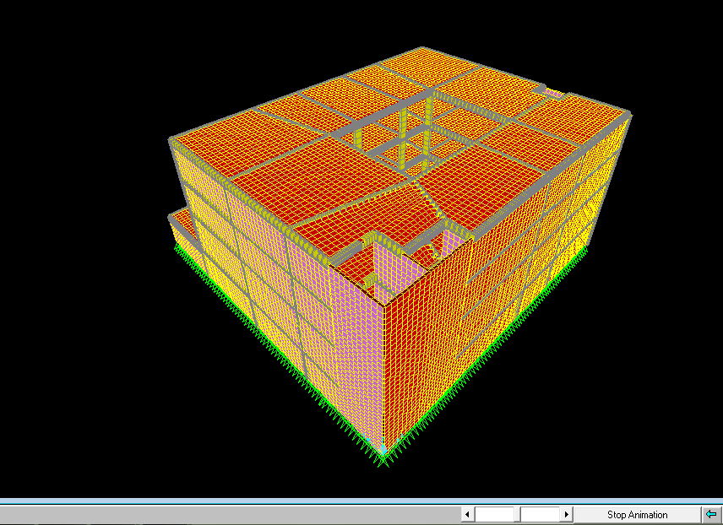
SAP Model and Dynamic Analysis
3D SAP model for building

Slide 48
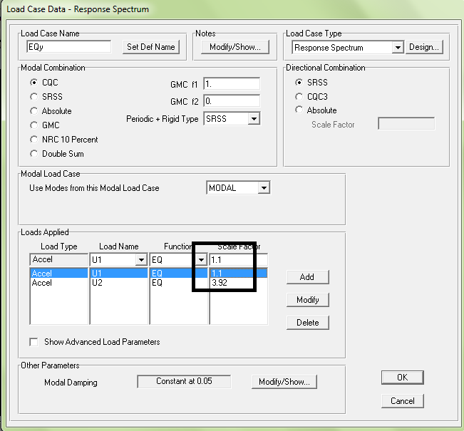
SAP Model and Dynamic Analysis
Response Spectrum Function Define:
Nablus zone : 2B
seismic zone factor Z = 0.2
Seismic coefficient (Cv)= 0.4
Seismic coefficient (Ca)= 0.28
Scale factor= gI/R = 3.92 (in main
direction)
Scale factor= gI/R*3 = 1.1( in second
direction)

Slide 49
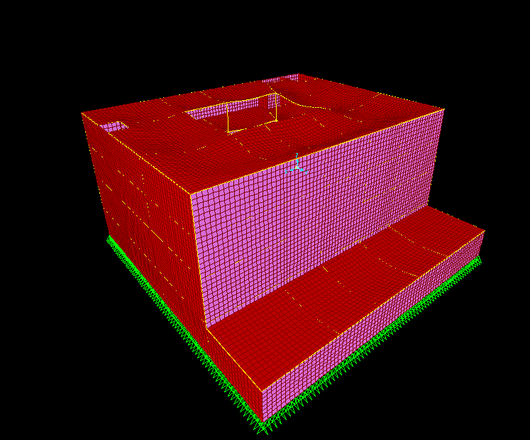
SAP Model and Dynamic Analysis
Check model:
1- Compatibility Check:

Slide 50
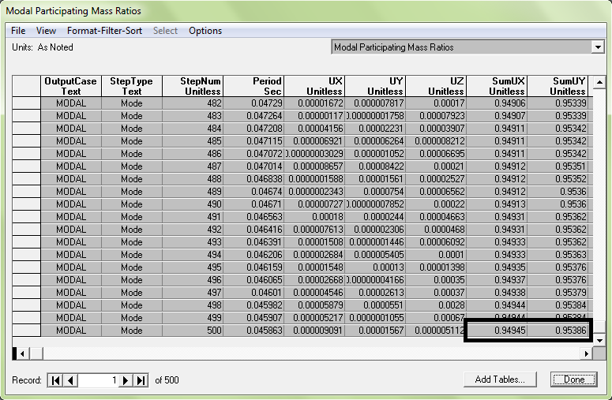
SAP Model and Dynamic Analysis
2- Model Participation Mass Ratio and Period Check:
The manually calculate for
period are the following:
T= .02*63^{(3/4)}= 0.44 sec
The period was checked
using SAP and found to be:
Period T=.35

Slide 51
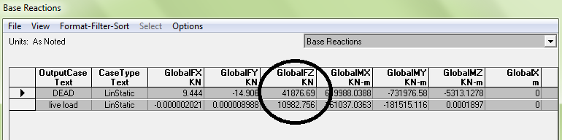
SAP Model and Dynamic Analysis
3- Equilibrium check:
1- Dead load :
Total dead load from SAP =41876.6Kn
Total dead load manual =42342.7Kn
Error %= SAP load- manual load/ manual load
Error = 41876.6-42342.7/42342.7= 1.1% <5% .. Ok
2- live load:
The total live load calculated = 10500 KN
SAP live load = 10982 KN
Error %= SAP load- manual load/ manual load
Error = 10982 -10500 /10500 = 4.5% <5% …OK

Slide 52
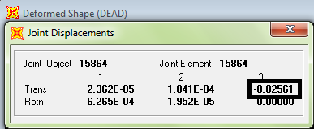
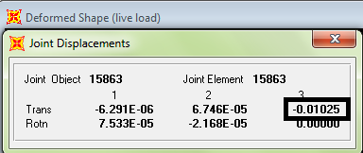
SAP Model and Dynamic Analysis
3- Internal load :
M= Wln2/8
M= 140*(10.5)2/8=1942KN.m= 1942/2= 971KN.m
From SAP M= 836.2KN.m
4- Deflection Check:
Deflection manual = 10.44/240= .043m
Dead load Live load

Slide 53
Design Elements
1- column:
2- beams:
Stirrups at middle | Stirrups at edge | Long Reinforcement | Dimensions (cm) | column
1φ10/20cm | 1φ10/15cm | 18φ14 | (35*80) | C1
B.S | M.S | T.S | Dimensions cm | beam
7φ22 | 2φ12 | 8φ25 | 40*60 | B6
3φ14 | 2φ12 | 5φ14 | 40*60 | B3

Slide 54
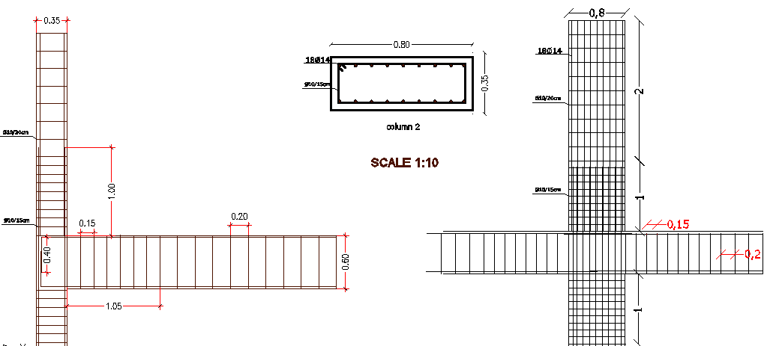
Design Elements

Slide 55
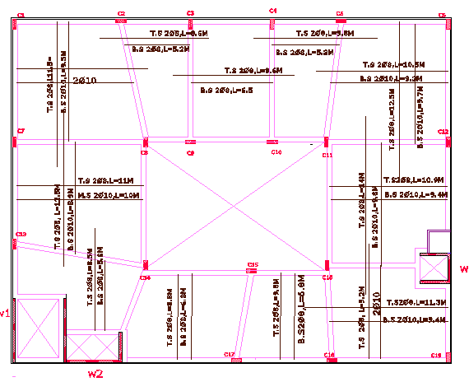
Design Elements
3- Slabs :

Slide 56
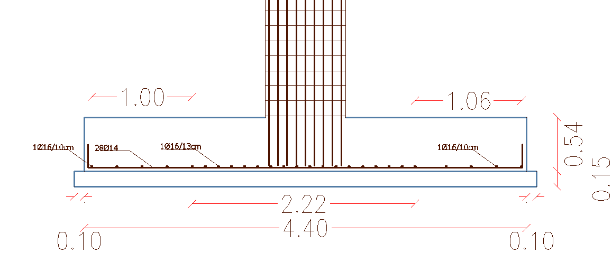
Design Elements
4-Footing:

Slide 57
Mechanical Design
Codes and specifications:
ASHREA 2009

Slide 58
Mechanical Design
Water Supply system.
Rain water
Sanitation system
Grey water and Black water
Elevator design.
HVAC system

Slide 59
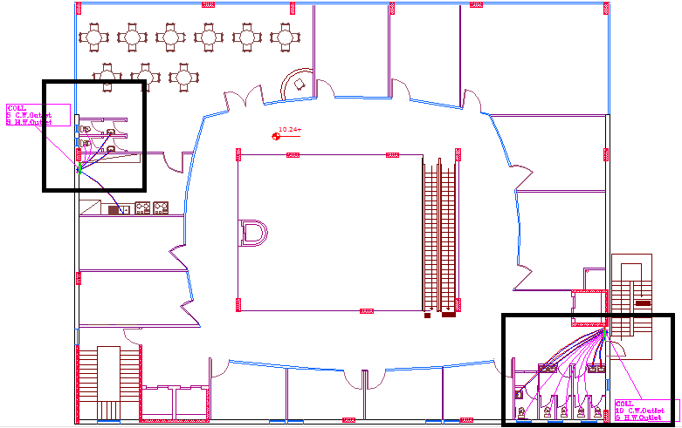
Water Supply system
In our Project PVC piping system used for water supply.
Zone B
Zone A

Slide 60
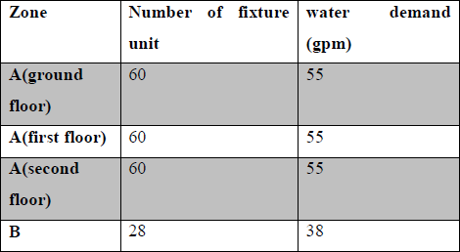


Water Supply system
water demand for each zone:
Zone B
Piping size for each zone :
1- Zone A
2- Zone B

Slide 61
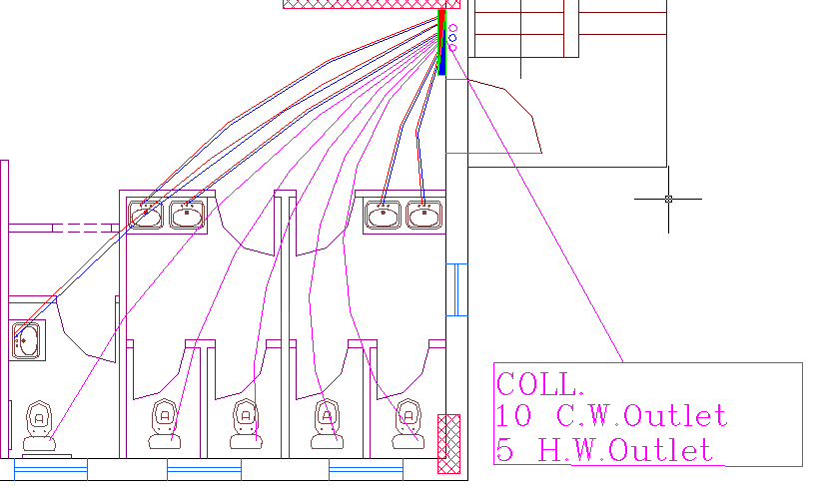
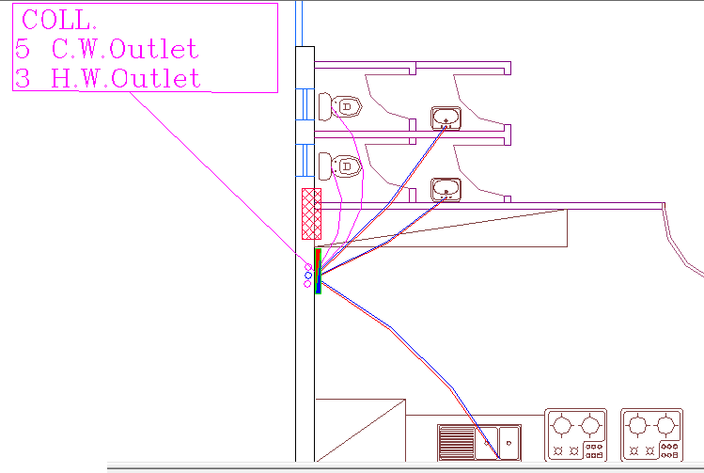
Water Supply Network
Ground Floor-Zone A
Second Floor-Zone B

Slide 62
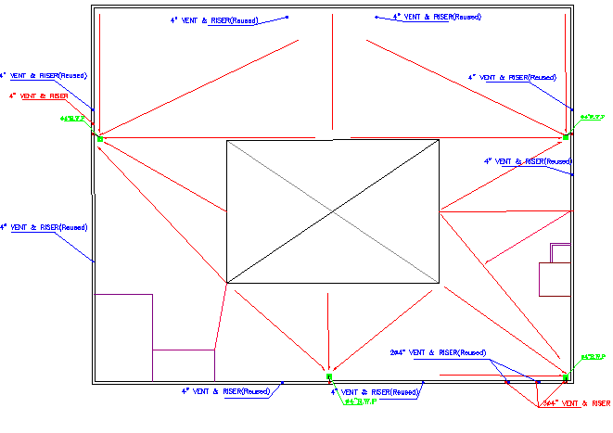
Rain water

Slide 63
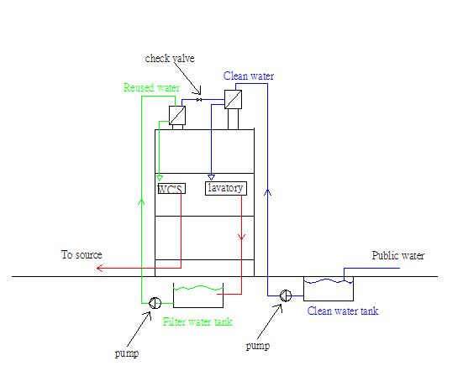
Tank system for water supply
System used:
Roof Tank with basement storage.

Slide 64
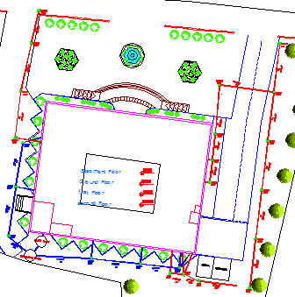
Sanitation system
Blue line is a reused water.
Red line is a black water.

Slide 65
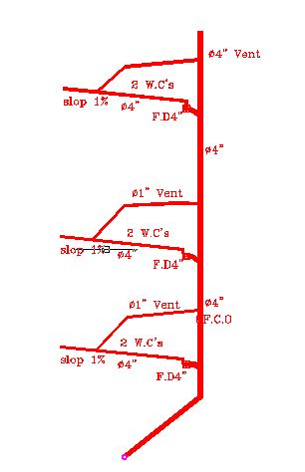
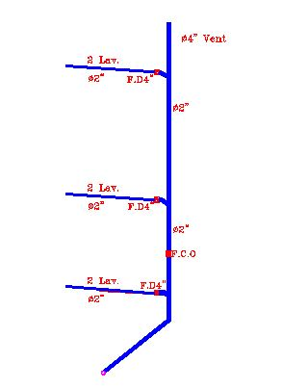
Stakes Sewer system
Stake for W.C's water Stake for Reused water

Slide 66

Grey water and Black water

Slide 67

HVAC system
From Ecotect analysis the total cooling load for the building is 150KW.

Slide 68

HVAC system
cooling loads and diameter for duct and speed for each floor.

Slide 69

HVAC system
loads and diameter duct for shops in second floor

Slide 70

HVAC system
Ducts and Diffuser in second floor

Slide 71

Elevator and Escalator design
We used 3 elevator for people one of them is panorama in addition, we used one elevator for service .

Slide 72

Elevator design
Average waiting time = 15 sec.
Minimum car speed = 2 m/s .
Elevator capacity = 2500 Ib (1139kg) .
Car passenger capacity (p) = 13 passengers.
Average trip time (AVTRT) = 57 sec.
Round trip (RT) = 82 sec.
Dimension of elevator (2x2) m.

Slide 73
Escalator design
Escalator size = 1.22m support at ends
Tread width = 1.02m
Size of motor = 7.5 Kw = 10 hp
Maximum speed = 0.65 m/s
Nominal number of passengers = 7000 pass. /hr

Slide 74

Standard Dimensions for Escalator

Slide 75
Electrical Design
Codes and specifications:
NEC 2008
Software:
Dialux

Slide 76
Electrical Design
Lighting Design.
Daylight.
Artificial light
Sockets Design.
Power Design.

Slide 77
Lighting Design
In the lighting design, we depended on the daylight, beside the artificial lighting when needed in spaces that don’t have enough daylight, also in the evening period.
In the artificial lighting design, we choose the fluorescent lamp which is considered the closet the natural light, and comfortable for the sight. Also we used a spot light at the frontal elevations of the stores which are special to show the goods.

Slide 78

illuminance needed for each functional room

Slide 79

Restaurant Lighting
Daylight:

Slide 80

Restaurant Lighting
Artificial light:

Slide 81

Restaurant distribution lighting

Slide 82

Restaurant lighting from Dialux

Slide 83

Superstore Lighting
Daylight:

Slide 84

Restaurant Lighting
Artificial light:

Slide 85
Sockets Design
The power for the sockets are selected according to the socket load if it is normal load or special load, where the current for the normal load is 2A, and for the special load is 15 A for one socket.

Slide 86

Sockets distribution
Restaurant

Slide 87
Power Design
We need to 3- phase in the Mall because the electrical loads its large , so the municipality is supply source plus we depend on generator alternate to main source.

Slide 88

Main Distribution Board

Slide 89

Safety Design

Slide 90

Fire Protection
Fire Alarm System :
1. Manual Fire Alarm.
2. Automatic Fire Alarm.
Smoke Detector.
Heat detector.

Slide 91


Fire Protection
Manual Fire Alarm Automatic Fire Alarm

Slide 92


Fire Protection
Smoke Detector Heat detector

Slide 93

Design of Fire Protection
Sprinklers for rooms.
Water Fire Extinguishers and Fire Hoses for corridors and halls.
Foam Fire Extinguisher
for the kitchen.

Slide 94




Fire Alarm and Fighting System

Slide 95


Sprinklers system

Slide 96
Thank You

