Slide 1
Laser Harp
Mohammad Ratrout
Bara’ Dweikat
Supervised By: Dr. Ashraf Armoush

Slide 2
Why Laser Harp?

Slide 3
Outline
What is the Harp?
What is the Laser Harp?
First Implementation
Second Implementation
Future Work
Conclusion
Demo

Slide 4
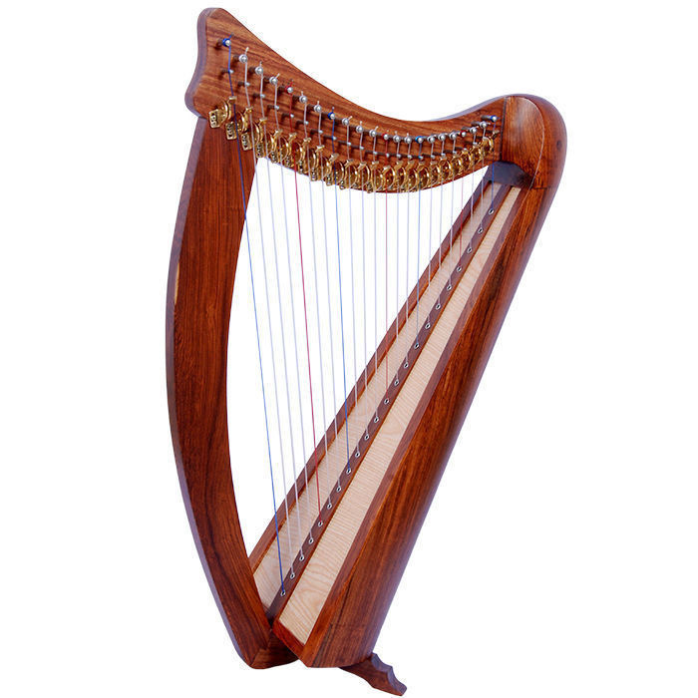
What is the Harp?
In old ages, Harp was an instrument that you only found in formal parties and in castle halls, it was originated in west Europe to serve this purpose.
It’s an instrument that contains 8 to 32 tight strings that are plucked to generate sounds.

Slide 5
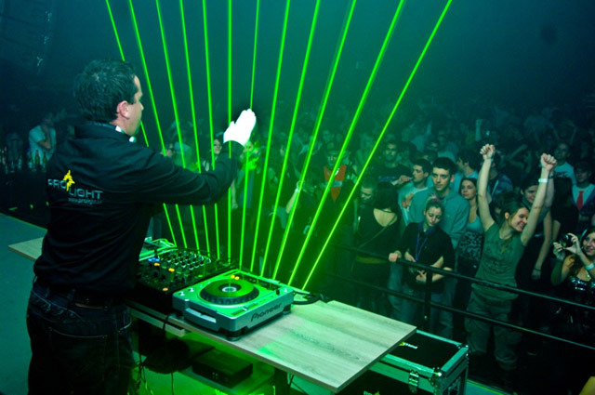
The Laser Harp
The Laser Harp was founded in informal parties with electric instruments and sounds.

Slide 6
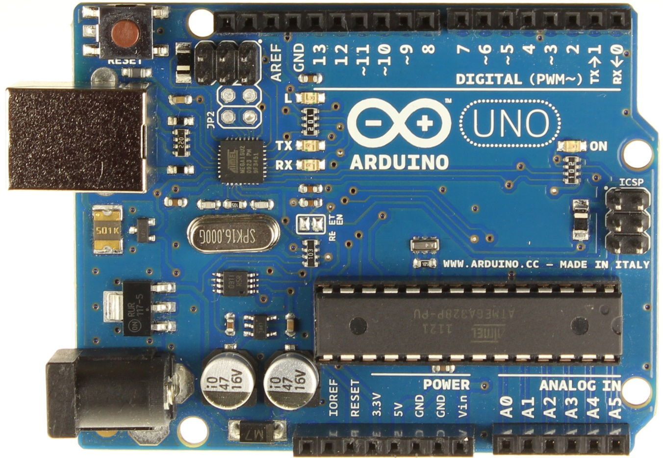
First Implementation
Components:
Arduino UNO

Slide 7
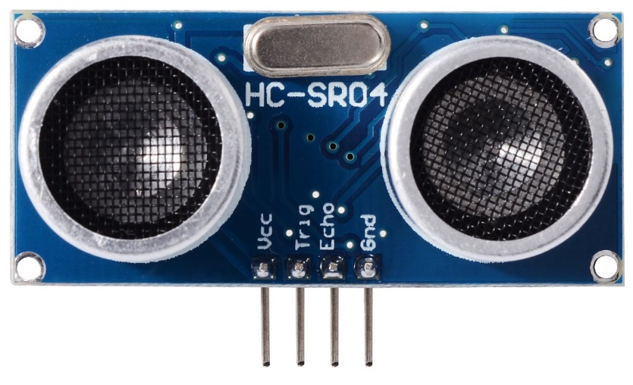
First Implementation
Components:
Ultrasonic sensors

Slide 8
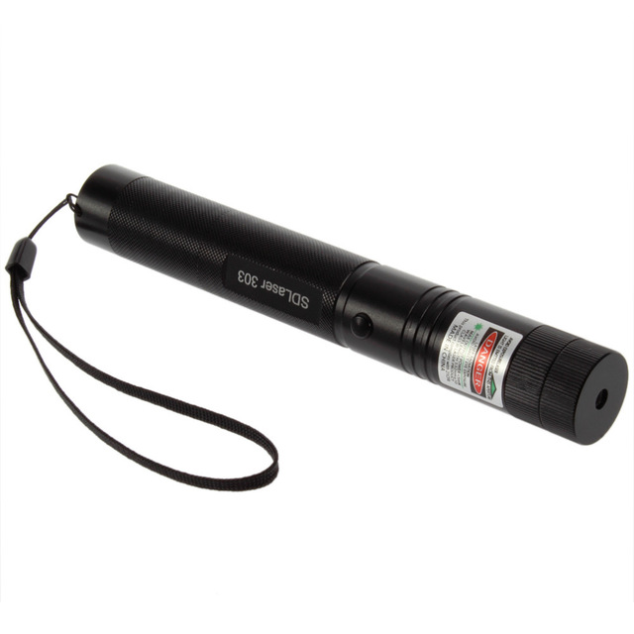
First Implementation
Components:
Laser

Slide 9
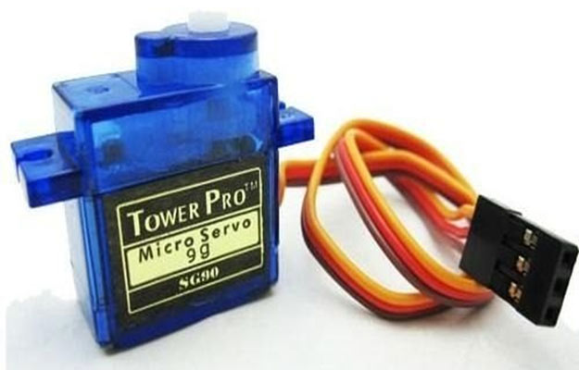
First Implementation
Components:
Servo Motor with mirror

Slide 10
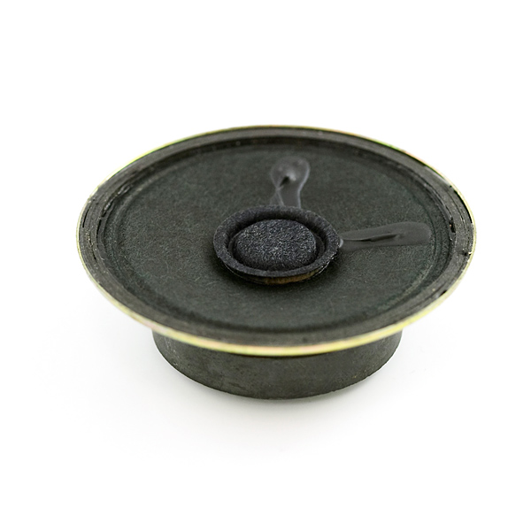
First Implementation
Components:
Speaker

Slide 11
First Implementation
At the beginning we’ve build the project as a single light source with servo motor to reflect the light using a mirror.

Slide 12
First Implementation
Problems:
Laser beams
Sound system

Slide 13
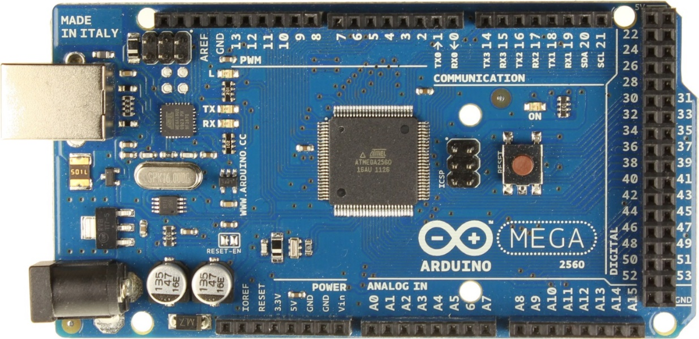
Second Implementation
Components:
Arduino Mega

Slide 14
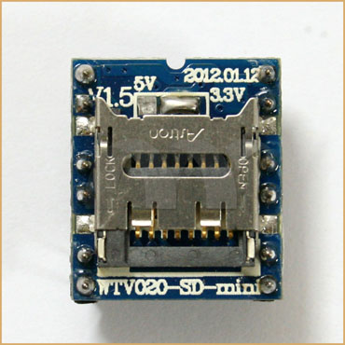
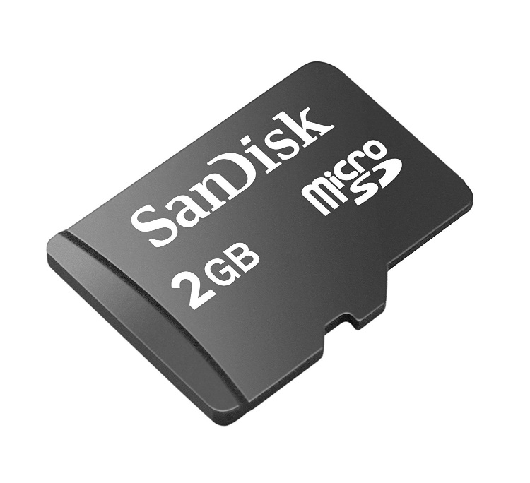
Second Implementation
Components:
Mp3 Module & SD Card

Slide 15
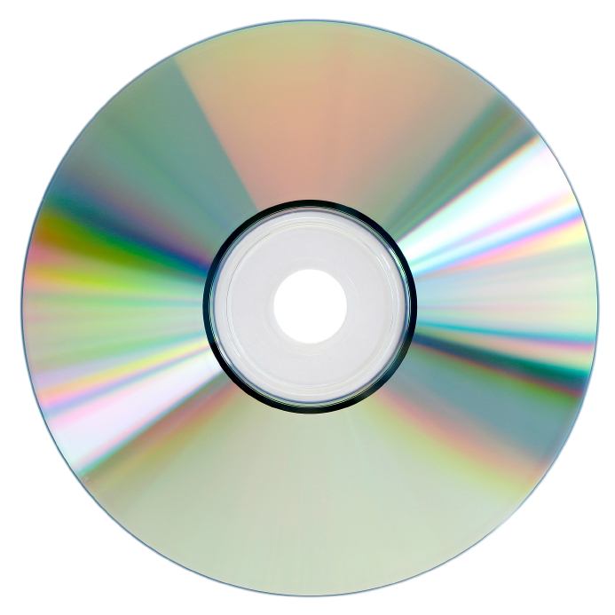
Second Implementation
Components:
Compact Disk (CD)

Slide 16
Second Implementation
To split the beams uniformly we used a CD, with the right angle we focused two lasers to generate 8 beams.
Then we put each ultrasonic in the direction of the beam.

Slide 17
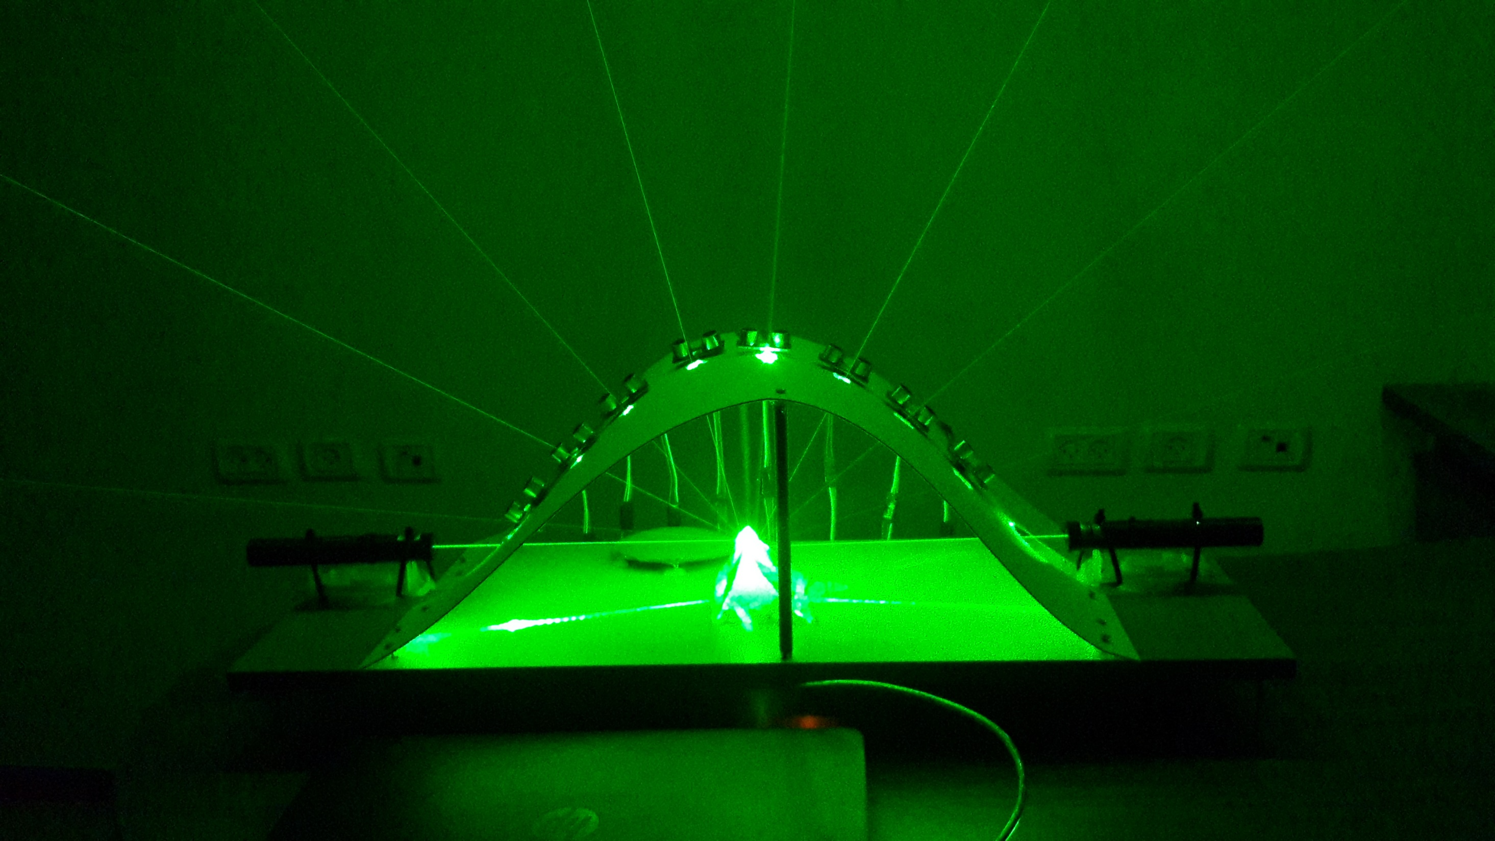
Second Implementation

Slide 18
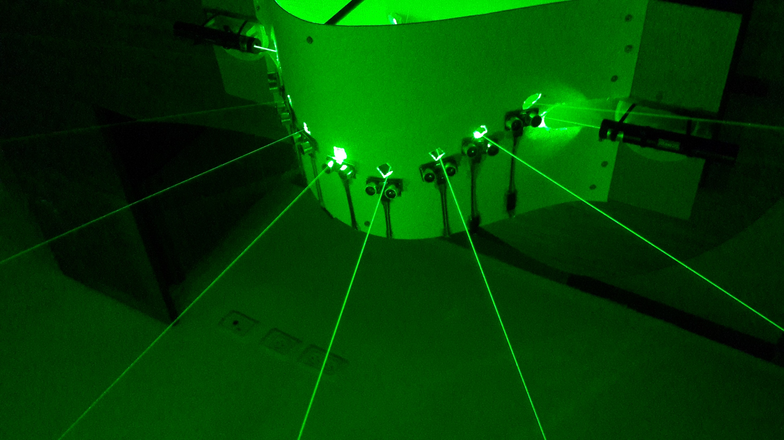
Second Implementation

Slide 19
Second Implementation
Problems:
Lighting
Lost Feature
Laser Charging

Slide 20
Future Work (Laser Harp Game)
The Game is consist of a screen and two players (two harps), the game can find out who finished the displayed symphony first.

Slide 21
Conclusion
We started this semester with no practical knowledge, and the output was very pleasing, now we are capable of building useful Arduino base projects, maybe we didn’t end up with the best desired result, but we proud of what we accomplish.

Slide 22
Demo Time

Slide 23
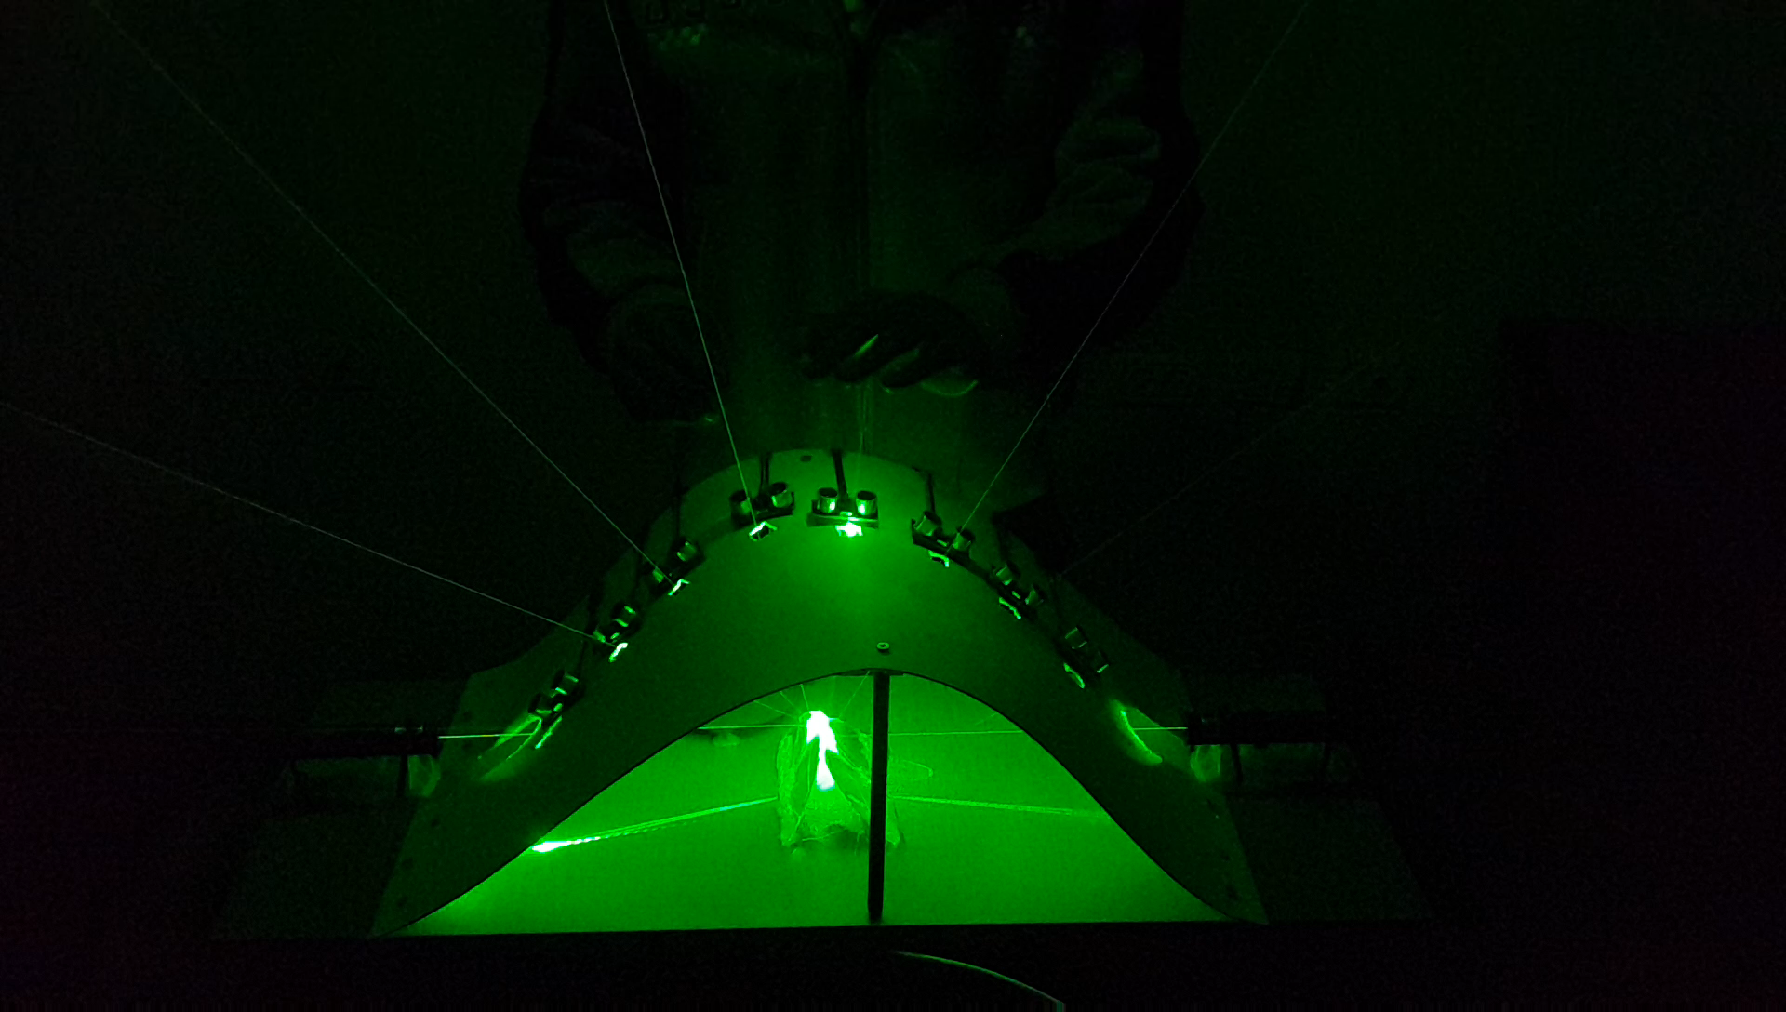

Slide 24
Thanks for your attention

