Slide 1

Content Management System
(CMS)
Prepared by
Thana’ Mer’i
Wala’ Nawahda
Supervisor: Haya Sama’neh
4/12/2012

Slide 2
Outlines
What is CMS?
Why Did We Choose CMS project?
The Desired Goals of Our CMS.
Languages and Tools.
Implementation.
Building our own MVC.
CMS Back-end ,Front-end.
Features.
Problems.

Slide 3
What is CMS?
A content management system (CMS) is a system used to manage the content of a website.
It is a web application designed for non-technical users to add, edit and manage a website without needing to know any HTML or Web design knowledge.

Slide 4
Why Did We Choose CMS project?
We saw a need to build a CMS that really can be used by a non-technical people.
Creative idea, there is always something to add.
Improve our knowledge of PHP.
Useful Application.

Slide 5
The Desired Goals of Our CMS
Flexibility and user Friendly.
You are no longer dependent on the web designers making changes for you.
All the technical details are simply handled by the CMS, allowing anyone to manage and update the site.

Slide 6
Languages and Tools
Server ( WampServer2.0c).
Database ( MySQL).
Dreamweaver.
PHP, JavaScript, and HTML as programming languages .

Slide 7
Implementation
Step1: We started looking around the internet for popular CMSs (Drupal, Joomla).
Step2: Deciding how to build the main structure of our CMS?
We had three choices:
1- using PHP hand coding (without MVC).
2- building our own MVC.
3- using a framework that implements MVC.

Slide 8
Implementation(Cont.)
We ruled out “PHP hand coding” because we would definitely have a messy PHP code.
The second choice also was ruled out, because building MVC from scratch is not an easy choice.
As a result we decided to choose the third option which is using a framework that implements MVC.

Slide 9
MVC Concept
Model–View–Controller is an architectural pattern used in software engineering to break apart your domain logic from your user interface.
Using MVC structure results in simple, clean and understandable code.
Model handles all our database logic. Using the model we connect to our database and provide an abstraction layer.

Slide 10
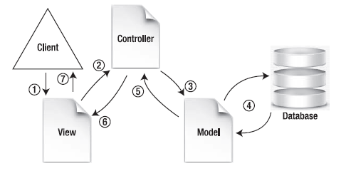
MVC Concept(Cont.)
View represents our presentation logic i.e. our HTML code.
Controller represents all our business logic i.e. all our ifs and else.

Slide 11
Framework Concept
A framework is designed to provide a structure for MVC so you spend less time writing up code and more time writing the application itself.
Step3: Which framework to use?
CakePHP was the answer(good beginner programmers).
BUT CakePHP started to slow us down (troubleshooting bugs was really a nightmare).

Slide 12
Building our own MVC
So we excluded the framework choice to go back to building our own MVC choice, although it seems hard to build something from scratch but it was the only solution.
The MVC is the "backbone" of the our CMS.
Directory structure
admin , model, view, controller, Includes, Sites layout, languages directories.

Slide 13
Building our own MVC(Cont.)
router.php is going to take web page requests passed to index.php and route the request to different files (controllers) in our CMS.
How does it work?
The URL requests would always take this form “Index.php?controller/action”

Slide 14
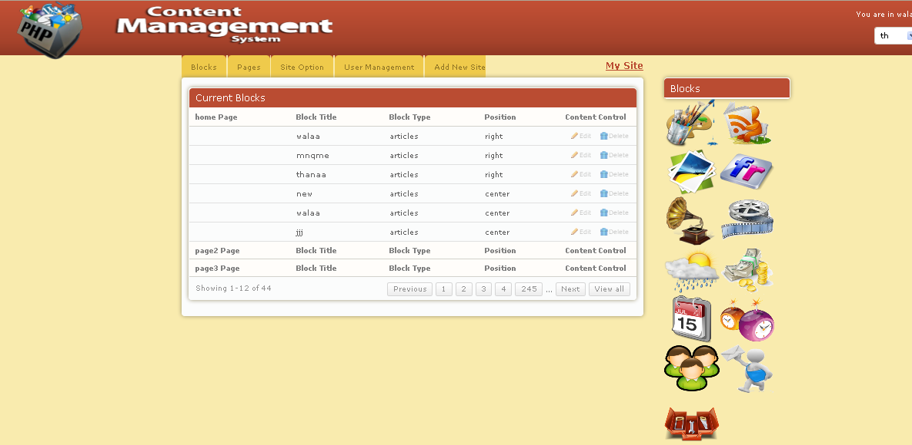
The CMS's private and public areas
A CMS consists of the admin area (back-end ), and the publicly visible area
(front-end).
CMS Back-end:
It can be accessed from admin folder.
From here you can edit the front-end contents. Just point-and-click, type in the new words, and hit save

Slide 15

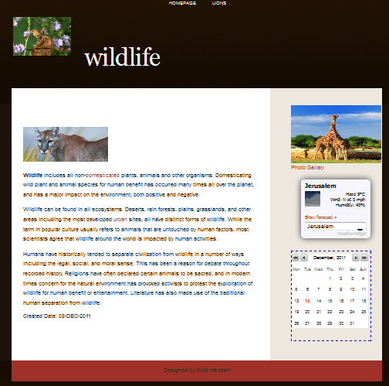
The CMS's private and public areas(Cont.)
CMS Front-end:
This is a site generated from Managing the backend (admin area), you can have more than one site, and also you can easily change the site template.

Slide 16
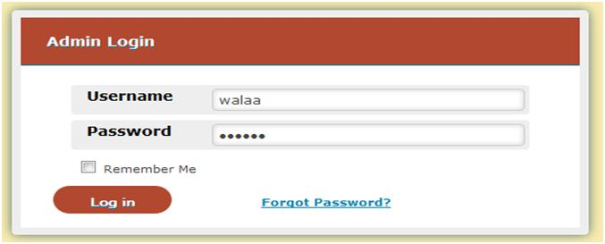
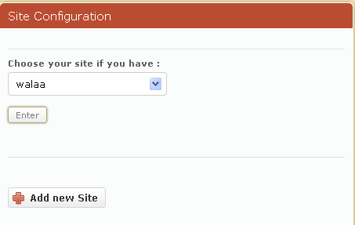
CMS Back-end Content
2) Site Configuration.
Admin Login.

Slide 17
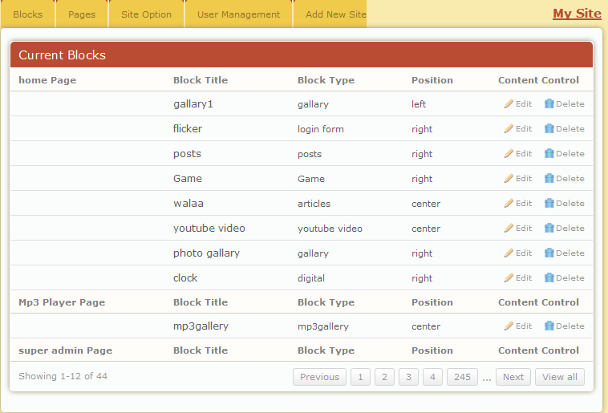

CMS Back-end Content(Cont.)
3) Control Panel
4) Blocks

Slide 18
Control Panel
From here you can start editing your new site.
Admin can add, delete, edit pages and blocks, also he can change site layout and template.
It’s easy to do just select and edit, and that’s done through Blocks, Pages Tabs
User Management: Through this option admin can easily add users to the site after choosing their types, and can edit them.

Slide 19












Blocks are the real power behind how a CMS does its things; they give CMS extra capabilities.
Blocks
Weather Articles Calendar Clocks Image Gallery
Video Users News Tools MP3 Flicker

Slide 20
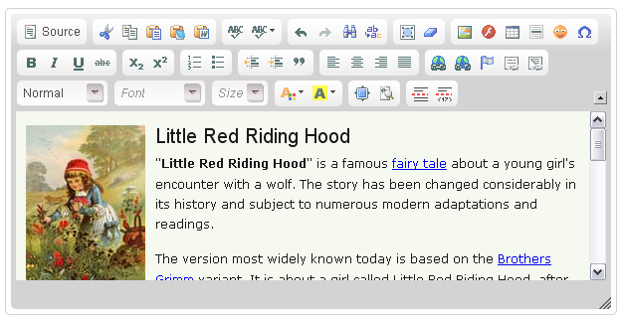
Articles: We are using Rich-text editing using Creditor. you can copy or paste from sources such as websites or word processor documents and the formats will be mostly retained.
Blocks(Cont.)

Slide 21
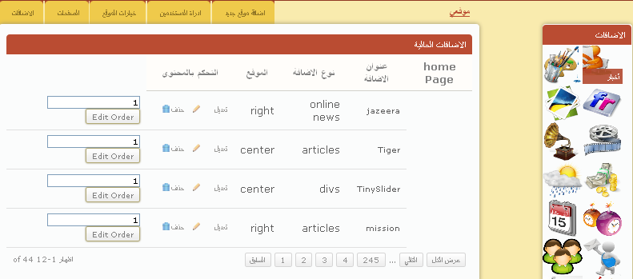
Languages
Arabic

Slide 22
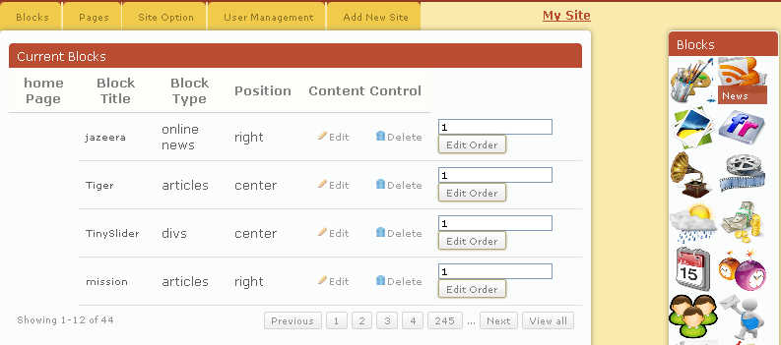
Languages(Cont.)
English

Slide 23
Features
Friendly User Interface.
Good Structure.
Languages(Arabic, English).
Dynamic Template.
Install Blocks.

Slide 24
Future Work:
The system can be improved by turning it into drag and drop system.
Adding more options per each block.
Allowing more than one admin to edit the same site with different privileges

