Slide 1
Jerusalem Temperature Prediction Using Deep Learning
Saher Hajji
Dr. Adnan Salman

Slide 2
Introduction
Model history
Data-driven only
Predict temperature at a single station
Compare to existing models

Slide 3
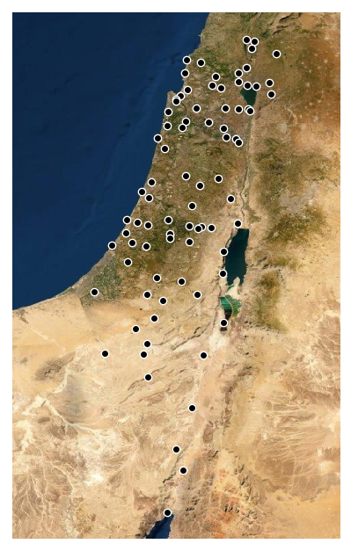
Israeli Meteorological Service (IMS)
82 stations
CIMO rating
Data span and interval

Slide 4
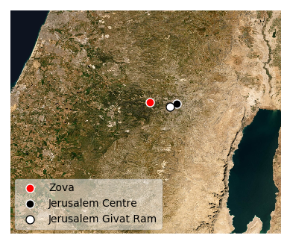
Target Station
Jerusalem stations
Selected station

Slide 5
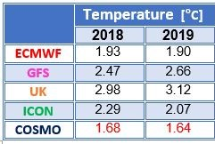
Goal and Benchmark
IMS models
IMS RMSE evaluation method and future prediction span
Test set
Train and validation sets
Problem formulation

Slide 6
Features
temperature (C°)
moist temperature (C°)
dew point (C°)
relative humidity (%)
wind speed (m/s)
wind direction (degrees)

Slide 7
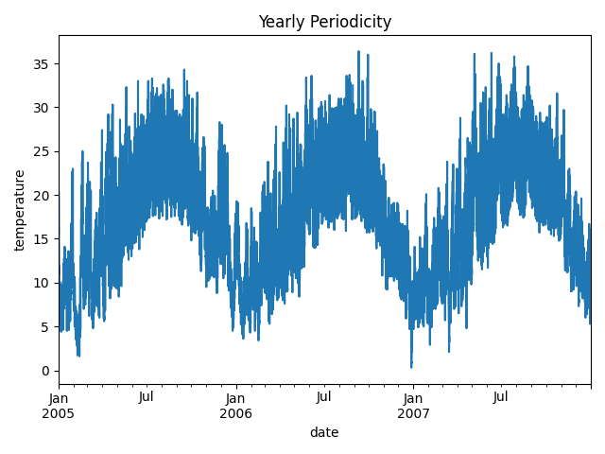
Yearly Periodicity of Temperature

Slide 8
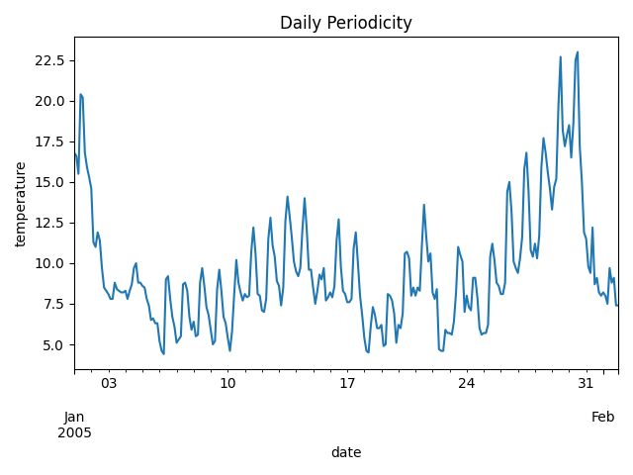
Daily Periodicity of Temperature

Slide 9
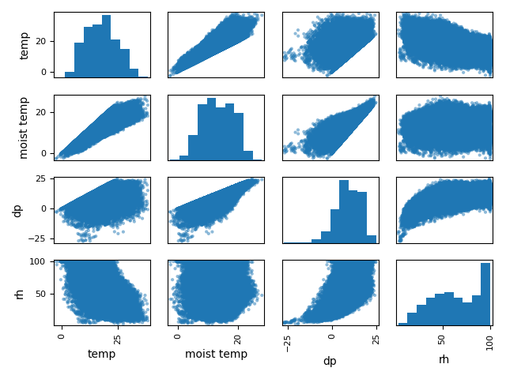
Scatter Matrix of Features

Slide 10
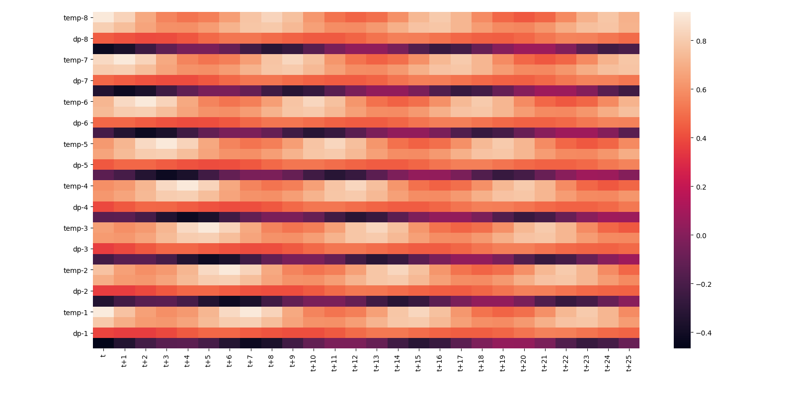
Correlation Heatmap

Slide 11
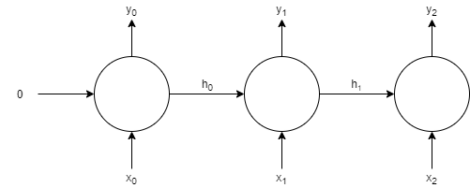
Recurrent Neural Networks (RNNs)
Meant for processing sequence-dependent data
Differences:
  3D Input (samples, timesteps, features)
  have hidden state as input, it can be as simple as the output, or complex
  can return a sequence or a vector

Slide 12
Long Short Term Memory (LSTM)
The type of recurrent layer used in this research.
Considered to be one of the strongest recurrent layer
Solves the Diminishing Gradients problem.
Has two hidden states (long and short)
Uses multiple transformations with logic gates.

Slide 13
Sequence to Sequence Architectures
Sequence-to-vector
Sequence-to-sequence with equal past and future timesteps
Encoder-decoder
Sequence-to-sequence (no restrictions on problem definition)

Slide 14
Performance at The Target Station
Model | Train Score | Validation Score | Past Steps
FFNN | 2.90 | 2.82 | 16
Sequence to Vector | 2.74 | 2.75 | 8
Sequence to Sequence | 3.22 | 3.5 | 26
Encoder Decoder | 2.72 | 2.74 | 8
Sequence to Sequence | 2.62 | 2.65 | 8

Slide 15
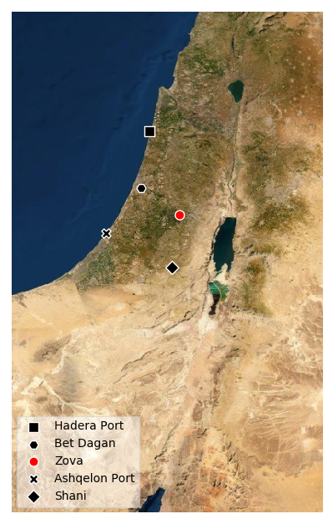
Using Neighboring Stations
Combining several stations as features failed.
Less data, more features.
Stations were evaluated individually
Selected stations trained and tuned individually using their individual observations along with the target temperature as a feature and target
Models ensembled using stacking.
Ridge regression for stacking.

Slide 16
An Example of The Best Model in The Ensemble: ‘Bet Dagan’
Sequence to sequence
Structure
Fine Tuning
EarlyStopping
Layer | No. Neurons
LSTM | 32
LSTM | 16
Time Distributed Dense | 26
LSTM(32, return_sequences=True, input_shape=(8, 11))
LSTM(16, return_sequences=True)
TimeDistributed(Dense(26))

Slide 17
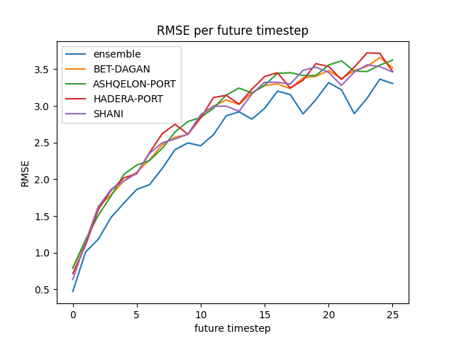
Ensemble Evaluation
2.56 RMSE test score using the IMS method.
Beat one IMS model, and performed close to another.
RMSE per future timestep

Slide 18
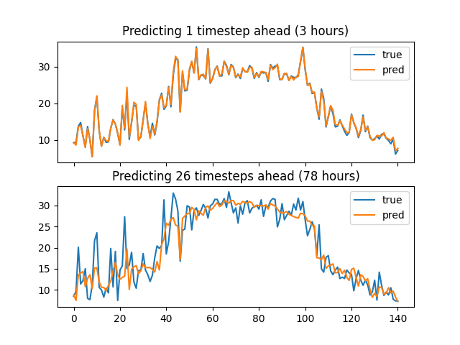
Ensemble Targets and Predictions

