Slide 1
Arbitration as a Dispute Resolution Technique in Construction Projects
Prepared by :
Mohamad Jarrar Laith Al-Ghoul Mohamad Shalabi Ameer Zeidan
Presented to:
Eng. Reema Nassar Eng. Fakhry Al-Safadi Eng. Hussein Abu-Zant

Slide 2
Outline
Review
Objectives
Methodology
Questionnaire
Conclusion
Recommendations
Case study

Slide 3
Review

Slide 4

Review

Slide 5
Objectives
Spread awareness
To preserve the rights of all parties involved in the project.
To provide competitive prices and higher quality.

Slide 6
Methodology
Data Collection
Data Analysis
Results

Slide 7
Questionnaire
Objective
Parameters

Slide 8
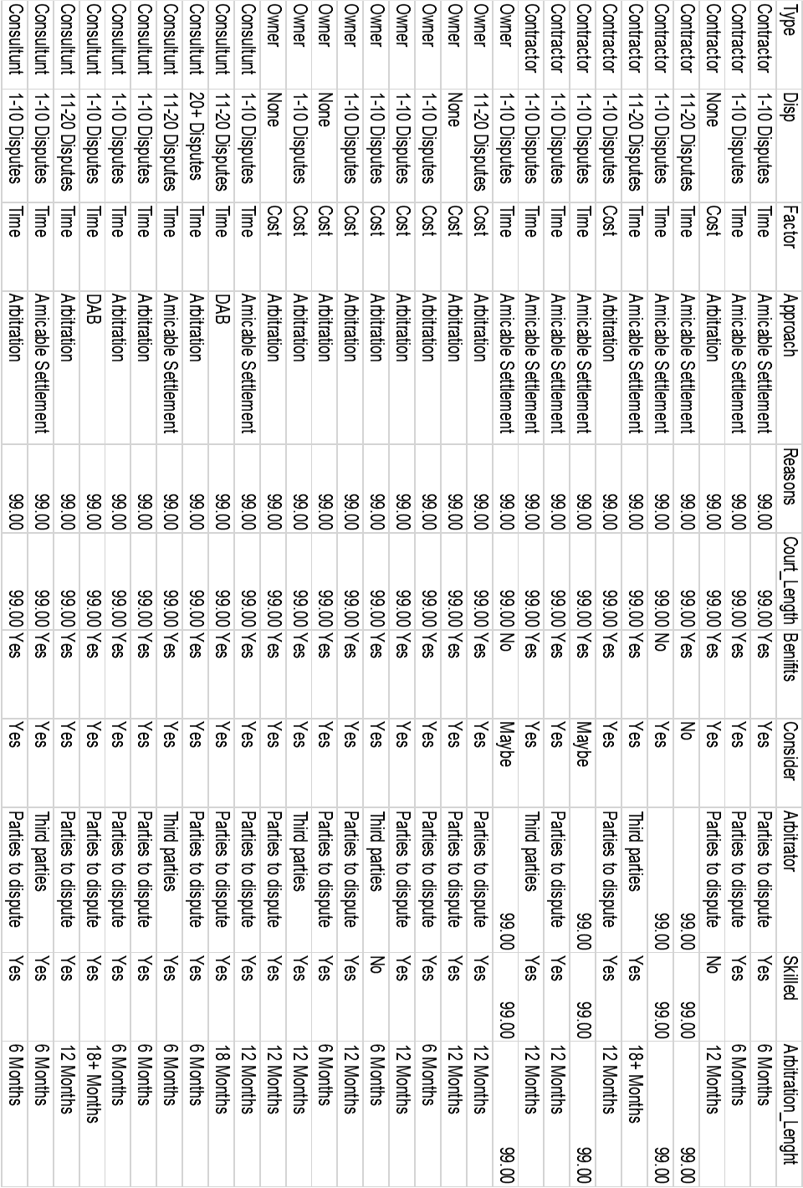

Slide 9
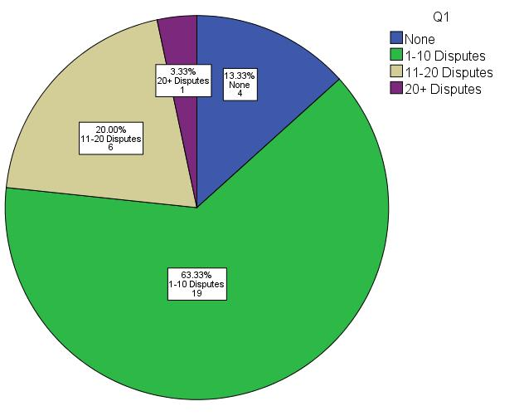
Question 1
“Roughly, how many construction disputes has your business entered into within the past 5 years?”
-”None”: 13%
-”1-10 Disputes”: 64%
-”11-20 Disputes”: 20%
-”20+ Disputes”: 3%

Slide 10
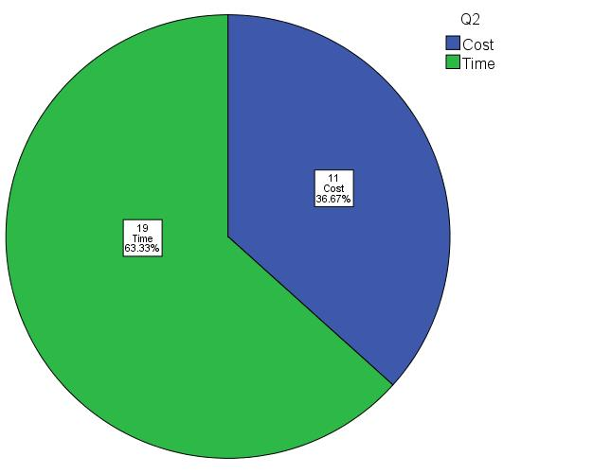
Question 2
“What factor(s) would influence your decision in choosing a means of settling disputes?”
-”Cost”: 37%
-”Time”: 63%

Slide 11
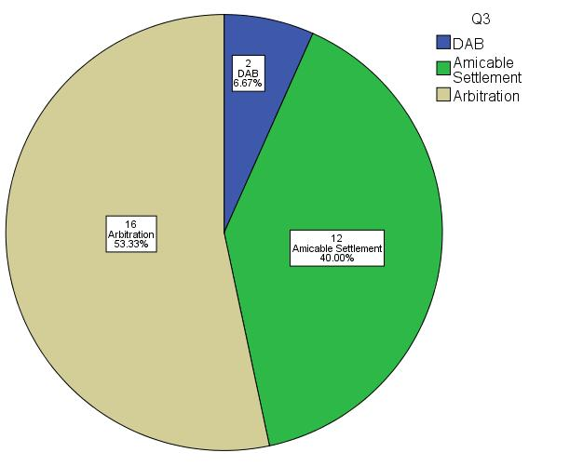
Question 3
“What approach would you take to resolve your construction disputes?”
-”DAB”: 7%
-”Amicable Settlement”: 40%
-”Arbitration”: 53%

Slide 12
Question 4 & 5
Question 4: “If you chose to refer your disputes to the courts in Question (3) , please state your reasons:”
Question5: “If you have previously submitted a case to court, how long did the entire process take to resolve?”

Slide 13
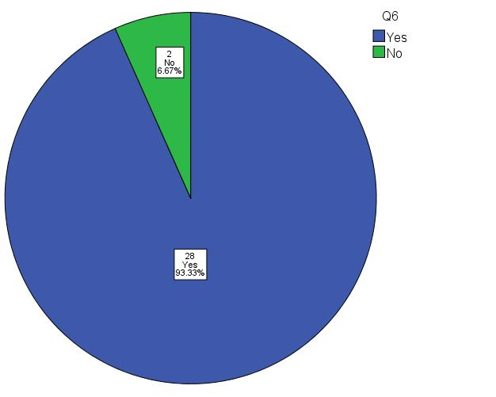
Question 6
“Are you aware of the benefits of using the arbitration services?”
-”Yes”: 93%
-”No”: 7%

Slide 14
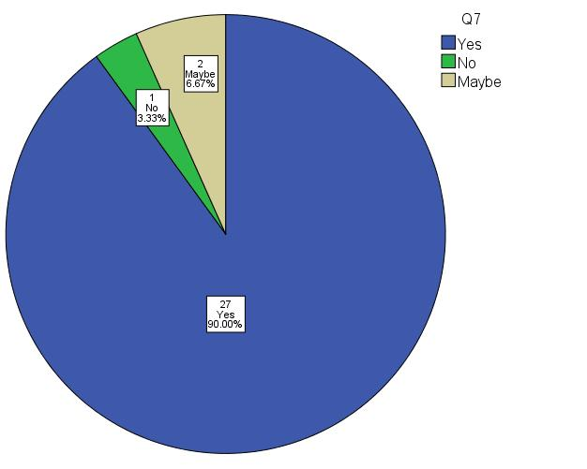
Question 7
“If you haven't already, would you consider arbitration or any other alternative dispute resolution as a means of resolving a dispute?”
-”Yes”: 90%
-”No”: 3%
-”Maybe”: 7%

Slide 15
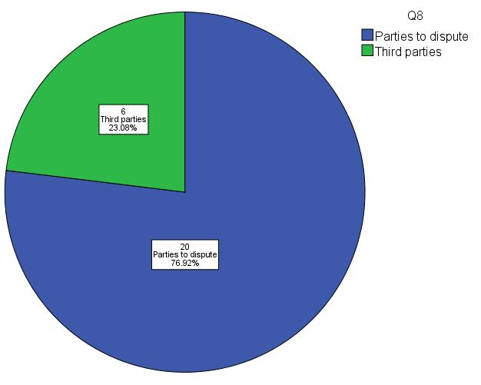
Question 8
“If you are currently using or have previously used arbitration as a dispute resolution, who appointed the arbitrator?”
-”Parties to dispute”: 77%
-”Third Parties”: 23%

Slide 16
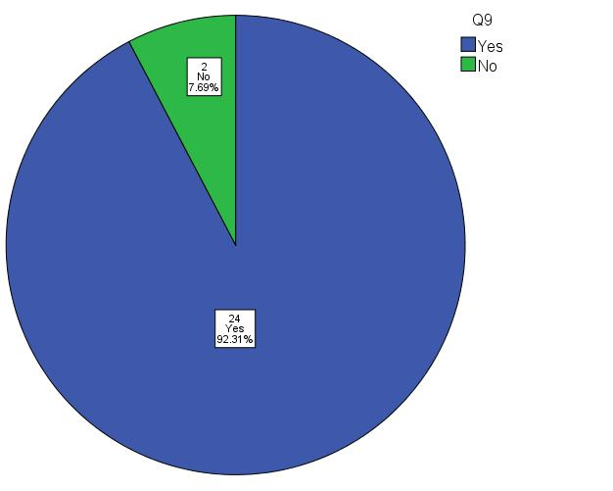
Question 9
“If you are currently using or have previously used arbitration as a dispute resolution, did a specialized arbitrator handle the case?”
-”Yes”: 92%
-”No”: 8%

Slide 17
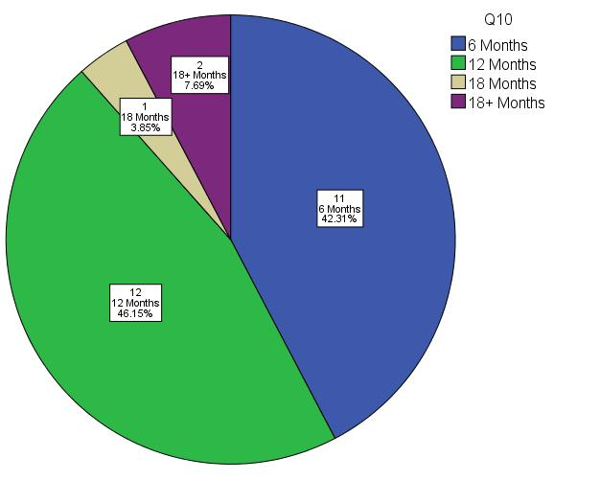
Question 10
“If you are currently using or have previously used arbitration as a dispute resolution, how long did it take to render an award?”
-”6 Months”: 42%
-”12 Months”: 46%
-”18 Months”: 4%
-”18+ Months”: 8%

Slide 18
Conclusion
Consulting Firms face more disputes
Contractors prefer Time and Amicable Settlement
Owners prefer cost and Arbitration
Litigation is not used in Palestine
High level of awareness of arbitration
High level of readiness to use arbitration
Average length of arbitration is from 6-12 months

Slide 19
Recommendations
Periodic evaluation
Evaluation cards
Conducting Workshops
Distributing awareness bulletins
Training programs
Organizing international conferences
Including Dispute Resolution Methods in the curriculum
More PIAC branches

Slide 20

Case study

Slide 21


