Slide 1

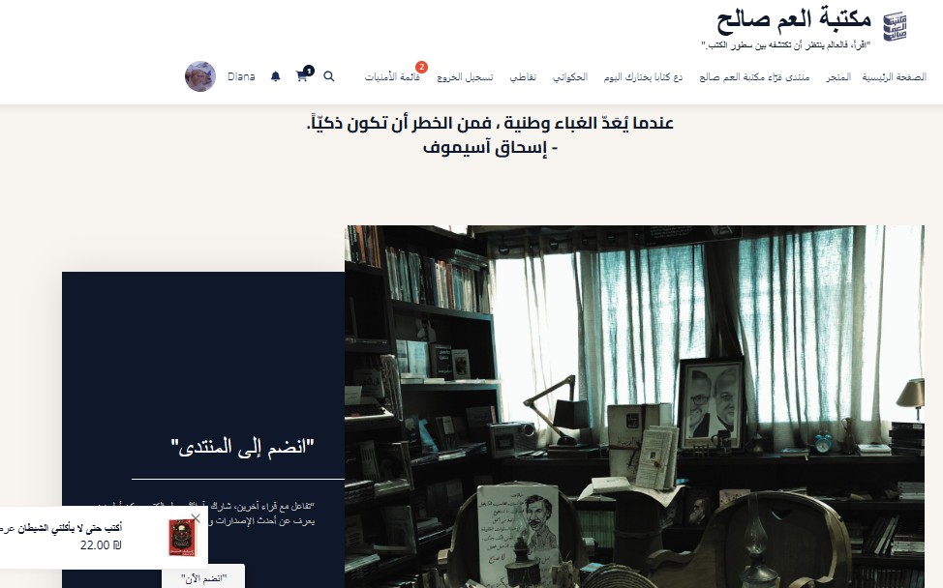
UNCLE SALEH THE SMART
The Future of Arab Libraries Using Management Information Systems
Batool Fatayer Saja Hassouna Diana falaha
Supervised by Dr. Ahmad Shraideh
http://bastet-kotob.site/wp/
18 JUNE 2025

Slide 2

Overview
Introduction Problems
Tools & Used Techology Website Features & Solutions Analysis & Reports
Future Plans

Slide 3

Introduction
The process of purchasing books has become tedious and lacks any creative commercial touches. Our electronic system is here to change this concept and provide a unique experience for the reader and the system user..

Slide 4














Problems
Lack of a flexible electronic ordering system sales and order tracking system
Difficulty in knowing readers' preferences
Lack of a smart customer communication strategy
Poor blogging and lack of sharing of cultural content

Slide 5

SOLUTIONS
Develop a flexible electronic system to facilitate and track orders
smoothly.
Analyze reader data and suggest personalized content based on
their preferences.
Create a smart customer engagement strategy using modern technologies
Promoting cultural blogging and encouraging the sharing of local and international content

Slide 6








TOOLS & USED TECHOLOGY
mycred
Buddypress
Crisp
Wordpress
Elementor
Woo commerce
Product Recommendation Quiz
metorik

Slide 7

Website Features
Smart personalized recommendations based on customer behavior.
Smart Search and chatbot
Custom product and store features
A blog on the site for discussion and quotes.
Interactive Feature: "Let a Book Choose You Today"
Interactive section “AL-HAKAWATI” Loyalty points system
Email Automation System&Smart order tracking
Analysis panel showing the library's profits

Slide 8
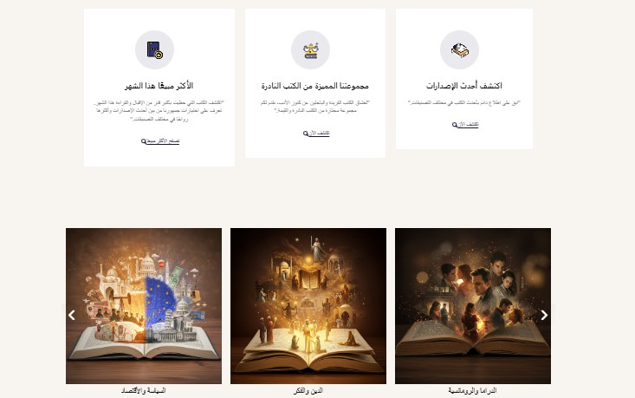
SECTION

Slide 9
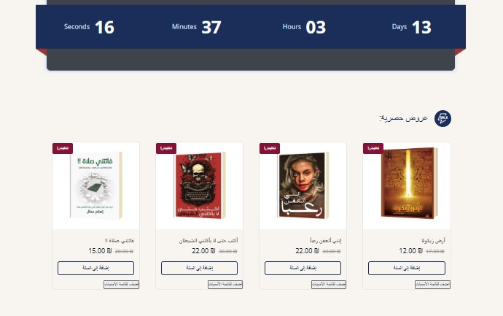
SECTION

Slide 10
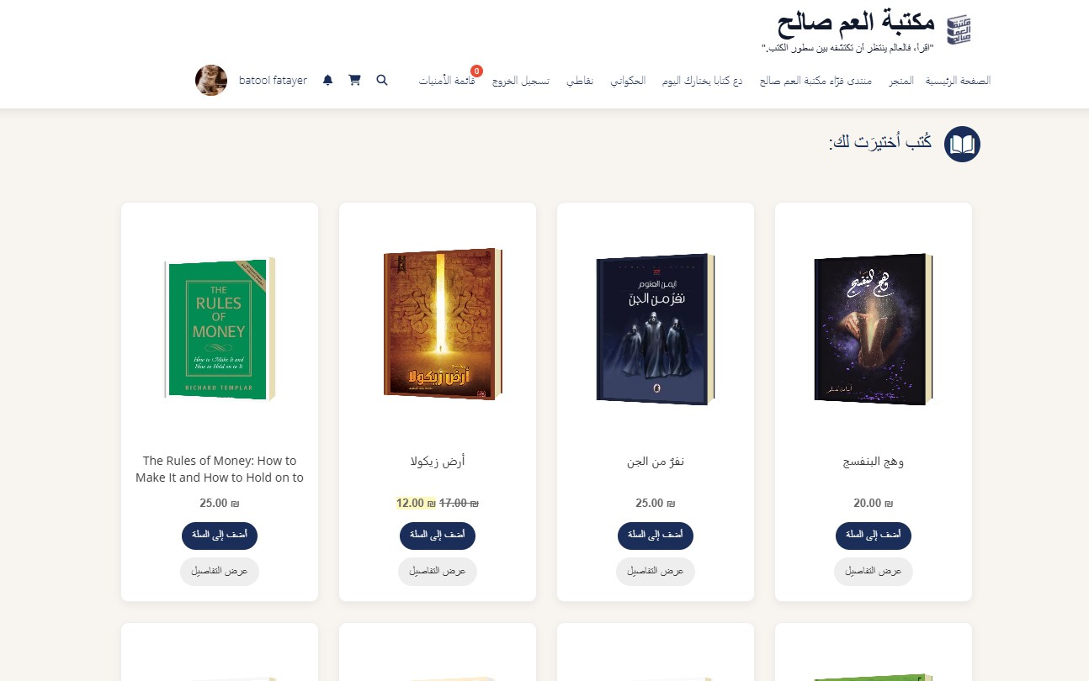
RECOMMENDATIONS

Slide 11
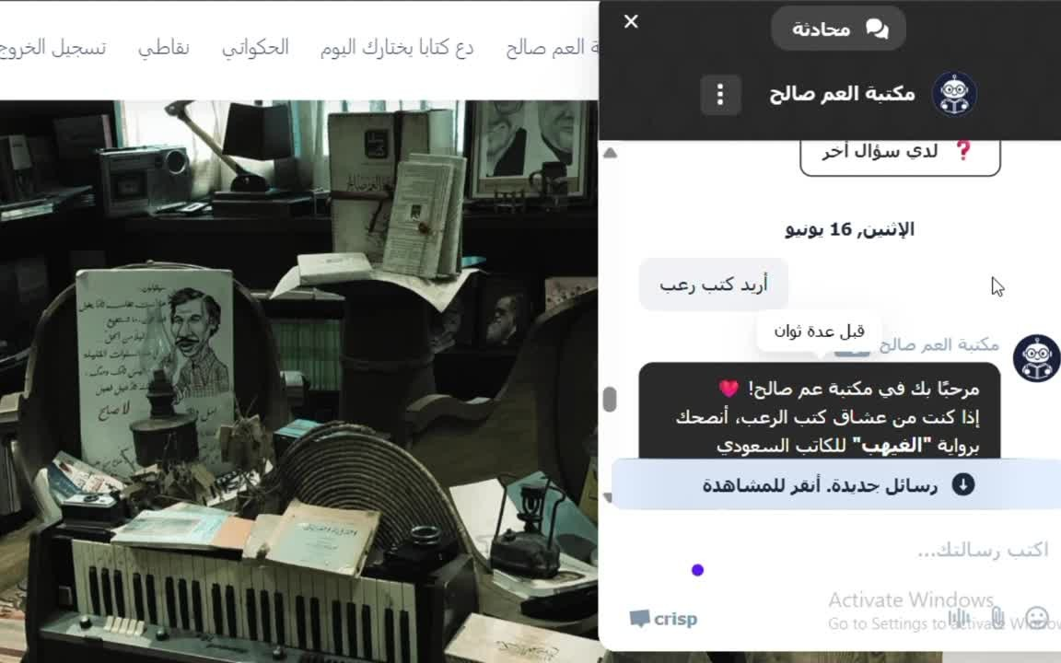
SMART CHAT

Slide 12
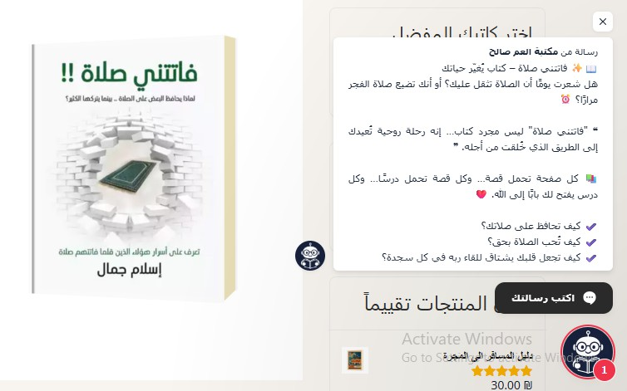
SMART CHAT

Slide 13
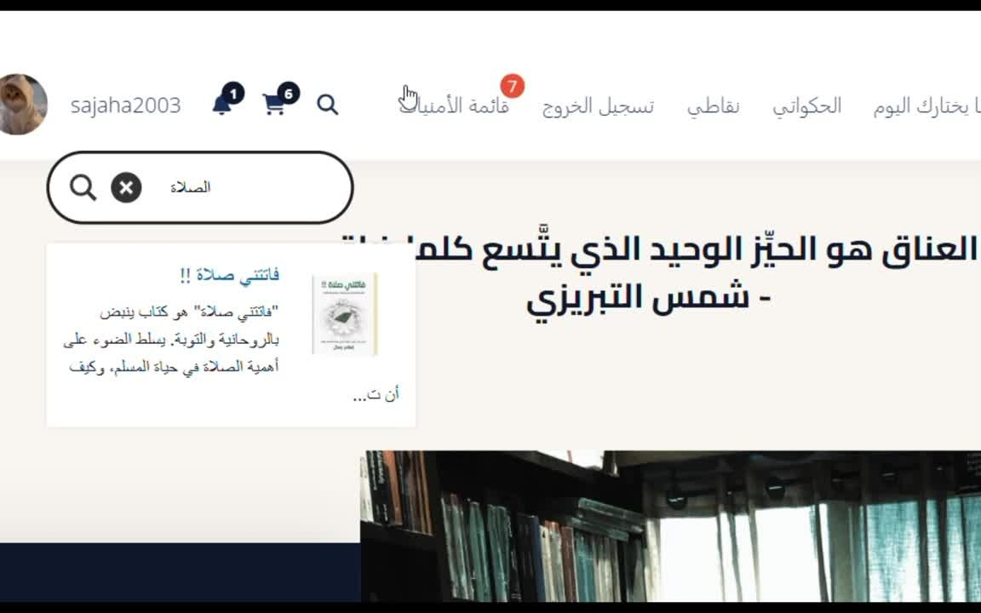
SMART SEARCH

Slide 14
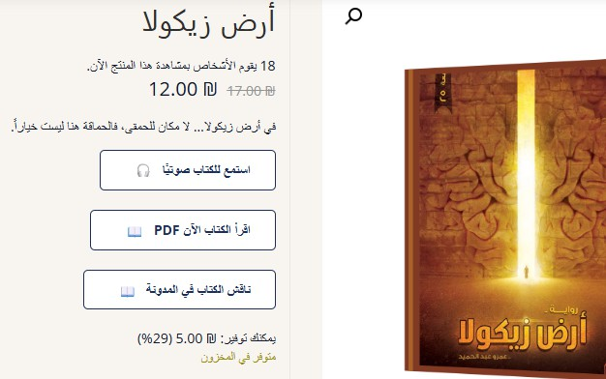
PRODUCT FEATURES

Slide 15
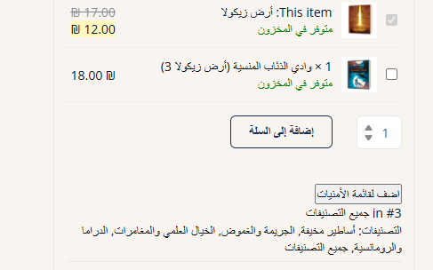
PRODUCT FEATURES

Slide 16
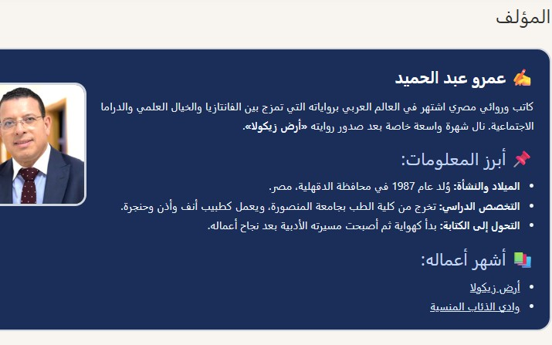
PRODUCT FEATURES

Slide 17
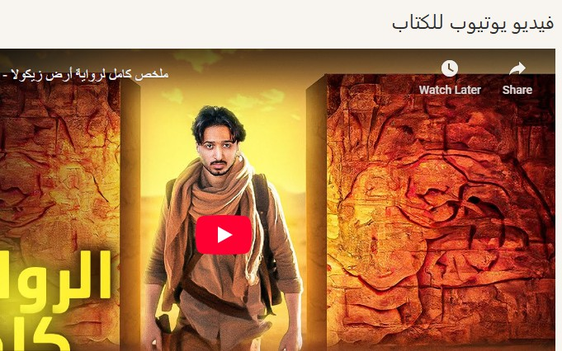
PRODUCT FEATURES

Slide 18
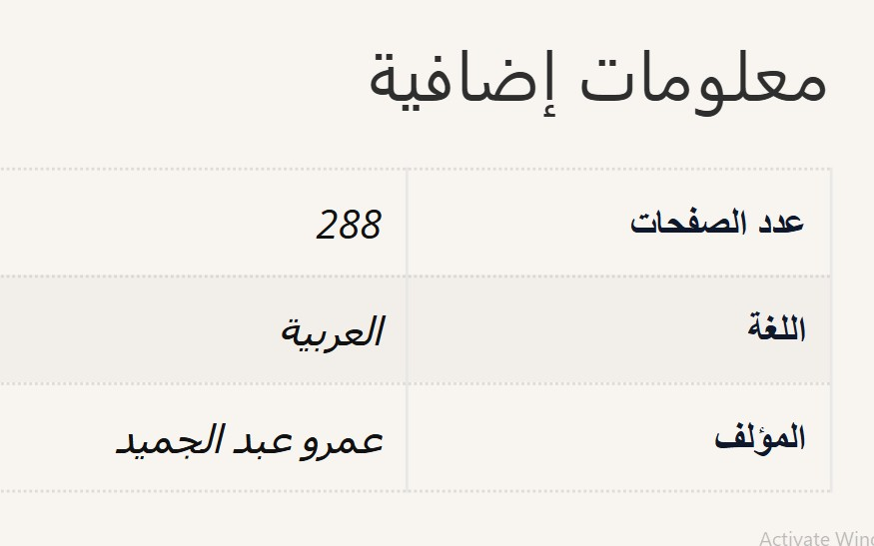
PRODUCT FEATURES

Slide 19
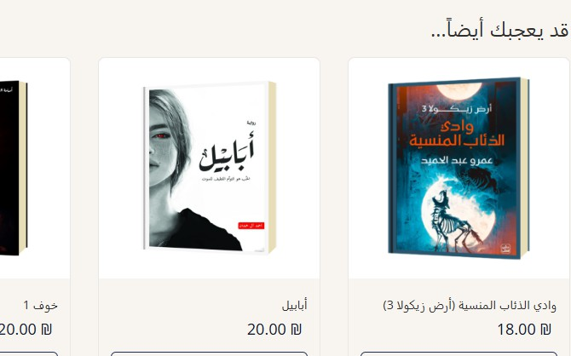
PRODUCT FEATURES

Slide 20
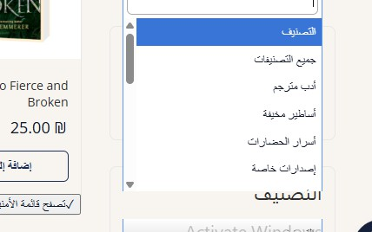
PRODUCT FEATURES

Slide 21
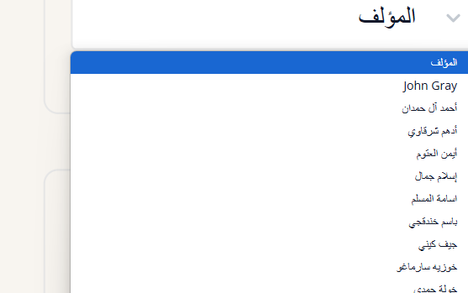
PRODUCT FEATURES

Slide 22
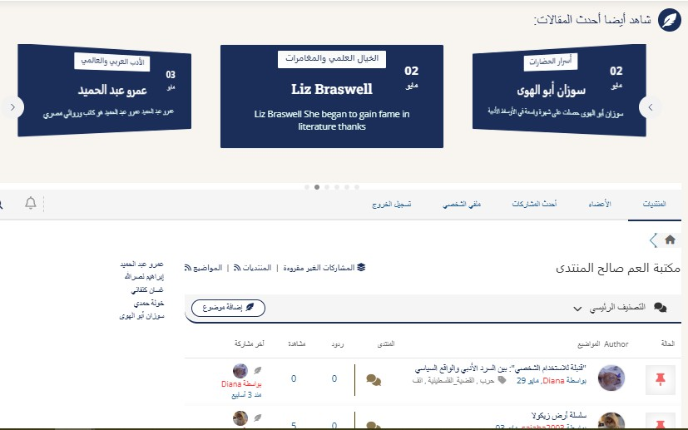
A BLOG ON THE SITE

Slide 23
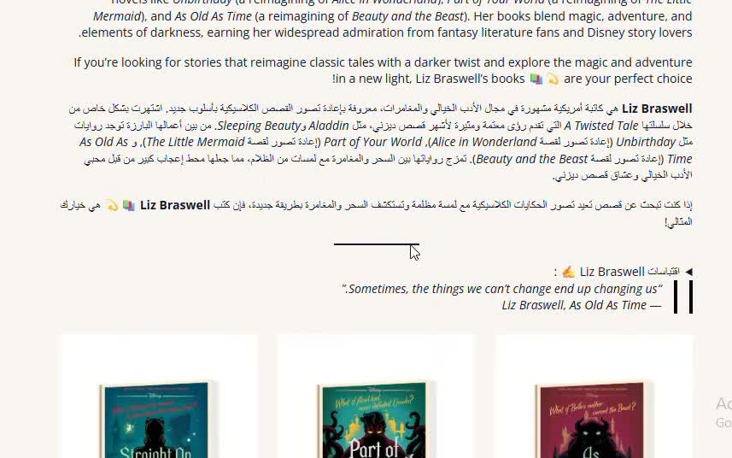

Slide 24
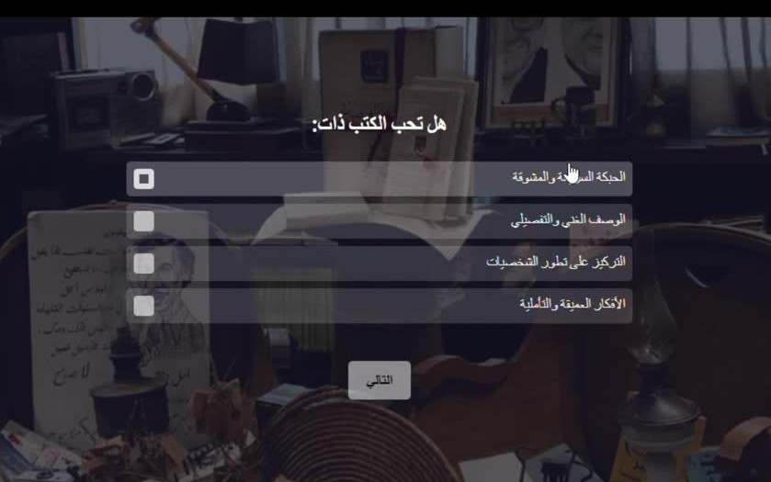
INTERACTIVE FEATURE: "LET A BOOK CHOOSE YOU TODAY"

Slide 25
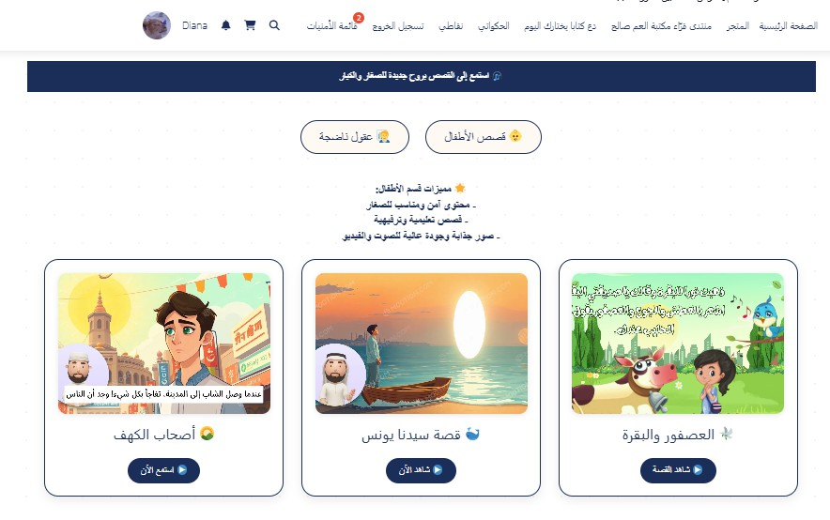
INTERACTIVE SYSTEM “AL-HAKAWATI”

Slide 26
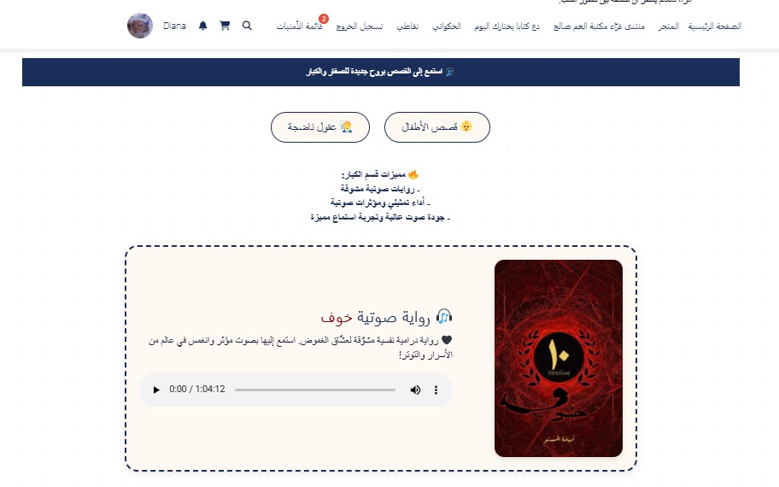
ANTERACTIVE SYSTEM “AL-HAKAWATI”

Slide 27
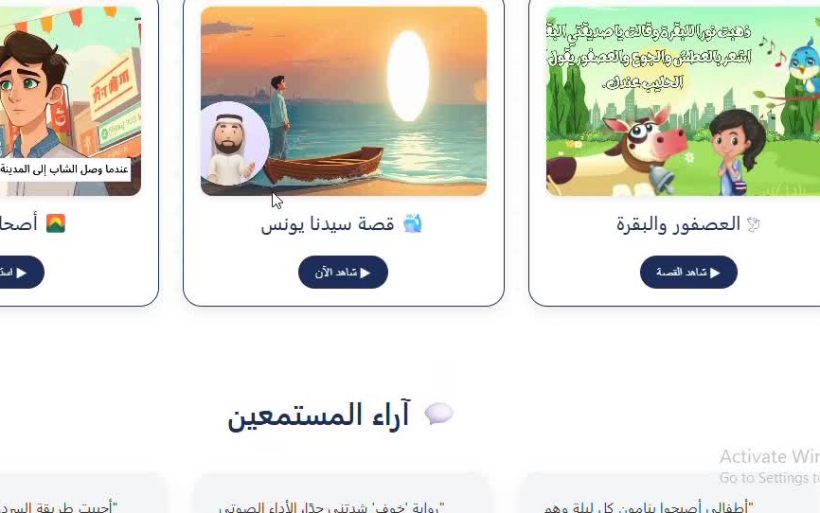

Slide 28
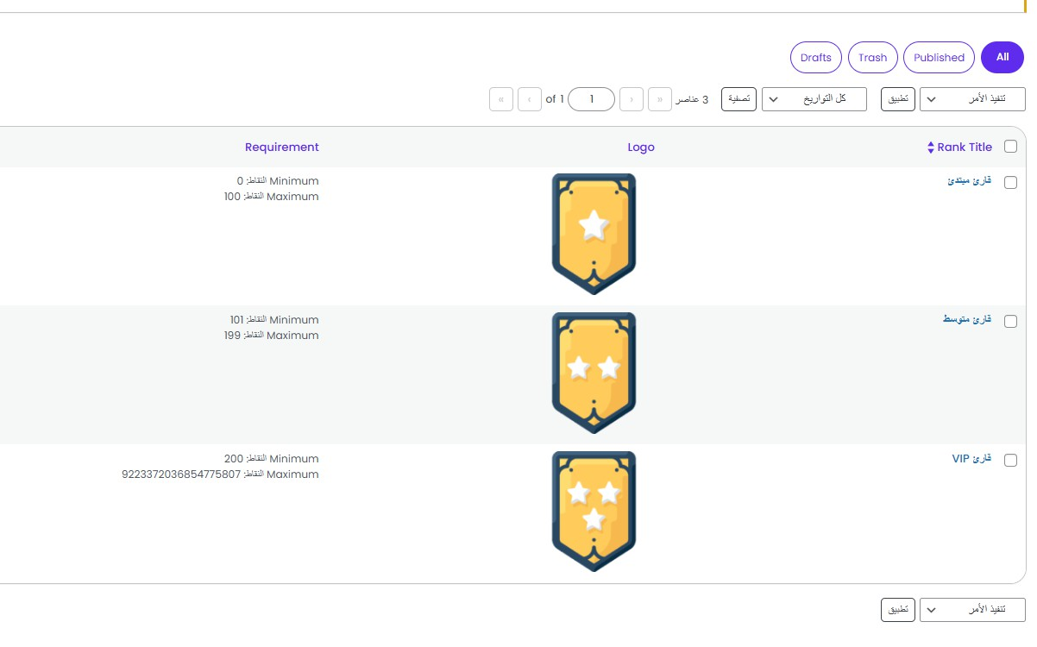
LOYALTY POINTS

Slide 29
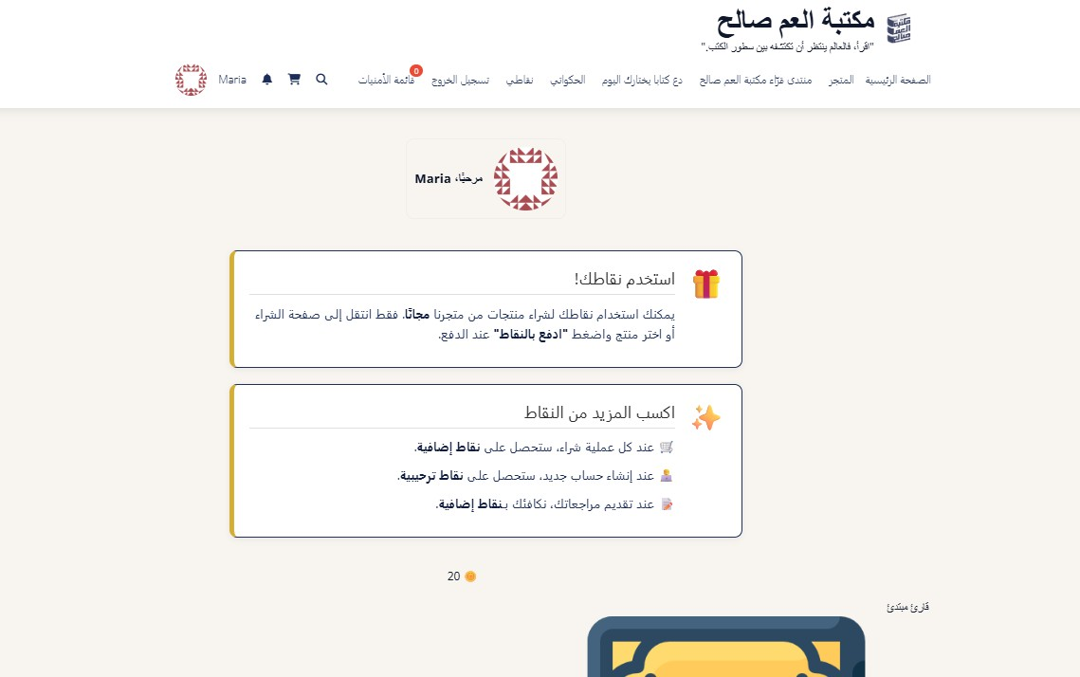
LOYALTY POINTS

Slide 30
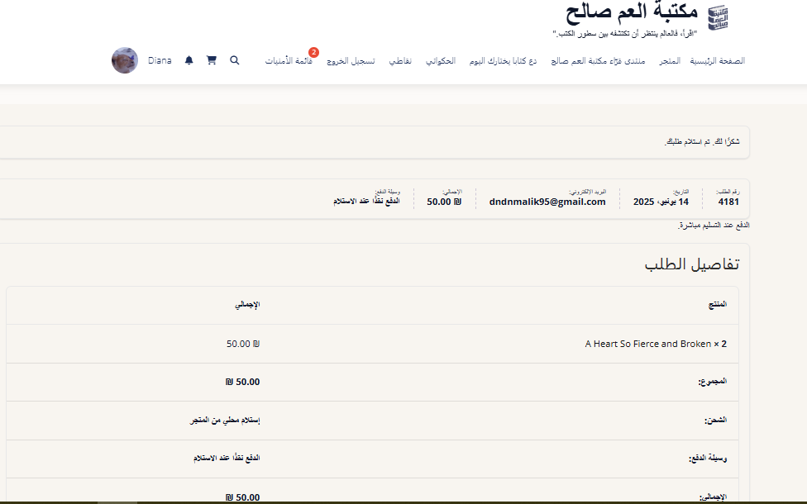
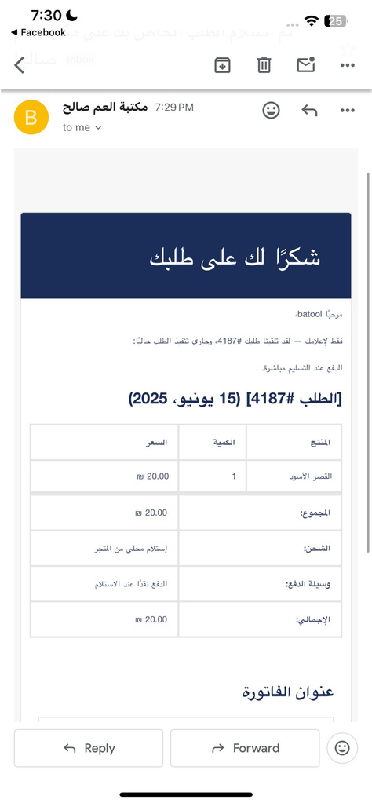

EMAIL AUTOMATION SYSTEM

Slide 31
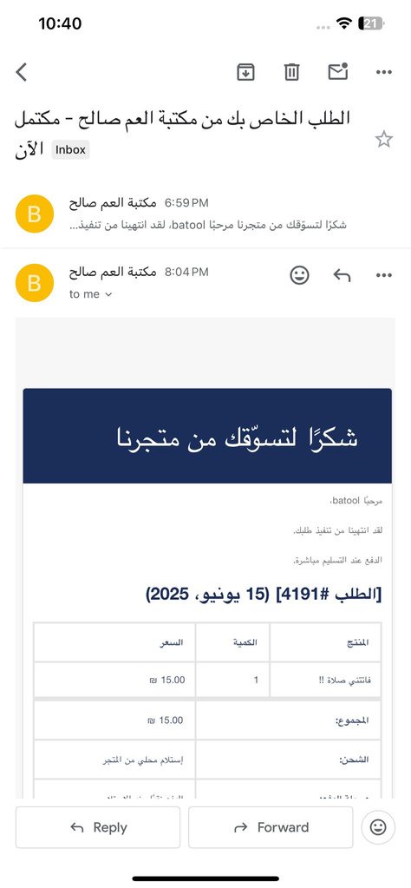

EMAIL AUTOMATION SYSTEM

Slide 32
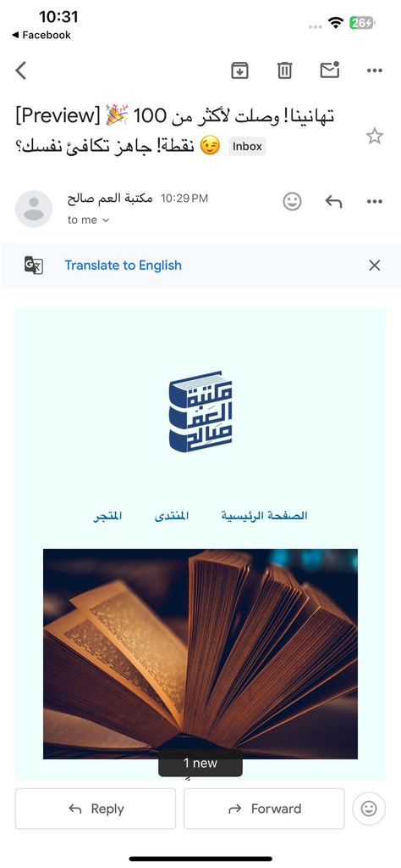
EMAIL AUTOMATION SYSTEM

Slide 33
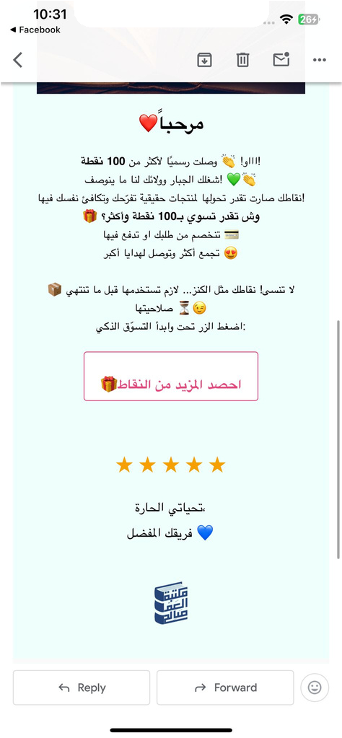
EMAIL AUTOMATION SYSTEM

Slide 34
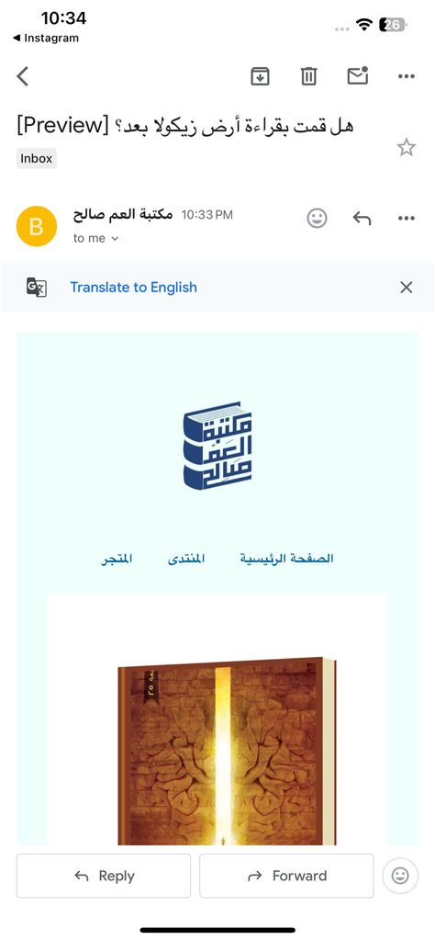
EMAIL AUTOMATION SYSTEM

Slide 35
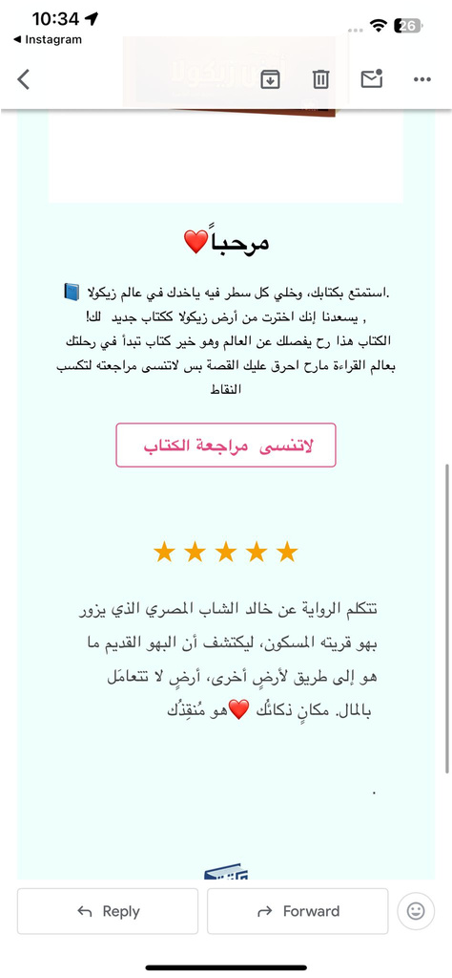
EMAIL AUTOMATION SYSTEM

Slide 36
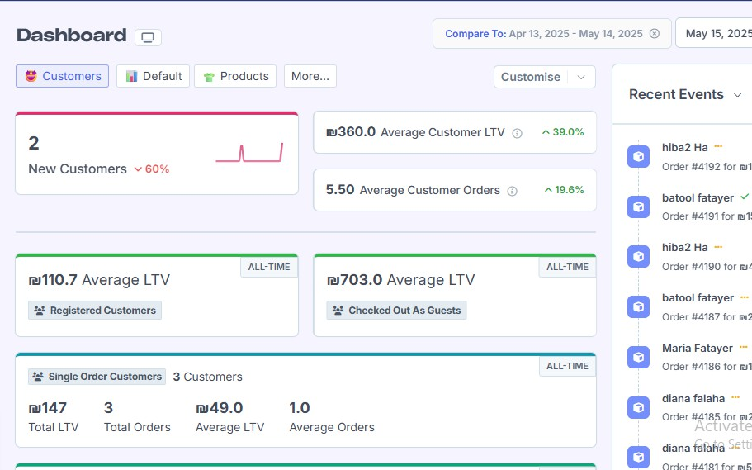
ANALYSES
GENERAL ANALYSIS

Slide 37
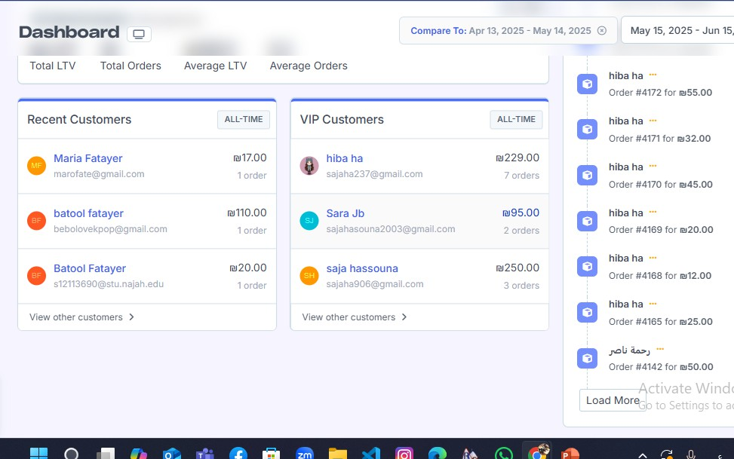
ANALYSES
GENERAL ANALYSIS

Slide 38
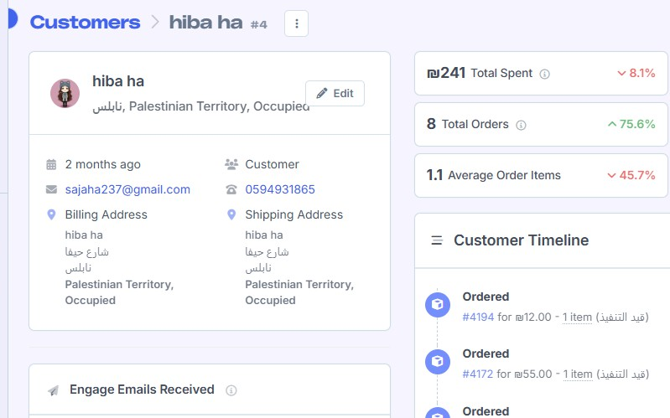
ANALYSES
CUSTOMER INFO

Slide 39
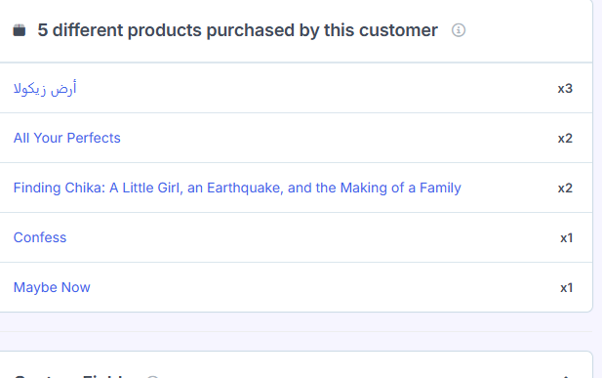
ANALYSES
CUSTOMER INFO

Slide 40
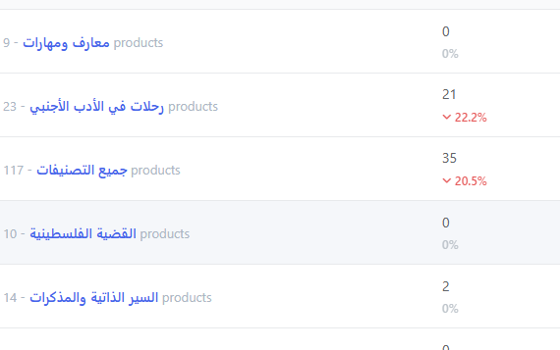
ANALYSES
BEST SELLING CATEGORIES

Slide 41
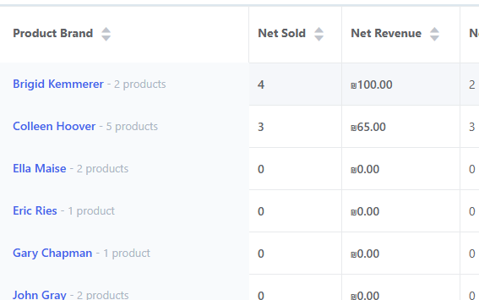
ANALYSES
BEST-SELLING AUTHOR

Slide 42
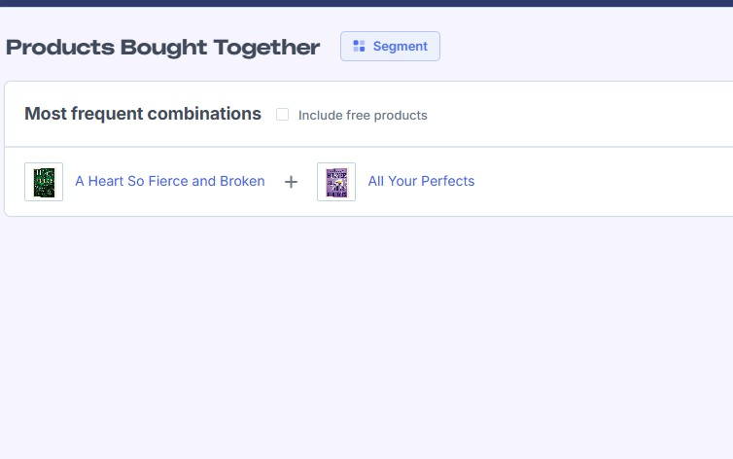
ANALYSES
BESTSELLERS TOGETHER

Slide 43
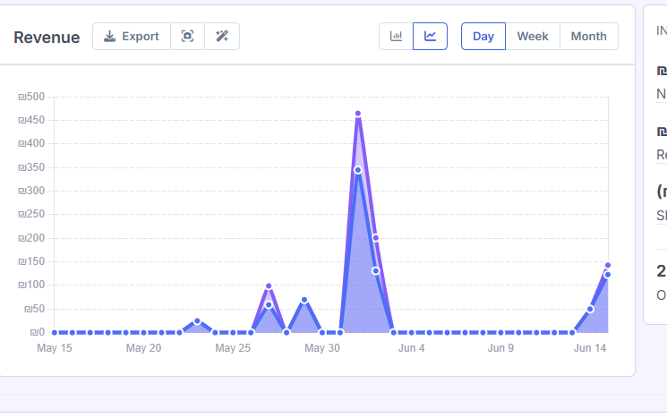
ANALYSES
REPORTS

Slide 44
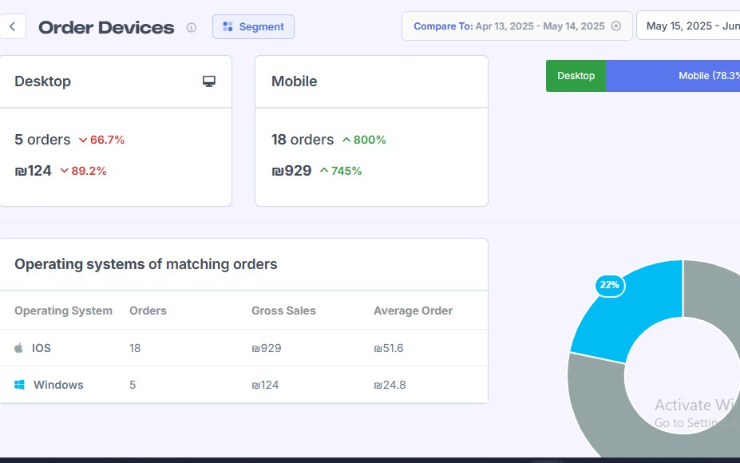
ANALYSES
DEVICES

Slide 45
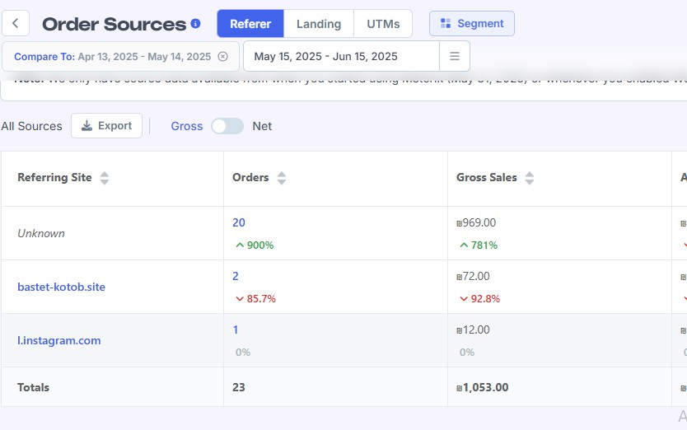
ANALYSES
SOURCE

Slide 46
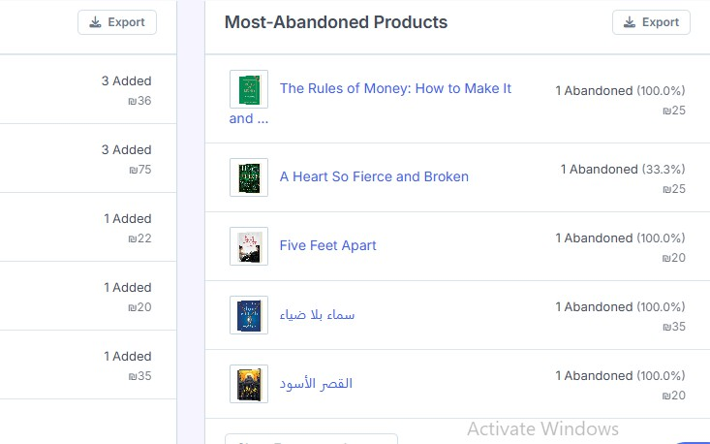
ANALYSES
THE MOST ABANDONED

Slide 47
Launching the "Monthly Reading Challenge"
Future Plans
A monthly reader challenge with an electronic badge for participants and symbolic prizes.
Supporting independent authors to publish their books
With an easy interface for self- publishing and marketing.
Library events and authors calendar
A blog-related page that allows the author to schedule upcoming events such as signings, discussion sessions, and new book launches.

Slide 48

THANK
YOU

Slide 49

PRODUCT FEATURES

Slide 50
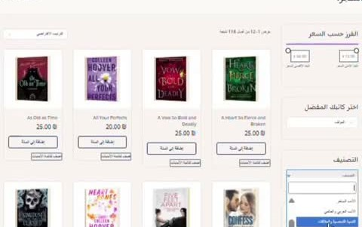
ANALYSES
RECOMENDATION TEST

Slide 51
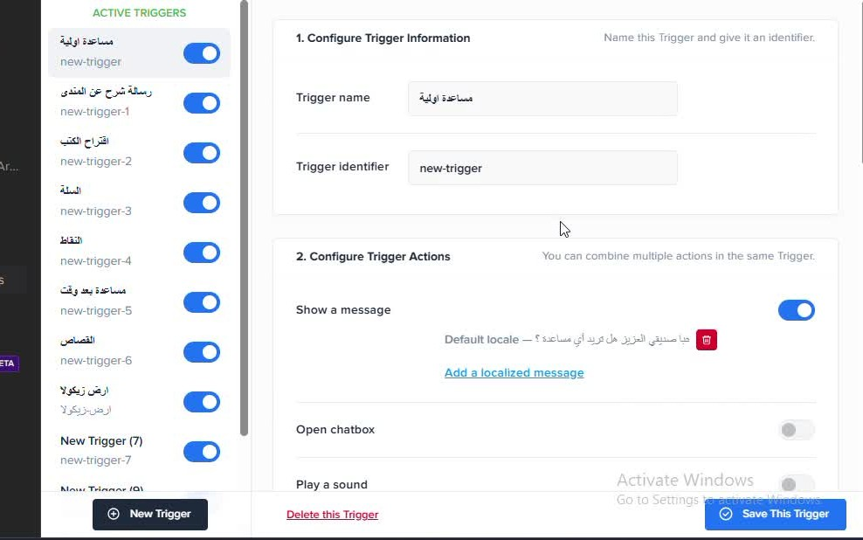
ANALYSES
CHATBOT

Slide 52
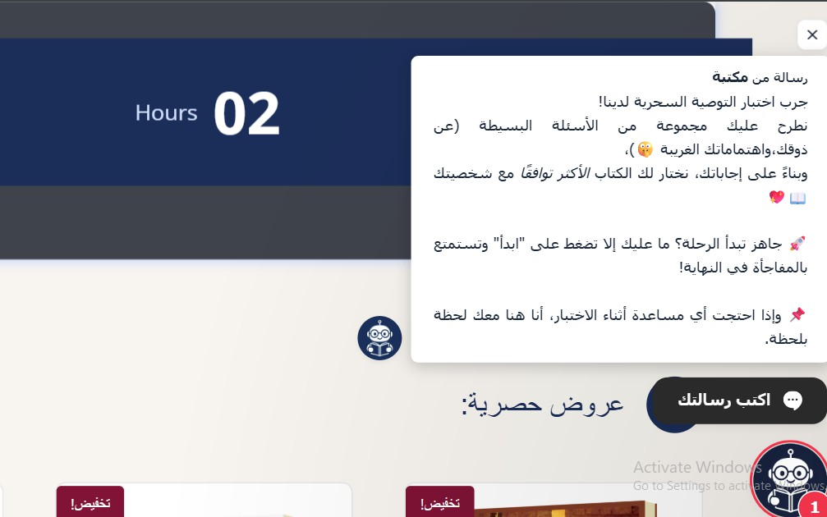
ANALYSES
THE MOST ABANDONED

Slide 53
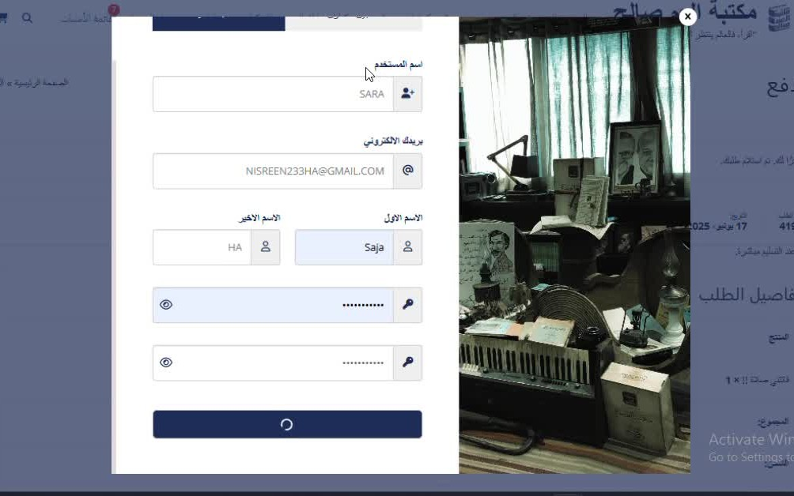
ANALYSES
THE MOST ABANDONED

Slide 54
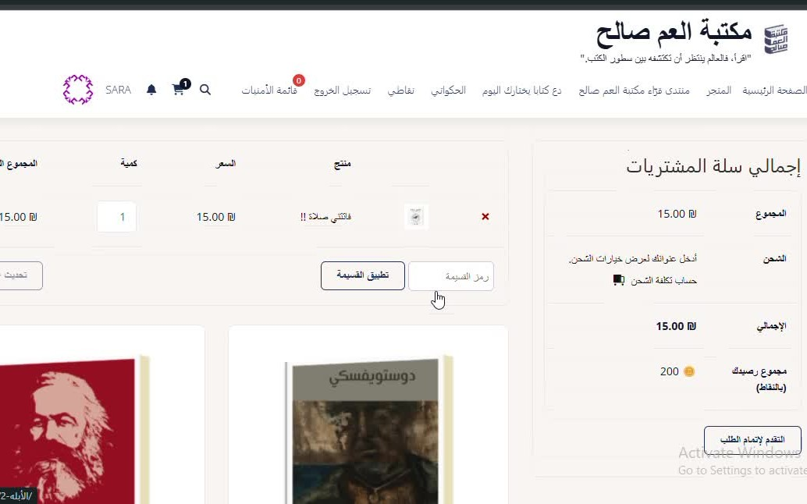
ANALYSES
PAY WITH POINT

Slide 55
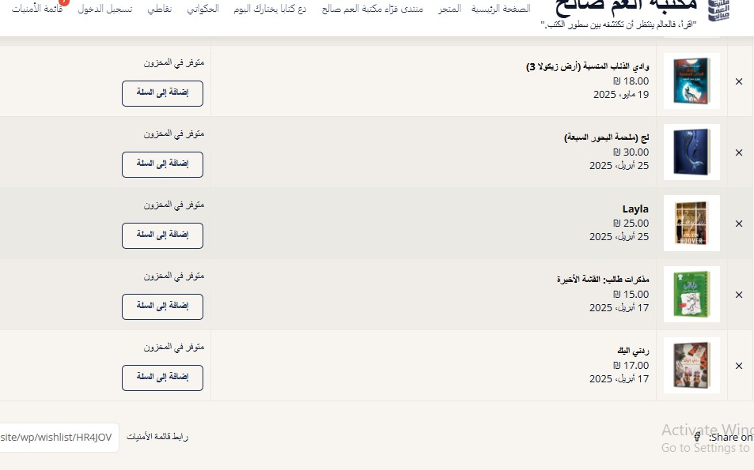
ANALYSES
THE MOST ABANDONED

Slide 56
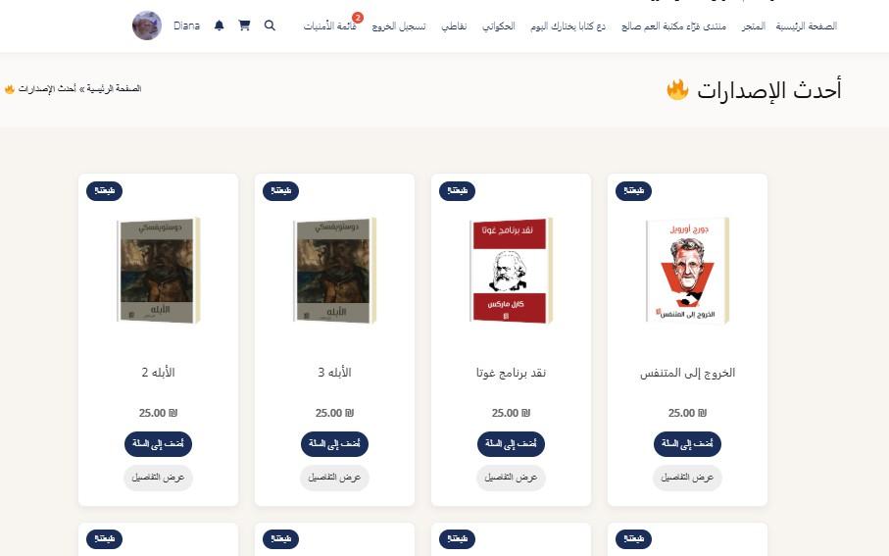
ANALYSES
SECTION

Slide 57
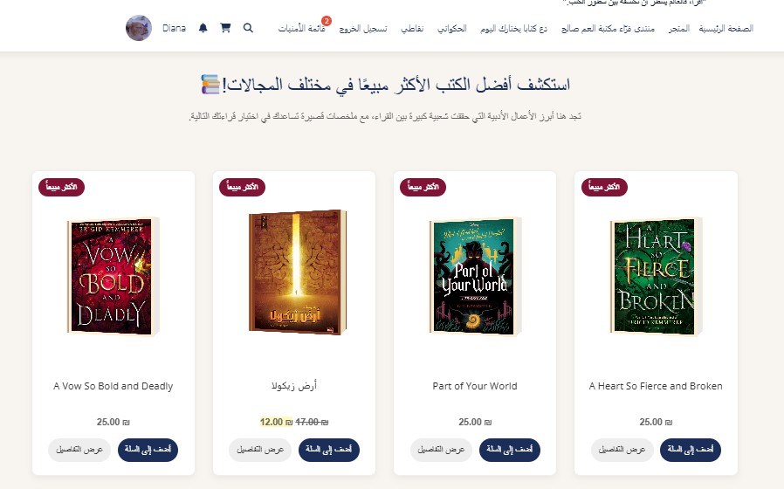
ANALYSES
SECTION

Slide 58
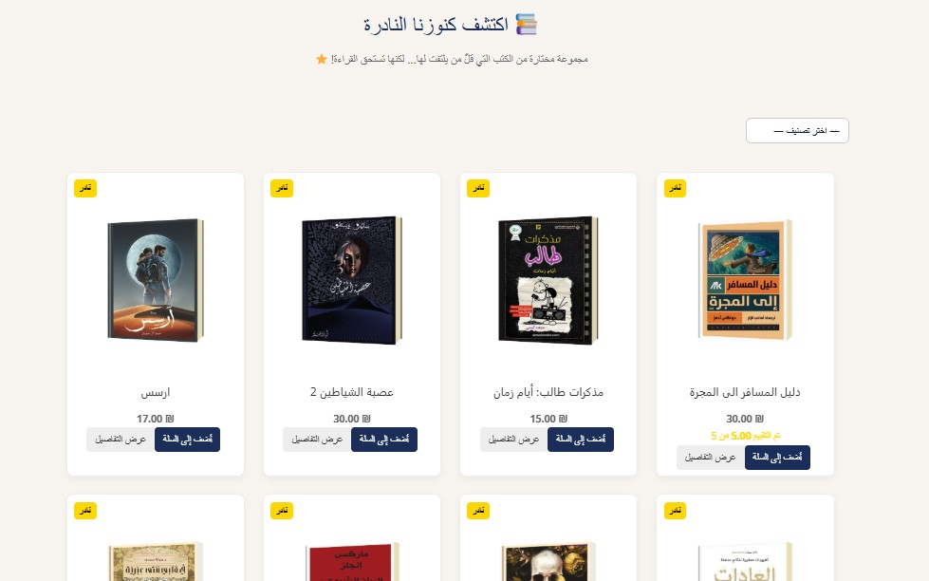
ANALYSES
SECTION

