Slide 1

Graduation Project
Management Information System Department
Abu Zahra Electronics
(E-Marketing, E-Commerce, and UI Design for mobile App)
Prepared By: Maram Hamed
Younes Abu Zahra
AbdAllah al-sharif
Supervised By: Dr. Maher Arafat
2023/2024
1

Slide 2
Introduction
Table Of
Content
Objectives of the project
Previous status
E-marketing strategies and implementation for social media Goals and Strategy
Abu Zahra Website
UI Design for mobile App
Brainstorm
2

Slide 3

Introduction
Established in 1984 in Nablus, Palestine
began selling and maintaining electronic spare parts and selling wholesale and retail
A comprehensive provider of electrical, electronic, and cellular devices and accessories
3

Slide 4




Objectives of the project:
Developing and Implementing digital marketing strategies through social media
Building an online store
UI Design for mobile
App
4

Slide 5
Previous state of Abu Zahra
A new Facebook page and weak interaction
They don't have an Instagram page
They don't have an online store
5

Slide 6





E-marketing strategies and implementation of social media:
Social Media Pages Analysis
Feedback & Customer Expectation
Increasing engagement through content
6

Slide 7



E-marketing strategies and implementation of social media(cont'd):
Paid Advertising
Posting scheduling
Automation
7

Slide 8


E-marketing strategies and implementation of social media(cont'd):
Price transparency
WhatsApp Button
8

Slide 9
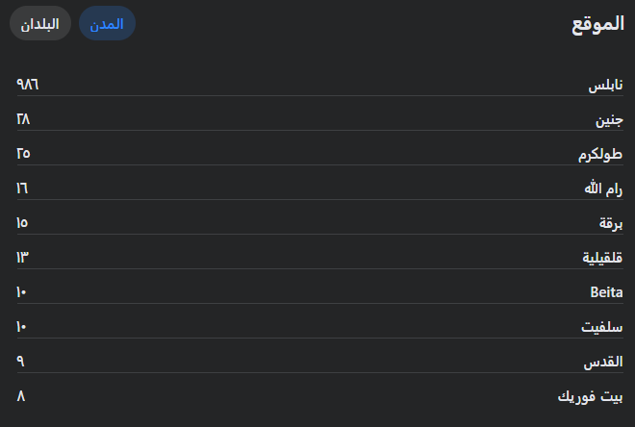

Studying the market from four aspects:
1- Geographically, we target people in Palestine, specifically we are expanding and present in the West Bank in the city of Nablus.
Tool Use
9

Slide 10
Studying the market from four aspects:
2-Type of the market: we belong to the consumer.
3-The economic condition of the population (the target audience)
is divided into three sections: A, B, and C.
our policy is designed to include all three sections, we focus specifically on the C category due to an easy-to-pay payment system, for example, our approach is in line with their preferences and needs, especially through our installment bill.
10

Slide 11
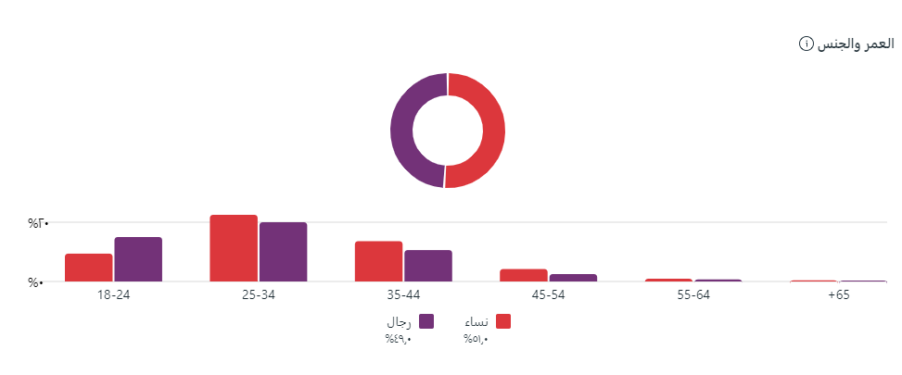


Studying the market from four aspects:
4- Target Audience: Young women and men between 25-34 years old are the groups who want to buy electrical appliances.
Tools Use
11
iconosquare

Slide 12
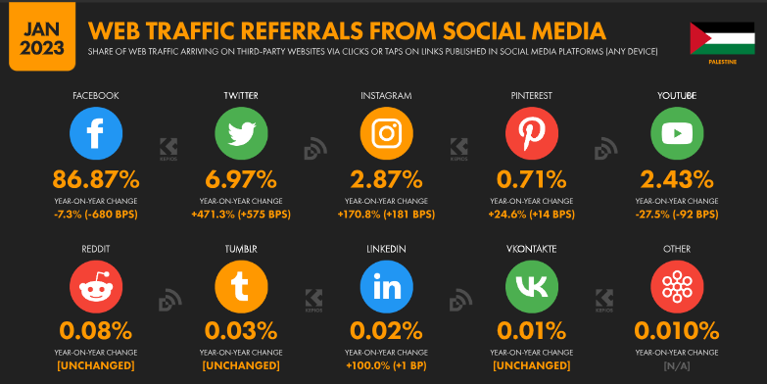




Social Media Statistics in Palestine:
Tools Use
&
&
12

Slide 13

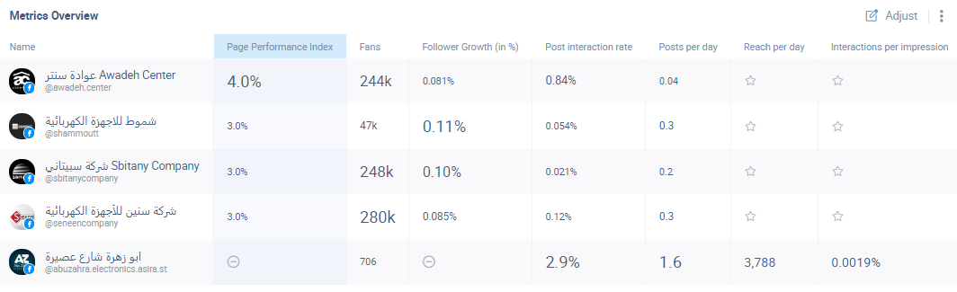

Our Competitors Analysis:
Tool Use
13

Slide 14
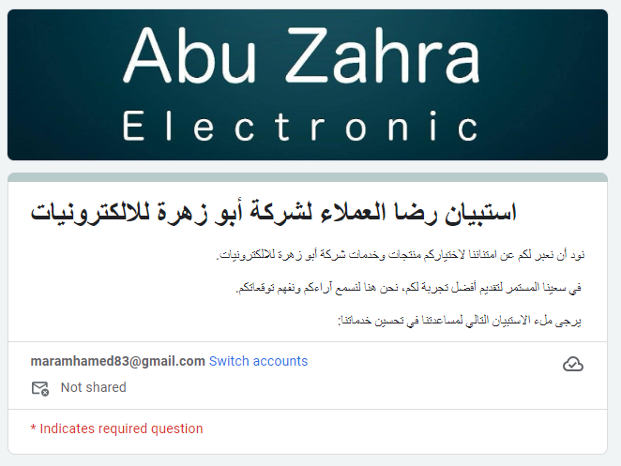
Feedback & Customer Expectation:
14

Slide 15
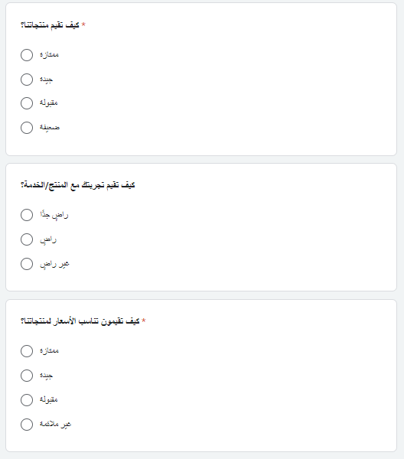
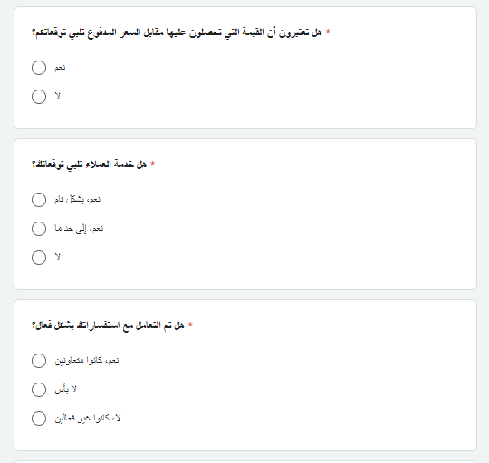
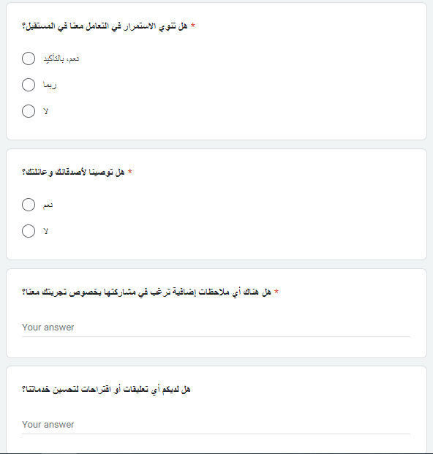

Feedback & Customer Expectation(cont'd):
15

Slide 16
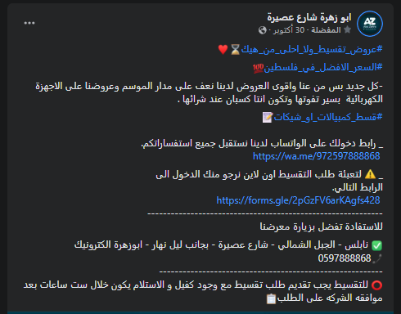

Increasing engagement through content:
Befor
16

Slide 17
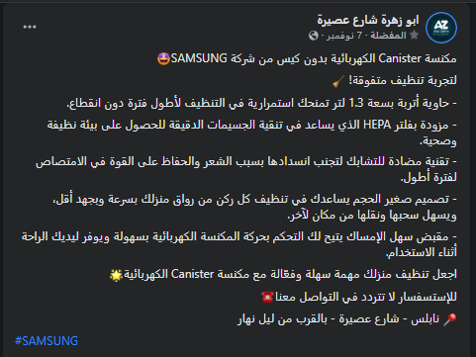


Increasing engagement through content:
After
Tools Use
17

Slide 18


Increasing engagement through content:
According to people's interests and season
18

Slide 19
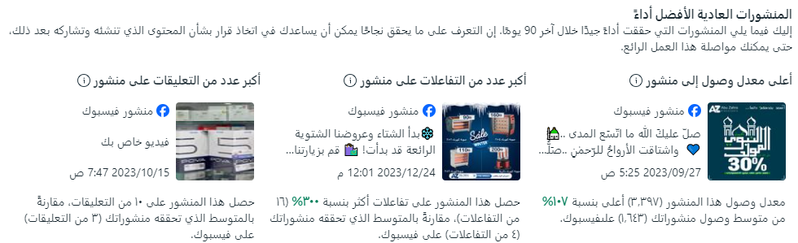
Increasing engagement through content:
According to people's interests and season
19

Slide 20

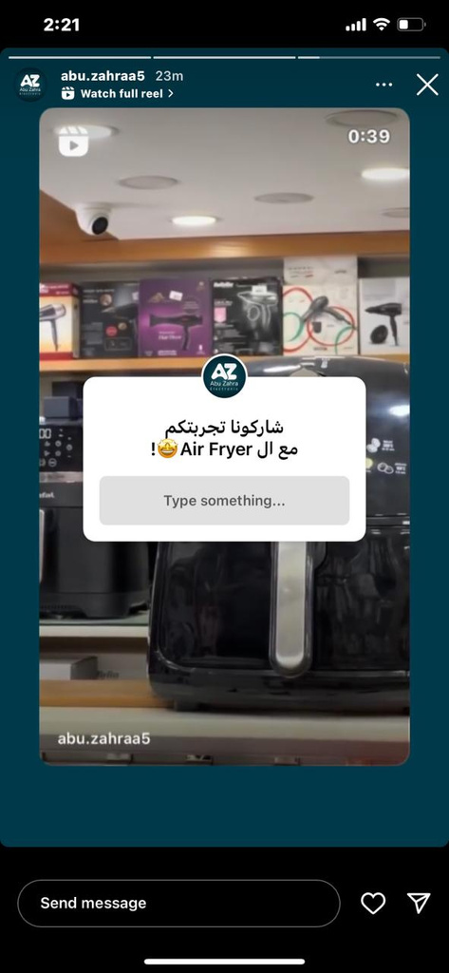
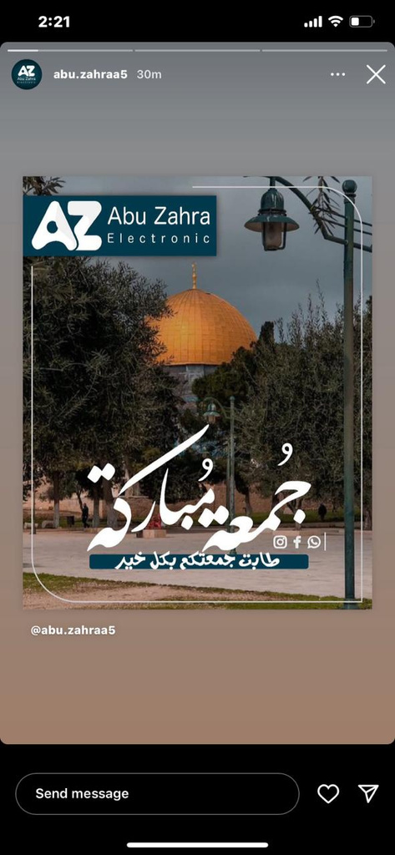
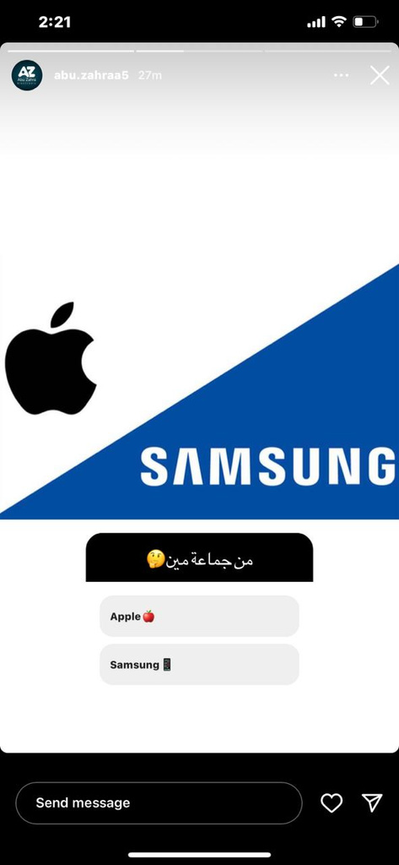
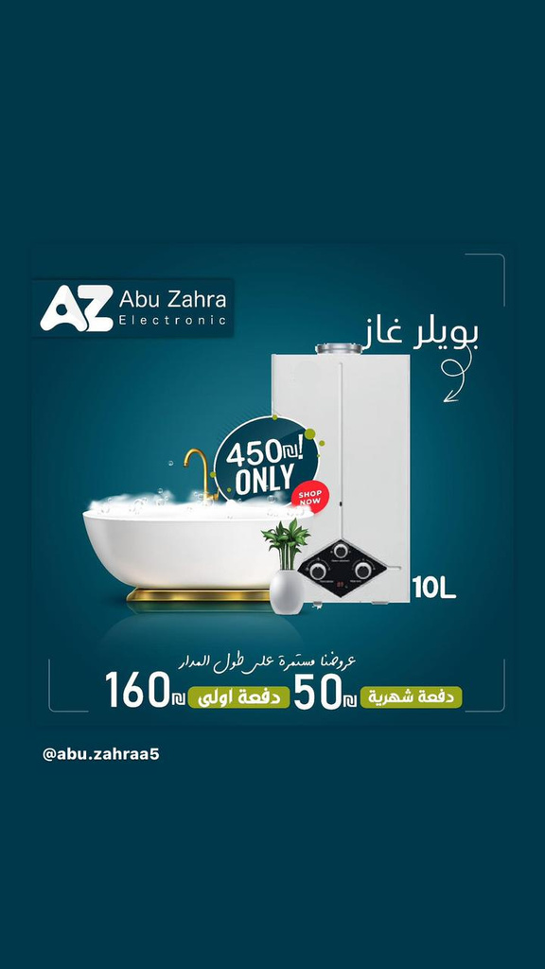
Increasing engagement through content:
20

Slide 21
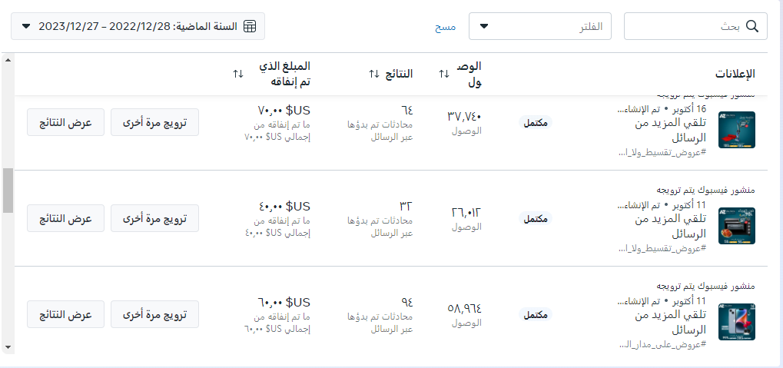
Paid Advertising:
21

Slide 22
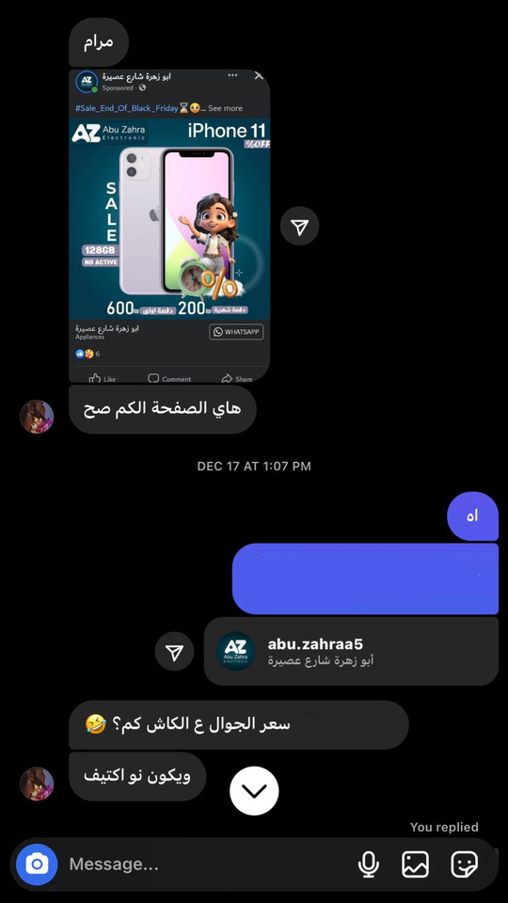
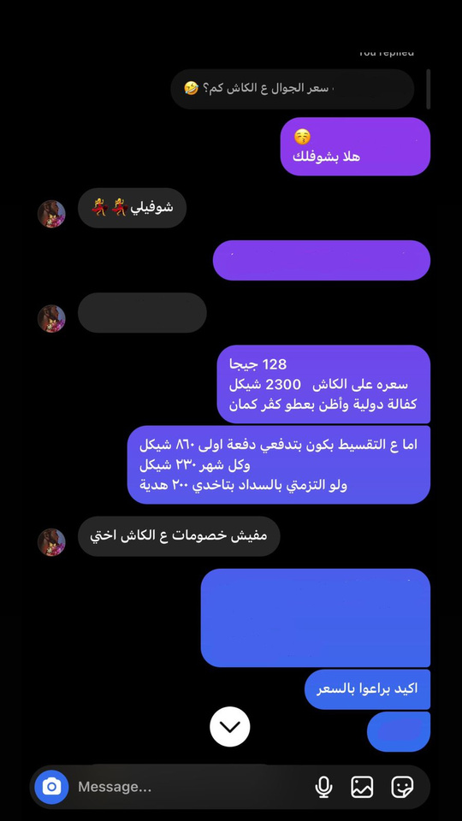
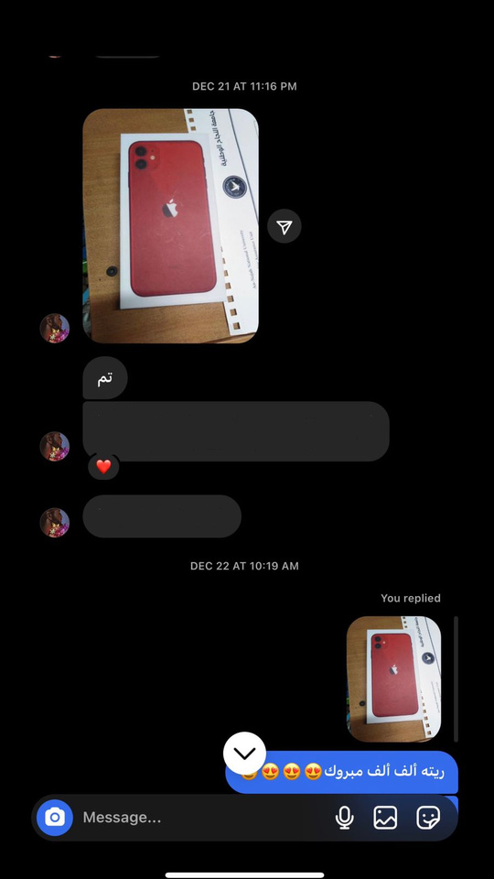
Paid Advertising (some results):
22

Slide 23
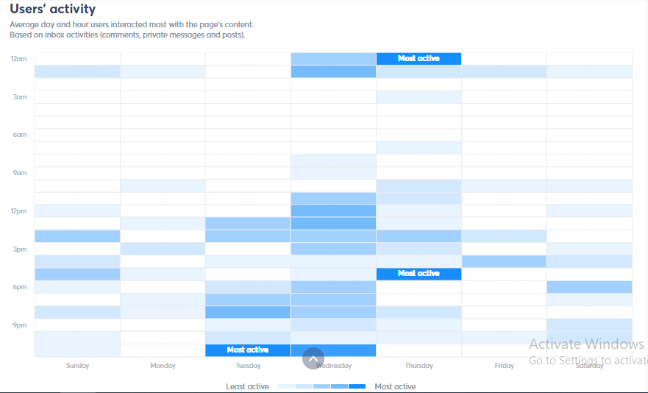

Posting On The “Golden Time”:
Tool Use
23

Slide 24
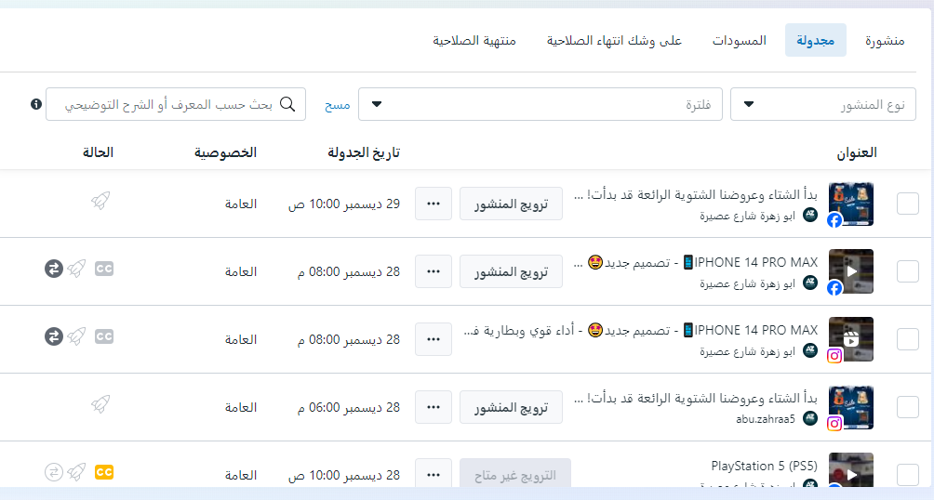
Posting scheduling:
24

Slide 25
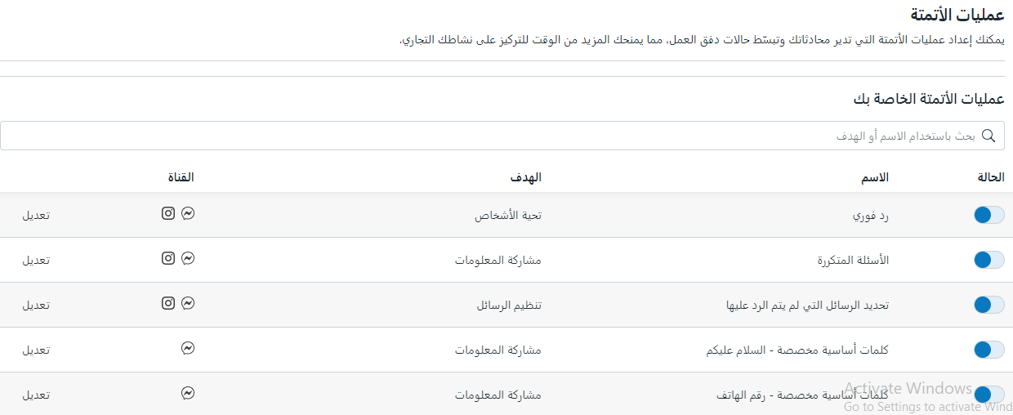

Automatic Reply:
Tools Use
25

Slide 26
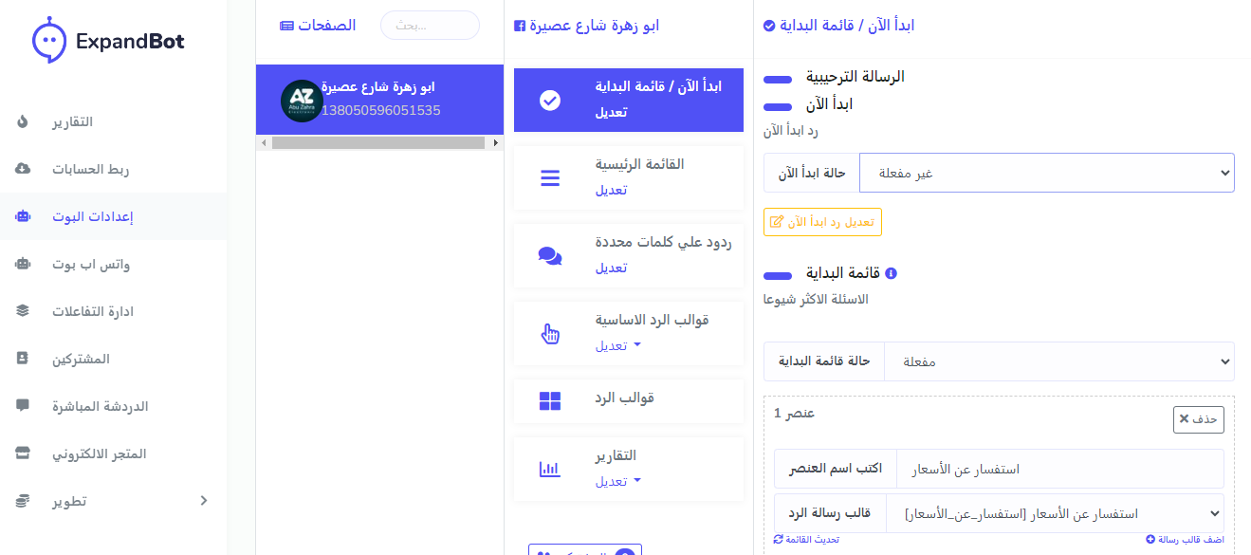
Automatic Reply:
26

Slide 27
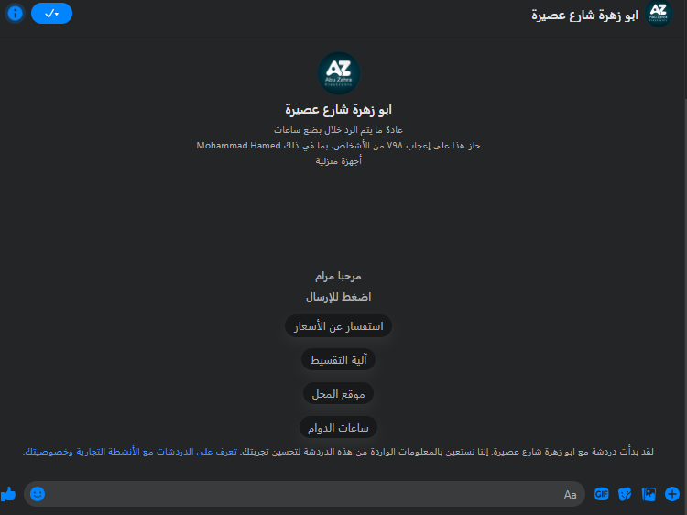
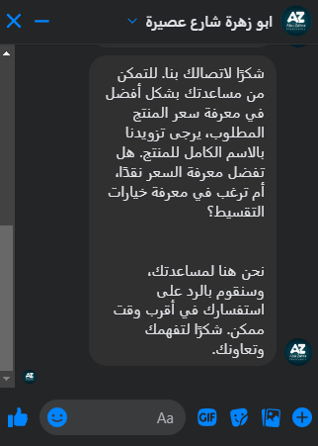
Automatic Reply:
27

Slide 28

Price Transparency:
28

Slide 29
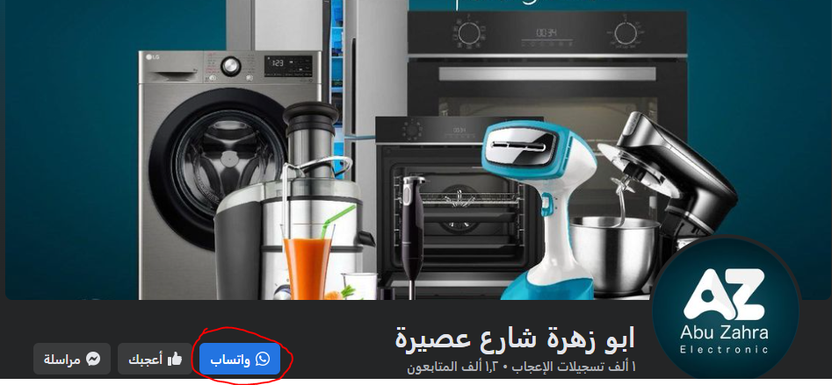
WhatsApp Button For Contact:
29

Slide 30
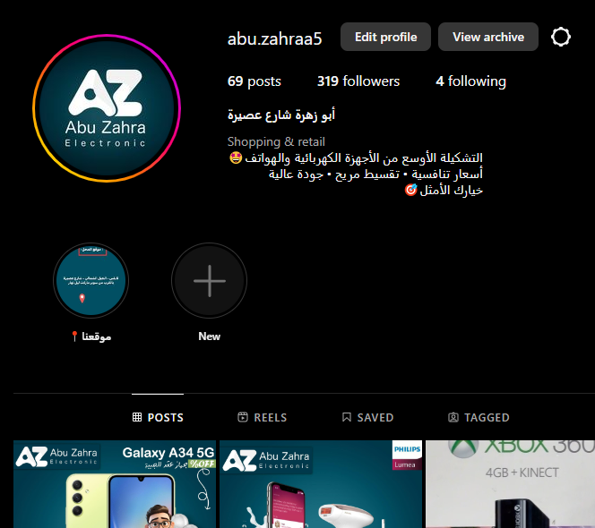
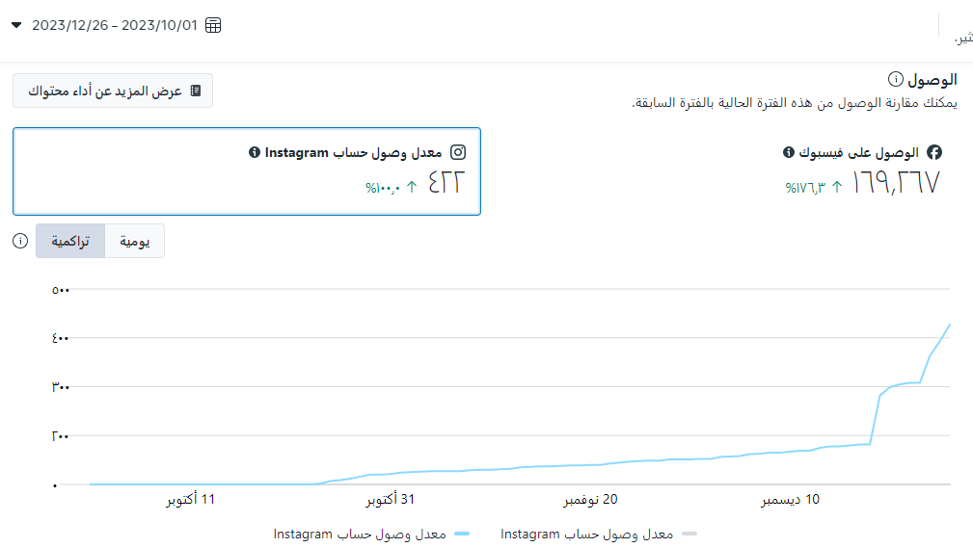
Results of marketing stratigy:
30

Slide 31

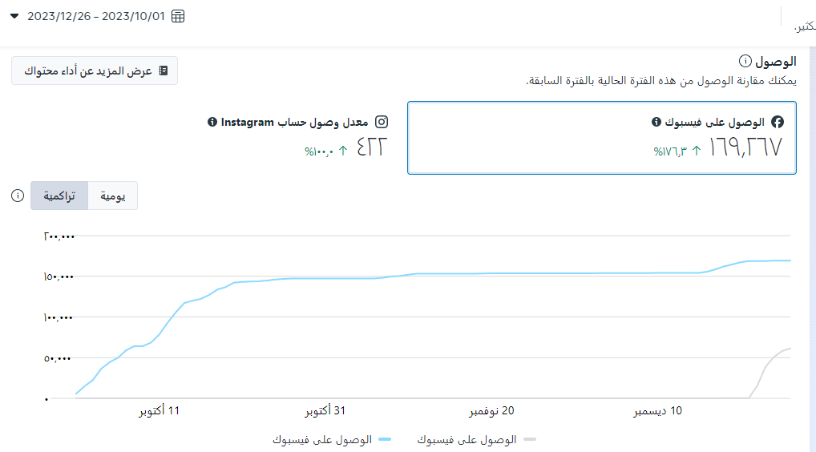
Results of marketing stratigy:
31

Slide 32
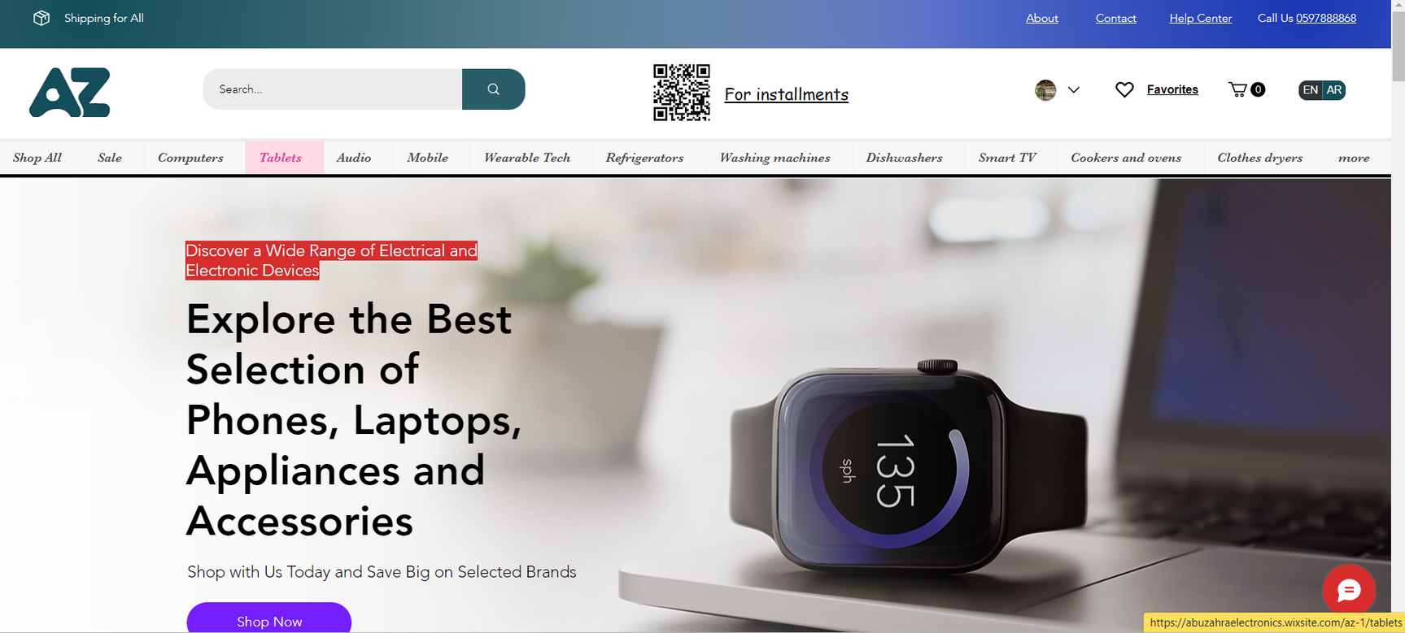
E-commerce website for AbuZahra Electronics :
32

Slide 33
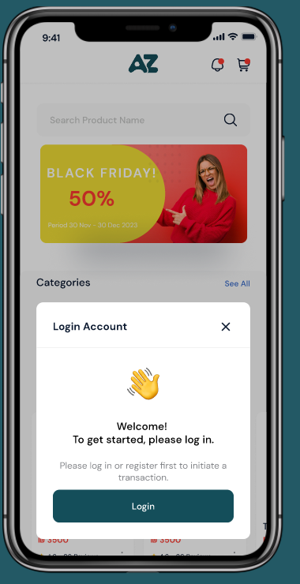
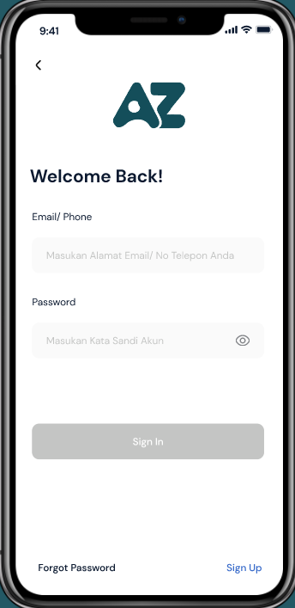
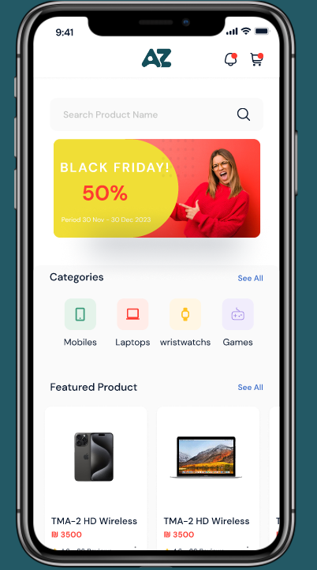
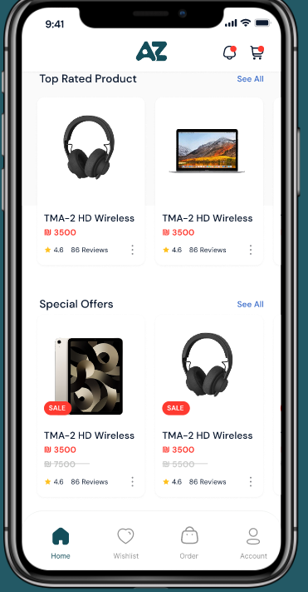
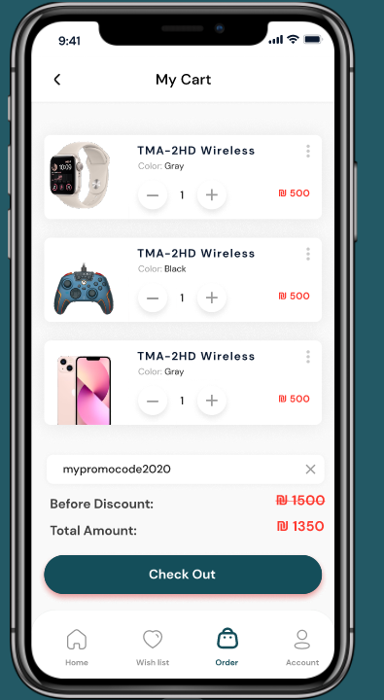
UI desgin for mobile app:
33

Slide 34

Thank you!
Any Question?
34

