Slide 1

Software Graduation Project
(Computer Engineering )
Ala’a Abu Ghdaib
Eyad Al Hasan

Slide 2
Table of contents
1
Introduction
2
Types of users
3
Technologies
4
Features
5
Constraints
6
6
Future work

Slide 3

1
Introduction

Slide 4
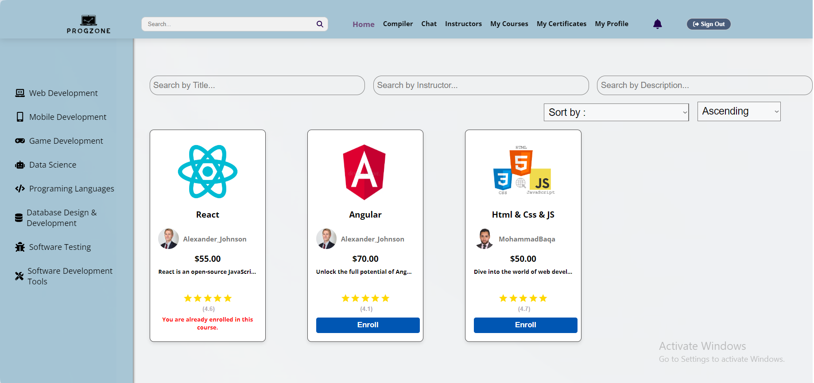
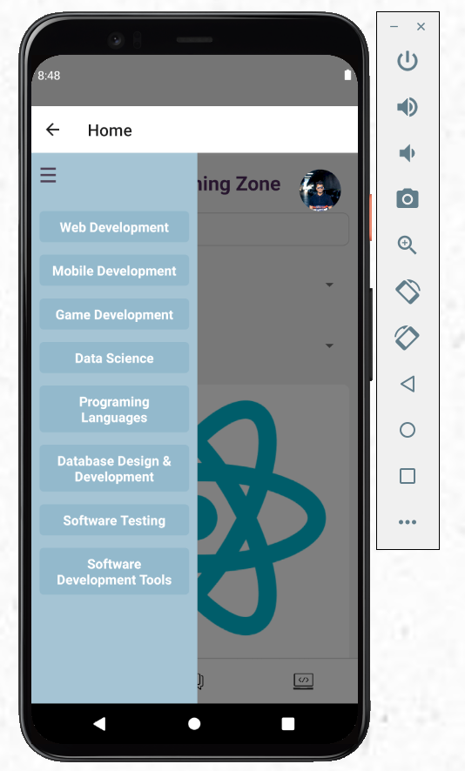
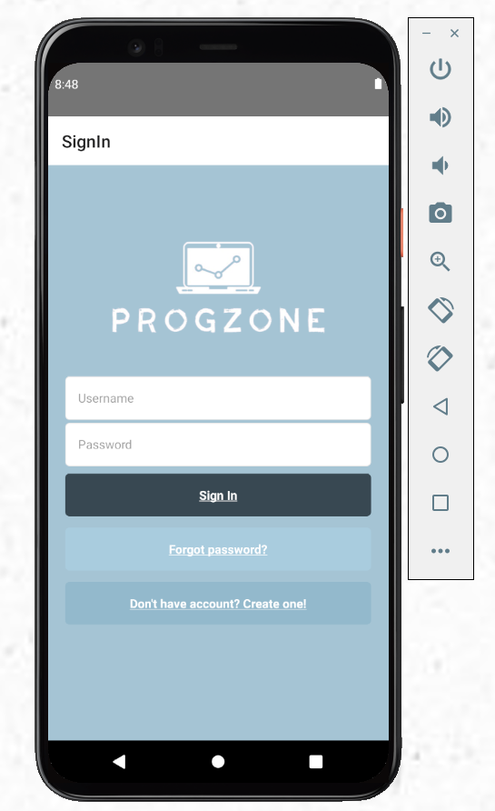
About Our Project
ProgZone is an innovative online platform designed to provide a comprehensive programming education through a seamless web and mobile interface. It offers a variety of programming courses tailored to different proficiency levels, along with features like private tutoring, a built-in compiler, and an interactive chat. ProgZone aims to enhance accessibility and engagement in learning, making high-quality programming education available to everyone.

Slide 5
2
Types of users

Slide 6
Constraints :
    Libraries versions conflict
      We encountered challenges in linking the website and the mobile application with the same database , we stocked there for a while .
    learning react.js and react native.

Slide 7



Type of Users
Students
Instructors
Admin

Slide 8
3
Technologies

Slide 9






What did we use?
React Js
Dijango
SQlite
GitHub
firebase
React Native

Slide 10
4
Features
Now we will show you the Features we worked on.

Slide 11
Authentication
Profile
Home Page
Rating & Comments
Quizzes & Assignments
1
2
Students profile, Instructors profile, Admin profile
Login, Logout, Sign up , Reset password
Payment
3
4
The student can pay a course with paypal payment
courses , admin dashborad , instructor’s home
5
6
Students can rate courses and add comments after purchasing them
The student takes exam & ِassignments after finishing watching the course videos

Slide 12
Certificaties
Contact Us
Compiler
Appointment Booking ( Private Meeting )
Notifications
Edit & Add & Delete Courses
7
8
Users can communicate with the admin for any suggestions or problems, through the Contact S button via email
Each student receives a certificate for the course he completed, which he can download in PDF format
10
9
There is a compiler for testing codes in different programming languages
student can book time for a private meeting with the instructors the
12
Students
Instructors
Admin
11

Slide 13
Manage Compiler
Manage Users
12
13
admin can add and delete users
Admin Can add a new language & delete language
15
14
Manage Courses
Recommendation System
16
Chatbot

Slide 14
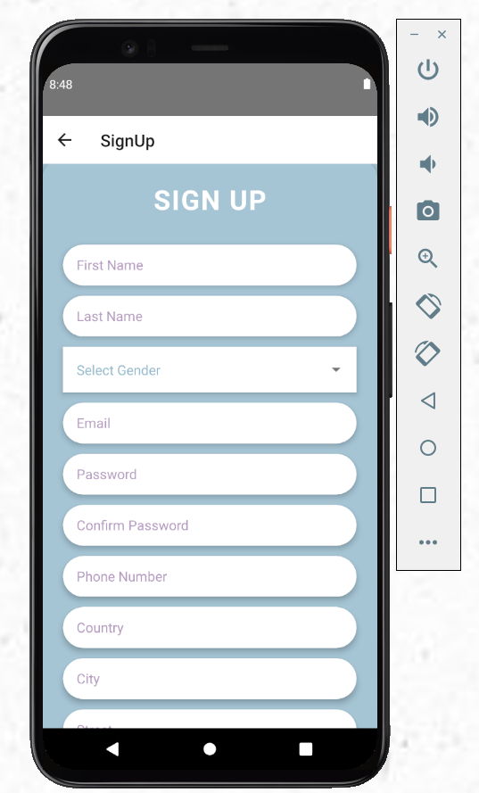
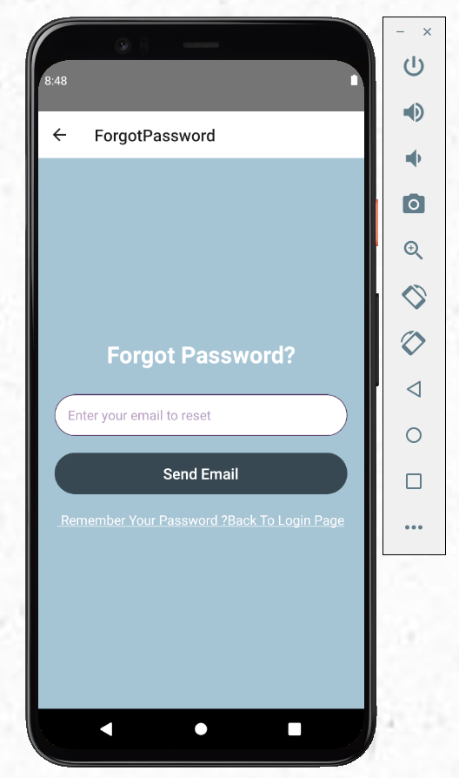
Authentication
Sign Up
Sign In
Forgot password

Slide 15
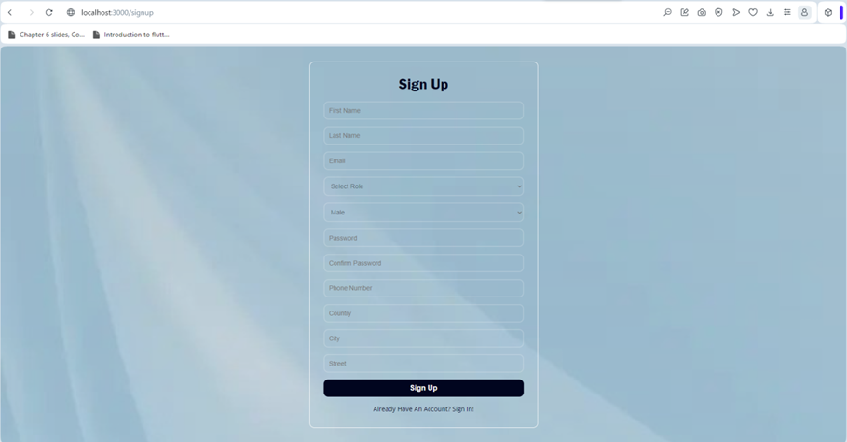
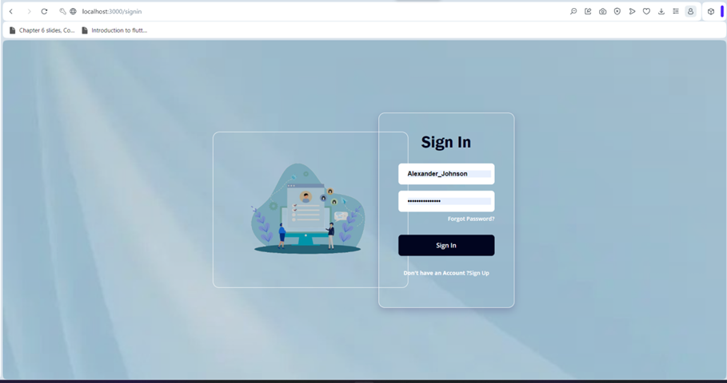
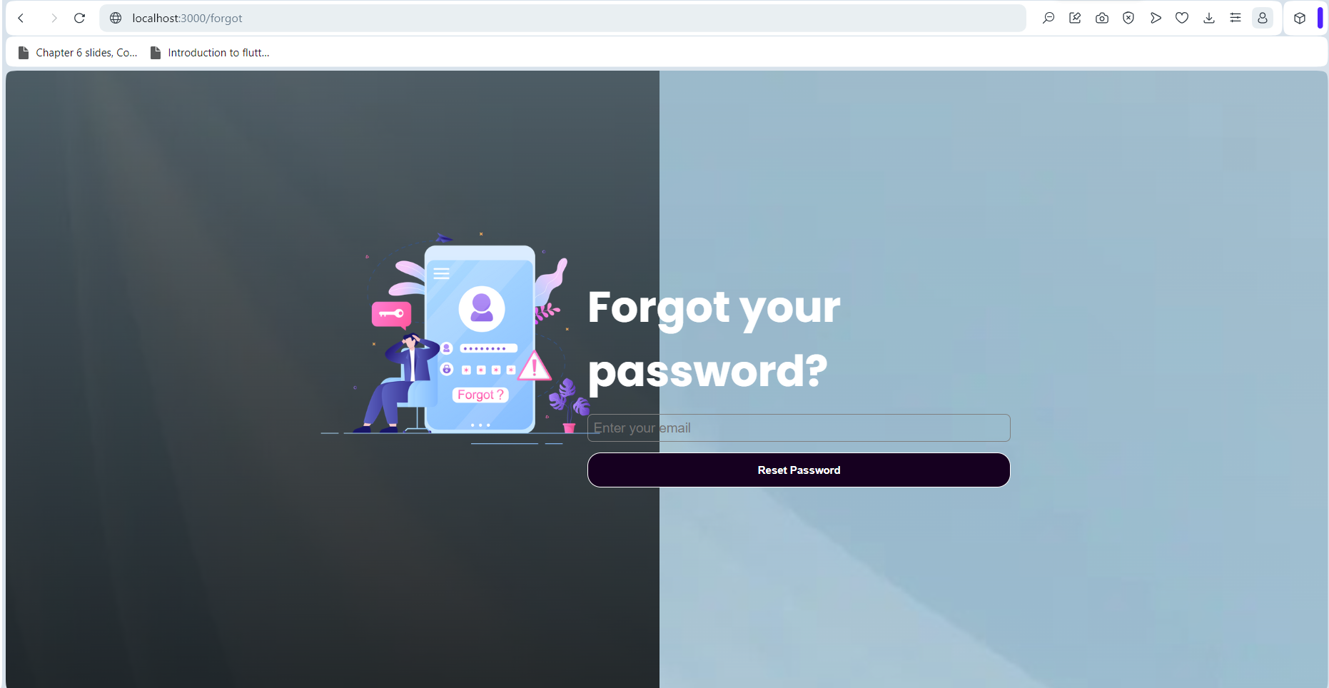
Authentication
Sign Up
Sign In
Fotgot password

Slide 16
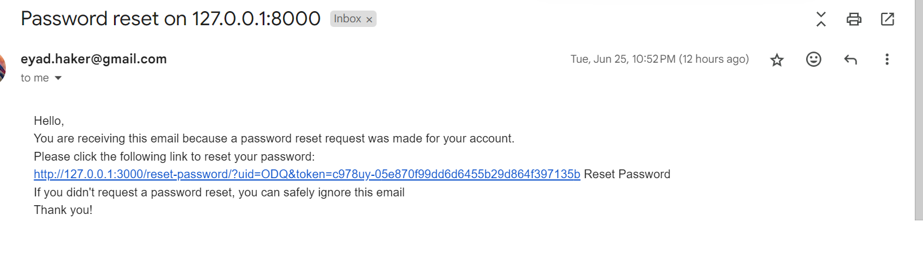
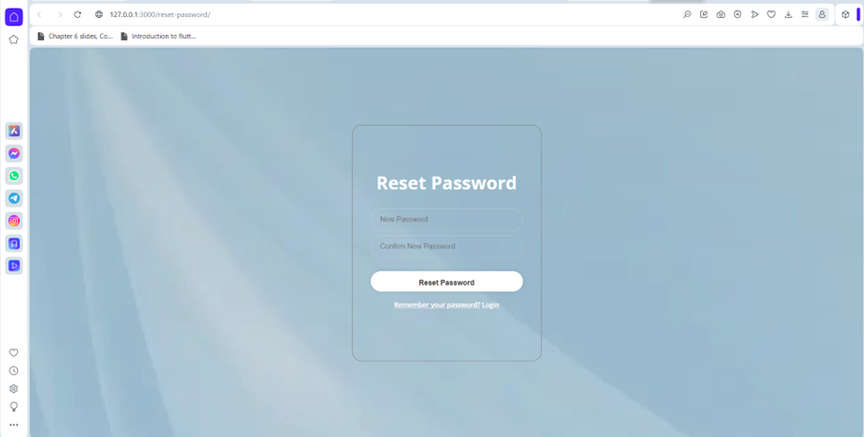
Email
Notifications

Slide 17
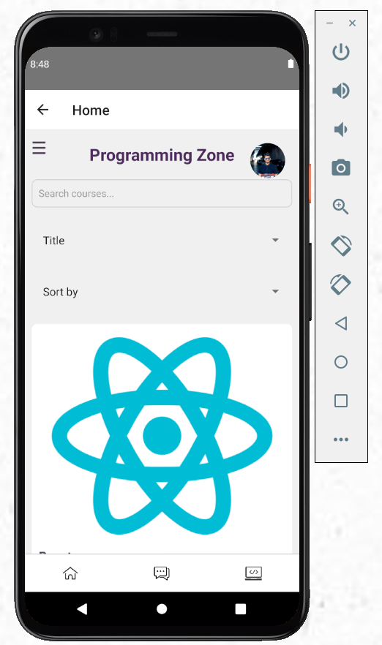
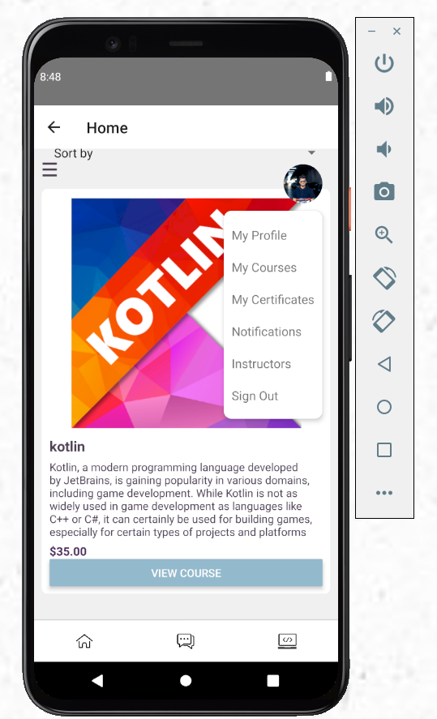
Home Page ( Students )

Slide 18
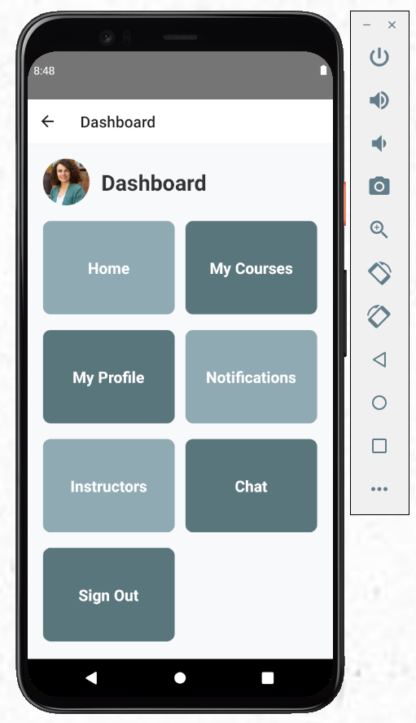
Dashboard (Instructors )

Slide 19
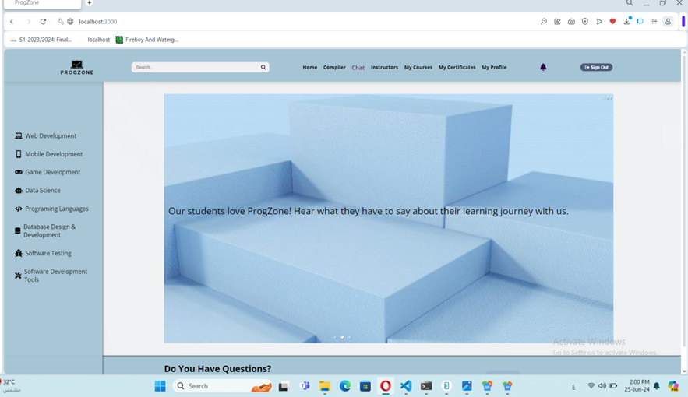
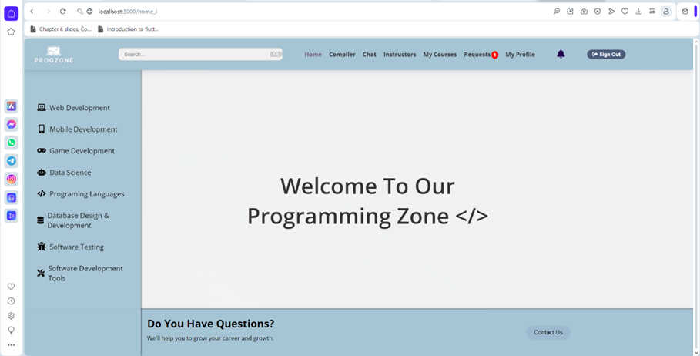
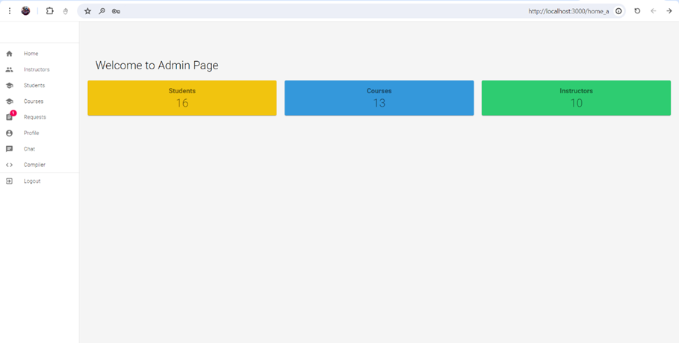
Home
Students
Instructors
Admin

Slide 20
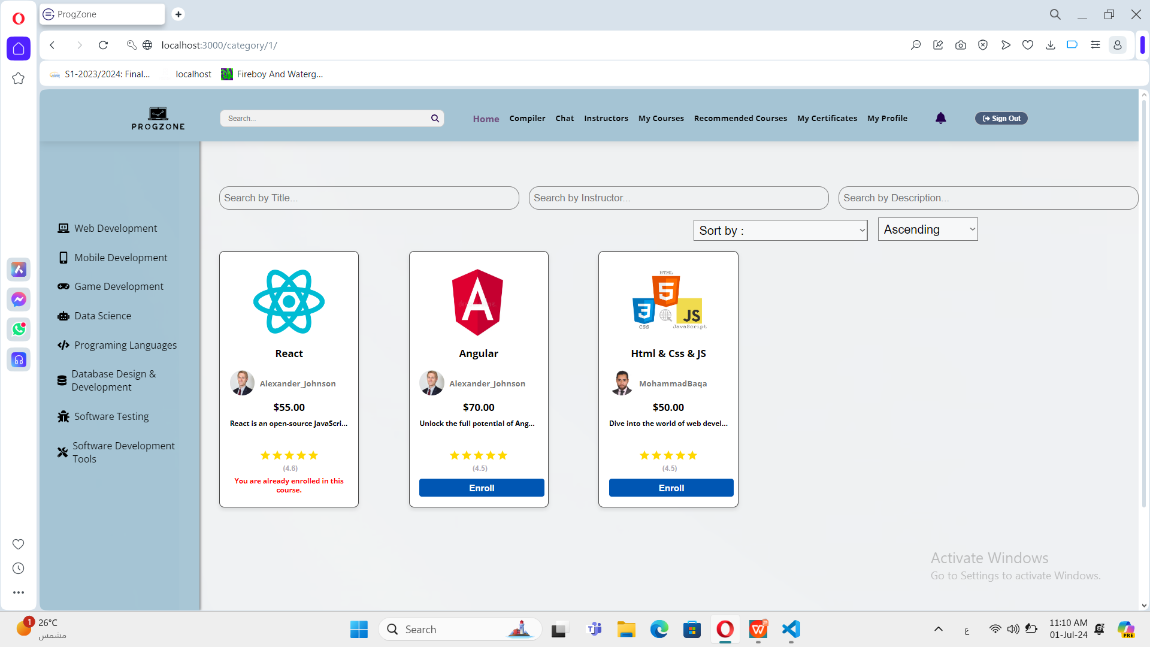

Slide 21
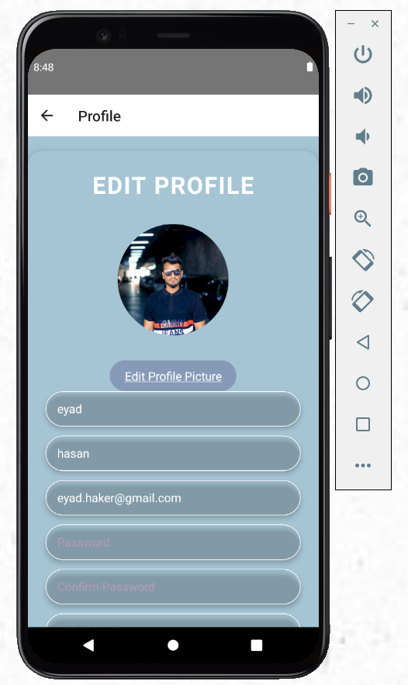
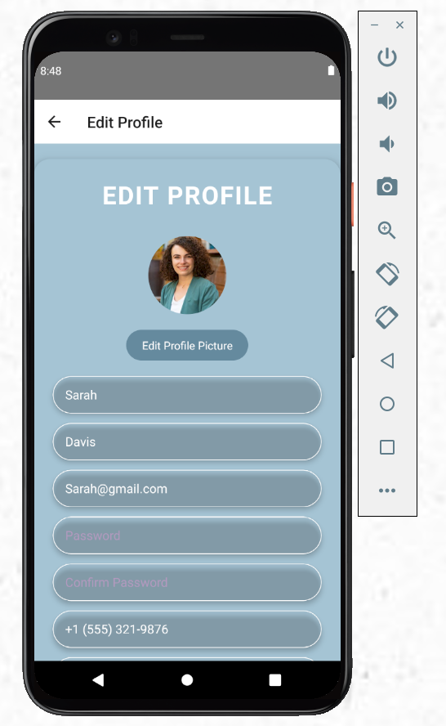
Edit Profile

Slide 22
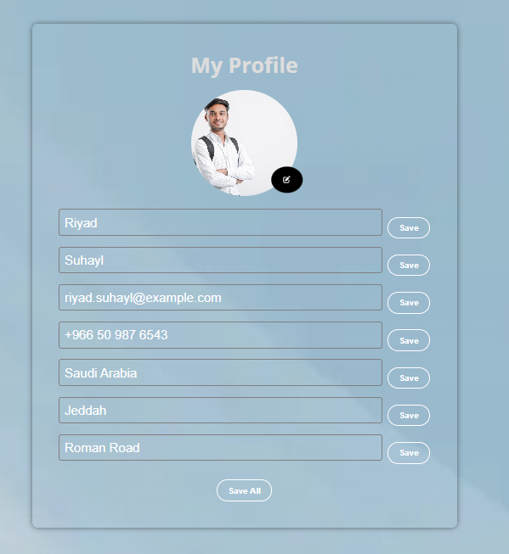
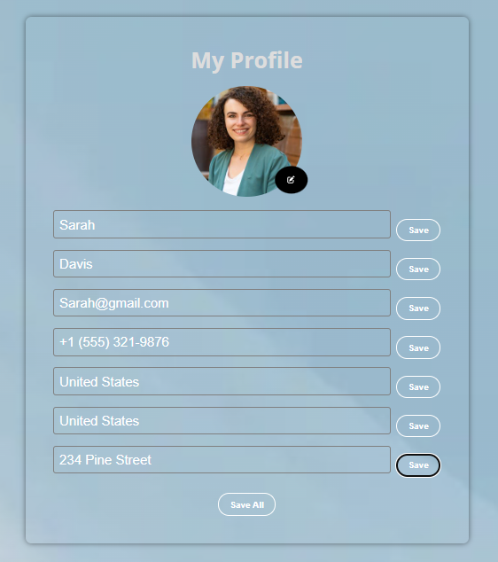
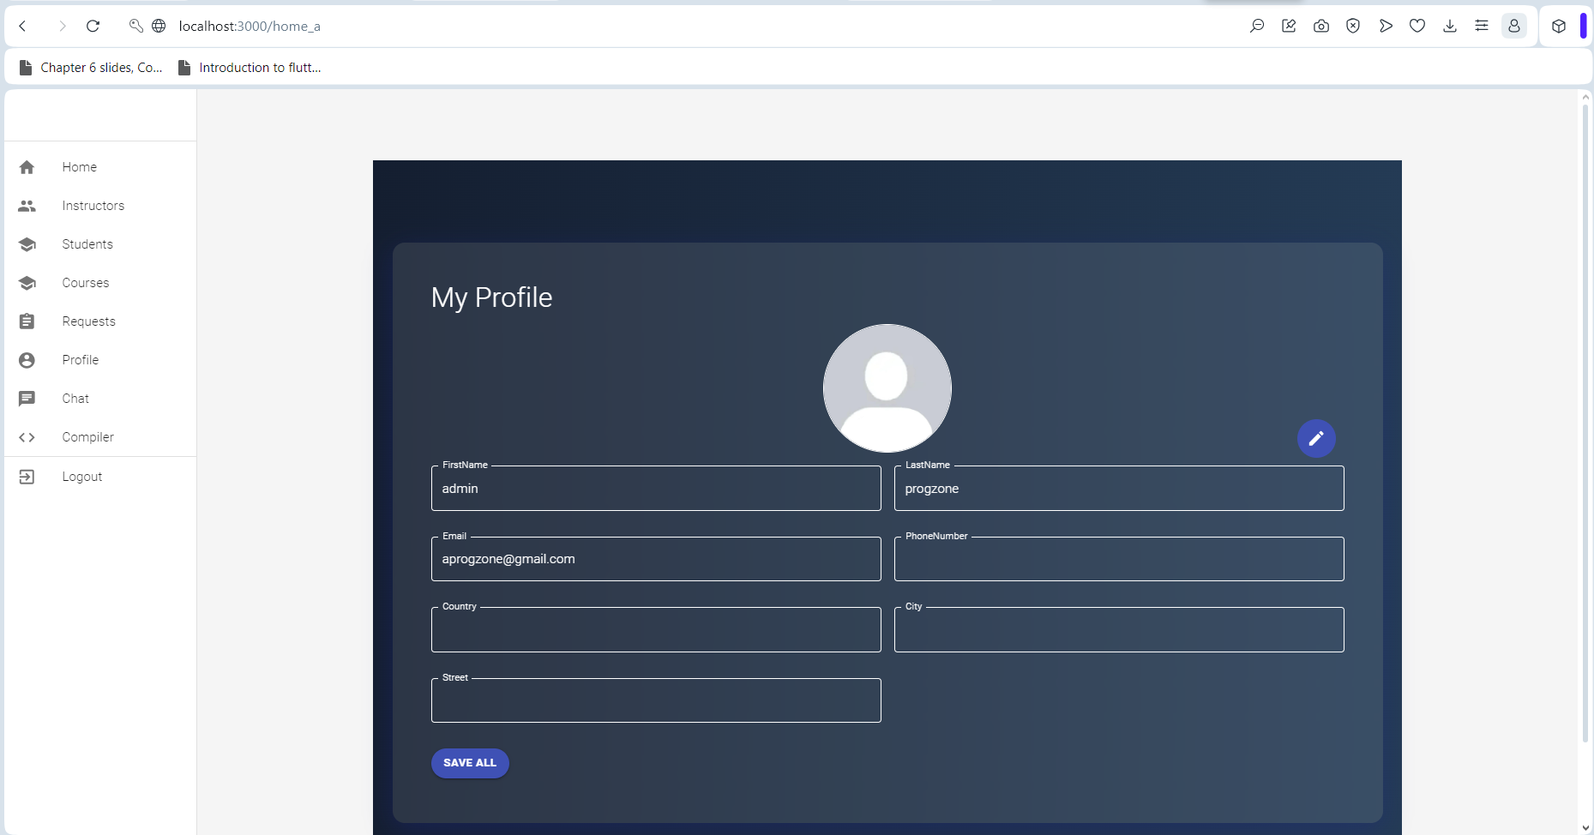
Edit Profile
Students
Instructors Admin

Slide 23
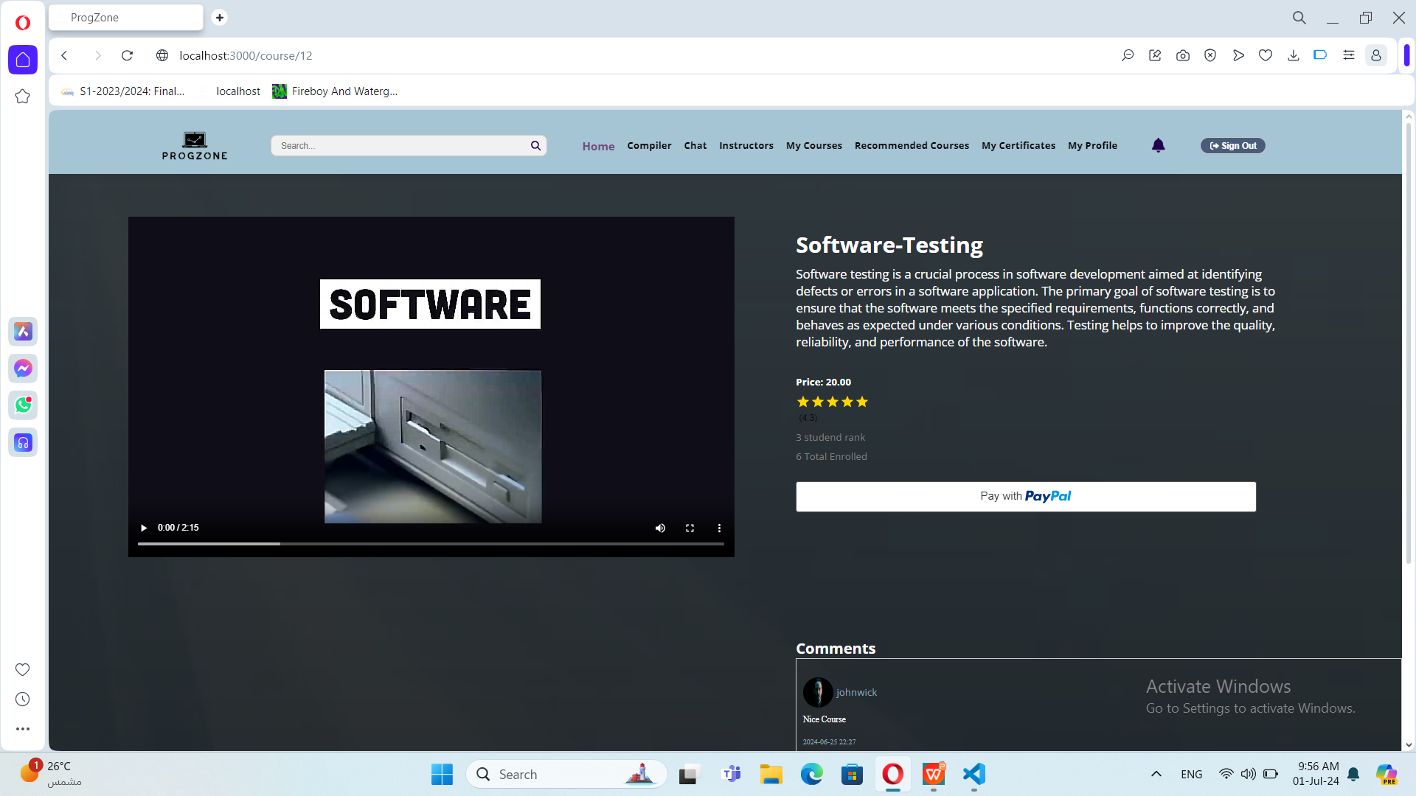
Course Page

Slide 24
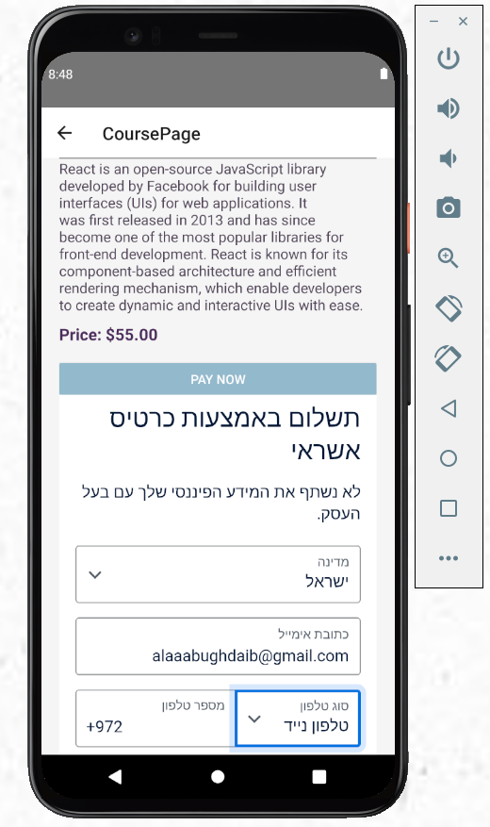
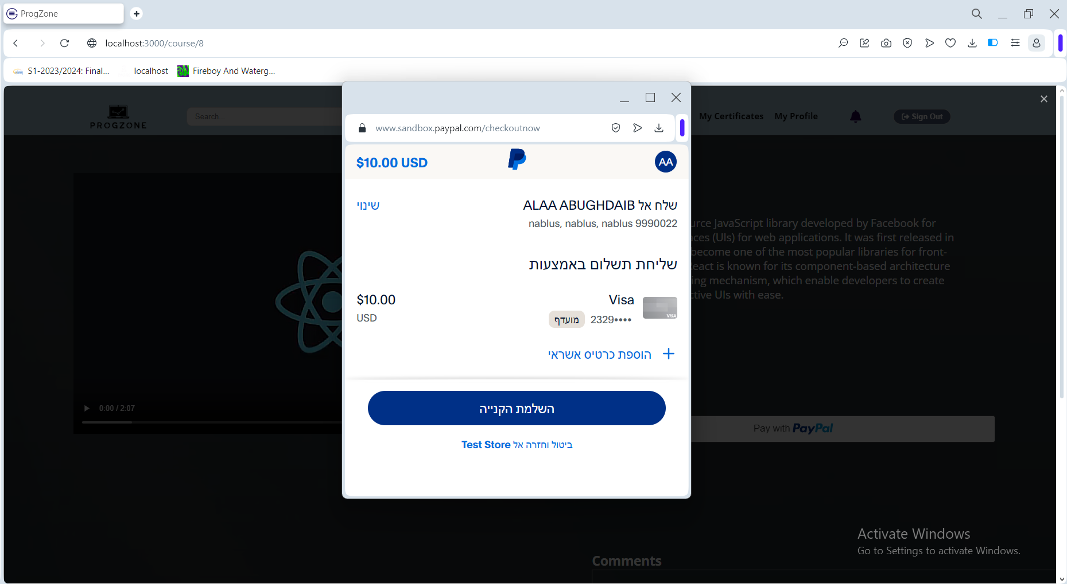
Payment

Slide 25
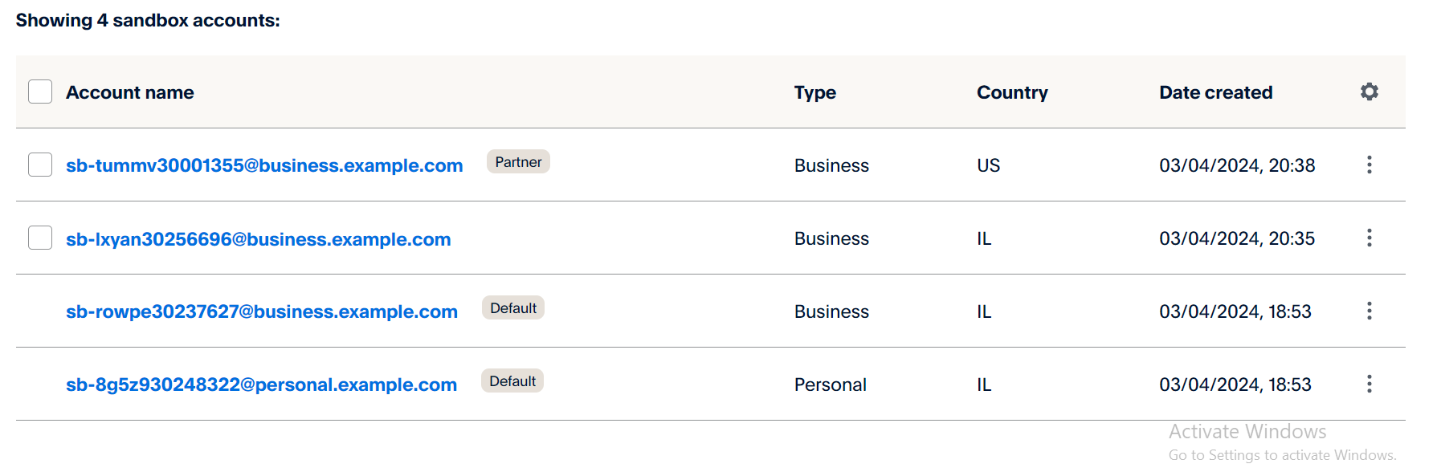
Divide profits

Slide 26
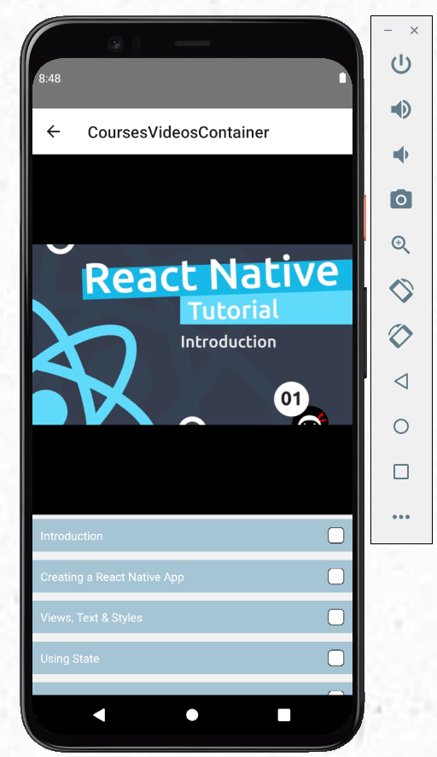
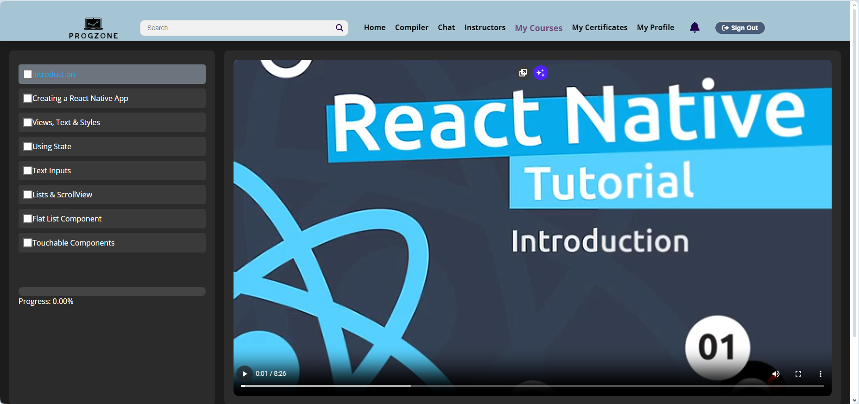
Course Videos

Slide 27
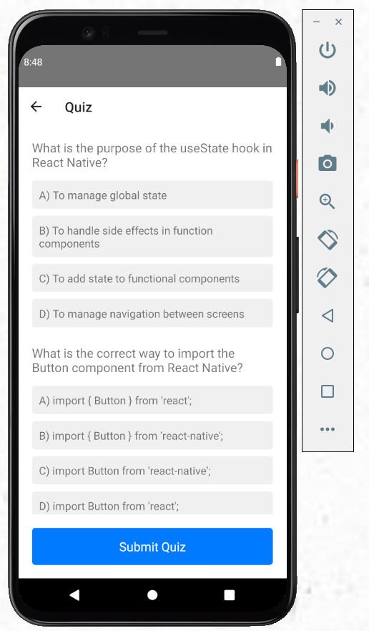
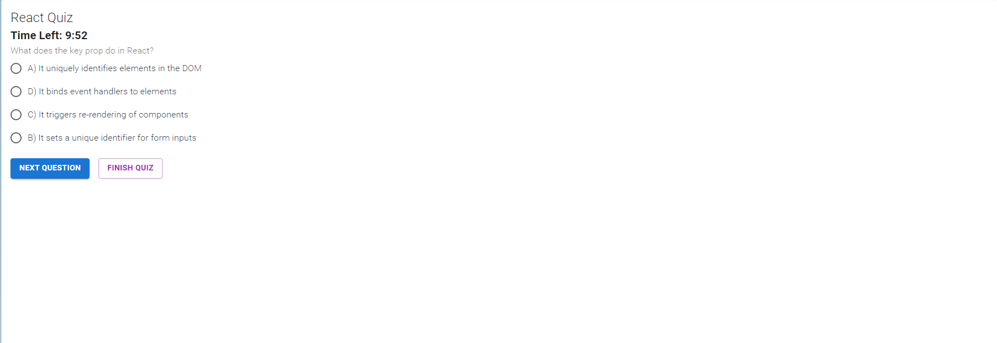
Quizzes

Slide 28
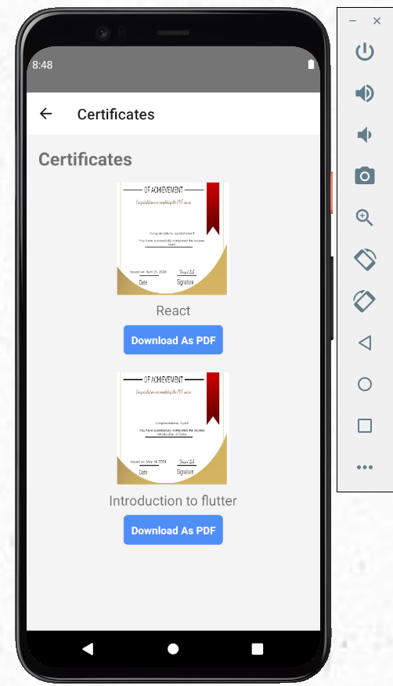
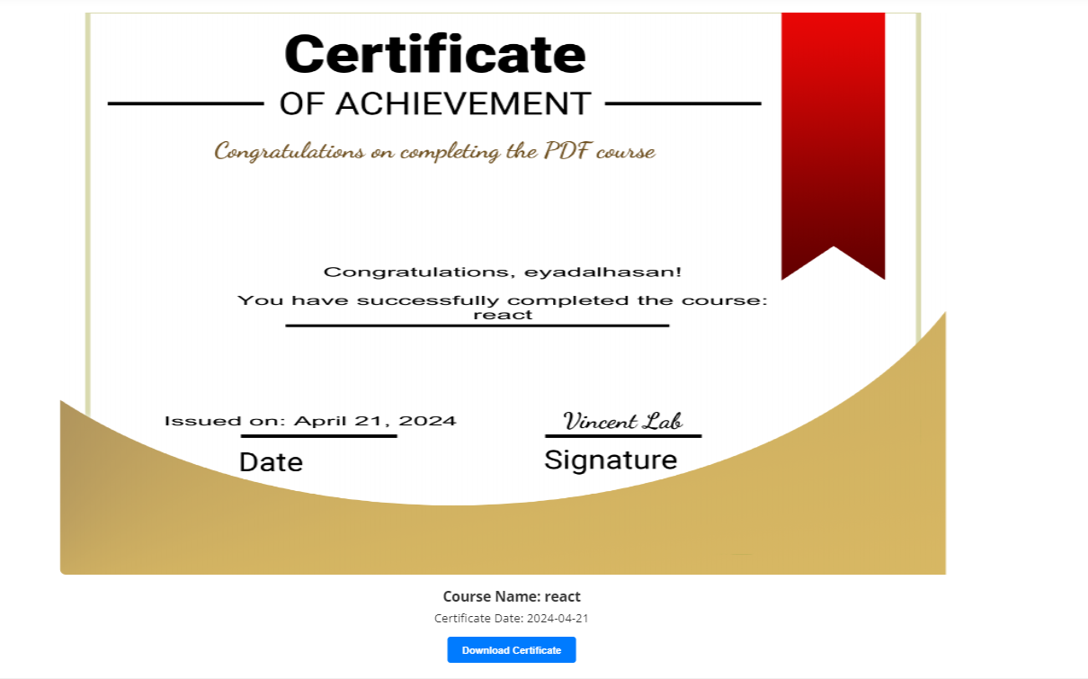
Certificaties

Slide 29
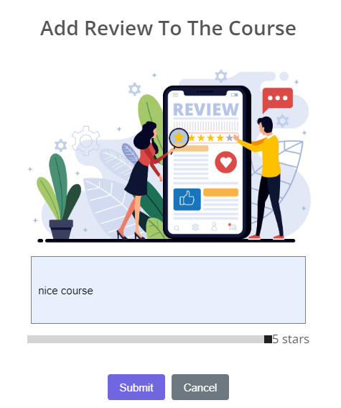
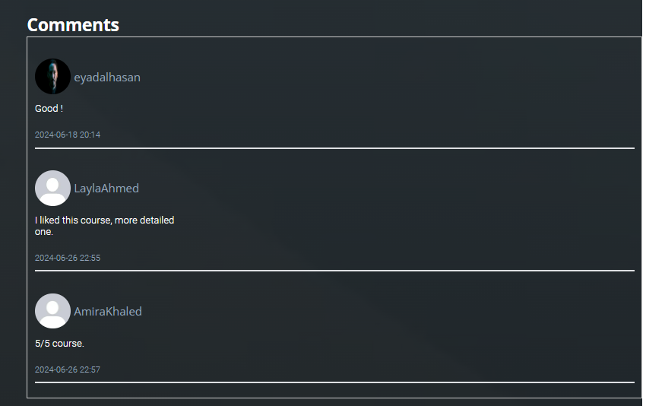
Review & Comments

Slide 30
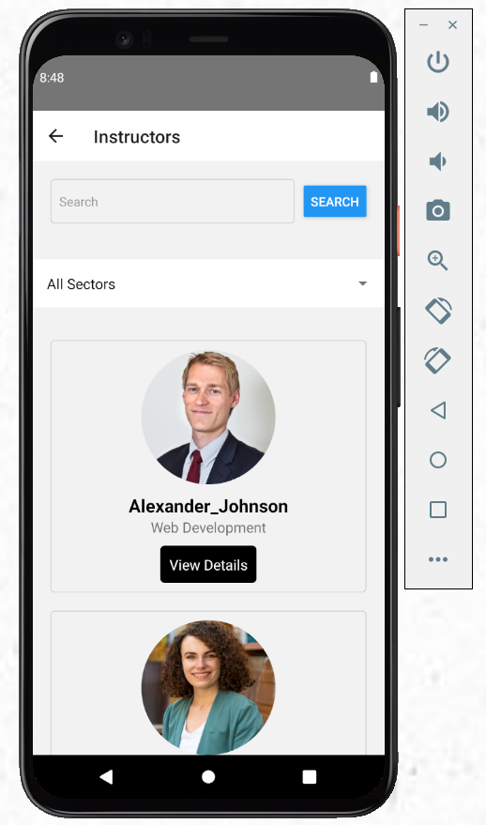
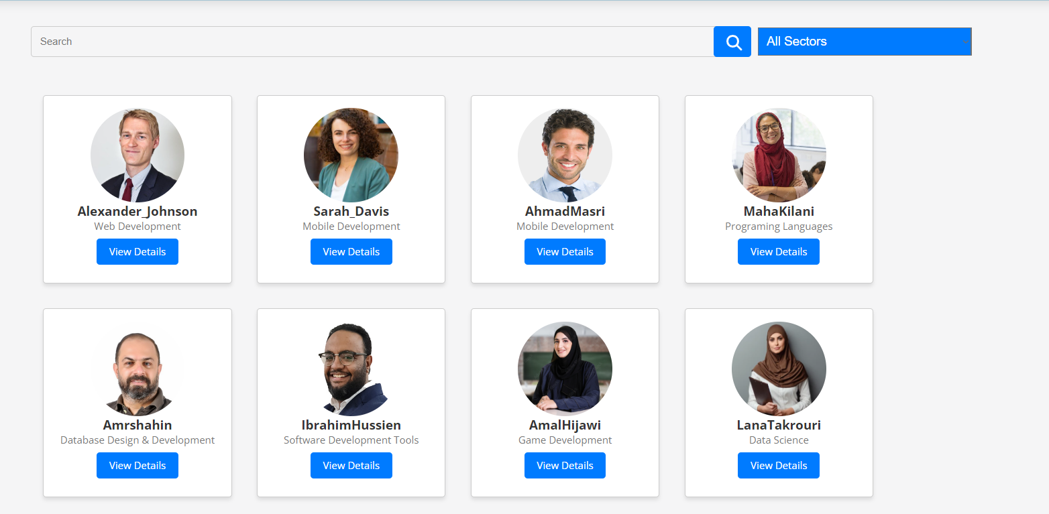
Instructors

Slide 31
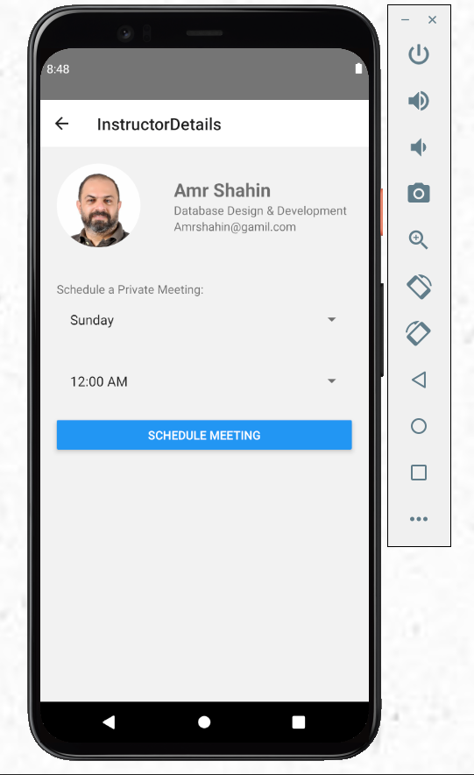
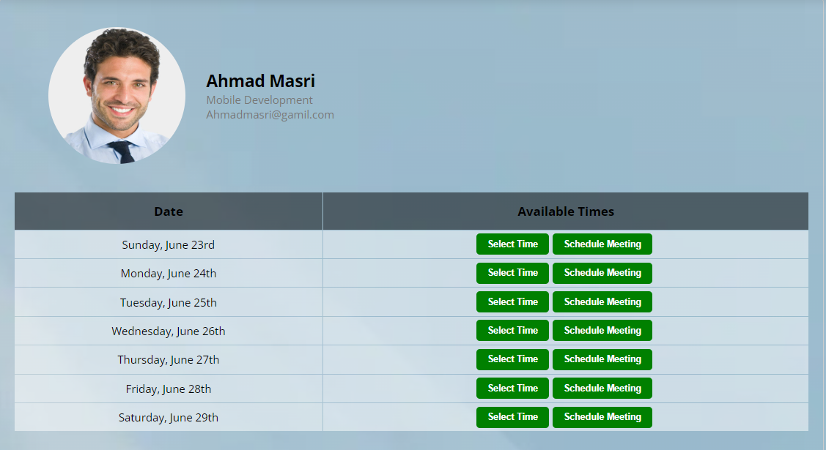
Instructors Details

Slide 32
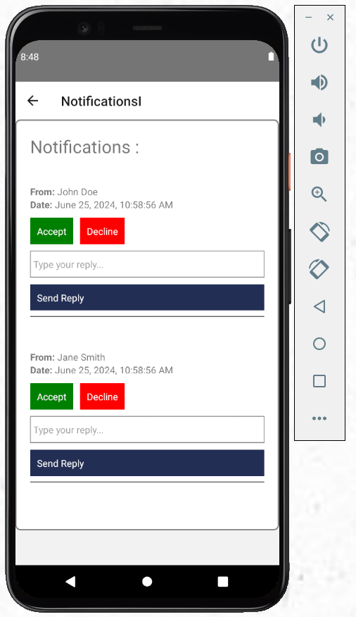
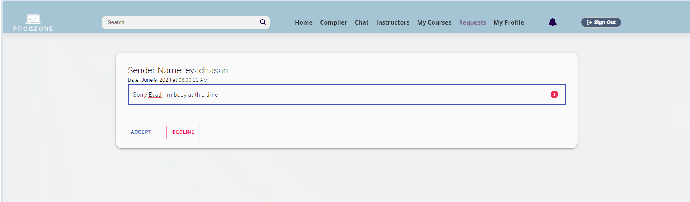
Notifications (Instructors)

Slide 33
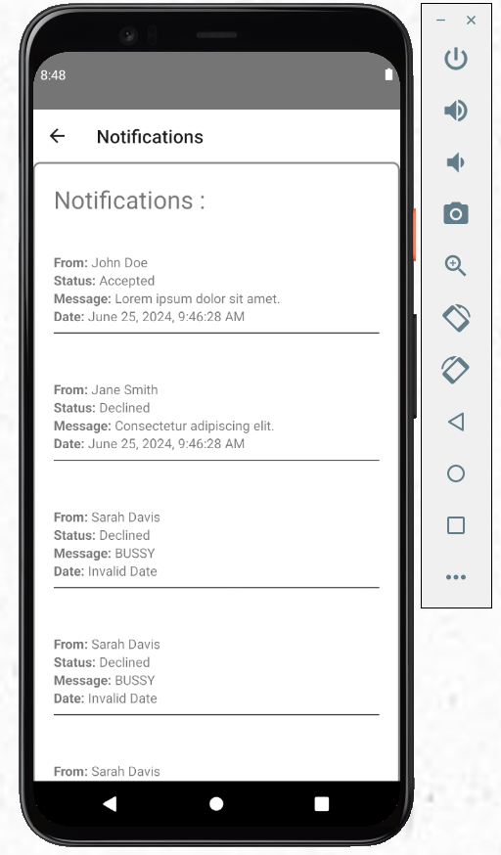
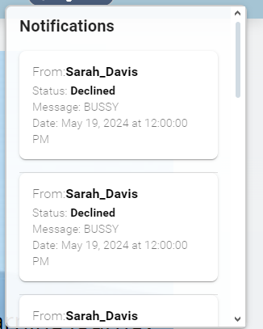
Notifications (Students)

Slide 34
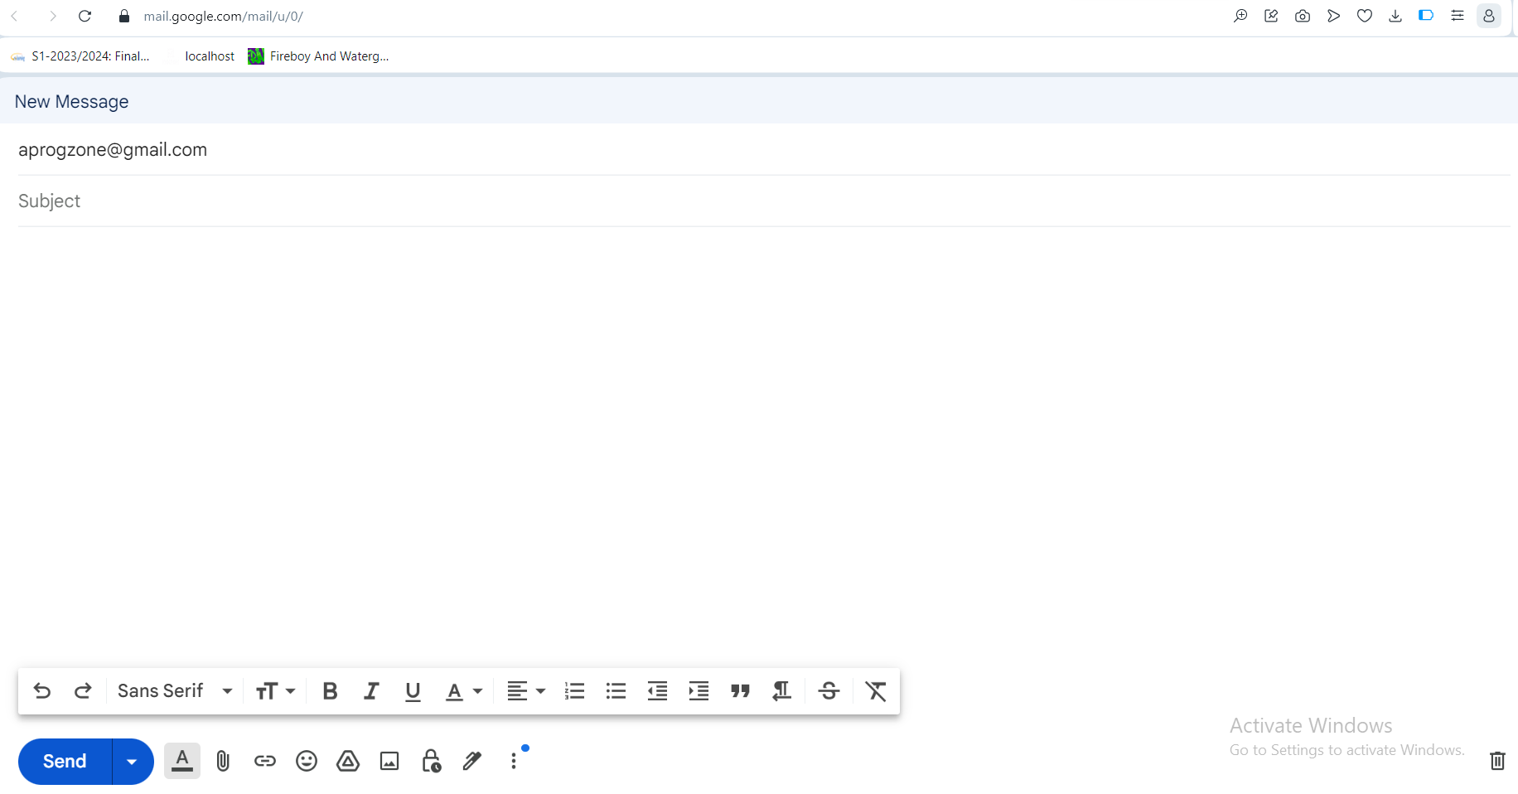
Contact Us

Slide 35
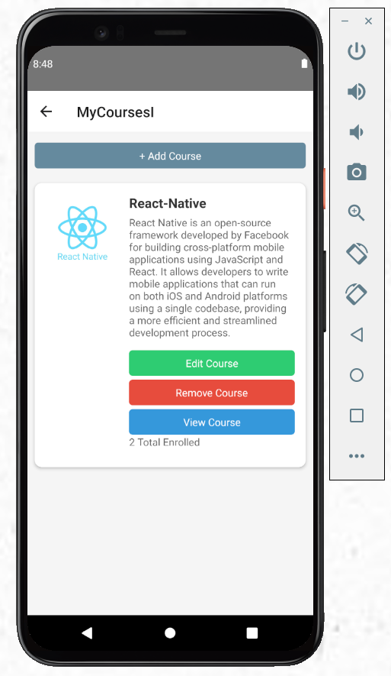
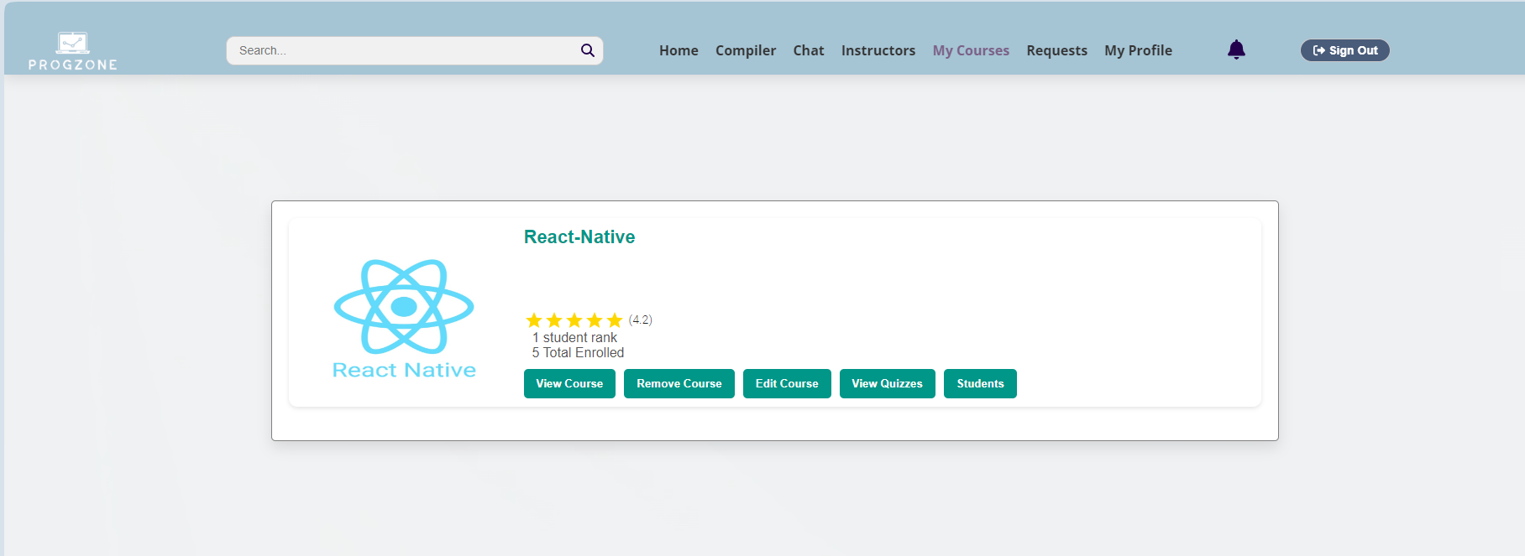
My Courses ( Instructor )

Slide 36
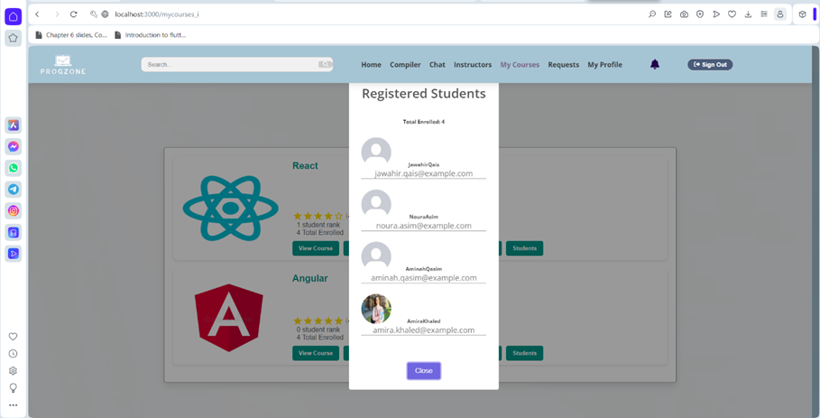
Students in the instructor courses

Slide 37
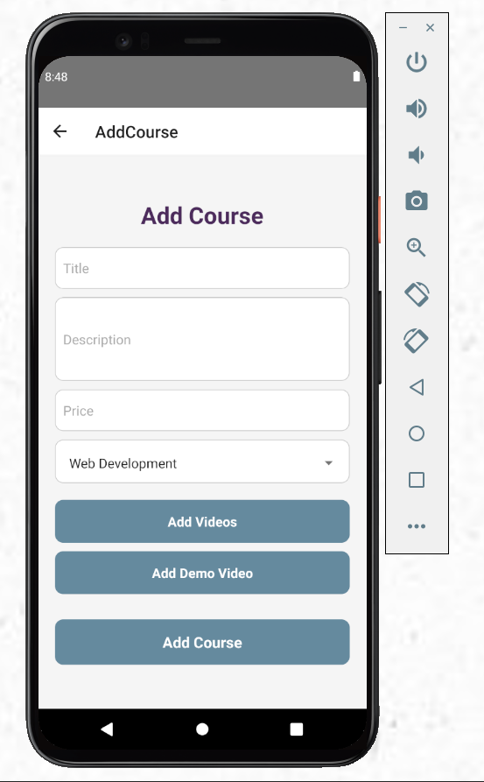
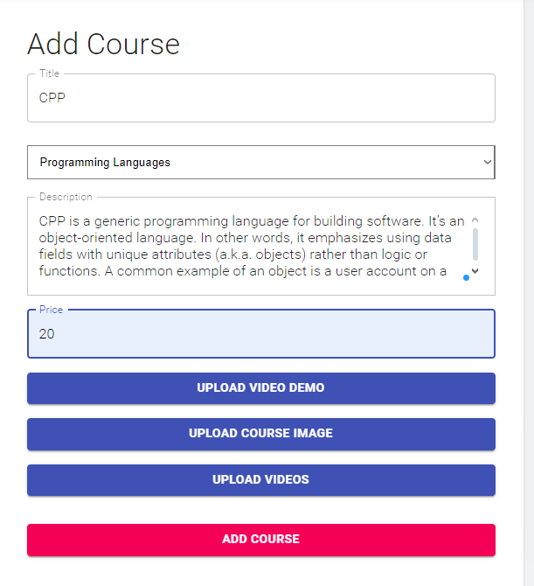
Add Course

Slide 38
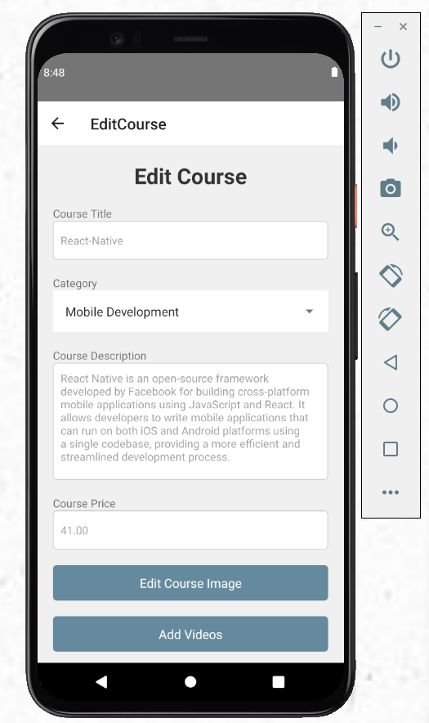
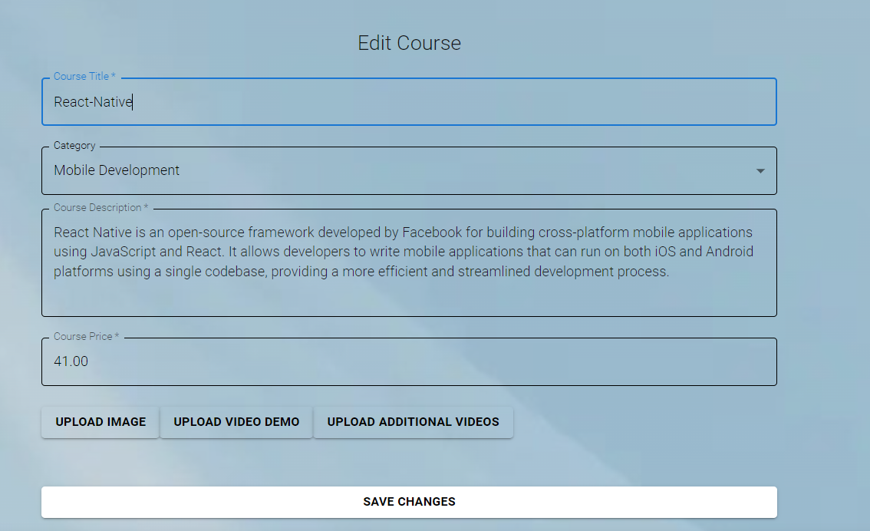
Edit course ( Instructor )

Slide 39

Delete Courses ( Instructor )

Slide 40


Add Quiz

Slide 41



Chat

Slide 42



Compiler

Slide 43



Compiler

Slide 44

Compiler Demo

Slide 45

Assignments

Slide 46

Assignments

Slide 47

Assingments

Slide 48

Admin Dashboard

Slide 49

Add Assingments

Slide 50

Admin All Courses

Slide 51

Admin All Students

Slide 52

Admin All Instructors

Slide 53




Admin Manage Compiler
Add Language
Delete Language
Edit Language

Slide 54


Slide 55

Admin Requests

Slide 56

Recomendation System

Slide 57

Chatbot

Slide 58
Future work
Offline Access:
Develop functionality for students to download course materials and access them offline.
Group sessions:
allowing multiple users to participate simultaneously. For instance, teams or study groups can collaborate in a shared workspace, fostering interactive learning and collaboration.
Analytics and Reporting:
Provide detailed analytics for instructors on student performance and engagement.
AI Tutors

Slide 59
Thanks!
Feel Free to ask

