Slide 1
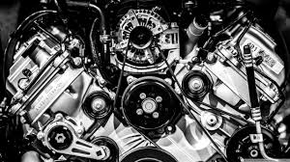
ANALYSIS OF UPGRADING DIESEL ENGINE BY MEANS OF TURBOCHARGER

Slide 2
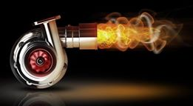
Diyaa atatri ramadan metlaq khalid khabbas saleh saleem

Slide 3
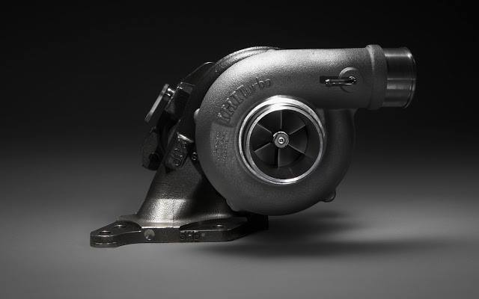
Outline:
Abstract
Introduction
Diesel Engine
Turbochargers
Turbine Wheel
Compressor Wheel
Design Turbocharger
Work Combustion
Piston rod
Conclusions

Slide 4
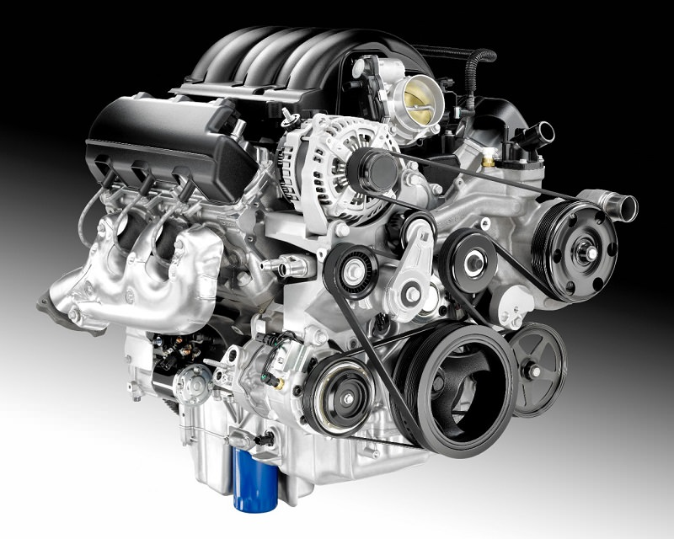
Abstract

Slide 5
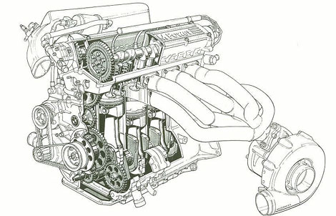
Introduction

Slide 6
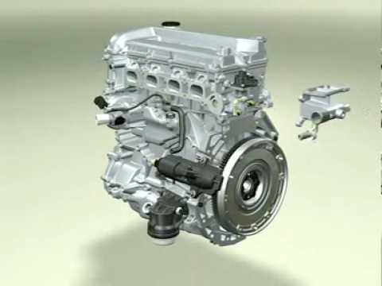
Diesel engine

Slide 7
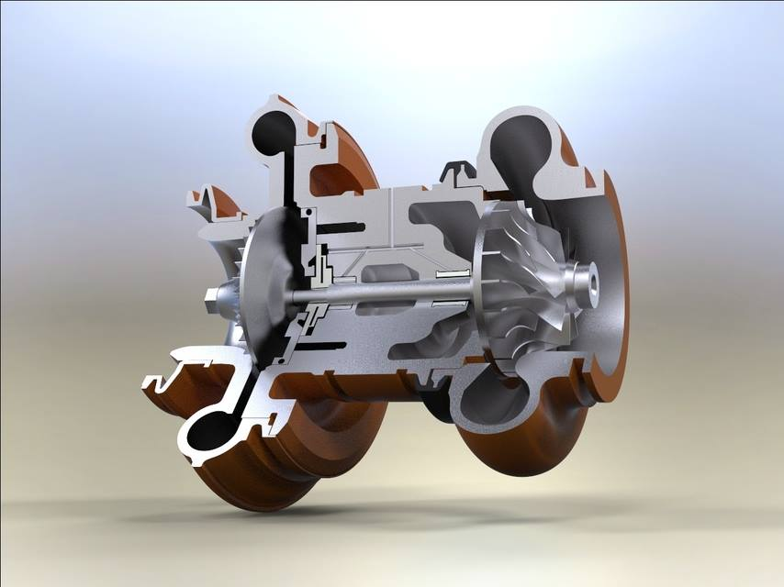
Turbochargers

Slide 8
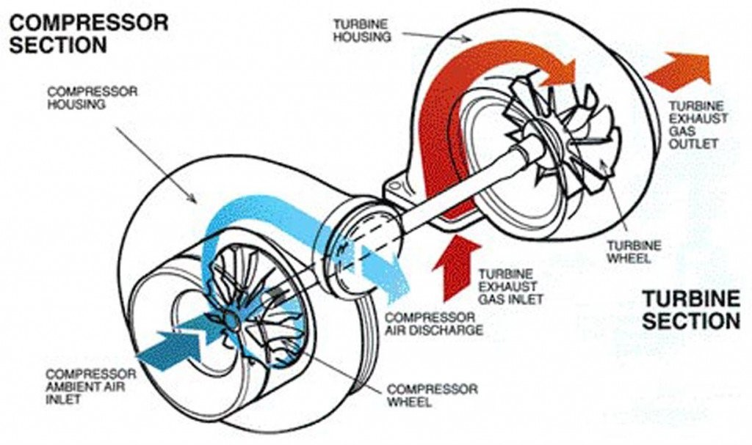
Turbochargers component
1. The turbine wheel.
2. The compressor.
3. Shaft
4. Body

Slide 9
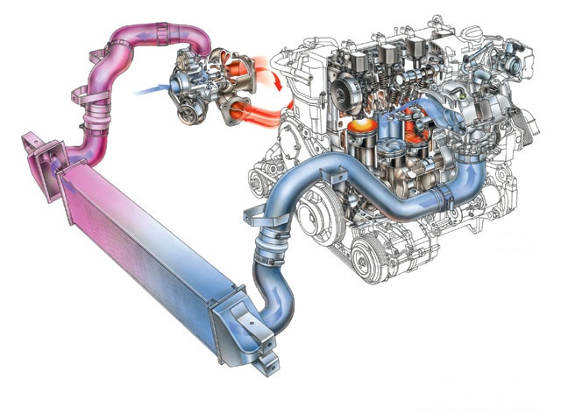
Turbochargers Work

Slide 10
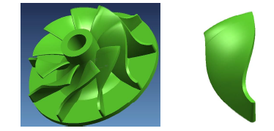
Turbine wheel

Slide 11
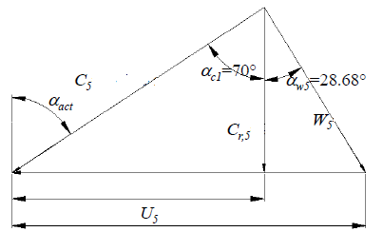
Design Turbine wheel
U₅=308.98 m/s
C₅=273.73 m/s
W₅=106.71 m/s

Slide 12
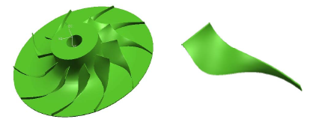
Compressor wheel

Slide 13
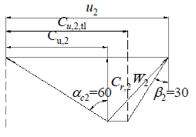
Design Compressor wheel
U₂=346.54 m/s
C₂=234.26 m/s
W=234.26 m/s

Slide 14
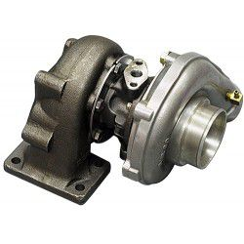
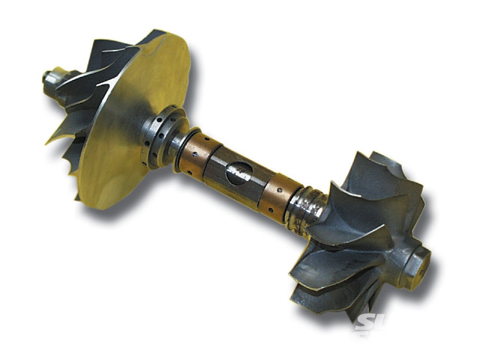
Shaft and Bode

Slide 15
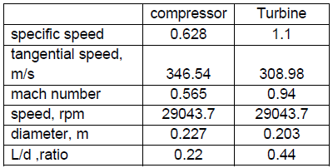
Design turbocharger

Slide 16
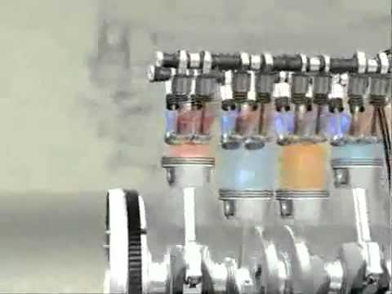
Work combustion
Qc.v + nihi = Wc.v +nehe
Wc.v = 35830 KJ/Kg

Slide 17
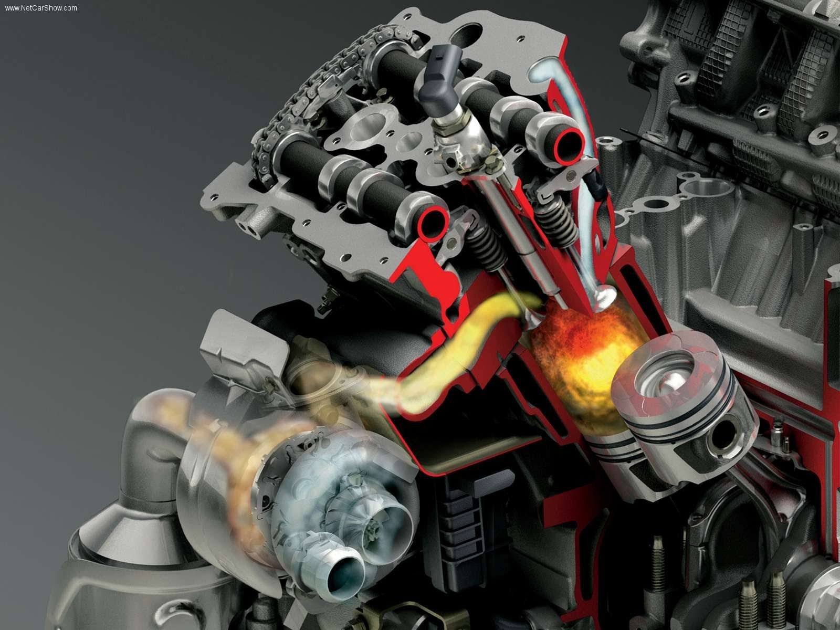
combustion

Slide 18
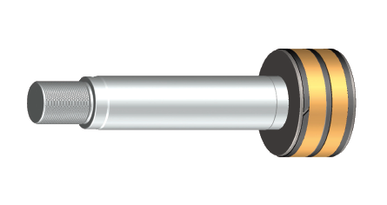
Design piston rod
F=P*(A peston)
(Normal strees = F/(A rod
Normal strees n=Sy/

Slide 19
Conclusion
QH=Cp(T3 – T2)
QL=Cv(T1-T4)
Wnet = QH – QL
Efficience = 1 _ (QL/QH)

Slide 20
Thank you

