Slide 1

Smart Spot Welding Machine
Smart Spot Welding Machine
Moath Nawasrha
Oday Hawi

Slide 2
Overview
Introduction
Applications
Advantages
Machine components
Process of spot welding
Future work

Slide 3
What is the Spot Welding?
Resistance spot welding is a welding process in which contacting metal surfaces are joined by the heat obtained from resistance to electric current.

Slide 4
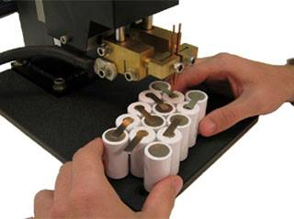
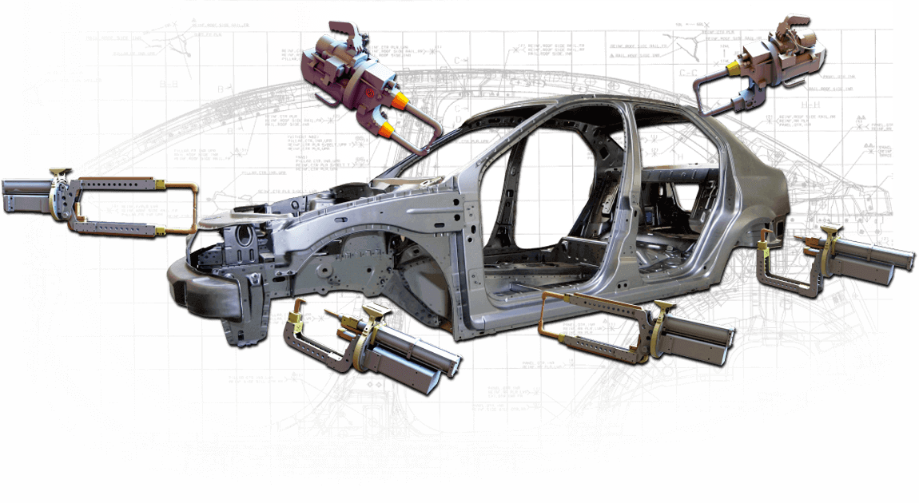

Application

Slide 5
Advantages
Quick and Easy
Multiple sheets joined together at the same time
No dangerous open flames
Saves production cost
Dimensional Accuracy

Slide 6
Machine Components
Transformer
Electrodes
Timer
Voltage regulator
Microtrack ll laser sensor
Micro controller
Snubber

Slide 7
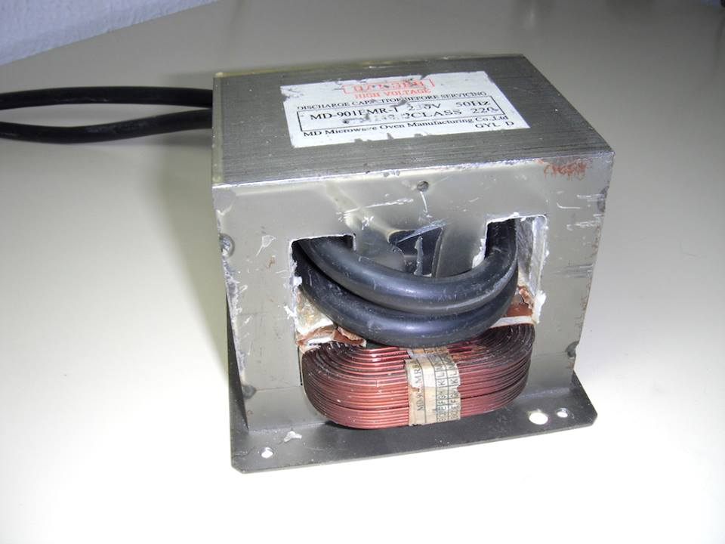
Transformer
Power = 1710 VA
P = V*I
Vp/Vs = Np/Ns

Slide 8
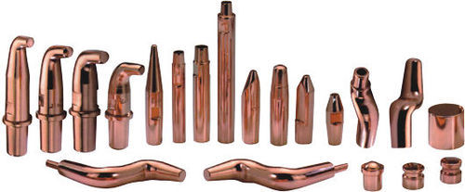
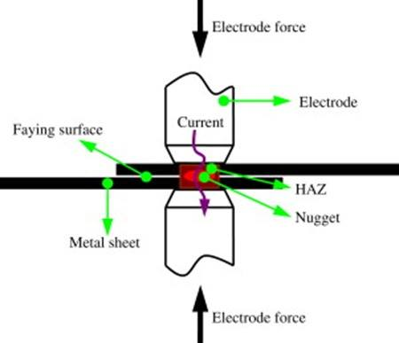
Electrodes
Shapes of electrodes
Electrode force

Slide 9
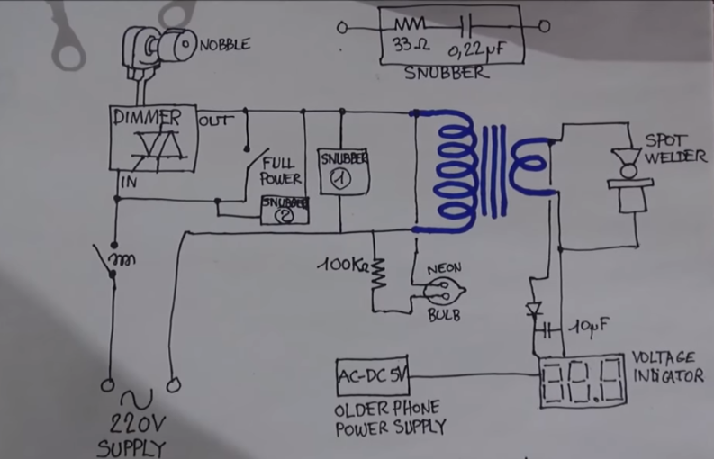
The circuit of machine

Slide 10
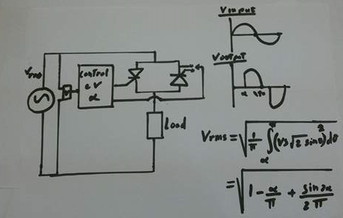
Voltage Regulator

Slide 11
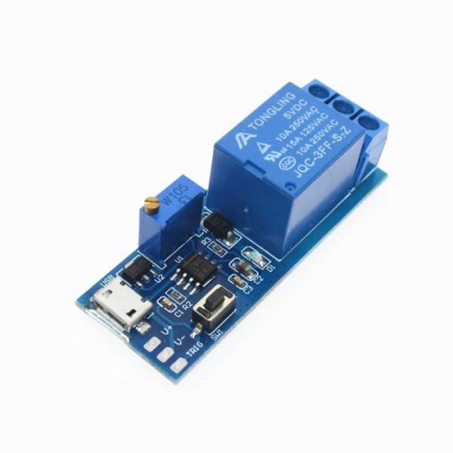
Timer
NO/NC timer
0-24 seonds

Slide 12
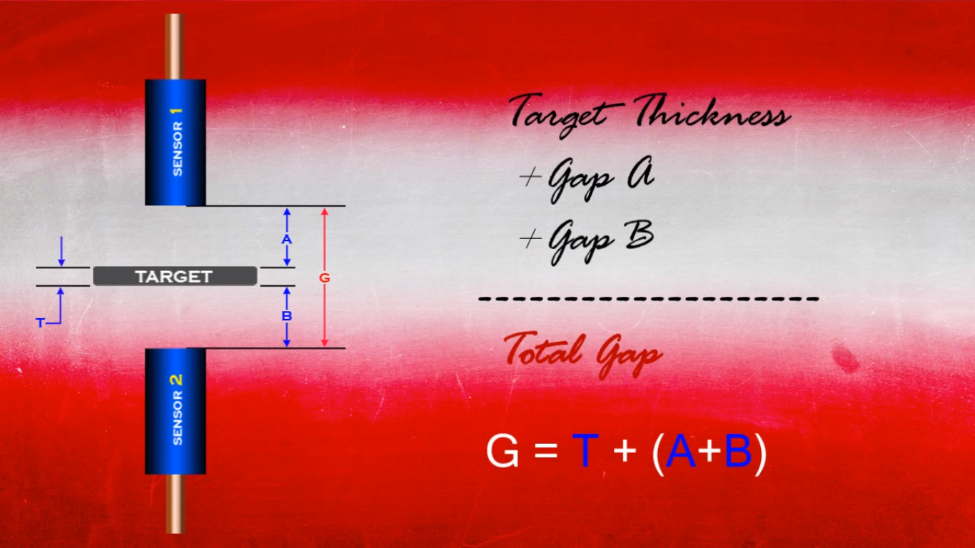
Microtrack ll laser sensor

Slide 13
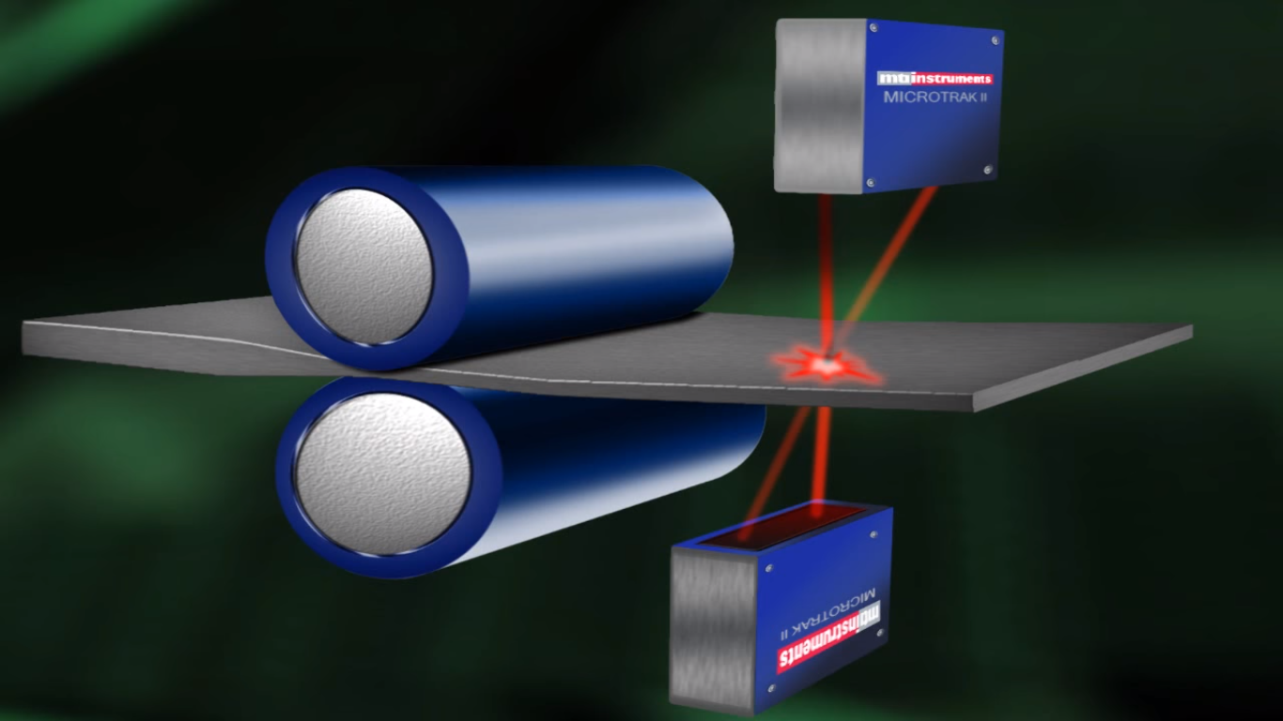

Slide 14
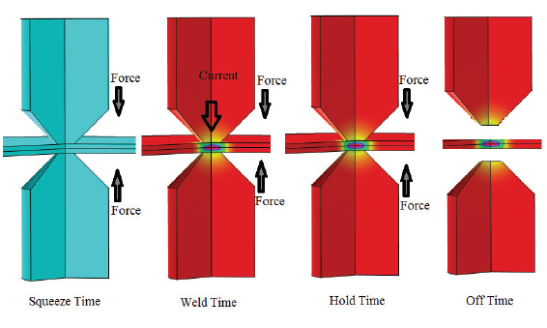
Process of spot welding

Slide 15
Future work
In our project 2 we will make a spot welding machine with smart system by using a micro controller, and sensors for measurement thickness of sheets. The machine will automatically choose the suitable current for welding based on thickness of sheets, And we will study more ways to make it more smarter.

Slide 16


Slide 17


