Slide 1
Management Of Tulkarm Electrical Network
By:
Nezar M. Ibrahim
Ahmad M. Asal
Supervisor:
Dr.Imad Breek

Slide 2
Outlines
1- Tulkarm Electrical Network.
2- Network configurations :
Case one: One connection point.
Case two: Two connection points.
Case three: New configuration.
3- Switchgear.
4- Conclusion .

Slide 3
Tulkarm Electrical Network, Facts…
Tulkarm electrical network is provided by Israeli Electrical Company (IEC) at 22KV.
Two Connection points at Khadouri .
Rated currents 350A & 200A at 22KV.
Actual maximum load = 20 MVA.
Notes:
Say why it is unique worldwide

Slide 4
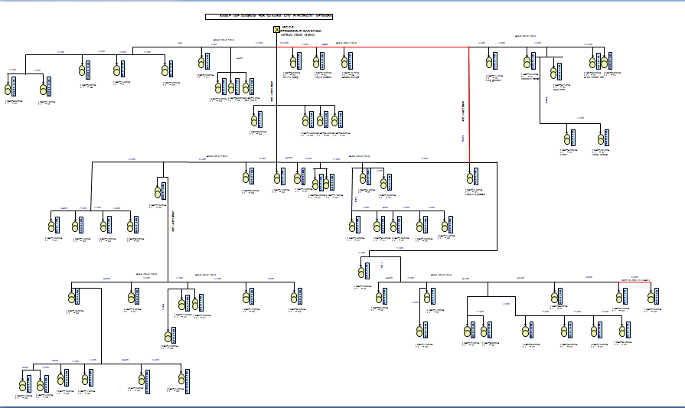
One Line Diagram
Notes:
With innate gestures, emphasize that even families don’t know sign language
How many deaf you know?
* The community treats deaf as a disabled helpless people. due to lack of knowledge about sign language
* They are isolated locally and worldwide
* Sever lack of engagement in many sectors, specially education. even in daily life
* Deaf people usually gather in isolated communities. No interaction with local societies or other deaf societies worldwide.

Slide 5
First case:
Analysis of one connection point
    Before improvement (max case)
    MW MVar MVA % PF
Swing Bus: 18.579 9.453 20.845 89.1 Lag.
Total Load: 18.077 8.546 19.995
Apparent Losses: 0.501 0.904
I Swing : 547 A

Slide 6
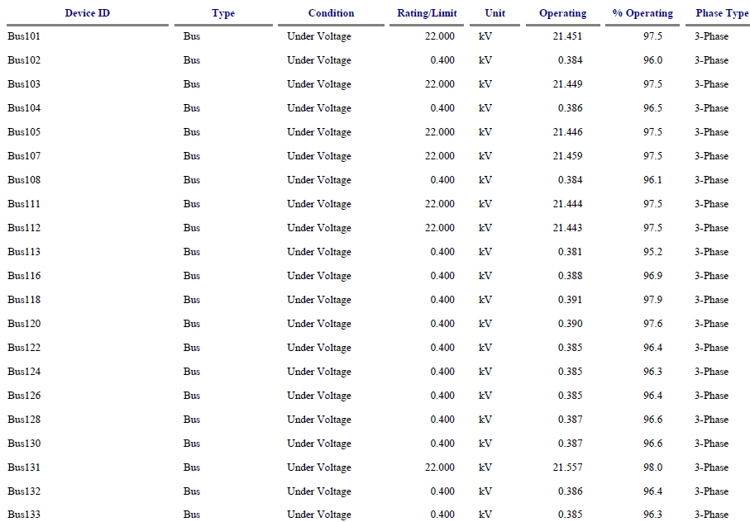
First Case: Margin Table

Slide 7
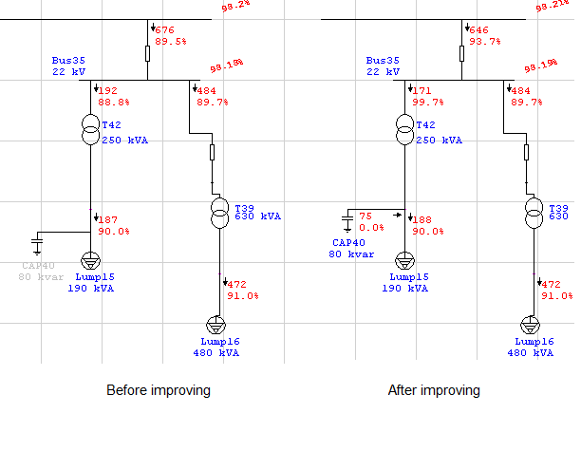
Flow of apparent power and power factor
a)original case without capacitor
b) improvement with capacitor

Slide 8
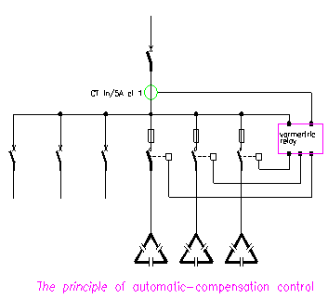
    After improvement (max case)
  MW Mvar MVA % PF
Swing Bus : 18.594 7.936 20.217 92.00
Total Load: 18.132 7.079 19.583
Apparent Losses: 0.471 0.857
I swing : 530.6 A

Slide 9
    After improvement (max case)
The improvement of P.F cause the losses in the network to decrease by 30 kW in real power losses.
ΔP original case = 501kW.
ΔP PF improvement= 471kW.
∆P= 501.4 - 470.9 = 30.5 KW .
∆Z = Z∆p –Zc =11590 - 2604.8 = 8985.2 $/year (saving per year).
S.P.B.P = Kc/∆Z
= 11840 / 8985.2 = 1.31 year (15.8 months ).

Slide 10
Second case: Two connection points
First connection point with 350 A, and the second connection point with 200A.
We redistribute the load according to the rating of connection points , the 350A takes load with 13.55 MVA , and the 200A takes load with 7.2 MVA.
By this distribution we can avoid the over load that can be happen on the sources .

Slide 11
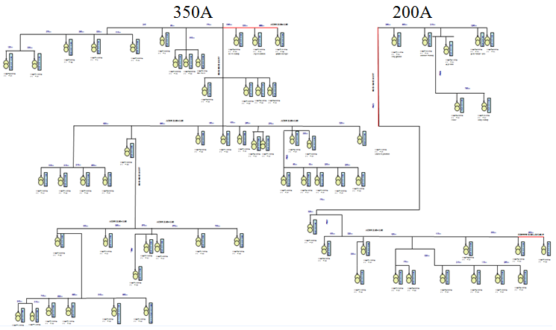
Second case: Two connection points

Slide 12
Analysis of Two connection points
  Before improvement (max case)
    MW MVar MVA % PF
Swing Bus: 18.513 9.421 20.772 89.12 Lagging
Total Load: 18.513 9.421 20.772
Apparent Losses: 0.454 0.884
I Swing : 545 A

Slide 13
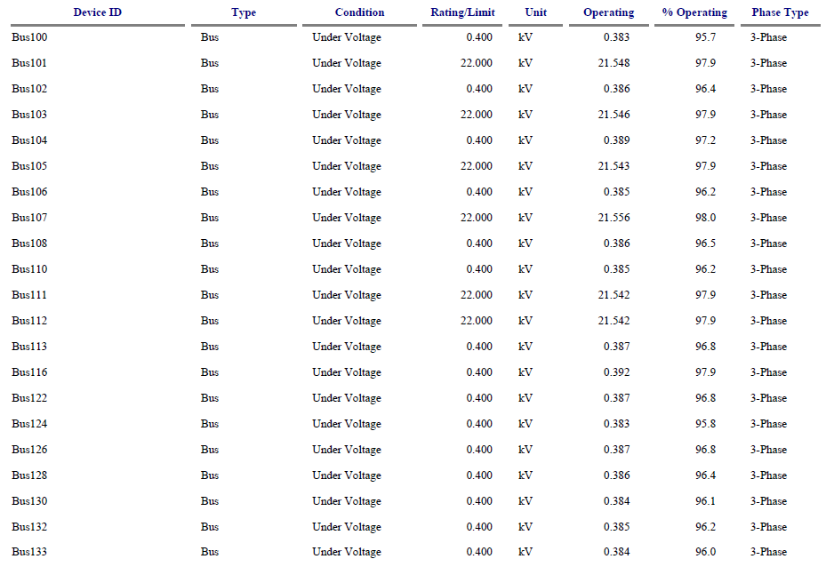
Second Case: Margin Table

Slide 14
    After improvement (max case)
After analysis we find that the network have two main problems:
1- The network has high loss.
2- Low power factor.
To overcome these problems we install capacitor banks on the low voltages buses especially at buses that have the highest drop voltage.

Slide 15
Analysis of Two connection points
  After improvement (max case)
    MW MVar MVA % PF
Swing Bus: 18.523 8.047 20.195 91.8 Lagging
Total Load: 18.523 8.047 20.195
Apparent Losses: 0.429 0.842
I Swing : 530 A

Slide 16
Economical study
 | Min case | Max case | Fixed | Regulated
 | (KVAR) | (KVAR) | capacitor | capacitor
Bus 106 | 40 | 90 | 40 | 50
Bus 104 | 40 | 90 | 40 | 50
Bus 102 | 40 | 90 | 40 | 50
Bus 113 | 10 | 40 | 10 | 30
Bus 110 | 40 | 90 | 40 | 50
Bus 108 | 40 | 90 | 40 | 50
Bus 96 | 40 | 90 | 40 | 50
Bus 238 | 40 | 80 | 40 | 40
Bus 241 | 30 | 70 | 30 | 40
Bus 289 | 40 | 90 | 40 | 50
Bus 288 | 40 | 90 | 40 | 50
Bus 286 | 40 | 90 | 40 | 50
Bus 254 | 40 | 90 | 40 | 50
Bus 229 | 30 | 90 | 30 | 60
Bus 230 | 40 | 90 | 40 | 50
Bus 257 | 40 | 90 | 40 | 50
Bus 16 | 40 | 90 | 40 | 50

Slide 17
Economical study
The total fixed capacitors = 630 KVAR.
The regulated capacitors = 820 KVAR.
∆∆P = 453.7 - 428.6 = 25.1 KW
Z ∆∆P = 0.0251 MW*3800 hour* 100 $/MWH = 9538 $/year.
∆Z = Z ∆∆P –Zc = 9538 - 2358.4 =7179.6 $/year. (saving per year)
S.P.B.P = Kc/∆Z
= 10720 / 7179.6 = 1.49 years (17.88 months).

Slide 18
Comparing between two cases
Before improvement
Two connection points | One connection point
89.12 Lag. | 89.1 Lag. | P.F %
0.454 | 0.501 | MW loss
0.844 | 0.907 | MVar loss
After improvement
Two connection points | One connection point
92 Lag. | 92 Lag. | P.F %
.429 | .471 | MW loss
.842 | .857 | MVar loss

Slide 19
Comparing between two cases
It is clear that the second case more efficient than one connection point , that refer to reducing the loss in the second case.
∆P= 501 - 454 = 47 KW.
The saving per year:
Z ∆p = ∆∆P *T*C
Z ∆p = 0.0477 MW*3800 hour* 100 $/MWH = 18126 $/year.

Slide 20
Switchgear
Switchgear is the combination of electrical disconnect switches, fuses or circuit breakers used to control, protect and isolate electrical equipment. Switchgear is used both to de-energize equipment to allow work to be done and to clear faults downstream. This type of equipment is important because it is directly linked to the reliability of the electricity supply.

Slide 21
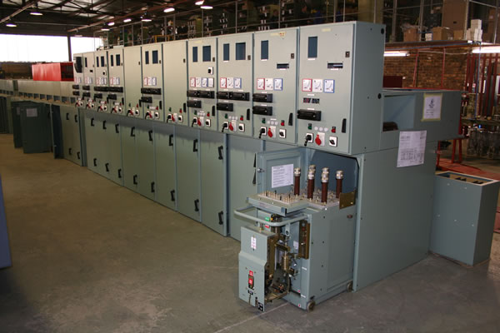
Switchgear

Slide 22
Third case: New configuration for two connection points
The feeders for 200A:
 | Feeder 1 | Feeder 2
Total load (KVA) | 4666 | 2538
Total current (A) | 122.4 | 66.6
The existing feeders for 350A:
Feeder1 | Feeder 2 | Feeder 3
1758 KVA | 10601 KVA | 810 KVA
The new feeders for 350A:
 | Feeder 1 | Feeder 2 | Feeder 3
Total load (KVA) | 2797 | 5786 | 4586
Total current (A) | 76.5 | 154.3 | 124.2

Slide 23
Design switchgear for Tulkarm electrical network
The main elements that switchgear consist of are :
1- Circuit Breakers.
2-Isolator switches.
3-measuring devices.
4-Bus-bars.
5-Local transformers.
6-Protictive devices (relays) from fault [over load, S.C].

Slide 24
Switchgear Settings
Circuit breaker calculations:
IN C.B >= Ksafty * Imax. load .
VC.B >= Vsystem .
Ibreaking capacity >= 1.2 *IS.C .
All C.B's have the same VC.B and equal to 24 KV.
Isolator Switch:
all Isolator Switches have VI.S = 23 KV.
Current Transformer (C.T):
The secondary side equal (5 A) for all C.T , and the primary side can be calculated by the following formula :
IC.T >= 1.1* Imax. load .
Potential Transformer (P.T):
VP.T >= Vsystem .
All P.T that we used 22KV at the primary side , and 120V at the secondary side.

Slide 25
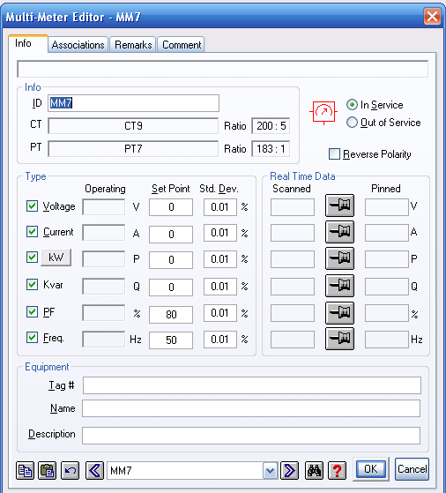
Switchgear Settings
Relay setting:
To make setting {T = to / K} .
For selectivity to another C.B:
to = to' + ∆t .
T = to / K .
Local Transformer:
Transformer (22/0.4) KV , 50 KVA.
Measuring devices :
Voltmeter , Ammeter , KW meter,
Kvar meter ,frequency meter
and P.F meter.

Slide 26
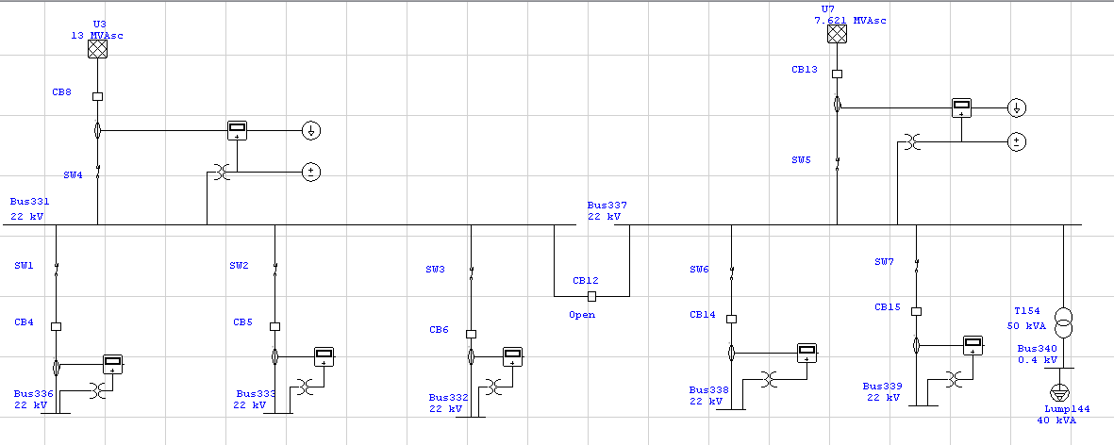
Final Switchgear

Slide 27
Final analysis with switchgear
  Before improvement (max case)
    MW MVar MVA % PF
Swing Bus: 18.526 9.4 20.77 89.18%
Total Load: 18.526 9.4 20.77
Apparent Losses: 0.371 0.823
I Swing : 546 A

Slide 28
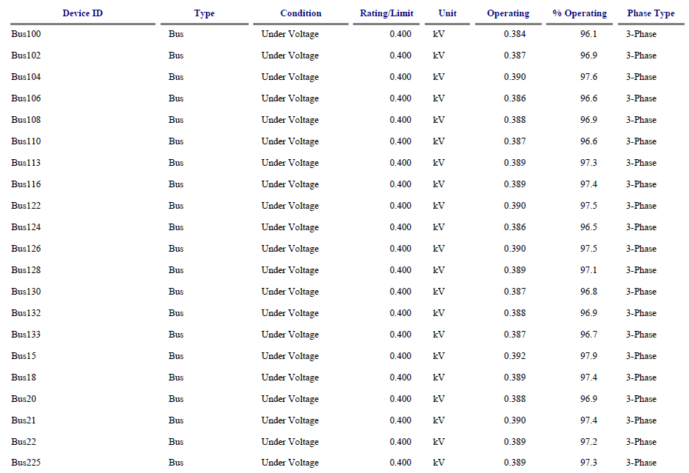
Second Case: Margin Table

Slide 29
    After improvement (max case)
    MW MVar MVA % PF
Swing Bus: 18.539 8.013 20.197 91.8 Lagging
Total Load: 18.539 8.013 20.197
Apparent Losses: 0.351 0.785
I Swing : 530 A

Slide 30
Economic study
` | Min case | Max case | Fixed | Regulated
 | (KVAR) | (KVAR) | capacitor | capacitor
Bus 106 | 40 | 90 | 40 | 50
Bus 104 | 40 | 80 | 40 | 40
Bus 102 | 40 | 90 | 40 | 50
Bus 113 | 10 | 40 | 10 | 30
Bus 110 | 40 | 90 | 40 | 50
Bus 108 | 40 | 90 | 40 | 50
Bus 96 | 40 | 90 | 40 | 50
Bus 238 | 40 | 80 | 40 | 40
Bus 241 | 30 | 70 | 30 | 40
Bus 289 | 40 | 90 | 40 | 50
Bus 288 | 40 | 90 | 40 | 50
Bus 286 | 40 | 90 | 40 | 50
Bus 254 | 40 | 90 | 40 | 50
Bus 229 | 30 | 90 | 30 | 60
Bus 230 | 40 | 90 | 40 | 50
Bus 257 | 40 | 90 | 40 | 50
Bus 16 | 40 | 90 | 40 | 50

Slide 31
Economic study
The total fixed capacitors = 630 KVAR.
The regulated capacitors = 810 KVAR.
∆∆P = 371 - 351 = 20 KW.
Z ∆∆P = 0.02 MW*3800 hour* 100 $/MWH = 7600 $/year
∆Z = Z ∆∆ p –Zc = 7600 - 2336.4 = 5263.6 $/year. (saving per year) .
S.P.B.P = Kc/∆Z
= 10620 / 5263.6 = 2.017 years (24.21 month).

Slide 32
Comparing between two cases
Before improvement
Switchgear case | Tow connection point
89.18 Lag. | 89.12 Lag. | P.F %
0.371 | 0.454 | MW loss
0.823 | 0.844 | MVar loss
After improvement
Switchgear case | Two connection point
92 Lag. | 92 Lag. | P.F %
0.351 | 0.429 | MW loss
0.785 | 0.842 | Mvar loss

Slide 33
Comparing between two cases
∆P=454 - 371 = 83 KW.
The saving per year:
Z ∆p = ∆∆P *T*C
Z ∆p = 0.083 MW*3800 hour* 100 $/MWH = 31540 $/year.
Benefits of switchgear :
improved personnel safety.
Easy and safe maintenance.
Improved protection of secondary equipment.
Less interruptions.
Good selectivity .

Slide 34
Conclusion

Slide 35
Thank You for Listening
Feel Free to Ask!

