Slide 1
Laser Game
Presented By :
Rami Hussien
Wisam Jaddo
Supervised By :
Eng. Haya Samaneh

Slide 2

OutLine
Overview
Motivation
Components
Implementation
Problems
  Future Work
Demo

Slide 3
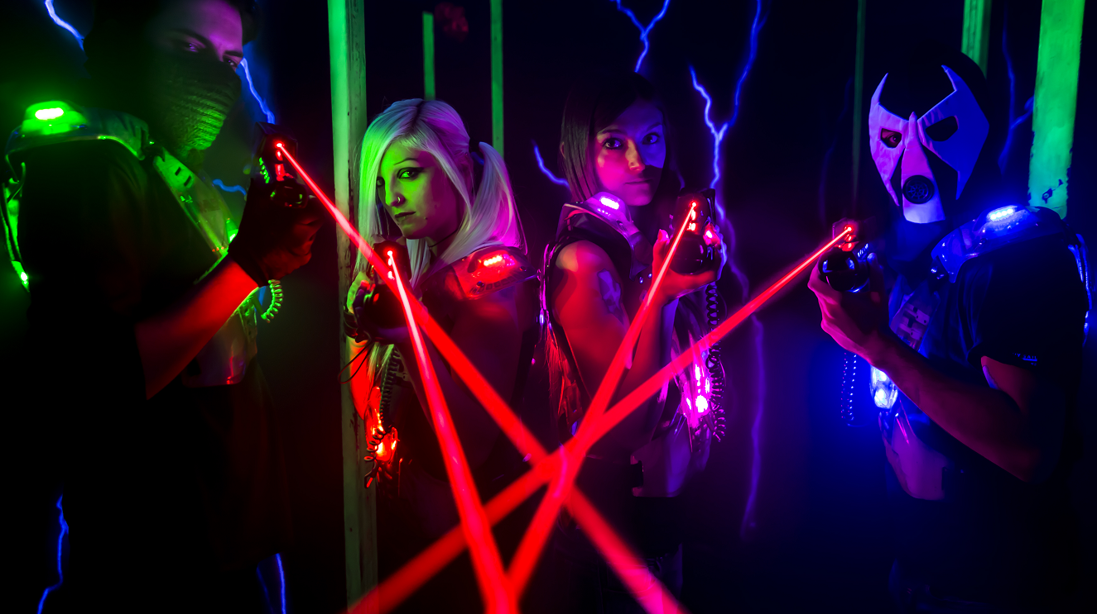
Overview
Overview
Laser game is a laser shooting game where players compete to score
maximum points
The game has a duration and the players will play till the duration ends
At the end of the game, the results will be shown on an LCD
The winner team is the team who has scored the maximum points

Slide 4
Motivation
The Laser Game doesn’t exit in our country
It’s so interactive, challenging, and fun

Slide 5
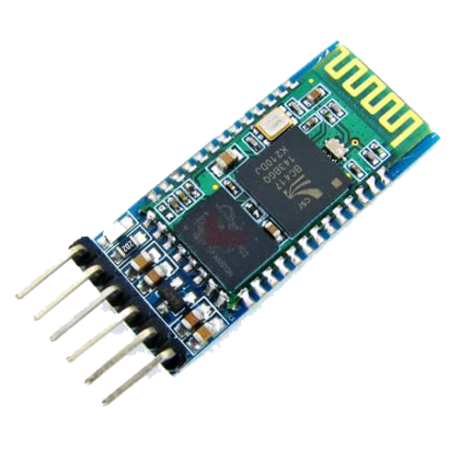
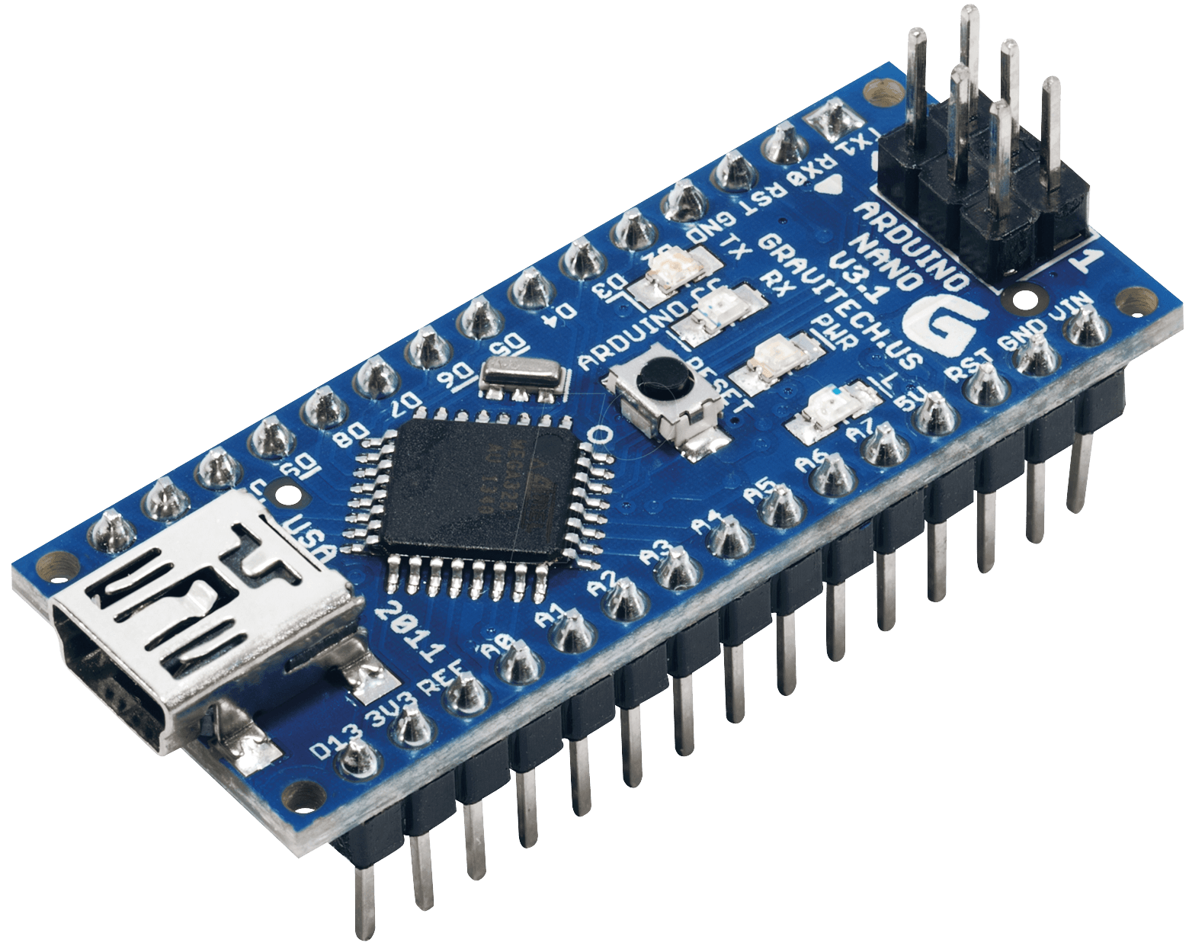
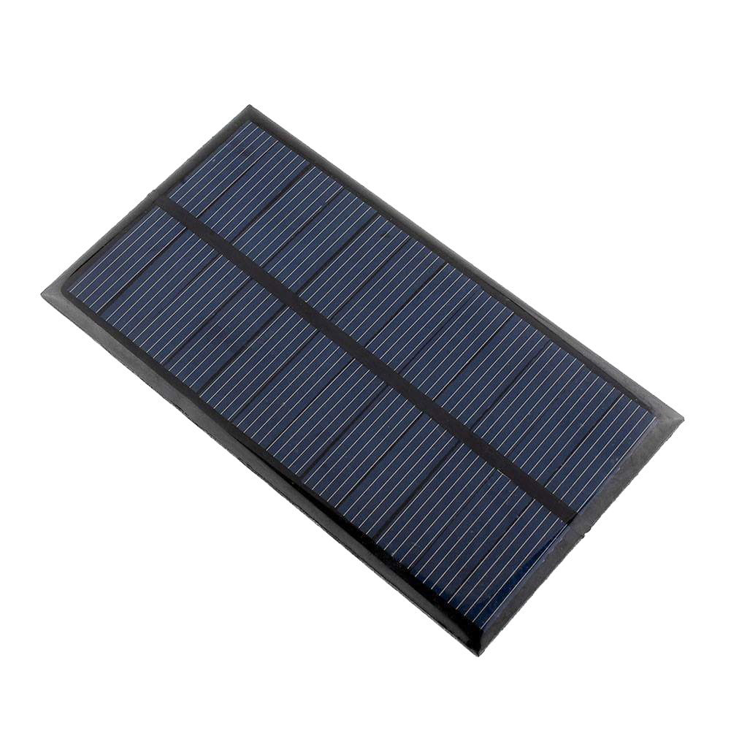
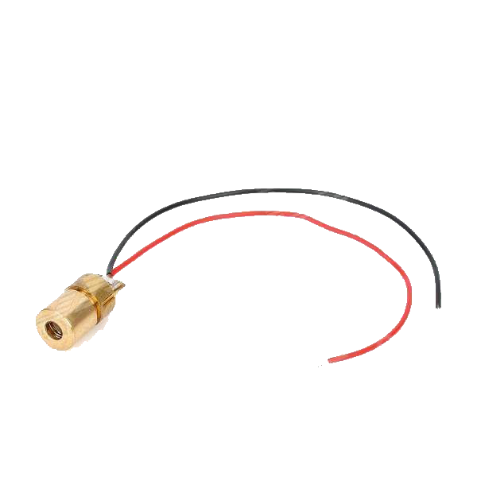
Components
Nano Arduino
Solar Cells
RGB LEDs
Bluetooth modules
Laser
Vests
Guns
LCD

Slide 6
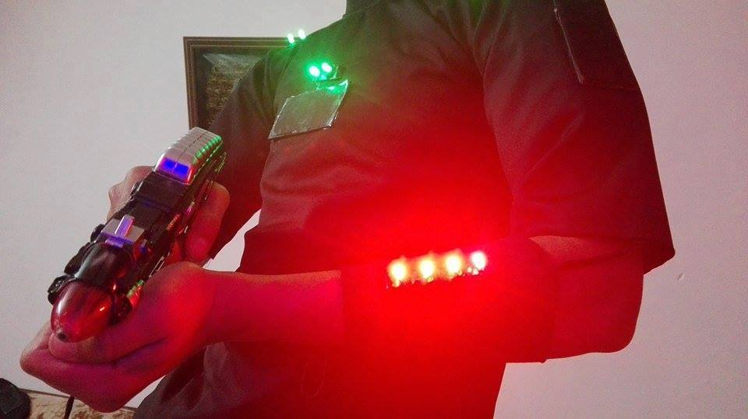
Implementation
Laser Gun Design
Laser gun was designed using a push-button and a laser module connected together to Nano Arduino
A unique frequency is given to each laser to distinguish each laser from the other

Slide 7
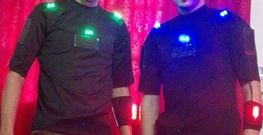
Implementation(cont.)
Vest Design
The vest consists of the following components:
Solar cells
Life indicator
Team indicator LEDs

Slide 8
Implementation(cont.)
Team Selection
The team for each player is selected through an android application
Every team has a unique color to be distinguished

Slide 9
Implementation(cont.)
Battery design
The batteries were designed in such a way to provide a specific voltage to generate a certain current

Slide 10
Problems
Solar cells must be in a dark place to work properly
Laser’s voltage is so low
Detecting laser’s voltage is not that accurate
Bluetooth modules problems
Nano Arduino has a single core that cannot handle multiple tasks

Slide 11
Future Work
Implement a communication system
Implement a tracking system
Implement an android application to control the game

Slide 12


Demo Time.

Slide 13
Thanks!

