Slide 1
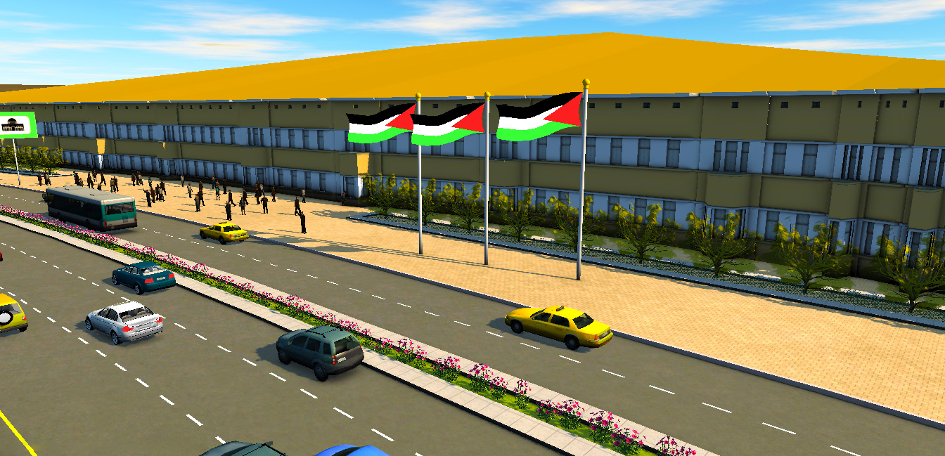
Landside Design of Al-Auja International Airport
Prepared by: Sabreen Shehada
Mohammed Nazzal
Supervised by: Prof. Sameer Abu-Eisheh

Slide 2
رَح نعَمْرهَا

Slide 3
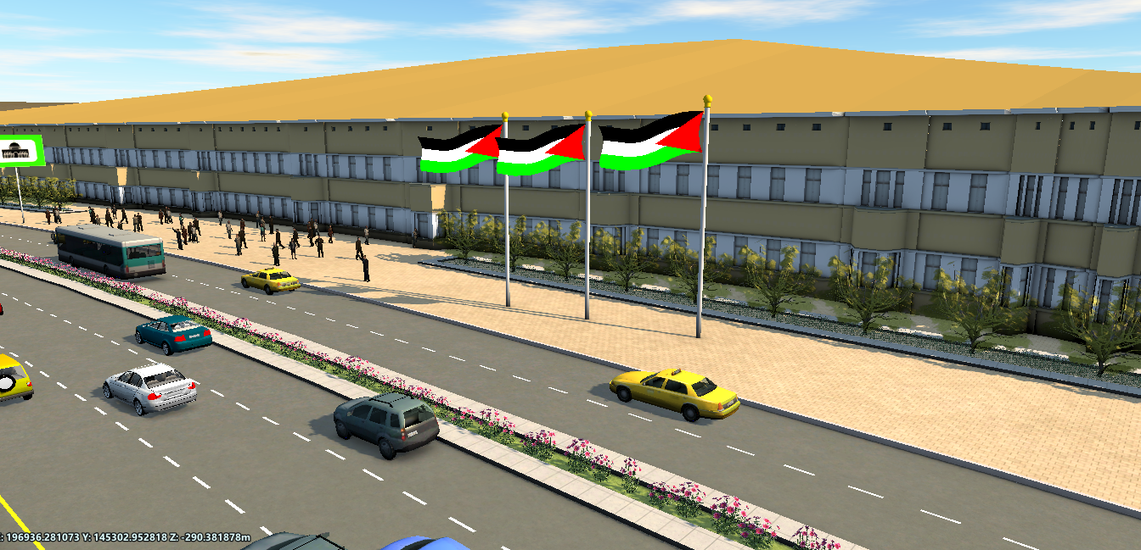

3
Palestine
2
2050
1

Slide 4
3
Graduation Project I
Final Result
2
1

Slide 5
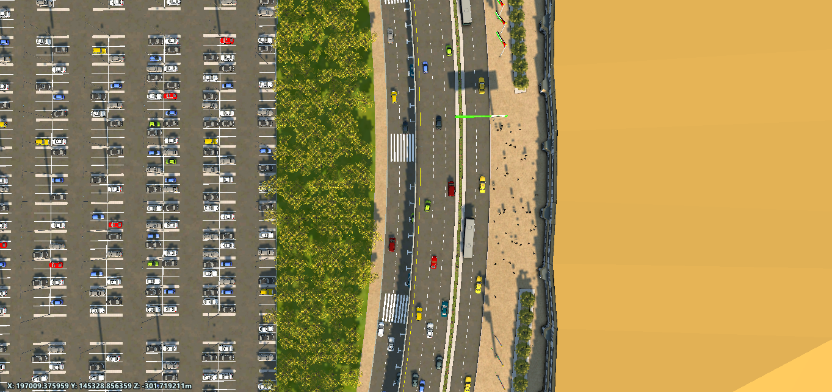
3
The Design of the Landside Facilities
2
1

Slide 6
3
Estimate the Cost of the Project
2
1

Slide 7




P
3
Result of Al-Auja International Airport Analysis

Slide 8
P
3
Al-Auja
Jericho
Palestine

Slide 9
3
P
2027-2034
3
phases
2035-2042
2043-2050

Slide 10
P
3
Number of passengers
West Bank
20,240,881
Gaza Strip
Tourists
Pilgrims

Slide 11
P
3
Number of Employees per Day
12,784

Slide 12
P
3
Bus
Private Car
Taxi
Arrivals
3
2,149
236
Departures
3
2,090
230

Slide 13
P
3
1,156
Long-term
243
Taxi Parking
258
Short-term
28
Bus parking
711
Employees parking

Slide 14
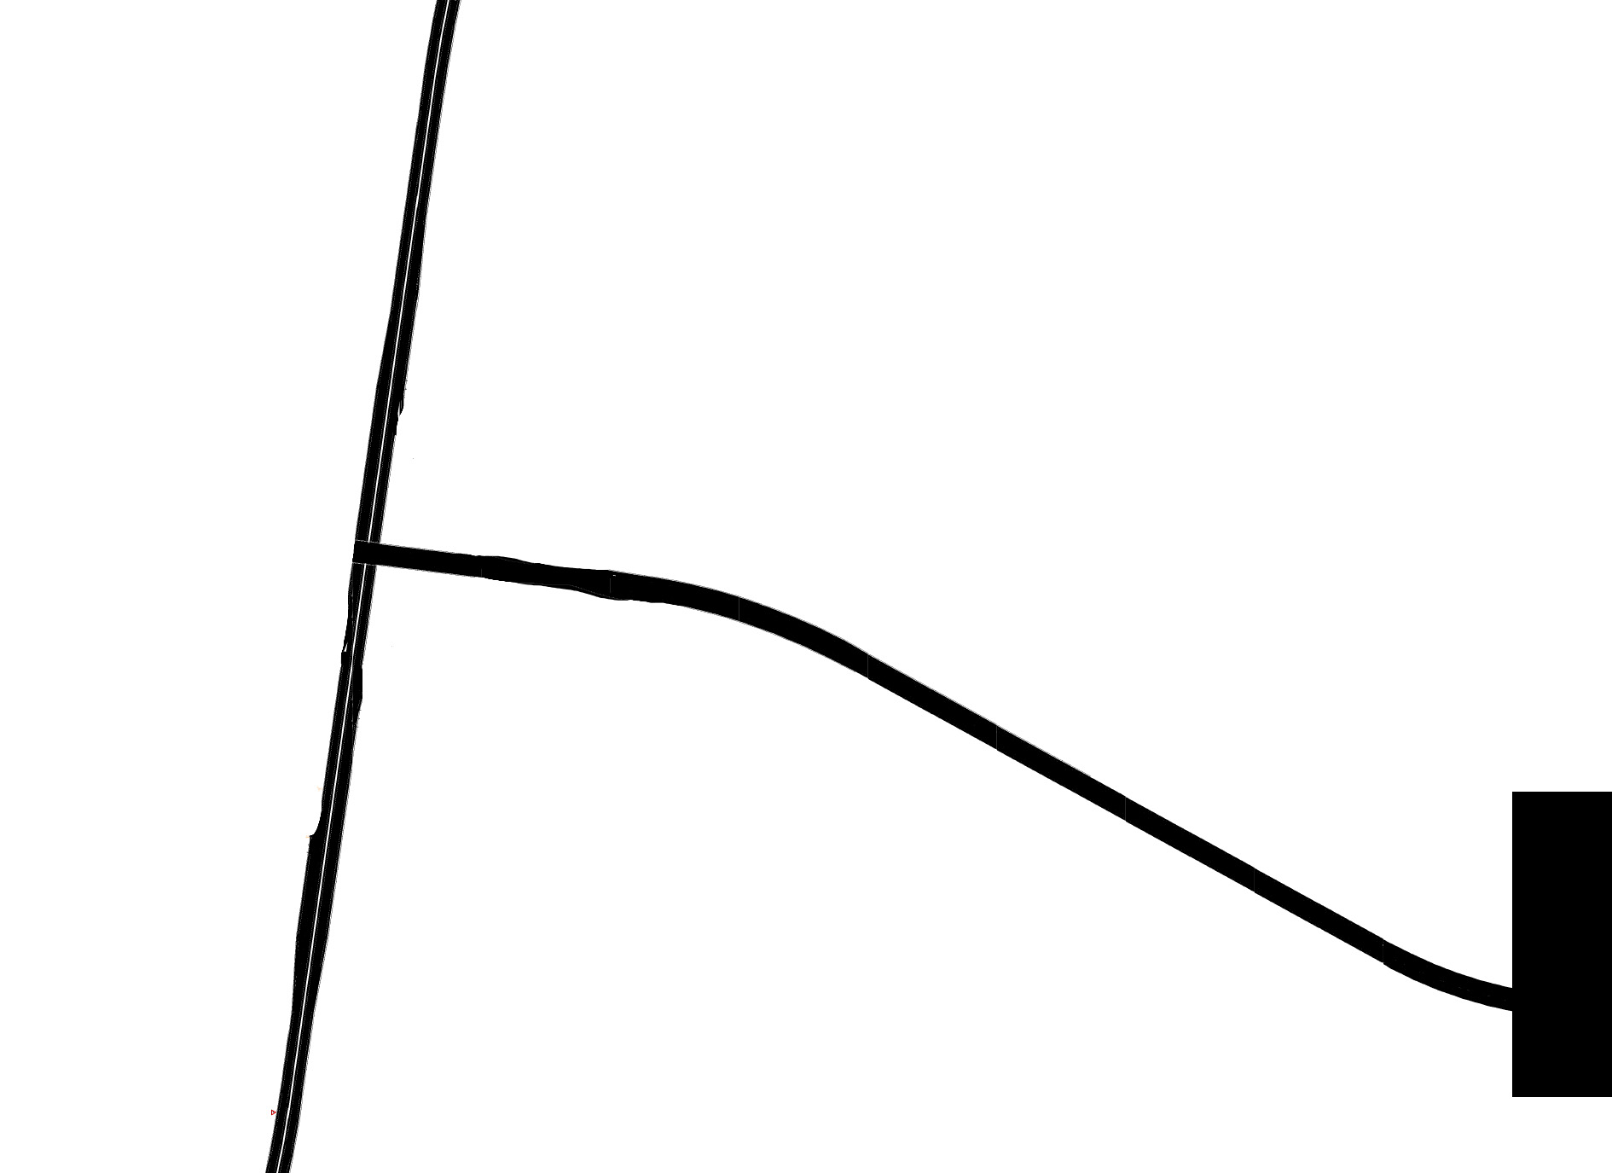
Airport Roadway
Terminal Building
Highway No.90

Slide 15
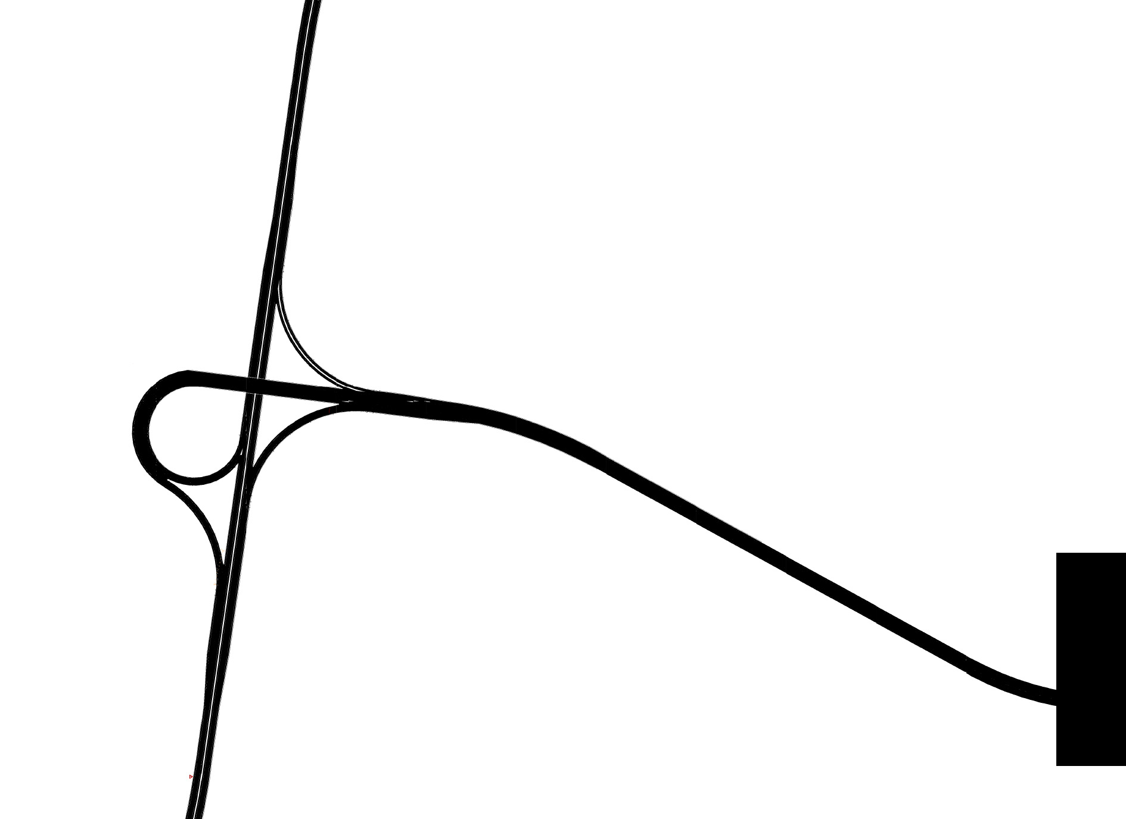
Trumpet Interchange

Slide 16
Landside Design

Slide 17
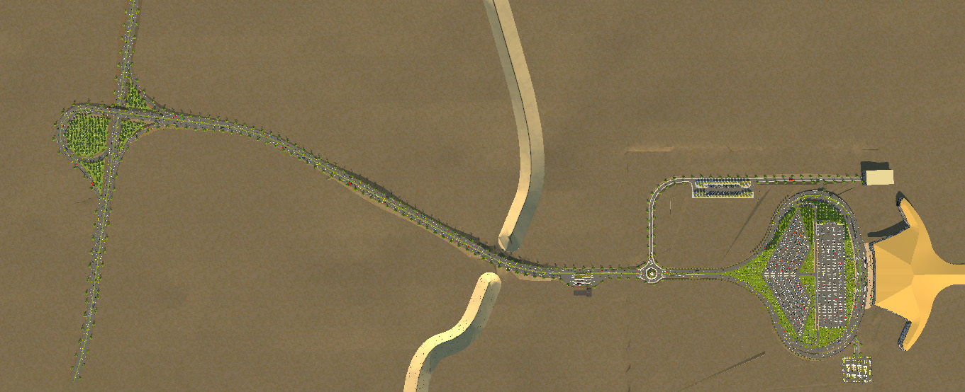
Highway No.90
Circulation Road
Airport Roadway
Interchange
Check Station

Slide 18
Cargo Roadway
Short-term parking spaces
Roundabout

Slide 19
Cargo processing Unit
Terminal Building
Valley
Bus Parking Spaces
Parking road
Long-term parking spaces
Taxi Parking spaces

Slide 20
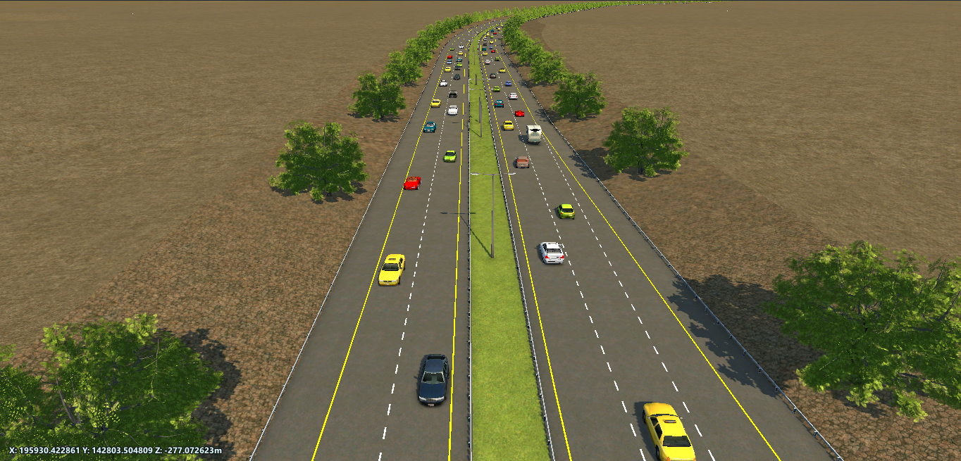
Highway No.90

Slide 21

Design Vehicle: WB-19
Speed: 100 Km/hr
$$R_{min}=414 m$$
$$L_{min}=300 m$$
$e_{max}$= 8%
$f_{max}=$0.11
Highway N.90

Slide 22
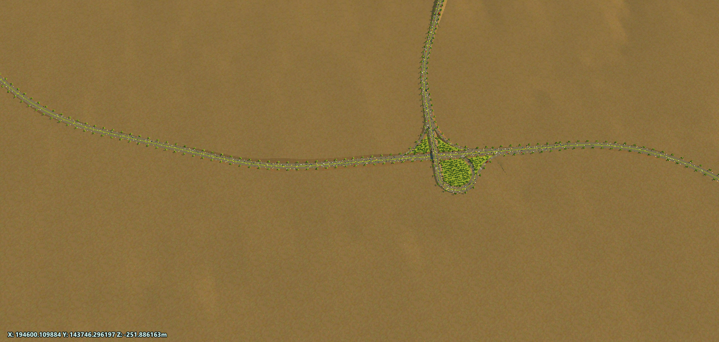
R=1300 m
R=1400 m
W=7.81m
3
1
W=7.75 m
2
W=7.705m
R=1100 m
Highway N.90

Slide 23
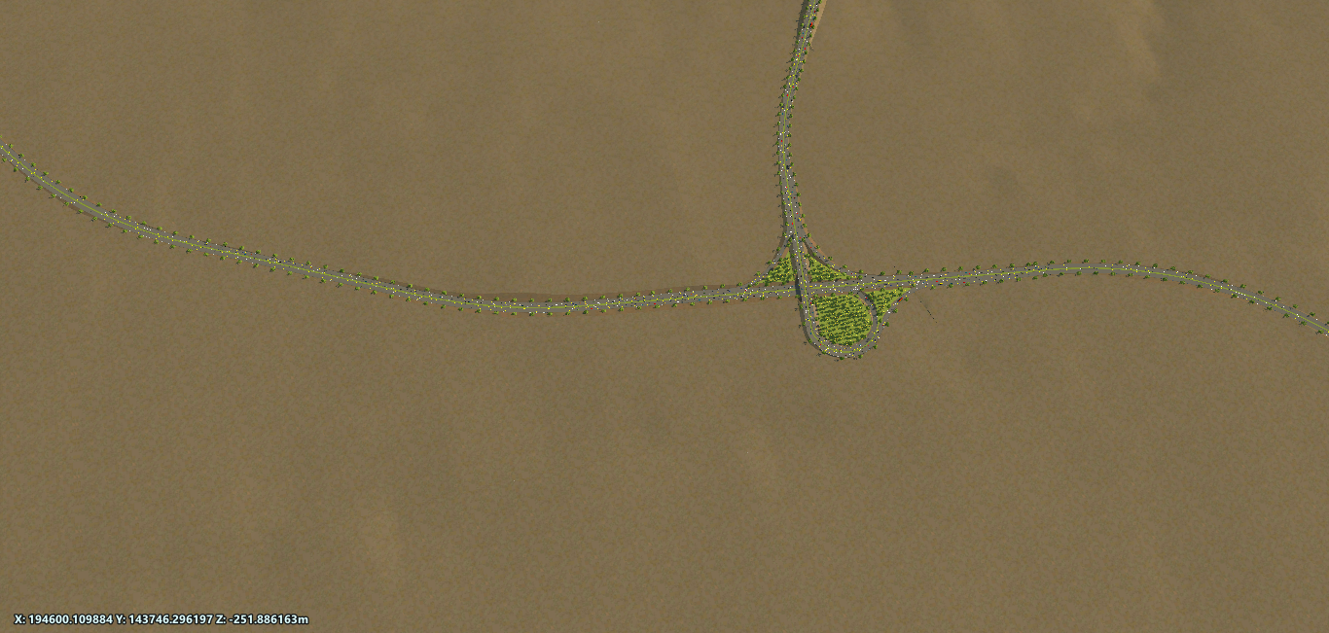
Vertical Alignment
2 Curves
Sag
Crest
K
157
577
L design
149
149
Highway N.90

Slide 24
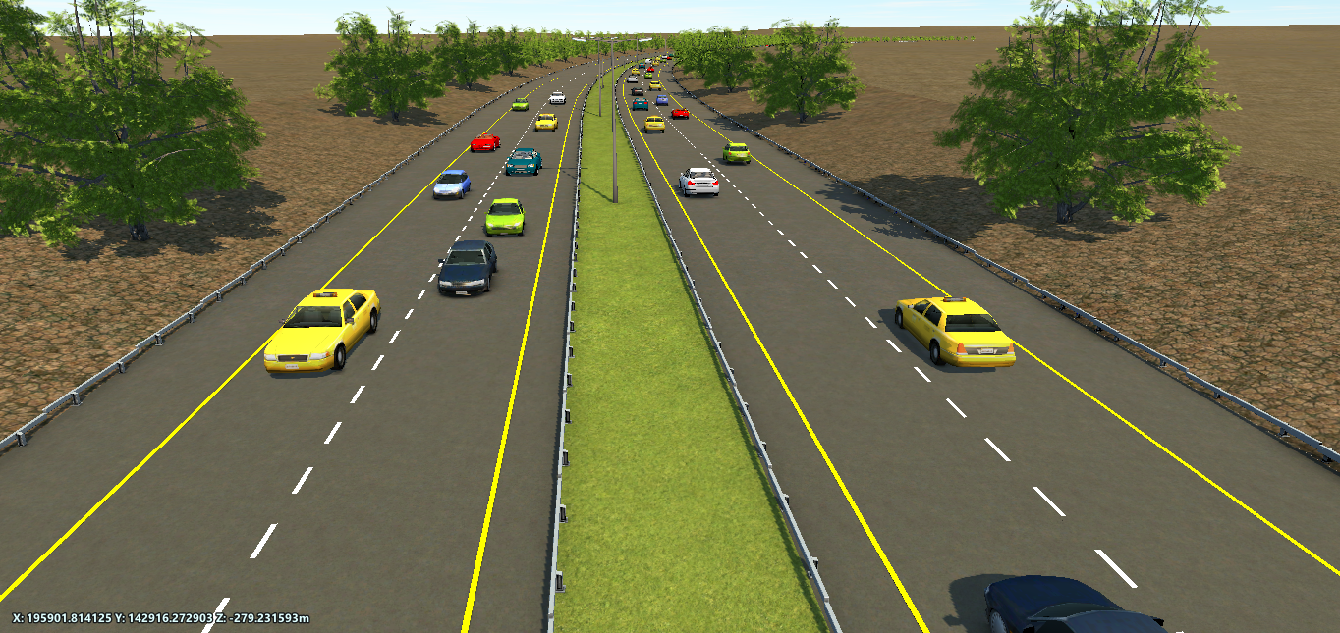
Surface layer = 11 cm
Base course = 52 cm
Surface layer =12 cm
Base course = 50 cm
South
3m
North
3.6m
3.6m
4m
1.2m
3
4
1
2
Highway N.90

Slide 25
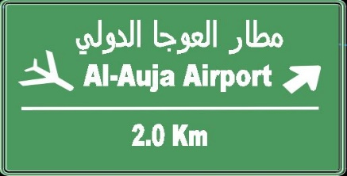

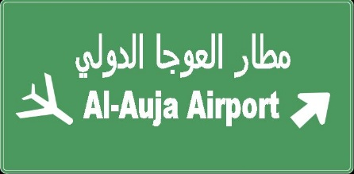
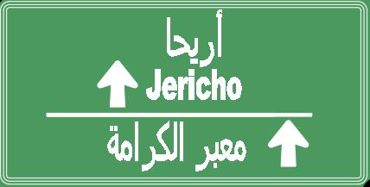
Guide Signs on Highway No.90

Slide 26
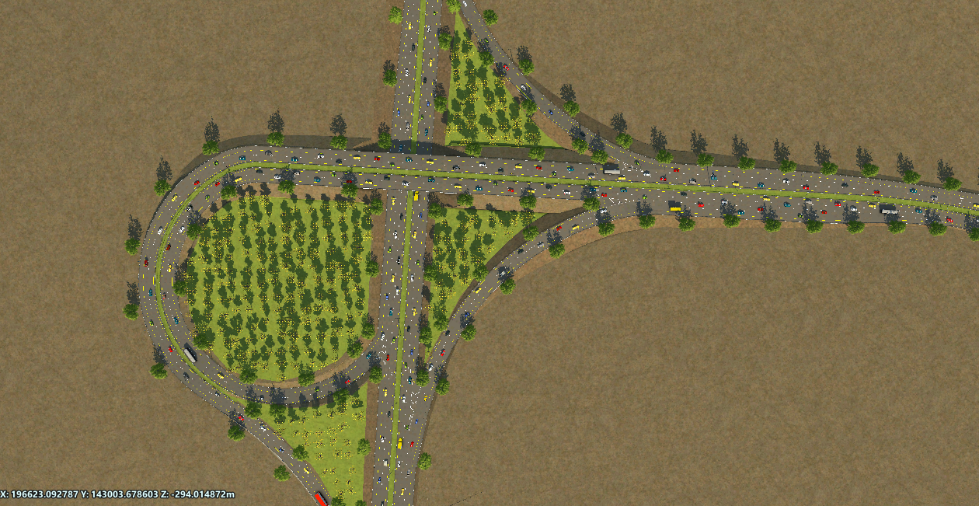
Interchange

Slide 27
Loop
Ramp 2
Ramp 1
Semidirect
Interchange

Slide 28
North
Loop
Ramp 2
Airport
Ramp 1
Semidirect
South
Interchange

Slide 29
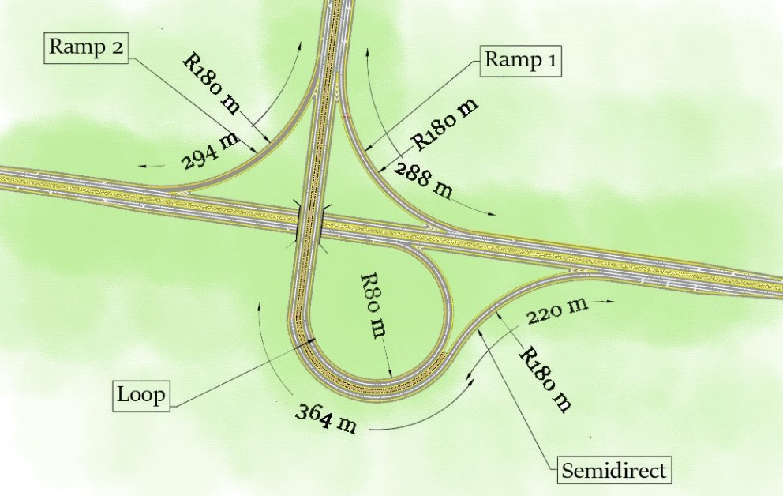

Slide 30
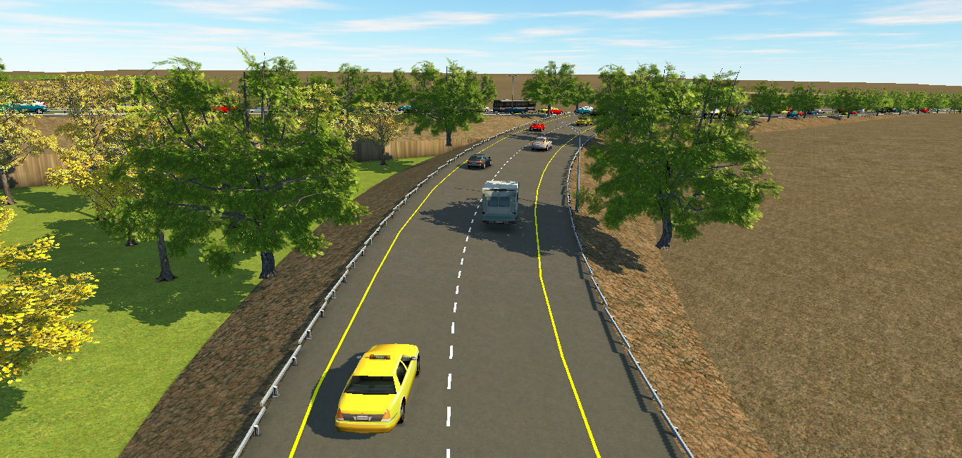
Surface layer =6 cm
Base course = 26 cm
Airport Roadway
8.1 m
2.4 m
1.2 m
1
2
Ramp 1

Slide 31
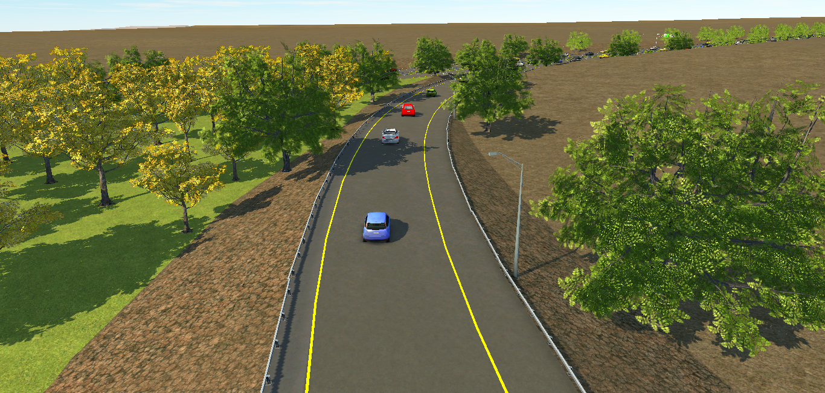
Surface layer =6 cm
Base course = 24 cm
Highway No.90
1.2 m
2.4 m
6.6 m
1
Ramp 2

Slide 32
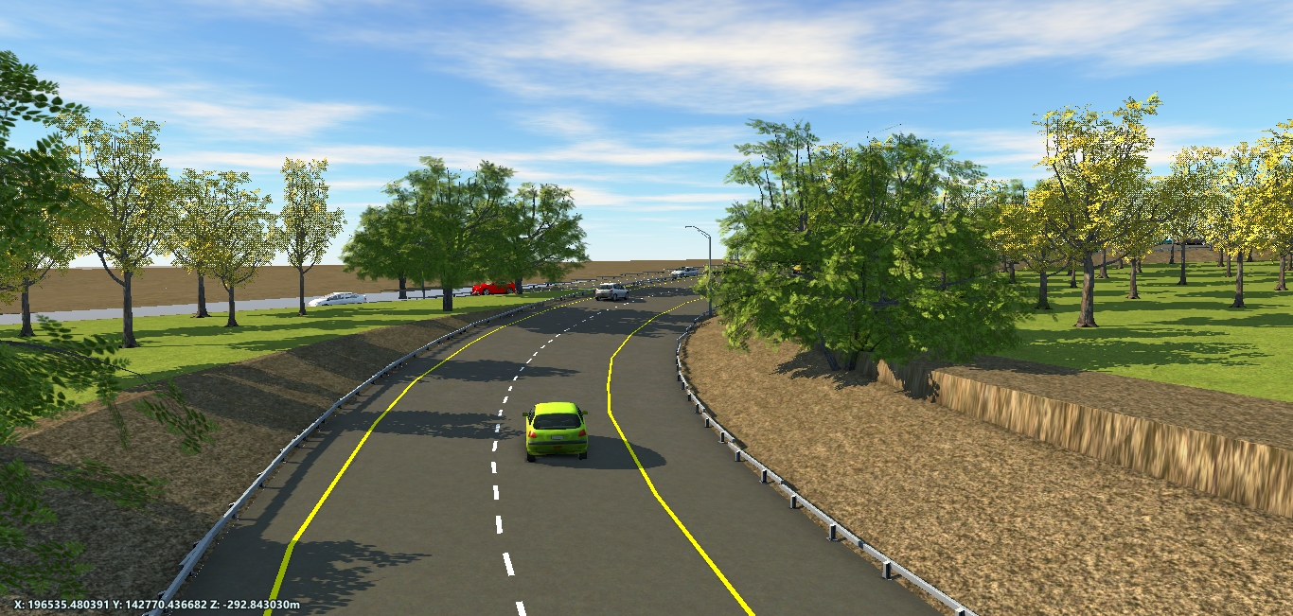
Surface layer =6 cm
Base course = 24 cm
Airport Roadway
8.6 m
2.4 m
1.2 m
1
2
Loop

Slide 33
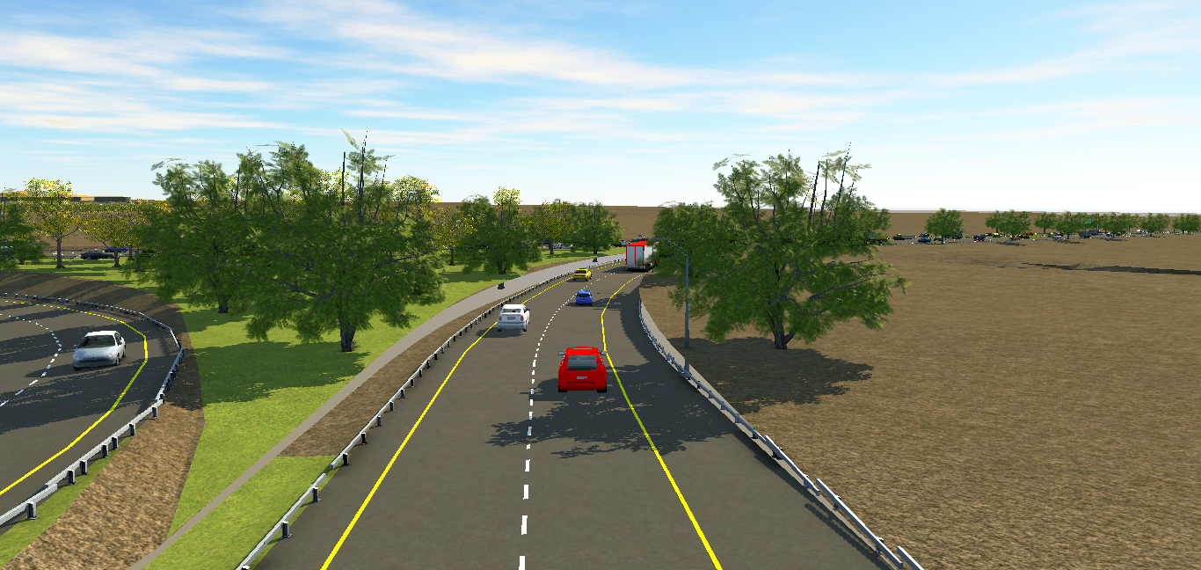
Surface layer =6 cm
Base course = 26 cm
Highway No.90
2.4 m
8.1 m
1.2 m
1
2
Semidirect

Slide 34
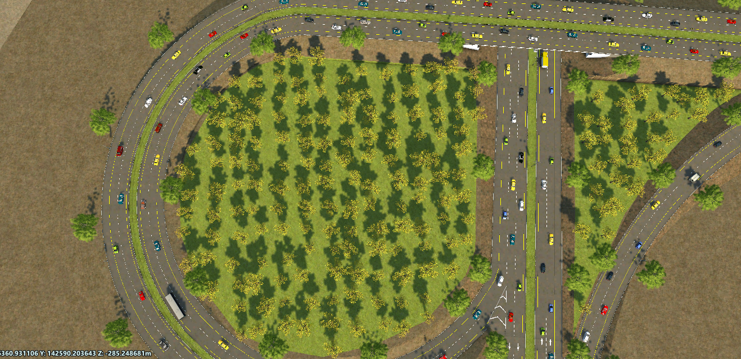
Semidirect and Loop

Slide 35
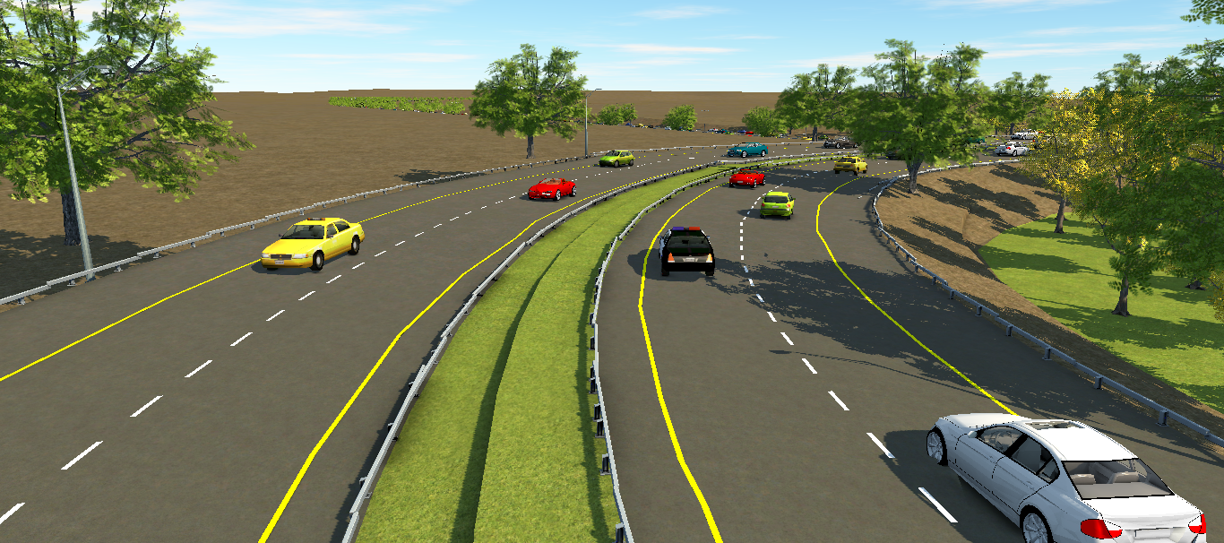
Airport Roadway
2.4m
Highway No.90
8.64m
1.2m
4m
1.2m
2.4m
8.64m
Loop and Semidirect

Slide 36
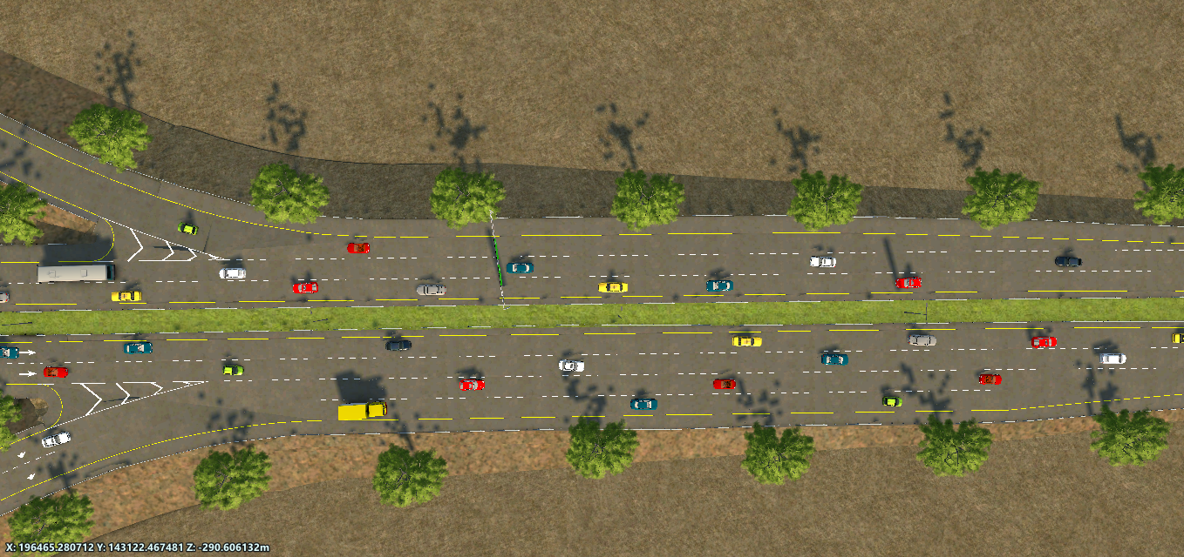
Deceleration Lane for Ramp 2
Acceleration Lane for Ramp 1

Slide 37
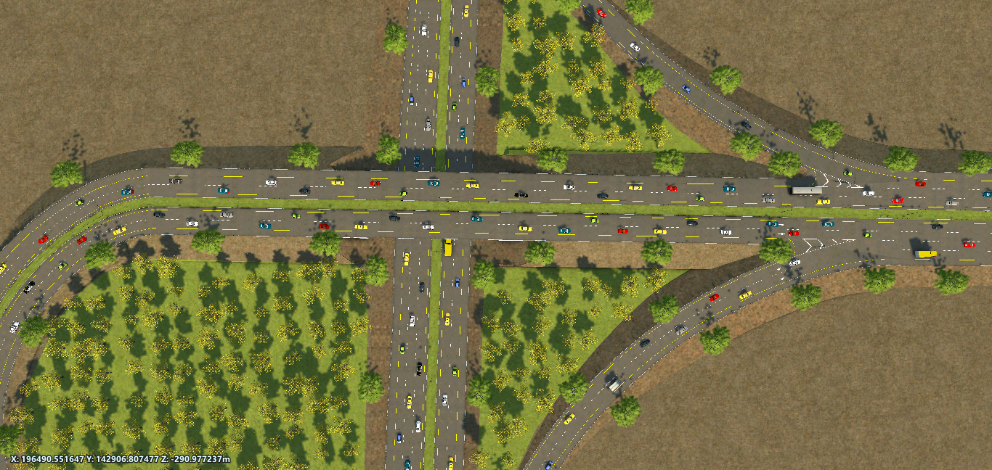
Bridge
Interchange

Slide 38
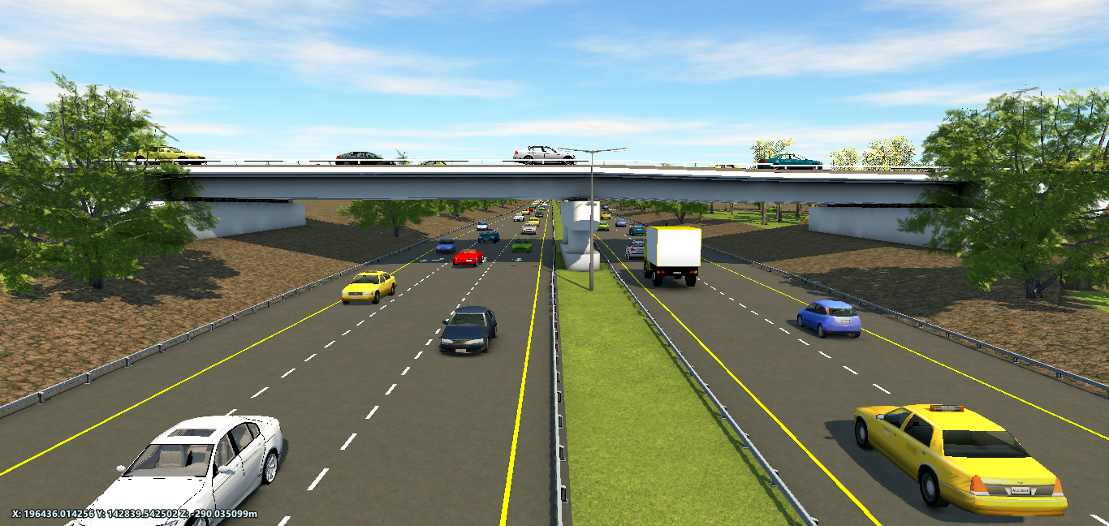
7m
Bridge

Slide 39
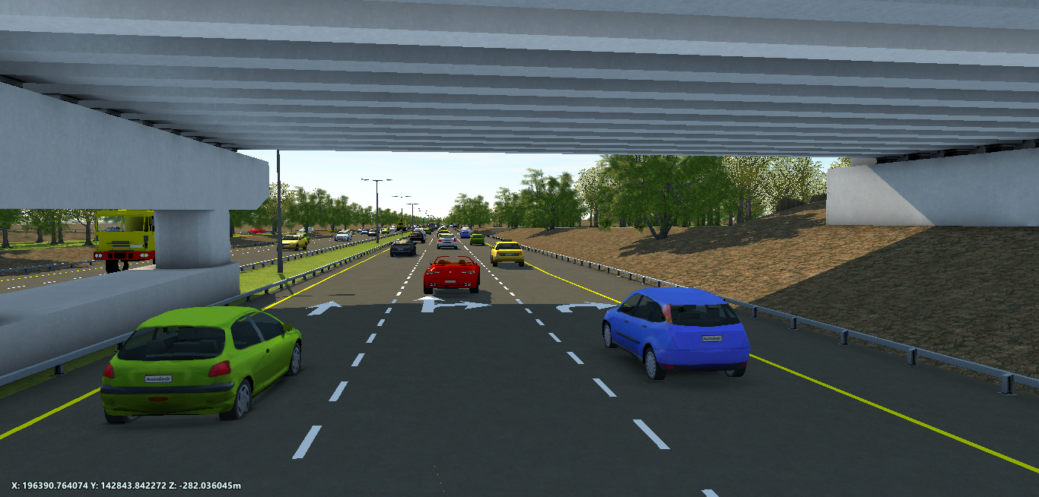
Bridge

Slide 40
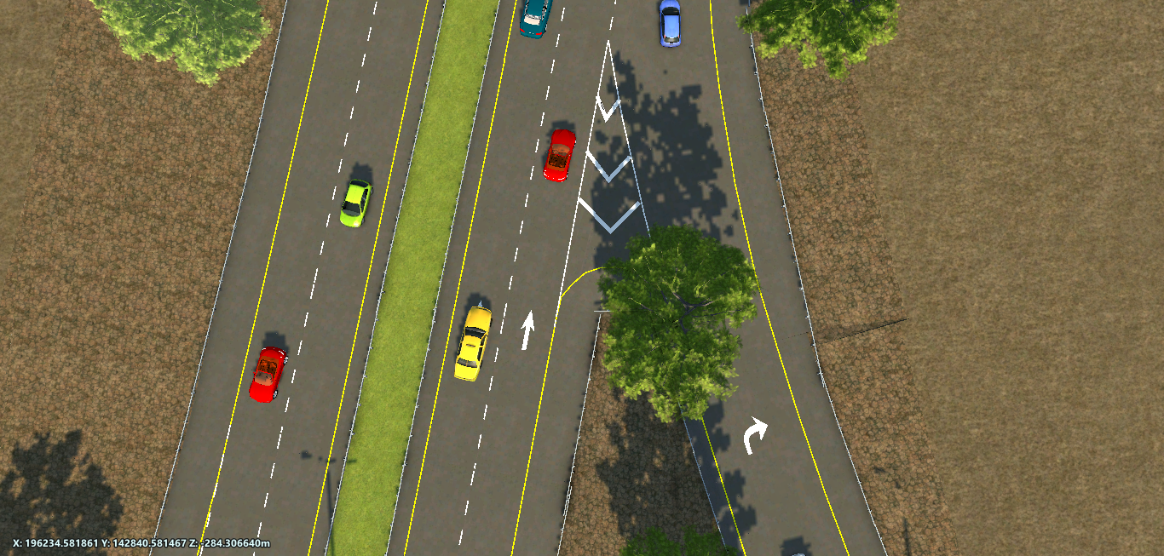
Marking

Slide 41
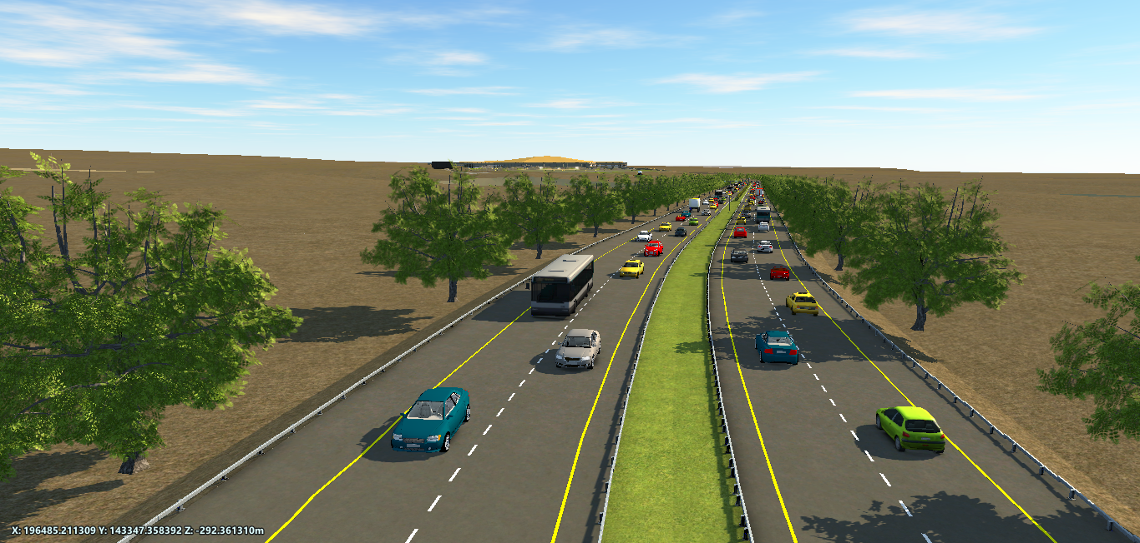
Airport Roadway

Slide 42
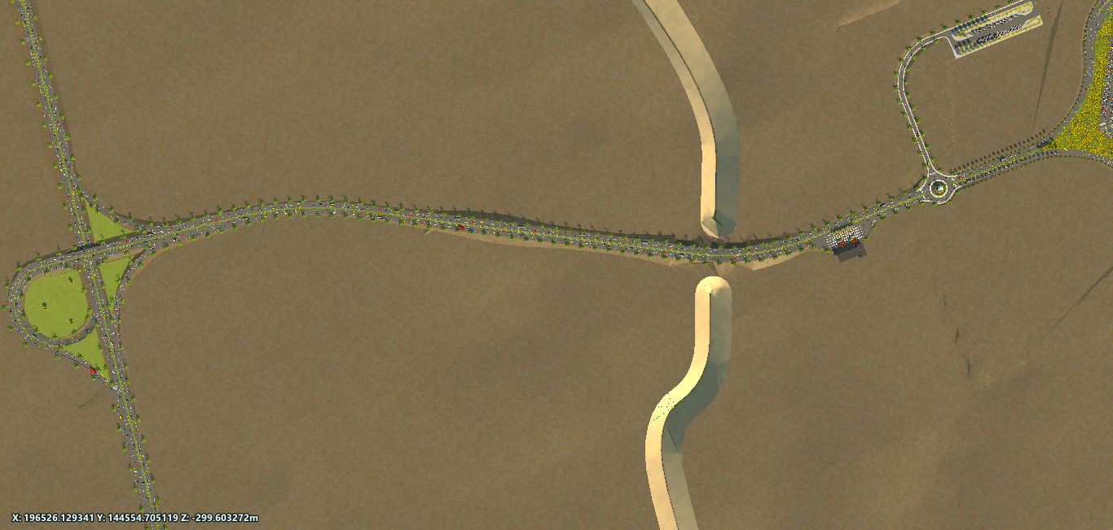
1.5 Km
Airport Roadway

Slide 43
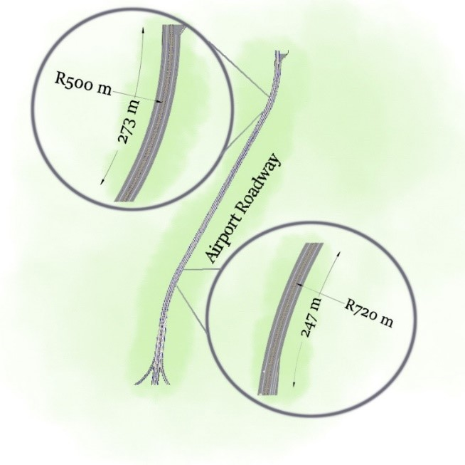
Widening = 8.05 m
Widening = 7.95 m

Slide 44
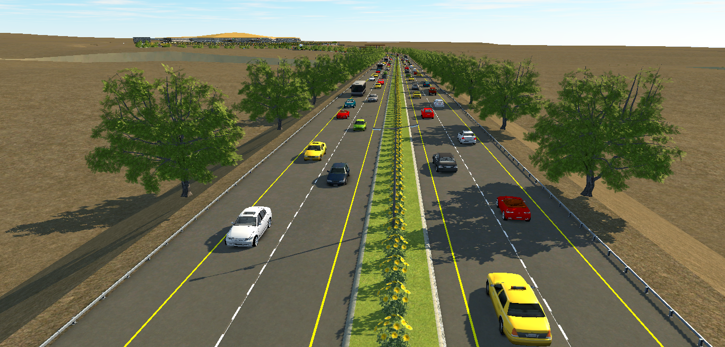
Surface layer =6 cm
Base course = 26 cm
Highway No.90
Roundabout
3
4
2
3m
1
3.6m
3.6m
4m
1.2m
Airport Roadway

Slide 45
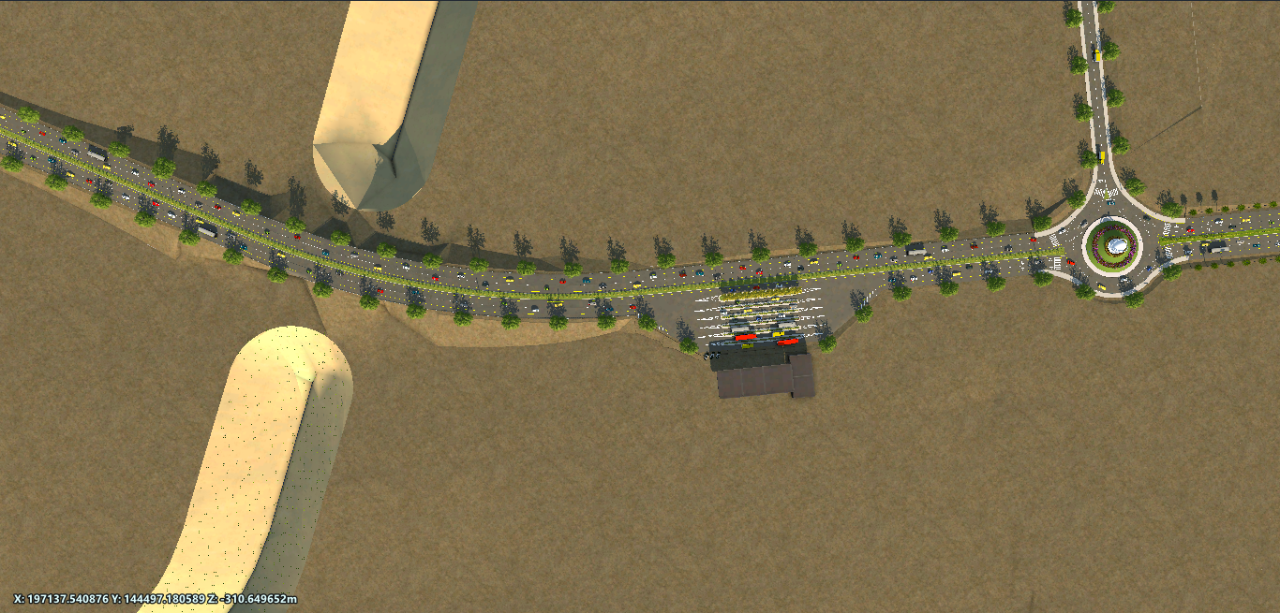
Valley
12 m
Bridge
Check Station
Airport Roadway

Slide 46
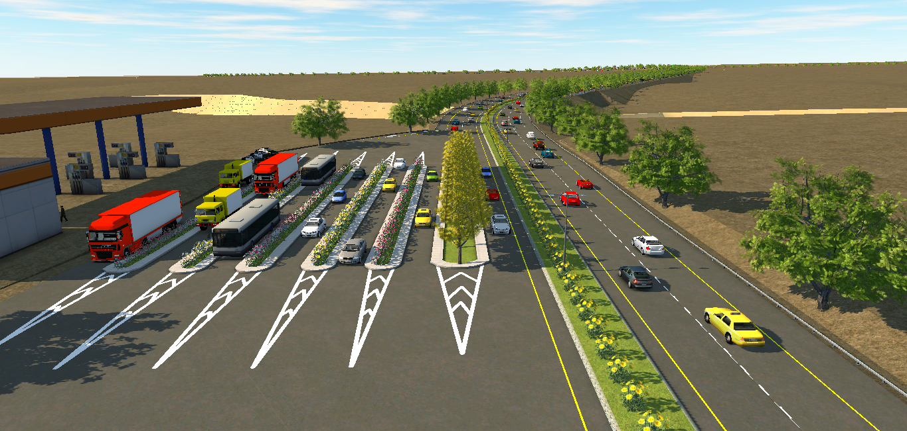
Truck
Private Car
2
3
1
Bus
4
6
7
5
3.6m
2.3m
VIP
Check Station

Slide 47


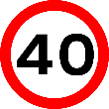


Warning Signs on Airport Roadway
Yield Sign
Left Bend
Speed Sign
Right Bend
No Truck

Slide 48
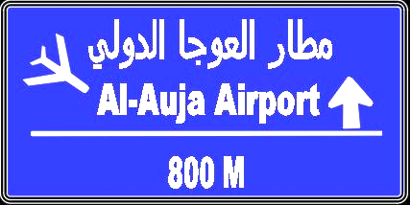

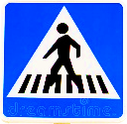
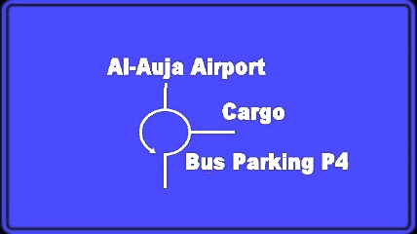
Guide Signs on Airport Roadway

Slide 49
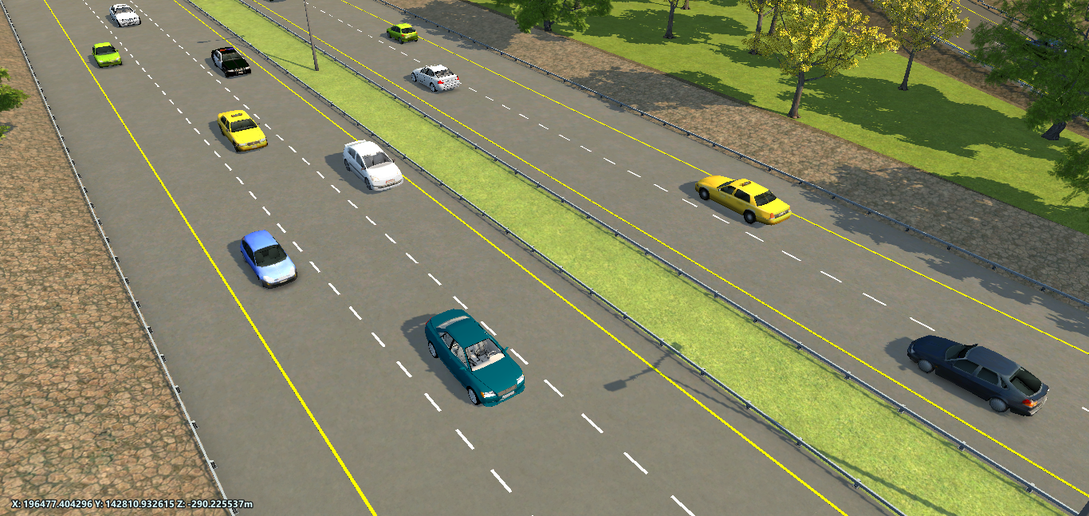
Guardrail
Rumble Strip

Slide 50
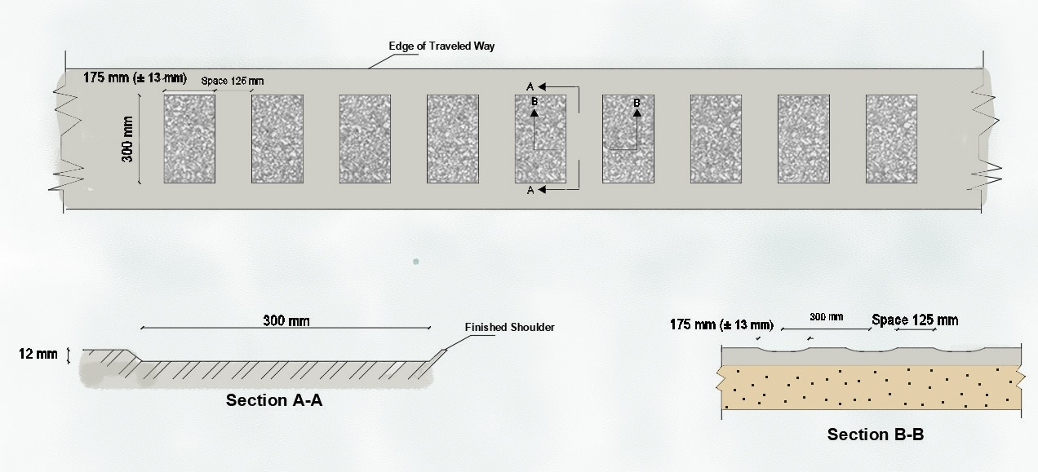
Rumble Strip

Slide 51
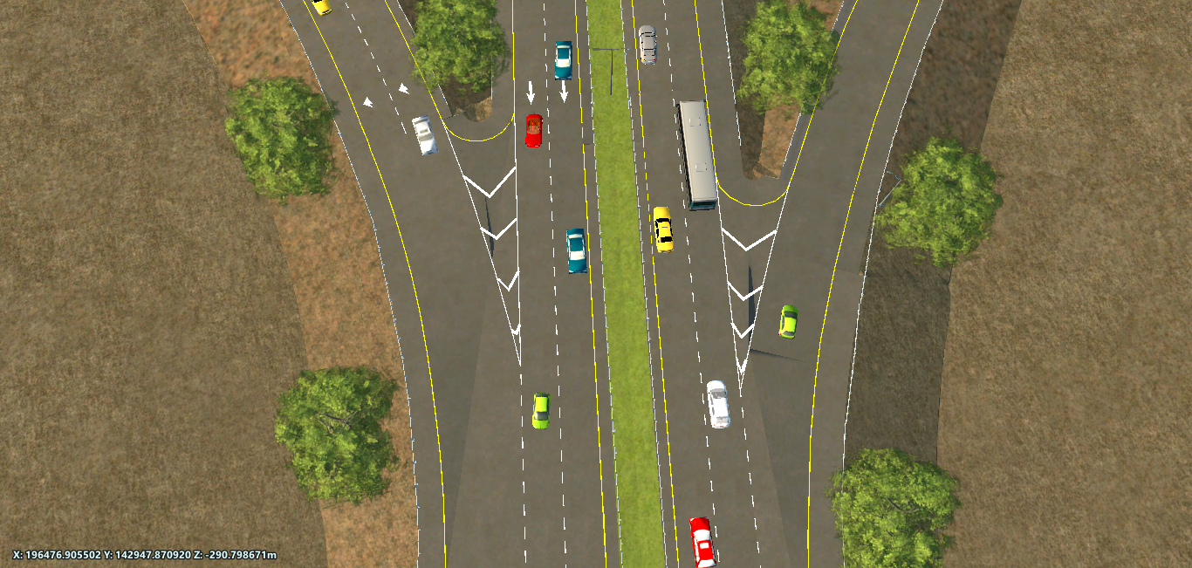
Gore Area
Airport Roadway

Slide 52
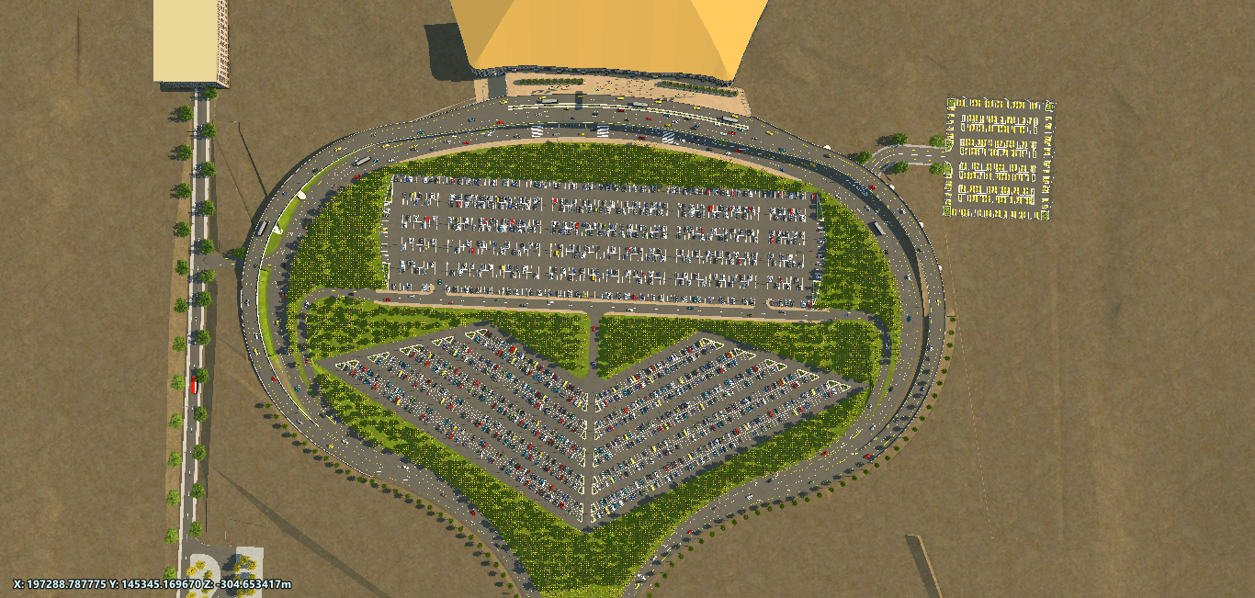
Circulation Road

Slide 53
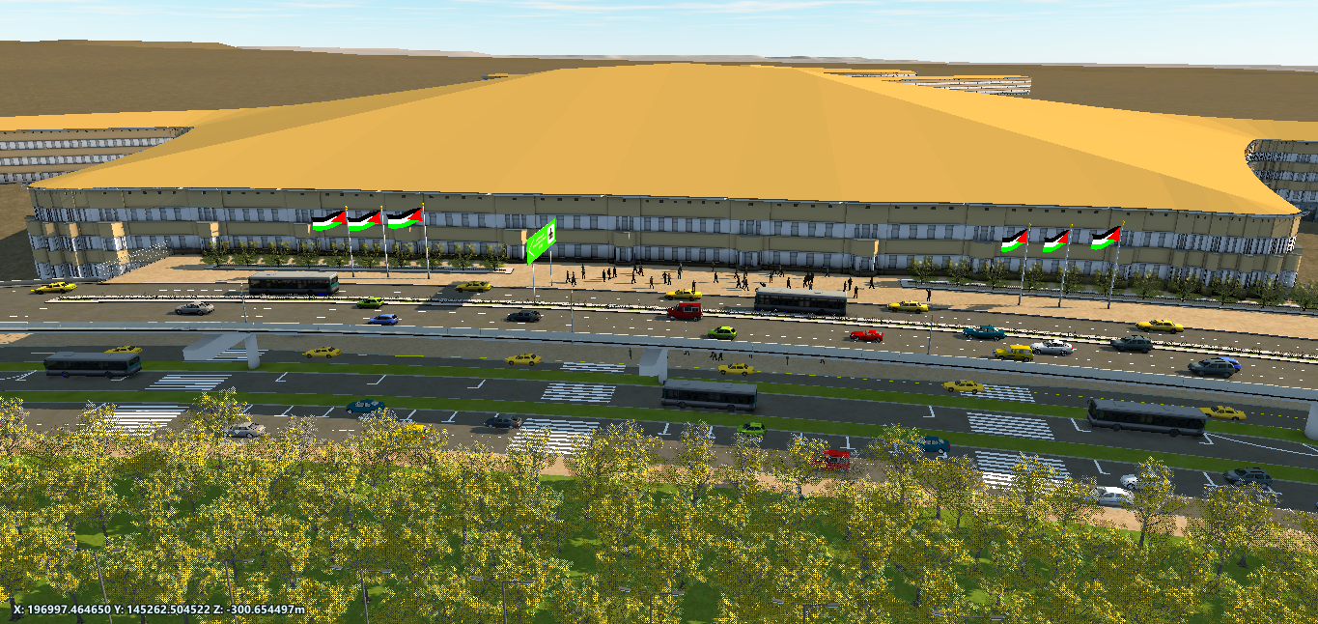
Level 1 : Arrival
Level 2:
Departure
Circulation Road

Slide 54
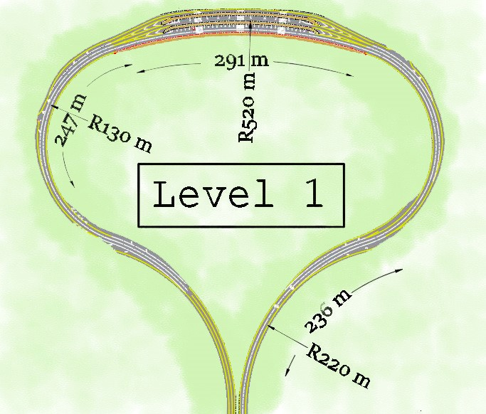
W = 7.89 m
W = 7.43 m
W = 7.99 m

Slide 55
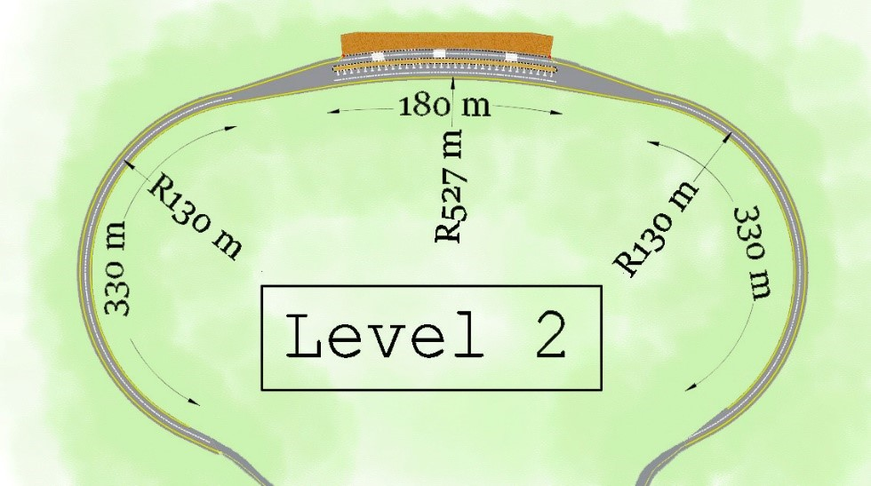

Slide 56
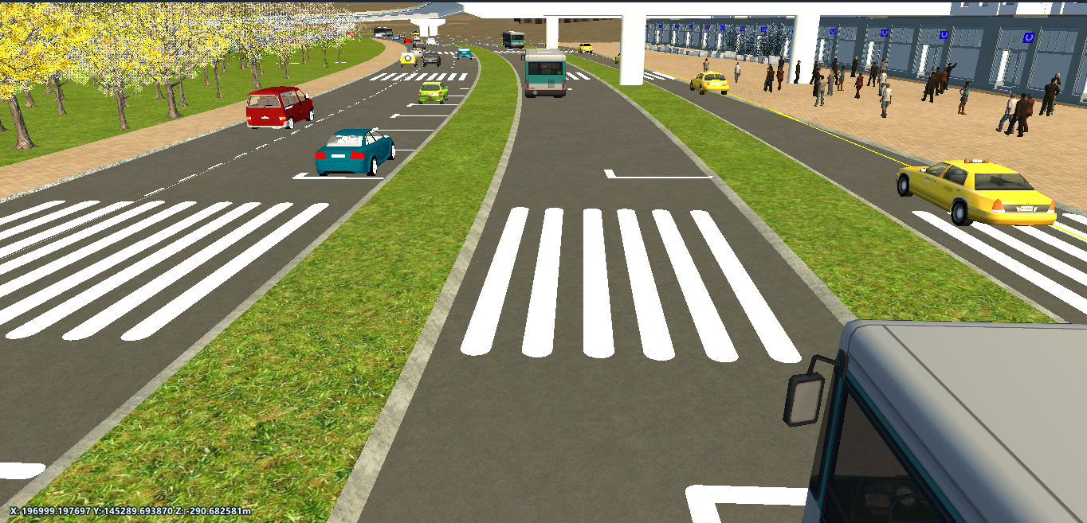
Taxi Lane
Bus lane
3.7
20 m
4
3.7
3.3
4
3.7
3
3.7
2 Lanes
Private Car
For Loading
For Loading
Level 1

Slide 57
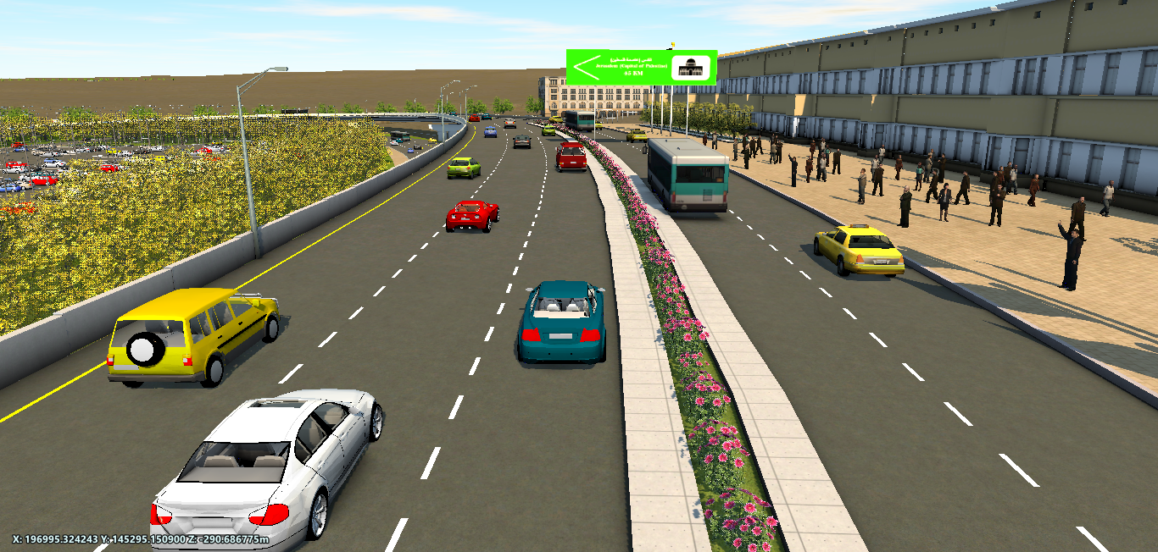
Public transportation Lane
2 Lanes Private car
1.2
3.7
3.7
3
4
3.7
3
For Loading
For Loading
Level 2

Slide 58
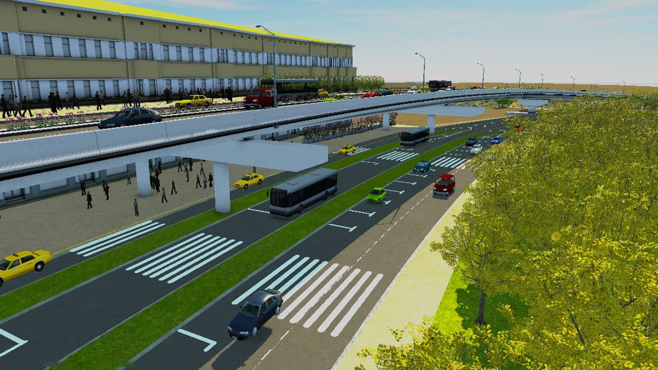
Bridges

Slide 59
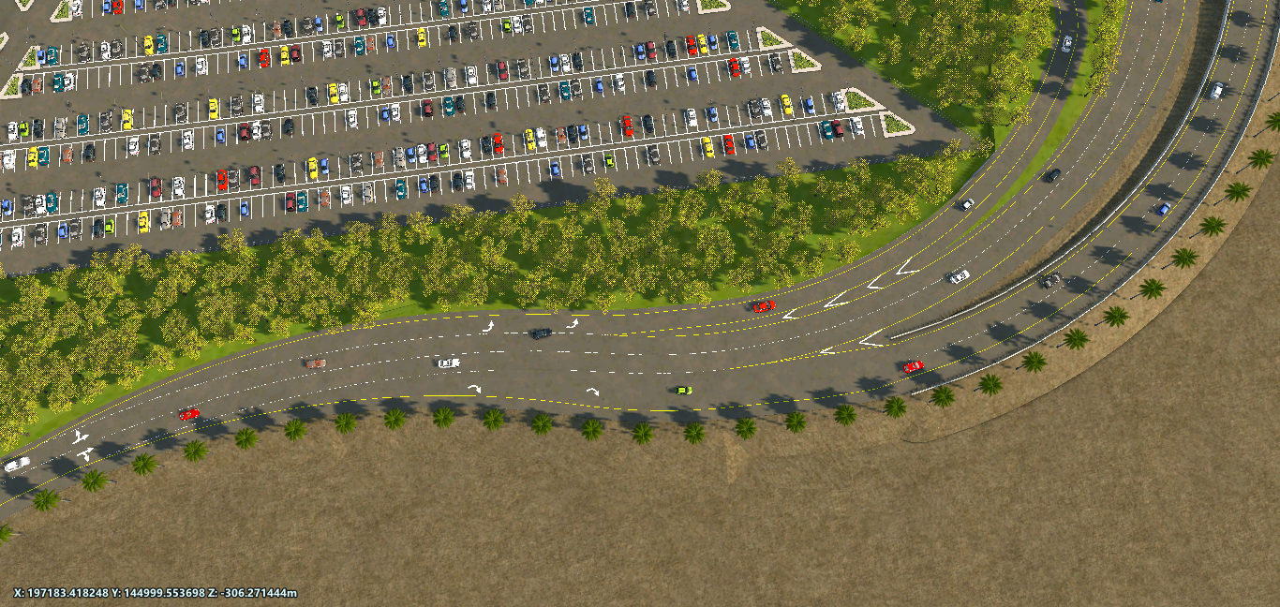

Slide 60
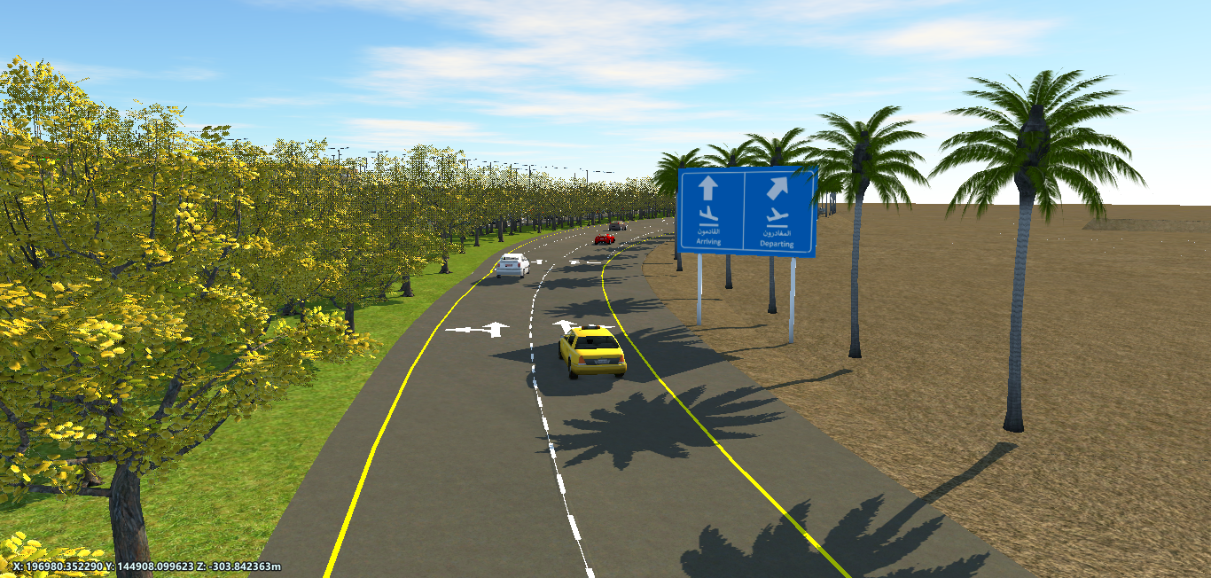
Terminal Building
3 m
1.2 m
4m
4m
1
2
Level 1

Slide 61
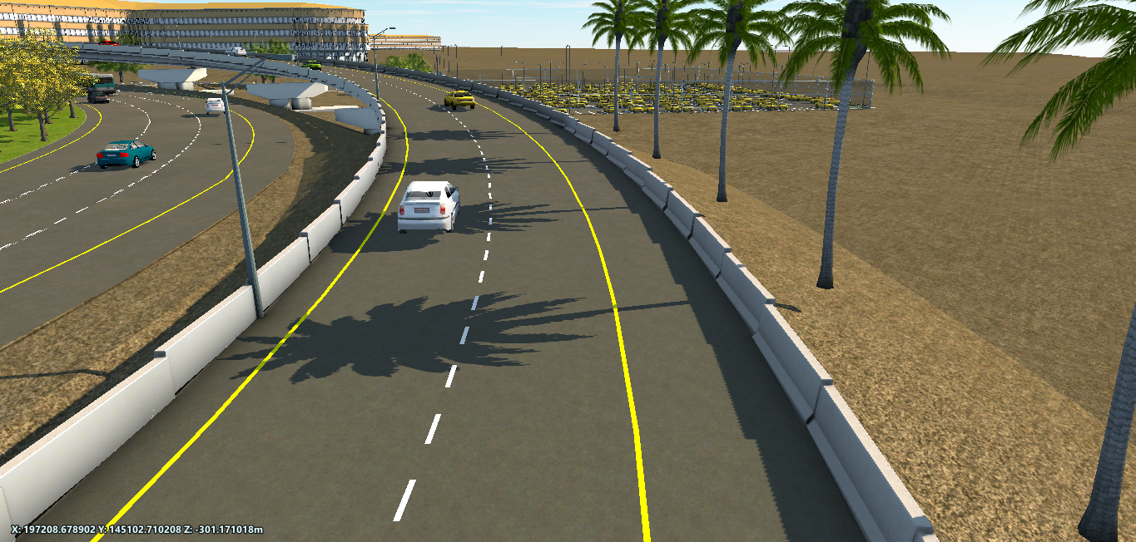
Level 2

Slide 62
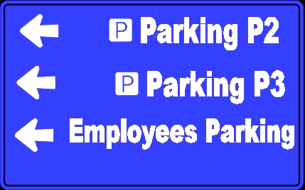




Guide Signs on Circulation Roadway

Slide 63

Cargo Road

Slide 64

Cargo processing unit
Surface layer =6 cm
Base course = 26 cm
Bus parking
2.5m
3.6m
3.6m
2.5m
1
2
Cargo Road

Slide 65


Warning Signs on Cargo Road
Yield Sign
Left Bend
Speed Sign
Right Bend
Stop Sign
No Entry

Slide 66

Guide Signs on Cargo Road

Slide 67

Parking Road

Slide 68
Parking Road
Parking Road

Slide 69

Surface layer =6 cm
Base course = 26 cm
2.5m
3.6m
3.6m
2.5m
1
2

Slide 70

Roundabout

Slide 71

Circulation
Roadway
Cargo Road
Airport Roadway
Roundabout

Slide 72


Slide 73

Directional traffic sign
Roundabout

Slide 74

Parking Spaces

Slide 75
Short-term and Employee Parking Spaces
Parking Spaces

Slide 76

Employee parking spaces
986
2
31,046
m
Parking Spaces
Short-term parking spaces
Short term and employee

Slide 77


Slide 78

1,250
2
36,178
m
Parking
Space
Long term

Slide 79


Slide 80

286
7,778
2
m
Parking
Space
Taxi Parking

Slide 81


Slide 82

28
2
Parking
Space
10,836
m
Bus Parking

Slide 83


Slide 84
Estimated Cost of the Project
Cut and Fill
11,667,578 $
Marking
271,641 $
Base Course and Bituminous
6,494,773 $
Guardrail
1,708,630 $
Curbstone
370,200 $
Street Lamp
485,562 $
Guide Signs
9,770 $
Bridges
27,078,000 $

Slide 85
Estimated Cost of the Project
50,543,212 $

Slide 86
The End

Slide 87









1
4
7
2
5
8
3
6
9

