Slide 1



ProjectsHub

Slide 2


The Problem

Slide 3

What Problems Do Researchers face ?
The Problem
  Funding
  Mentoring
  Prototyping
  Legal limitations

Slide 4
The Problem
AND MOST IMPORTANTLY ...
IDEA!

Slide 5

What Do Researchers Need ?

Slide 6
What Do Researches Need ?
  SOMEWHERE TO DISCUSS IDEAS
  SOMEWHERE TO GET NEW IDEAS
  SOMEWHERE TO SEE WHAT OTHER RESEARCHERS WORK ON

Slide 7


What Is ProjectsHub?

Slide 8

SOCIAL MEDIA APP AND WEBSITE

Slide 9

ALL ABOUT SHARING IDEAS

Slide 10

ALSO, ABOUT SHARING YOUR WORK

Slide 11

AND ABOUT HELPING OTHERS THROUGH THEIR PROBLEMS

Slide 12

Tech Stuff

Slide 13


Front-End

Slide 14


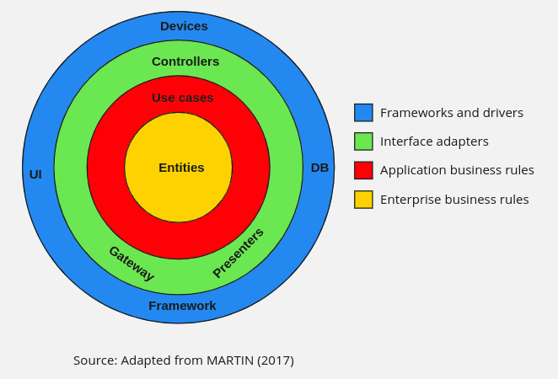
Back-End

Slide 15



Dev-Ops

Slide 16

Recommendations

Slide 17
Recommendations
  Support different languages (not only English).
  Improving chat system.
  Better Recommendation system and topic Following
  A notification system.

Slide 18
Recommendations
  Better searching.
  Native Developing.
  Better UI/UX.
  More Privacy Options For accounts and posting.

Slide 19

Demo

Slide 20

Questions ?

Slide 21
Thank You

