Slide 1

Al - NAJAH NATIONAL UNIVERSITY
FACULITY OF ENGINEERING
INDUSTRIAL ENGINEERING DEPARTMENT
Implementation of Statistical Process
Control “SPC” at Al-Safa
Dairy Plant
Presented to :
Eng. Tamer Haddad
Eng.Suliman Duaifi
Eng.Ayham Jaroon
Prepared by:
Malak Tamam Zeina Abdelhaq

Slide 2

Contents
. Introduction.
. About the factory
Problem Statement .
. Objective
. Specifications
. Row Milk Process Flow Chart
. Cream Milk
. Cream Milk Process Flow Chart
. Minitab Tests Results

Slide 3
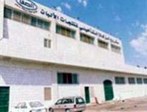
Al -SAFA Dairy Plant
Establishment Idea
Al-SAFA dairy plant for milk and dairies productions establishment idea was started as one of Al Zakat projects in Nablus-Palestine in 1990 at the area reach to 7 dunms.
Production Capacity
production capacity is 60 ton daily.

Slide 4
Starting Production :
The factory started its production process with the highest technological specifications at 2001. In the cooperation
with Tetra Pak company .

Slide 5
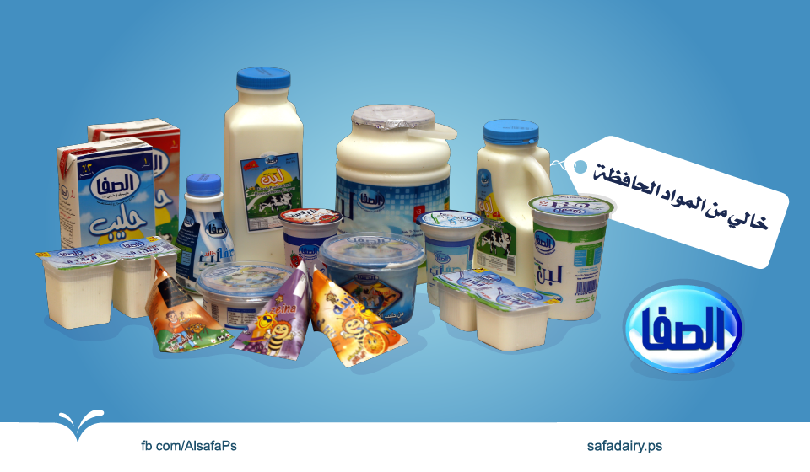
The Main type of Al SAFA products

Slide 6
Problem Statement
In this project we present a case study in Statistical Quality Control of Cream Milk at AL-SAFA Dairy Plant.
Al-SAFA dairy plant has been suffering from not enough sufficient quality system .
Moreover AL SAFA factory don't implement its data by any type of analytical programs so they don't have any indicators about their progress in production and the causes for non-conforming products.

Slide 7
Objectives
1. Improve and implement an advanced quality system in Al- SAFA dairy plant for Dairy products.
2. Increase customer satisfaction and reduce customer complaints. .
3. Reduce the percentage of out of control and variance in order to achieve continuous improvement for the process.
4. Monitoring and optimizing microbiological quality of products we can find out of control products to prevent failures before any out of control state appear with the production process.

Slide 8
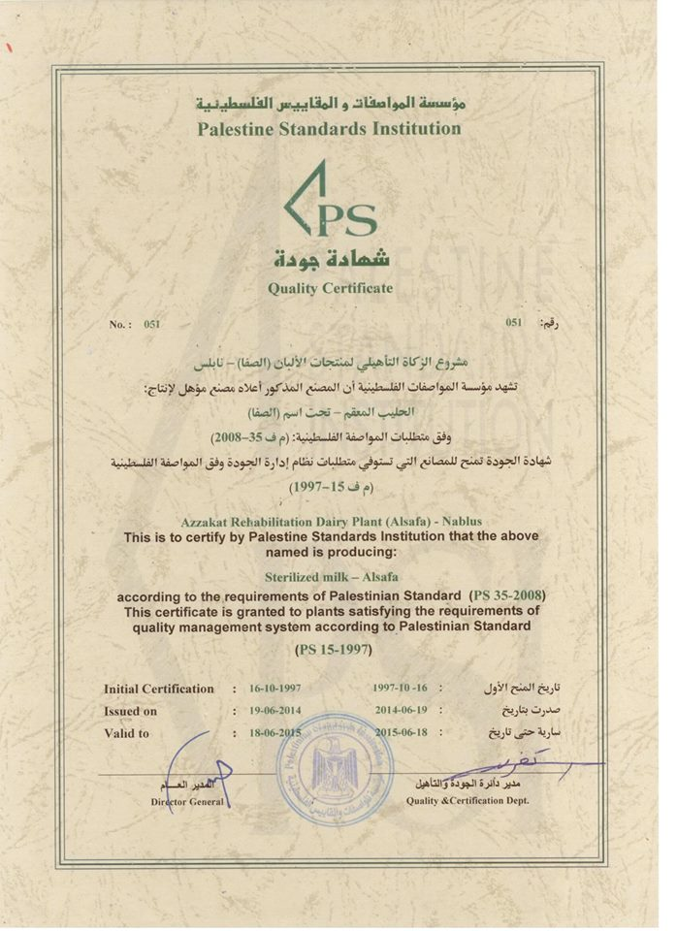
Specifications
Al -SAFA dairy plant productions are Palestinian product at 100 % for sterilized Palestinian milk , for which the factory has Palestinian specification as a quality assurance tool.

Slide 9
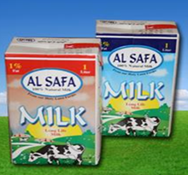
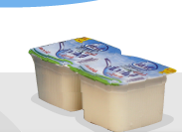
Palestinian standard for quality used to measure
Raw Milk Palestinian Specification number is 35 .
Cream Milk Palestinian Specification number is 74

Slide 10
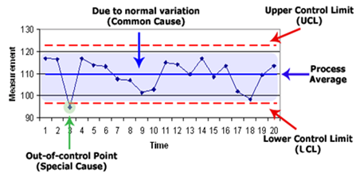
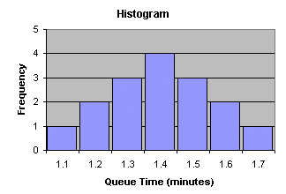
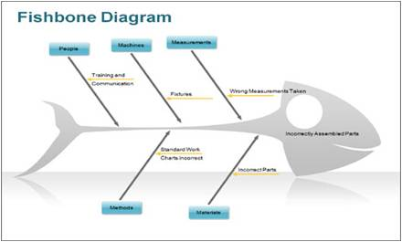
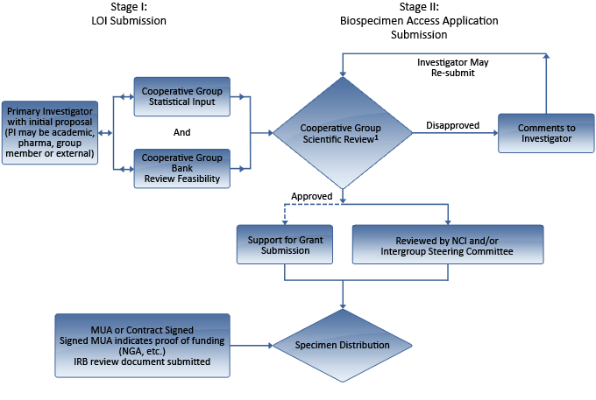
SPC Tools we used at our Project

Slide 11
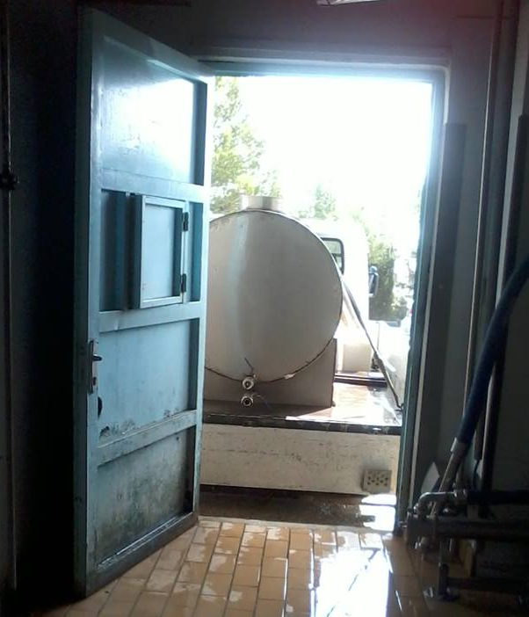
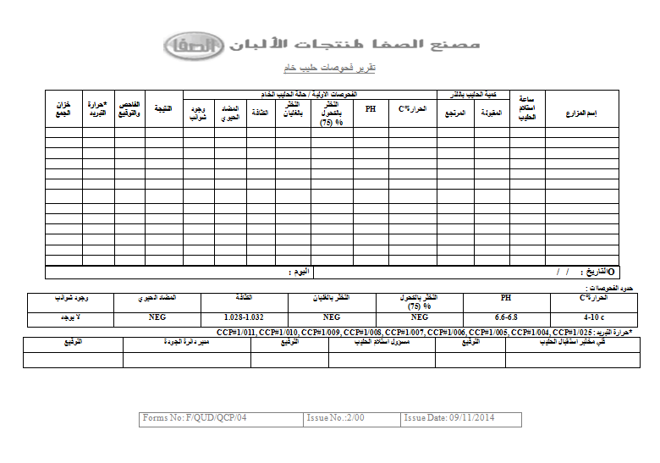
Process Flow Chart for Row Milk
The process of manufacturing started from receiving Raw milk from farmers at receiving area , and then the sample of 100 ml is taken to check it by Test (1)

Slide 12
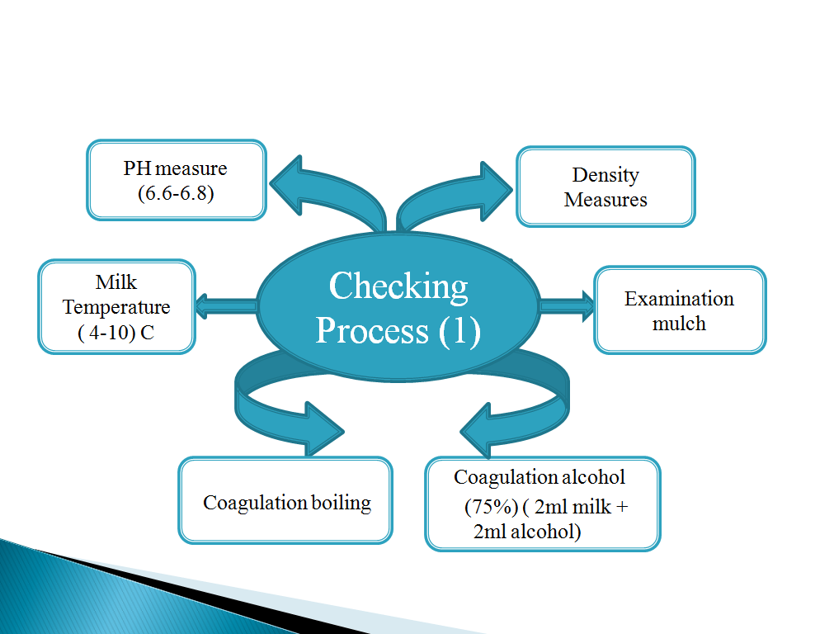
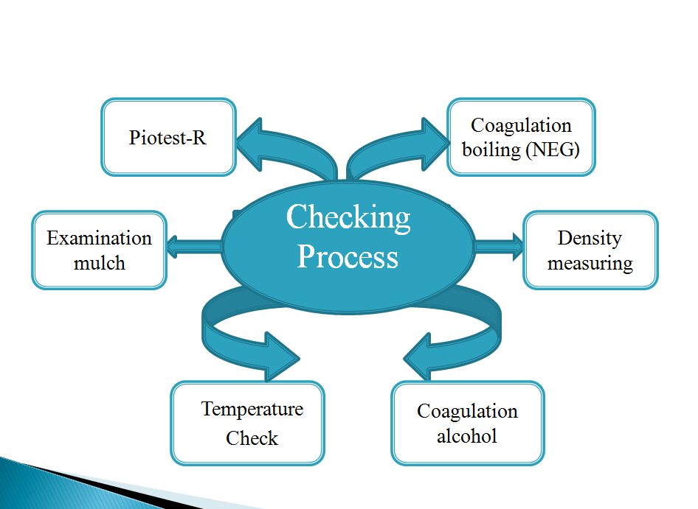
Test (1)
Test (1)
Density Measures
(1.028-1.032)

Slide 13
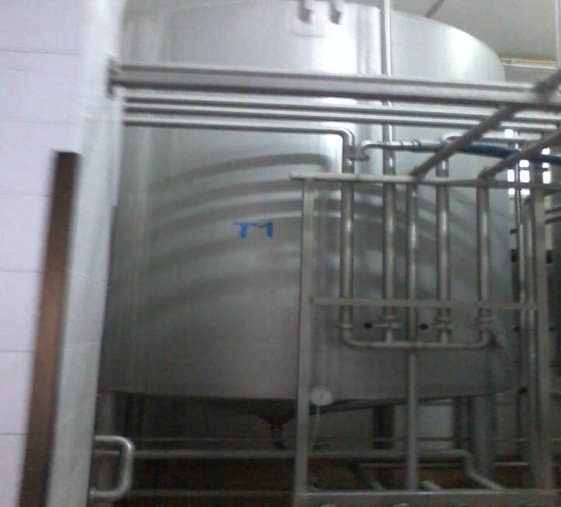
Test (1)
Row Milk Process Flow Chart
Receiving row milk
From the farms
Passed
Failed
Filtration Process
Returning the row milk to the farmers
Filling Milk into Tanks
Filtration Process (2)
Cooling Process at 4C
Storage at Tanks
Filtration Process(3)

Slide 14
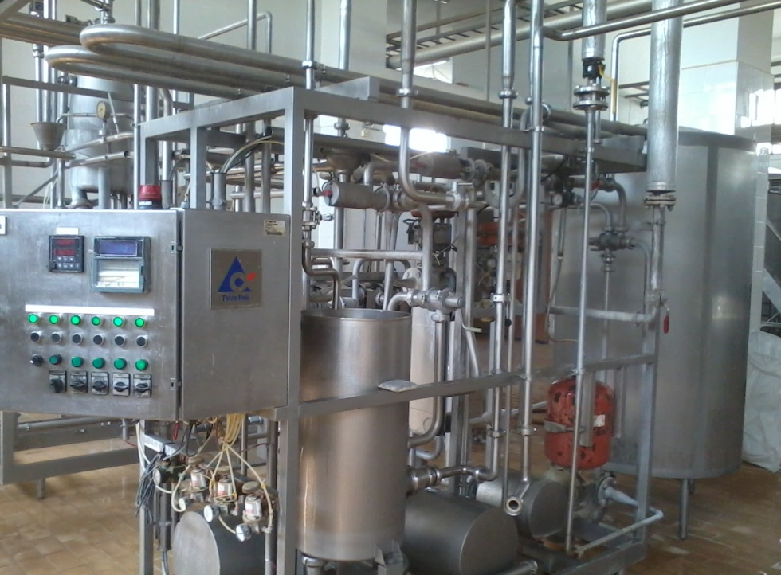
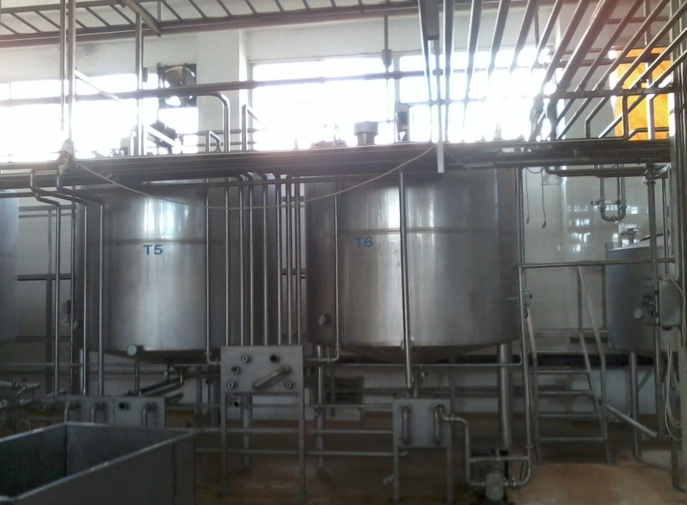
Pasteurization Process
Balance Tank
Deodorizations
Separation Process
Homogenization
Pasteurization
Cooling

Slide 15
ABC Analysis

Slide 16
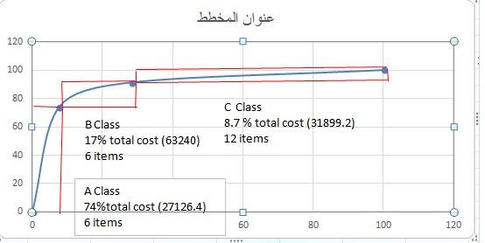

Slide 17

Cream Milk
It one of the most important type of dairy products , its produced from Fresh bovine milk and homogeneous and pasteurized , that are fermented by adding some Microbiology that called Prefix on it
The Packaging criteria by using plastic cups 190 ml or 115 ml , and the packaged cups must be saved at the Icebox at temperature between ( 4-6 C ) , every carton have 48 cup of cream milk

Slide 18
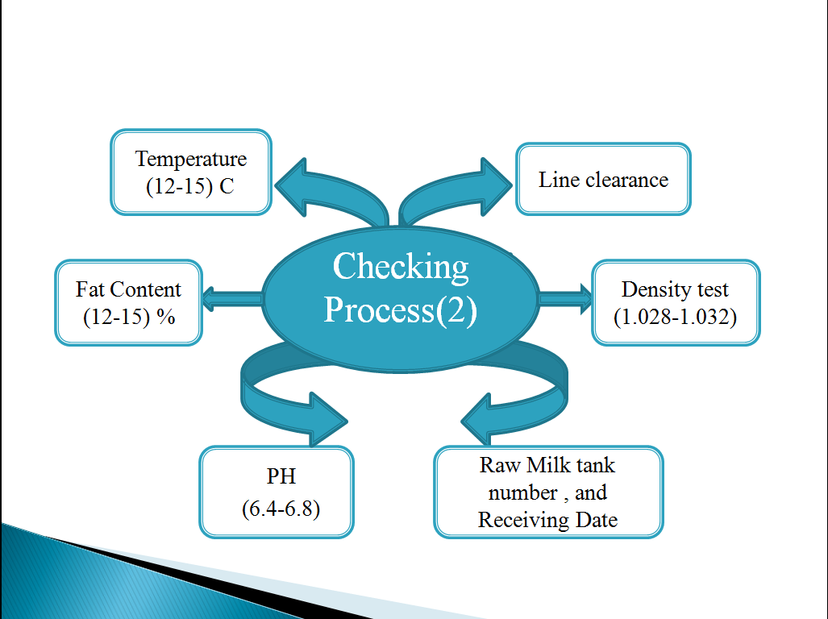
Test (2)

Slide 19
Cream Milk Process Flow Chart
Test (2)
Prefix
Passed
Failed
10-12 % Add Fat
Mixing Process
Preservatives
Pasteurization
Heating
Packaging Material
Filling Process

Slide 20
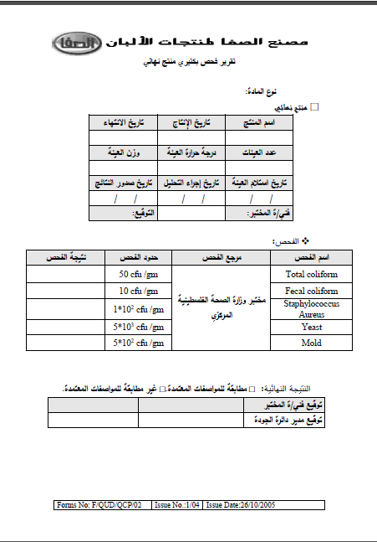
Covering Stage
Incubation
Cooling Process
Final Test Germs Test

Slide 21
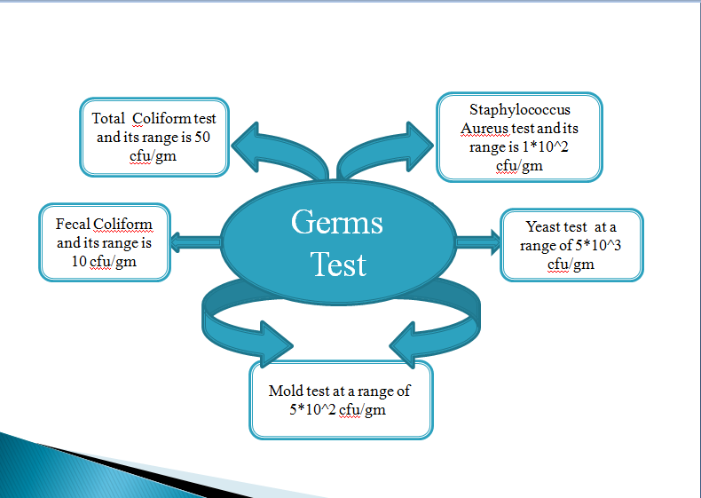

Slide 22
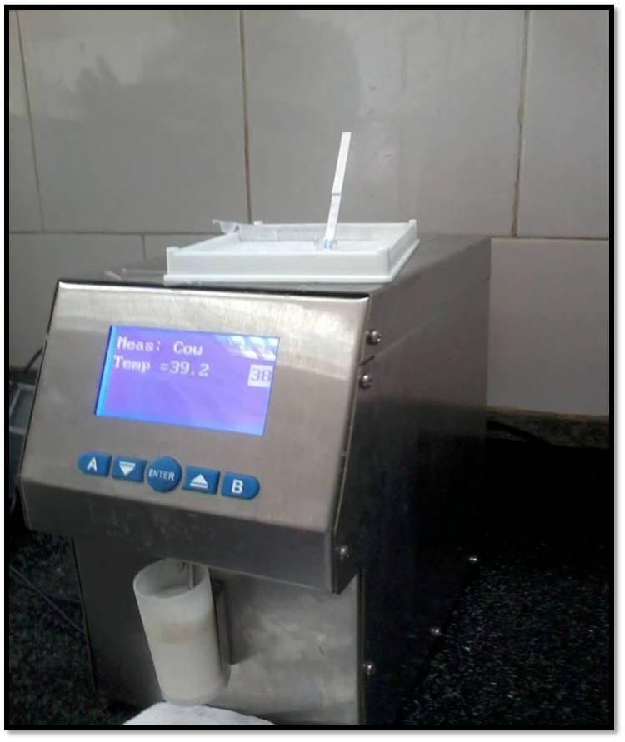
Apparatus used to take readings for Raw Milk Tests
The Eight tests we talked about are
Fat Test
Density Test
Solid Test
Solubility Test
Freezing Point Test
Water added Test
Protein Test
Lactose Test

Slide 23
The Data for first 25 Sample of Raw Milk
S-bar | X-Bar | X12 | X11 | X10 | X9 | X8 | X7 | X6 | X5 | X4 | X3 | X2 | X1 | Sample | Date
.251 | 2.76 |  |  |  |  |  | 2.72 | 2.64 | 3.02 | 2.70 | 3.20 | 2.60 | 2.49 | N1 | 12/12/14
.284 | 2.73 |  |  | 2.29 | 2.75 | 3.09 | 2.92 | 2.42 | 2.56 | 2.99 | 2.50 | 2.79 | 3.08 | N2 | 13/12/2014
.327 | 2.78 |  |  |  | 2.82 | 2.72 | 2.64 | 2.89 | 3.52 | 2.92 | 2.53 | 2.61 | 2.38 | N3 | 14/12/2014
.240 | 2.75 |  |  |  |  | 3.18 | 2.67 | 2.47 | 2.92 | 2.62 | 2.65 | 2.57 | 2.97 | N4 | 15/12/2014
.561 | 2.90 |  |  | 2.70 | 2.66 | 2.52 | 3.19 | 2.42 | 3.54 | 3 | 2.53 | 4.12 | 2.41 | N5 | 16/12/2014
.331 | 2.76 |  |  |  | 2.84 | 2.79 | 2.32 | 3.11 | 2.66 | 3.16 | 2.5 | 3.15 | 2.35 | N6 | 17/12/2014
.410 | 2.86 |  |  | 3.07 | 2.78 | 2.30 | 3.20 | 2.41 | 3.61 | 2.99 | 2.43 | 2.76 | 3.10 | N7 | 18/12/2014
.242 | 2.86 |  |  |  |  |  | 2.89 | 2.77 | 3.08 | 3.20 | 2.92 | 2.68 | 2.48 | N8 | 19/12/2014
.377 | 2.88 |  | 2.72 | 2.65 | 2.32 | 2.72 | 3.04 | 3.44 | 2.72 | 2.82 | 3.63 | 2.63 | 3.01 | N9 | 20/12014
.219 | 2.80 |  |  |  | 2.68 | 2.75 | 2.79 | 3.09 | 2.66 | 3.01 | 2.76 | 3.10 | 2.44 | N10 | 21/12/2014
.404 | 2.68 |  |  | 2.81 | 2.74 | 2.40 | 3.34 | 2.82 | 2.07 | 2.09 | 2.68 | 2.76 | 3.12 | N11 | 22/12/2014
.271 | 2.79 |  |  |  |  | 2.74 | 2.85 | 2.79 | 2.55 | 2.95 | 3.36 | 2.56 | 2.57 | N12 | 23/12/2014
.396 | 2.83 |  |  | 2.22 | 2.83 | 2.75 | 2.35 | 2.71 | 3.15 | 3.07 | 2.78 | 3.62 | 2.88 | N13 | 24/12/2014
.267 | 2.77 |  |  | 2.84 | 2.39 | 2.61 | 2.89 | 2.42 | 2.79 | 3.06 | 2.59 | 3.22 | 2.89 | N14 | 25/12/2014
.339 | 2.85 |  |  |  |  | 2.85 | 2.77 | 2.84 | 3.28 | 2.57 | 3.44 | 2.52 | 2.57 | N15 | 26/12/2014
.319 | 2.77 |  | 2.51 | 2.81 | 3.35 | 2.30 | 2.81 | 2.69 | 2.80 | 2.89 | 2.31 | 3.13 | 2.95 | N16 | 27/12/2014
.282 | 3.03 |  |  |  | 2.94 | 2.91 | 2.77 | 3.18 | 2.99 | 3.47 | 3.47 | 2.69 | 2.88 | N17 | 28/12/2014
.331 | 2.81 |  | 2.17 | 2.80 | 2.64 | 2.89 | 2.83 | 2.93 | 2.53 | 2.94 | 2.76 | 3.54 | 2.91 | N18 | 29/12/2014
.391 | 3.02 |  |  |  | 2.82 | 2.90 | 2.74 | 3.60 | 2.84 | 3.53 | 2.63 | 3.48 | 2.7 | N19 | 30/12/2014
.297 | 2.89 | 2.39 | 2.57 | 2.85 | 2.69 | 2.84 | 2.86 | 3.18 | 2.79 | 2.80 | 3.19 | 3.43 | 3.19 | N20 | 1/1/2015
.147 | 2.84 |  |  |  |  | 2.85 | 2.84 | 2.83 | 2.65 | 2.83 | 2.80 | 2.76 | 3.17 | N21 | 2/1/2015
.316 | 2.94 |  | 2.85 | 2.93 | 2.81 | 2.79 | 2.69 | 2.76 | 2.89 | 3.73 | 2.75 | 2.80 | 3.36 | N22 | 3/1/2015
.488 | 2.92 |  |  |  | 2.65 | 2.82 | 2.79 | 2.99 | 4.17 | 2.78 | 2.87 | 2.80 | 2.47 | N23 | 4/1/2015
.378 | 2.82 |  | 2.88 | 2.96 | 2.74 | 2.80 | 2.78 | 2.06 | 2.88 | 3.65 | 2.65 | 2.63 | 3.08 | N24 | 5/1/2015
.302 | 2.85 |  |  |  |  | 2.79 | 2.59 | 3.09 | 2.53 | 2.92 | 2.93 | 3.41 | 2.56 | N25 | 7/1/2015

Slide 24
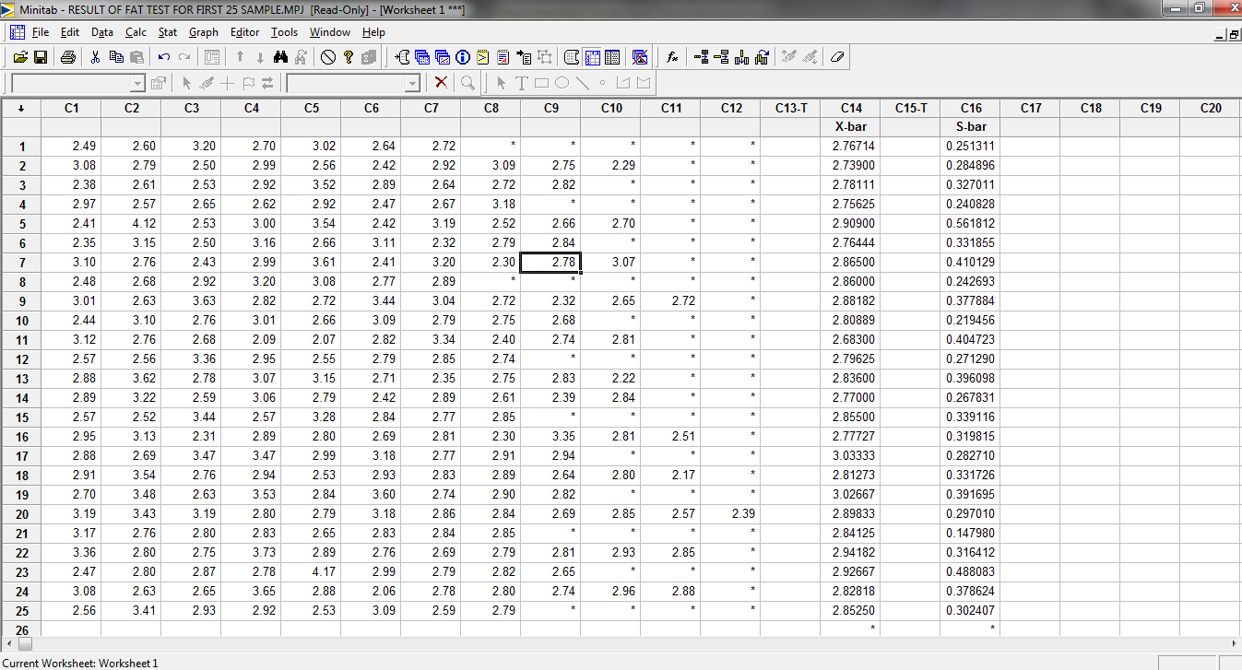
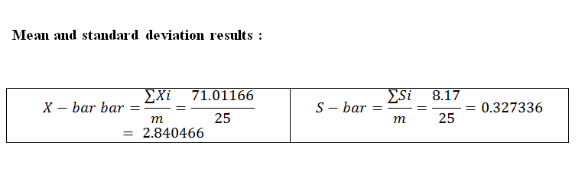

Slide 25
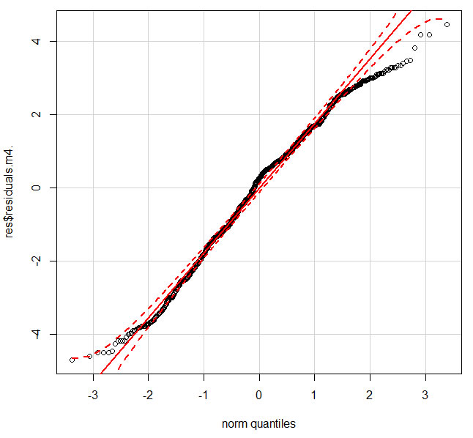
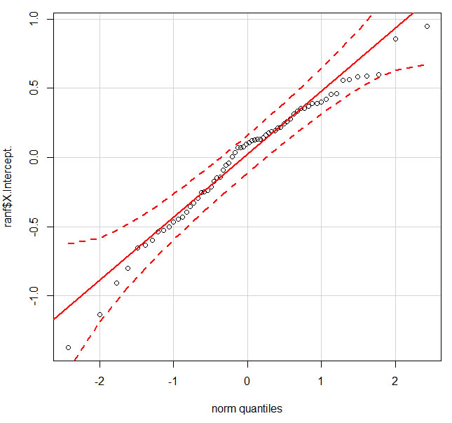
Normality Test
The first test we made is the Normality test to make sure that all the data of the samples are lies on the blue line of the graph , which mean that the process ( test ) has Normal distribution for which we can found the control charts for the test
Un-Normal
Normal

Slide 26
Fat Content Normality Test

Slide 27
X-Bar Chart
X-Bar Chart :It is constructed to control the variation s in the average quality std of the products in the production process

Slide 28
S-Bar Chart
S-Bar Chart : is a type of control chart used to monitor variable data when samples are collected at regular intervals from a business or industrial process.

Slide 29
Histogram
Process Capability

Slide 30
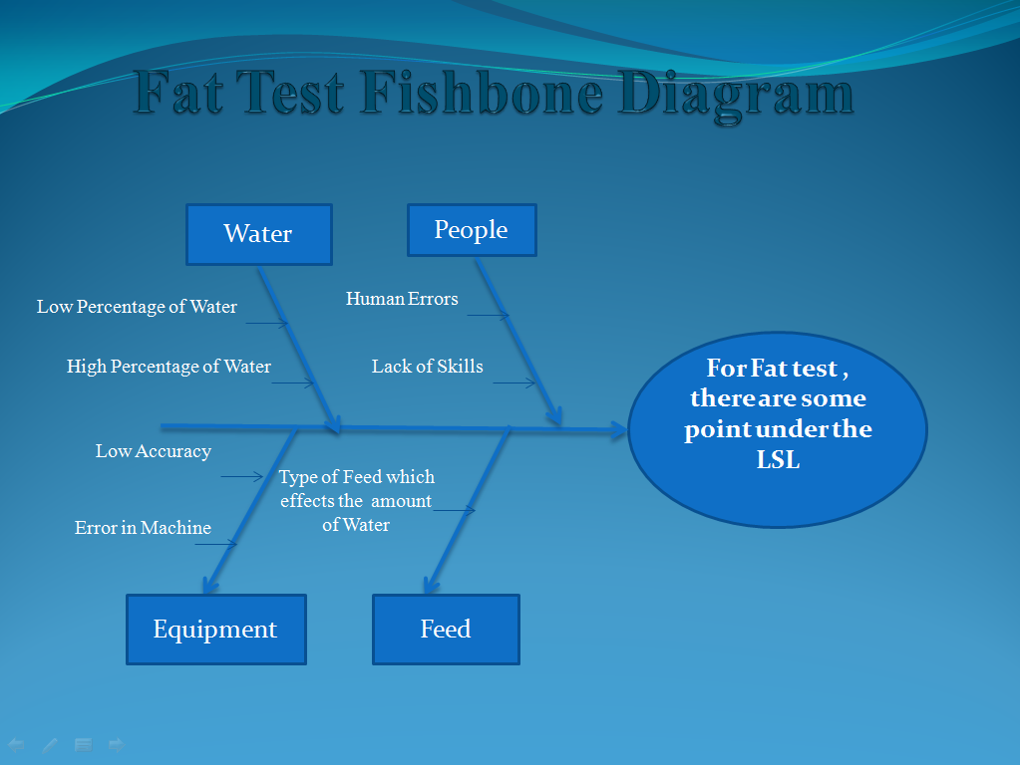

Slide 31
Another 25 Sample Fat test
X12 | X11 | X10 | X9 | X8 | X7 | X6 | X5 | X4 | X3 | X2 | X1 | Sample | Date
 |  |  |  | 2.75 | 2.79 | 2.62 | 3.15 | 2.36 | 3.12 | 2.31 | 2.49 | N26 | 11/2
 |  | 2.32 | 2.77 | 3.51 | 3.08 | 2.35 | 2.93 | 3.11 | 2.26 | 2.19 | 2.59 | N27 | 24/2
 |  |  | 2.36 | 2.57 | 2.27 | 3.13 | 2.40 | 3.09 | 3.14 | 2.13 | 2.58 | N28 | 25/2
 |  |  | 2.61 | 2.43 | 2.47 | 3.01 | 2.95 | 2.20 | 3.01 | 2.19 | 2.48 | N29 | 26/2
 |  | 2.77 | 2.54 | 2.59 | 2.29 | 2.48 | 3.02 | 3.13 | 2.46 | 2.89 | 2.21 | N30 | 27/2
 |  |  | 2.72 | 3.44 | 2.60 | 3.09 | 3.16 | 2.36 | 2.47 | 2.54 | 2.81 | N31 | 28/2
 |  | 2.62 | 2.59 | 2.60 | 3.18 | 2.73 | 2.73 | 3.06 | 2.40 | 2.54 | 2.79 | N32 | 3/3
 |  |  |  | 2.64 | 2.65 | 3.12 | 2.39 | 3.06 | 3.05 | 2.99 | 2.14 | N33 | 5/3
 |  | 2.96 | 2.66 | 2.90 | 2.70 | 3.05 | 2.59 | 2.35 | 3.27 | 2.29 | 2.53 | N34 | 6/3
2.85 | 2.85 | 2.18 | 2.90 | 2.70 | 2.35 | 2.80 | 2.76 | 3.13 | 3.10 | 2.29 | 2.66 | N35 | 7/3
 | 2.87 | 2.88 | 2.72 | 3.15 | 2.45 | 2.66 | 2.43 | 3.06 | 2.41 | 3.15 | 2.62 | N36 | 8/3
 |  |  |  | 2.67 | 2.57 | 2.63 | 2.87 | 3.15 | 2.25 | 3.09 | 2.54 | N37 | 9/3
 |  | 2.38 | 3.29 | 2.73 | 2.76 | 2.81 | 3.22 | 2.65 | 3 | 3.05 | 2.63 | N38 | 10/3
 | 2.96 | 2.61 | 2.70 | 3.20 | 2.76 | 2.30 | 2.30 | 2.31 | 3.01 | 3.07 | 2.61 | N39 | 11/3
 | 2.35 | 2.64 | 2.77 | 2.70 | 3.10 | 3.08 | 2.52 | 2.35 | 2.32 | 2.95 | 2.62 | N40 | 12/3
 |  |  | 2.95 | 2.92 | 3.24 | 3.05 | 2.75 | 2.55 | 3.20 | 2.25 | 2.63 | N41 | 13/3
2.38 | 2.81 | 2.99 | 2.77 | 2.64 | 2.70 | 3.17 | 2.56 | 3.02 | 3.09 | 2.55 | 2.75 | N42 | 14/3
 |  |  |  | 2.88 | 3.32 | 3.17 | 3.09 | 2.63 | 3.07 | 3.02 | 2.72 | N43 | 15/3
 |  |  | 2.74 | 2.87 | 3.18 | 2.65 | 2.63 | 2.32 | 3.04 | 2.35 | 2.74 | N44 | 16/3
 |  | 2.70 | 3.04 | 2.63 | 2.35 | 2.20 | 2.63 | 3.15 | 2.64 | 3.04 | 2.38 | N45 | 17/3
 |  | 2.51 | 2.76 | 2.78 | 2.71 | 2.99 | 2.59 | 2.59 | 3.00 | 2.19 | 2.71 | N46 | 18/3
2.25 | 2.20 | 2.71 | 2.70 | 2.39 | 2.86 | 2.21 | 2.24 | 2.61 | 2.81 | 2.39 | 2.58 | N47 | 20/3
 | 2.52 | 2.72 | 2.97 | 2.63 | 2.60 | 2.30 | 3.25 | 2.33 | 2.90 | 2.25 | 2.62 | N48 | 21/3
 |  |  |  | 2.86 | 2.88 | 3.21 | 2.67 | 3.07 | 2.61 | 2.35 | 2.64 | N49 | 21/3

Slide 32
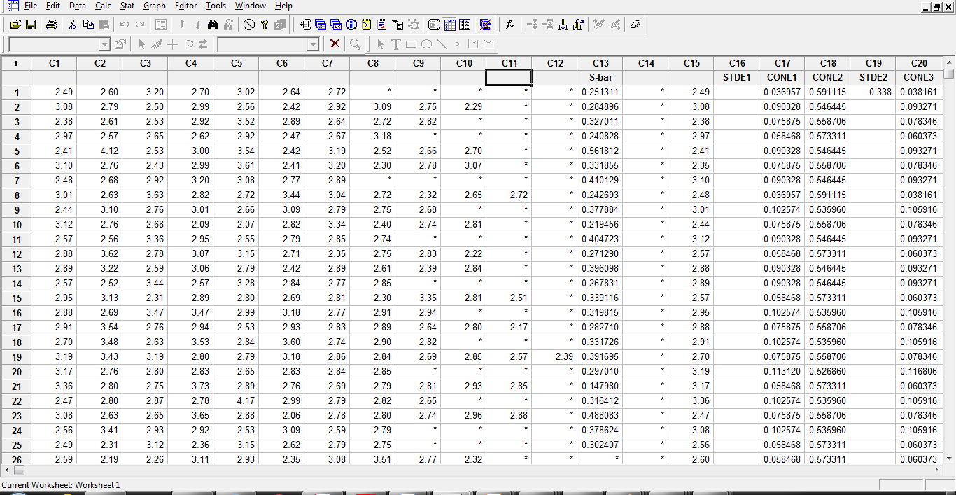

Slide 33
Fat test X-Bar Chart for 50 Sample

Slide 34
Fat test S-Bar Chart for 50Sample

Slide 35
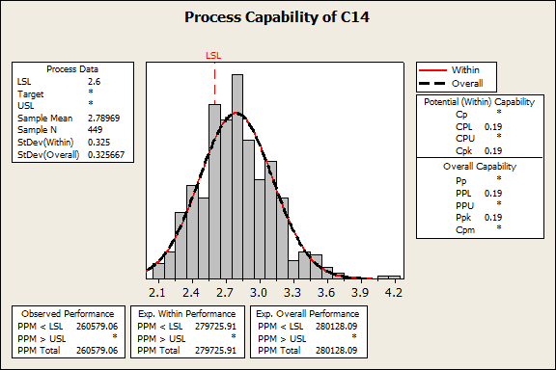
Process Capability
Histogram

Slide 36
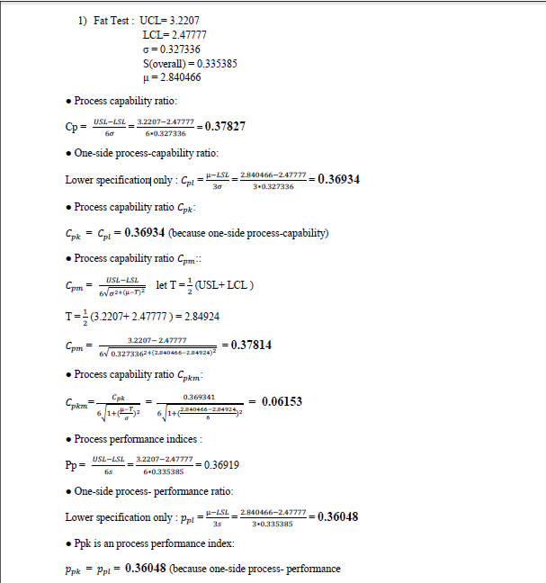
Process Capability Calculations for Fat test

Slide 37


Slide 38
Cream Milk Data for Volume Test
S-Bar | X-Bar | X6 | X5 | X4 | X3 | X2 | X1 | Date
0.00 | 115 |  |  |  | 115 | 115 | 115 | 6/7/2014
2.1213 | 116 |  |  |  |  | 118 | 115 | 8/7/2014
1.41421 | 116 |  |  |  |  | 117 | 115 | 9/7/2014
1.16905 | 116 | 117 | 117 | 118 | 115 | 118 | 116 | 10/7/2014
2.5000 | 115 |  |  | 118 | 116 | 112 | 115 | 11/7/2014
39.3823 | 169 | 195 | 195 | 196 | 195 | 120 | 118 | 12/7/2014
2.08167 | 117 |  |  |  | 119 | 118 | 115 | 13/7/2014
0.00 | 115 |  |  |  |  | 115 | 115 | 14/7/2014
2.12132 | 116 |  |  |  |  | 115 | 118 | 15/7/2014
0.00 | 115 |  |  |  |  | 115 | 115 | 16/7/2014
0.707107 | 115 |  |  |  |  | 116 | 115 | 17/7/2014
2.12132 | 116 |  |  |  |  | 115 | 118 | 18/7/2014

Slide 39
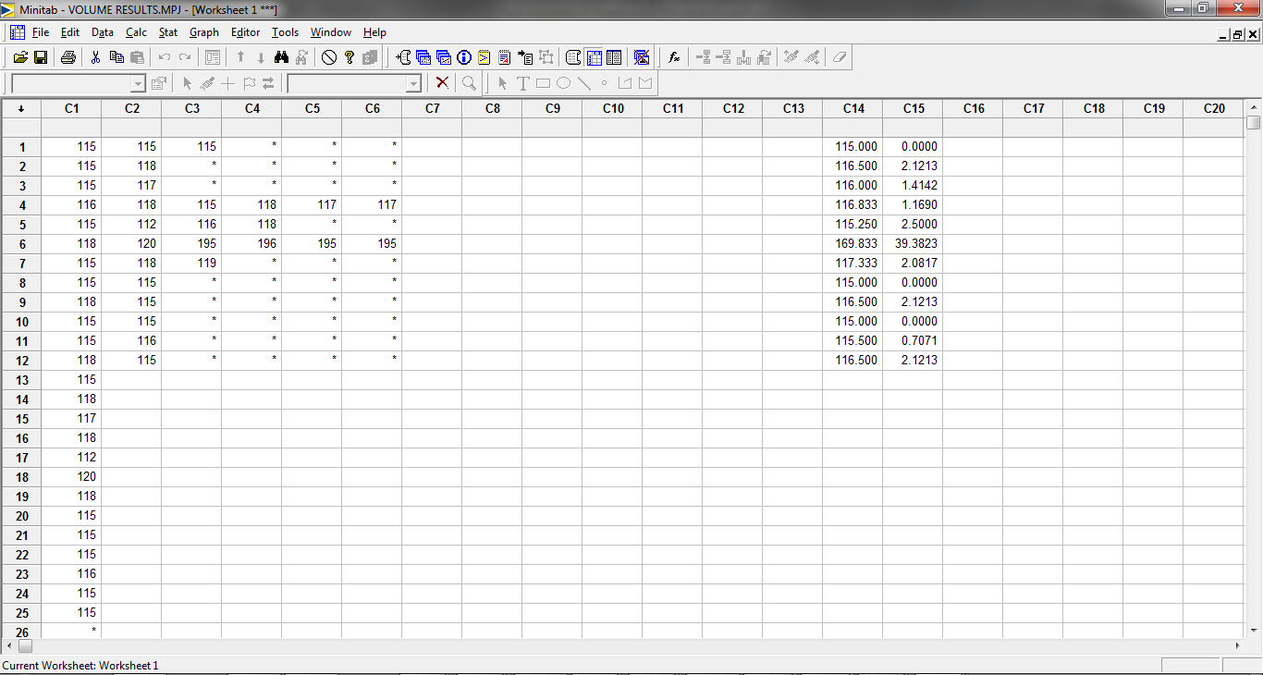
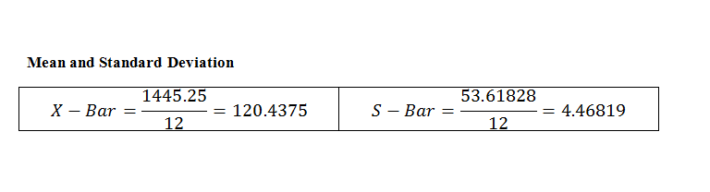

Slide 40
Cream Milk S-Bar Chart
Cream Milk X-Bar Chart

Slide 41
Cream Milk X-Bar Chart
Cream Milk S-Bar Chart

Slide 42
Result for Error in Volume of the Cream Milk during
filing Process
As an example if the raw milk which filled in the cream milk cups
( 118, 190) ml exceeds by 2or 4 ml this mean there are 2 or 4 ml of raw milk are loosed , and for the future if we calculate the amount of raw milk losses per 1000 can of cream milk we well find the amount of losses
When the factory filled 1000 can of raw milk to produce Cream milk , if there are 2 Ml loosed per can , by filling the 115 ml can in 118 ml of raw milk , then the amount of raw milk loosed per 1000 can of Cream milk is equal to Then the number of cans of Cream milk loosed is equal to = can
This mean nearly 17 can of Cream milk is loosed per 1000 can filled .
2000/118=1 6.9

Slide 43
Conclusion
Our project depends firstly on Control charts as an empirical tool for the tests on cream milk and raw milk , in order to found if there are any out of control limit point to detect the effect and find the result.
And we used flow process charts to describe the manufacturing process for the raw milk and the cream milk at Al-SAFA dairy plant.

Slide 44
Recommendations
We recommend the factory to improve the quality of the Cream milk filling machine in order to reduce losses and to increase their profit , by taking the volume of each can of cream milk before its enter to the incubators.
The factory must develop safety considerations such as water in the ground must be removed, cables of electricity must be more safe .
By our and people opinion we recommend the factory to change the shape of the Cream Milk can to be more attractive ,to cancel the traditional shape of the can , and to change the material of the cup cover from Silvan to another more colorful cover .

Slide 45

Any Question

