Slide 1
Wireless Power Transfer
Team:
SARAH MUSBAH
AMAL ALOSH

Slide 2
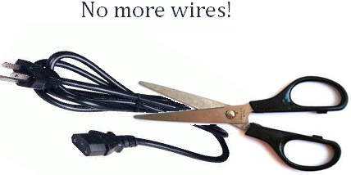
Objective
Client needs to charge a device that is not directly connected to a source, i.e. No Wires!
Sub-Project for Saleh Alamassy
Construct a testing device for a wireless charging system. Device will be used system set-up and deployment.

Slide 3
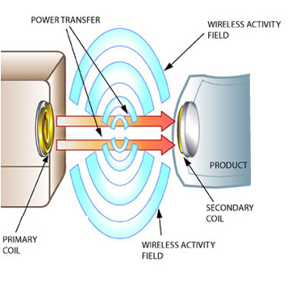
Requirements
Transmit power wirelessly at least 24 inches
Produce 5-V / 10W output to receivers
Transmission frequency should be greater than 2MHz
System must utilize Magnetic Induction
Primary side must plug into a wall outlet
Must charge a device
(Sub-project) Must have testing device
http://www.leggettecoupled.com/how-ecoupled-technology-works.asp

Slide 4
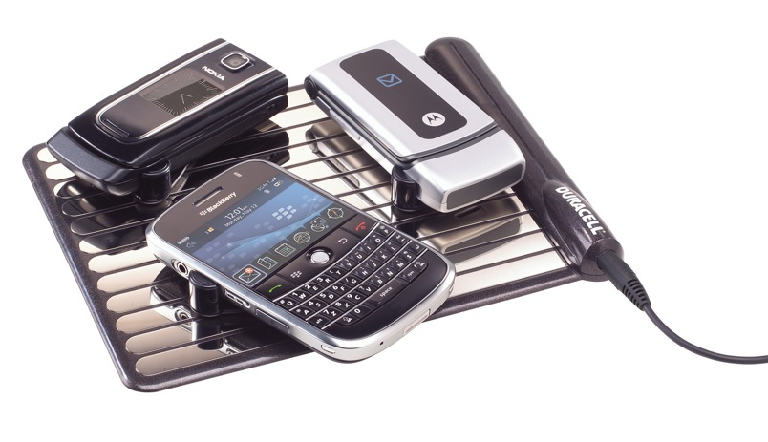
Project Impact
Societal Effects of Wireless Power
    Convenience
    Reduces clutter in workspaces, homes, etc.
    Variety of Applications
Health and Safety Concerns
  Believed to pose no health risks
Environmental Impact
  Battery disposal
Ethical Issues
  FCC compliance with other devices
http://www.gizmodo.com.au/2009/08/duracells-smart-power-lineup-includes-wireless-gadget-charging-pad/

Slide 5
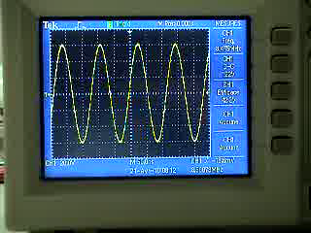

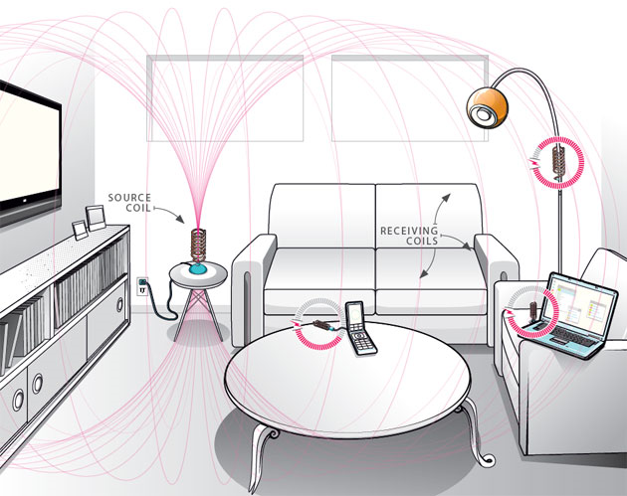
Magnetic Resonant Induction
Resonance Tuning
AC power is supplied at the system operating frequency
The inductor and capacitor are chosen so that they resonate at the operating frequency, creating a much larger magnetic field
By placing a resonant receiver within the magnetic field, a resonant circuit is created
This resonant circuit allows the system to pass voltage and current to the receiver over significant separation distance
http://media.popularmechanics.com/images/witricity-0907a.jpg

Slide 6
Design Components
Source
Side
Power Source
Power Processing
Wireless Channel
Sending
Receiving
Charging Receiver
Power Processing
Output Power
Seth McCaleb Matt Harding
Eli Baughman Levi Moore
Mike Gary Justin Stiles
Testing Device
Power Detection
Better Range Finder
Saleh Alamassy

Slide 7
Full System Schematic
Charging Receiver
Source Side
Tuning Capacitor
Tuning Capacitor
Receiving Coil
USB Out
Viking I
RF Amplifier
Voltage Regulator
Primary Coil
Test Receiver
LED Array
Tuning Capacitor
Receiving Coil

Slide 8
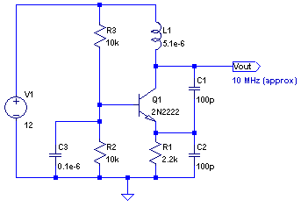
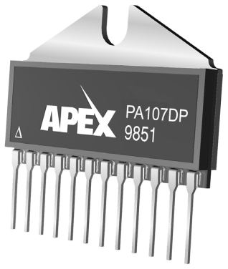
Source Side – Problems
Source
(DC supply)
Colpitts Oscillator
Power
Amplifier
Primary Coil
Colpitts Oscillator
Power Amplifier
Creates output AC signal at designed
frequency
Extremely robust
Colpitts Oscillator provides small signal input
Can provide at least 30W output for up to 7MHz frequency
Simulation
Mounting
Heat Dissipation
Signal Quality
Frequency Compatibility
Mounting
Heat Dissipation
Compatibility With Coils
http://www.biocrawler.com/w/images/f/f6/NPN_Colpitts_oscillator_collector_coil.png
http://www.cirrus.com/en/pubs/proDatasheet/PA107U_A.pdf

Slide 9
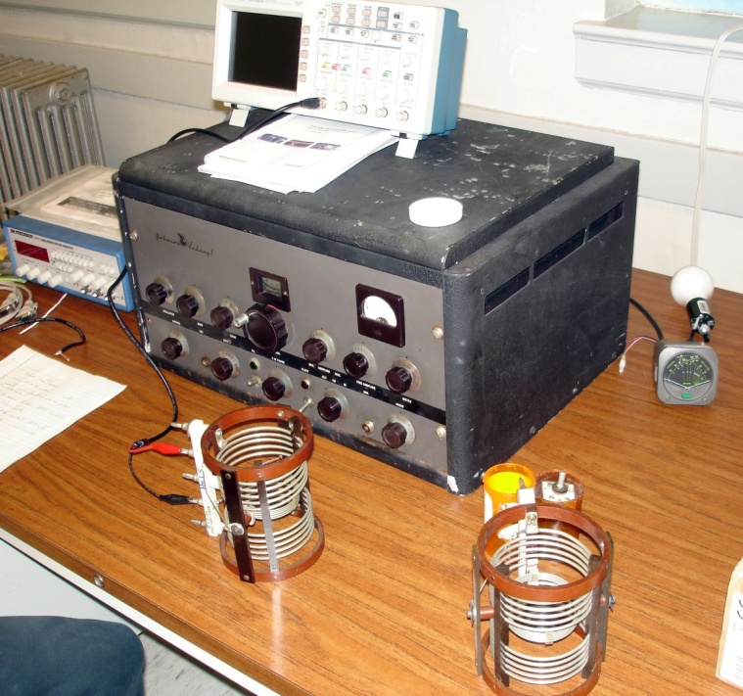
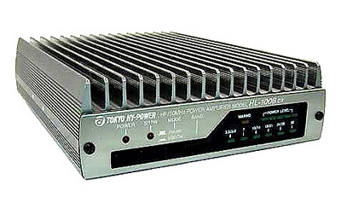
Source Side – Solution
Wall Outlet
RF Transmitter
Primary Coil
Provides oscillation frequency and
power amplification
Driven by crystal oscillators (8.5 MHz)
Tunable output power
Connect to coils through coax cable
Cost and Project Requirements
Viking 1 ($120, 80lbs)
Tokyo HL-100DBX ($805, 5lbs)

Slide 10
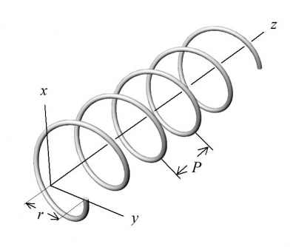
Wireless Channel – Design
Transmission Coil
Receiving Coils
Design Features
Helical Coils
Coil geometry selected to maximize inductance
Capacitance can be tuned to resonance
Resonance can be achieved with a variety of geometries
Wire Gauge | Diameter | Turns | Spacing | L | C_{coil} | C_{total}
18 | 2.5 in | 37 | 2 mm | 39.3 μH | 3 pF | 9 pF
18 | 2.5 in | 50 | 2 mm | 56.0 μH | 3.3 pF | 6.26 pF
18 | 4.5 in | 23 | 2 mm | 59.9 μH | 5.9 pF | 5.97 pF
12 | 2.5 in | 65 | 3 mm | 49.1 μH | 5.0 pF | 7.1 pF
12 | 2.5 in | 70 | 2.5 mm | 58.5 μH | 4.9 pF | 5.9 pF
12 | 4.5 in | 28 | 2.5 mm | 60.3 μH | 5.5 pF | 5.8 pF
10 | 2.5 in | 75 | 3mm | 52.2 μH | 5.9 pF | 6.7 pF
http://www.advancedtubular.com/wiki/images/thumb/a/a8/Coilpitch.jpg/400px-Coilpitch.jpg

Slide 11
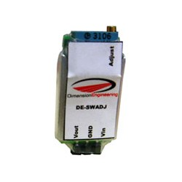
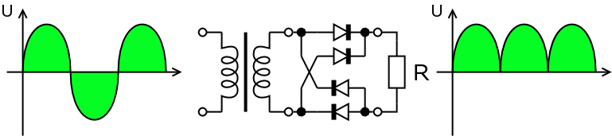
Charging Receiver – Design
Secondary Coil
Full-Wave Rectifier
Voltage Regulator
Charger
Design Features
Full-Wave Rectifier must handle MHz frequency and up to 15W
Voltage Regulator will provide 10W 5V dc output for charging device
Charger, plan to charge a phone with a phone charger.
http://www.robotshop.us/dimension-engineering-de-swadj-1.html?utm_source=google&utm_medium=base&utm_campaign=jos
Rectifier Circuit Components
Rectifier Diodes (50V max)
100 mF Capacitor
http://upload.wikimedia.org/wikipedia/commons/c/cc/Gratz.rectifier.en.png

Slide 12
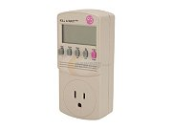
Testing Device – Plan
Receiving Coil
LED Light
Wattmeter
Same coil design as Charging Receiver.
Wattmeter to display amount of power received.
LED array for visual indication of signal strength .
http://www.newegg.com/product/product.aspx?Item=N82E16882715001

Slide 13
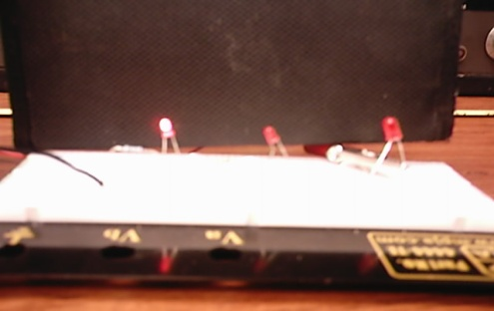
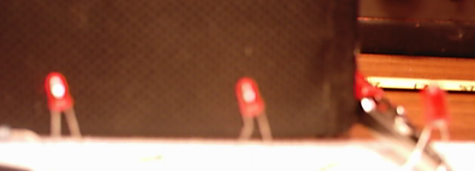
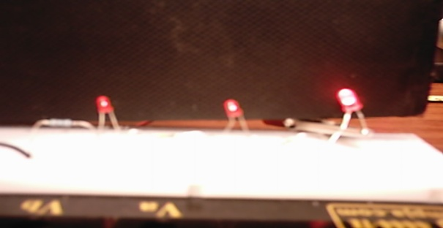

Testing Device – Design
3 stage LED array to identify field strength
Each LED has a different resistor in series
As field strength increases, enough power is increased to illuminate each successive LED
Led 1 on
Led 1 & 2 on
Test Receiver
LED Array
Led 1 & 2 & 3 on
Tuning Capacitor
Receiving Coil
http://www.netgate.com/support/Drivers/STA_24071bin/ACU/Manual/images/tray_icons.gif

Slide 14
Schedule
September | October | November | December | January | February | March | April | May
Continued Research / Planning
Schematic Completed
Budget Completed
 |  | Order
 |  |  | Prototype
 |  |  |  |  | Construct Coils / Finalize System
 |  |  | Testing and Validation

Slide 15
Testing
Task | Equipment | Prototype | Final
Primary Side operation Freq. | Oscilloscope | Complete | Complete
Wireless channel operation (test coils) | Oscilloscope | Complete | NA
Constructed Coil operation | Oscilloscope / Function Generator | Complete | Complete
Rectification and charging test | Charger/Scope | Complete | Complete
Testing Device | Oscilloscope / Function Generator | Complete | 4/22/10
Range | Oscilloscope / Testing Device | Complete | 4/22/10

Slide 16
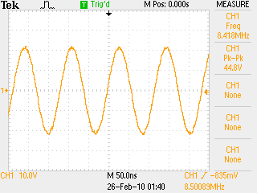
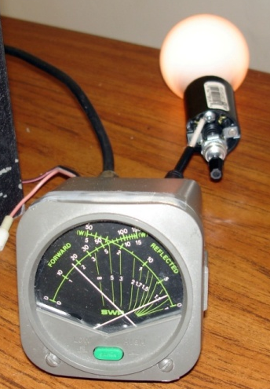
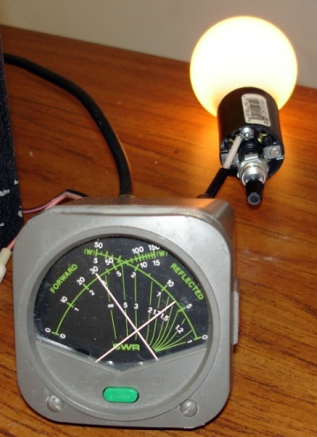
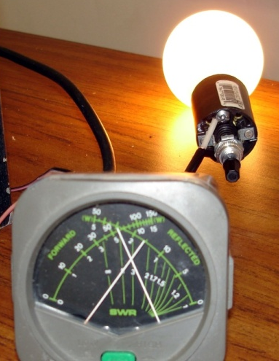
Source Side – Testing
Status:
  Clean waveform at 8.5MHz
  Multiple power outputs available
  Current could not be measured due to frequency limit of multimeters
18W
30W
60W

Slide 17
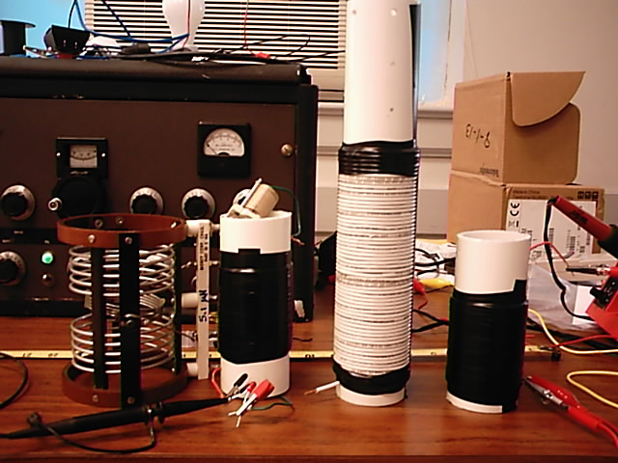
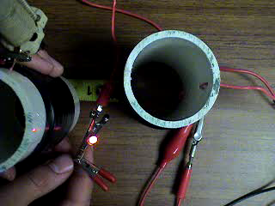
Wireless Channel – Design
BC-610 PA’s did not have a high enough inductance to transfer power
All constructed coils were able to resonate
Without grounding, power was received at 3ft
With grounding, power was received at 8ft
Un-grounded Test
BC-610 PA
5.1 µH
AWG 18 37 turns
39.3 µH
AWG 12 65 turns
49.1 µH

Slide 18
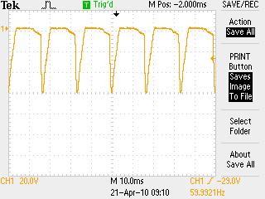
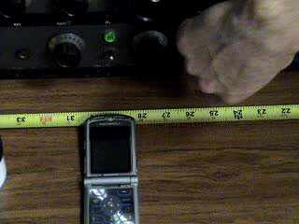
Charging Receiver – Test Results
Charging Test
Oscilloscope Waveform
Successfully rectified and regulated signals.
Typically used pre-built adapters for charging devices.
Most higher end devices have required turn on voltages which are difficult to achieve.
Virtually no error or difficulties in testing the receiving side with the system.

Slide 19
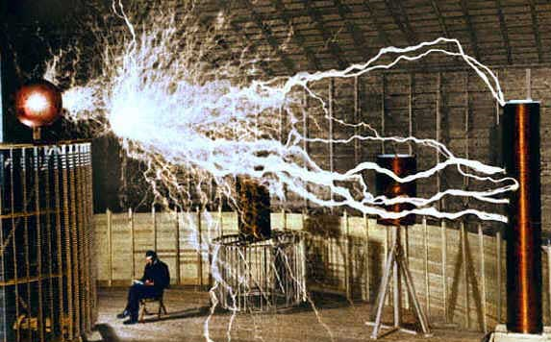
Testing Issues
Plate Current Limit
Cannot use crystals above 8.5MHz
Frequency of Operation
High failure rate for LEDs
Resonance with Oscilloscope
Multi-meter frequency limit
Grounding
http://painawaynow.com/WP/images/tesla.jpg
Difficulties creating virtual ground
Arcing has occurred due to grounding issues
Best results have been achieved when receiving coil is properly grounded (i.e. connected to ground with a wire!)

Slide 20
Project Cost
Component | Division | Prebuilt | Cost
Rf Transmitter | Source Side | Yes | Donated (Must Return)
Frequency Crystals | Source Side | Yes | $78.00
Test Coils (bc-610’s) | Wireless Channel | Yes | Donated (Must Return)
Coils | Wireless Channel | No | $61.37
Bridge Line Rectifier | Charging Receiver | No | $26.25
Voltage Regulator | Charging Receiver | Yes | $28.20
Charger | Charging Receiver | Yes | $5.00
Wattmeter | Testing Device | Yes | $25.98
Led lights | Testing Device | No | ECE 333 kit
Actual Cost to Date: |  |  | $224.80
Total Project Budget: |  |  | $500.00

Slide 21
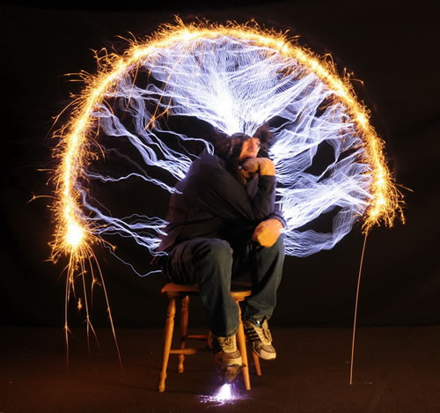
Questions?
http://neatorama.cachefly.net/images/2009-04/tesla-rodin-thinker.jpg

