Slide 1

An-Najah National University
Graduating project II
Delay in construction projects

Slide 2
Outline :
Definition of delay .
Case study .
Literature review.
Methodology.
Analysis.
Discussion and conclusions.
Recommendations.

Slide 3
Definition of delay :
Delay means: an event or a condition that results in finishing the project later than stipulated in the contract .
The delay is one of the main problems that face the construction projects so it has been chosen.

Slide 4

Case study :
Alquds open university building was taken as a case study about delay.
Building | Administration | Theater
Area (m square) | 900 | 550

Slide 5

Literature review:
A number of studies have been carried out to determine the causes of delay in construction projects.
These studies helps to classify delay , and to know the main reason of delay.

Slide 6
Literature review:
Delay can be classified to:
Excusable delay.
Non excusable delay.
Concurrent delays.

Slide 7
Literature review:
Previous studies have had big impact on guiding the researcher how to work on the study, it has benefited from the methodology used in these studies to determine the methodology to be used in this research

Slide 8

Methodology :
Schedule analysis is used in order to identify delays and to measure the net impacts of delays on a project. Basic tools which are used in the schedule analysis are known as bar chart schedules and daily reports ,also interviews with contractor.

Slide 9
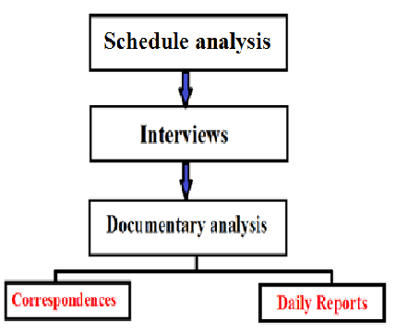
Methodology :

Slide 10
Methodology :
All the previous steps in the methodology was done except the correspondences because the contractor was not able to provide the corresponds document ,instead of that in the interview with the contractor a documented paper explains the reasons of delay was provided

Slide 11

Analysis :
By comparing the baseline schedule with updated schedule following results was conduct:
Delay in foundation excavation due to errors in estimating bearing capacity (waiting of new design of foundation).

Slide 12

Analysis :
There was delay in theater work because there was need for anew design of benches ,according to client request(change order).
There were a change in form work in the theater specifications , from wood to steel due to high height of theater that extent to 10m height

Slide 13

Analysis:
There was delay in stone building activity (the occupation authorities was closed the stone quarry in Jammai'n area).
Also there was lack in stone building labors .

Slide 14
Analysis :
The table below shows the reasons behind delay with its period and percentage of each type :
Reason of delay | Period | Percentage
Resources | 40 | 46
implementing | 10 | 11.5
Redesign | 37 | 42.5

Slide 15

Conclusions and Discussions:
there are two main types of delay :
Excusable delay :
this is a delay that entitles the contractor to additional time for completing the contract work ,excusable delay usually come from reasons beyond the contractors control.

Slide 16
Conclusions and Discussions:
Non excusable delay :
this type of delay that doesn’t entitles the contractor to time extension and compensation ,such as lack of labors and equipments

Slide 17

Recommendations :
Contractors should consider the following factors:
Should assign agreements with materials supplier to get the material on time , also contractor must find an alternative suppliers of materials , to call them when the supplying materials stop (backup plan).
Contractor should provide enough number of resources before start of the activity ,also contractor must make good resource leveling during the construction process .

Slide 18
Recommendations :
Contractor can provide some specimen’s from many sources in the first stage of project to consultant to get approval on them .
Site management and supervision: administrative and technical staff should be assigned as soon as project is awarded to make arrangements to achieve completion within specified time with the required quality, and estimated cost.

Slide 19
Recommendations :
Consultants should consider the following points:
Reviewing and approving the design submittals prior to construction phase to eliminate any errors in the design.
Consultant should use the results of laboratories tests such as soil test and doesn’t depend on practical experience or expert judgment .

Slide 20
Recommendations :
Owner should consider the following points :
Change orders should minimize as much as possible to reduce delay in constructions projects .
Check for resources and capabilities ,before awarding the contract to the lowest bidder.

Slide 21


