Slide 1

Integrated Redesign of an Al-Rahma dispensary
Building
Graduation Project 2
Prepared by :-
Ahlam Damra
Asil Abu Lail
Duaa Ghazal
Supervisor :-
Dr. Monther Dwaikat

Slide 2
Outlines
Site Analysis.
Architectural and Passive Design.
Structural Design.
Electro-mechanical Design.
Safety Design.
Quantity Survey.

Slide 3
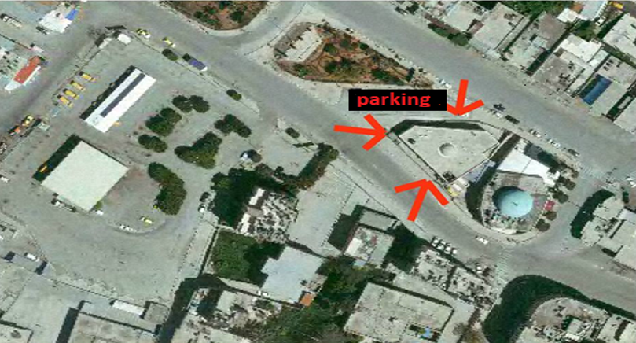
Site Analysis

Slide 4
Architectural and
Passive Design

Slide 5
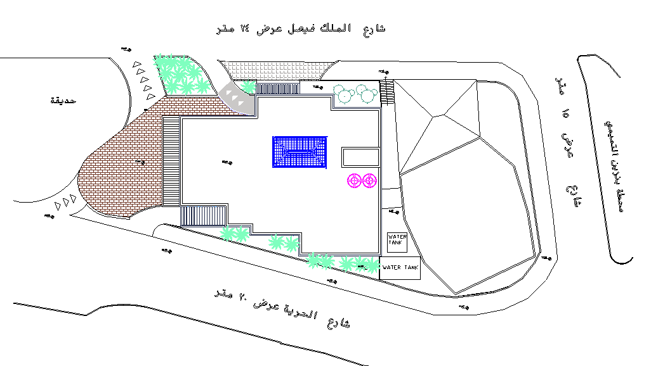
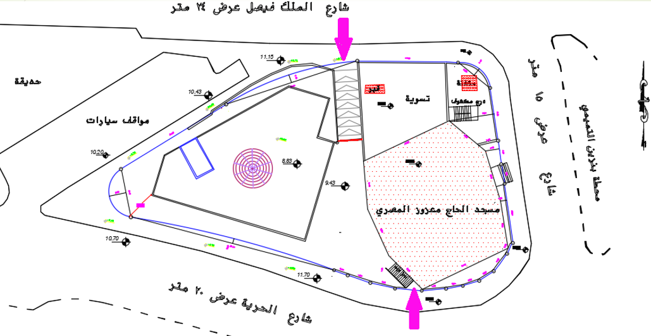
Architectural Design
Site plan
New building
Old building

Slide 6
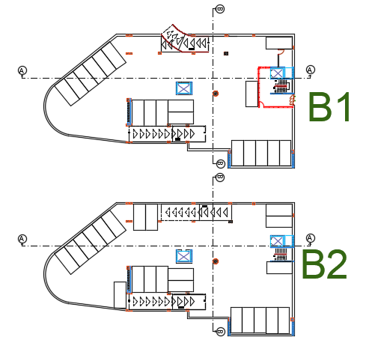
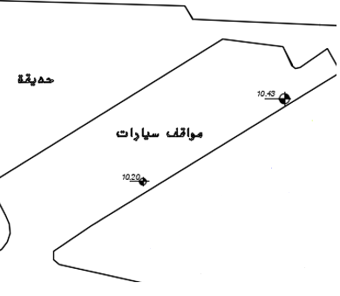
Architectural Design
Basement plans: in the new design there is two basement plan for parking with area 1135 m2 for each floor, and 40 car parks.
New car parking
Old car parking

Slide 7
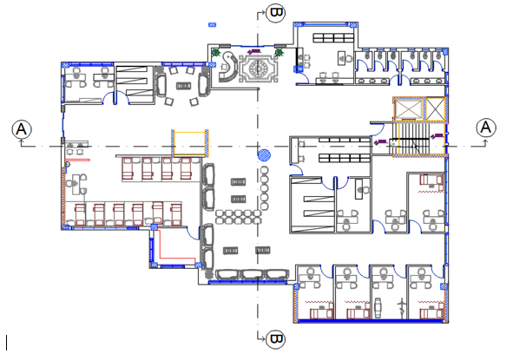
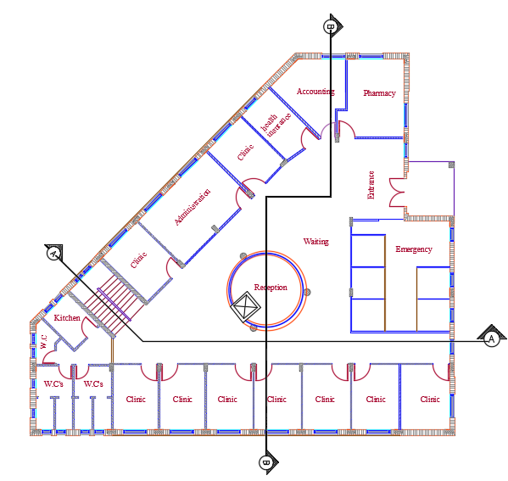
Architectural Design
Ground floor: in the new design .
The floor area equal 751 m2.
Contains: emergency, clinics, pharmacy, registration.
New building
Old building

Slide 8
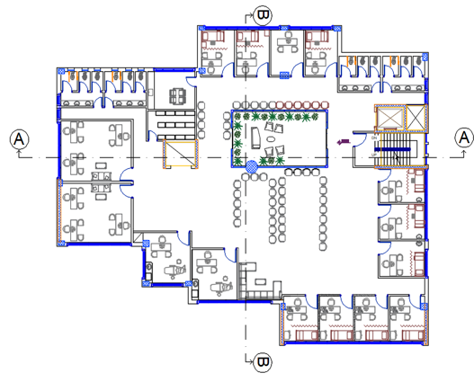
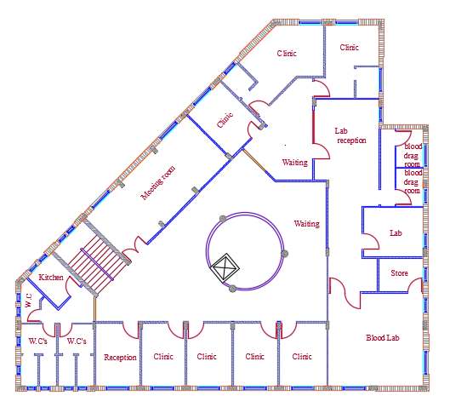
Architectural Design
First floor: in the new design .
The floor area equal 771 m2.
Contains: storage, clinics, doctor’s room, nurse’s room, kitchen, w.c.
New building
Old building

Slide 9
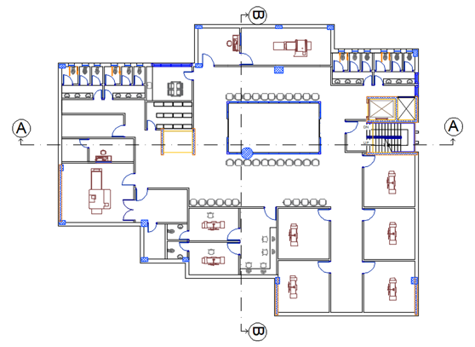
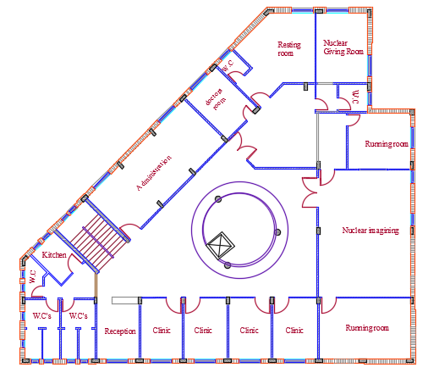
Architectural Design
Second floor: in the new design .
The floor area equal 771 m2.
Contains: storage, radiology, MRI department, CT scan, ultra-sound, kitchen, w.c.
New building
Old building

Slide 10
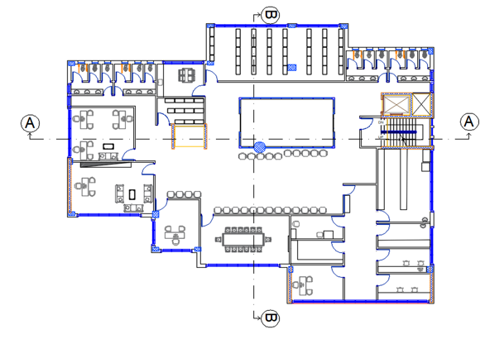
Architectural Design
Third floor: in the new design .
The floor area equal 771 m2.
Contains: storage, kitchen, W.C, administration department and laboratories.

Slide 11
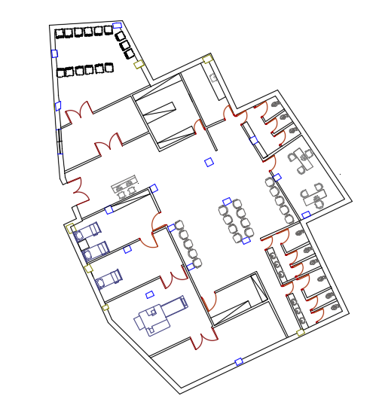
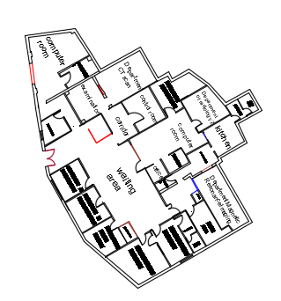
Architectural Design
Old building: in the new design .
Contains: Nuclear department, Laundry.
New design
Old design

Slide 12
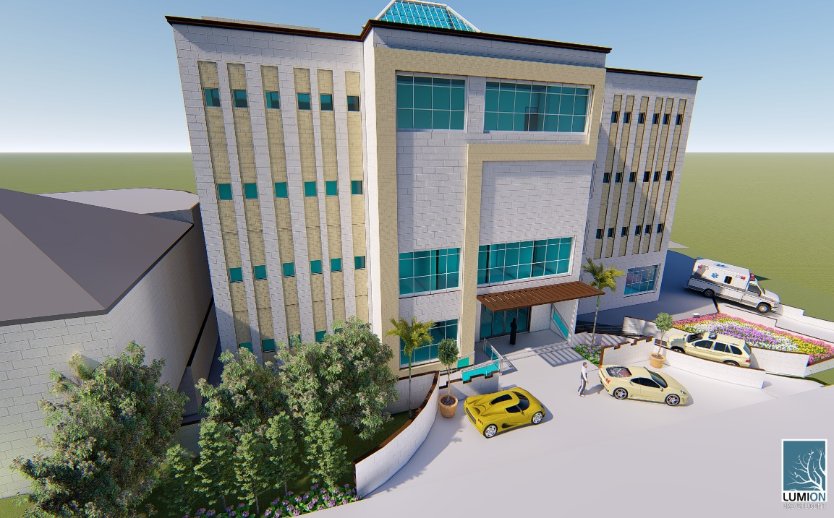
Architectural Design
3D View

Slide 13
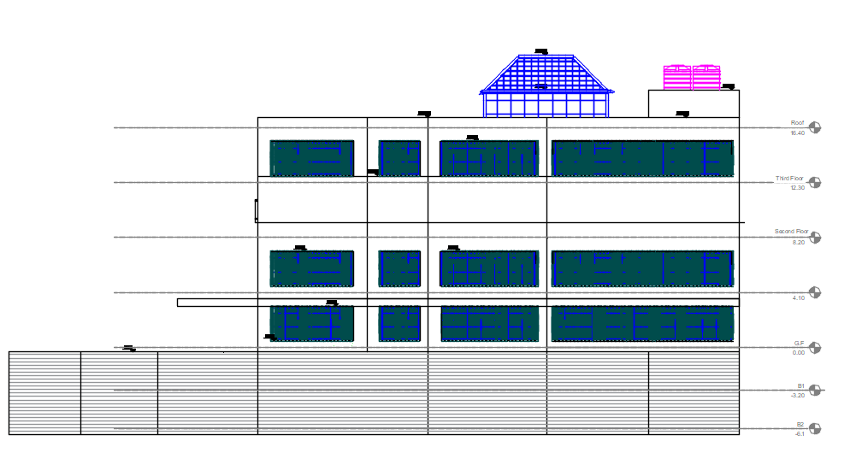
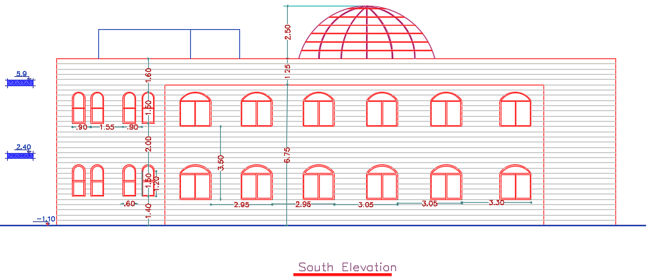
Architectural Design
South Elevation:-
New building
Old building

Slide 14
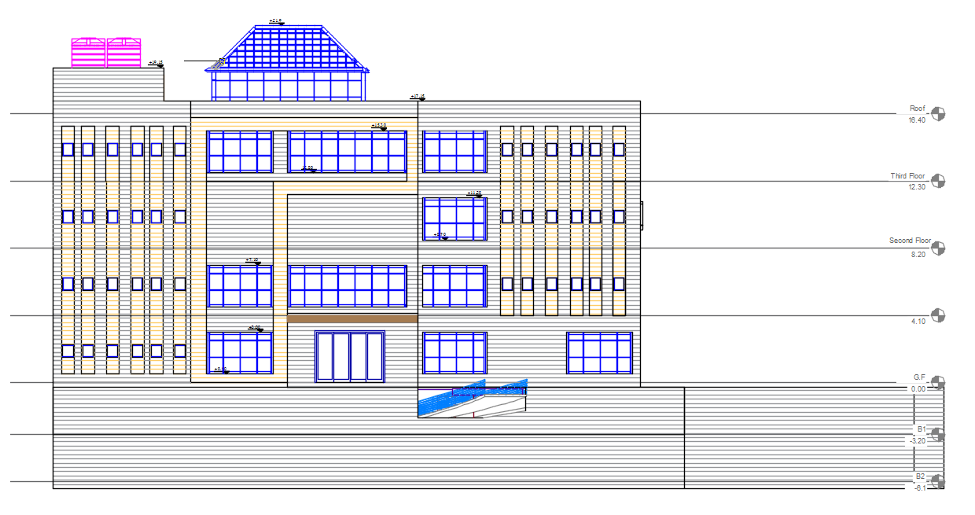
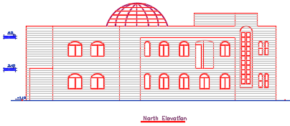
Architectural Design
North Elevation:-
New building
Old building

Slide 15
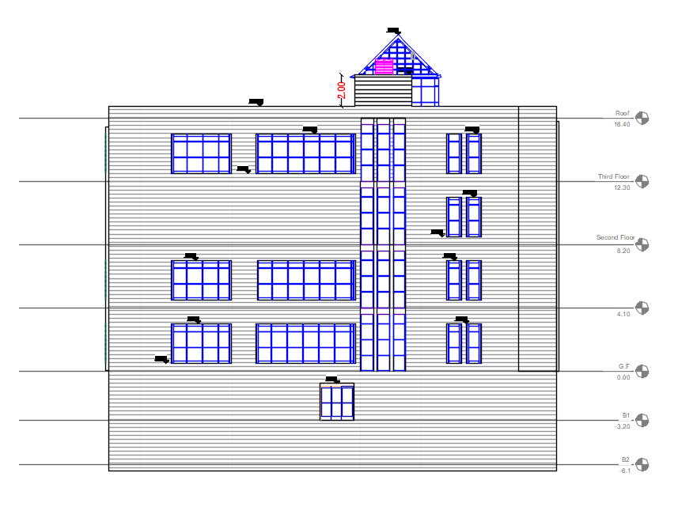
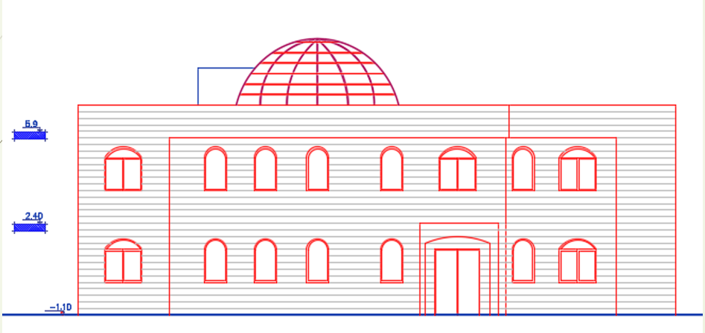
Architectural Design
East Elevation:-
New building
Old building
15

Slide 16
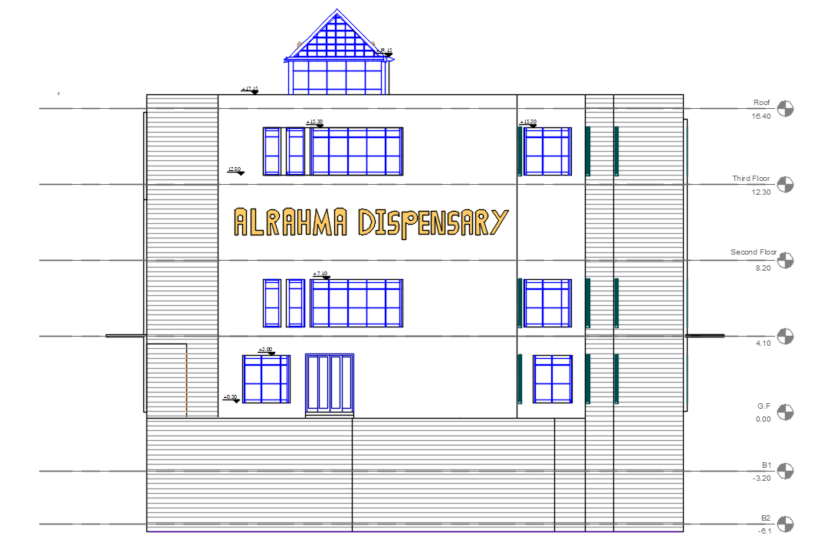
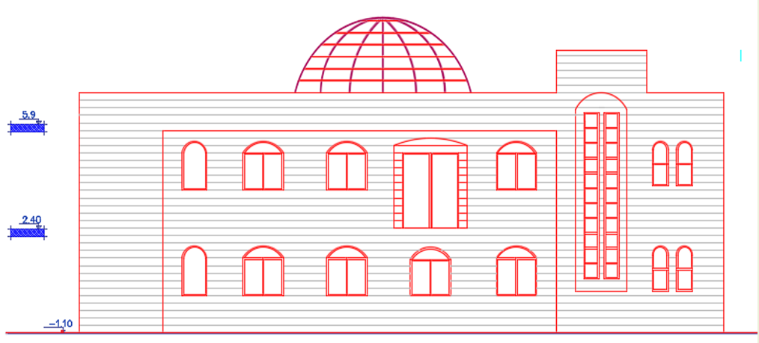
Architectural Design
West Elevation:-
New building
Old building

Slide 17
Architectural Design
Sections in the plan:-

Slide 18
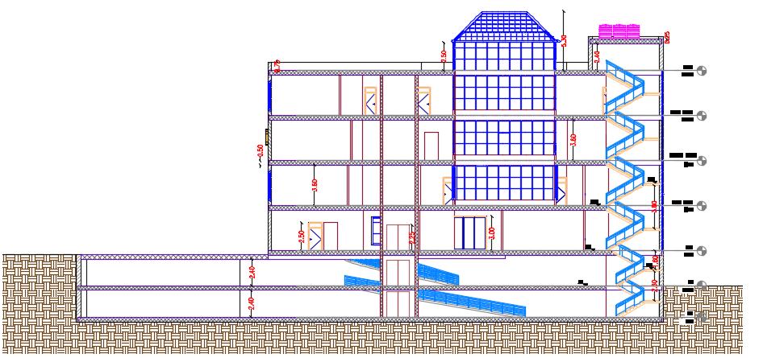
Architectural Design
Sections :-
Section A-A

Slide 19
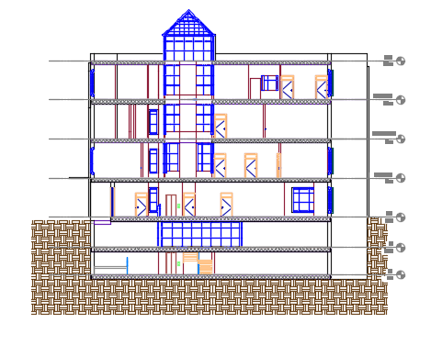
Architectural Design
Sections :-
Section B-B

Slide 20
Passive Design
Thermal Design
Acoustical Design

Slide 21
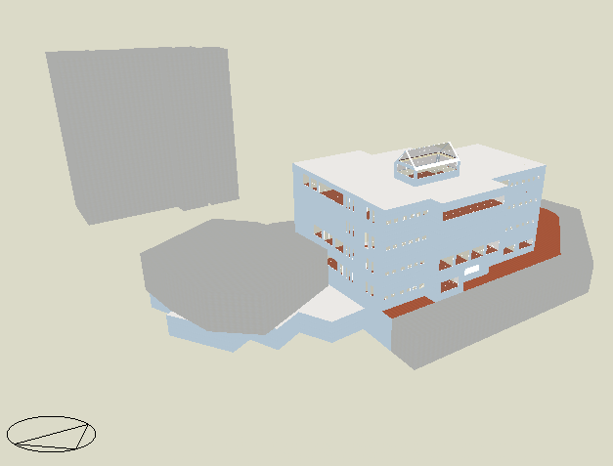
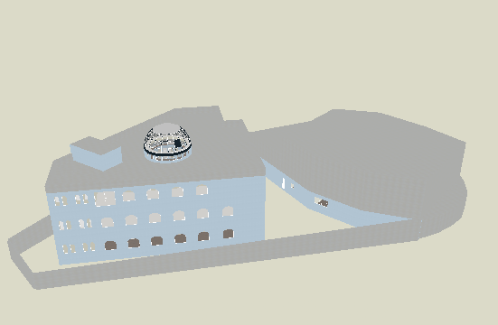
Thermal Design
Design builder programme 3D model :
New building
Old building

Slide 22
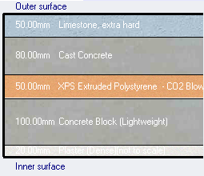
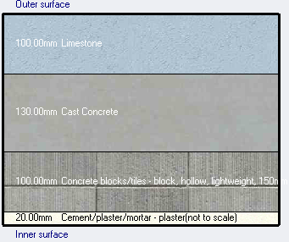
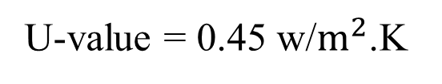
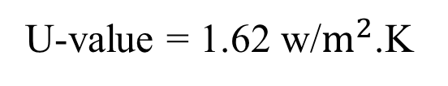
Thermal Design
Material : External wall
U-value = 0.45 w/$m^{2}$.K
U-value = 1.62 w/$m^{2}$.K
New building
Old building

Slide 23
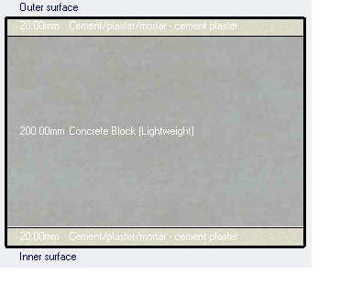
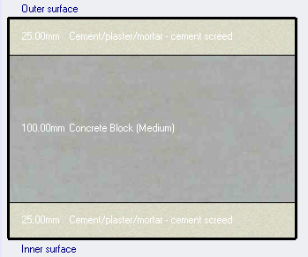
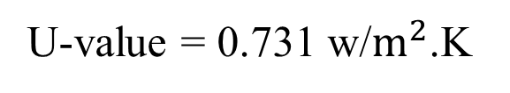
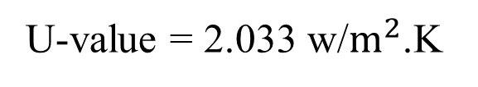
Thermal Design
Material :
Internal wall
U-value = 0.731 w/$m^{2}$.K
U-value = 2.033 w/$m^{2}$.K
New building
Old building

Slide 24
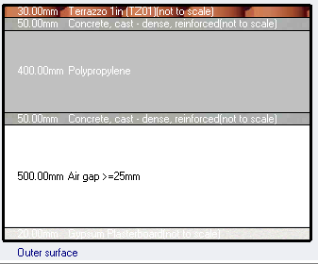
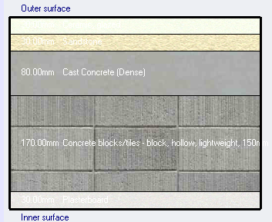

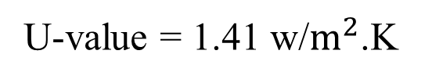
Thermal Design
Material : Floor
U-value = 0.424 w/$m^{2}$.K
U-value = 1.41 w/$m^{2}$.K
New building
Old building

Slide 25
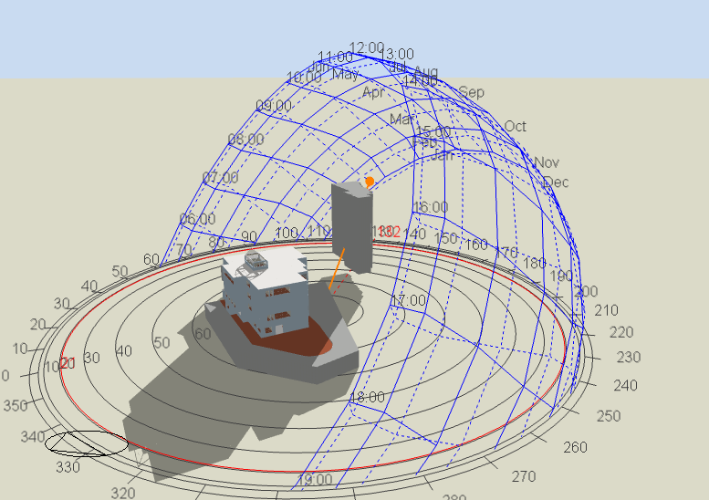
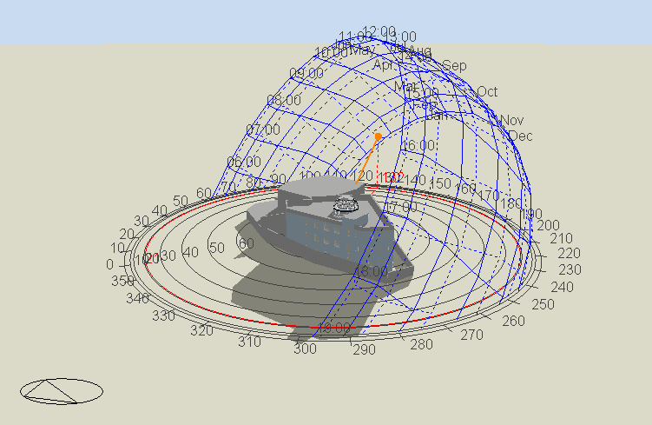
Thermal Design
Shading :
1- In winter 21 -1 at 9:00AM
New building
Old building

Slide 26
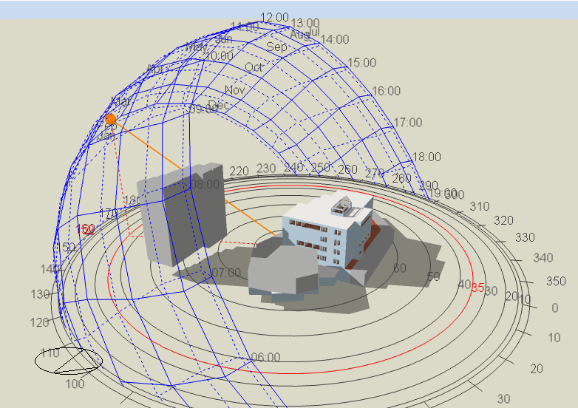
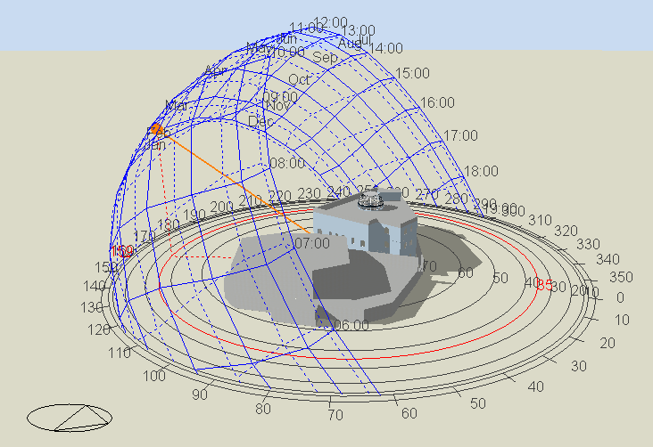
Thermal Design
Shading :
2- In winter 21 -1 at 11:00AM
New building
Old building

Slide 27
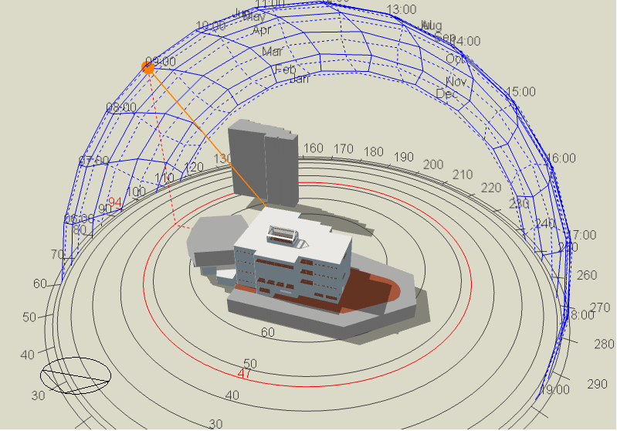
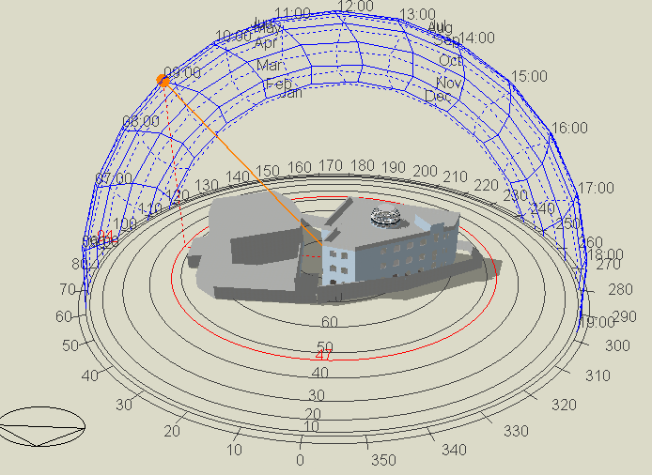
Thermal Design
Shading :
3- In summer 21 -7 at 9:00AM
New building
Old building

Slide 28
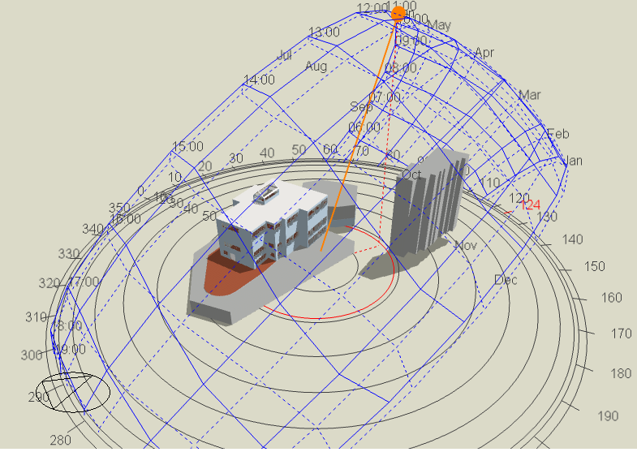
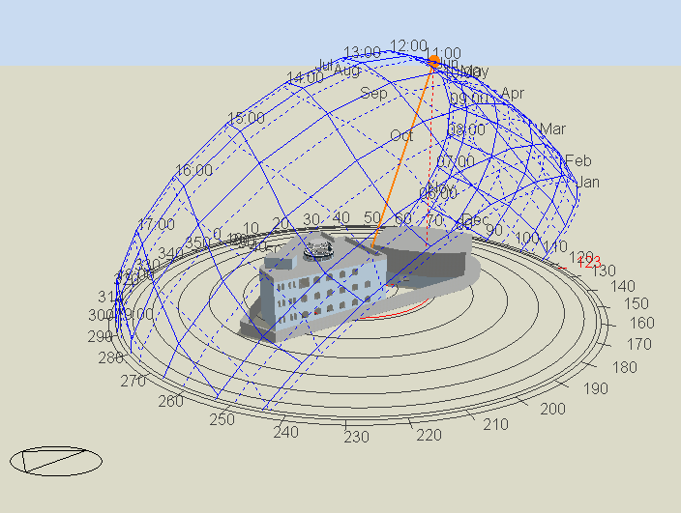
Thermal Design
Shading :
4- In summer 21-7 at 11:00AM
New building
Old building

Slide 29
Thermal Design
cooling and heating capacity
 | New building | Old building
Cooling | 127.35 kW | 194.71 kW
Heating | 45.76 kW | 186.96 kW

Slide 30
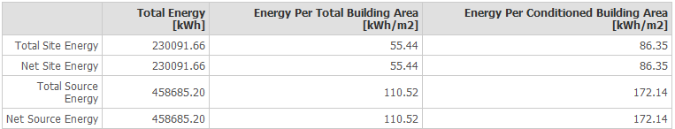
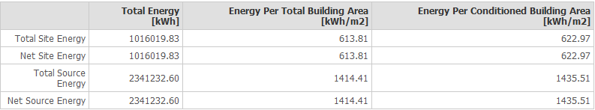
Thermal Design
Site energy
New building
Old building

Slide 31
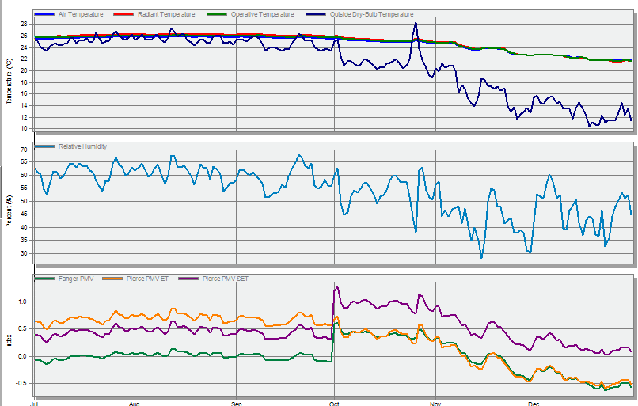
Thermal Design
Simulation : comfort range

Slide 32

Acoustical Design
Reverberation time (RT60)
Ecotect program
Manager Room : The standard value = 0.4- 0.7 secound
Surface | Material
Floor | Tile (Terrazzo)
Walls | Plaster
Ceiling | Wood fibreboard
Door | Hollow core plywood
Window | Double glazing (aluminium frame)
materials
Ceiling absorption

Slide 33


Acoustical Design
RT60 values

Slide 34


Acoustical Design
Sound transmission class (STC)
Insul program
External wall with window: the standard of STC equal 50 dB.
External wall layer
TLc combined Value

Slide 35


Acoustical Design
Sound transmission class(STC)
Insul program.
internal wall.
Function | Adjacent | STC
Meeting& Manager Room | Public space | 50
 | Patient room | 50
Clinic | Public space | 50
 | Clinic | 50
MRI | Patient room | 60
 | Public space | 50
Internal wall layer

Slide 36


Acoustical Design
Impact Insulation class (IIC):
Insul program.
ceiling
Ceiling layer
IIC Value

Slide 37

Acoustical Design
Noise reduction (NR):
In clinic room
NR= 46.85 dB
Noise= 75 dB
IL in clinic =75 – 46.85= 28.5
standard = 25-30 dB in clinic
In old design | STC
External wall | 38 dB
Internal wall | 48 dB

Slide 38




Acoustical Design
Loud speaker distribution:
Emergency Room: We used PC-1867FC ceiling mount speakers with 90 coverage angle.
Corridor

Slide 39
Structural and
Seismic Design

Slide 40
Codes of design:
Structural Design
The American Concrete Institute code ACI 318-08.
The American Concrete Institute code ACI 350.3.
The seismic design according to UBC-97.
The analysis and design were done using ETABS, SAP, and SAFE programs.

Slide 41
Design Data :
Structural Design
Concrete Compressive Strength :
f’_{c} =24 Mpa For Slabs, Beams.
f’_{c} =28 Mpa For Columns, Shear walls, and Footing
Yielding Strength Of Steel :
The Yield strength of steel Fy= 420Mpa

Slide 42
Design Data :
Structural Design
Loads:
Live load = 5 kN/m².
Superimposed dead load = 4 kN/m².

Slide 43
Design Data :
Structural Design
Sections of beams and columns used in design
Column name | Dimension (cm)
C60*30 | 60*30
C60*40 | 60*40
C60*60 | 60*60
C80*60 | 80*60
C110 | 110
Beam name | Dimension (cm)
Main beam | 80*50
Secondary beam | 40*50
Dropped beam | 80*100

Slide 44
Structural Design
 | Old Design | New Design
System of slab | Ribbed slab with hidden beams | Voided slab with hidden and drop beams
Thickness of slab | 25 cm | 50 cm

Slide 45

Structural Design
The old distribution of columns and shear walls in the building:

Slide 46

Structural Design
The new distribution of columns and shear walls in the building:

Slide 47


Structural Design
3D modeling from ETABS Program for new design:
Block 1
Block 2

Slide 48


Structural Design
Check model: 1- Compatibility Check

Slide 49
Structural Design
2- Equilibrium Check:
Load | Manual calculation | Calculation from ETABS (kN) | Difference (%)
Dead load | 56279 | 57164 | 1.56
Live load | 22750 | 22878 | 0.56
Superimposed Dead load | 18200 | 18302 | 0.56
For Block 1
Load | Manual calculation | Calculation from ETABS (kN) | Difference (%)
Dead load | 6781 | 6807 | 0.37
Live load | 2866 | 2866 | 0
Superimposed Dead load | 2293 | 2293 | 0
For Block 2

Slide 50
Structural Design
Internal Force Check For Block 1 (slab and beams using Equivalent Frame Method):
 | Manual calculation |  |  |  | ETABS result |  |  | Difference % M_{Beam} | Difference % Cs | Difference % MS
 | M_{Beam*} | %CS | CS* | MS* | M | CS | MS
1 | 5.6 | 98.3 | 5.5 | 0.1 | 7.02 | 7.54 | 0.13 | 25 | 36 | 30
2 | 30.68 | 76.3 | 23.04 | 7.64 | 25 | 30 | 10 | 18.5 | 30.2 | 30.9
3 | 25.93 | 77.05 | 20 | 5.93 | 38 | 27 | 4.5 | 31.7 | 35 | 24
4 | 6.85 | 98.5 | 6.75 | 0.1 | 10 | 9 | 0.15 | 46 | 33.3 | 50
5 | 18.14 | 82.8 | 15 | 3.14 | 24 | 20 | 5 | 32.30 | 33.3 | 59
6 | 16.4 | 87.3 | 14.32 | 2.08 | 26 | 20 | 2.8 | 58.5 | 39.6 | 34.6

Slide 51
Structural Design
Internal Force Check For Block 1 (columns):
 | Manual calculation | ETABS result | Difference %
Column 1 | 10820.72 | 11738 | 8.4
Column 2 | 107.04 | 97.5 | 8.9
Column 3 | 5635.34 | 6073 | 7.7

Slide 52
Structural Design
Internal Force Check For Block 2 (slab and beams using Equivalent Frame Method):
 | Manual calculation |  |  |  | ETABS result |  |  | Difference % M_{Beam*} | Difference % CS | Difference % MS
 | M_{Beam*} | %CS | CS* | MS* | M | CS | MS
1 | 23.84 | 88.3 | 21 | 2.79 | 20 | 17 | 3.5 | 16 | 19.23 | 25.4
2 | 23.84 | 88.3 | 21 | 2.79 | 20 | 17 | 3.5 | 16 | 19.23 | 25.4
3 | 10 | 69.8 | 7 | 3.02 | 8 | 8 | 4 | 20 | 14.6 | 32.45

Slide 53
Structural Design
Internal Force Check For Block 2 (column):
 | Manual calculation | ETABS result | Difference %
Column 1 | 1200 | 1166 | 2.4
Column 2 | 438 | 411 | 5.89
Column 3 | 39.15 | 39.3 | 0.38

Slide 54
Structural Design
Seismic Design Using Response Spectrum – UBC 97:
W = 63971.52 KN
Soil type SD
Z = 0.2
I = 1.5
R = 5.5
C_{v} = 0.40
C_{a} = 0.28

Slide 55
Structural Design
Period check (T) for the building:
 | T(Sec) for Block 1 | T(Sec) for Block 2
ETABS Value | 0.72 | 0.10
Manual Value | 0.79 | 0.25

Slide 56
Structural Design
Base shear check for the building:
Load case/comp | T (sec) | V_{manual} | V_{ETABS}
EQx | 0.72 | 9549.4 | 11789.88
EQy | 0.72 | 9549.4 | 11947.98
For Block 1
Load case/comp | T (sec) | V_{manual} | V_{ETABS}
EQx | 0.10 | 1436 | 1800
EQy | 0.10 | 1436 | 1800
For Block 2

Slide 57

Structural Design
Slab Structural systems for old design (one way ribbed slab):

Slide 58

Structural Design
Slab Structural systems for new design (Two way voided slab):

Slide 59

Structural Design
    1. New Slab Design :

Slide 60

Structural Design
    1. Typical section in ribbed slab:

Slide 61

Structural Design
    1. Typical section in voided slab:

Slide 62

Structural Design
    2. Main Beam Detailing :

Slide 63



Structural Design
    2. Main Beam Sections :

Slide 64


Structural Design
    3. Column Design Detailing:

Slide 65

Structural Design
    4. Footing Design : the new design of footing is Mat Footing

Slide 66

Structural Design
    Footing design
    (Mat Footing):

Slide 67

Structural Design
    Footing design
    (Mat Footing):

Slide 68



Structural Design
    5. Shear walls design :

Slide 69

Structural Design
    7. Water tank design :

Slide 70

Structural Design
    Water tank design :

Slide 71

Structural Design
    8. Stair design :

Slide 72

Structural Design
    8. Ramp design :

Slide 73
Elector-mechanical
Design

Slide 74

Electrical Design
Lighting Design
Sockets Design
Circuit Breaker Design

Slide 75

Electrical Design
Lighting Design
DIAlux evo programm
Pharmacy Room
Surface | Finish material | Reflection factor
Ceiling | Paint White + blue plaster | 85%
Wall | Paint White +blue tile | 85% + 56% with cover 8%
Floor | White porcelain | 75% with cover 11%
Reflection factor
Luminaire type
 | Standard | Design
illuminance | 500 | 560
Glare (UGR) | 19 | 18.8

Slide 76


Views:
Pharmacy Room
Pharmacists Office

Slide 77
Electrical Design
Lighting Design
DIAlux evo program
Other functions Results
In old design
 | Clinic | Meeting | Registration | MRI | Waiting
Illuminance(Lux | 507>500 | 309> 300 | 451 > 400 | 70>50 | 298>200
Glare (UGR) | 18>19 | 16> 22 | 15.1 >19 | - | 16.4>22
 | Clinic | Meeting | Pharmacy | Emergency
Illuminance(Lux | 333 | 377 | 481 | 700
Glare (UGR) | 26 | 22 | 21 | 20

Slide 78






Views:
Patient Room
MRI
Meeting Room
Clinic
Emergency
Blood Lab

Slide 79

Lighting Arrangement in ground floor:

Slide 80
Electrical Design
Sockets Design
Sockets number in each floor :
Floor | Total power from lighting (Watt) | NO. Of Normal Outlet | NO. Of Special Outlet | Total Load (Amp)
Basement 2 | 3080 | 10 | 0 | 20
Basement 1 | 3080 | 10 | 0 | 20
Ground floor | 21212 | 124 | 1 | 258
First floor | 11859 | 85 | 3 | 200
Second floor | 1830.5 | 55 | 11 | 220
Third floor | 9711.5 | 145 | 1 | 300
Old floor | 1293 | 42 | 3 | 114

Slide 81


Sockets arrangement in ground floor:

Slide 82

Circuit Breakers Calculations :
Ground floor
Number of circuit breaker for lighting = 15 CB’s
Number of circuit breaker for general sockets = 31 CB’s
Number of circuit breaker for special sockets = 1 CB’s

Slide 83
Mechanic Design
1- HVAC system VRF system used with the following components:
Out door unit
Controller
indoor unit (Fan coil)
Linear Slot
Ducts

Slide 84
Mechanic Design
VRF Design:
Out door unit was selected from Toshiba company SMMSi Outdoor Units (MMY-AP4824HT8-E).
The fan coil was selected from TOSHIBA Company (MMD-AP0486BHP-E with flowrate = 0.58m³/s.
Linear slot diffuser was selected from TROX company (VSD50) with 0.02 m³/s flow rate .
Cooling load for building is 127.35kW .
For ground floor, cooling load = 22.34 kW.
2 fan coil needed in ground floor.
Each Fan coil can connect to 29 linear slot .

Slide 85
Electro Mechanic Design
VRF Design: For first fan coil
Duct section | Volumetric flowrate m³/s | Velocity m/s | diameter (m) | ⍙P/EL
A-B | 0.57 | 5 | 0.2 | 1.3
B-C | 0.06 | 3.5 | 0.15 | 1.3
B-D | 0.51 | 5.9 | 0.34 | 1.3
D-E | 0.19 | 4.6 | 0.23 | 1.3
D-F | 0.32 | 5.2 | 0.28 | 1.3
F-G | 0.14 | 4.3 | 0.21 | 1.3
F-H | 0.18 | 4.6 | 0.23 | 1.3
H-I | 0.14 | 4.3 | 0.21 | 1.3
H-J | 0.04 | 3.2 | 0.13 | 1.3
J-K | 0.04 | 3.2 | 0.13 | 1.3

Slide 86
Mechanic Design
2- Water supply system :
The standard quantity of water consumption in the dispensary is 392 L/m² yearly .
The water consumption of the building
standard L/m² yearly | Area (m²) | L/ year | L/ day | M³ / day | M³/week
441 | 3086 | 1360926 | 3728.6 | 3.73 | 26.1
442 | 470 | 207740 | 569.2 | 0.57 | 4.0

Slide 87


Mechanic Design
Pipes diameter : in ground floor, first collector

Slide 88
Mechanic Design
Pipes diameter : in ground floor , first collector
Feeder | Diameter (inches) | Loss
MVF | 2 | 8.3
MHF | 1.25 | 1.09
MHB | 1 | 3.78

Slide 89


Electro Mechanic Design
Pipes diameter : in first floor , second collector

Slide 90

Electro Mechanic Design
Pipes diameter : in first floor, second collector
Feeder | Diameter (inches) | Loss
MVF | 2.5 | 1.33
MHF | 1.5 | 2.5
MHB | 1 | 4

Slide 91

Electro Mechanic Design
Pipes diameter :
Old building
Feeder | Diameter (inches) | Loss
MVF | 2 | 1.66
MHF | 1.5 | 0.7
MHB | 1.5 | 0.6

Slide 92

Rain water :
The quantity of rain water = 600 mm, surface area of the building is 723 m²
The amount of rain water falling on the roof will be 723 * 0.6 = 433m³ .

Slide 93



Electro Mechanic Design
3- Drainage system

Slide 94
Electro Mechanic Design
3- Drainage system : for third floor
pipe | diameter | slope
stack | 4" | 0%
sewer | 4" | 1%
branch | 4" | 1%

Slide 95
Safety Design

Slide 96

Safety Design
1- Detectors system : In old floor
Flame detector
Smoke detector

Slide 97

Safety Design
1- Detectors system : In first floor

Slide 98



Safety Design
2- Alarms System
- Automatic and manual alarm.

Slide 99


Safety Design
3- Firefighting system : For basement 1 floor
Hose station

Slide 100



Safety Design
3- Firefighting system : For second floor
Extinguishers D
Extinguishers k
Water sprinkler
FM200 sprinkler

Slide 101

Safety Design
3- Firefighting system : For old building floor

Slide 102

Safety Design
Escape plan in ground floor

Slide 103

Reflected Ceiling in Ground Floor

Slide 104
Quantity Survey

Slide 105
Bill Of Quantity
Items | Total cost (NIS)
Architectural items | 2387032
Structural items | 8157219
Electrical items | 13552.00
Mechanical items | 413740
Fire items | 36610
Total cost | 11008155
Unit cost | 2343 NIS/m2

Slide 106



