Slide 1
Movie Genre Classification Based on Arabic Synopsis
Ahmad Mansour
Mahdi Barham

Slide 2
Problem
Text classification is a famous problem in machine learning. However, most of the research is focused on the English language.
When it comes to Multi-label classification problems like movie genre classification, Arabic studies are almost non-existent.

Slide 3
Objectives
Our goal is to make a comparative study between different machine learning techniques and see how they perform on an Arabic dataset to classify movie genres.
Then encapsulate the results in a website and use the most accurate model to predict movie genres and use the results as a recommendation tool.

Slide 4

Data Collection
The first step is to collect the data. We built the dataset ourselves by using BeautifulSoup to scrape multiple websites for movie summaries and their corresponding genres.
We ended up with around 8500 records. Where each record contains the Arabic synopsis of a movie and its genres.

Slide 5
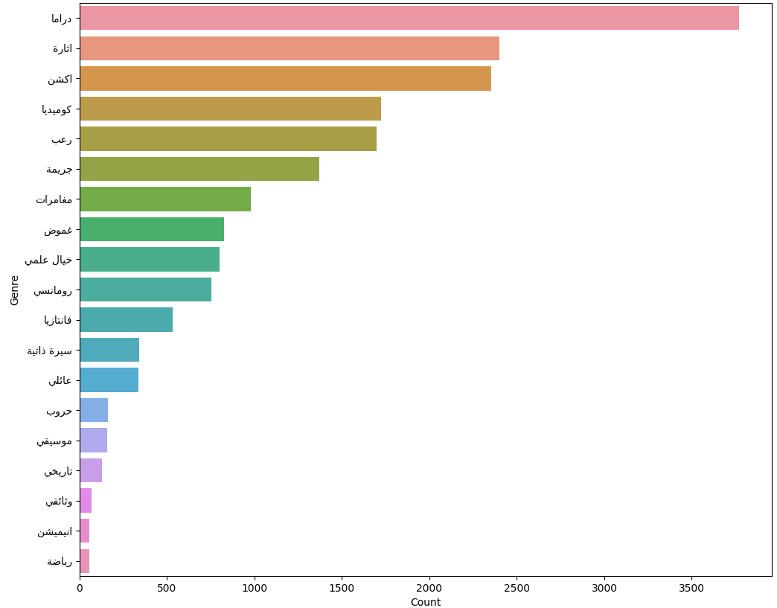
Data Collection

Slide 6
Text Processing
The next step is to clean the data. Which consisted of removing things like:
Punctuation marks
Words in foreign languages
Arabic vowelization
Replacing special Arabic characters with a similar one

Slide 7
Multi-label Classification
There are multiple ways of dealing with a multi-label problem. For simplicity and due to hardware constraints we will use a problem transformation technique called binary relevance.
This treats each label separately and performs binary classification on each one.

Slide 8
Hyper-parameter Tuning
The goal is to make a comparative study. We used 10 different machine learning algorithms and tuned some of their parameters using the GridSearch library.
We evaluated each classifier using F1 score and got the following results:

Slide 9
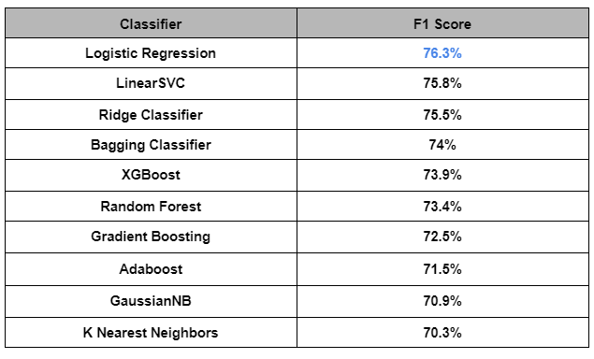

Slide 10
Optimization
Before applying our results. We wanted to see if we could increase the accuracy even further. Our first attempt was to use word stemming as part of text processing, however that reduced the accuracy by 2%.
Our second attempt was to reduce the imbalance. By removing the rare genres and keeping the top 7 genres.

Slide 11
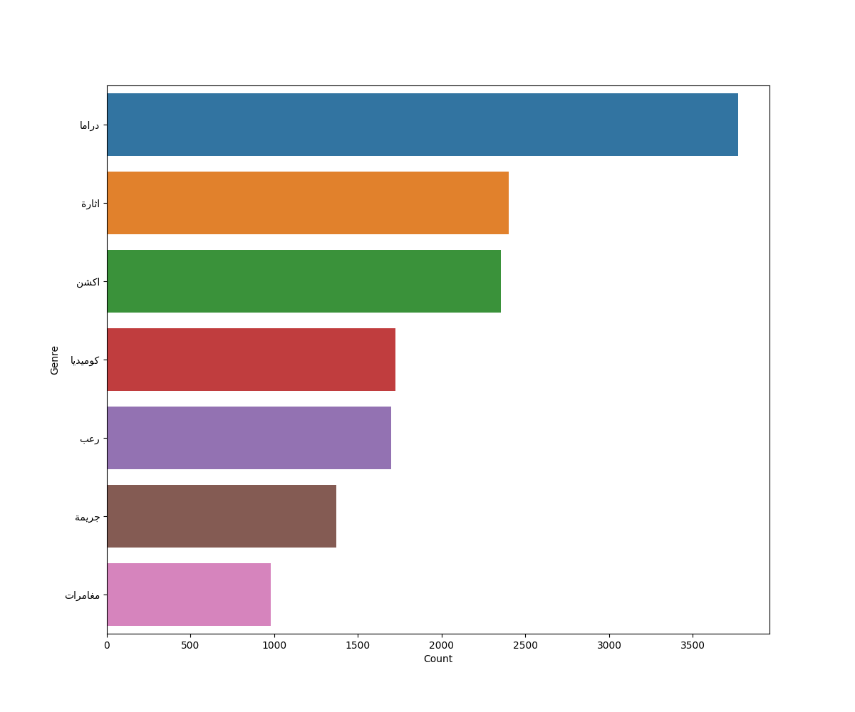

Slide 12
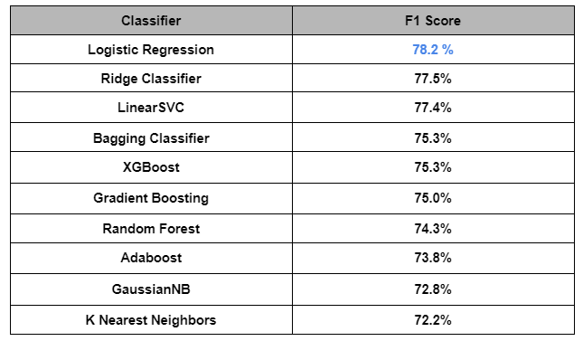

Slide 13
Building a Website
Now we can build a website around our best performing model which is logistic regression to take an Arabic synopsis as an input and predict the genres then recommend movies based on output genres.

