Slide 1
Graduation project 2
Structural design of alhuda building by hane daghlas , raed Abdullah

Slide 2
Project description:
This building consists of eight floors with roof the Total area 4482 m²
Floor Name | Function | Area(m²) | Height (m)
Ground | Multipurpose store | 469.68 | 5
First | Car parking | 469.68 | 2.5
Second | Apartments | 446.5 | 3
Third | Apartments | 446.5 | 3
Fourth | Apartments | 446.5 | 3
Fifth | Apartments | 446.5 | 3
Sixth | Apartments | 446.5 | 3
Seventh | Apartments | 446.5 | 3
eighth | Apartments | 452.8 | 3
Roof | Apartments | 410.7 | 3
Total area | 4482 m²

Slide 3
Objective:
In this project the concepts of structural engineering that we learned over all last years are applied. Many courses have been studied in the programing of Civil Engineering Department at An - Najah National University, Different types of analysis and design are done in this project in order to choose the most safe and economical type and method for the design. After completing the design phase in proper way we get feasible solutions of projects.
In any structural system there are many alternatives that can be used. The successful one takes into consideration strength, serviceability, safety and economy aspects.

Slide 4
Site and geology:
The building is located in Nablus..
The soil in the site has bearing capacity of about 3 kg /cm²

Slide 5
Methodology:
First, a preliminary analysis and design using ID and 2D models are made, and then the Structural elements are modeled as 3D dimensional elements (Beams, columns and footing) using (ETAPS program), after using 3D model to represent the structure, it was analyzed considering gravity, and compare the results with hand calculations to verify that 3D model results are ok. This is in brief, an overview of the project methodology, of which a full discussion is presented deeply later in this report.

Slide 6
Codes and standard:
The codes used in this project to design the members and the elements are the following:
ACI318-14: building code requirements for structural concrete provides minimum requirements necessary to provide public health and safety for the design and construction of structural concrete buildings.
ASCE7-10: is standard not code used for determine the value of minimum design loads for building.

Slide 7
Materials:
Concrete:
Compressive strength of concrete (fc,=28MPa) for reinforced concrete slabs, beams, columns, shear walls, basement walls, and foundations and unit weight of reinforced concrete=25KN/m³
Steel:
Steel reinforcement has a yielding strength of 420 MPa and modulus of elasticity (Es) of 200 GPa .

Slide 8
loads:
Dead load
Superimposed load
Live load
Dead load: loads that relatively don’t change over time, such as the weight of all permanent components of a building including wall ,beams , columns, flooring material ,etc.
Superimposed load: weight of plastering, filler, tiles, mortar and partition.
Super imposed dead loads calculations:
12cm fill under tiles unit weight=16kN/m³
3cm mortar under tiles, unit weight=23kN/m³
3cm tiles, unit weight=25kN/m³
Super imposed dead loads = (thickness for each one square meter of the layer) *(density of this layer)
S.I.D= (0.12*16)+(0.03*23)+(0.03*25)=3.36KN/m²
Live load: weight of everything superimposed on, or temporarily to a structure (people, machinery and equipment, furniture, appliances, etc.)
Live load on floors and roofs =2 KN/m²
Live load on garage =2 KN/m²

Slide 9
load combinations
Table shows load combination from ACI code for gravity
load combinations | Primary load
1.4D | D
1.2D+1.6L | D AND L

Slide 10
Computer programs
ETABS: This program is used to analyze and design the structural elements.
AutoCAD: This program is used to draw structural details
SAP: this program is used to analyze and design the structural elements.

Slide 11
Preliminary Design:
The structure consists of several elements that work together to resist all the forces and loads that exposed to the building. Each element passes the load to another one until it reaches the soil and spreads through it .Therefore, the safe structural system is the one that can provide safe path for load. In this chapter, preliminary design for some of the elements will be discussed Hand calculations and the structural analysis and design software (ETAPS) will be used.

Slide 12
Design Requirements:
Strength Requirements
• ASCE 7-CODE was used for live load determination.
• Analysis and design are according to American Concrete Institute ACI-318-08. .
• The nominal strength of members is reduced by reduction factor (Ø)
• Design strength > required strength.
• Ø Nominal strength > Ultimate strength.
• The nominal strength Reduction factors Ø are:
(1) Axial load and bending: 0.9
(2) Shear and torsion: 0.75
(3) Tied column: 0.65
The used load combinations are:
W_{u}= 1.4DL
W_{u}=1.2DL+1.6LL
Where:
DL: Dead Load.
LL: Live load.

Slide 13
Preliminary design calculation:
Slab:
Slabs are structural elements with a small thickness comparable to their dimensions in the other two directions. Slabs are usually used in floor and roof construction. Type of slab depends on the way it supported by. It may be supported by edge beams or walls, or they may be supported directly by columns (flat slab).
The choice of type of slab for a particular floor depends on many factors. Economy of construction is obviously an important consideration, but this is a qualitative argument until specific cases are discussed, and it is a geographical variable. The design loads, required spans, serviceability requirements, and strength requirements are all important.

Slide 14
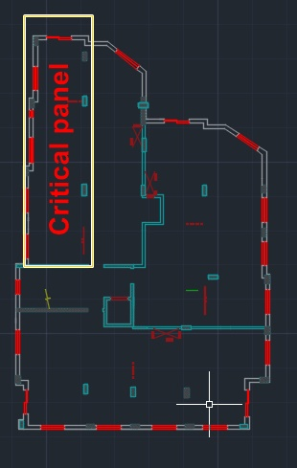

One way solid slab will be used in this project
For critical panel:
L = 14.78 m / B= 4 m
$\frac{L}{b}=\frac{14.78}{4}=3.7>2$

Slide 15
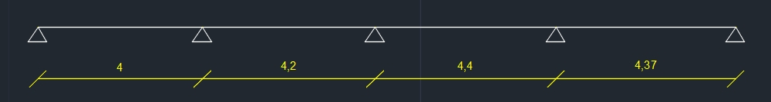
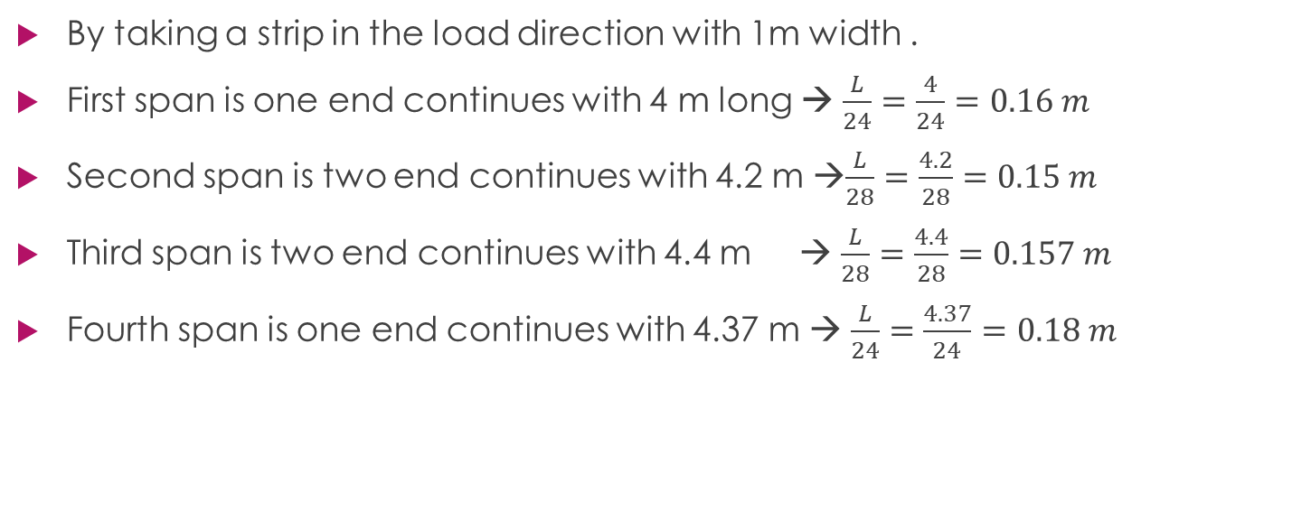
Check thickness of one way solid slab
By taking a strip in the load direction with 1m width .
First span is one end continues with 4 m long → $\frac{L}{24}=\frac{4}{24}=0.16 m$
Second span is two end continues with 4.2 m →$\frac{L}{28}=\frac{4.2}{28}=0.15 m$
Third span is two end continues with 4.4 m → $\frac{L}{28}=\frac{4.4}{28}=0.157 m$
Fourth span is one end continues with 4.37 m → $\frac{L}{24}=\frac{4.37}{24}=0.18 m$

Slide 16

Check slab for shear
Own weight = 1 x 0.25 x 25 = 6.25 KN/$m^{2}$
Wu= 1.2 (3.5 +6.25) + 1.6 (2 ) =16.5 KN/$m^{2}$
Vu = Wu (0.5 Ln – d)
Vu = 62.37 KN
$VC=0.75∗ \frac{1}{6}{\left(fc\right)}^{0.5}∗bW∗d$
V_{c} = 134.72 > Vu → OK

Slide 17
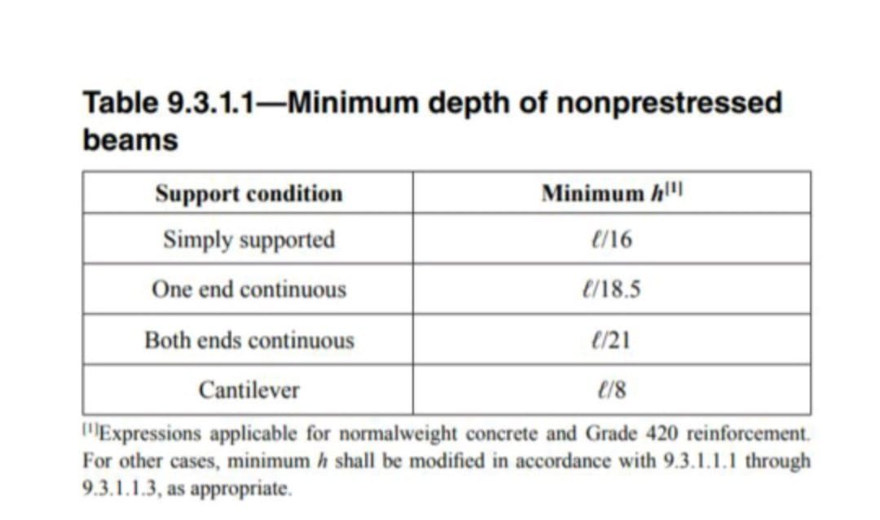
beams:
The preliminary dimension of beams will be find by the following table

Slide 18
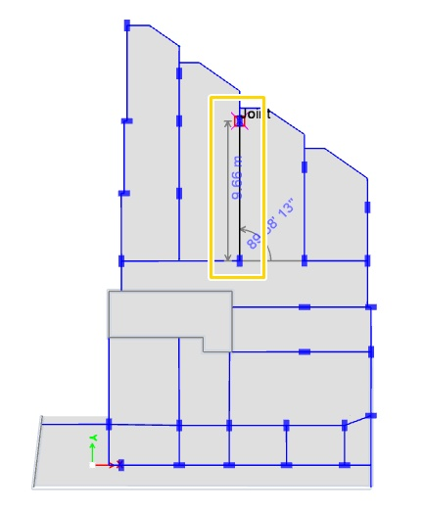
h=L/18.5
h=9.66/18.5=0.52 m.
Try h = 550 mm

Slide 19
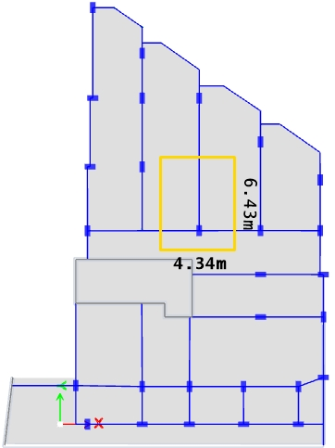

Columns
The tributary area for critical column equal 28 $m^{2}$ as shown in the following figure:
Then the load on the column by using factored load combination
Pu=1.2D+1.6L
For live
L=2 KN/$m^{2}$ in all floors
PL= tributary area*L*No. Of floors =28*3*9=756 KN
For dead
PD = D_{slab} + D_{beam}
D_{slab} = no. of floor × (superimposed dead load x tributary area + thickness of slab x tributary area x 25)
D_{slab} = 9 x (3.5x28+ 0.25 x 28 x 25) = 2363 KN
D_{beam} = depth × width × length
D_{beam} = 0.5 x 0.5 x (2.1+2.237+4.83) x 25 = 57.3 KN
PD = 2363 + 57.3 = 2420.3 KN
Pu = (1.2 × 2420.3)+ (1.6 × 756) = 4114 KN
To calculate area for column, will use the following equation:
Pu = ϕ × λ × (0.85 f'c ×Ag × (1- ρ) + fy × ρ ×Ag)
Assume ρ = 0.03
4114 x 10^3 = 0.65 x 0.8 (0.85 x 24 x 0.97 Ag + 420 x 0.03 x Ag)
4114000=16.83 Ag
⇛ Ag = 244445 mm²
Try column 700 x 400 mm²

Slide 20
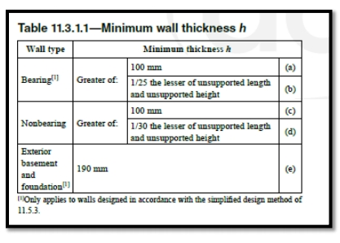

Shear wall :
Shear wall is 25.4 m long and 4 m height
Minimum thickness (h) = $\frac{L}{25}=\frac{4}{25}=0.16 m$
Use h = 0.25 m

Slide 21
Summary of preliminary design:
Type | Thickness (mm) | Dimension (mm)
Slab | 250 | ---------
Column | -------- | 800 x 400
Beam | -------- | 550 x 350
Shear wall | 250, 300 | ---------

Slide 22
Modeling , analysis and design:
input data of the models:
material:
Material that used in this project is reinforced concrete f_{c =} 28MPa for slab, beams, columns and shear wall
section on ETABS:
After defining the material used in elements, all sections of these elements will define on ETAPS and that includes columns, beams, slabs and shear wall.

Slide 23
modifiers on ETAPS:
Section | Modifier
Column | 0.7
Beam | 0.35
slab | 0.25
Shear wall | 0.7

Slide 24
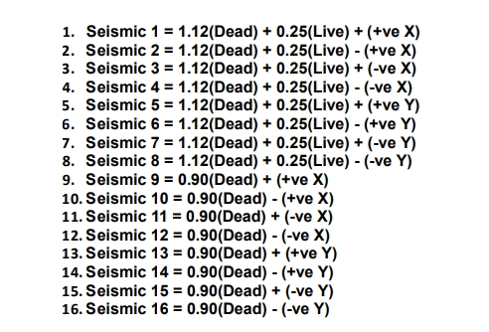
2 Load combinations for seismic design on ETAPS

Slide 25
Load Cases on ETAPS
Load Cases on ETAPS:
Load type | Case
Live load in each floor | 2KN/m²
Superimposed load in each floor | 3.5KN/m²

Slide 26
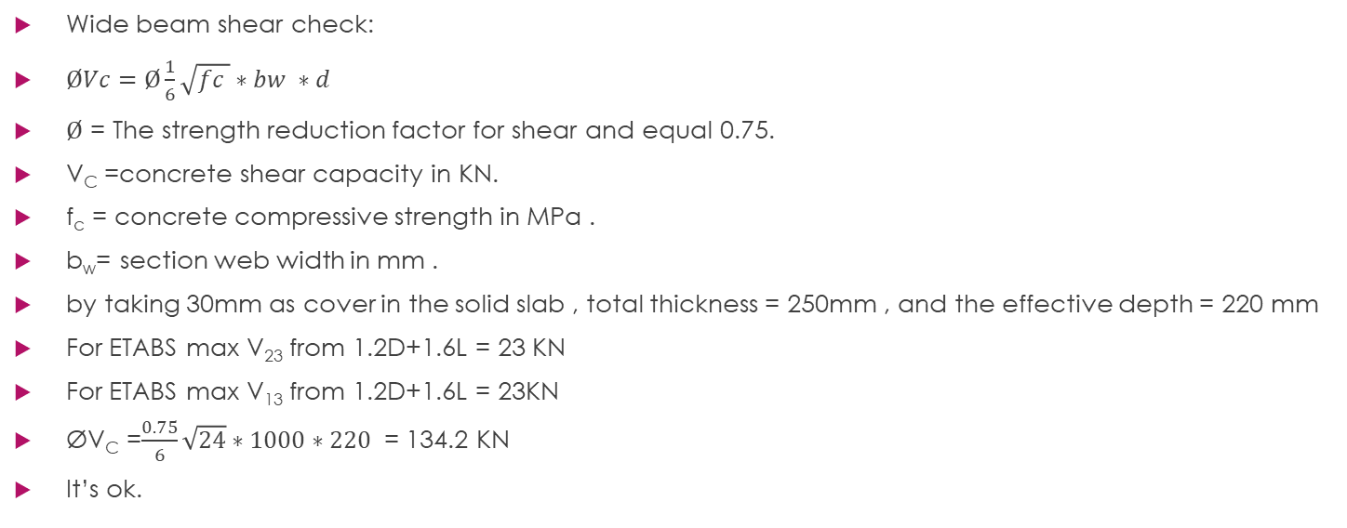
slab Check
Wide beam shear check:
$ØVc=Ø\frac{1}{6}\sqrt{fc }∗bw ∗d$
$Ø$ = The strength reduction factor for shear and equal 0.75.
V_{C} =concrete shear capacity in KN.
f_{c} = concrete compressive strength in MPa .
b_{w}= section web width in mm .
by taking 30mm as cover in the solid slab , total thickness = 250mm , and the effective depth = 220 mm
For ETABS max V₂₃ from 1.2D+1.6L = 23 KN
For ETABS max V₁₃ from 1.2D+1.6L = 23KN
ØV_{C} =$\frac{0.75}{6}\sqrt{24}∗1000∗220$ = 134.2 KN
It’s ok.

Slide 27
Check slab for deflection:

Slide 28
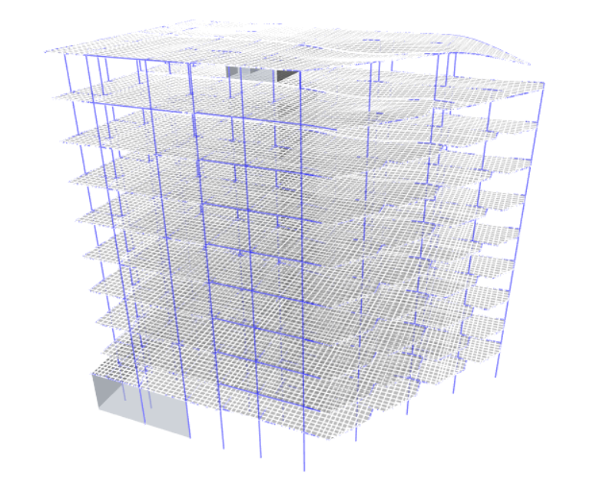
Check for compatibility
We used the model shapes, and periods as an indication for compatibility check of the structure.
Since all parts of the structure (slabs, beams and columns) move together and the period is reasonable that the compatibility check its ok.
As shown in figure that the period =0.846s which is less than 1 s (its ok)

Slide 29
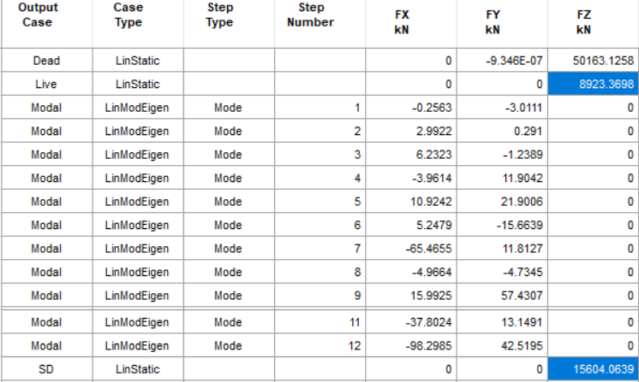

Equilibrium check:
Hand calculation
Live load = (4482* 2) = 8964KN
SD load = (4482 *3.5) = 15687 KN
%Error_{live} =$\frac{8923.3−8964}{8964}$ = 0.454%
%Error_{SD} =$\frac{15604−15687}{15687}$ = 0.5291%

Slide 30

Stress strain check:
M_{hand} = $2 ∗\left(3.96 −0.6 \right)2 ∗\frac{3.62}{8}$ = 10.218 KN.m
M=5.3433KN.m
M_{ETABS} =$\frac{4.1479+5.3433 }{2}$ +5.9321
=10.67KN
%error = $\frac{10.67−10.218}{10.218}∗100\%$ =4.42%

Slide 31
Seismic Analysis
seismicity of site and structure
To determine the earthquake load and seismic design category, some factors should be fined and calculated.
These factors affected by type of soil and natural of structure and location of building,

Slide 32
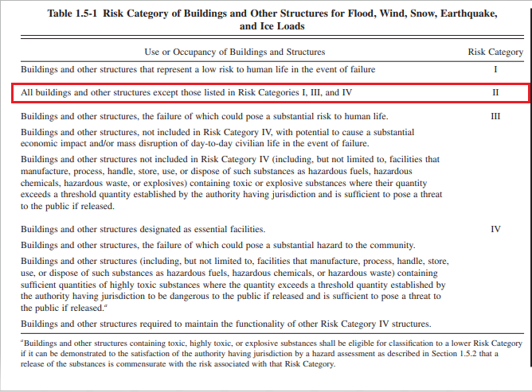
Risk category:
It's classification for building according to the importance of building and the risk of failure structure.

Slide 33
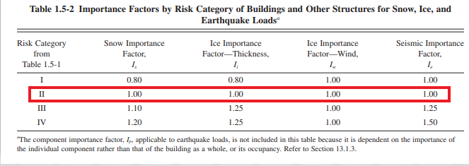
importance factor
The importance factor will find according to risk category

Slide 34
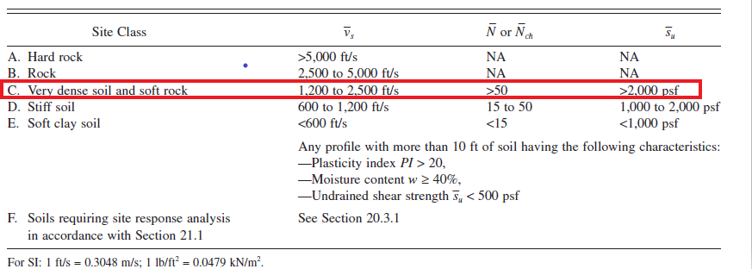
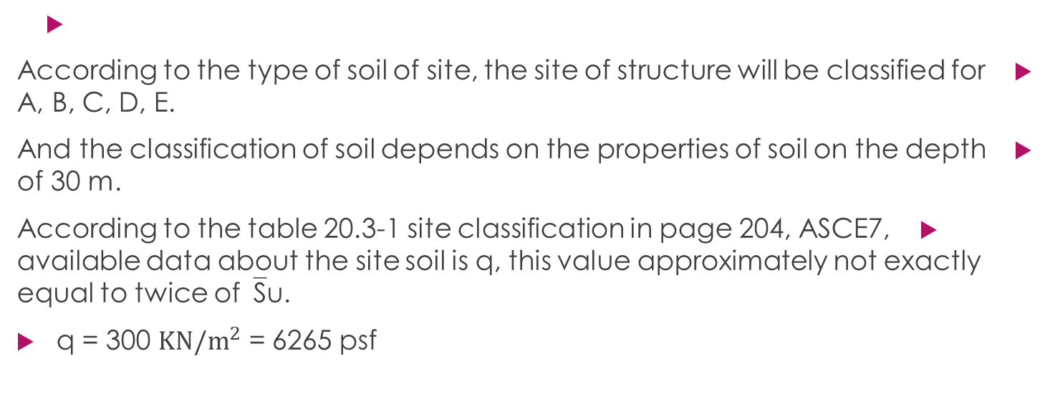
Site classification
According to the type of soil of site, the site of structure will be classified for A, B, C, D, E.
And the classification of soil depends on the properties of soil on the depth of 30 m.
According to the table 20.3-1 site classification in page 204, ASCE7, available data about the site soil is q, this value approximately not exactly equal to twice of‾Su.
q = 300 $KN/m^{2}$ = 6265 psf

Slide 35
Seismicity of the site:

Slide 36
The Z factor will be used to calculate S1 and Ss
Ss: it is acceleration will effect on the soil of site B within a short period of time and will be as a percent of g.
S1: it is acceleration will effect on the soil of site B within 1 second and will be as a percent of g.
Ss = 2.5 × Z = 2.5 × 0.20 = 0.50
S1 = 1.25 × Z = 1.25 × 0.20 = 0.25

Slide 38
SMS: acceleration will effect on the soil of the project within a short period of time and will be as a percent of g.
SM1: it is acceleration will effect on the soil of the project within a 1 second and will be as a percent of g.
SMS = Fa × Ss = 1.2 × 0.50 = 0.60
SM1 = Fv × S1 = 1.55 × 0.25 = 0.3875

Slide 39
Then SDS, SD1 will be calculated due to SMS, SM1
SDS: acceleration will effect on the structure within a short period of time and will be as a percent of g (design acceleration).
SD1: acceleration will effect on the structure within a 1 second will be as a percent of g (design acceleration).
SDS = 2/3SMS = 0.40
SD1 = 2/3SM1 = 0.2583

Slide 41
Seismic force resisting system: Special reinforced concrete moment frames.
From ASCE 7 10 Table 12.2 1:
R =8 ʊ_{O} =3 C_{d} =5.5
T_{a} = C_{t} *h_{n} ^{x} = 0.0466*31.5 ^{0.9} =1.039 s
Dead load = 57542, 62 KN
Live load = 8923 KN = 0.25 * 8923 = 2230.75 KN
S.D Load = 15604 KN
Weight of building = 75377.37KN
C_{s} = S_{DS}/ (R/I_{e}) = 0.4/ (8*1) =0.05
C_{S MAX} = S_{D1}/ T(R/I_{e}) = 0.2583/ 1.039(8/1) =0.03107 controlled
C_{S MIN} = 0.044(S_{DS}* I_{e}) = 0.044*0.4*1 =0.0178 more then 0.01
V =C_{S} * W = 0.03107 *75377.3 = 2341.9 KN

Slide 43
Seismic checks :

Slide 44
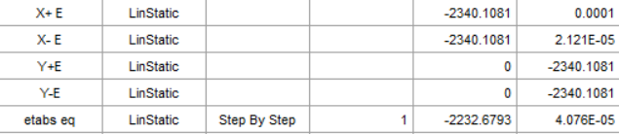
ETABS check codes

Slide 45

Beam design:
shear reinforcement for beams:
From ETAPS:
V_{u} = 181.49 KN
$Vc=\frac{1}{6} ձ \sqrt{fc }bw d$
Assume cover = 60 mm
$Vc$ = 151.24.33 KN
V_{s} = V_{u}/0.75 –$Vc$
$Vs$ = 90.73 $\sqrt{fc} bw d$
$Vs$ _{Max} = 617.34 KN ok section size is adequate
$\left(\frac{Av}{s}\right)$_{Min =} 87.65/ (420*500) = 0.4173
$(\frac{Av}{s}$) _{min} = max $\left(0.062\sqrt{fc}\frac{b}{fy} ,\frac{0.35b}{fy}\right)$
$(\frac{Av}{s}$) _{min} = max (0.273, 0.291)
Use 0.4409
Assume stirrup with diameter (10mm) two leg, A_{v} =157 mm
Spacing =$\frac{Av}{0.4409}$ = 356.08mm
S_{max =} min (d/2, 600) = 500/2 = 250 mm
Use 1Ǿ 10 /250 mm

Slide 46

Longitudinal reinforcement for beams:
To check longitudinal steel in this span
Ꝭ=$\frac{0.85fc}{fy} (1−√(1−\frac{2.61Mu}{bd^{2}fc}$)
M_{u} =265 KN.m
b_{w} = 350 mm
d =490 mm
f_{c} = 28 MPa
f_{y} =420 MPa
Ꝭ =0.00905 ≤ Ꝭ_{min} =0.0033
Use Ꝭ = 0.00905
A_{S} = 0.00905 * 350 *490
A_{S} = 1552.39 mm²

Slide 47
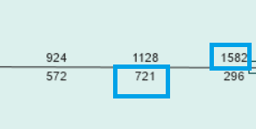
At bottom Ꝭ =0.00413≤ Ꝭ_{min} =0.0033
Use Ꝭ = 0.00413
A_{S} = 0.00413* 350 *490
A_{S} = 708 mm
Figure 27 : Rienforcment in beams

Slide 48

Torsion reinforcement for beams:

Slide 49
columns

Slide 50

Slab design
Design slab for flexure :
Ꝭ=$\frac{0.85fc}{fy} (1−√(1−\frac{2.61Mu}{bd^{2}fc}$)
In y direction bottom
Mu = 28 KN.m
Ꝭ =0.00187
A_{s} = 0.00187 *1000 *200 =375 mm^{2 /}m
In y direction top
Mu = 23 KN.m
Ꝭ =0.00153
A_{s} = 0.0018 *1000 *200 = 360mm² /m
In y direction bottom
Mu =8 KN.m
Ꝭ =0.000531
A_{s} = 0.0018 *1000 *200 =360 mm^{2 /}m
In y direction top
Mu = vary small (KN.m )
Ꝭ =0.0018
A_{s} = 0.0018 *1000 *200 = 360 mm² /m

Slide 51
Shear wall

Slide 52
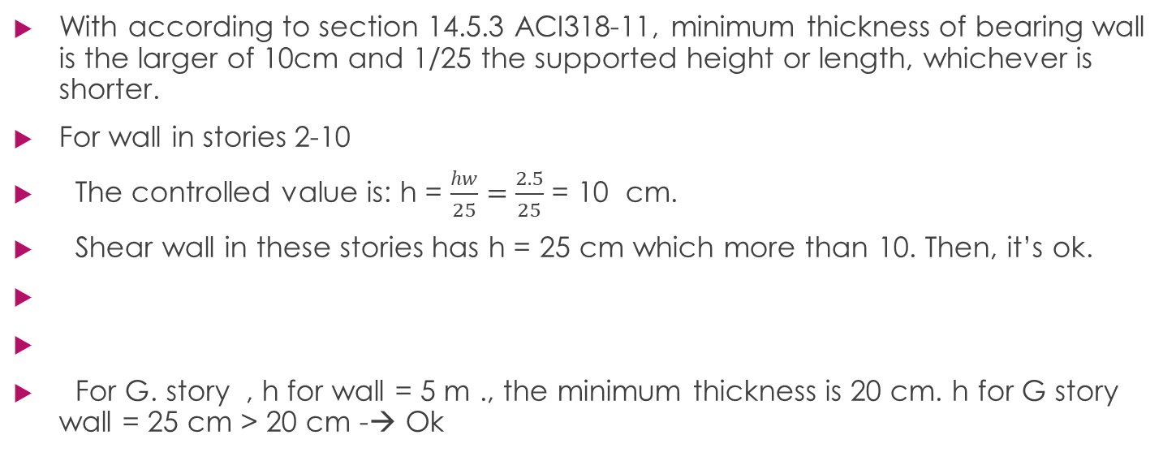
With according to section 14.5.3 ACI318-11, minimum thickness of bearing wall is the larger of 10cm and 1/25 the supported height or length, whichever is shorter.
For wall in stories 2-10
The controlled value is: h = $\frac{hw}{25}=\frac{2.5}{25}$ = 10 cm.
Shear wall in these stories has h = 25 cm which more than 10. Then, it’s ok.
For G. story , h for wall = 5 m ., the minimum thickness is 20 cm. h for G story wall = 25 cm > 20 cm -→ Ok

Slide 58
Footing design

Slide 59
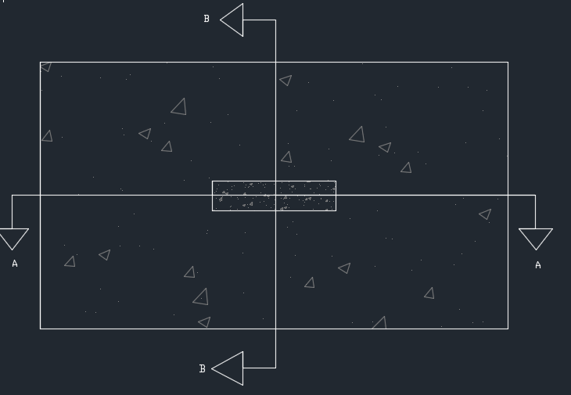
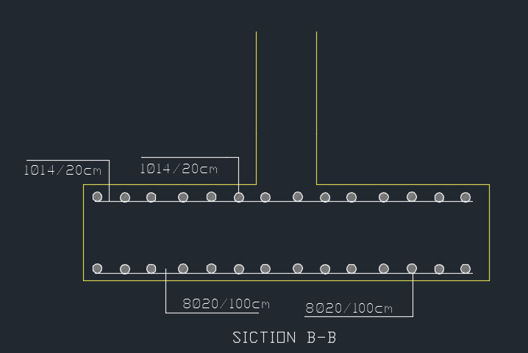
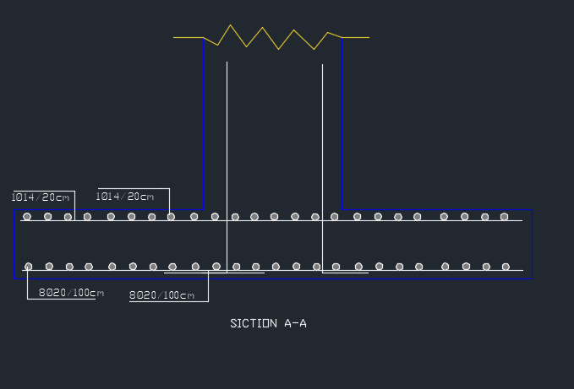
Figure 37 : Reinforcment detailing for single footing

Slide 60
Design wall footing

Slide 61
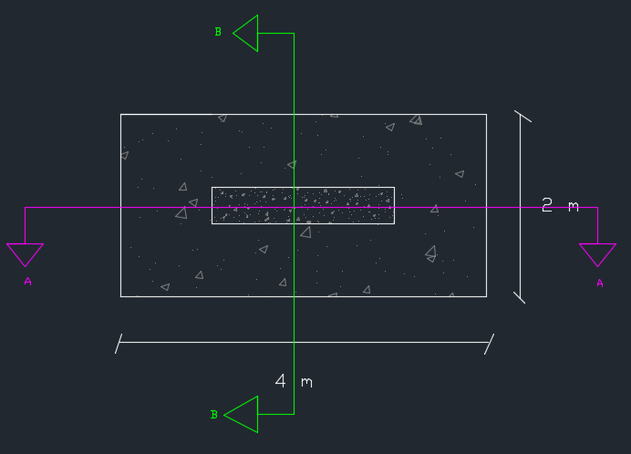
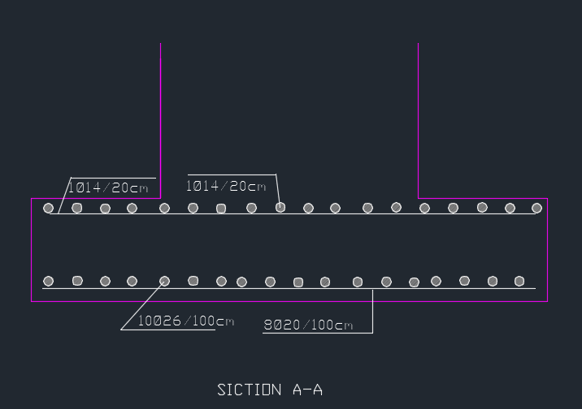
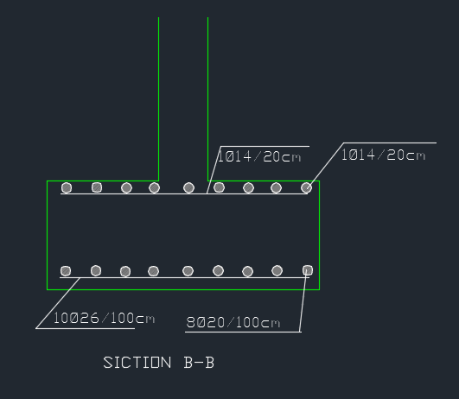
Figure 38 : Wall footing on Auto-CAD

Slide 63
