Slide 1

Master plan design for wastewater reuse sector in Jenin governorate.
(A framework for analyzing socio-economic, governance and environmental impacts of reusing wastewater in agriculture in Jenin governorate)
By: Muna MN Masri

Slide 2
Introduction
The reuse of wastewater in many sectors in life could solve a big part of the problem. As wastewater is normally produced continuously throughout the year, it could be reused in large amounts and fill the gap between the actual supply of water and the growing demand.

Slide 3
Project outline
Upstream issues
Treatment capacity
Treatment technology
Cost.
Sewage collection.
Water availability.
Upstream
Treatment
Downstream
Injected to groundwater or surface water
Other uses and disposal
Reuse in Agriculture

Slide 4
Reuse in Agriculture
Associated concerns
Environmental Social Economic Governance
-Soil.
-Crops.
-Groundwater quality.
.
-Acceptance
-Water pricing policy
-Regulations and policies to develop the wastewater reuse project
-Relation between actors and stakeholders

Slide 5
Assumptions
Safe yield sufficient for future needs
Climate change is not taken into consideration (effect is insignificant)
No new regulations anticipated in the future

Slide 6
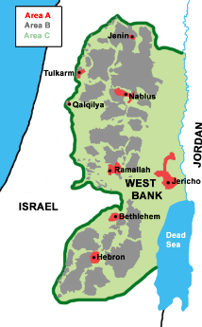
Study area: Jenin Governorate
Jenin governorate is located at the northern part of the west bank.

Slide 7
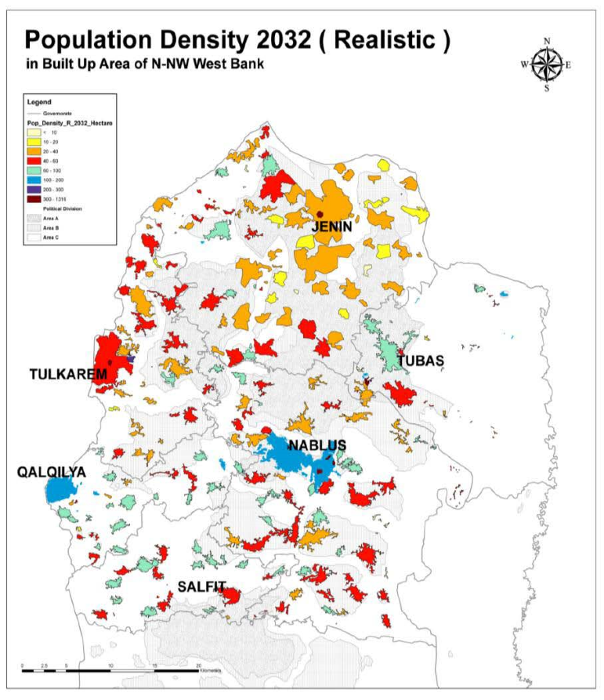
The populations is expected to be dense in the orange and red areas, as shown in the map.

Slide 8
Population
Jenin has a population of 332,050 capita for 2020, and expected to have a population of 461,260 by 2032.

Slide 9
The main goals of any wastewater system are:
Goal 1: Provide reliable and safe sewer services.
Goal 2: Provide wastewater collection and treatment, pretreatment, residual disposal and sewer overflow control.
Goal 3: Assure appropriate future wastewater collection and treatment capacity.
Goal 4: Manage regional sewer service efficiently and cost-effectively.

Slide 10
RESEARCH OBJECTIVES
Assess the current wastewater infrastructure situation in Jenin Governorate regarding the collection networks, the WWTPs (effluent quality, efficiency and generated treated wastewater).
Assess the current water situation in Jenin governorate and water resources.
Design a questionnaire to assess the farmers’ opinon of reusing treated wastewater in agriculture and in irrigation, concerning the socio-economic aspect, as the farmers are part of the decision making.

Slide 11
RESEARCH OBJECTIVES
Designing (GAT), governance assessment tool template to assess the cooperation framework between the involved actors, and the regulation and laws’ of each involved body and institution.
Design a questionnaire and conduct a focus group to discuss with end users and customers their social acceptance to buy products that are irrigated with treated wastewater.

Slide 12
Methodology
Questionnaires for the farmers.
Interviews with the relevant stakeholders. ( PWA, MoA, MoH..etc), by the template of GAT.
Focus groups with the sellers and end users.

Slide 13
Advantages of reusing wastewater in agriculture
It permits higher crop yields.
It therefore reduces the cost of fertilizers (or simply makes them more accessible to poor farmers).
Reduces the use of fertilizers.
The cost of pumping wastewater from nearby channels is lower than the cost of pumping groundwater.
Can recharge aquifers through infiltration.

Slide 14
Disadvantages of reusing wastewater in agriculture
Contamination of soil, some substances that may be present in wastewater can reduce soil productivity.
Contamination of groundwater, infiltration of wastewater to aquifers may cause aquifer pollution with pathogens and organic matter.
Public health, pathogens contained in wastewater can cause health problems for humans.
Water salinity and metal content in soils could be increased in the long term.

Slide 15
Water Governance
Water governance has been deﬁned as “...the range of political, social, economic and administrative systems that are in place to develop and manage water resources, and the delivery of water services, at different levels of society ” (Rogers & Hall, 2003).

Slide 16
Wastewater Governance
Wastewater governance is defined as “a context of political, social, economic, and legal structures within which societies manage their wastewater related affairs. It can also be looked as processes of decision-making involving both formal and informal actors in society at all levels”. (Wawi, 2017)

Slide 17
The existence of multi-decision makers require multi-dimension analysis, in the situation where many stakeholders and institutions are involved, it is important to assess the cooperation between all actors, to have a clear vision of how harmonically they act, evaluate the efficiency of policies and to check whether there is overlapping in the responsibilities or not. To achieve the mentioned, governance assessment is carried out.

Slide 18
Barriers against wastewater reuse in agriculture
These include financial barriers, regulations and laws, technical issues, institutional managerial aspects, monitoring and evaluation, policy and political, health impacts and environmental safety and public acceptance.

Slide 19
1- Institutional barrier
Many institutions are involved in the wastewater reuse sector, and each has different roles in the management and development of this sector.
There has to be a clear framework to manage the responsibilities of all stakeholders, in order to decrease the occurrence of overlapping in the roles, so it’s important to assess the relationship between these institutions, and how do they function and cooperate together.

Slide 20
2- Technical barriers
Technical resources are important to assess, operate design and develop any wastewater reuse project.
What technical resources do we have, and
What technical resources do we need in order to develop the wastewater reuse project/sector in Jenin?

Slide 21
3- Human resources barrier
Qualified experts are needed to manage and operate the wastewater reuse sector.

Slide 22
4- Economic barrier
The investment and the operation cost of these projects is very high, especially for small and medium sized communities which suffer from a lack of funding resources (Özerol, 2013).
All costs cannot be handled by the municipalities, the Palestinian Water Authority (PWA) or the research centers unless people pay for the service.
In this project we will assess the possibility of the application of a new principle (the polluters pay), in which the citizens who produce wastewater are responsible for cleaning and treating it, so they pay to the municipalities an amount of money for this reason.

Slide 23
5- Social barriers
Social acceptance, including the farmers, sellers and customers of the products.

Slide 24
Risks of using untreated wastewater in agriculture
There is a big risk on health when consuming products that are irrigated with untreated wastewater, and treated wastewater too especially when the wastewater is not treated it as should be and therefore doesn’t meet the standards.
The main risk for the public arises when vegetable or salad crops grown with untreated wastewater are consumed raw. This can be linked to cholera and typhoid as well as to faecal bacterial diseases.
The following table shows health risks due to heavy metals that exist in the raw wastewater.

Slide 25
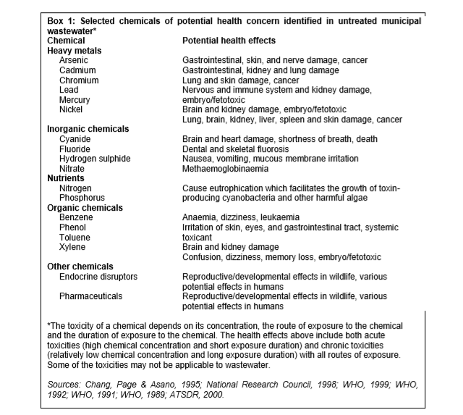

Slide 26
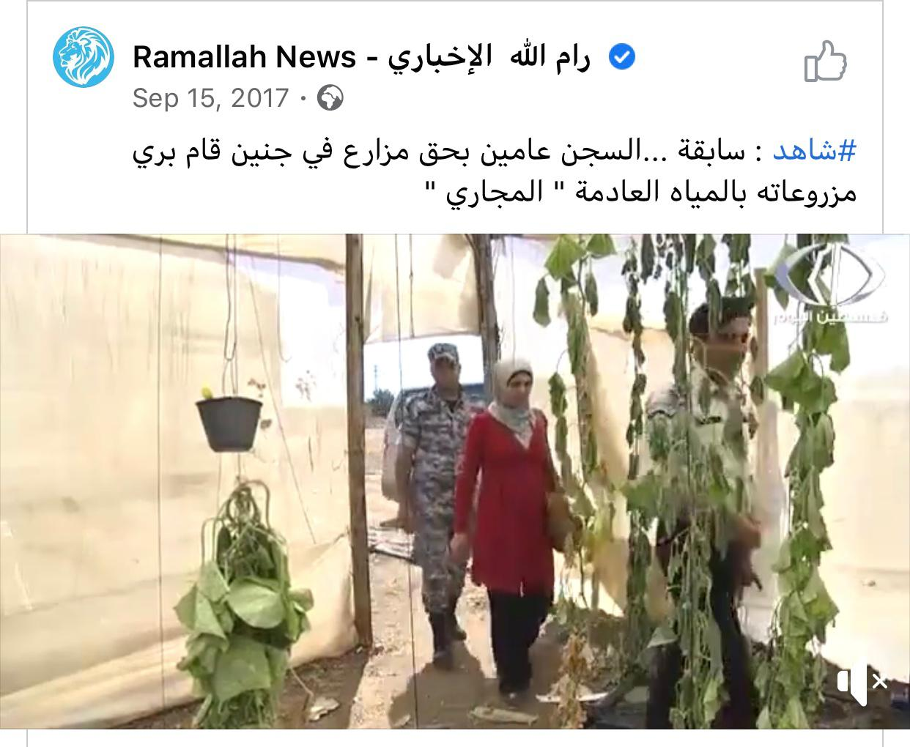

Slide 27
Strategies of managing health risks
Wastewater treatment: Most conventional domestic wastewater treatment plants focus on the removal of environmental pollutants (e.g. suspended solids, BOD - Biochemical Oxygen Demand-, COD - Chemical Oxygen Demand -, etc.) but not on pathogens, so disinfections is needed or leaving the water in ponds for five days.

Slide 28
Strategies of managing health risks
Choice of irrigation techniques: Farmers use different irrigation techniques depending on convenience and knowledge. However, farmers using treated wastewater for irrigation need to take some precautions during irrigation. Sprinkler/spray irrigation has the highest potential to spread bacterial and viral diseases and hence a buffer zone of 50–100 meters from houses or roads should be maintained to prevent health risks to local communities.

Slide 29
Strategies of managing health risks
Crop Selection: Water of poorer quality can be used to irrigate non-edible crops such as cotton or flowers, or crops that are cooked before consumption. Plants (eg.zucchini) with rough, textured surfaces, deep crevices or hairy surfaces that grow close to the ground may harbour bacteria or contaminated soil and should be avoided. But crop restriction cannot be a stand-alone solution.

Slide 30
Data collected for Jenin governorate
Concerning the water and wastewater situation

Slide 31
Water Resources in Jenin
Jenin is located in the northern part of the West Bank, so it is located over the northern-eastern basin, which yields 100-145 Mm³/year.
It depends on the rainfall.
The Palestinian utilization reached 23M m³/year from springs and wells.

Slide 32
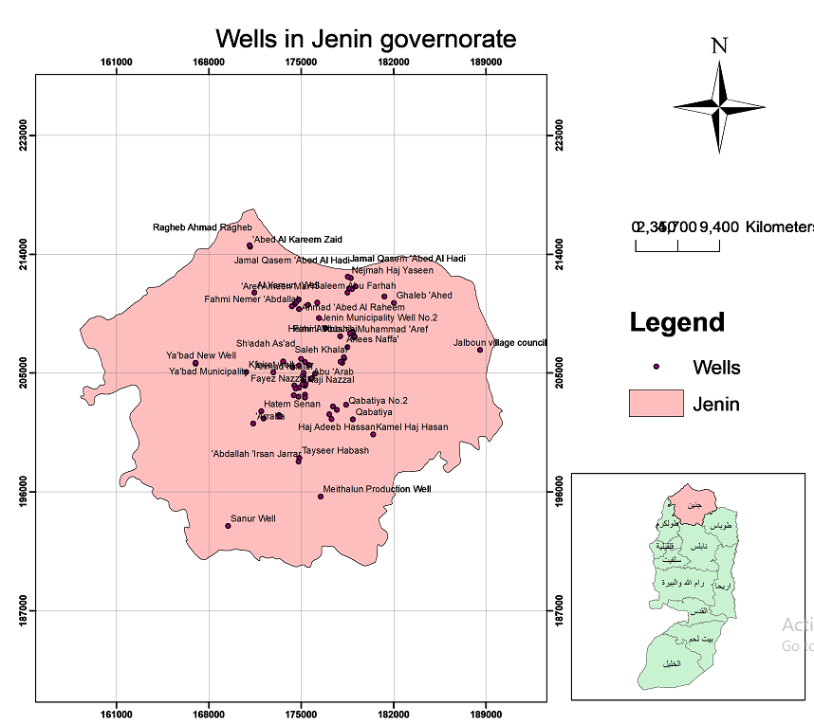
The following map shows the wells’ distribution for Jenin governorate.
There are 125 wells, 10 of which are tapping the deep aquifers (i.e. Upper and Lower aquifers) while the remaining wells are tapping the Eocene shallow aquifer. The summary of these wells are shown in Table 1 (attached in the report).

Slide 33
Water Demand
The water demand in Jenin in 2020 as follows:
 | Domestic | Industrial | Irrigation
Urban areas | 19,299 m³/day | 830 m³/day | 30,825 m³/day
Rural areas | 12,137 m³/day | 522 m³/day | 33,759 m³/day
Total Consumption | 31,436 m³/day | 1,352 m³/day | 64,584 m³/day

Slide 34
The expected water demand in 2032 is as follows:
 | Domestic | Industrial | Irrigation
Urban areas | 33,981 m³/day | 2,379 m³/day | 51,593 m³/day
Rural areas | 21,370 m³/day | 1,496 m³/day | 56,505 m³/day
Total Consumption | 55,351 m³/day | 3,875 m³/day | 108,098 m³/day

Slide 35
The expected water demand in 2032/day is 214,453 m³
While in 2020, it was 95,089 m³/day

Slide 36
  Coverage of wastewater collection system in Jenin governorate in 2014
 | Population | Population served by wastewater collection networks | Population served by septic tanks
Urban areas | 178,837 | 21,246 | 157,591
Rural areas | 112,460 | 4,789 | 107,671
Camps | 12,268 | 12,268 | 0
Total | 303,565 | 38,303 | 265,262

Slide 37
Notes
It’s noticed that the number of people who are served with wastewater collection systems are less than those who depend on septic tanks for wastewater disposal. That is a bad sign.
From the previous table, we notice that before starting a wastewater reuse project and master plan, the first step is to collect the biggest quantity of generated wastewater in order to treat it and reuse it. And that is done by providing the whole population with wastewater collection systems.

Slide 38
Projected wastewater flows in 2032
 | Population | Average flow (m³/day) | Average dry flow (m³/day) | Average wet flow (m³/day) | Peak factor | Peak wet flow (m³/day)
Urban areas | 283,117 | 24,876 | 27,363 | 32,338 | 3.1 | 138,707
Rural areas | 178,083 | 14,959 | 16,455 | 19,447 | 4.3 | 72,692
camps | 19,426 | 1,632 | 1,795 | 2,121 | 2.76 | 5,860

Slide 39
Wastewater infrastructure in Jenin
Generally, Jenin governorate lacks wastewater collection systems.
In 2014, the population of Jenin governorate was 303,506 capita, however the population connected to sewerage network was only 38,303 capita, which only forms 13% of it’s population.

Slide 40
WWTPs in Jenin governorate
Name of WWTP | Technology | Notes
Jenin WWTP | Aerated Lagoons | Treats 20% of the inflow, and the remaining diverted by WWTP operator to the adjacent Wadi to save on energy costs.
Anza WWTP | Activated sludge | Filtration unit Process not constructed due to limited budget
Maythalon WWTP | Pretreatment + wetland

Slide 41
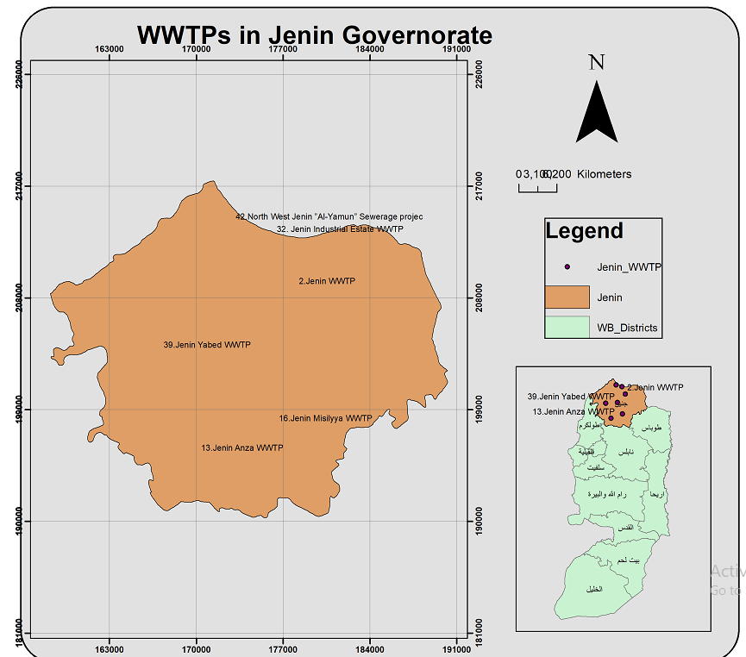
The following map shows the WWTPs in Jenin governorate, only Jenin, Maythalon and Anza WWTPs are operating, the rest are only planned to be existing by 2032.

Slide 42
Only 13% of the generated wastewater is collected by collection systems, where only 80% of the collected wastewater is treated.

Slide 43
Sustainability of the wastewater reuse sector
Long term reuse of wastewater could cause soil contamination, so it’s important to determine the effect of wastewater reuse on soil (concentrations of heavy metals, nutrients ions such as chloride, boron and sodium.. etc)
Determine the effect of wastewater reuse on the groundwater quality
Monitor the efficiency of wastewater treatment plants
Improve the stakeholders cooperation framework
Construct a constant funder for the wastewater reuse sector.

Slide 44
The following map shows the agricultural land classes that have a high value regarding agriculture for Jenin governorate, the pink areas are the lands that are classified as high agricultural land value.
The lands that have a high agricultural value makes 24% of the whole area of the agricultural lands in Jenin governorate. Which is a high percentage.
They are distributed majorly in the south, east and north of the governorate.

Slide 45
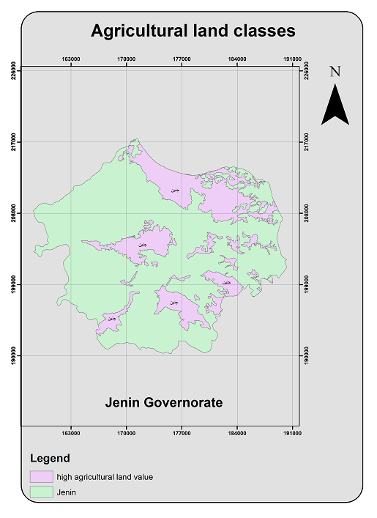

Slide 46
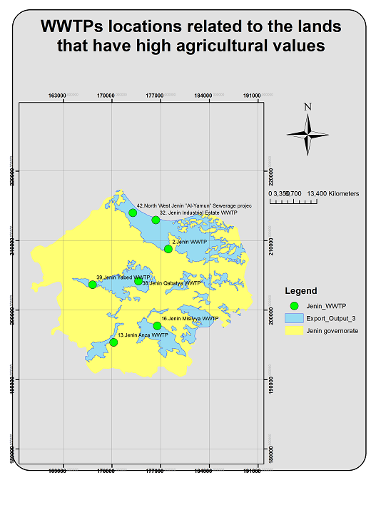
The following map shows the locations of the WWTPs in Jenin related to the lands that have high agricultural value.

Slide 47
Questionnaire Design
A questionnaire was designed to be delivered to the farmers, the sample of farmers contains about 400 farmers, 200 reuse treated wastewater in agriculture, and 200 use freshwater.
The main goal of the questionnaire is to assess the socio-economic dimension, the social acceptance of the farmers of using treated wastewater, the effect of reusing treated wastewater on the economic aspect and their income levels, the effect of reusing treated wastewater on their health and knowledge assessment.
The questionnaire is in the report.

Slide 48
Conclusion
By 2032, the water demand will be much larger than the available water in Jenin due to the increase in population. And the water supply won’t meet the water demand.
Jenin is poor of having wastewater collection network systems, so many villages and areas depend on septic tanks, so the idea of implementing reuse projects and building a reuse sector in the governorate is still an early step.
Lots of dimensions affect the reuse of treated wastewater in agriculture, all are addressed in the questionnaires and interviews.

Slide 49
Master plan design steps.
The first step is to build wastewater collection system and collect the generated wastewater from the citizens.
Second step, build enough WWTPs in the governorate, and they should be efficient.
Third step, study the political possibility (policies, regulations and laws) defined as governance. As the institutions are the decision makers.
Forth step, it is important to study the social acceptance of the farmers, end users and customers as they are the biggest part of the decision makers. In addition to the economic state, both defined as socio-economic state.
Fifth step, designing a masterplan based on the data collected from all parts of the system.

Slide 50
Thanks for your attention ☺
Highly appreciated

