Slide 1

Cinderella Store
E-commerce&Marketing
Submitted to: Dr. Kamal Irshaid
Group Members :
Mais Alreem Sabih Masri
Saja Nour Aldeen Suboh
Zaina Helmi Abusoud
Sohaib Khalid Baker

Slide 2
Contents
Introduction
1
  2
  Problems & Solution
  Tools & Plugins
  3
  Website Features
  4
  Report
  5
  Future Plan
  6

Slide 3
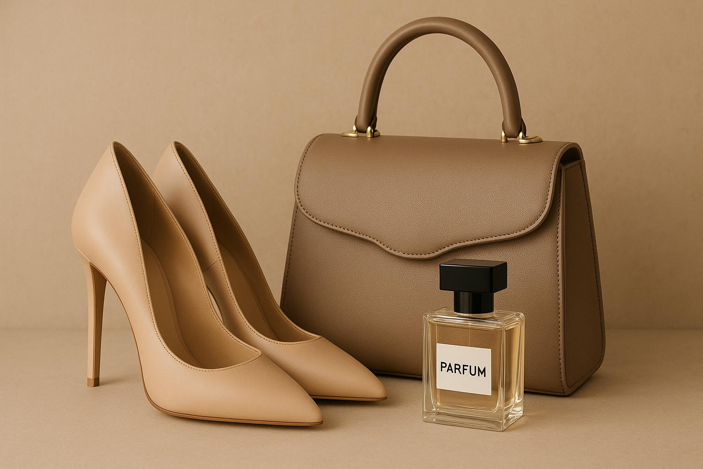

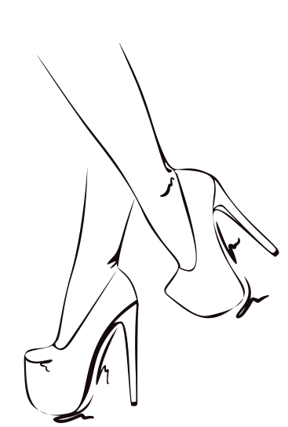
Cinderella Store is a Palestinian brand specializing in contemporary footwear. The brand aims to offer designs that combine elegance and comfort, inspired by the latest global fashion trends while catering to local tastes. Since its launch, it has focused on quality and unique details in every pair, which has earned it customers' trust and a distinguished position in the market

Slide 4


Problems & Solution
Implementing a digital sales system to manage inventory, invoices, and customer orders efficiently.
1
Lack of an electronic sales management system
1
Enhancing the user experience through interactive features and personalized product recommendations
2
2
Lack of a comprehensive shopping experience
3
Using an automated order tracking and processing system to handle purchases smoothly.
3
Difficulty managing large orders

Slide 5










Tools & Plugins

Slide 6




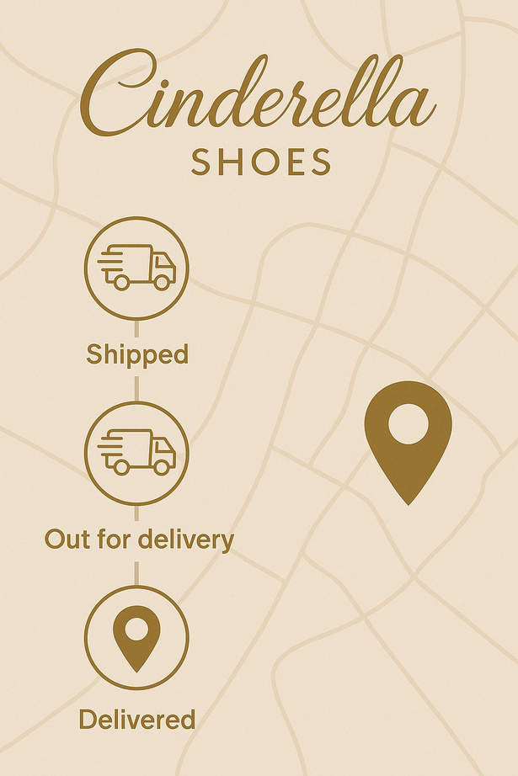
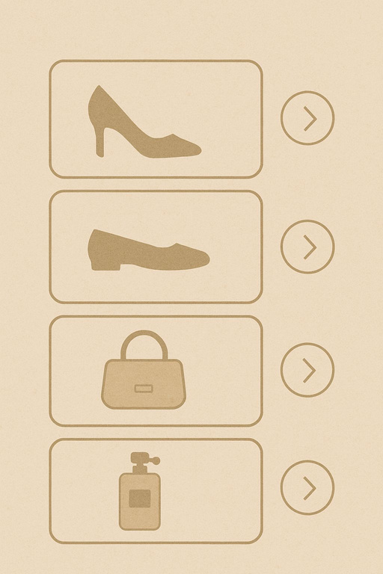

Website Features

Slide 7




Website Features

Slide 8
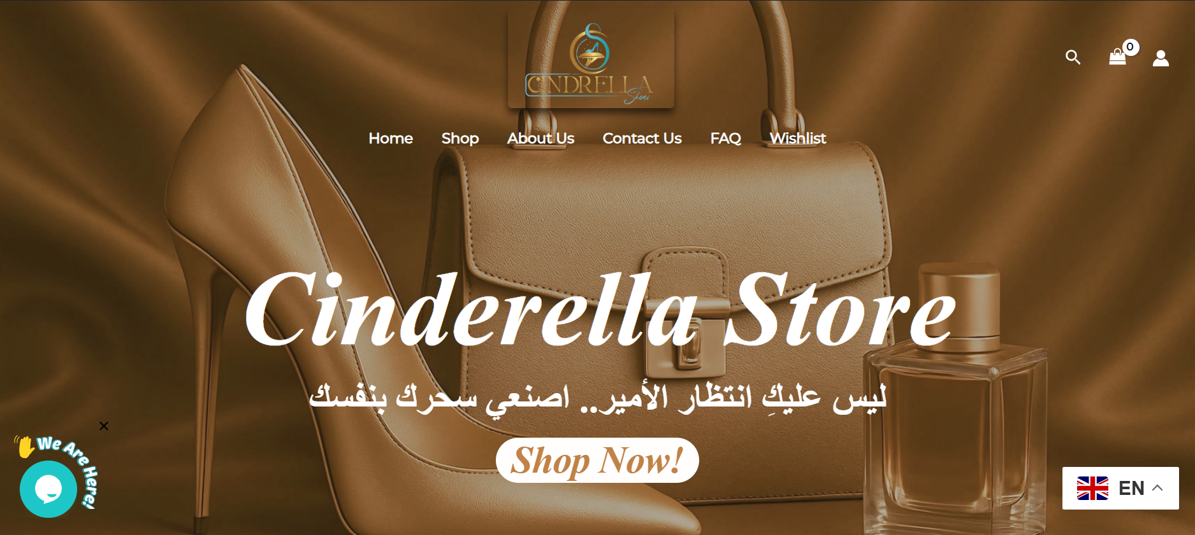

Slide 9



Slide 10
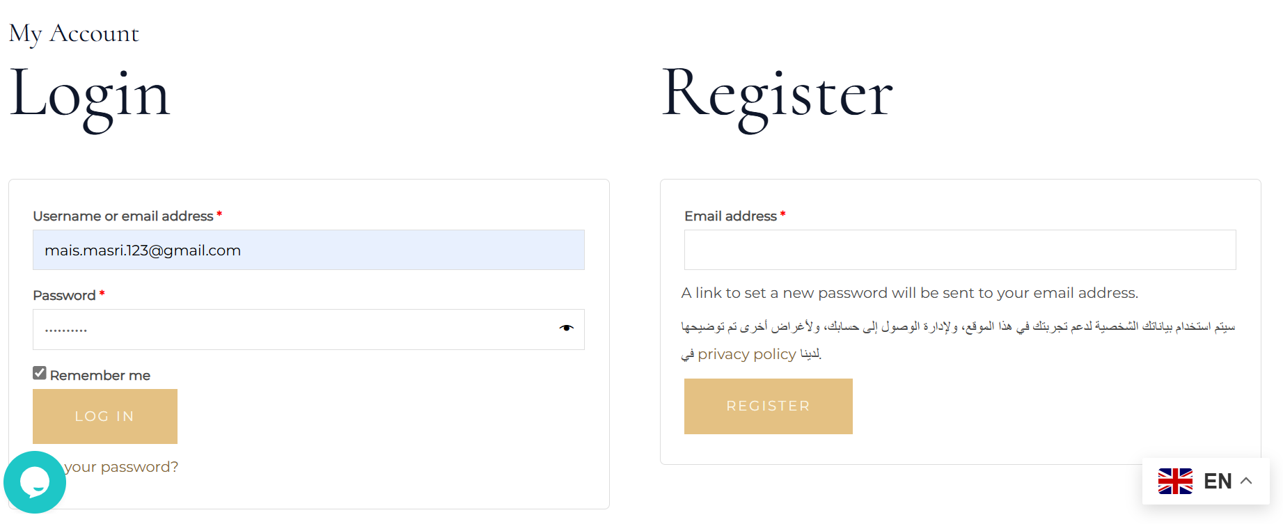




Slide 11


Slide 12
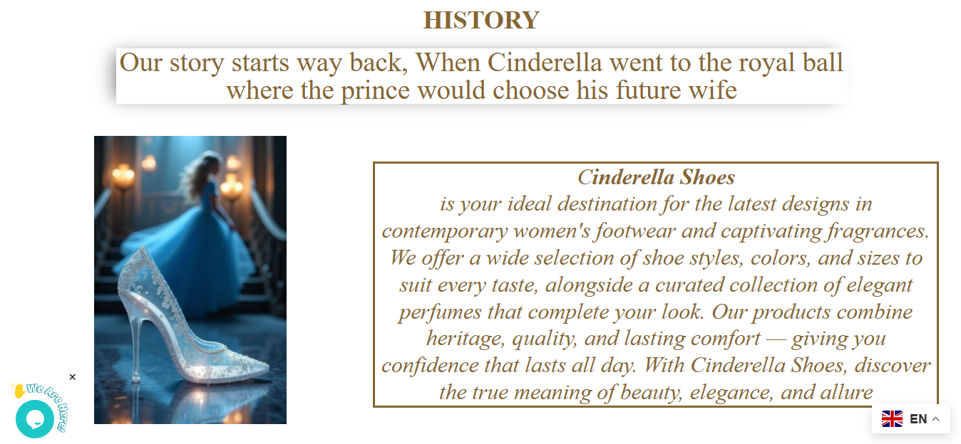

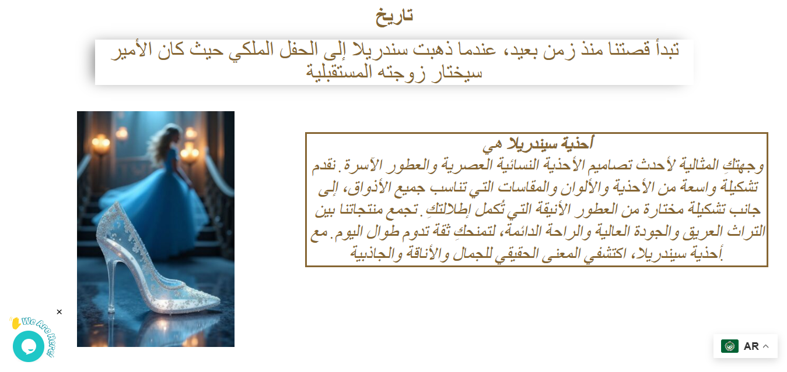

Slide 14
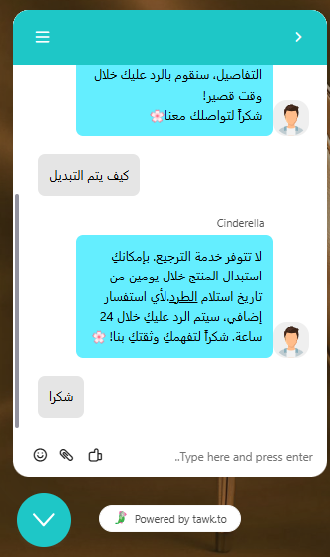
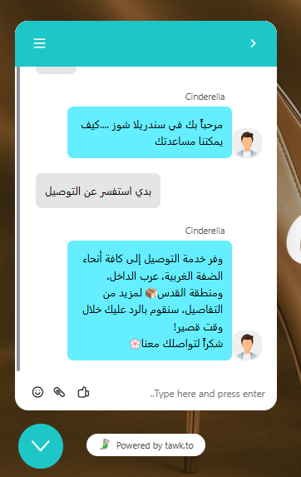

Slide 15
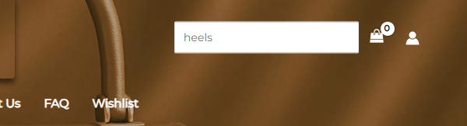

Slide 16
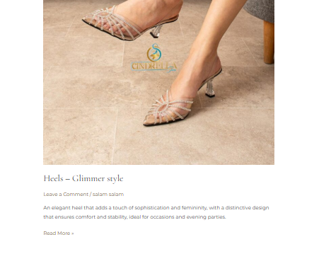
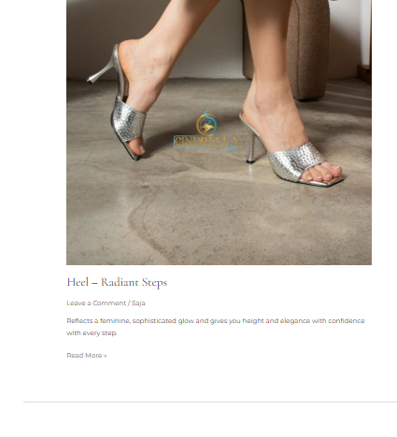

Slide 17
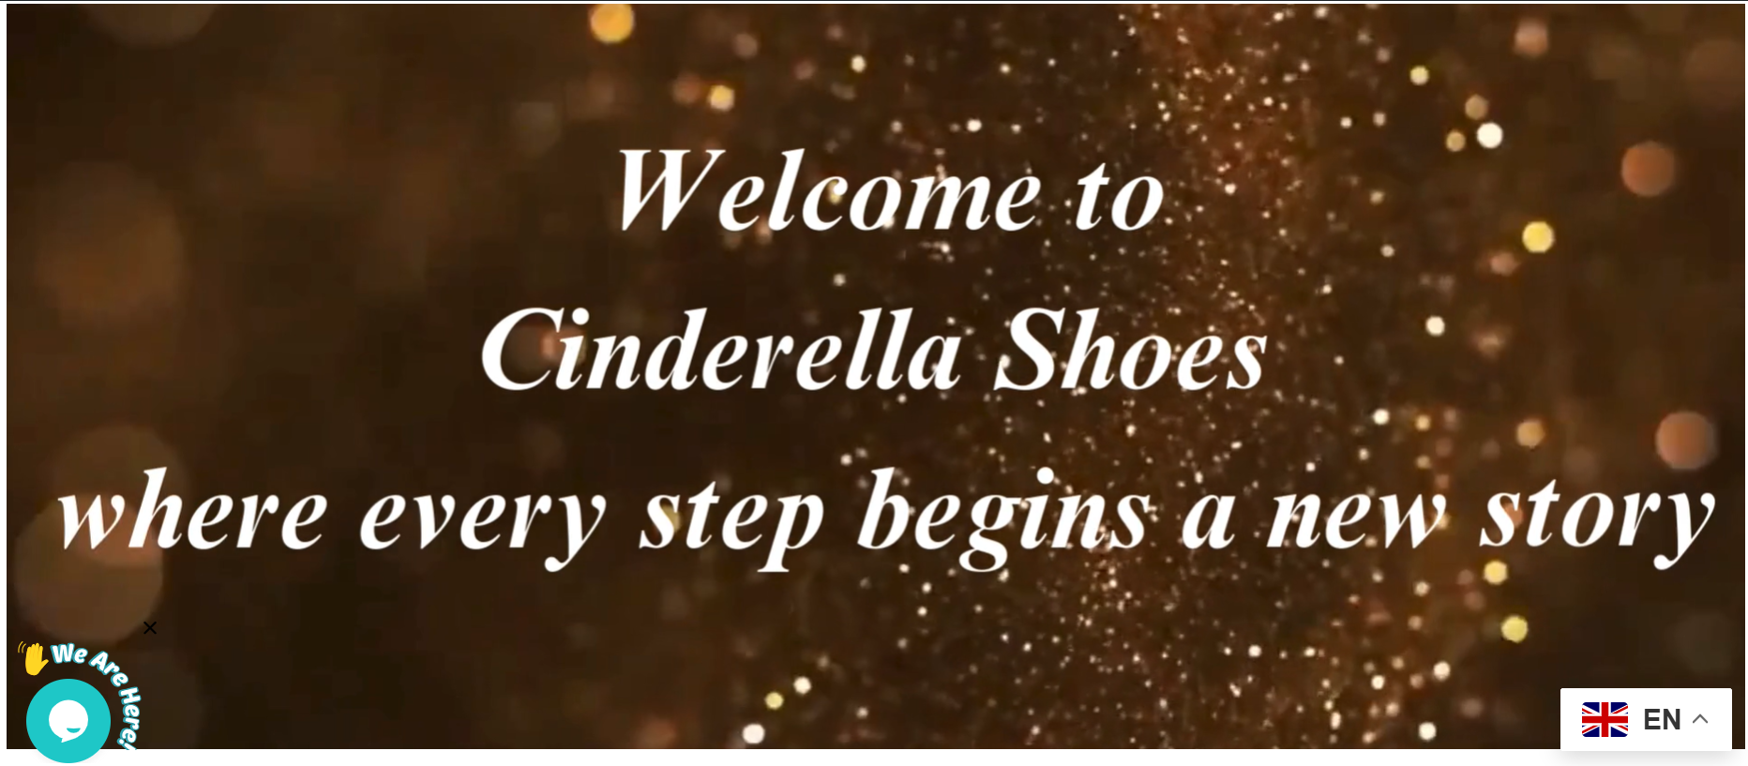

Slide 18
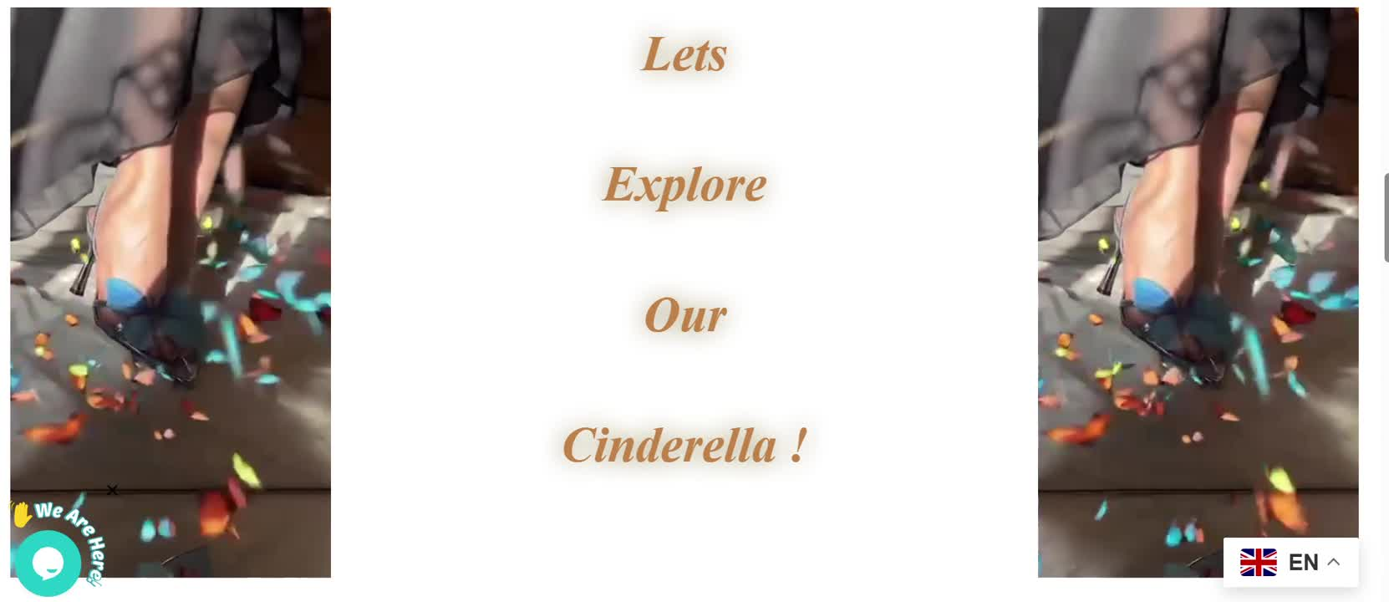

Slide 19


Slide 21
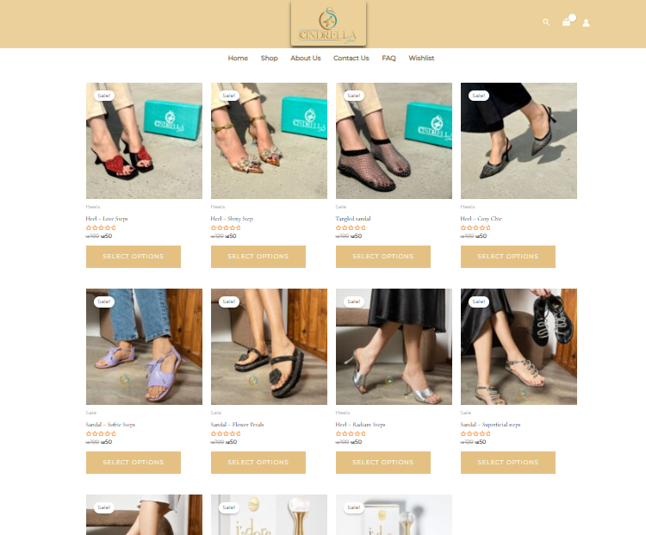

Slide 22
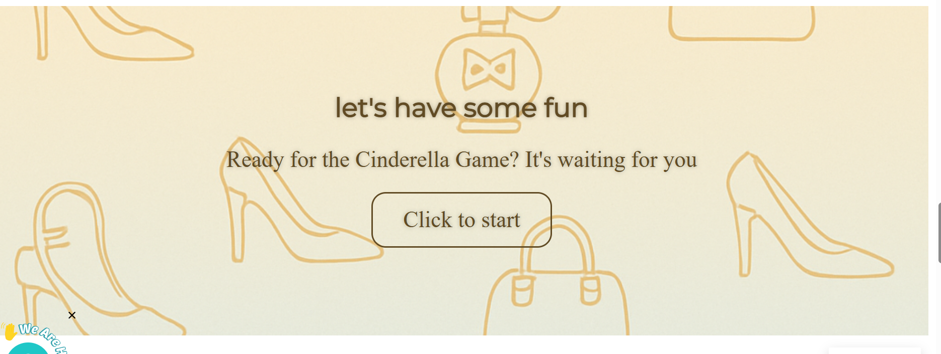

Slide 24
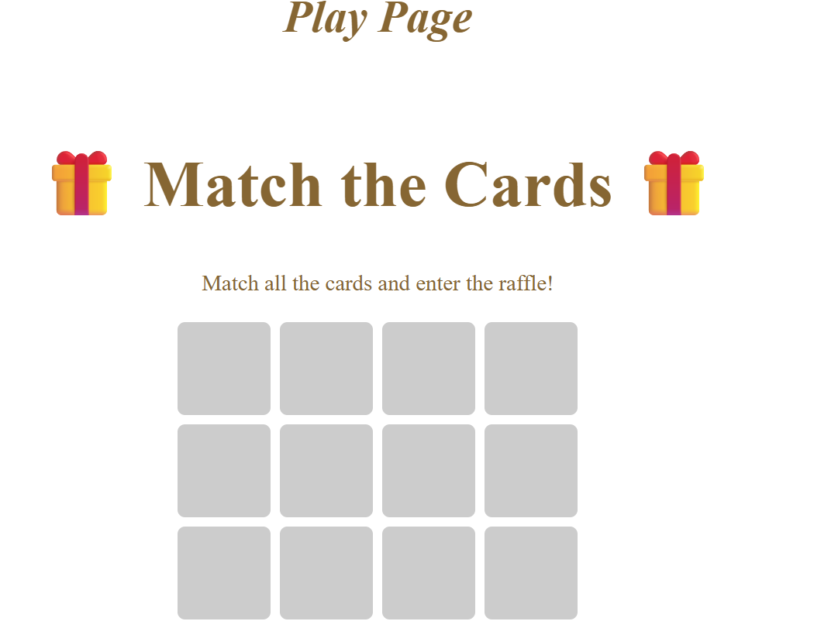

Slide 25
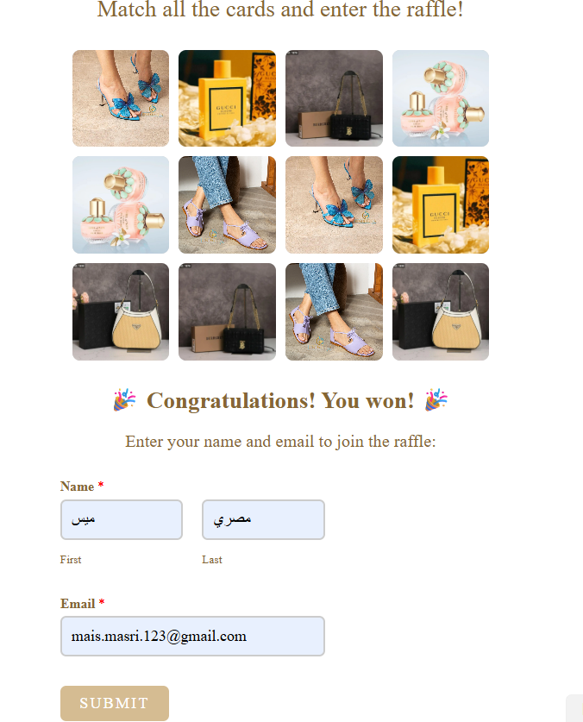
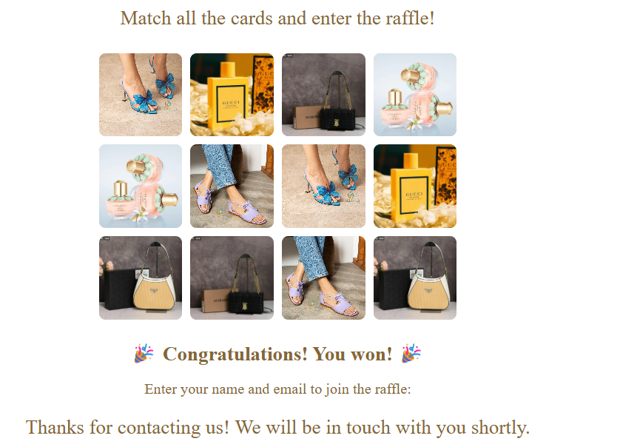


Slide 27
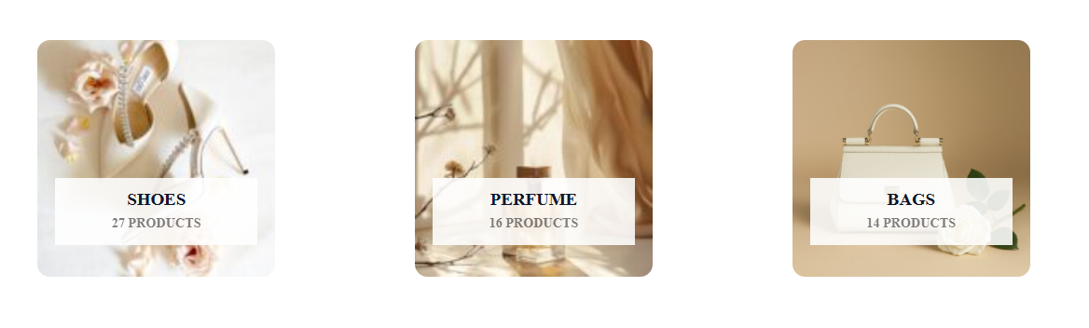
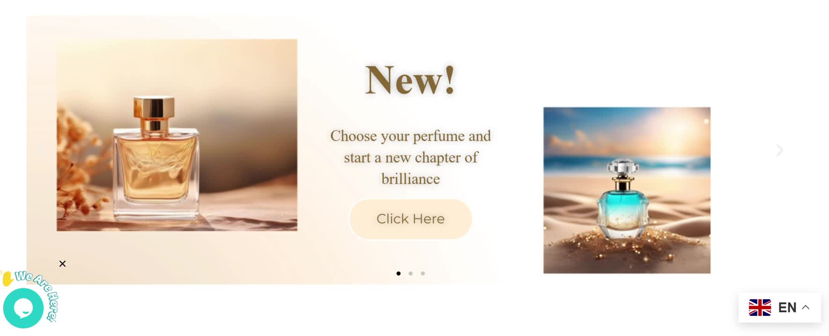

Slide 29
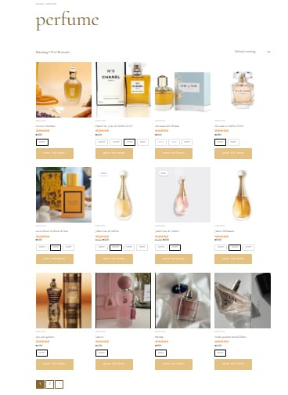
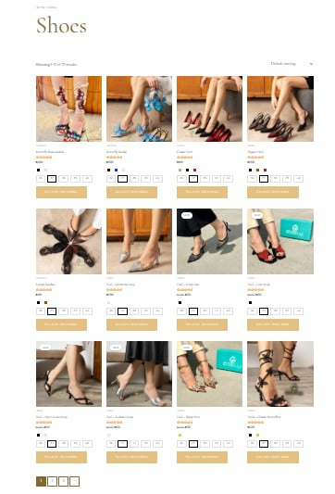
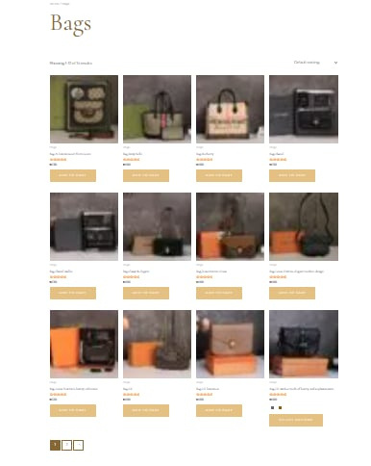

Slide 30
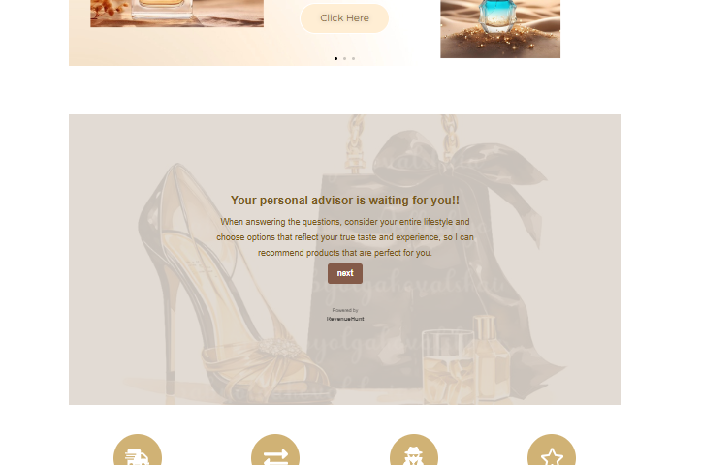
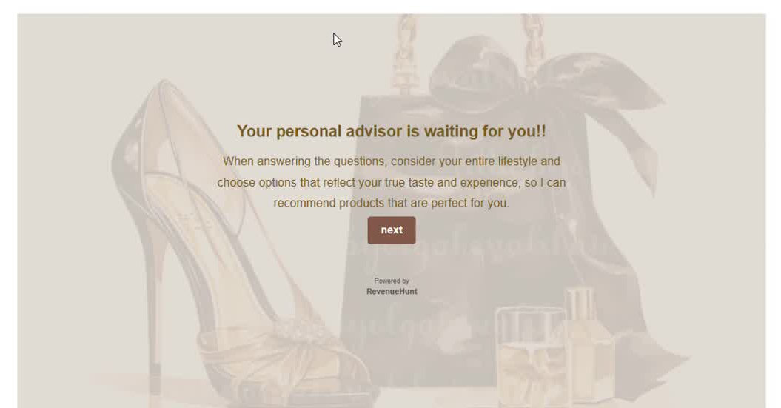

Slide 31
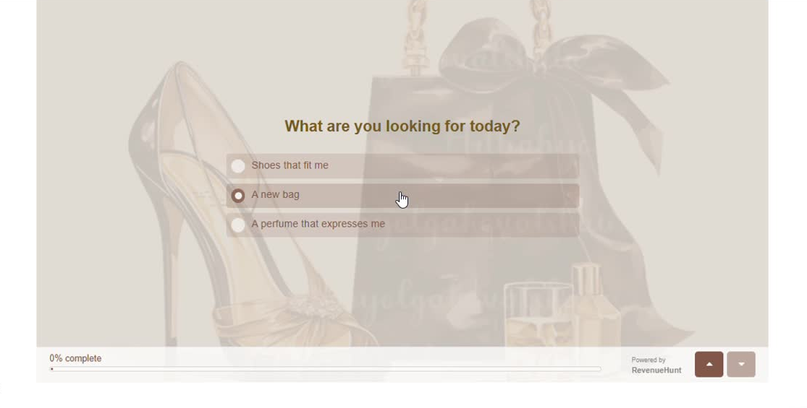

Slide 32




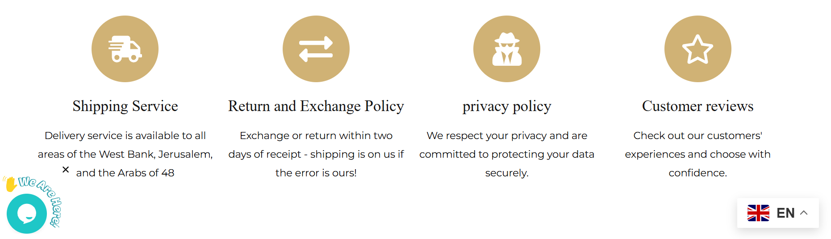

Slide 33
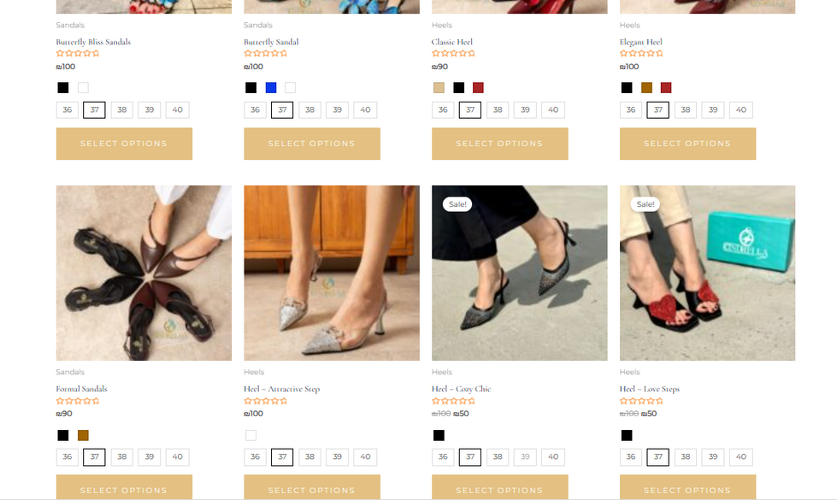
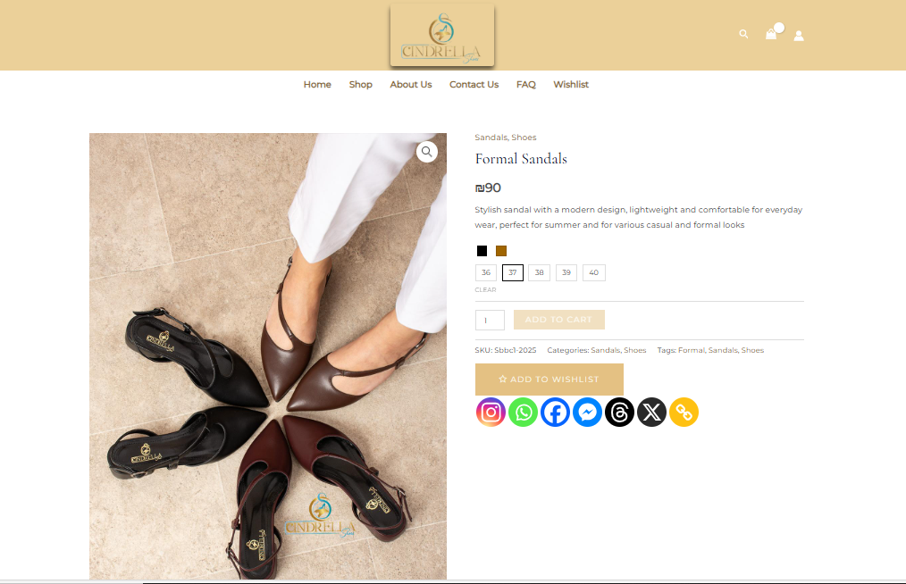
Purchase process

Slide 34
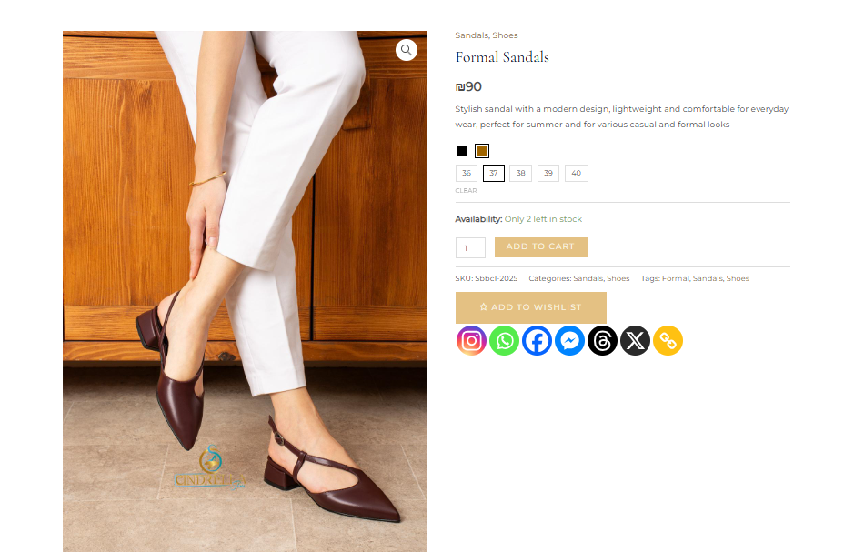

Slide 35
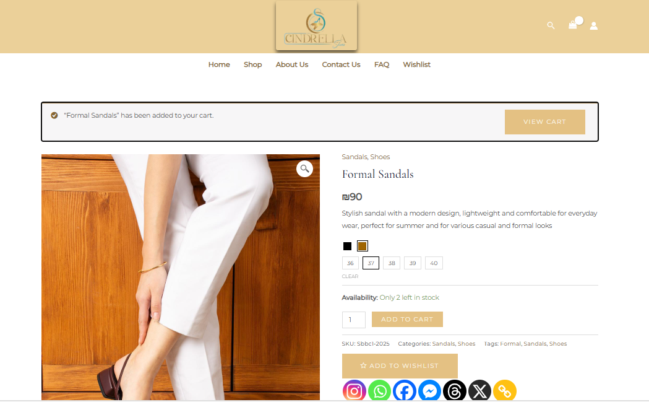

Slide 36
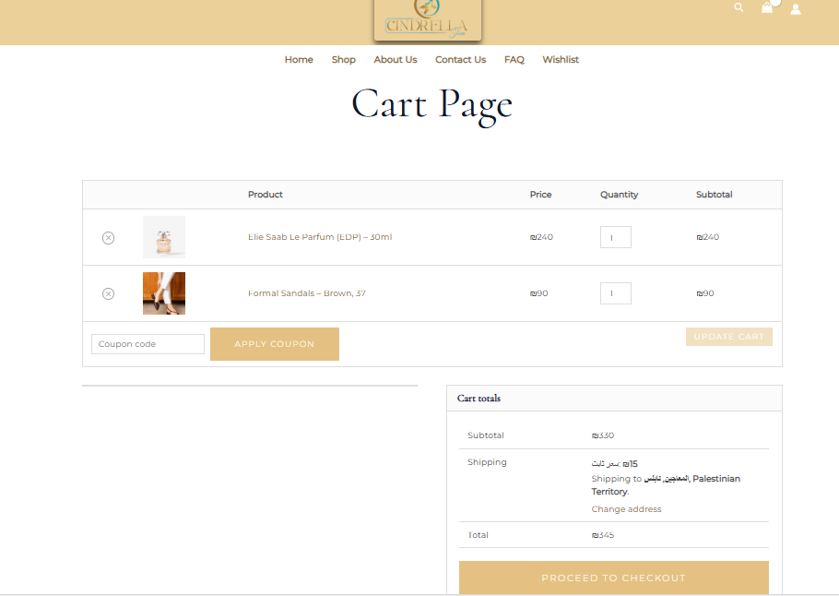
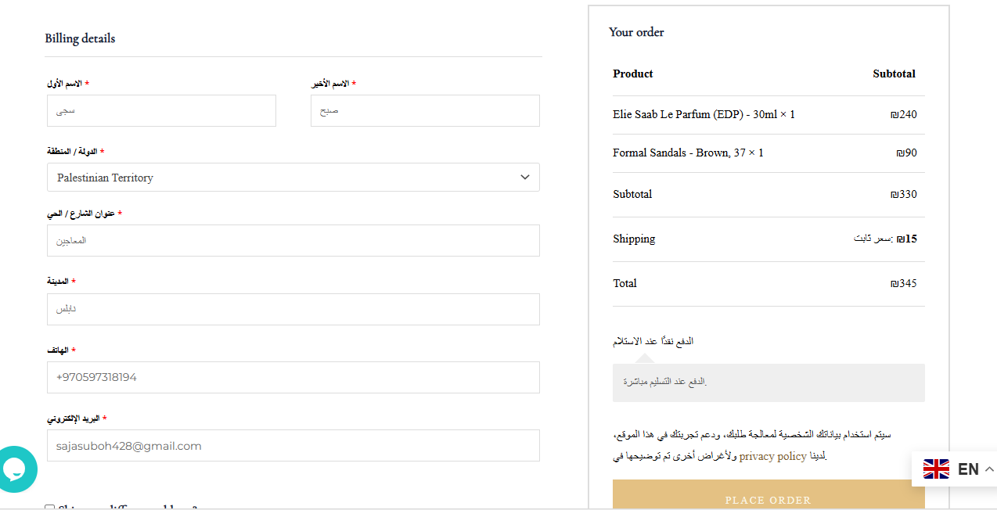

Slide 37
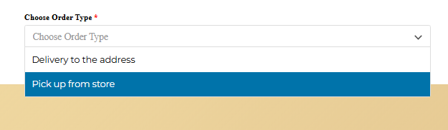
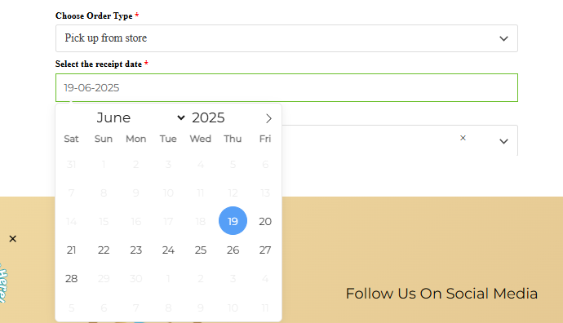
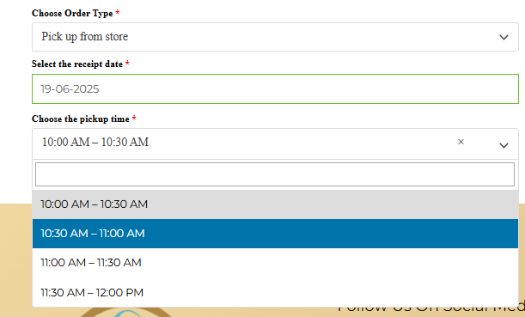

Slide 38
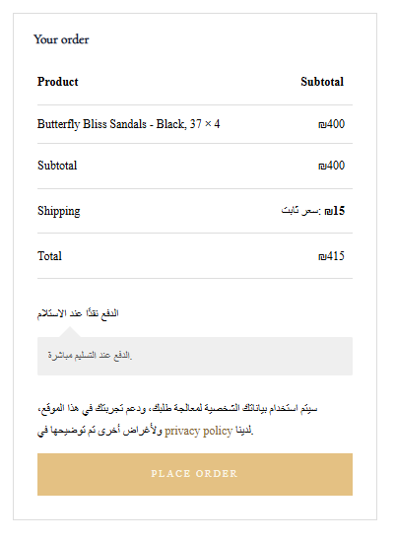

Slide 39
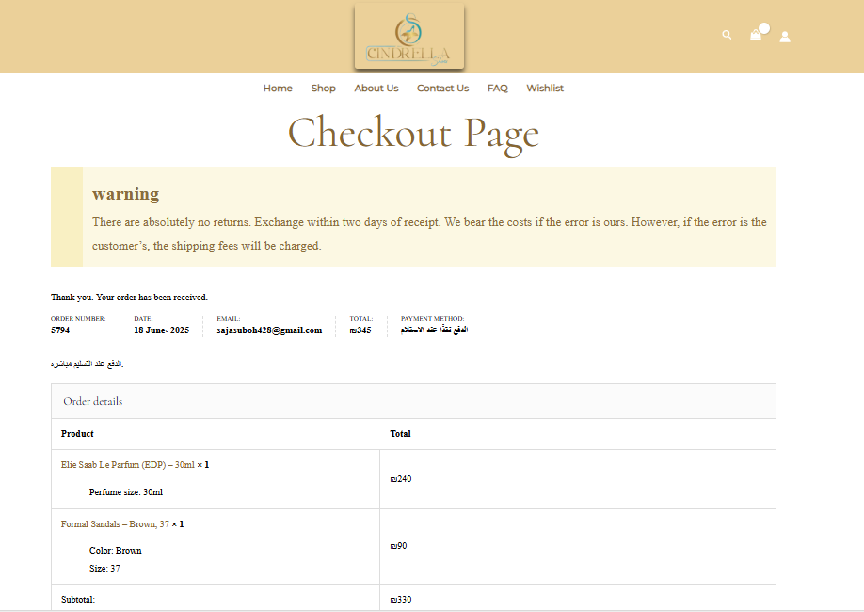
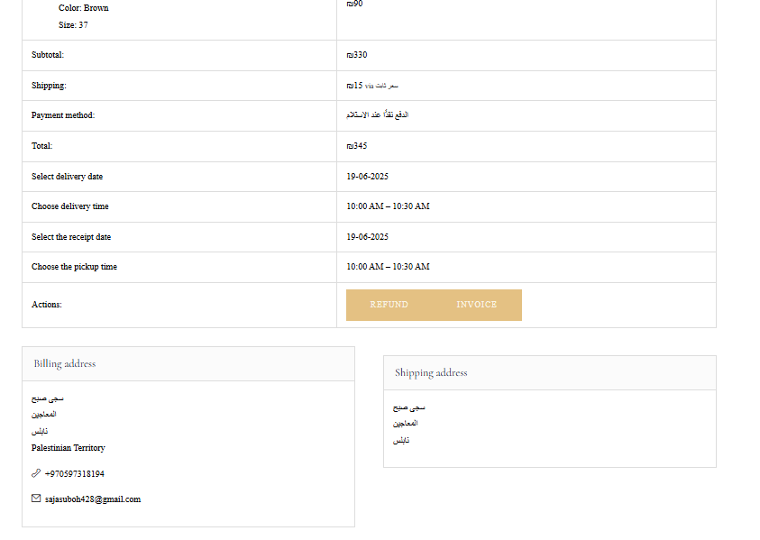

Slide 40
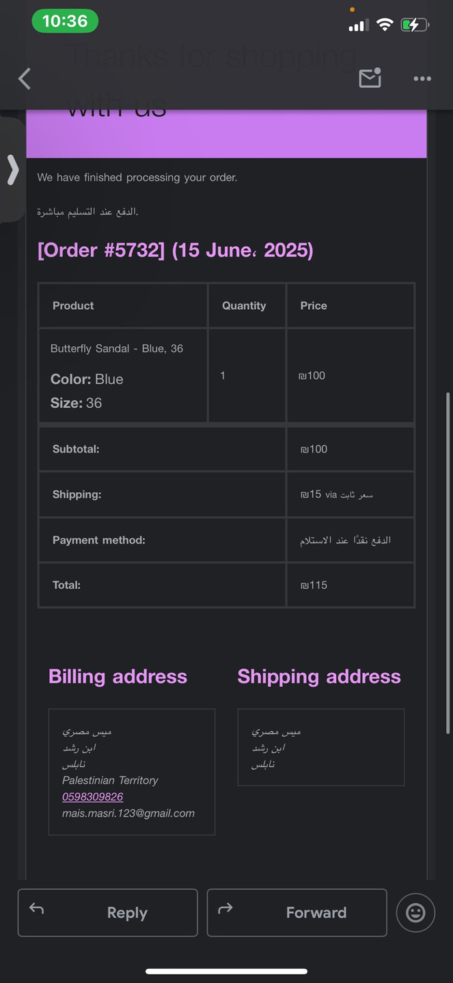
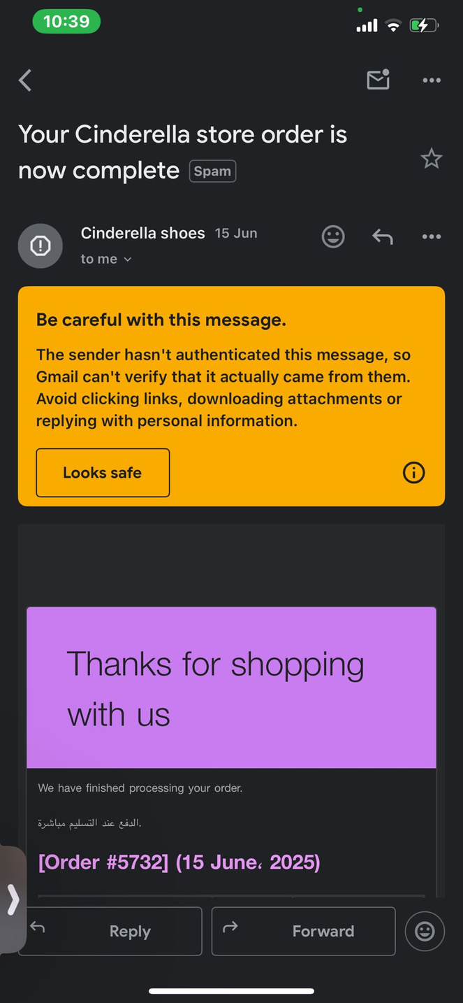
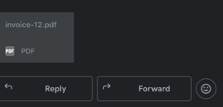

Slide 41
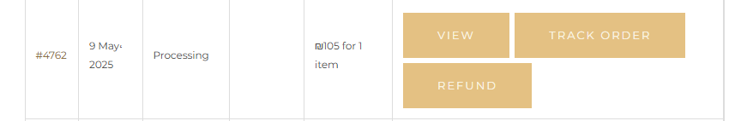
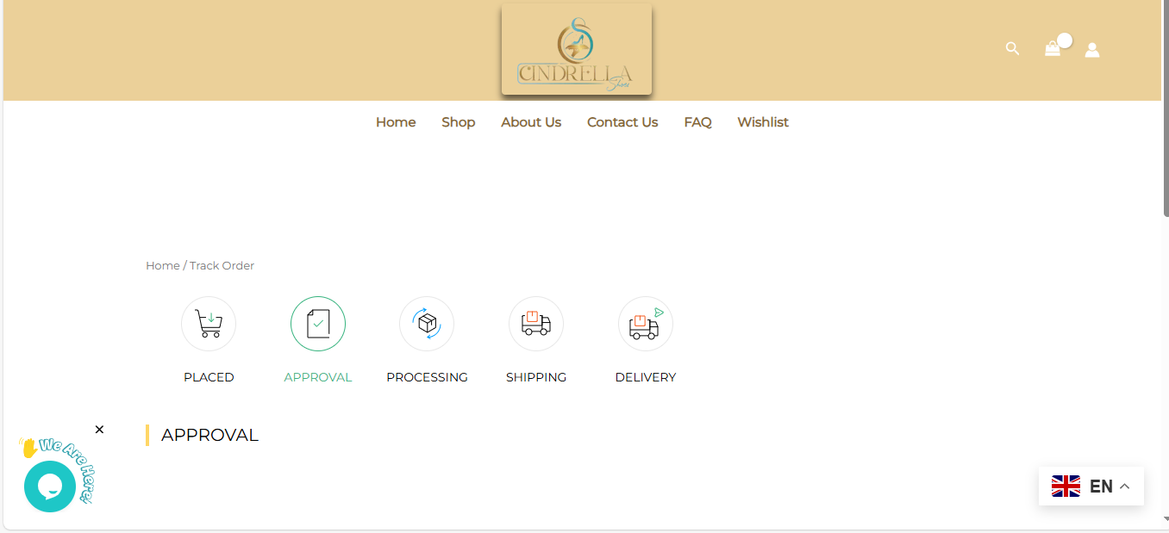

Slide 42
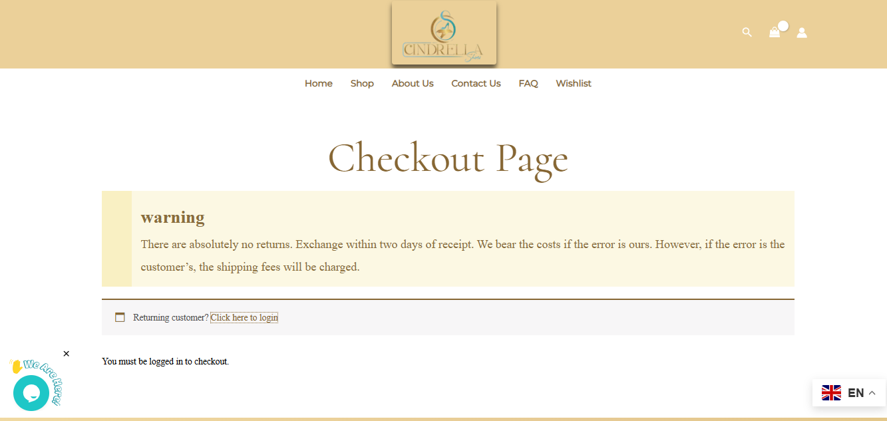
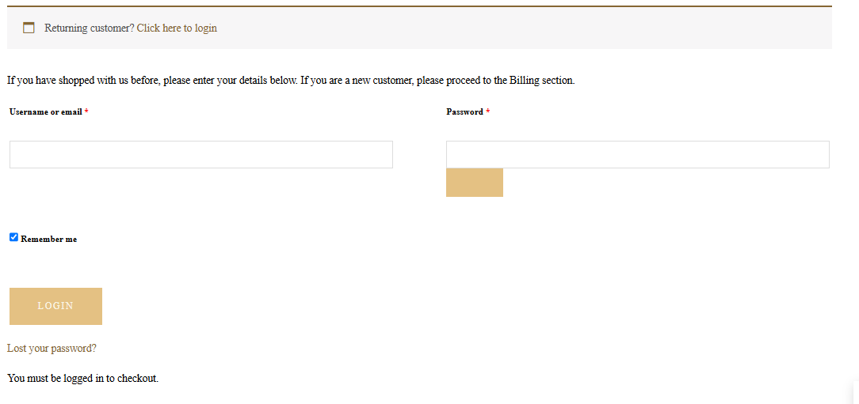

Slide 43
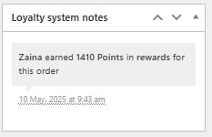
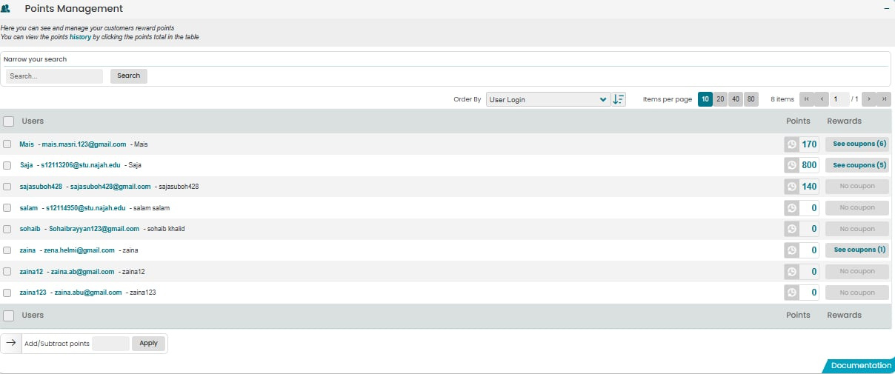
Customer loyalty system

Slide 44



Slide 45




Slide 46




Slide 47



Slide 49




Slide 51


Slide 53


Slide 55


Slide 56


Slide 57



Report

Slide 58




Slide 59






Slide 60




Slide 61




Slide 62



Slide 63



Slide 64



Slide 65


Notjustanalytics

Slide 66



Slide 67


Slide 68



Future Plan
Launching a mobile app
Supporting international shipping
Launching the Virtual Try-On feature

Slide 69
Thank you.

