Slide 1
Smart Pathfinder
Made By : Marah Haj Mohammed
Ihda’ Dwekat supervisor: Dr-Hanal AbuZant

Slide 2
Idea of our project
We noticed that no interest in people with special needs in the our community
Especially the blind people, they have difficulty in moving and practice their normal lives
So, we decided to make a device that make their life easier and can move only without any help from other people

Slide 3
Introduction
In our project, we were aiming to build this tool which helps blind people to find their path by wearing a cap containing a camera to identify people and guide them on the right path. This project also make the blind to communicate with others by have a database in raspberry which contain picture of people who their know and when the camera see him tell the blind who is come and can tell him the right path, and the heat sensor tell him if the object have a high temperature or not, If you meet someone who is not found in the database, the blind can add his to the database and in the next time when see the person that added can know him and tell the blind his name. Also, we use image processing to define the people by use python language, this language use it to make code this code can take images and compare it with the save images in the database and when know him the cap tell the bland the name of this person.

Slide 4
Some product same our devise
There are many tools use to help blind people to find the right path and to facilize their life such as the stick, some of the stick provides a vibration to tell them that some object in the round. And it can’t support them to know the people who meet him and can’t help him to across the round alone. So, we find that this tool not practical and can’t make their life easily like the normal people so we make our project to cover all these problems to make their life more easily and make blind people communicate with other people in an easy way.

Slide 5
stick project
Is designed to guide a visually impaired person to walk and avoid bumping into obstacles. Low cost ultrasonic rangefinders along with a microcontroller is used to measure the distance to obstacles and if they are close enough provide a feedback to the user in form of beeps or vibrations.
Image below describe who the stick work.

Slide 6
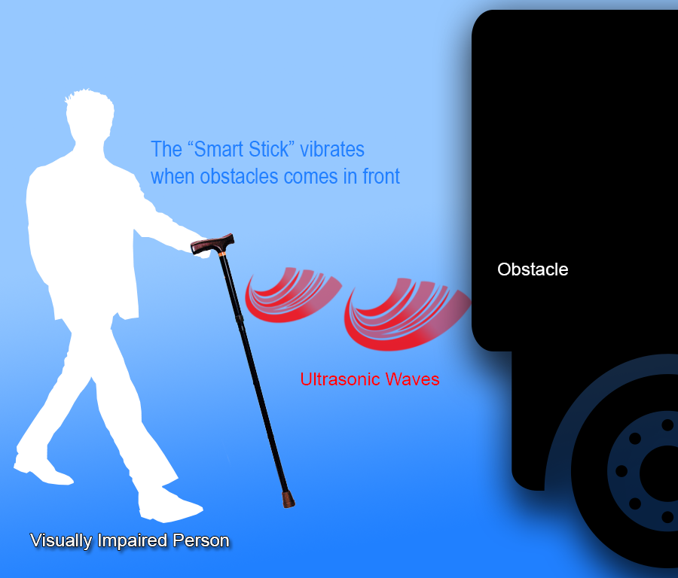

Slide 7
Tools in our project
Raspberry pi 3
Ultrasonic
Microphone
Raspberry Camera
Headphone:

Slide 8
Raspberry pi 3
The Raspberry Pi 3 is the third-generation Raspberry Pi. It replaced the Raspberry Pi 2 Model B in February 2016.

Slide 9
Features of pi 3
A 1.2GHz 64-bit quad-core ARMv8 CPU
802.11n Wireless LAN
Bluetooth 4.1
Bluetooth Low Energy (BLE)
Like the Pi 2, it also has:
1GB RAM
4 USB ports
40 GPIO pins
Full HDMI port
Ethernet port
Combined 3.5mm audio jack and composite video
Camera interface (CSI)
Display interface (DSI)
Micro SD card slot (now push-pull rather than push-push)
Video Core IV 3D graphics core

Slide 10
Comparison between Raspberry pi 3 and pi 2
More processor speed: the cpu on the pi3(1.2GHz) is faster than the cpu on pi2 and the board performs better.
On-board connectivity: The Pi 3 features 802.11 b/g/n 2.4 GHz Wireless LAN and Bluetooth Classic & Low Energy (BLE). You can get connected much quicker without the need for any external device.
A power supply: the pi3 need more power than pi2. It need Power Supply (9098126 — white) or (9098135 — black).
The Pi 3 features a chip antenna where status LEDs were located previously. The status LEDs are still on the board, right next to the micro SD card slot.

Slide 11
Advantages and Disadvantage of pi3
The Advantages are:
Small size
Minimize an enterprise’s budget.
The Disadvantages are:
High cost

Slide 12
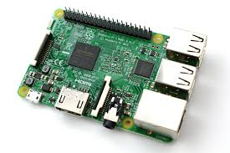
Raspberry Pi3

Slide 13
Ultrasonic
An Ultrasonic sensor is a device that can measure the distance to an object by using sound waves. It measures distance by sending out a sound wave at a specific frequency and listening for that sound wave to bounce back. By recording
the elapsed time between the sound wave being generated and the sound wave bouncing back, it is possible to calculate the distance between the sonar sensor and the object.

Slide 14
Connect Ultrasonic sensor with raspberry pi
What we need to make this connection:
HC-SR04
1kΩ Resistor
2kΩ Resistor
Jumper Wires

Slide 15
Sound consists of oscillating waves through a medium (such as air) with the pitch being determined by the closeness of those waves to each other, defined as the frequency. Only some of the sound spectrum (the range of sound wave frequencies) is audible to the human ear, defined as the “Acoustic” range. Very low frequency sound below Acoustic is defined as “Infrasound”, with high frequency sounds above, called “Ultrasound”. Ultrasonic sensors are designed to sense object proximity or range using ultrasound reflection, similar to radar, to calculate the time it takes to reflect ultrasound waves between the sensor and a solid object. Ultrasound is mainly used because it’s inaudible to the human ear and is relatively accurate within short distances.

Slide 16
A basic ultrasonic sensor consists of one or more ultrasonic transmitters (basically speakers), a receiver, and a control circuit. The transmitters emit a high frequency ultrasonic sound, which bounce off any nearby solid objects. Some of that ultrasonic noise is reflected and detected by the receiver on the sensor. That return signal is then processed by the control circuit to calculate the time difference between the signal being transmitted and received. This time can subsequently be used, along with some clever math, to calculate the distance between the sensor and the reflecting object.

Slide 17
The HC-SR04 Ultrasonic sensor we’ll be using with Raspberry Pi has four pins: ground (GND), Echo Pulse Output (ECHO), Trigger Pulse Input (TRIG), and 5V Supply (Vcc). We power the module using Vcc, ground it using GND, and use our Raspberry Pi to send an input signal to TRIG, which triggers the sensor to send an ultrasonic pulse. The pulse waves bounce off any nearby objects and some are reflected back to the sensor. The sensor detects these return waves and measures the time between the trigger and returned pulse, and then sends a 5V signal on the ECHO pin.
ECHO will be “low” (0V) until the sensor is triggered when it receives the echo pulse. Once a return pulse has been located ECHO is set “high” (5V) for the duration of that pulse. Pulse duration is the full time between the sensor outputting an ultrasonic pulse, and the return pulse being detected by the sensor receiver. Our Python script must therefore measure the pulse duration and then calculate distance from this.

Slide 18
The sensor output signal (ECHO) on the HC-SR04 is rated at 5V. However, the input pin on the Raspberry Pi GPIO is rated at 3.3V. Sending a 5V signal into that unprotected 3.3V input port could damage your GPIO pins, which is something we want to avoid! We’ll need to use a small voltage divider circuit, consisting of two resistors, to lower the sensor output voltage to something our Raspberry Pi can handle.

Slide 19
Voltage Dividers
A voltage divider consists of two resistors (R1 and R2) in series connected to an input voltage (Vin), which needs to be reduced to our output voltage (Vout). In our circuit, Vin will be ECHO, which needs to be decreased from 5V to our Vout of 3.3V.
The simple equation can be applied to many applications where a voltage needs to be reduced.

Slide 20
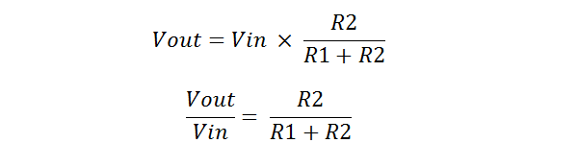
So, we’ll use a 1kΩ for R1 and a 2kΩ resistor as R2

Slide 21
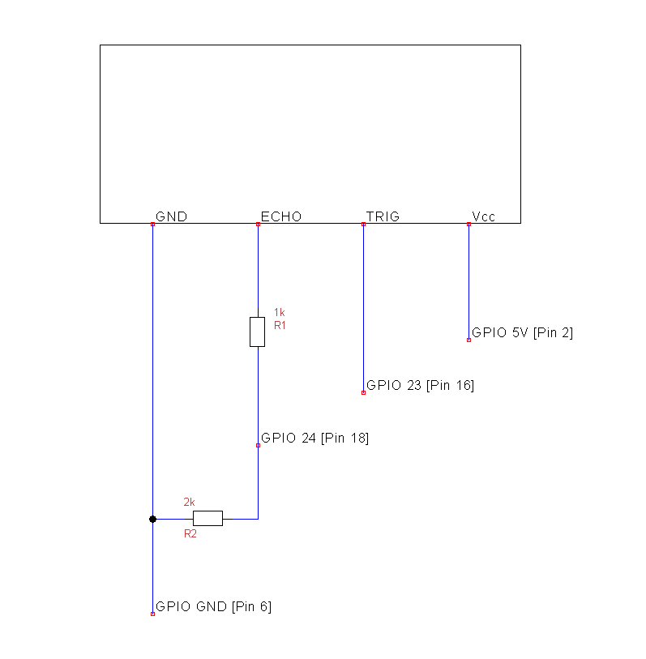
Assemble the Circuit
We’ll be using four pins on the Raspberry Pi for this project: GPIO 5V [Pin 2]; Vcc (5V Power), GPIO GND [Pin 6]; GND (0V Ground), GPIO 23 [Pin 16]; TRIG (GPIO Output) and GPIO 24 [Pin 18]; ECHO (GPIO Input)

Slide 22
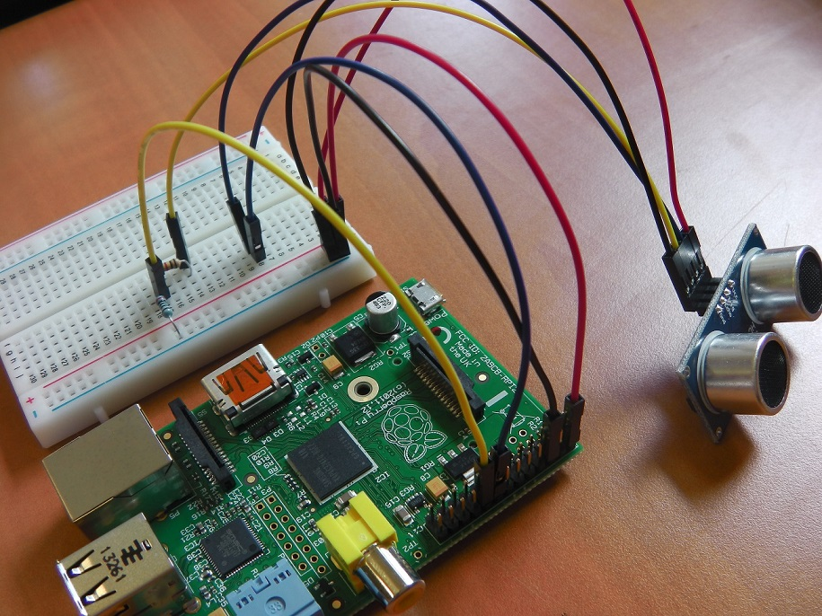

Slide 23
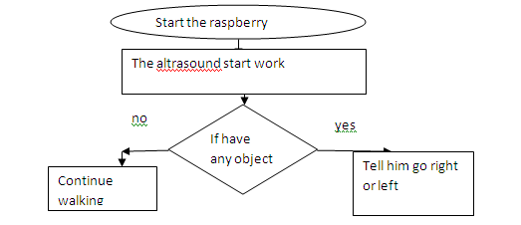
Flow chart how work Ultrasonic

Slide 24
Work principle of Ultrasonic
We use the ultrasonic in our project to defined the path it tell the blind person where go such that if the blind go and faced the wall the device tell him go right or left by calculate the distance

Slide 25
Raspberry Camera
The Raspberry Pi Camera Module v2 has a Sony IMX219 8-megapixel sensor (compared to the 5-megapixel Omni Vision OV5647 sensor of the original camera).
It can be used to take high-definition video.
You can read all the gory details about IMX219 and the Exmor R back-illuminated sensor architecture on Sony’s website, but suffice to say this is more than just a resolution upgrade: it’s a leap forward in image quality, color fidelity, and low-light performance. It supports 1080p30, 720p60 and VGA90 video modes, as well as still capture. It attaches via a 15cm ribbon cable to the CSI port on the Raspberry Pi.
The camera works with all models of Raspberry Pi 1, 2, and 3. It can be accessed through the MMAL and V4L APIs, and there are numerous third-party libraries built for it, including the Picamera Python library. See the Getting Started with Picamera resource to learn how to use it.

Slide 26
The Advantages
Advantages are:
The Raspberry camera connects directly to the GPU
Picture quality is good

Slide 27
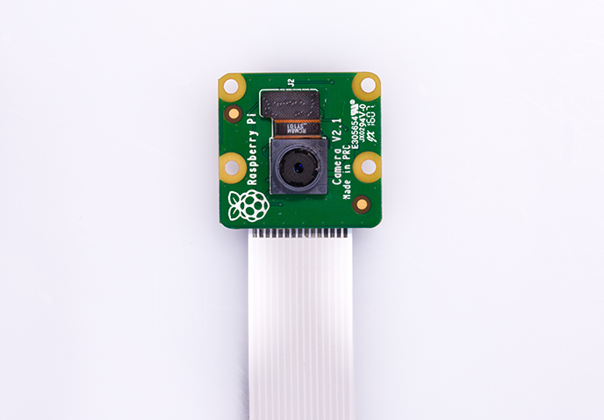

Slide 28
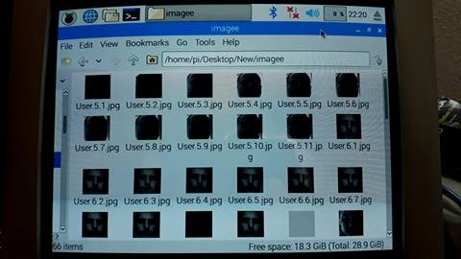
How we use camera to our project
In our project, we capture images and save the images in folder using unique id also the audio saved in the same id like images below

Slide 29
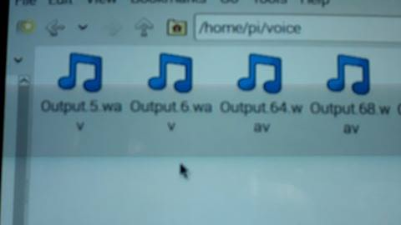
We save ten picture for each person that added to the database with a unique id and save the audio with the same id like the picture below.

Slide 30
When the camera sees, the person check the images that saving it in the database and if it’s found the voice command appear to see the name of the person. If the person not found the blind bush button and capture ten images to the person and voice command appear to tell blind to say the name of the person so the voice also saved in the same id.

Slide 31
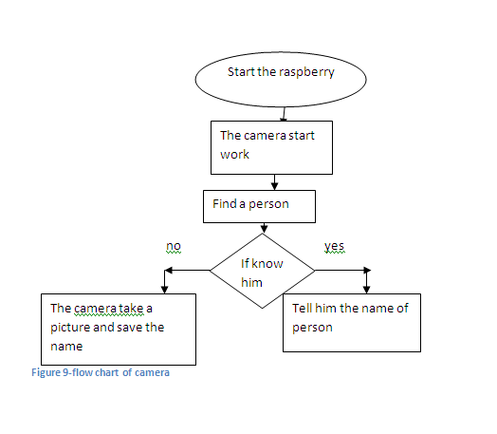

Slide 32
python
Is the widely programming language general-purpose programming, created by Guido van Rossum and first released in 1991.it make code emphasizes and readability (notably using whitespace indentation to delimit code blocks rather than curly braces or keywords), and the syntax in it allows programmer to express concepts in fewer lines of code than possible in languages such as C++ or Java, and it provides constructs intended to enable writing clear programs on both a small and large scale.

Slide 33
Python
The Python has many features
a dynamic type system
automatic memory management
supports multiple programming paradigms
supports object-oriented
Support imperativefunctional programming
Procedural styles. It has a large and comprehensive standard library.
Python uses dynamic typing and a mix of reference counting and a cycle-detecting garbage collector for memory management.
Dynamic name resolution (late binding), which binds method and variable names during program execution.

Slide 34
Python
We use python language to make code to manage our devise
We import the library
from picamera.array import PiRGBArrayfrom picamera import PiCamera
import time
import matplotlibimport
import cv2
import numpy
import pyaudio

Slide 35
Traffic Light
In our project, we make object detection for traffic light using color detection for color. In our project, we make detection for red circle and voice command appear to tell blind stop and if it sees green circle voice command to tell the blind to go but we have a problem to detect only the circle in the traffic and recognized the color correct.

Slide 36
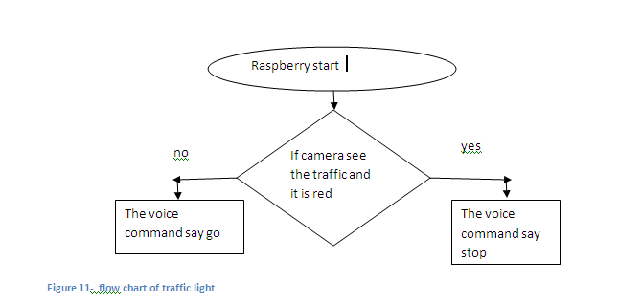

Slide 37
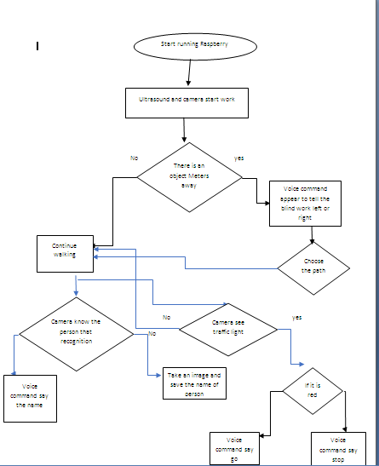

Slide 38
constraints
We faced some constraints like time and money
And we faced some problem the library we used in python some time causes problem
And the device some time not work

Slide 39
conclusion
We made a project to help blind people to live life easier
The future work to save the path and tell him where go

