Slide 1
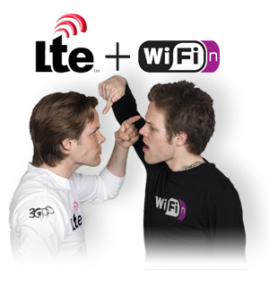
Graduation Project 1:-
“ Coexistence between LTE and WiFi on 5GHz “
with corresponding deployment scenarios
Prepared by : Noor aldeen Hamarsheh
Yahya Khwaira
Superviser: Dr. Ahmed Masri

Slide 2
Outline:

Slide 3

Why LTE in Unlicensed band?!
Best solution for large and rapidly growing mobile data traffic demand.
Licensed spectrum is expensive and limited in access.
Provide mobile data offloading.
Freeing bandwidth for other users.
Unlicensed spectrum could be used as a secondary resource to enhance speed.

Slide 4
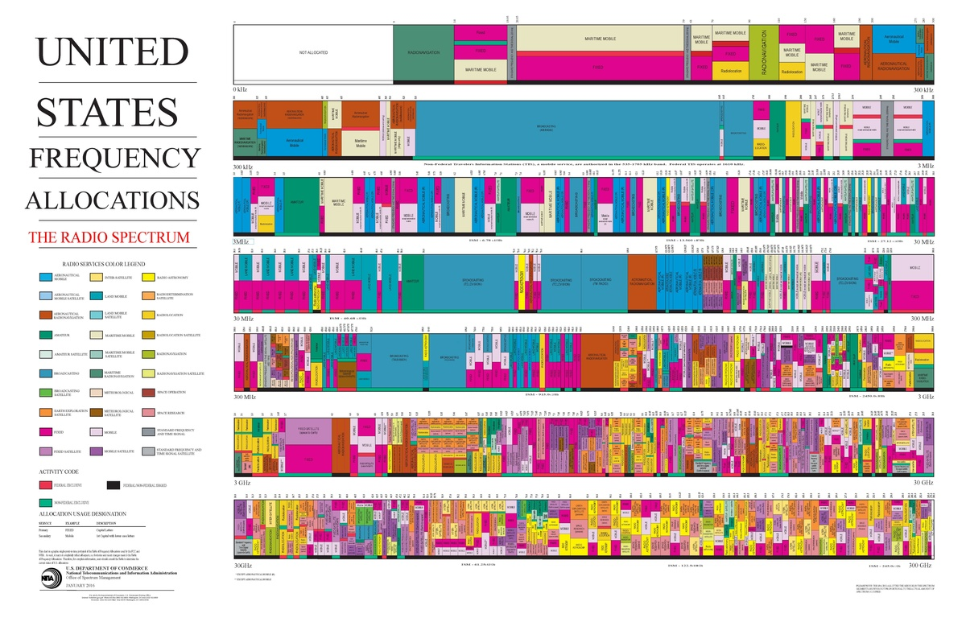

Slide 5
Coexistence Challenges In 5Ghz:
Includes:
Sharing spectrum regulations.
Channel selection protocols.
Minimum radio frequency interference.
Proper coexistence mechanism.

Slide 6
Coexistence techniques:-
There are three main approaches to achieve coexistence and boost to LTE data throughput.
LTE- Unliscened
(LTE-U)
(Non-3GPPstandard)
Licensed Assisted Access
(LAA)
(3GPP standard)
“LTE-WLAN Aggregation”
( LWA)
(3GPP standard)
Significant risk on WI-FI.
Duty-cycled (CSAT)
approach to channel
access.
More promising WI-FI coexistence.
Use LBT (listen before talk ) protocol.
More promising WI-FI coexistence.
Tunnels LTE data
within 802.11
frames.

Slide 7
LTE- Unlicensed:-
It is a non 3GPP standard and non LBT mechanism.
Used in region that doesn't require LBT.
Uses CSAT (Carrier Sense Adaptive Transmission) that is used to apply adaptive TDM transmission.
Blank sub-frame used to turn on LTE for some period and goes silent for some period (blank).

Slide 8
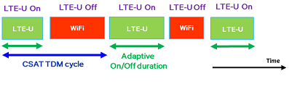
The channel is clean to neighboring Wi-Fi with normal Wi-Fi transmissions during the LTE-U off period.
The small cell will measure Wi-Fi channel utilization during the LTEU off period, and adaptively adjust On/Off duty cycle accordingly as is shown in Figure 1.
CSAT (carrier Sense adaptive transmission :-

Slide 9
Disadvantages:-
When LTE-U coexist with WIFI in the same frequency band:-
LTE interference severely affects WIFI nodes
WIFI nodes will be blocked all the time .
The prpoesed Solution is ABS ( Almost Blank Subframe).

Slide 10
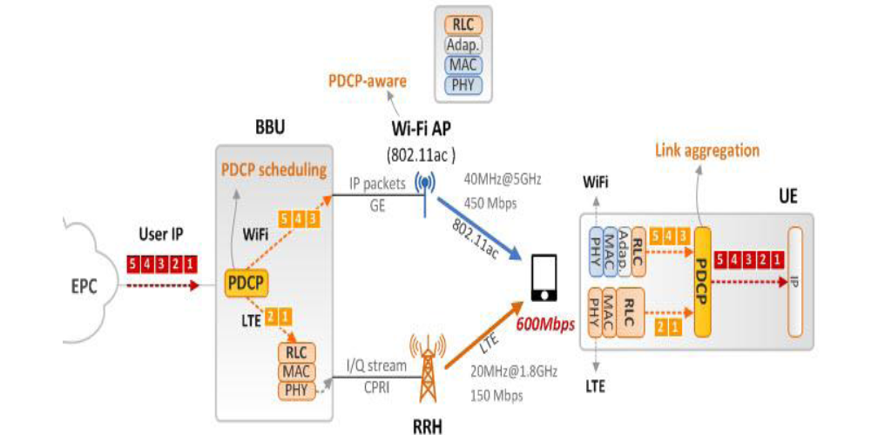
LWA (LTE and WIFI Link Aggregation) :-
It is a 3GPP standard .
Actually it is not a coexistence scheme it is a link aggregation.
It Tunnels LTE data within 802.11 frames with software update.
Uplink carried via cellular, downlink with both WIFI and LTE.
Figure 2: LWA architecture.

Slide 11
LAA (Licensed Assisted Access) :-
Listen-Before-Talk (LBT) Overview:
It's similar to Wi-Fi MAC layer strategy that uses Distributed Coordination Function (DCF).
There are two types of adaptive schemes:-
Load Based Equipment (LBE) scheme.
Frame Based Equipment (FBE) scheme

Slide 12
Frame Based Equipment (FBE):
Apply clear channel assessment (CCA) using energy detect for channel observation time ≥ 20 μs
If clear, transmit with a channel occupancy time (no need to re-evaluate during this period) between [1ms 10ms]. Follow by an idle time > 5% of channel occupancy time. Perform a new CCA.
If not clear, remain quiet for the next fixed frame period.
CCA is performed once every fixed frame period
  Channel access opportunity is only once every fixed frame period.
Apply CCA for a duration ≥ 20 μs
Clear
Yes
Occupy the channel
for [1ms 10ms]
Remain idle for > 5% of channel occupancy time
No
Remain quite for the next fixed frame period

Slide 13
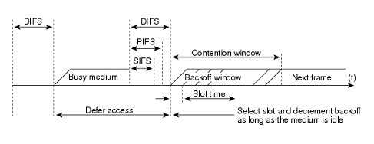
Wi-Fi Listen-Before-Talk (LBT) Vs. European Load Based Equipment Listen-Before-Talk (EU- LBE LBT):
Extended CCA in EU LBE LBT is a Static Backoff, since Q uses a static range from zero to q slots, and each slot is 20µs
On the other hand, Wi-Fi uses Exponential Backoff which is variable for a given product and each time that a station encounters a collision, it will double the contention window figure 5, illustrates Wi-Fi LBT exponential backoff process used by DCF.

Slide 14
LBT parameters for Frame Based Equipment (FBE) :-
Parameter | Requirements
Clear Channel Assessment | Min 20µs
Channel Occupancy Time | Min 1ms, Max 10ms
Idle period | Min 5% of channel occupancy time
Fixed Frame Period | Equals to channel Occupancy time + Idle Period
Short Control signaling transmission time | Max Duty cycle of 5% within an observation period of 50ms"Part of Channel occupancy time"
CCA Energy detection threshold | Assuming we have an antenna with 0dBi gain:If EIRP= 24 dBm at Trans and our threshold ≤ -73dBm/MHz Otherwise (Different transmit power levels. P_{h} )Threshold= -73_{dBm/MHz} +23 _{dBm} - P_{h dBm}

Slide 15
Table3 : IEEE 802.11ac MAC parameters
In DCF the exponential backoff process is also called binary exponential backoff.
At first the contention window has CWmin value, and it increases each time that transmission fails,and no ACK is received.
After a failed transmission, the backoff will have a CW value from 2*(CW + 1) - 1 to CWmax.
After a successful transmission, the backoff value will reset to CWmin.
Slot Duration | 9 µs
DIFS | 34 µs
SIFS | 16 µs
PLCP preamble + headers duration (T_{plcp}) | 40 µs
PLCP service fild (L_{s}) | 16 bits
MPDU delimiter Field (L_{del}) | 32 bit
MAC header ( L_{mac-h}) | 288 bits
Tail Bits (L_{t}) | 6 bits
ACK length ( L_{ack}) | 256 bits
Payload (D) | 768.000 bits ( 64x 1500B)

Slide 16
Load Based Equipment (LBE) :
Apply clear channel assessment (CCA) using energy detect for channel observation time ≥ 20 μs
If clear, transmit with a channel occupancy time (no need to re-evaluate during this period) for less than (13/32*q) ms where q is a fixed number in the range [4 - 32].
  Channel occupancy time: [1 – 10] ms.
If not clear perform an extended CCA.
  Extended CCA: Channel is observed for the duration of (N*channel observation time). N is a random number selected in the range of [1 q].
Apply CCA for channel observation time ≥ 20 μs
Clear
Yes
Occupy the channel
for < 13/32*q ms
No
Yes
Perform Extended CCA with observation time=
N* CCA observation time
N random chosen from [1 q]
q fixed between 4 and 32
Clear
No

Slide 17
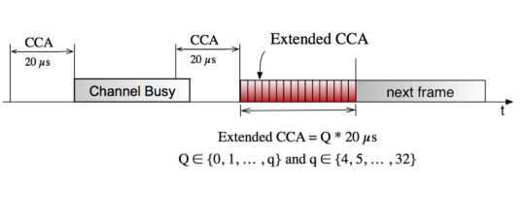
Load Based Equipment (LBE) Scheme:-
Load Based Equipment is a scheme where the transmission and reception structure is demand-driven just like WiFi .
Figure 4 shows the EU LBE LBT backoff process, LBE has all the regulations mentioned in FBE, and in addition, it has the following regulations as well:
Fig 4 : EU LBE LBT static backoff process

Slide 18
LBT parameters for Load Based Equipment
(LBE) in Europe:-
Parameters | Requirements
Clear Channel Assessment | Min 20µs
N (# of clear idle slots in extended CCA ) | N shall be randomly selected in the range of 1 - q every time{q=4 … 32}
Channel Occupancy time | ≤ (13/32) x q_{ms}
Idle Period | At least the duration of a single random factor N multiplied by the CCA time slot
Short control signaling transmission time | Max duty cycle of 5% within an observationperiod of 50_{ms}
CCA Energy detection Threshold | Assuming we have an antenna with 0dBi gain:If EIRP= 24 dBm at Trans and our threshold ≤ -73dBm/MHz Otherwise (Different transmit power levels. P_{h} )Threshold= -73_{dBm/MHz} +23 _{dBm} - P_{h dBm}

Slide 19
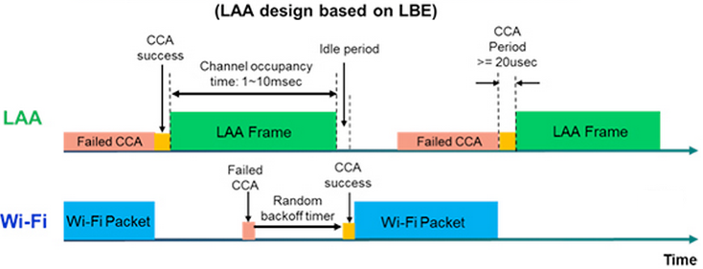
LBT for LAA LTE :
In FBE-LBT, channel access is possible only once during one fixed frame period.
The extended CCA in LBE-LBT is similar to the backoff mechanism in Wi-Fi.
However, unlike Wi-Fi, the backoff mechanism in LBE LBT is not exponential. The contention window size is always within the [20 20×q] μs range and does not increase after a collision.

Slide 20
2-SC indoor scenario:-
2 Operators ‘A’ and ‘B’, distributed in (120m*50m) one floor building, each operator have 2 small cells with 20 user for each one.

Slide 21
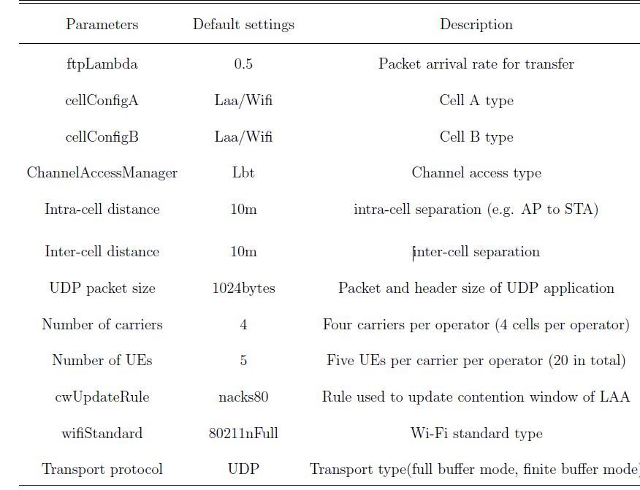
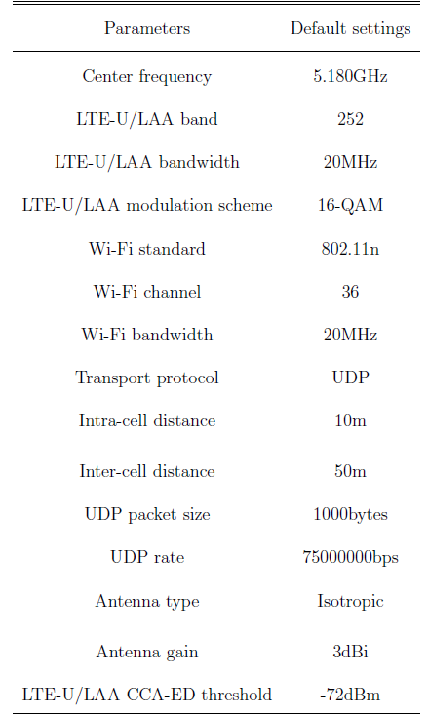
Table 3.1: Default experimental configurations
Table 4.1: NS-3 parameters for 2-SC indoor scenario

Slide 22
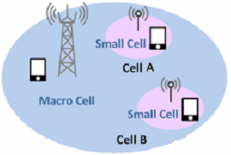
2-SC Simulation Results:-
As we mentioned before, there are two Coexistence cases to evaluate in the simulation. These two co existence scenarios are as follows:
Wi-Fi/Wi-Fi coexistence
Wi-Fi/LAA coexistence
LAA/LAA coexistence

Slide 23
First case (WIFI/WIFI):-
As it is plotted, the Wi-Fi throughput of operator B is greater than operator A for 4 users.
In dense area, where there are lots of users, the Wi-Fi throughput of operator A and B are fluctuated.

Slide 24
Second case (LTE/WIFI):-
As it is illustrated, Wi-Fi network has better throughput than LAA. But as the number of users are increasing, LAA outperforms the Wi-Fi network significantly.

Slide 25
By comparing the two figures , we conclude that LAA is a better neighbor to Wi-Fi compared to Wi-Fi as a neighbor, since LAA outperforms the replacing Wi-Fi significantly.
First case (WIFI/WIFI):-
Second case (LTE/WIFI):-

Slide 26
Third Case (LTE/LTE):-
LAA/LAA simulation scenario, where there is two LAA networks in congested area, while using LBT channel access scheme, the evaluation results is plotted in the following Figure.

Slide 27
OVER ALL throughput :-
The overall user throughput evaluation of all the mentioned scenarios is plotted in the Figure.
As is obvious, using LBT coexistence mechanism, the results have confirmed that LAA/LAA is the high performance coexistence scenario, comparing to other scenarios.
In other words, LAA is a better neighbor to Wi-Fi than Wi-Fi itself. It is worth mentioning that LAA can operate in unlicensed band without impacting Wi-Fi more than an equivalent Wi-Fi network

Slide 28
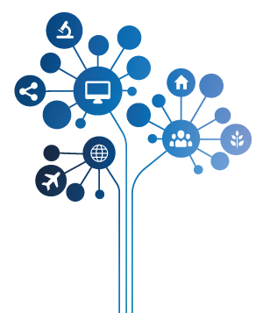
Future work:-
Simulate the proposed mechanisms using open source Network Simulator (NS-3 ).
Model large number of nodes and parameters to evaluate which is better
Change the transfer protocols, obtain throughput and latency of the competitive networks.

Slide 29
Conclusion:-
The channel access scheme that were evaluated for LAA with downlink-only, where there is at least one LBT scheme for LAA, which does not have impact on Wi-Fi more than another Wi-Fi network. When a suitable channel access scheme was used, it is feasible for LAA to obtain fair coexistence with Wi-Fi, and for LAA to coexist with itself, as different simulation scenarios and their results proved.

