Slide 2
Balanduino
Supervisor: Dr. Raed Al-Qadi
Prepared by:
Nadeen Kalboneh
Nardeen Mabrouk

Slide 3
Outlines
o Introduction.
o Motivation.
o Hardware Components.
o Hardware Development.
o PID Controller.
o Implementation.
o Problems.
o Future Works.
o Demo.

Slide 4
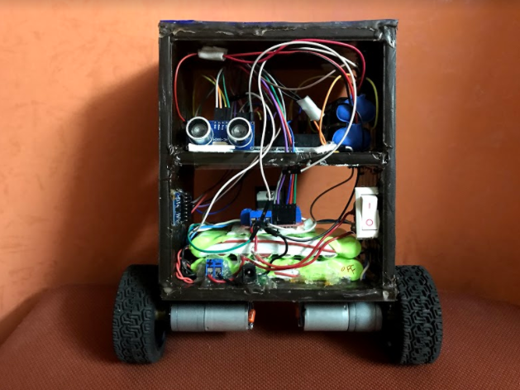
Introduction
What is Balanduino?
Balanduino is two-wheeled self-balanced robot,
that can be balanced automatically using motors,
sensors and a microcontroller.

Slide 5
Introduction
The main features of our robot that it is able to:
o Self-Balancing.
o Avoid obstacles.
o Carry loads with different weights.
o Move by controlling it via Bluetooth.

Slide 6
Motivation
This type of robot has gained fame and interest among researchers and engineers because it utilizes a control system to stabilize an unstable system.

Slide 7
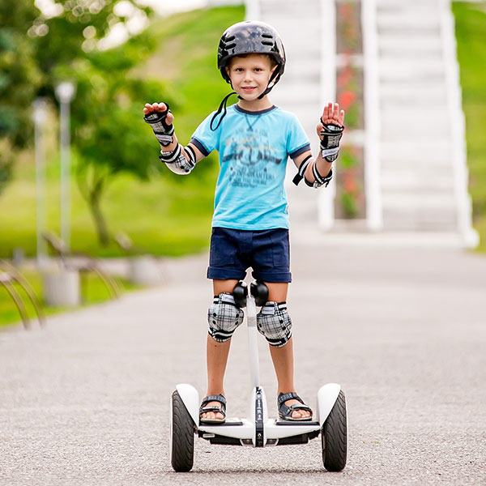
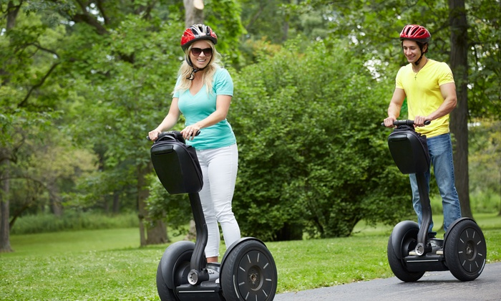
Real Models
Segway (Hoverboard):

Slide 8
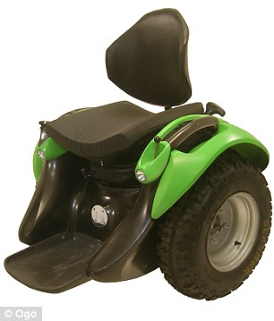
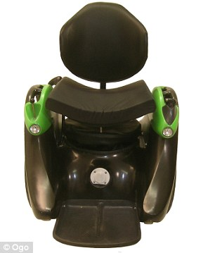
Real Models
Ogo is the only hands-free two-wheeled self-
Balancing vehicle.

Slide 9

Hardware Components
1. Arduino Mega.
2. MPU 6050.
3. Two DC Motors.
4. Dual H-Bridges [L298N]
5. Ultrasonic sensor
6. Two Battery pack.

Slide 10
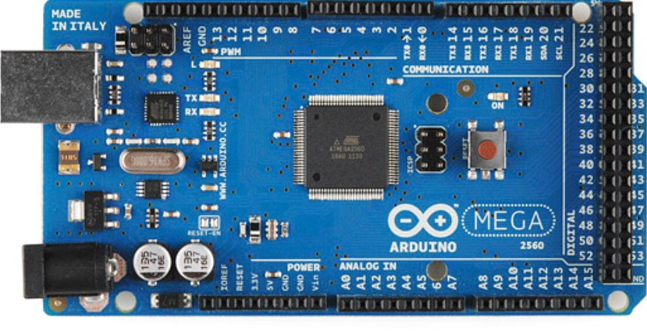
Hardware Components
Arduino
An Open Source Platform.
Consists of both Hardware and Software.
Uses C++.
Very Flexible.

Slide 11
Hardware Components
MPU 6050: It’s the world’s first integrated 6-axis Motion Tracking device. It combines:
- 3-axis gyroscope
3-axis accelerometer
- And a Digital Motion
Processor™ (DMP)

Slide 12
Hardware Components
Dual H-Bridge: It is used in controlling motors speed and direction, this depend on the obtained tilt angle of the balancing.

Slide 13
Hardware Components
How H-Bridge works?
OFF
Motor move forward
Motor move backward

Slide 14
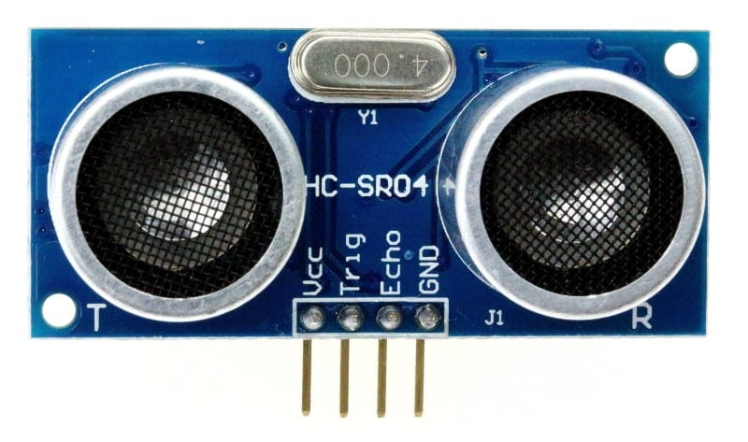
Hardware Components
Ultrasonic sensor: It uses sonar to determine distance to an object. So it is used in order to enable the robot to avoid obstacles.

Slide 15
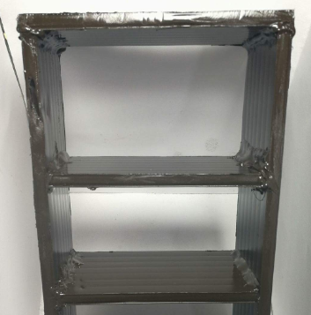
Hardware Development
Here are the steps that have been taken to design
and build the robot:
1:Building the robot's frame: The frame is created from
strong Corrugated PP Plastic Sheet, it has a light weight
and it is easy to process.

Slide 16
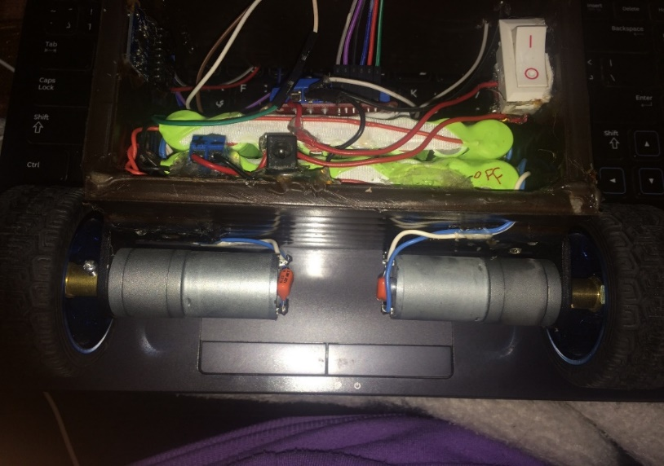
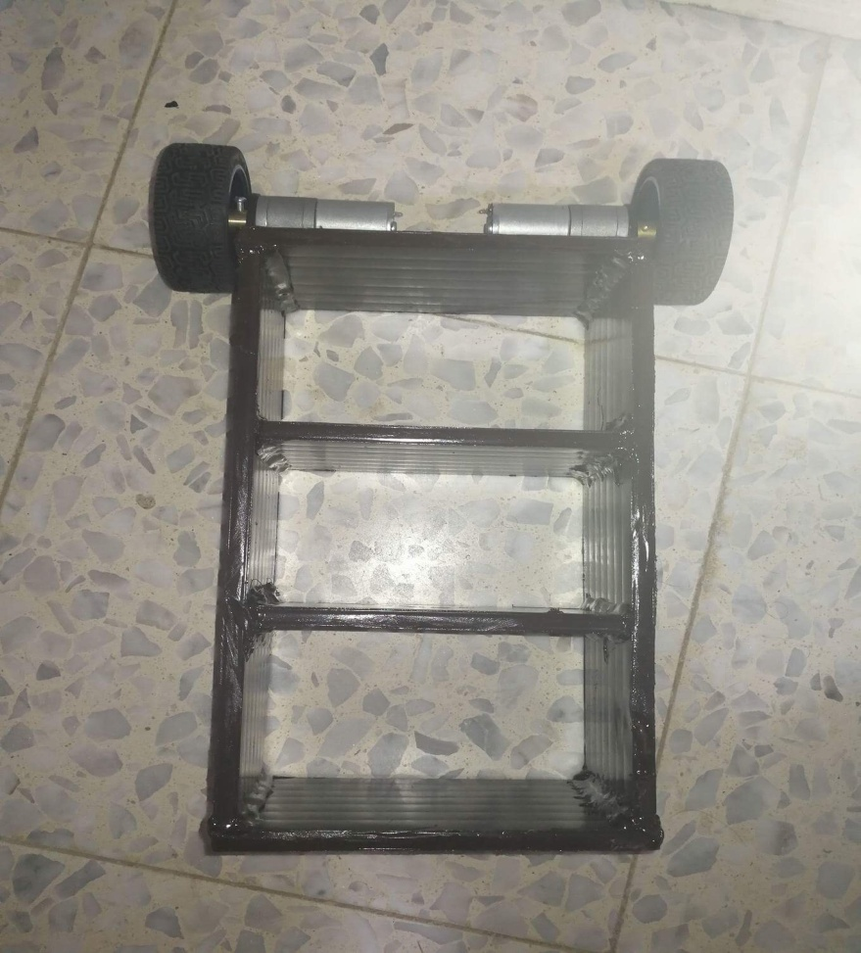
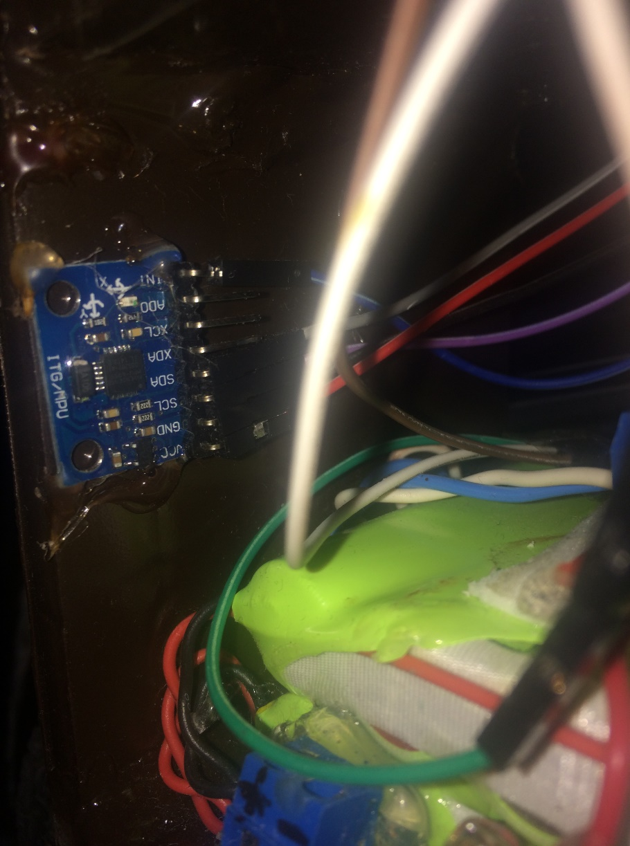
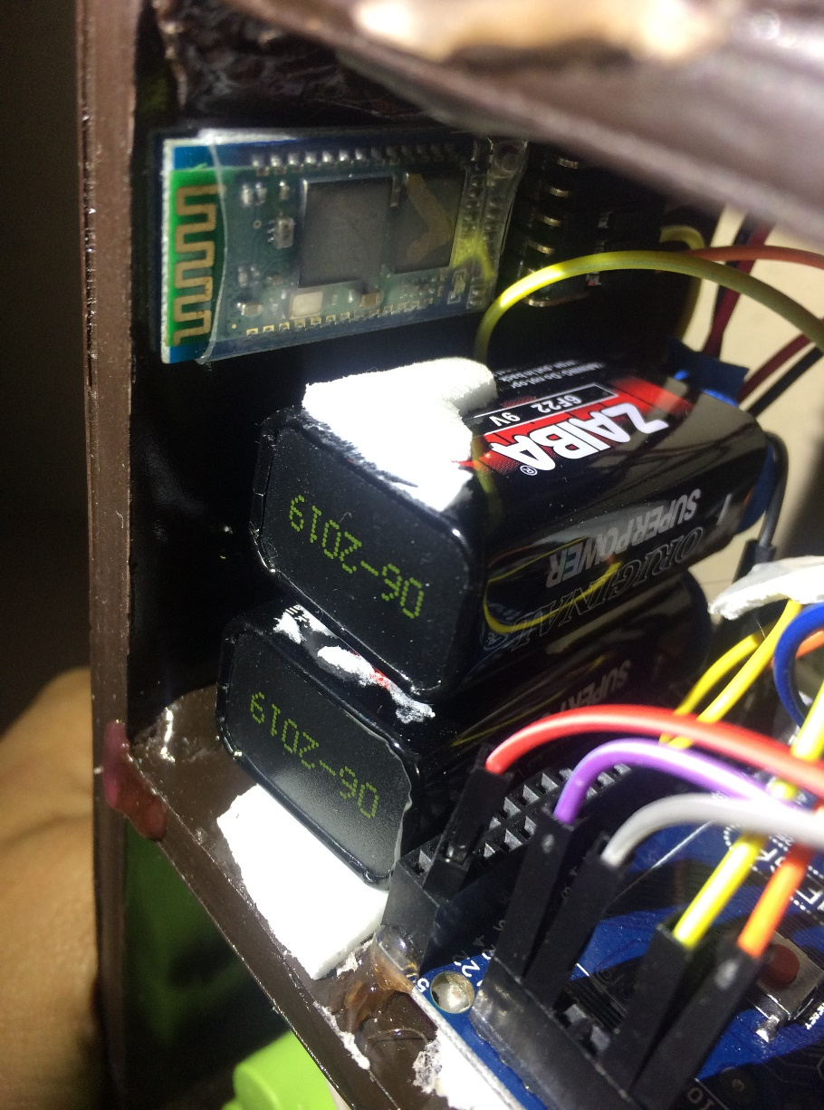
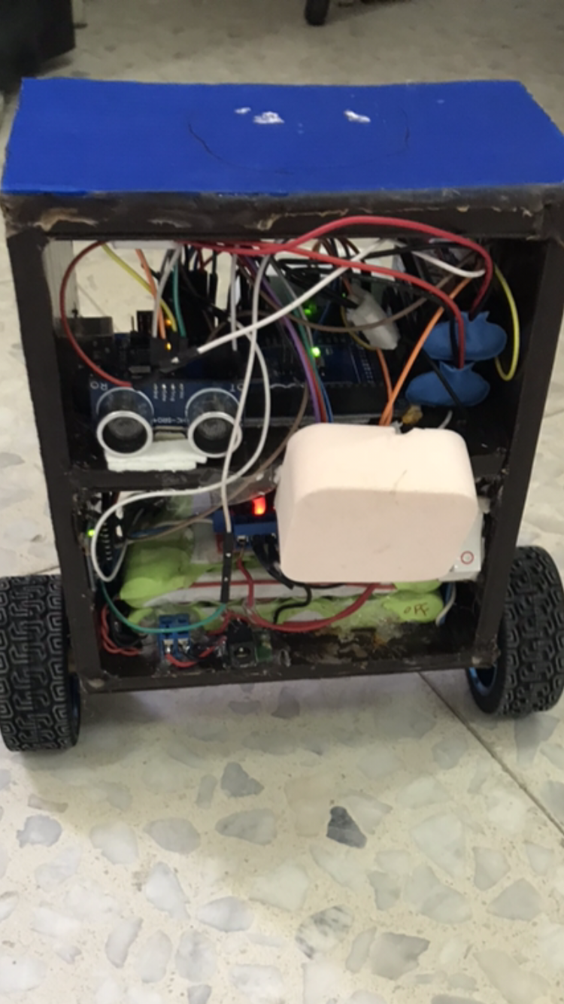
Hardware Development
.
2:
3:
4:
5:
6:

Slide 17
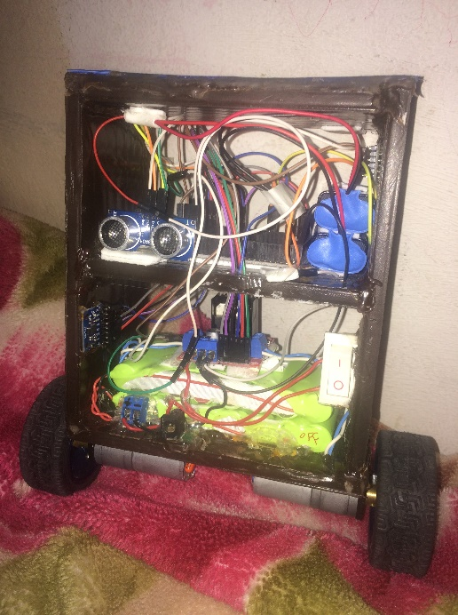
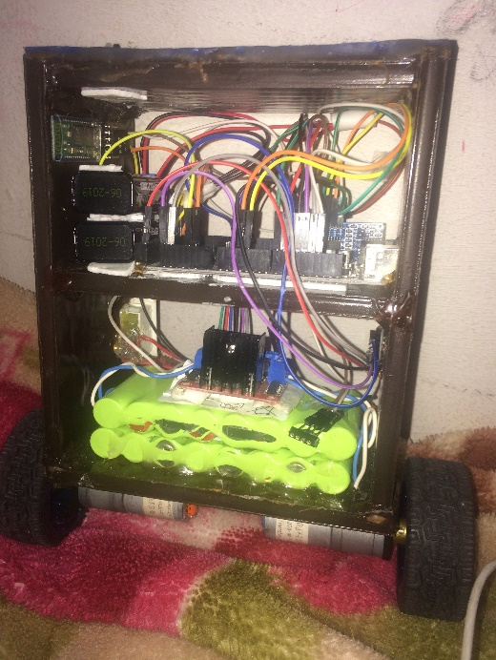
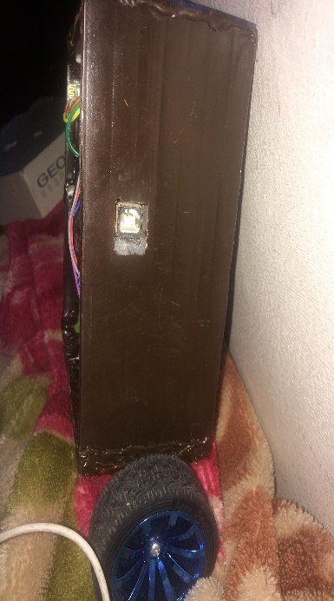
Hardware Development
.
Overall design:

Slide 18
PID controller
The most common controller that is used to maintain the
balance position on the self-balancing two wheel robot
was the PID controller.

Slide 19
PID controller
PID Component:
1: Proportional Part. Kp
2: Integral Part:
Ki: It is called “Slow Mode”.
3:Derivative Part:
Kd: It is called “Fast Mode”.

Slide 20
PID controller
Here are the PID Tuning Methods:
Obtain PID’s values manually.
Model based and Frequency Response based.
Ziegler-Nichols methods.
And there are many other methods.

Slide 21
PID Tuning
In our project we obtain PID’s values manually, by
following these steps:
Set Kp=Ki=Kd =Zero.
Adjust Kp until the system remains in balance, but rapidly oscillates around equilibrium.
Adjust Ki. We changed it many times until the robot is almost steady.
Lastly, we adjust the value of Kd. The appropriate Kd value decrease settling time

Slide 22
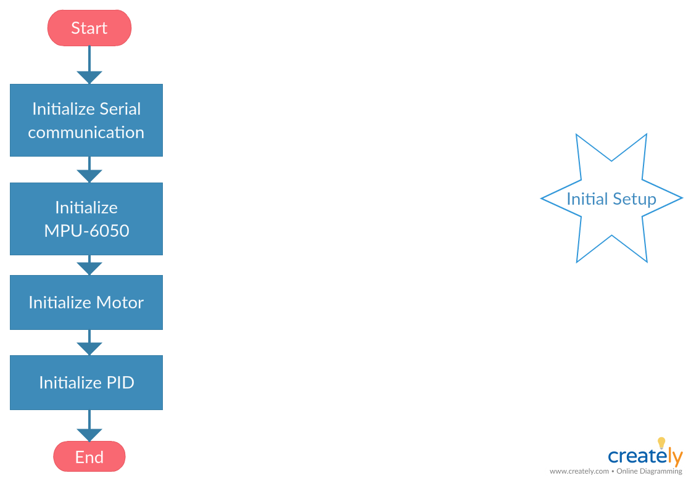
Implementation
Working Process:
We started with the initialization
process.

Slide 23
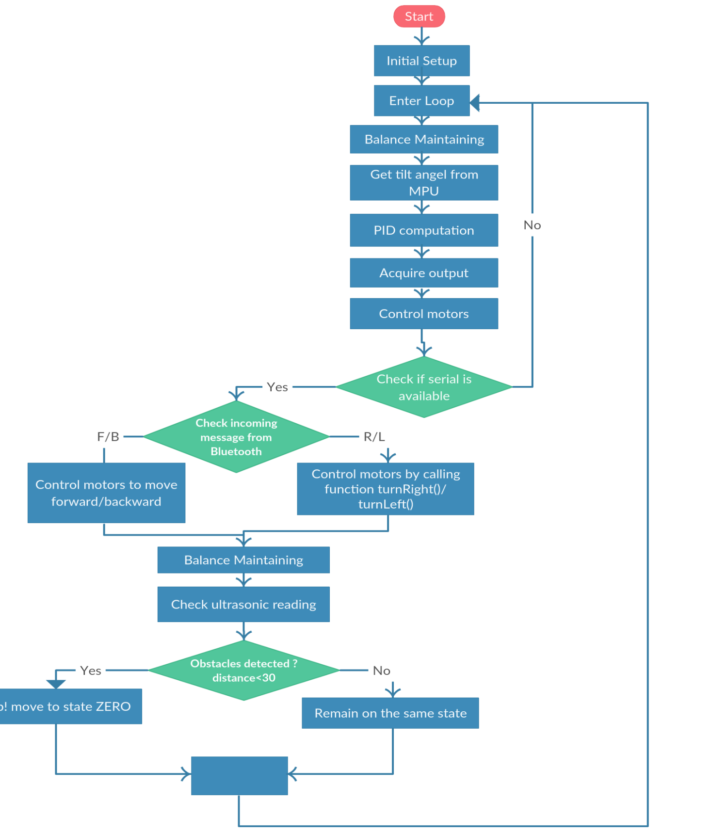
Implementation
This is the Working Process of the
whole project.
Notes:
Program Algorithm
1:Algorithm was used to write the program to main Arduino board. 2:System will first initially start and check connection with all connected components
3:Afterwards it will get feedback from the MPU sensor and will get initial data of the angle. 4:With the help of complementary filter it will reduce the noise.
5: After obtaining the offsets it will recalculate the actual angle 6:PID controller will control the whole process.
7: Based on the angle calculation DC motor will be controlled

Slide 24
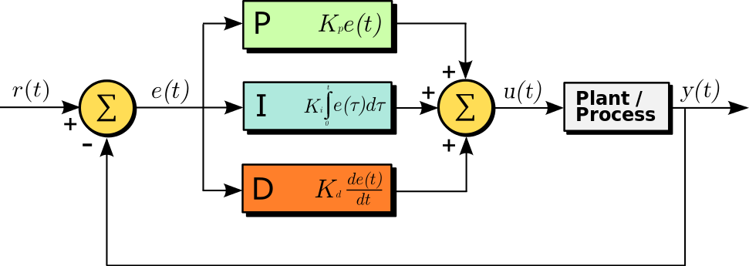
Implementation
PID Algorithm Equations:
r(t) is the desired process value or setpoint.
y(t) is the measured process value.

Slide 25
Constrains and Difficulties
Analyze and understand the physical concept of self-balancing and implement it on the robot take a lot of time.
IT was difficult to reach to the correct PID coefficients Kp, Ki and Kd.
Difficult to find batteries which are sufficient to operate both DC motors and Arduino.

Slide 26
Future Work
Try to make it as a real model in order to have ability to carry people, like Segway.
Add a Wi-Fi shield to control it via Internet also.
Make robot’s movement smoother.
Add encoder to make robot back to the same point.

Slide 27
Demo Video
-

Slide 28
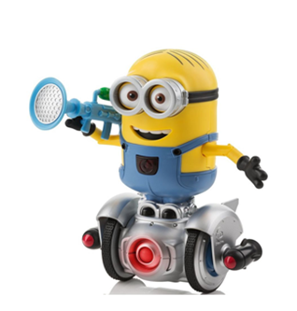
Thank you ☺

