Slide 1


An-Najah National University
Faculty of Engineering
Civil Engineering Department
The Impact of New Road Connection on Road Network
Prepared by:
Tasnim Rabee’ Nagham Dmaidi
Submitted to:
Eng. Hussin Abu-zanet Saturday, January 16, 2016

Slide 2
Project Outline
Project Brief Description.
Project objectives.
Proposed Outcomes.
Methodology.
Data Collection.
Data Analysis.
Results.
Case Study: AL-Salam Intersection.
Conclusion & Recommendations

Slide 3
Project Brief Description
Assessment the performance of study area.
To achieve this; New Traffic Movement Counts (2015) at selected. In addition to some parameters were collected.
Performance Assessment or (LOS) for network could be determined using analysis software tool..

Slide 4
Project Objective:
Evaluate the new connection on surrounding Road Network.
Make a comparison between previous situation and after implementation of traffic plan in the western area.

Slide 5
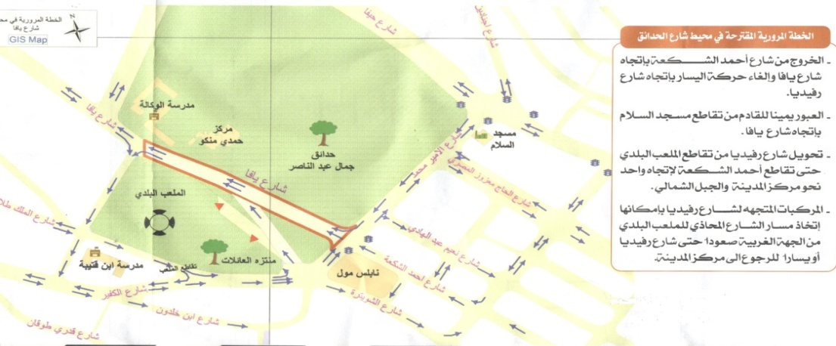
Study Boundary
Case Study: Nablus City-Western area of Nablus’s CBD.

Slide 6
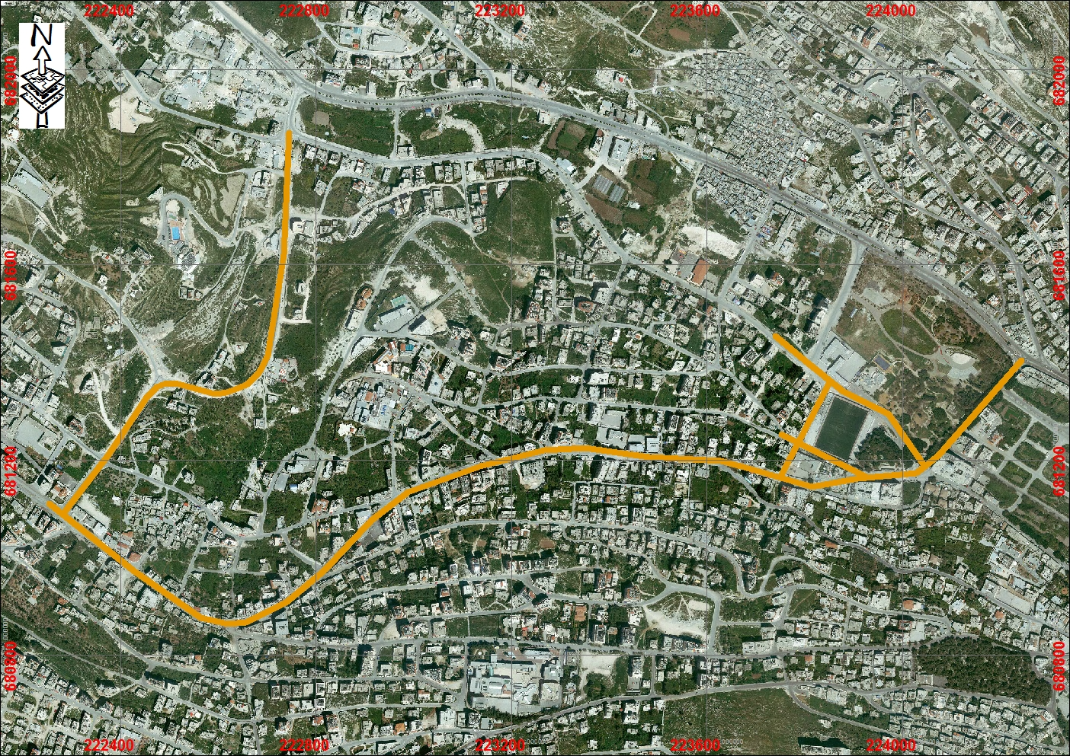
Study Area Before Implementation Proposal Road

Slide 7
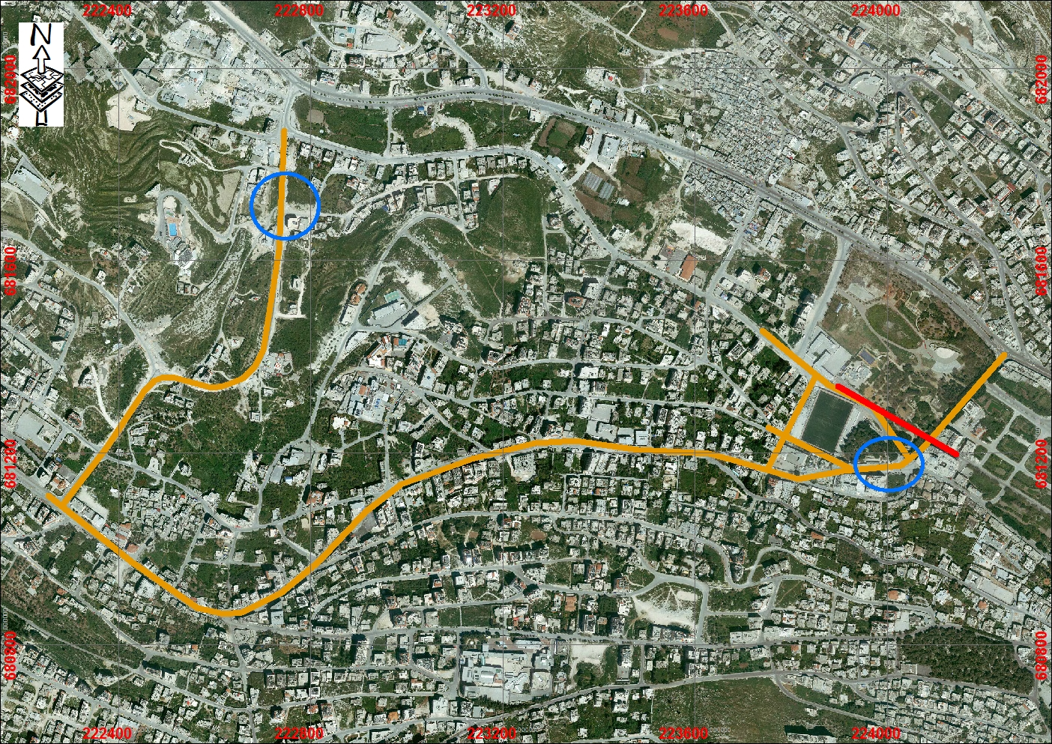
Study Area After Implementation Proposal Road

Slide 8
Why This Project?
This action affects the most important road network in the western area of Nablus CBD (Rafidia Str. & Surrounding Intersections).

Slide 9
Proposed Outcome
Checking the level of service at the study area based on the old condition.
Assessing this action after completion especially on Rafidia Street.
Provide recommendation and solutions for unexpected conditions or negative impacts

Slide 10
Methodology
Preparation
Site Visit
AM & PM period
Data Collection
Traffic Count
Analysis
Identify main Intersections
Duration
Before Implementation
After Implementation
Inventory Study
Timing for signalized Inr.
Excel
Synchro
Flow Characteristic
LOS

Slide 11
Data Collection
Parameters affecting operation of the system should be measured.
Charts And documents which include: areal photographs.
Traffic Counts
Volume
Period
Timing
Inventory Study
Physical characteristics used in analyzing network were collected such as No. of lanes.
Duration (2 hr.)
Signalized intersection

Slide 12
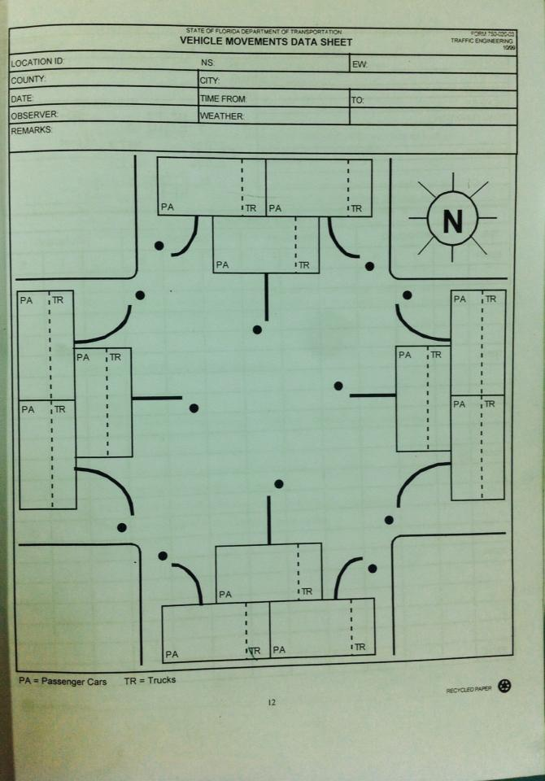
TMC Sheet

Slide 13
Traffic volume count (AM) at the network before road implementation

Slide 14
Intersection :
There are two types of intersections; signalized and un-signalized intersection, which differ in control type.

Slide 15
Control Type at Intersection
Traffic Signal
Stop Sign
Yield Sign

Slide 16
Data Analysis
Analysis Tools
Used To produce:
Synchro (8)
3D View
Max 15 min.
Peak Hour Volume (PHV).
Peak Hour Factor (PHF).
Turning movements volume
Excel
SimTraffic
information at Microscopic Level.
Synchro package used HCM
Information at Macroscopic Level

Slide 17
Power of Synchro 8
Synchro used to design, model and analyze signalized and un-signalized intersections.
The software used for optimizes traffic signal timings for an isolated intersection, an arterial or a network.
SimTraffic is a microsimulation tool which models individual vehicles interactions and provide animation of the model in a network

Slide 18
Analysis Outputs
Numerical outputs from the traffic analysis are the MOEs which are metrics used to assess the performance of a system.
MOEs are also used to compare and contrast the system performance under various design or improvement alternates.
Level of Service (LOS) is readily recognizable indicator of traffic operations and has been widely used by different agencies when evaluating the traffic operations performance of facilities.
Performance measures of effectiveness (MOEs)

Slide 19
Results

Slide 20
LOS at All Network:
Intersection No. | Intersection Name | LOS (before) | LOS (after) (Current) | LOS (after 3 year) | LOS (after 5 years) | Recommendation
1 | AL-Wakala | B | F | F | F | It becomes worse, so remedial action should be applied.
2 | AL-Badawi | E | C | C | D | It becomes better.
3 | Ibn-Qutaiba | F | C | C | D | It becomes better.
4 | Ahmad ALshka’h | C | C | C | C | No effect.
5 | Tuin-Abd_alraheem | F | F | F | F | Still worse and needs remedial actions.
6 | Tuin-Yaffa | F | F | F | F | Still worse and needs remedial actions.
7 | Shwetreh | C | B | C | C | It becomes better.
8 | AL-Salam | F | F | F | F | Still worse and needs remedial actions

Slide 21
Traffic Signals Output for Signalized Intersection
Intersection No. | Max v\c |  | Cycle Length (s) | App. LOS range |  | Intersection LOS |  | Intersection Delay (s)
 | After | Before |  | Before | After | Before | After | Before | After
2 | 1.82 | 1.65 | 100 | B-F | A-C | E | C | 75.4 | 74.8
4 | 0.87 | 0.61 | 115 | C-D | A-C | C | C | 225.1 | 21.8
5 | 2.07 | 1.87 | 105 | A-F | A-F | F | F | 110.5 | 164.8
8 | 1.62 | 2.02 | 100 | A-F | A-F | F | F | 189.3 | 149.4

Slide 22
Traffic Output for Un-Signalized Intersection
Intersection No. | Max v\c |  | Cycle Length (s) | Approach LOS range |  | Intersection LOS |  | Intersection Signal Delay
 | Before | After |  | Before | After | Before | After
1 | 0.13 | 3.19 | - | A-B | B-F | B | F | -
3 | 1.07 | 0.65 | - | A-F | B-D | F | C | -
6 | 9.23 | high | - | A-F | A-F | F | F | -
7 | 0.79 | 1.82 | - | C-B | C-F | C | B | -

Slide 23
Case Study:
AL-Salam Intersection

Slide 24
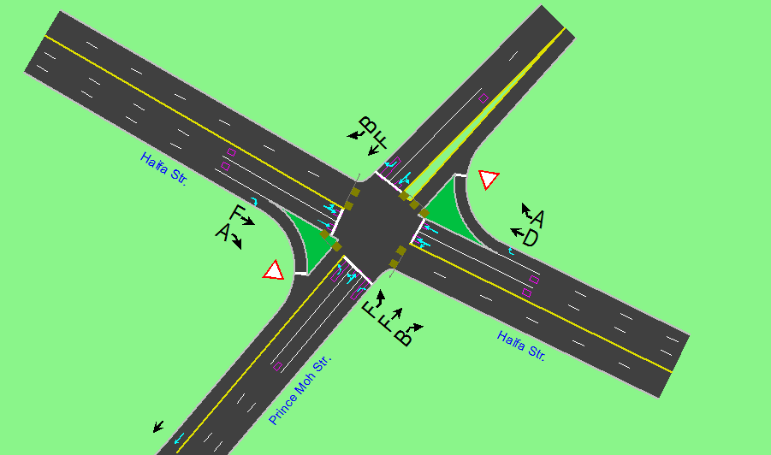
Case Study: AL-Salam Intersection
LOS at AL-Salam Intersection before treatment.

Slide 25
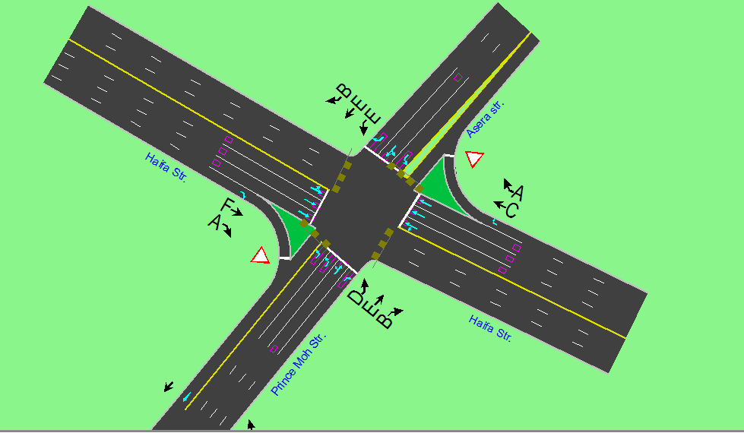
Case Study: AL-Salam Intersection
LOS at AL-Salam Intersection after treatment.

Slide 26
Conclusion:
The new connection resulted in a positive action on several intersections, and negative action on only two intersection.
The beneficial of this project will be maximized when some remedial actions being applied on some intersections.

Slide 27
Recommendations
It is recommended to includes more detailed parameters in this project such as Grade, Operational Speed, Pedestrian, bus blockages, parking, turning radius, etc.
It is recommended to study the existing condition in long range plan such as (20 years) to see the unexpected effects on traffic system..
It is recommended to study each intersection to enhance its level of service
It is recommended to check the warrants at critical intersections based on the current conditions and proposed modifications..

Slide 28
Thank you

