Slide 1
HHO Generator By Solar Energy
by
Ehab Jaber
Tawfiq Nasasrah
Yousef Khalaf
Supervision
Dr. Ramez Al-khaledi

Slide 2
OUT LINE
CELL DESIGN
Storage
Solar panel
Battery
Result
Challenges
Conclusion

Slide 3
CELL DESIGN
Specification Plates:
stainless steel is used where corrosion resistance and good
Mechanical properties are primary requirements.
It is also widely used in application where corrosion resistance is required
The plate has a thickness of 0.2 cm with 20cm in height and 17.5 in width .
Composition Cell:
- Tube a diameter of 6" and 2 covers.
- Screw 8 mm plastic length of 11.5 cm.
- Two Screws 8 mm Stainless Steel length of 5 cm.
- The number of nuts Stainless steel, plastic washers.
- Hose.

Slide 4
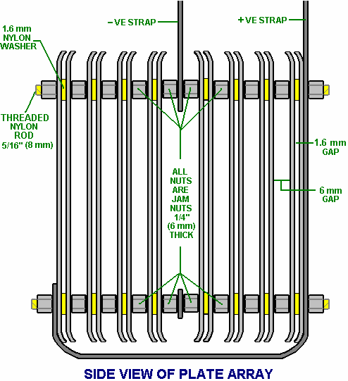
CELL DESIGN

Slide 5
CELL DESIGN
Catalysts for interaction:
Distilled water is mixed with a certain amount of sodium hydroxide so that the amounts of 20 grams of hydroxide per liter of distilled water.

Slide 6
Storage
When the hydrogen is produced the next step is to store and distribute it.
Hydrogen is the first element in the periodic table , consisting of one proton and one electron making it the smallest and lightest of all elements . this makes hydrogen the element that contains most energy compared to its weight but the least when compared to volume. The great challenge for hydrogen therefore is to find ways to store it so that it reaches an energy density comparable to gasoline. Hydrogen can be stored in three different ways as a gas as a liquid as a material

Slide 7
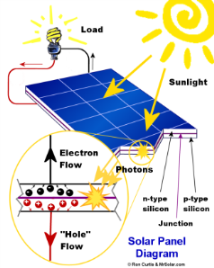
Solar panel
The solar panel absorb the sun's rays as a source of energy for generating electricity, this electricity is important to provide appropriate electricity to batter .

Slide 8
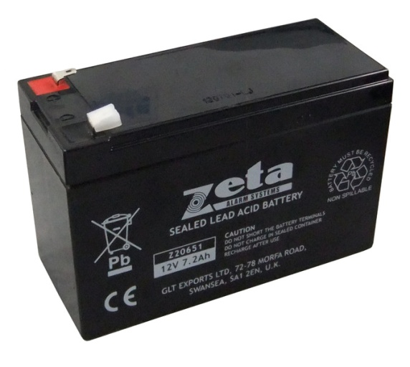
Battery
After the solar panel charging the battery. The battery connected with stainless steel plates cathode and anode by wires to begin chemical reaction operation.
H2O + electricity ➞ H2 + 1 /2O2

Slide 9
Results
Chemical calculations
In this section show the chemical quantities for molecular water and how much be the present hydrogen and oxygen, in water as we know the one mole of any pure element has a mass that is exactly equal to that element's atom mass in grams. Like
2.01588 g One mole of H2
31.988 g One mole of O2

Slide 10
Results
energy in the hydrogen
Using a fairly efficient HHO device, producing 6.1 milliliters/ minute watt, it took 500 watts or 13.89 volts x 36 am/s
In one hour, it will produce 6.1 x 500 x 60 183000 milliliters or 183 liters x 0.00722413544 Mega Joules per liter =1.322 Mega Joules of energy, However 500 watts for one hour is a half a kilowatt hour.
A kilowatt hour= 3.6 Mega Joules of energy, so we used 1.8 Mega Joules of energy to create 1.322 Mega Joules worth of HHO.

Slide 11
Power flow
Time= 3 minutes=3x60=180s
Area=(2πr^2)+h2πr=(2*3.14*10^2)+30*2*3.14*10=2512
Volume =hπr^2 =30*3.14*10^2=9510
Flow rate gas=9510/180 ==52.83 ml/s
In one minutes =52.83*60=3.16 L/min
7224.13522
7224.13522 *3.16 =22899.06
22899.06 * 1/60 = 381.65
Power in =12 V * 50 A =600
Max efficiency =381.65/600= 63.6 %

Slide 12
Power Flow
Experiment | Flow rate (L/M)
1 | 2.7
2 | 3.2
3 | 3.38
Average | 3.16

Slide 13
solar panel
In our project we chose a battery (50A &12 V) so
The power by this battery is p = V*I = 50*12 =600 watt
To know the energy by the solar panel we should know the rate of sun radiation in Nablus , the rate of sun radiation is 5.4 w/m^2.
the power by solar panel is 85 w
so the number of solar panel 600/85=7.058solar panel
so we need one solar panel to charge the battery .

Slide 14
Challenges
When we work in this project we found the problem with the battery, because the battery be low in 20 minutes and the solar pleat take 5 hour to full the battery, this problem can solve it be increase the number of solar pleats or get battery bigger than that we used like in this pictures it get 80w but like what we say it not enough.

Slide 15
Conclusion
This project is very good if we have cheap parts, which make in to our hand, then we not need the natural gases and we not buy fuel and we will save the money, health and our land from pollution, so we must search about like this fuel in the future, that renewable resources.

