Slide 1
Water Works For Marj-Ibn Amer
Analysis & Design

Slide 2
Outline
1.Study Area
2.Objectives
3.Design Methodology
4.Analysis of Population & WW production
5.Design of Trunk Pipe lines
6.Design the Treatment Plant
7. Conclusion

Slide 3
Study Area
Location:
In the northeast of the Jenin city in the northern of the West Bank .

Slide 4
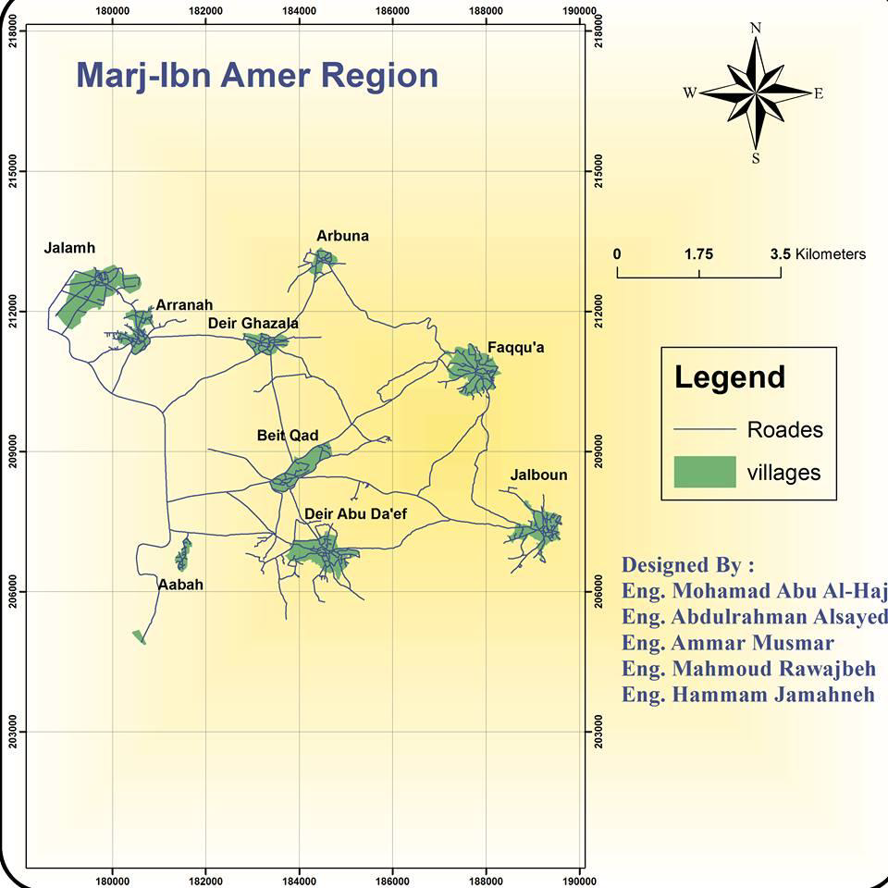

Slide 5
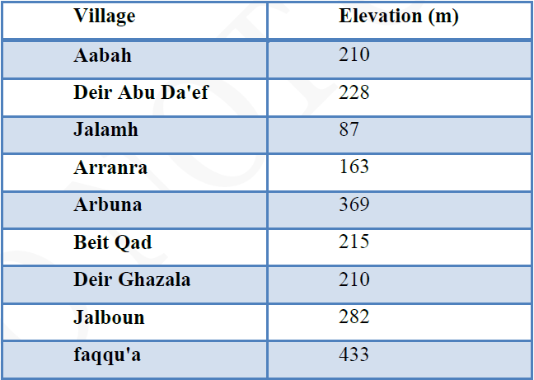
Topography
Elevation for each village above MSL

Slide 6
Major Problems
1- Absence of Water Distribution Network .
2- Suffering from the drainage of waste water

Slide 7
Objective
1.Design the Trunk pipe Lines.
2. Design a wastewater treatment plant .

Slide 8
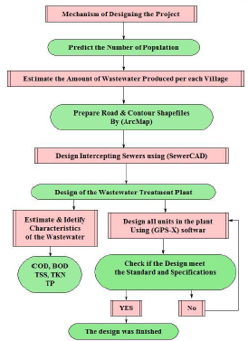
Design Methodology

Slide 9
Population
P_{(t)} = P₀(1+i)^{n}

Slide 10
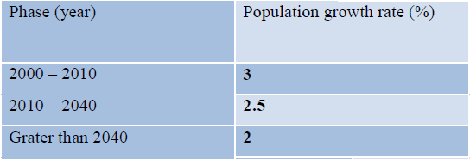
Population growth rate (i)
Design Period = 30year
The design period for this project was falling in the last two phases, so the number of population was estimated as the following:

Slide 11
Forecasted number of population in 2045
Village | Number of population in 2045
Aabah | 506
Deir Abu Da'ef | 14179
Jalamh | 5113
Arrana | 4954
Arbuna | 2011
Beit Qad | 3592
Deir Ghazala | 2223
Jalboun | 5933
Faqqu'a | 8606
Total | 50000Capita

Slide 12
WW Design Load

Slide 13
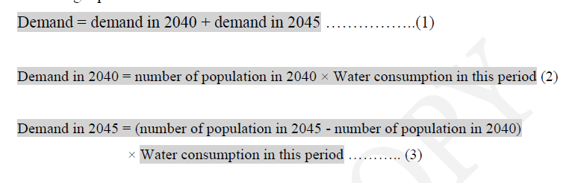
Water Demand
Phase | Water Consumption(m³/capita.day)
2000-2010 | 50
2010-2040 | 57
Greater than 2040 | 83
The following equations were used to estimate the water demand:

Slide 14
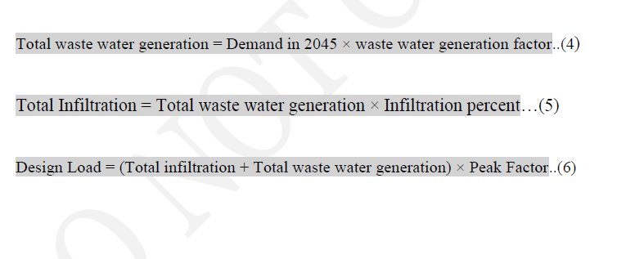
The amount of waste water produced in each village calculated as the following:
Factors:
Wastewater generation factor = 0.8
Peak factor = 2
The infiltration rate = 0.2

Slide 15
(Wastewater Design Load for each village)
Village | Average Flow (m³/day) | Design Load (m³/day)
Aabah | 79.69 | 159.36
Deir Abu Da’ef | 2217.6 | 4435.2
Jalamh | 799.68 | 1599.36
Arrana | 774.72 | 1549.44
Arbuna | 314.88 | 629.76
Beit Qad | 561.6 | 1123.2
Deir Ghazala | 347.52 | 695.04
Jalboun | 928.32 | 1856.64
Faqqu’a | 1345.92 | 2691.84
Total | 7368 (m³/day) | 14736 (m³/day)

Slide 16
Design of Trunk Lines

Slide 17
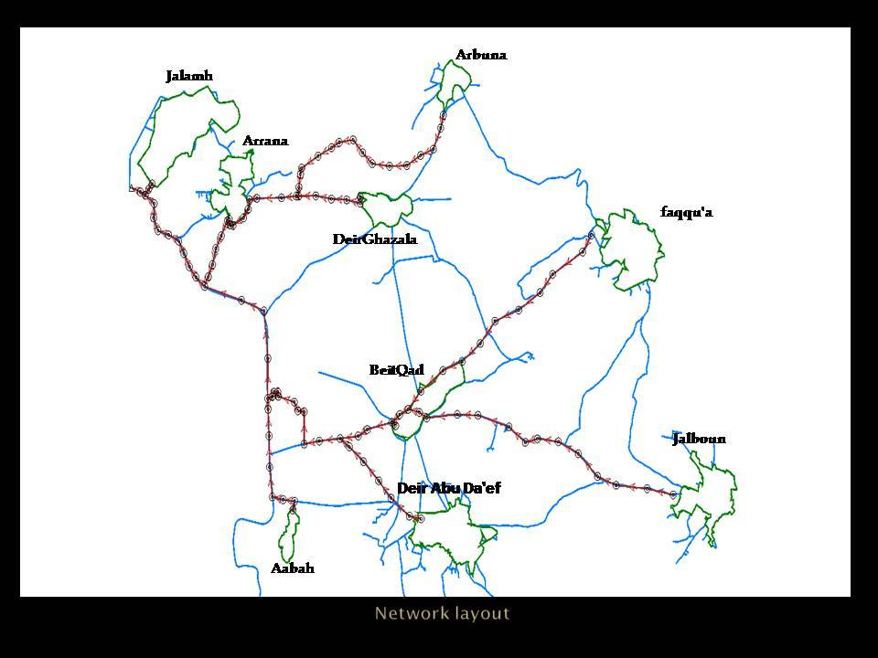

Slide 18
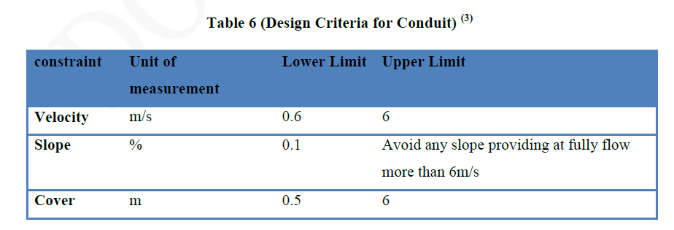
Design Criteria

Slide 19
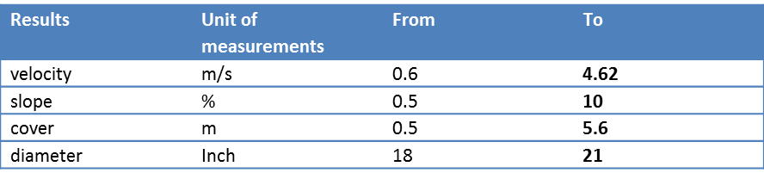
The Results

Slide 20
Treatment Plant

Slide 21
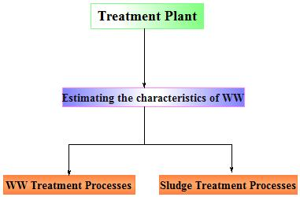
Mechanism of Designing the Treatment Plant

Slide 22
WW Characteristics
1.BOD
2.TN
3.TP
4.COD
5.TSS

Slide 23


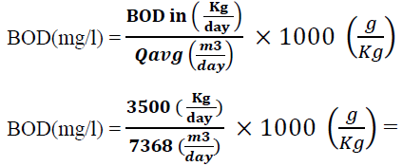
Estimation of BOD
Assume BOD Production Rate = 70 (g/capita.day)
Qavg = 7368 m3/day

Slide 24
The same method was used to estimate the amount of TN & TP, by replacing BOD production rate with N production rate, and repeated it for P production rate.
Estimation of COD and TSS:

Slide 25
WW Treatment Processes
This process include:
1.Preliminary Treatment
2.Primary Treatment
3.Secondary Treatment
4.Tertiary Treatment

Slide 26
Preliminary Treatment
The main objectives for Preliminary Treatment:
1) Removal of untreatable solid materials
2) Protection and improvement of the performance of subsequent treatment units
Preliminary Treatment consist of:
1) Coarse Screens
2) Fine Screens
3) Grit Chamber

Slide 27
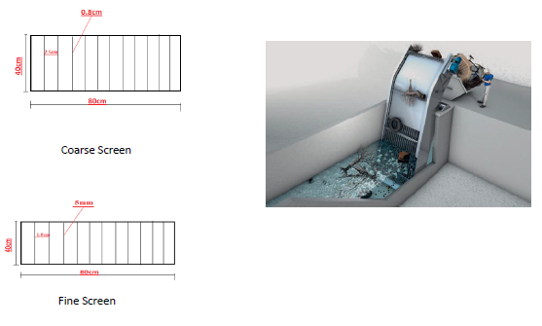
Coarse & Fine Screen
Objectives:
is to remove the large objects such as rags, paper, plastics, metals These objects, if not removed, may damage the pumping and sludge removal equipment, and block valves, and pipelines.

Slide 28
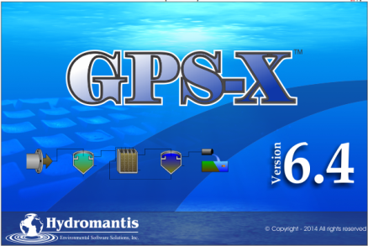
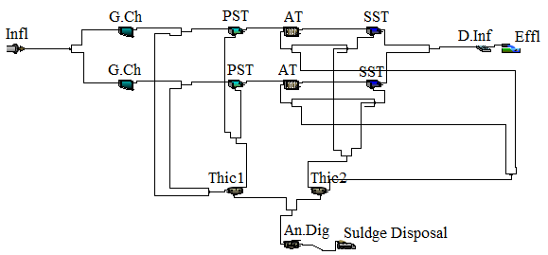
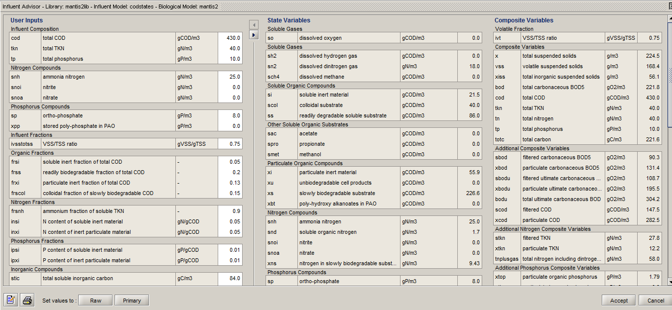
GPS-X
Facilitate the design process
Making a simulation for the plant

Slide 29
Grit Chamber
Objectives
* Protect moving mechanical equipment and pumps from unnecessary wear and abrasion
* Prevent clogging in pipes, heavy deposits in channels

Slide 30
Design Criteria of Grit chamber
Criteria | Value | Assumptions
Detention Time | 2-5 min | 4 min
Depth of water | 2-5 m | 2m
width | 2.5-7.5m | 2.5m
length | 7.5-20 m

Slide 31
Design criteria for the grit
Volume = WW flow rate * detention time = 10.233 * 4 = 40m3
S.A= Volume / water depth = 40/2 = 20 m2
Length equal to area divided on width = 20/2.5 =8 m
Assume free board = 0.5 m
So the total depth equal to 2.5m

Slide 32
Primary Treatment
The main objective:
Removing of settleable organic solids
PST remove1.
1. BOD 30 to 40 %
2. TSS 50 to 70%

Slide 33
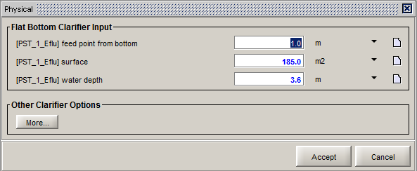
Physical Dimension of PST
Assume Over Flow Rate = 40 then
A= 7368 / 40 = 185 m
Assume :
W= 5m,,,,,,,,D = 3m
L= 37m
2

Slide 34
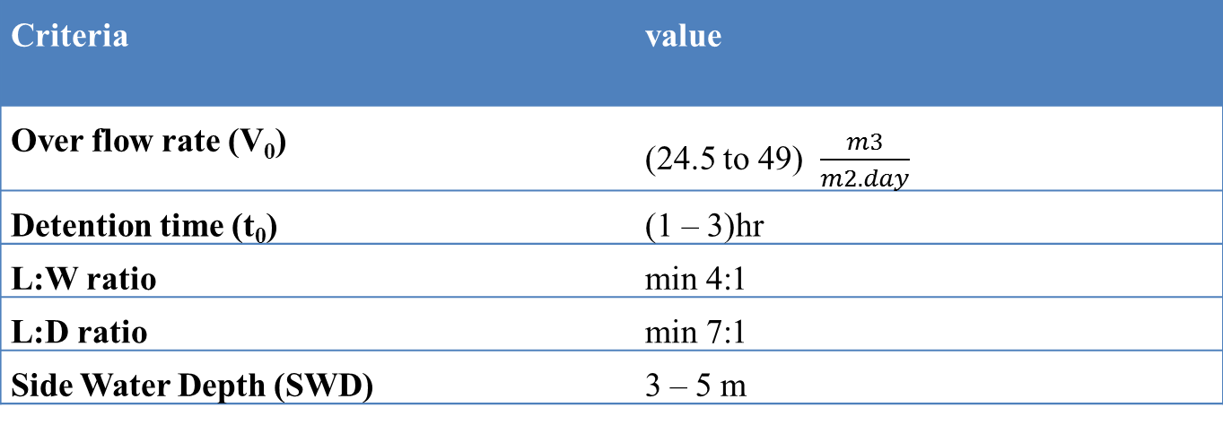
Design Criteria of PST
Criteria | value
Over flow rate (V₀) | (24.5 to 49) $\frac{m3}{m2.day}$
Detention time (t₀) | (1 – 3)hr
L:W ratio | min 4:1
L:D ratio | min 7:1
Side Water Depth (SWD) | 3 – 5 m

Slide 35
The Results of the PST
 | Unit of measurement | Influent | Effluent
TSS | mg/L | 753.4109 | 301.7945
cBOD5 | mg/L | 487.0694 | 268.20023
COD | mg/L | 682.1054 | 378.13168
TKN | mg/L | 49.43192 | 39.781958
TP | mg/L | 48.56843 | 24.250534
HRT | hour | 2.095 | -
Over flow rate | m³/m².day | 39.61 | -

Slide 36
Secondary Treatment
Extended Aeration Tank
Secondary Clarifier

Slide 37
Extended Aeration Tank
Objective:
treatment of the effluent from PST to remove the residual organics and suspended solids
Design of AT will be restricted on the volume of the tank

Slide 38
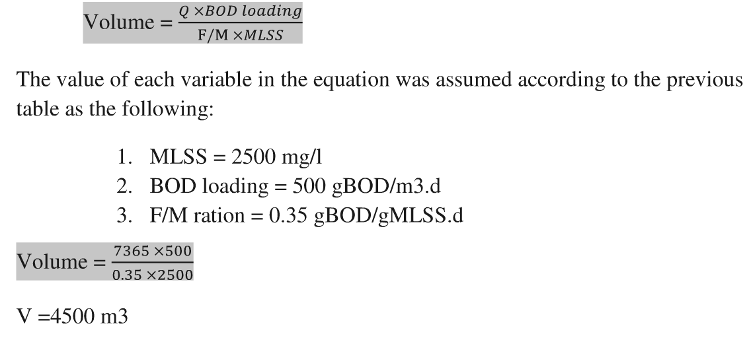
Physical Properties

Slide 39
Design Criteria
Criteria | Unit of measurement | Value
MLSS | mg/l | 2000 - 8000
F/M ratio | gBOD/gMLSS.d | 0.2 – 0.5
BOD Loading | gBOD/m3.d | 320 - 640
RAS ratio | % | 2 - 40

Slide 40
The Results of the AT
Criteria | Unit of measurement | Value
MLSS | mg/L | 2694.733
F to M Ratio | gBOD5/(gMLSS.d) | 0.45952
BOD Loading | gBOD5/(m3.d) | 436.7492
RAS Recycle Ratio | % | 28.04312

Slide 41
Secondary Clarifier
The main objectives of this unit are:
➢ 1. separate biomass from liquid and then return abortions of it to the Aeration Tank
➢ 2. meet total suspended solids discharge limit

Slide 42
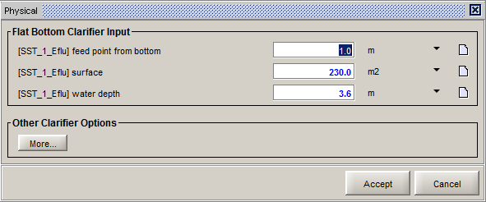
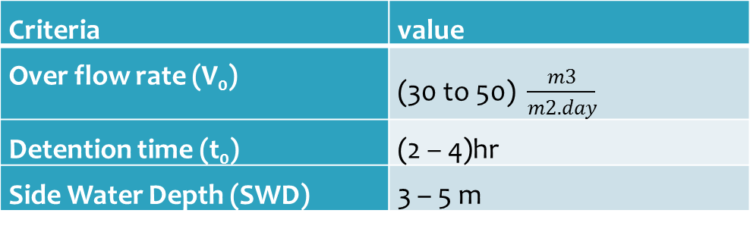
Physical Properties
Design Criteria
Criteria | value
Over flow rate (V₀) | (30 to 50) $\frac{m3}{m2.day}$
Detention time (t₀) | (2 – 4)hr
Side Water Depth (SWD) | 3 – 5 m

Slide 43
The Results of the SST
 | Unit of measurement | Influent | Effluent
TSS | mg/L | 2695 | 16.83
cBOD5 | mg/L | 584 | 4.235
HRT | hour | 2.118 | -
Over flow rate | m³/m².day | 31.93 | -

Slide 44
Tertiary treatment
The main objective :
kill types of micro organism like fecal coliform .
Three agents are used for disinfecting waste water
1-chlorine gas or chlorine-based disinfectant
2-Ozone (O3)
3- Ultraviolet (UV) Radiation .

Slide 45
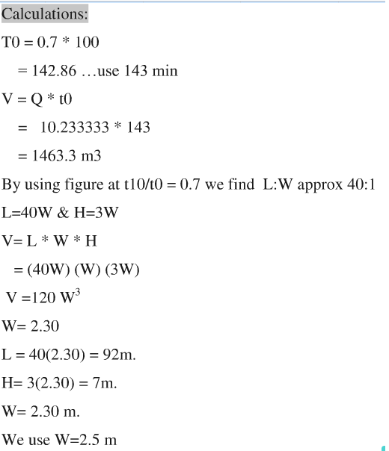
Physical Dimension for
Longitudinal-serpentine basins

Slide 46
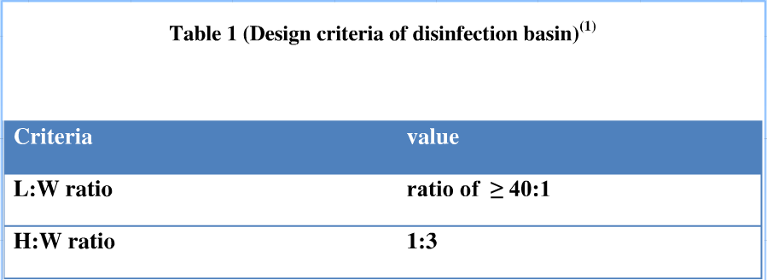
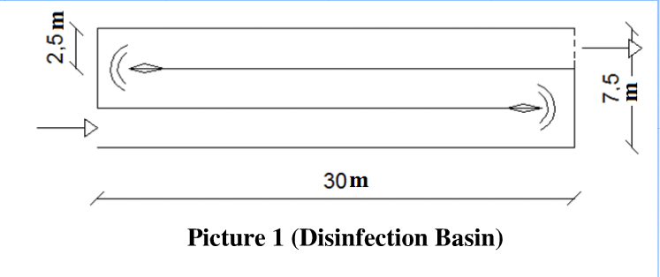
The Results
Design Criteria

Slide 47
Disinfection Results
Criteria | Unit of measurement | Value
Detention Time | min | 50.01
Eff. Coliform Density | MPN/100mL | 65.5

Slide 48
Sludge Treatment
This stage include two units:
1. Thickening process
2. Digestion process
Sludge Thickening:
the process used to increase the solids content of sludge by the separation and removal of a portion of the liquid phase.

Slide 49
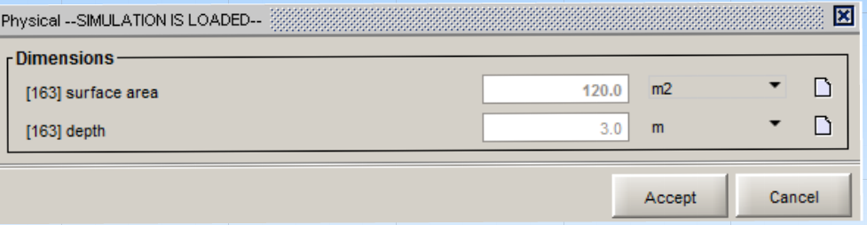
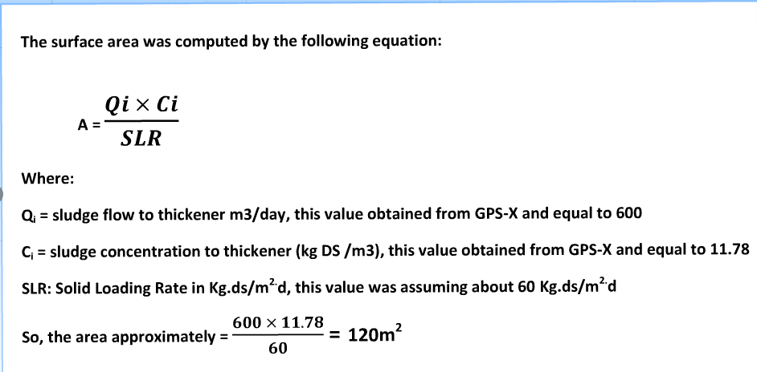
Design of Thickener 1
Total Depth = 3m

Slide 50
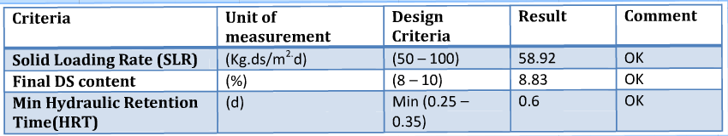
Results
As shown, all results was falling within the design criteria..... so everything is OK

Slide 51
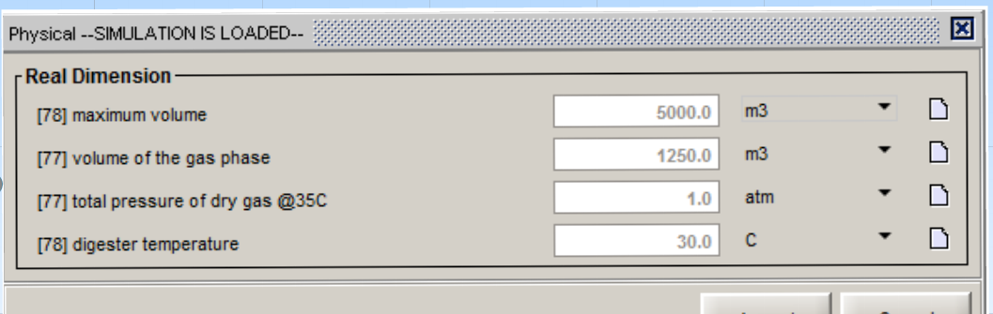
Anaerobic Digester
Objectives:
1. To reduce the amount of sludge that needs to be disposed
2. Treatment of organic sludge and concentrated organic industrial wastes

Slide 52
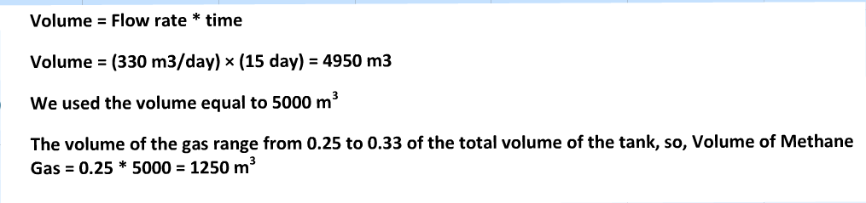
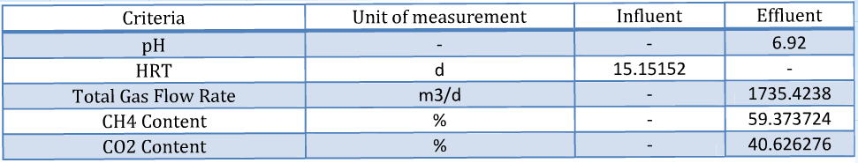
Results
Calculation of Dimensions

Slide 53
Conclusion

Slide 54
Comparison between Influent, Specification, Effluent

Slide 55
Comparison between the various types of Aeration Tank
Type | Efficiency (%) | Standard value of BOD (mg/l) | Influent BOD (mg/l) | Effluent BOD (mg/l) | Comment
Extended Aeration Tank | 95 | ≤ 20 | 500 | 25 | Effluent value Less than Standard Value…. Acceptable
Conventional Aeration Tank | 90 | ≤ 20 | 500 | 50 | Effluent value More than Standard Value …. Rejected
Trickling Filter | 85 | ≤ 20 | 500 | 75 | Effluent value More than Standard Value …. Rejected
The extended aeration tank that is the only type has achieved a value for BOD effluent less than the standard value , so, the extended aeration tank was used.

Slide 56
Thank You

